Slide 1

Team - 4
Microservices Implementation - DEMO
Kannadasan
Juan
Jaison
Yashika

Slide 2
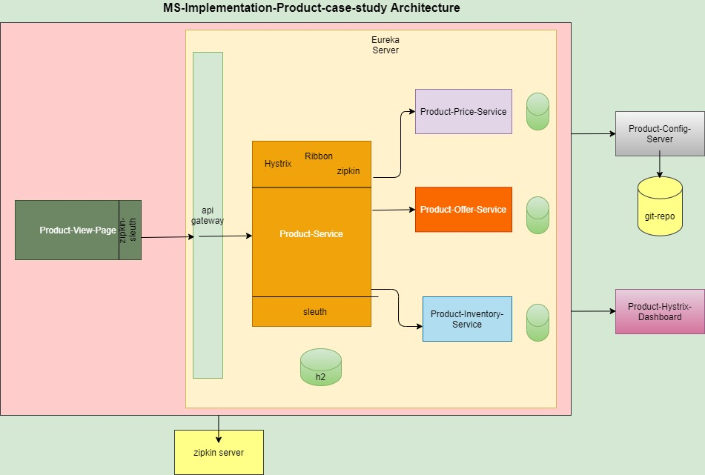

Slide 3
1. product-view-service
This is a client service to view the product details by invoking product service through gateway url.
i) getting service name
GET /case-study/message
ii) getting all products
GET /case-study/products
iii) getting a product based on product id
GET /case-study/products/{id}

Slide 4
2. product-api-gateway
Registered product-service end points on gateway. So we can access product service all endpoints through gateway url
eg:
GET /api/productservice/case-study/products
GET /api/productservice/case-study/products/{id}

Slide 5
3. product-service
This service pulls all the details of product.
1. To get the service name:
GET /case-study/message
2. To get all products:
GET /case-study/products
3. To get product by id
GET /case-study/products/{id}
4. To add a new product:
POST /case-study/products
eg: payload:
{
"name": "iphonse4s",
"brand": "apple",
"madeIn": "india"
}
5. To edit a product
PUT /case-study/products/{id}
eg: payload:
{
"name": "iphonse6s",
"brand": "apple",
"madeIn": "india"
}
6. To delete all the products:
DEL /case-study/products
7. To delete a product by id
DEL /case-study/products/{id}

Slide 6
4. product-price-service:
This service pulls price for a product:
1. To get the service name:
GET /case-study/message
2. To get the price for a product
GET /case-study/prices/{id}
3. To add a price for a product
POST /case-study/prices
eg: payload:
{
"productId": 1,
"priceValue": 58000
}
4. To edit a price for a product
PUT /case-study/prices/{id}
eg: payload:
{
"productId": 1,
"priceValue": 65000
}
5. To delete a price for a product
DEL /case-study/prices/{id}

Slide 7
5. product-offer-service:
This service pulls offer for a product
1. To get the service name:
GET /case-study/message
2. To get the offer for a product
GET /case-study/offers/{id}
3. To add a offer for a product
POST /case-study/offers
eg: payload:
{
"productId": 1,
"offerPercent": 0.27
}
4. To edit a offer for a product
PUT /case-study/offers/{id}
eg: payload:
{
"offerPercent": 0.30
}
5. To delete a offer for a product
DEL /case-study/offers/{id}

Slide 8
6. product-inventory-service:
This service pulls quantity of a product
1. To get the service name:
GET /case-study/message
2. To get the quantity for a product
GET /case-study/inventories/{id}
3. To add a quantity for a product
POST /case-study/inventories
eg: payload:
{
"productId": 1,
"quantity": 9
}
4. To edit a quantity for a product
PUT /case-study/inventories/{id}
eg: payload:
{
"quantity": 11
}
5. To delete a quantity for a product
DEL /case-study/inventories/{id}

Slide 9
7. product-service-registry:
This service is to register all services using eureka
8. product-config-server:
This service is used to read the configurations from github
9. product-hystrix-dashboard:
This service is used for hystrix-dashboard

Slide 10
DEMO

