Slide 1
zomato
Better Food for More People
ZOMATO RESTAURANT PROJECT | FINAL REVIEW
Excel · SQL · Power BI · Tableau

Slide 2

ZOMATO
Final Review Project
DATA ANALYSIS
PRESENTED BY GROUP 1
Excel | SQL | Power BI | Tableau
Akula Prathyusha
1. ___________________________
Thamaraikannan.D
2. ___________________________
Shiva Parendekar
3. ___________________________

Slide 3
INTRODUCTION & OBJECTIVES
Introduction
Objectives
▸ Zomato is one of India's leading food delivery & restaurant discovery platforms, operating across 15+ countries.
1
Analyze pricing trends across restaurants
▸ This project analyzes the Zomato restaurant dataset to uncover patterns in pricing, ratings, delivery adoption, and city-wise presence.
2
Understand online delivery & table booking adoption
▸ The dataset contains 9,551 restaurants with 21 attributes covering cuisines, costs, ratings, and service features.
3
Study customer rating distribution patterns
4
Identify top cities by restaurant concentration
▸ Analysis was carried out over 4 weeks using Excel, SQL, Power BI, and Tableau in a structured project workflow.
5
Build interactive dashboards for business insights

Slide 4
DATASET OVERVIEW
9,551
15
21
2010–18
Total Restaurants
Countries Covered
Dataset Columns
Year Range
Across 15 countries
Global dataset
Features per record
9 years of data
Dataset Source: Kaggle — Zomato Restaurant Dataset | Format: CSV | Tools: Excel · SQL · Power BI · Tableau
Key Dataset Columns
Column
Description
Restaurant ID
Unique identifier for each restaurant
Restaurant Name
Name of the restaurant
City / Country
Location details of the restaurant
Avg Cost for Two
Basis for Price Bucket classification
Aggregate Rating
Customer rating out of 5 (Rating Bucket)
Has Online Delivery
Whether online delivery is available (Yes/No)
Has Table Booking
Whether table reservation is offered (Yes/No)

Slide 5
PROJECT WORKFLOW — 4 WEEK PLAN
01
02
03
04
05
Raw Data
Acquisition
Data Cleaning
(Excel)
SQL
Analysis
Power BI
Dashboard
Tableau
Dashboard
▶
▶
▶
▶
Zomato CSV
9,551 records
Power Query
Null removal
GROUP BY
CASE WHEN
DAX Measures
Interactive
Charts
Visualizations
Week 1
Week 1
Week 2
Week 2
Week 3
06
Insights & Presentation — Key findings, recommendations, and final review
Week 4

Slide 6
WEEK 1 — EXCEL: DATA CLEANING & DASHBOARD
Data Cleaning (Power Query)
Excel Dashboard Components
Imported Zomato dataset into Excel
KPI Cards
Total Restaurants: 9,551
Online Delivery %: 12%
Removed null values using Power Query
Average Rating: 2.89
Table Booking %: 26%
Fixed incorrect data types across columns
Charts & Visuals
Standardized column naming conventions
◆ Country & City-wise restaurant distribution
◆ Top 10 Cuisines percentage
Created Rating Bucket column (1–2, 2–3, 3–4, 4–5)
◆ Rating distribution (column chart)
Created Price Bucket column (Low / Medium / High)
◆ Restaurant openings trend (line chart)
◆ Online delivery vs Table booking comparison
◆ Price range distribution (bar chart)

Slide 7
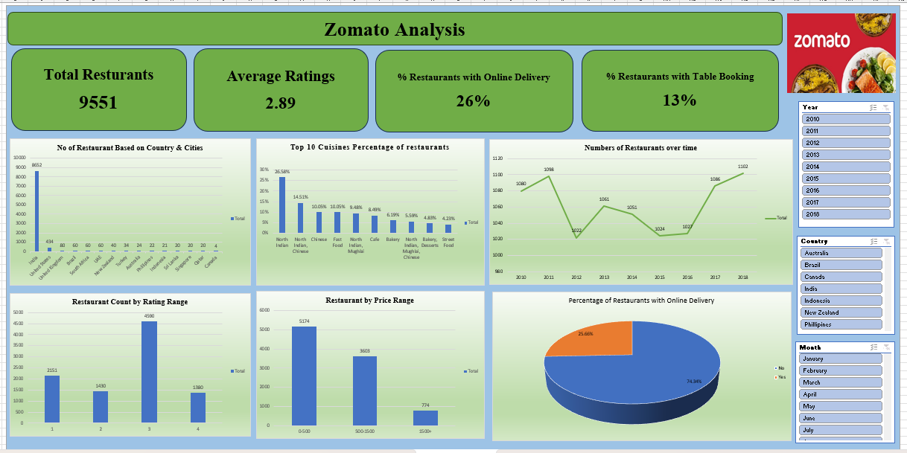
EXCEL DASHBOARD — ZOMATO ANALYSIS
Week 1 — Excel Dashboard | KPIs: Total Restaurants · Average Rating · Online Delivery % · Table Booking %

Slide 8
WEEK 2 — SQL: DATA ANALYSIS
GROUP BY
CASE WHEN
COUNT / AVG
WHERE / HAVING
Aggregate by city, price, rating
Bucket classification logic
Summary statistics computation
Conditional filtering
Analysis Performed via SQL Queries
Restaurant Count
Online Delivery %
SELECT COUNT(*) AS Total_Restaurants FROM zomato;
SELECT AVG(CASE WHEN Has_Online_delivery='Yes'
THEN 1 ELSE 0 END)*100 FROM zomato;
City-wise Distribution
Rating Bucket Analysis
SELECT City, COUNT(*) AS Count
FROM zomato GROUP BY City ORDER BY Count DESC;
SELECT Rating_Bucket, COUNT(*) AS Count
FROM zomato GROUP BY Rating_Bucket;
Price Category Analysis
Table Booking %
SELECT Price_Bucket, COUNT(*) AS Count
FROM zomato GROUP BY Price_Bucket;
SELECT AVG(CASE WHEN Has_Table_booking='Yes'
THEN 1 ELSE 0 END)*100 FROM zomato;

Slide 9
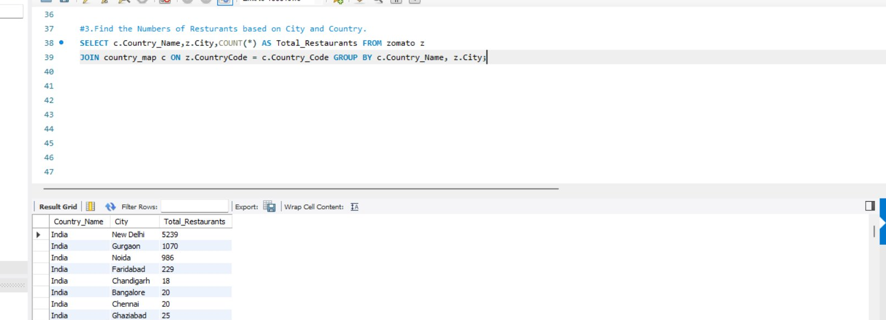
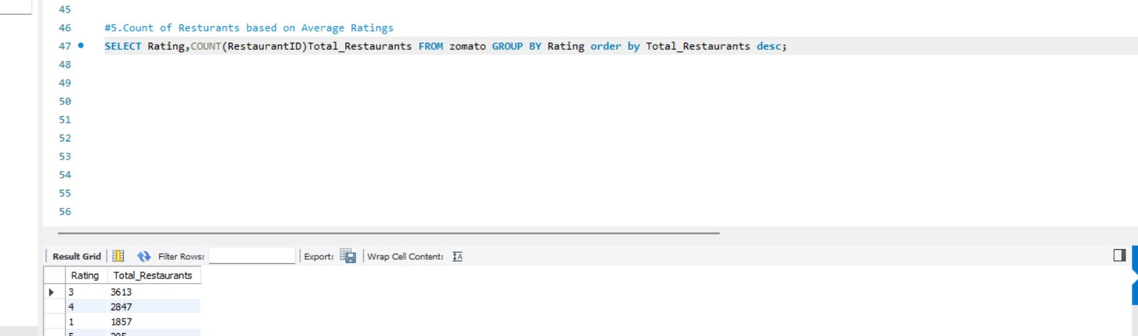
SQL QUERIES IN ACTION — PART 1
Query 3
Restaurant Count by City & Country
Concept: JOIN + GROUP BY
Result: New Delhi leads with 5,239 restaurants, followed by Gurgaon (1,070) and Noida (986).
Query 5
Count of Restaurants by Rating
Concept: GROUP BY + ORDER BY DESC
Result: Rating 3 has the highest count (3,613), followed by Rating 4 (2,847) and Rating 1 (1,857). Most restaurants are mid-rated.

Slide 10
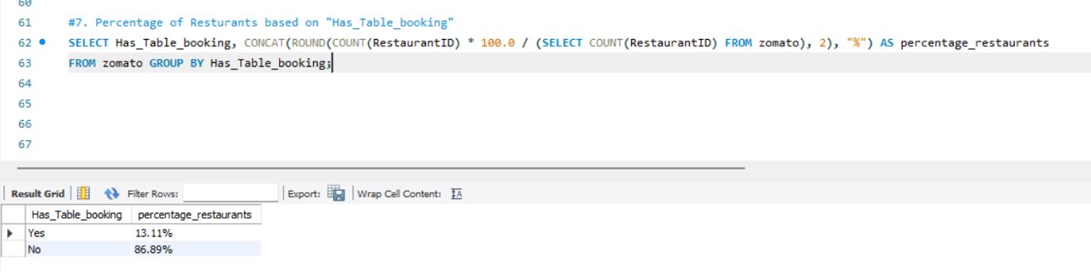
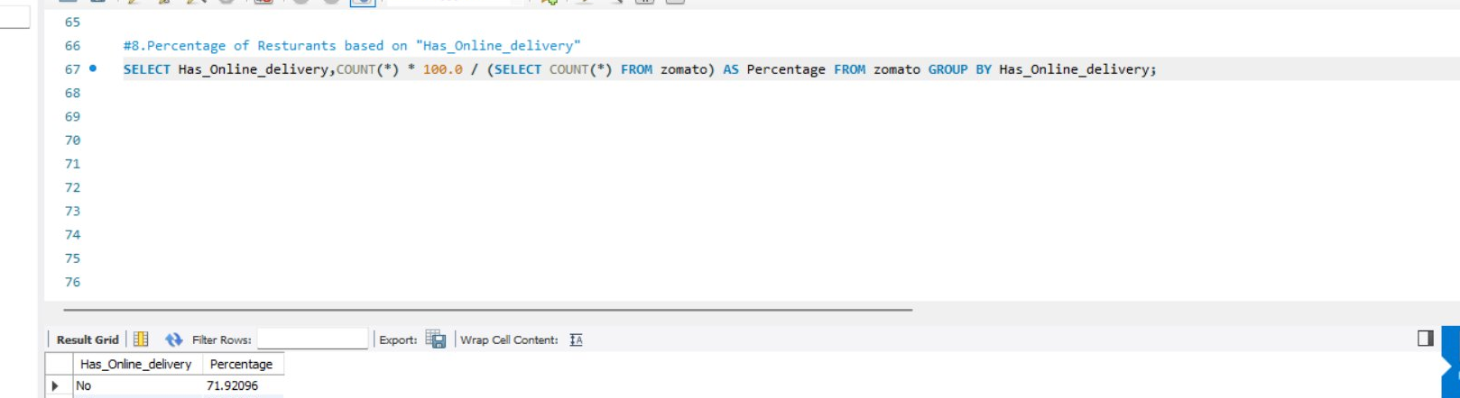
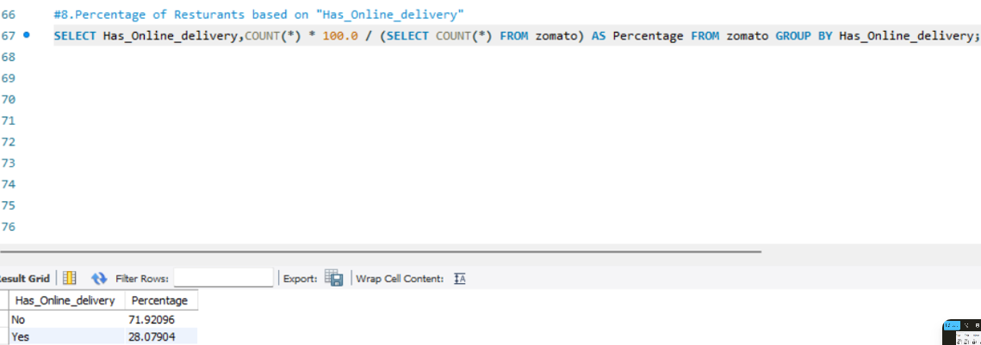
SQL QUERIES IN ACTION — PART 2
Query 7
Percentage of Restaurants with Table Booking
Concept: CONCAT + ROUND + Subquery
Result: Only 13.11% of restaurants offer table booking, while 86.89% do not — showing low adoption of advance reservations.
Query 8
Percentage of Restaurants with Online Delivery
Concept: COUNT(*) + Subquery + GROUP BY
Result: 28.00% of restaurants offer online delivery while 71.92% do not. This confirms that home delivery is still the minority service offering.

Slide 11
WEEK 2 — POWER BI: INTERACTIVE DASHBOARD
Dashboard Features
DAX Measures Created
KPI Cards
Total Restaurants = COUNTROWS(zomato)
Total Restaurants, Avg Rating, Delivery %, Booking %
Avg Rating = AVERAGE(zomato[Aggregate_rating])
Bar Charts
City-wise & cuisine-wise restaurant distribution
Online Delivery % =DIVIDE(COUNTROWS(FILTER(zomato,
zomato[Has_Online_delivery]="Yes")),
[Total Restaurants])*100
Column Charts
Price bucket and rating bucket breakdowns
Table Booking % =DIVIDE(COUNTROWS(FILTER(zomato,
zomato[Has_Table_booking]="Yes")),
[Total Restaurants])*100
Line Chart
Restaurant openings trend 2010–2018
Slicers Added
Donut Charts
City
Country
Year
Online delivery & table booking percentages

Slide 12
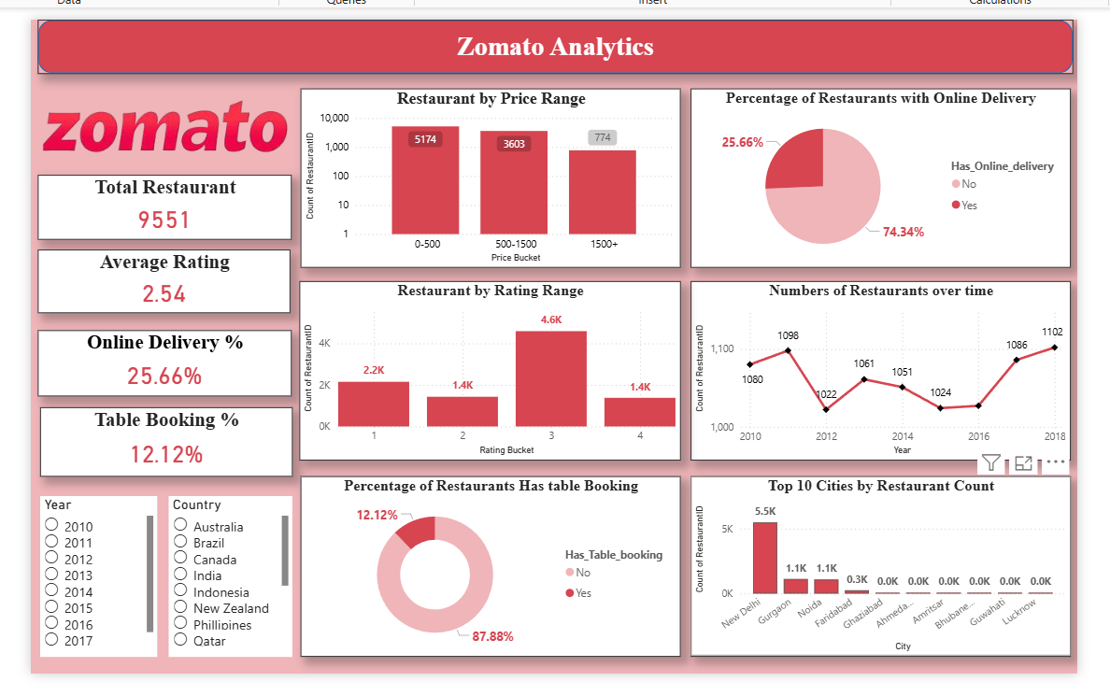
POWER BI DASHBOARD — ZOMATO ANALYTICS
Week 3 — Power BI Dashboard | Slicers: City · Country · Year | DAX Measures Applied

Slide 13
WEEK 3 — TABLEAU: INTERACTIVE DASHBOARD
Dashboard Features
Calculated Fields Created
Bar Chart
Total Restaurants
= COUNT([RestaurantID])
Top 10 cities by restaurant count — interactive & sortable
Avg Rating
= AVG([Aggregate_rating])
Map View
Geographic spread of restaurants across 15 countries
Online Delivery % = COUNTD(IF [Has_Online_delivery]='Yes'
THEN [RestaurantID] END)
/ TOTAL(COUNT([RestaurantID])) * 100
Treemap
Cuisine popularity ranked by restaurant count
Table Booking % = COUNTD(IF [Has_Table_booking]='Yes'
THEN [RestaurantID] END)
/ TOTAL(COUNT([RestaurantID])) * 100
Line Chart
Restaurant openings trend from 2010 to 2018
Filters / Parameters Added
Pie / Donut
Country
City
Year
Online delivery & table booking percentage breakdown

Slide 14
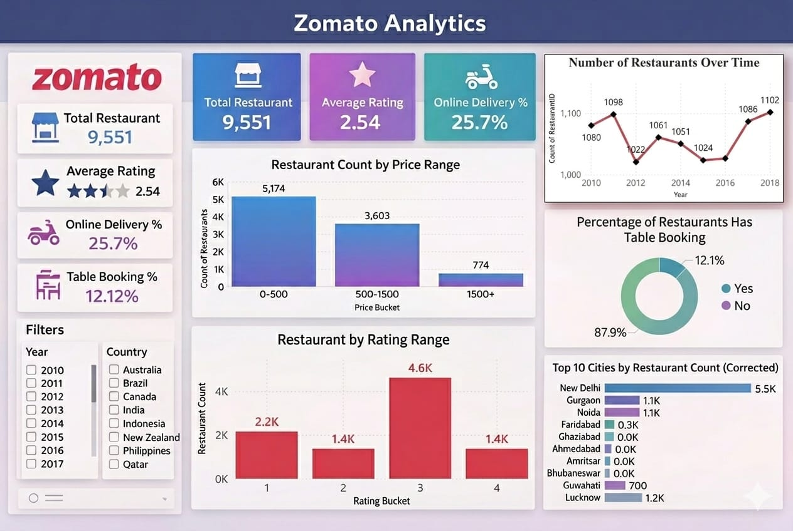
TABLEAU DASHBOARD — ZOMATO ANALYTICS
Week 3 — Tableau Dashboard | Filters: Country · City · Year | Calculated Fields Applied

Slide 15
KEY KPIs & METRICS
9,551
2.54
25.66%
12.12%
Total Restaurants
Average Rating
Online Delivery
Table Booking
Across 15 countries
Out of 5.0 scale
Have delivery option
Offer reservations
Price Distribution
Rating Distribution

Slide 16
INSIGHTS — PRICING & DELIVERY
💡 Insight 1: Pricing Trends
54.2% of restaurants fall in the Low Price category (₹0–500), indicating Zomato is dominated by budget-friendly options. Only 8.1% are in the High Price segment (₹1500+), suggesting a largely price-sensitive customer base across the platform.
Online Delivery vs Table Booking
Table Booking Distribution
Key
Takeaway
Online delivery (25.66%) is 2× more common than table booking (12.12%). Customers clearly prefer delivery over dine-in reservations.

Slide 17
INSIGHTS — RATINGS & CITY DISTRIBUTION
💡 Insight 2: Customer Ratings
Average rating of 2.54/5 shows moderate satisfaction. The 3–4 bucket has the highest count (4,600), meaning most restaurants offer average-to-good experiences. Very few achieve excellence (4–5 range: only 1,400 restaurants).
Top Cities by Restaurant Count
Restaurant Openings Trend

Slide 18
CHALLENGES & LEARNINGS
Challenges Faced
Key Learnings
1
Handling missing & inconsistent data across 9,551 rows in Power Query.
Gained hands-on experience with Power Query for real-world data cleaning.
2
Converting multi-currency costs into comparable price bucket categories.
Learned SQL aggregation (GROUP BY, CASE WHEN, AVG) for business KPI analysis.
3
Writing optimised SQL queries for aggregation without duplicate counts.
Developed DAX & Power BI skills to build interactive, filter-driven dashboards.
4
Building accurate DAX measures for delivery & booking percentages in Power BI.
Understood how to translate raw restaurant data into meaningful business insights.
5
Designing dashboards that are both visually appealing and analytically clear.
Improved data storytelling skills using Tableau and Power BI visualisations.

Slide 19
CONCLUSION
This project successfully demonstrated how raw restaurant data can be transformed into actionable business insights using a structured, multi-tool data analytics workflow.
01
Data Cleaning & Preparation
The Zomato dataset of 9,551 restaurants was imported into Excel and cleaned using Power Query — null values removed, data types corrected, and new calculated columns (Price Bucket and Rating Bucket) were created for meaningful analysis.
02
SQL-Based Analysis
Structured queries using GROUP BY, CASE WHEN, COUNT, and AVG were applied to extract key statistics — city-wise distribution, price category breakdown, rating analysis, and delivery & booking percentages.
03
Interactive Dashboards — Power BI & Tableau
Two fully interactive dashboards were built using Power BI (with DAX measures and slicers) and Tableau (with calculated fields and filter actions), enabling dynamic exploration of the data across cities, countries, and years.
04
Key Business Insights Uncovered
Most restaurants (54%) fall in the low price range. Online delivery (25.66%) is far more adopted than table booking (12.12%). New Delhi dominates restaurant count. Average rating of 2.54 indicates moderate satisfaction across the platform.

Slide 20

THANK YOU
Zomato Data Analysis — Final Review Project
Excel | SQL | Power BI | Tableau

