Slide 1
Disney+HotStar Data Analysis
Kannan R
Batch: MBE 11

Slide 2
Disney+HotStar
About :
Disney+ Hotstar is a streaming service that offers a wide variety of content, including movies, TV shows, and live sports

Slide 3
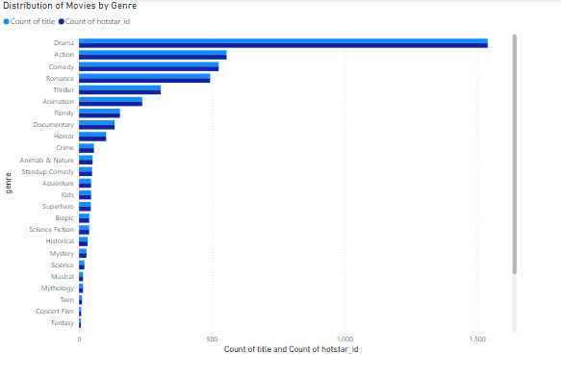
Distribution of Movies by Genre
Distribition of Movies by Genre is shown in chart
most of the people watching Drama; the people watching travel videos is very less

Slide 4
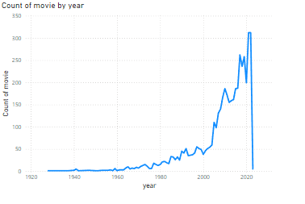
Movies Released Each Year
In the year 2021 there is 312 movies released
Every year there is increase of movies releasing in Disney + hot star.

Slide 5
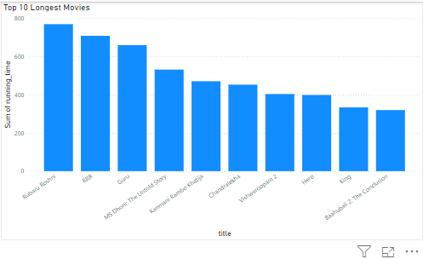
Top 10 Longest Movies
This chart shows the most top 10 longest runing time movies
The most watched movie wich has longest watching time is Rubaru Roshni

Slide 6
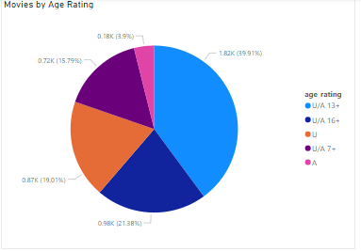
M0VIES BY AGE RATING
The Pie chart shows the movies by Age rating
The movies which has age_rating U/A 13+ has high countings
The movies which has age_rating A has low countings

Slide 7
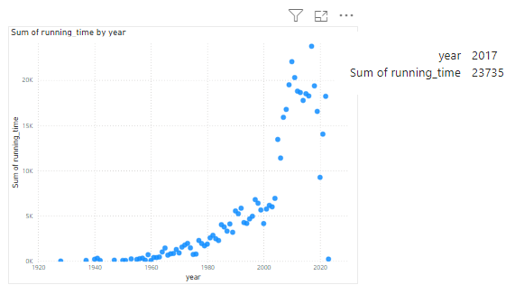
Correlation Between Running Time and Year
The chart shows the correlation between running time and year
In the year 2017 has highest sum of running time

Slide 8
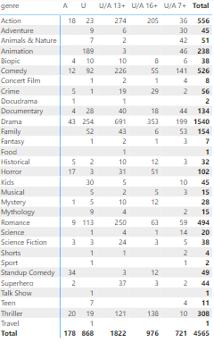
Movies by Genre and Age Rating
The movies which has U/A + 13 genre has more counts of ids
The movies which has A genre has less counts of ids

Slide 9
Thanking you

