Slide 1
Predicting Customer Churnin Telecom Industry using PowerBI or Tableau and SQL

Slide 2
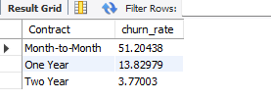
My SQL
Customers churn rate by contract
from bellow table the person who are in month to month contract are have highly churn rate 51.20

Slide 3
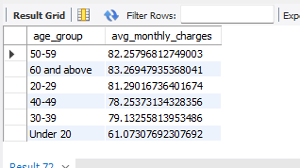
Average Montly Charges by Age group
from the below table the age aove 60 are having average monthly charges 83.26

Slide 4
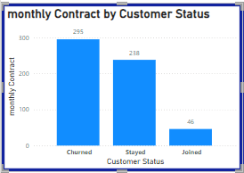
Data visualization using Power BI
Bar Chart
From this Bar Chart we come to decision the most of customers churned due to high monthly charges

Slide 5
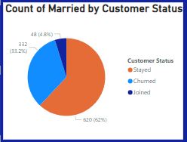
Pie Chart
From the pie chart we come to conclusion that mostly 62% of customers do not churned from the services who are got married

Slide 6
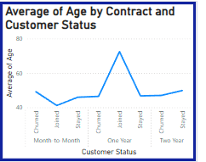
Line Chart

Slide 7
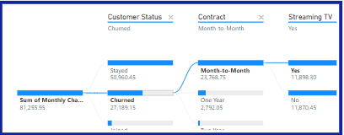
Decomposition Tree
From this decomposition tree we understand that customers who are using month to month contract they churned mostly

Slide 8
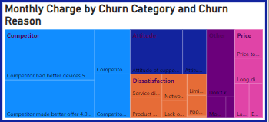
Tree Map
From the tree map we identify most of the customers churned due to competitor who giving better services, better offers, better support. They are also given more profit to company

Slide 9
Results The result get from the above calculation and visualization are as follows.
The age of the churned customers are between the age of 46 to 50
The churned customers are mostly in the month to month contractso the cost of recharge or offers must be given in this category
Customers churned due competitor who are giving better offers and better services support we must have eye on this.

Slide 10
Thank You

