Slide 1

Food Delivery Management

Slide 2
About me
Name : Kanneganti Sravika Chowdary[B.Tech]
Why you want to learn Data Analytics?
I want to learn Data Analytics because I enjoy working with data and finding meaningful insights. It helps convert raw data into useful information that supports business decisions. I am interested in building a career where I can solve real-world problems using data.
Any work experience
I am a fresher without professional industry experience. However, I have gained practical exposure through academic projects, internships, and hands-on training in SQL, Python, Excel, Power BI, and Data Analytics.
Share your LinkedIn and GitHub profile URLs
LinkedIN [https://www.linkedin.com/in/kannegantisravika/]
GitHub [https://github.com/KannegantiSravikaChowdary]

Slide 3
Table of contents
Project Overview
Business Scenario
Business Objectives
Dataset & Database Overview
ER Diagram & Database Structure
Key Analysis Questions
Sample SQL Queries
Learning Experience
Overall Key Findings
Business Recommendations
Conclusion

Slide 4
Project Overview
The Food Delivery Management platform connects customers with restaurants and enables online food ordering, payments, and delivery services.
This project focuses on analyzing customer behavior, restaurant performance, order patterns, payment outcomes, delivery efficiency, and menu-item demand using MySQL.

Slide 5
Business Scenario
The platform generates large volumes of data related to:
  Customers
  Restaurants
  Menu Items
  Orders
  Payments
  Deliveries
Management wants to transform this raw data into meaningful business insights to support operational and strategic decision-making.

Slide 6
Business Objectives
Understand customer behavior and engagement
Evaluate restaurant performance
Analyze order patterns and trends
Assess payment and delivery performance
Identify high-demand menu products
Generate business recommendations

Slide 7
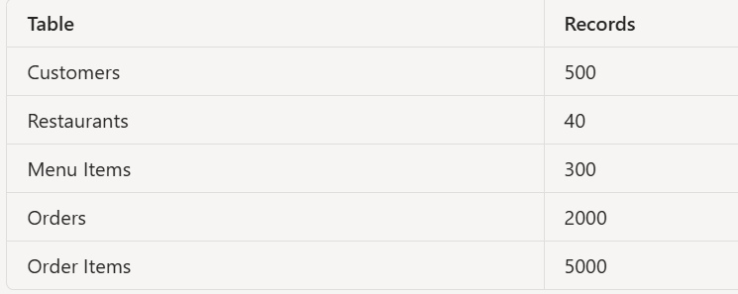
Dataset & Database Overview
Database Components
Dataset Summary
5 Tables
Primary Keys
Foreign Keys
One-to-Many Relationships

Slide 8
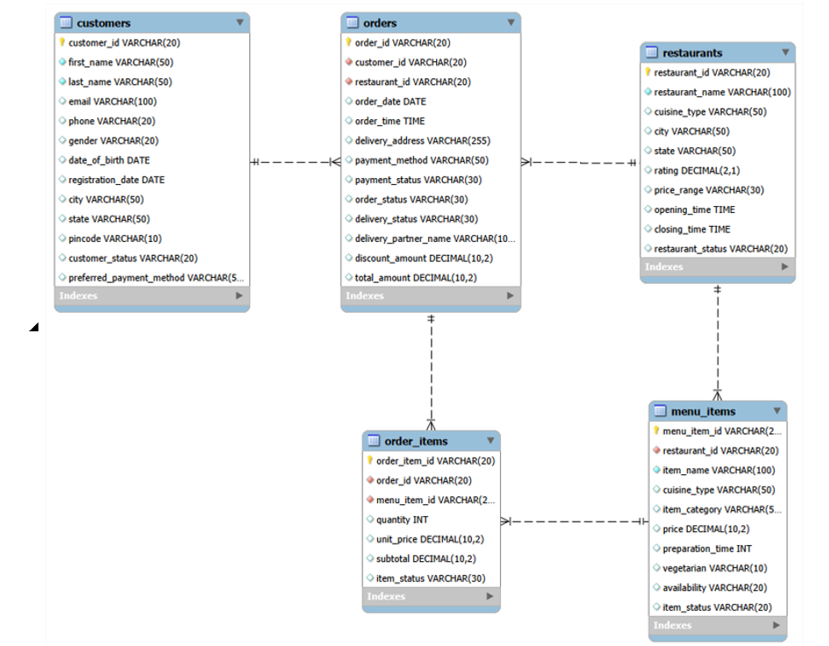
ER Diagram & Database Structure
Customers
Stores customer details, contact information, location, registration date, and preferred payment method.
Restaurants
Stores restaurant details, cuisine type, location, ratings, price range, and operating status.
Menu Items
Stores menu item details including category, cuisine type, price, preparation time, and availability.
Orders
Stores order information such as customer, restaurant, payment details, order status, delivery status, discounts, and total amount.
Order Items
Stores individual items ordered, quantity, unit price, subtotal, and item status.
Relationships
The tables are connected using Primary Keys and Foreign Keys to maintain data consistency and establish relationships between customers, restaurants, orders, and menu items.

Slide 9
Analysis of objectives
Customer Analysis
How are customers distributed across customer groups?
  Which customers generate the highest revenue?
Restaurant Analysis
Which cuisines and restaurants perform best?
Order Analysis
How do order patterns change over time?
Payment & Delivery Analysis
How effective are payment and delivery operations?
Product Analysis
Which menu items drive customer demand?

Slide 10
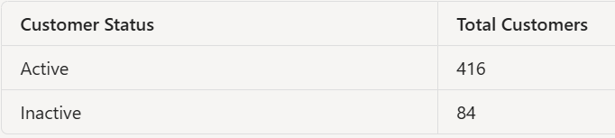
Sample SQL Queries
Customer Status Analysis
Output
select customer_status,
count(*) as total_customers
from customers
group by customer_status ;

Slide 11
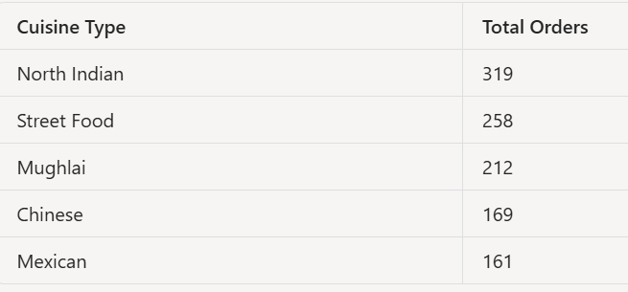
Query 2: Popular Cuisine Analysis
Output
select r.cuisine_type,
count(o.order_id) as total_orders
from restaurants r
join orders o
on r.restaurant_id=o.restaurant_id
group by r.cuisine_type;

Slide 12
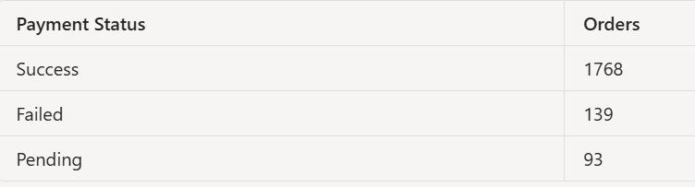
Query 3: Payment Success Analysis
select payment_status,
count(*) as total_orders
from orders
group by payment_status;
Output​
​

Slide 13
Overall key findings
Customer Insights
Active customers generated most platform activity.
High-value customers contributed significantly to revenue.
Restaurant Insights
North Indian cuisine showed strong customer demand.
Mid-range restaurants formed the largest restaurant group.
Order Insights
Most orders were successfully delivered.
Order volume increased over time.
Payment & Delivery Insights
Payment success rate was high.
Delivery operations were effective.
Product Insights
Vegetarian products generated higher demand.
Pizza and Dessert categories performed strongly

Slide 14
Business Recommendations
Strengthen customer loyalty programs.
Promote top-performing menu items.
Expand high-performing cuisine categories.
Reduce order cancellations.
Improve payment failure handling.
Increase visibility of popular vegetarian items.
Optimize delivery operations during peak periods.

Slide 15
Learning Experience
Improved SQL querying skills.
Gained hands-on database design experience.
Learned business analytics concepts.
Developed data-driven problem-solving skills.

Slide 16

Conclusion
The project successfully transformed food delivery operational data into meaningful business insights using MySQL.
Key Outcomes
Better understanding of customer behavior.
Identification of high-performing restaurants and cuisines.
Evaluation of payment and delivery performance.
Recognition of high-demand menu products.
Generation of actionable business recommendations.
The insights can support revenue growth, customer satisfaction, and operational efficiency.

Slide 17

THANK YOU

