Slide 1
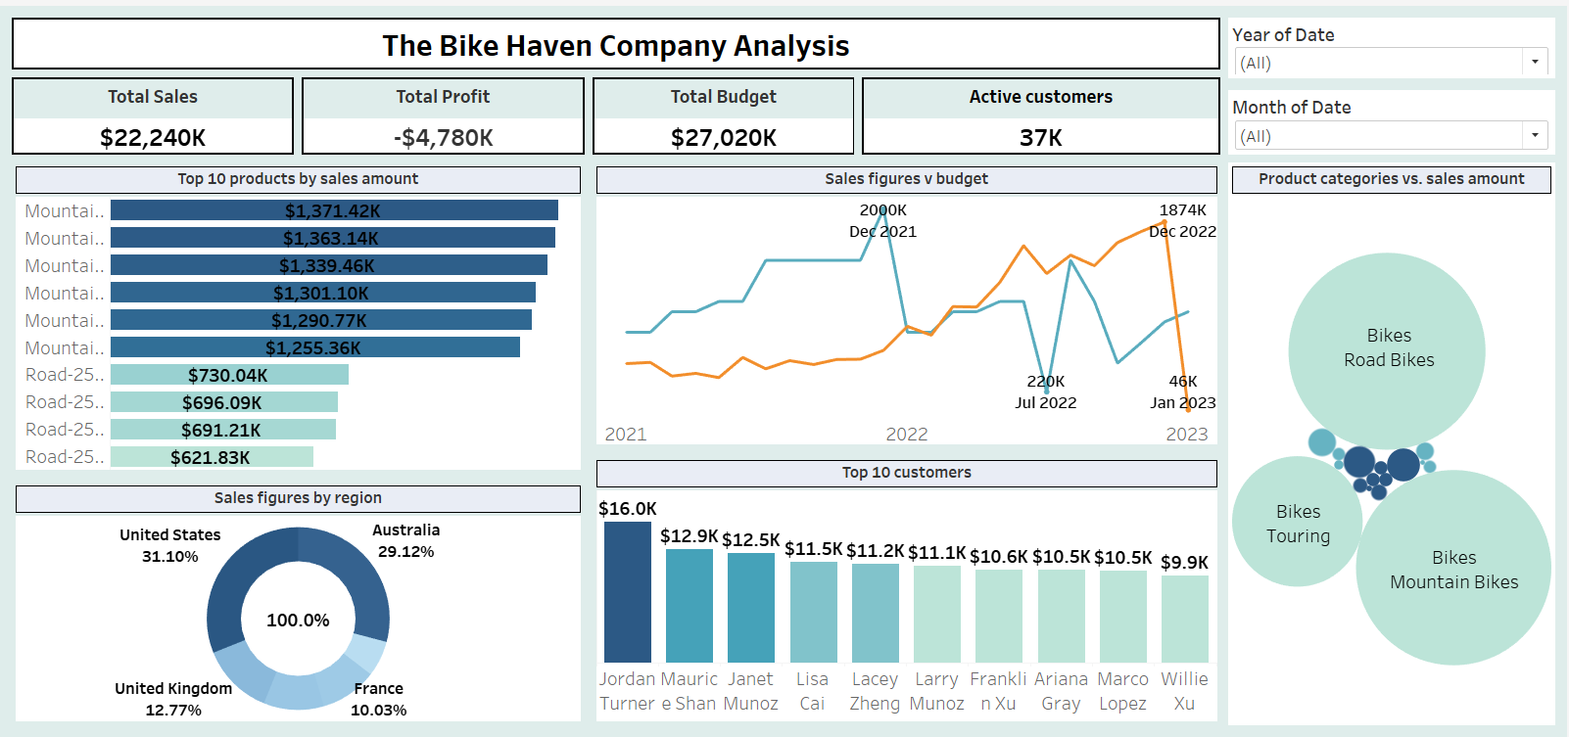
The Bike haven dashboard

