Slide 1
Patient Application
Marcel Kanne(294074) and anatoly Kubasov (299764)

Slide 2
Overview
Idea of this App
App architecture
Flow
Results
Problems

Slide 3
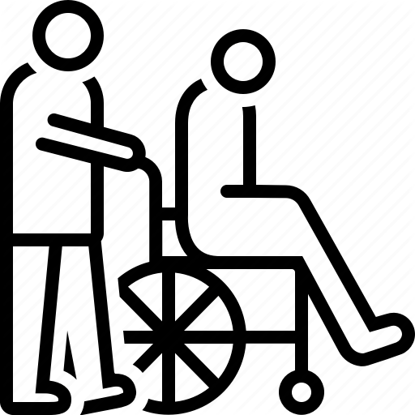
Idea of this App
Android Platform
Collaboration with ucura GmbH
Make it easy to match patients and caretaker
Patient app specifically
Registration of patient
Login
Search caretaker for relevant treatment
Send request to caregiver

Slide 4
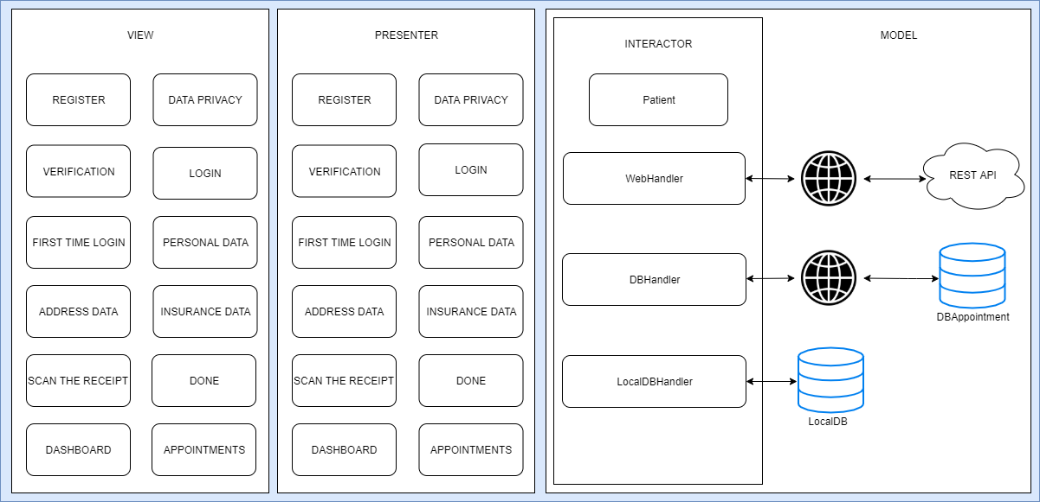
App architecture

Slide 5
Flow
Patient performs a registration
Accept Data Privacy
Get an email to confirm the registration and a „Thank you“
Patient performs a login
If patient had perform logging in the first time
Patient can complete his profile
Patient can fill out Personal- and Address Data (like gender, name, city, etc.)
After completing the profile, dashboard will open
On dashboard, patient can select a relevant treatment and a list of all possible caregivers will displayed
Patient have to choose a caregiver by a „click“
Request

Slide 6
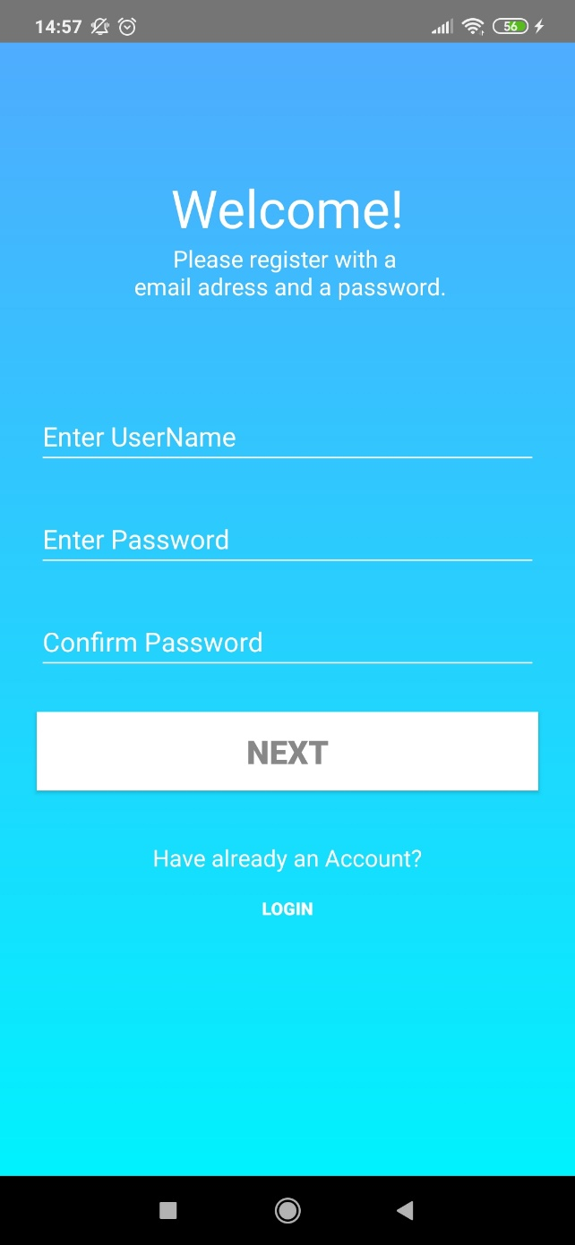
Results (Registration)
Register View
E-Mail and password
Confirm Password
Login button on the bottom

Slide 7
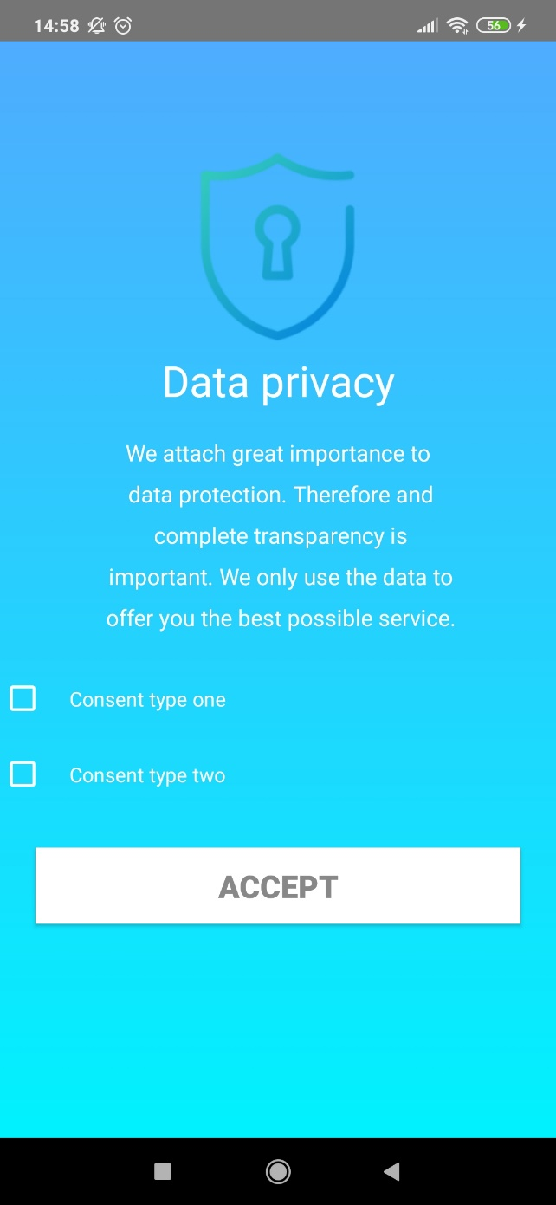
Results (Data Privacy)
Data Privacy view
Need to confirm both consent types
Go on with „Accept-Button“

Slide 8
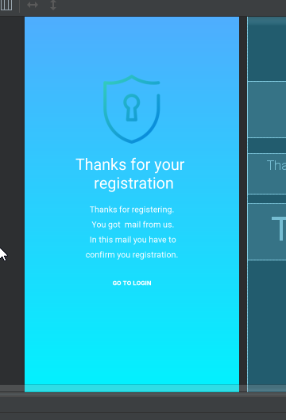
Results (Thanks for registration)
E-Mail was sent
Need to confirm by clicking a link
Perform first login

Slide 9
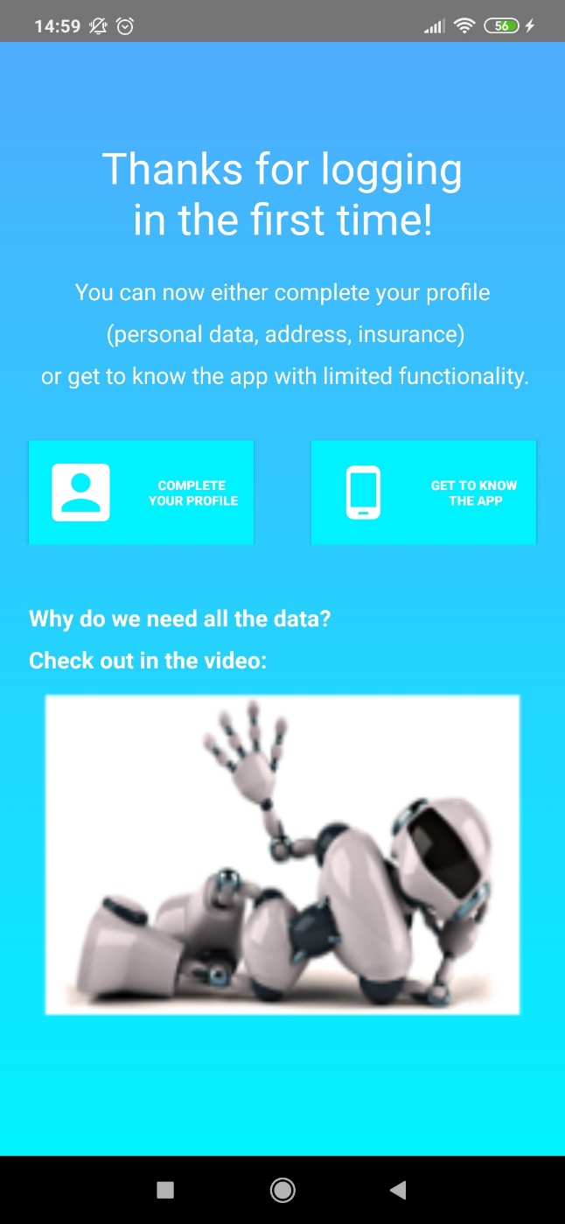
Results (Thanks for logging )
2 Buttons
One of them is imlemented
Placeholder for a video

Slide 10
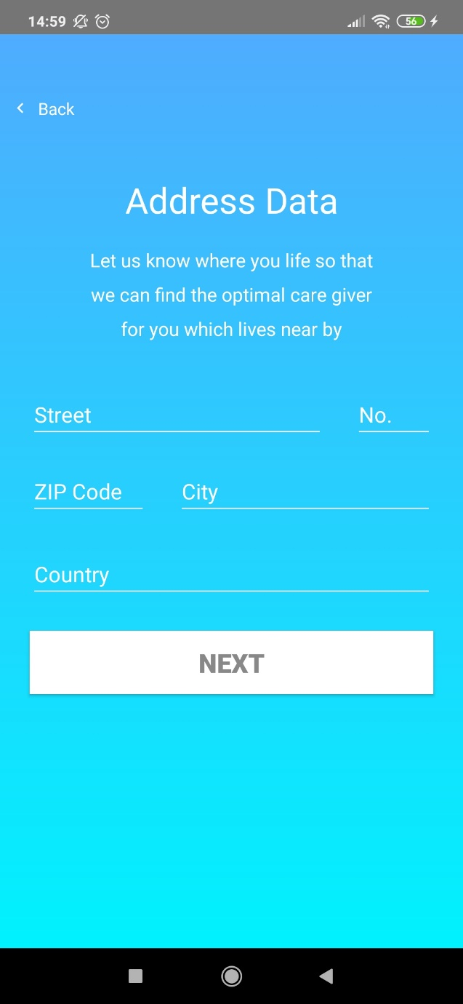
Results (Profile)
Address Data View
Street, city, etc.
Confirm with click on Next-Button

Slide 11
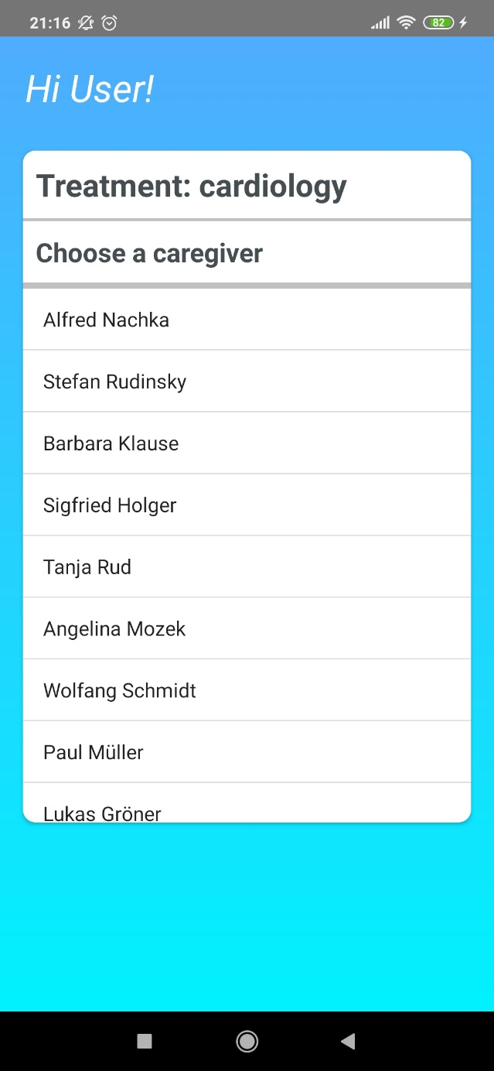
Results (Dashboard)
Dashboard
Treatment
List of caregivers
On a „click“ a new view opens
Can see the profile of a caregiver and sent a request for appointment

Slide 12
Problems
Time
E.g. functionality for selecting a treatment is not implemented yet
Some Backend problems
E.g. password length
Lack of knowledge w.r.t REST API of ucura GmbH
Implementation of network
Our solution is not the best for communication to network combined with saving data locally
No time for implementing the founded alternative
But… In general we have a nice working app!

Slide 13
Thanks for your attention! Let‘s look into the app!

