Slide 1







DEPARTMENT OF MECHANICAL ENGINEERING
TITLE OF THE PROJECT FABRICATION OF WALL MOUNTED SLIDING LADDER
MINOR PROJECT III
DATE OF REVIEW – 10.08.2024
TEAM MEMBERS
V KANNYA DHARSHINI
S KARUNAKARAN
M LIVIN KUMAR
UNDER THE GUIDANCE OF
Dr.M.MOHAN PRASAD M.E, MBA, Ph.D.
Associate Professor
Dept. of Mechanical Engineering
(927622BME033)
(927622BME035)
(927622BME307)

Slide 2
OVERVIEW OF PROJECT
OBJECTIVE
PROJECT COMPONENTS
EXPECTED OUTCOME
TOOLS AND MATERIALS
PROJECT SKETCH
PROGRESS PLAN
CONCLUSION

Slide 3
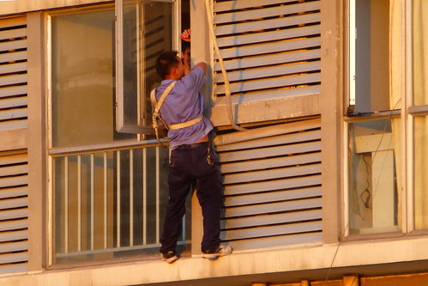
OBJECTIVE
To develop a minor project that automates the cleaning and painting process of walls around air conditioning units mounted on bridges or other elevated structures.

Slide 4
PROJECT COMPONENTS
SLIDING MECHANISM DESIGN
Design a sliding rail or track system that can be mounted on the bridge wall.
The system should be capable of moving a cleaning and painting unit horizontall
and vertically.
CLEANING UNIT
Attach a cleaning brush or sponge that can scrub the wall surface.
Include a spray system for water or cleaning solution.

Slide 5
PROJECT COMPONENTS
PAINTING UNIT
Attach a paint spray system that can evenly coat the wall surface.
Ensure that the system can switch between cleaning and painting modes.
CONTROL SYSTEM:
Use a simple microcontroller (like Arduino) to automate the movement of the sliding mechanism.
Implement basic controls for speed, direction, and operation of the cleaning and paintings.

Slide 6
PROJECT COMPONENTS
SAFETY FEATURES:
Design the system to handle uneven surfaces and avoid damaging the air conditioning units.
Implement emergency stop buttons and limit switches to prevent accidents.
POWER SYSTEM: The system could be powered by a battery or connected to a nearby power source.

Slide 7
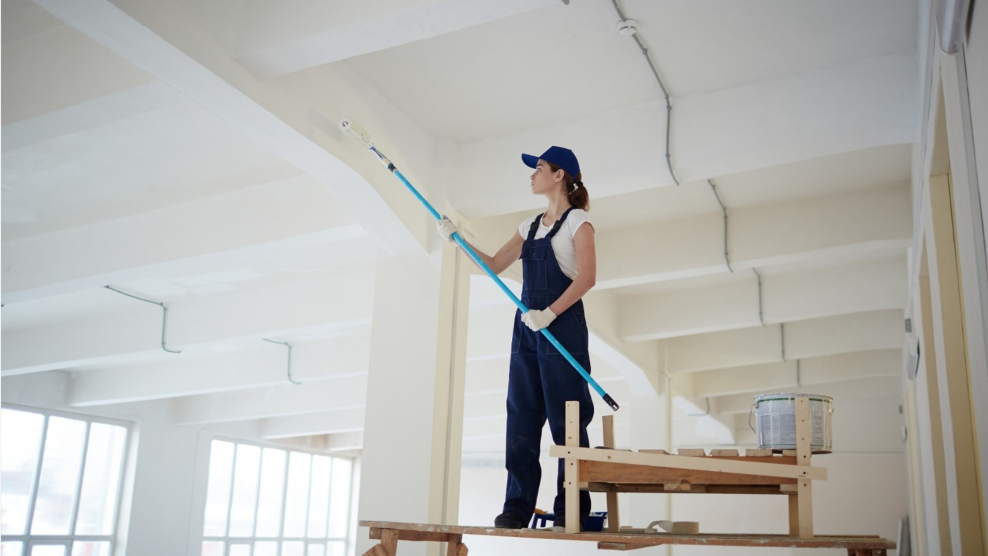
EXPECTED OUTCOME
A functional prototype that can clean and paint the designated wall areas efficiently.
Improved maintenance efficiency, reducing the need for manual labor, especially in hard-to-reach areas.

Slide 8
TOOLS AND MATERIALS
Aluminum/steel rails for the sliding mechanism.
Brushes, sponges, and spray nozzles for the cleaning and painting units.
Arduino or similar microcontroller.
Motors and gears for movement control.- Paint and cleaning solutions.

Slide 9
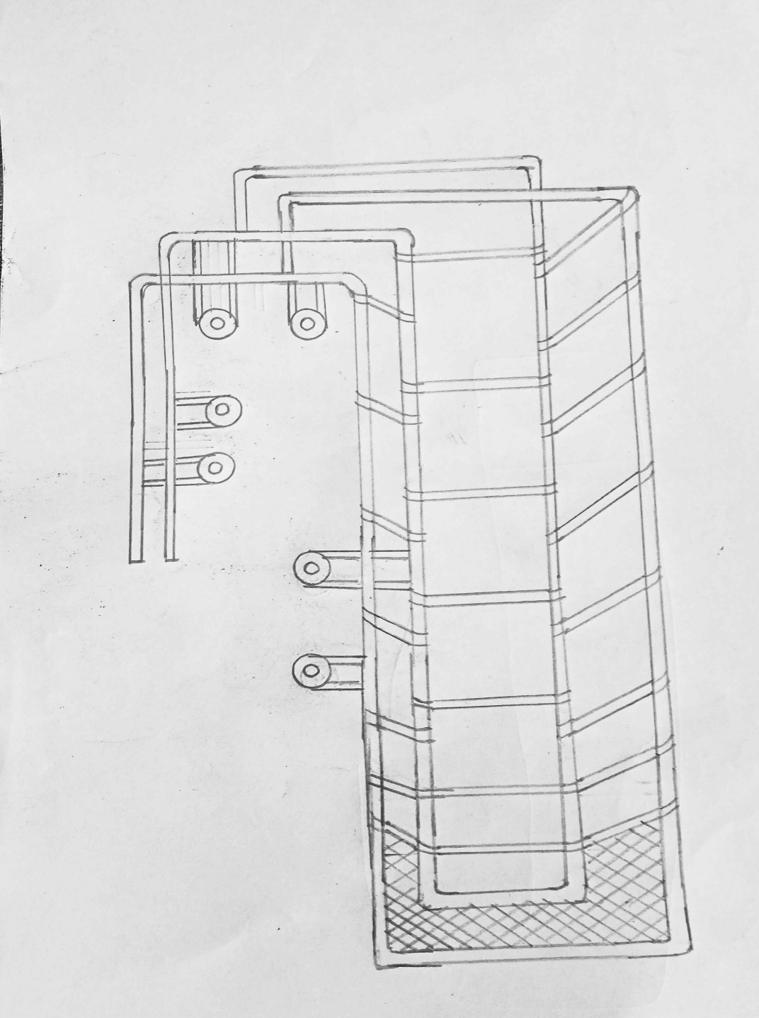
PROJECT SKETCH
WHEELS
BUCKEL
BASKET

Slide 10
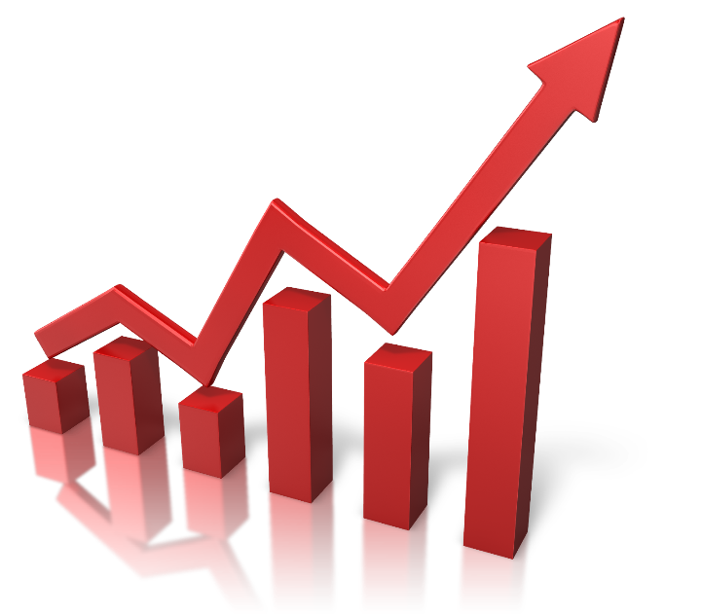
PROGRESS PLAN
ZEROTH REVIEW: Deciding the topic and make or alter in our project
FIRST REVIEW : Buying the product to implement the project product
SECOND REVIEW: Assemble the project to work on the field
FINAL REVIEW : Submitting the project protype and project review

Slide 11

CONCLUSION
This project could serve as an efficient maintenance tool, especially for areas that are difficult to access, such as bridge walls with mounted air conditioning systems. The automation aspect would enhance safety and reduce the time required for these tasks.

