Slide 1
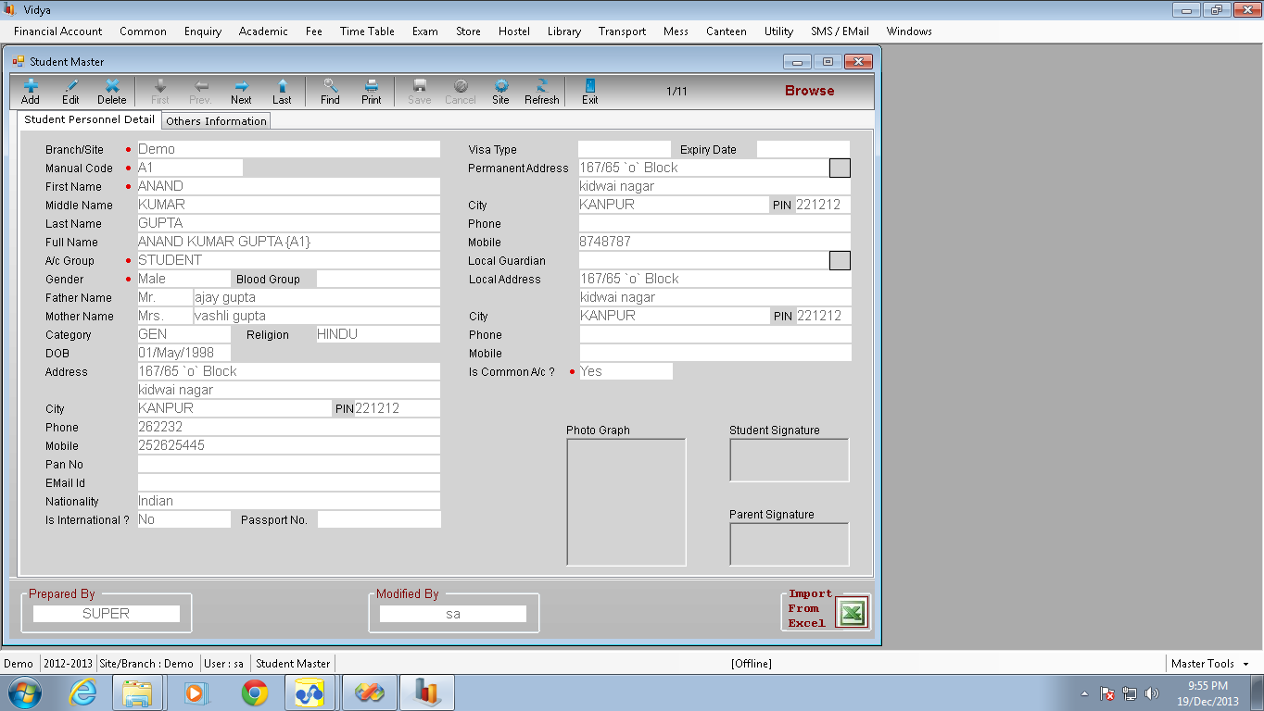
Student Master

Slide 2
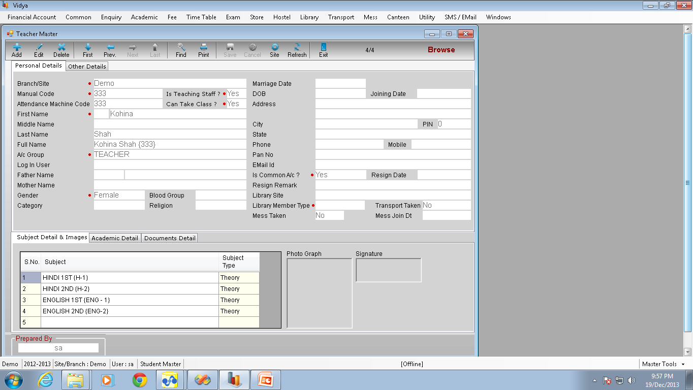
Teacher Master

Slide 3
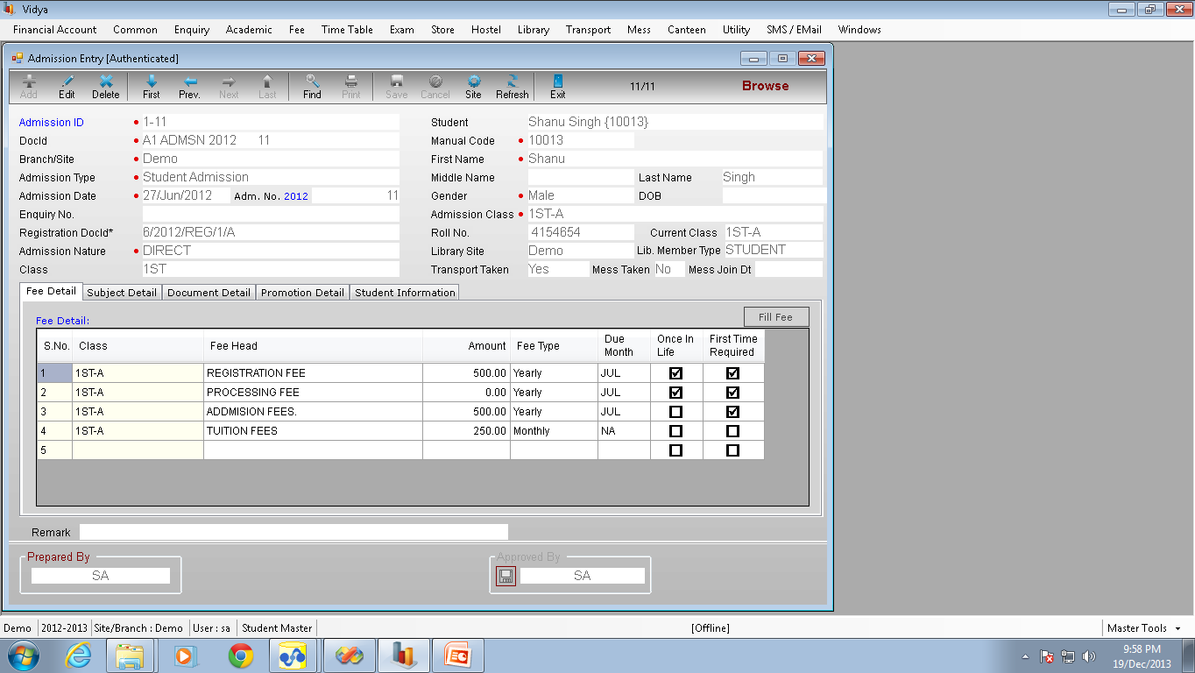
Admission Entry

Slide 4
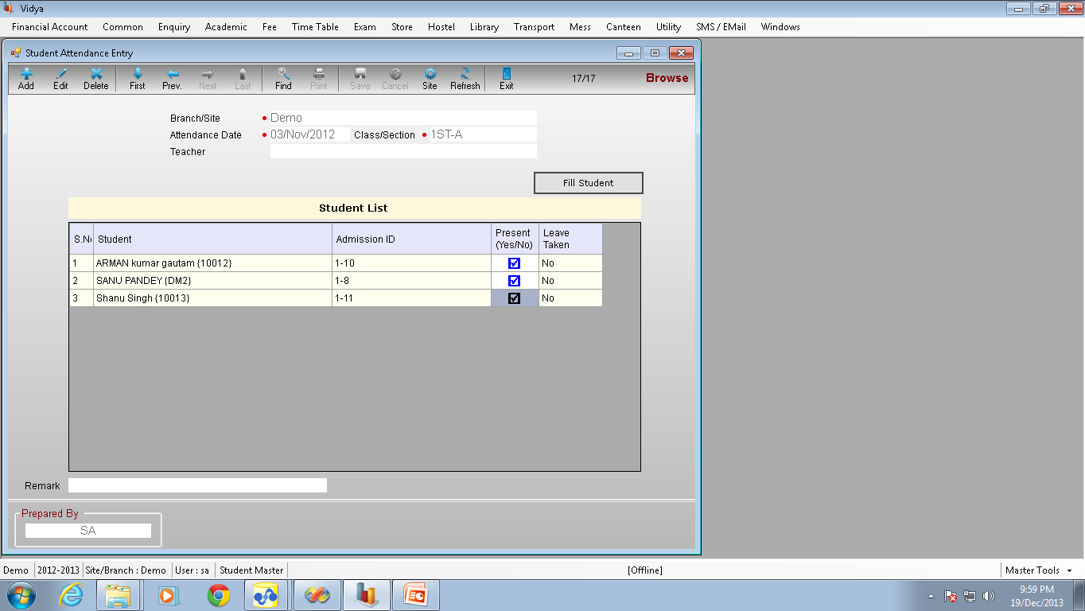
Student Attendance Entry

Slide 5
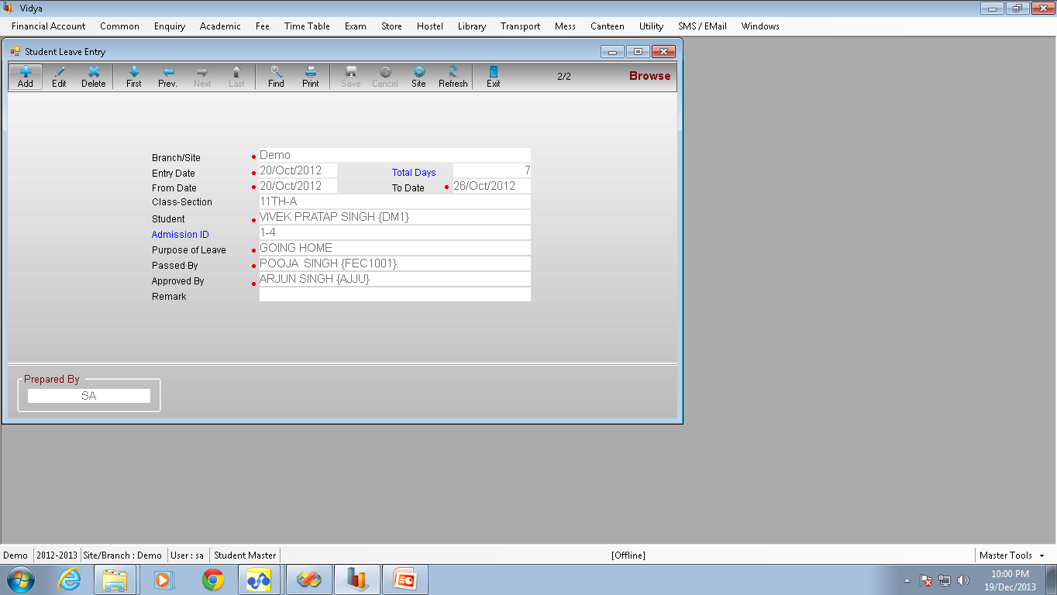
Student Leave Entry

Slide 6
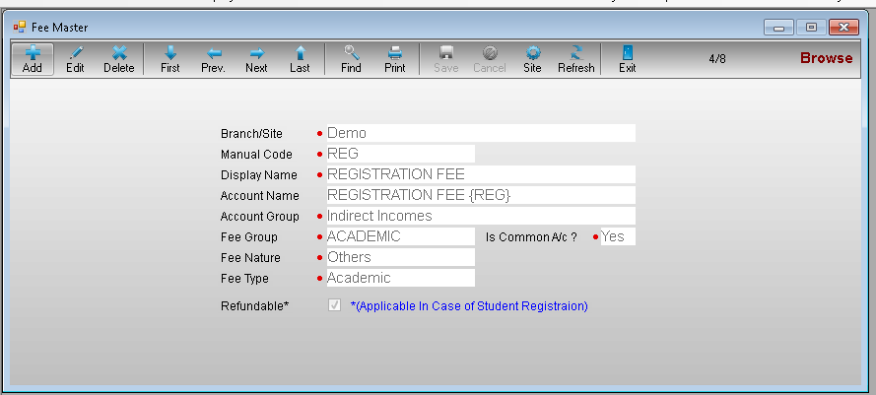
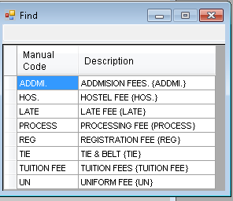
Fee Master

Slide 7
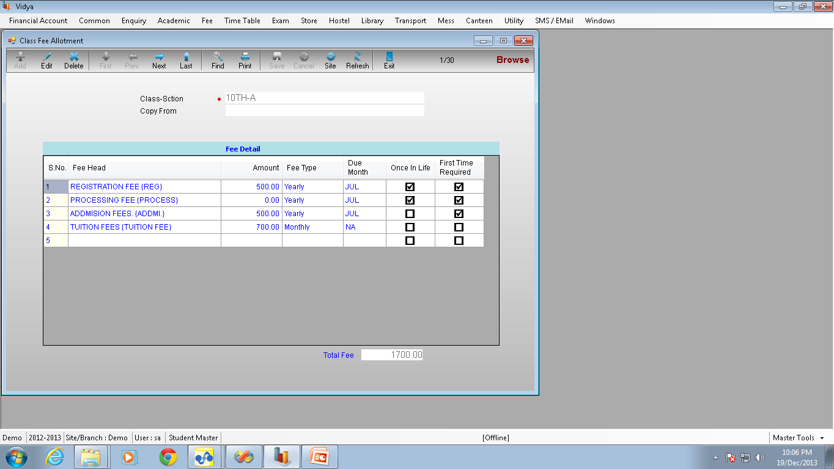
Class Fee Master

Slide 8
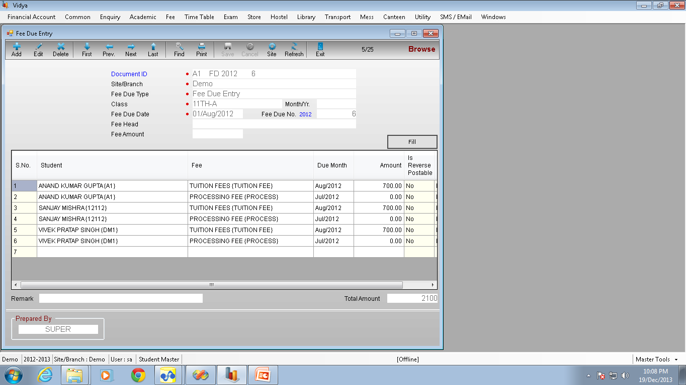
Fee Due Entry

Slide 9
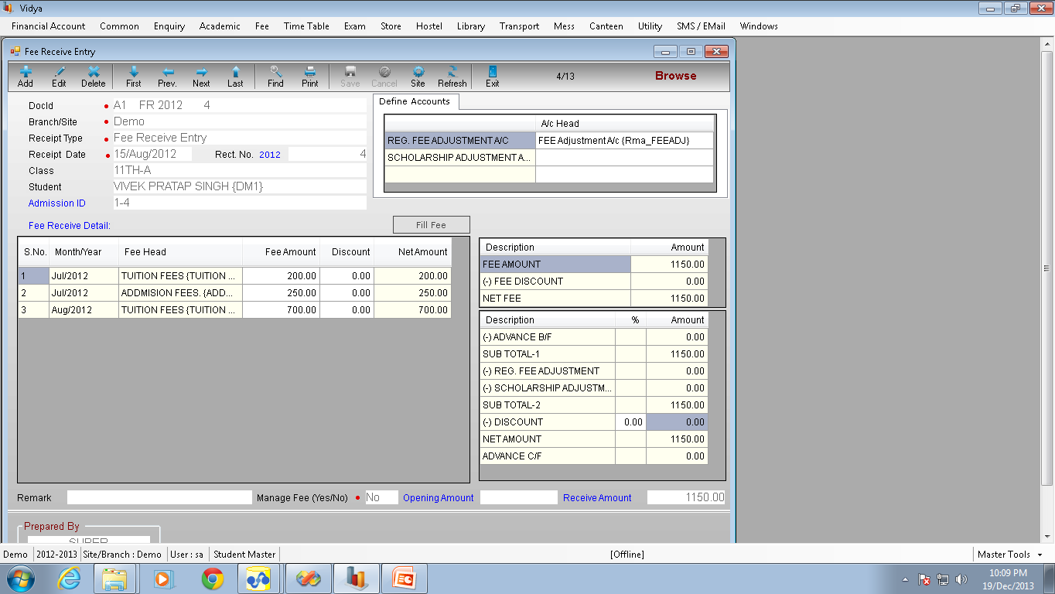
Fee Receive Entry

Slide 10
Other Features
Store Management
Stationary Shop
Transport Management
Admission Report
Outstanding Report
Fee Due Report
Fee Collection Report

