Slide 1
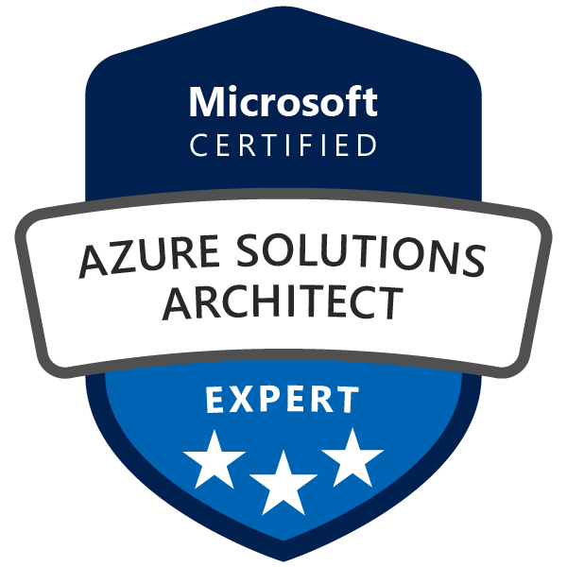
Exam AZ-300: Microsoft Azure Architect Technologies Crash Course
Tim Warner

Slide 2

Tim Warner
Twitter: @TechTrainerTim
Work: Pluralsight.com
Web: TechTrainerTim.com

Slide 3
Course Materials
timw.info/az300

Slide 4
Day 1 of 2 Agenda
Introduction
Module 1: Deploy and Configure Azure Infrastructure
Module 2 Implement Azure Workloads and Security
Module 3: Create and Deploy Apps in Azure
Synthesis and look ahead to Day 2

Slide 5
Day 2 of 2 Agenda
Quick content review
Module 4: Implement Authentication and Secure Data in Azure
Module 5: Develop for the Cloud and for Azure Storage
Module 6: Exam AZ-300 Exam Strategy

Slide 6
Module 1: Deploy and Configure Azure Infrastructure

Slide 7
Module 1 Learning Objectives
Analyze resource utilization and consumption
Create and configure storage accounts
Create, configure, and automate deployment of Windows and Linux virtual machines (VMs)
Create connectivity between virtual networks

Slide 8
Module 1 Learning Objectives (Cont’d)
Implement and manage virtual networking
Manage Azure Active Directory (Azure AD)
Implement and Manage Hybrid Identities

Slide 9
Our Environment

Slide 10
Module 2 Implement Azure Workloads and Security

Slide 11
Module 2 Learning Objectives
Migrate servers to Azure
Configure serverless computing
Implement application load balancing

Slide 12
Module 2 Learning Objectives (Cont’d)
Integrate an on-premises network with an Azure virtual network
Manage role-based access control (RBAC)
Implement Multi-Factor Authentication (MFA)

Slide 13
Module 3: Create and Deploy Apps in Azure

Slide 14
Module 3 Learning Objectives
Create web apps by using PaaS
Design and develop apps that run in containers

Slide 15
Module 4: Implement Authentication and Secure Data in Azure

Slide 16
Module 4 Learning Objectives
Implement authentication
Implement secure data solutions

Slide 17
Module 5: Develop for the Cloud and for Azure Storage

Slide 18
Module 5 Learning Objectives
Develop solutions that use Cosmos DB storage
Develop solutions that use a relational database
Configure a message-based integration architecture
Develop for autoscaling

Slide 19
Module 6: Exam AZ-300 Exam Strategy

Slide 20
Module 6 Learning Objectives
Grasp the content
Acquire the hands-on skills
Master computer-based testing
Comprehend what to expect before, during, and after the exam

Slide 21
Tim's Certification Study Pyramid
Interdependence
Content knowledge
Practical application
Test-taking skills

Slide 22
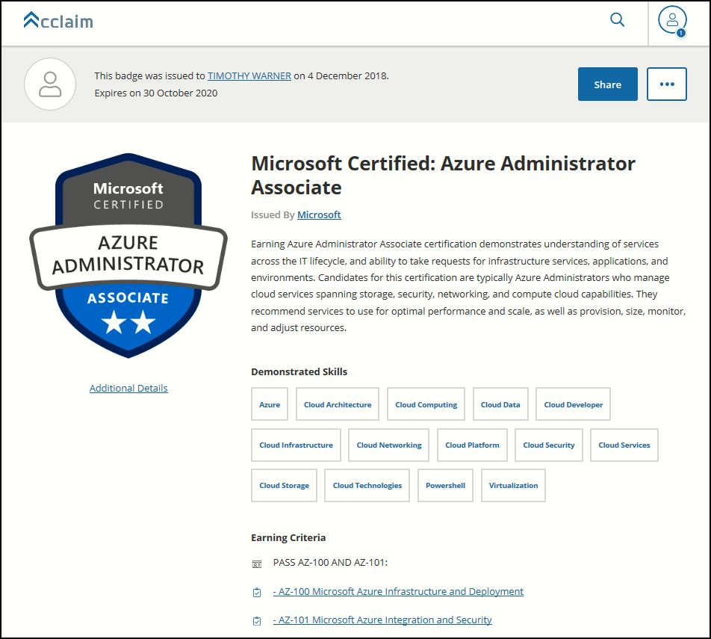
Digital Credentials by Credly/Acclaim

Slide 23
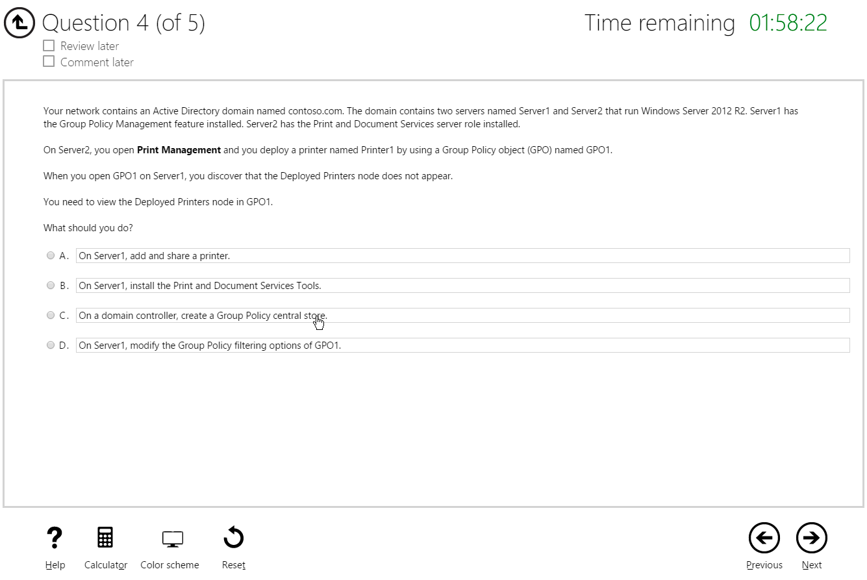
Multiple Choice

Slide 24
Repeated Scenario
You need to move an Azure VM to another hardware host.
Solution: You redeploy the VM.
Does this solution meet the goal?
Yes
No

Slide 25
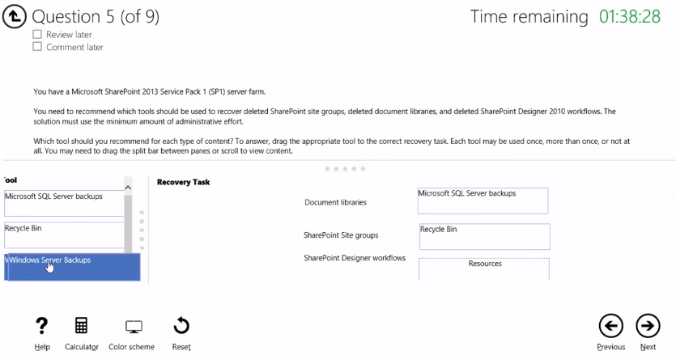
Select and Place

Slide 26
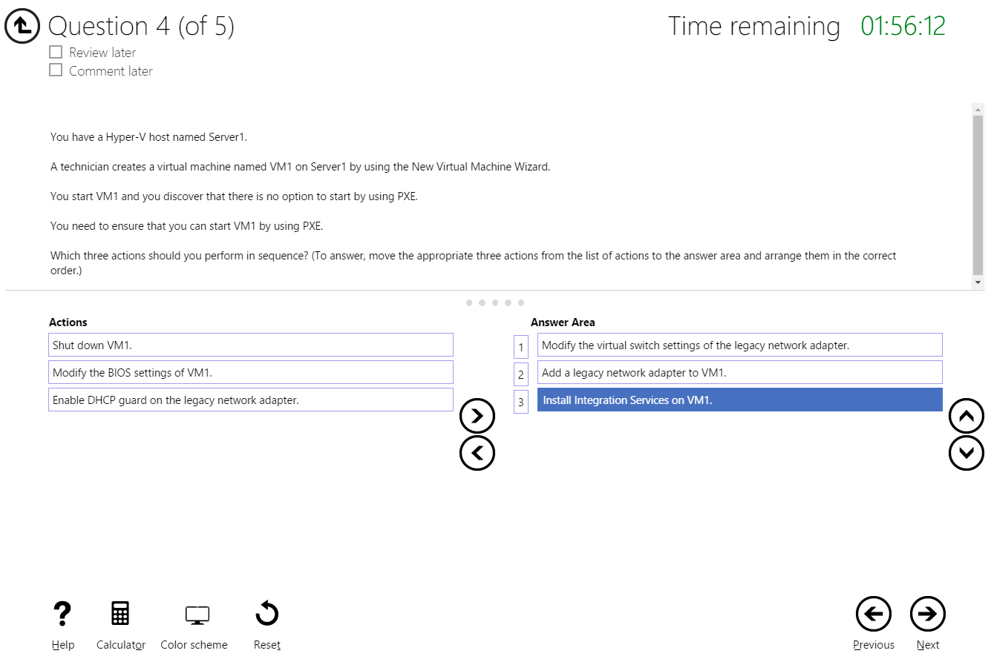
Build List and Reorder

Slide 27
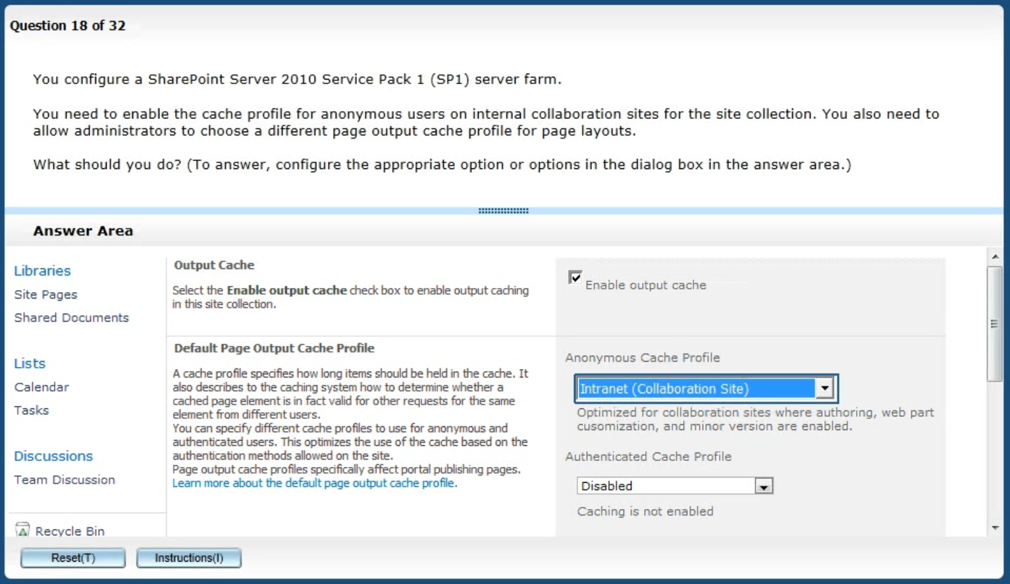
Active Screen/Fill in the Blank

Slide 28
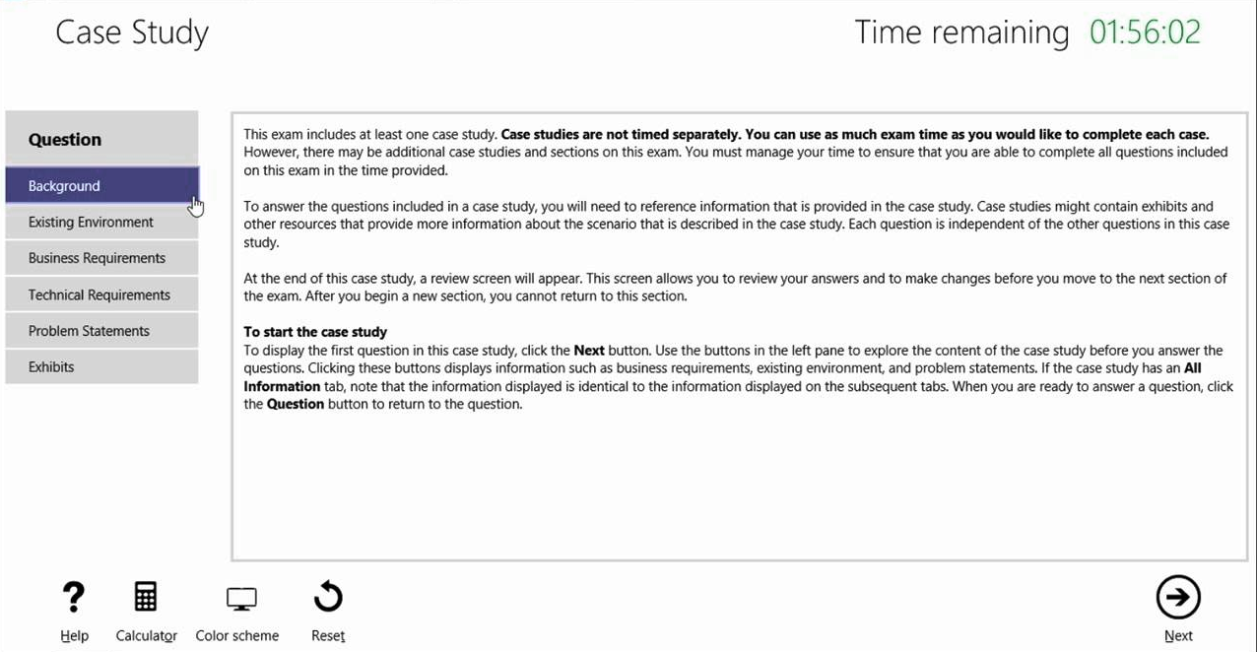
Case Study

Slide 29
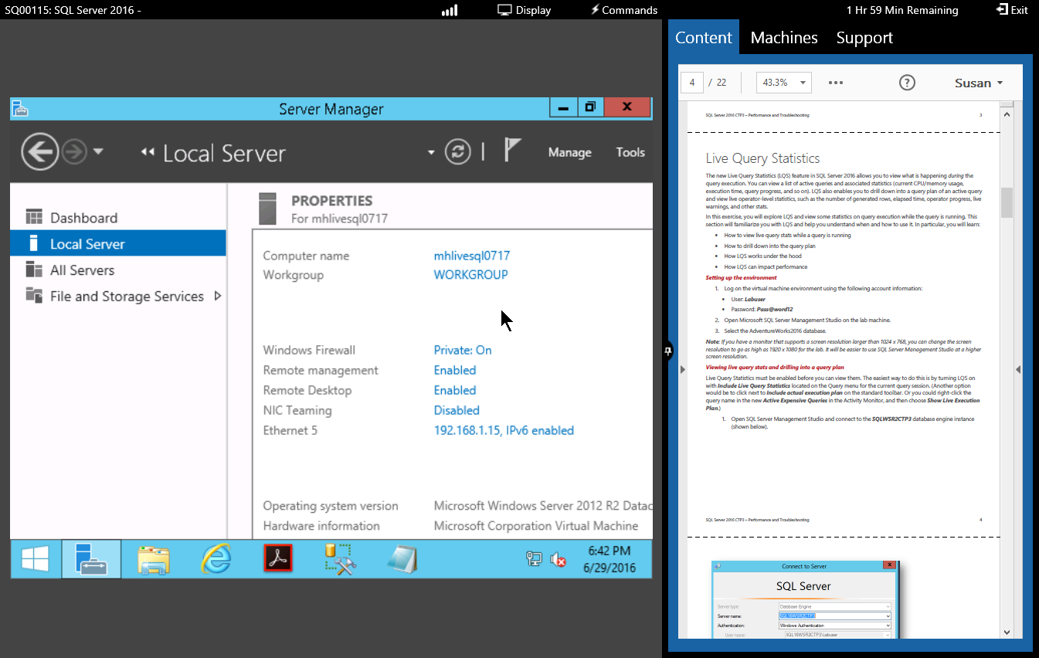
Performance-Based Lab

Slide 30
Thank you!
Course materials: timw.info/az300
Twitter: @TechTrainerTim
Work: Pluralsight.com
Web: TechTrainerTim.com

