Slide 1



HACKX 2025
Project Title: AI – Powered Smart Shopping Assistant
Team Name and Unique ID: Scope Dealer | U851CN4J
Institution Name: U.V. Patel College of Engineering, Ganpat University
Department: Computer Engineering
State: Gujarat
Team Members:
Krish Kansagara | kansagara.krish2006@gmail.com
Ujjwal Roy | ujjwal777roy@gmail.com
Ujjwal Kumar Mohanka | mohankaujjwal36@gmail.com
Patel Sudip Alpeshbhai | patelsudip69@gmail.com

Slide 2

Scope Dealer
Executive Summary
Problem Statement
In today's fragmented e-commerce landscape, consumers lack a unified platform for real-time product comparison across multiple websites. Shoppers must manually search and compare prices, specifications, and seller credibility across numerous platforms, leading to suboptimal purchasing decisions, wasted time, and increased risk of fraud.
Proposed Solution: Quick Deals
Quick Deals is an AI-powered smart shopping assistant that revolutionizes online purchasing through three integrated capabilities:
Unified Product Aggregation & Comparison: Aggregates product data from various e-commerce platforms, normalizes specifications and pricing information, and presents intuitive side-by-side comparisons through an intelligent dashboard.
Predictive Price Intelligence: Leveraging machine learning algorithms, the system analyzes historical pricing patterns to predict future price drops, enabling users to optimize purchase timing and maximize savings.
Intelligent Seller Trust Assessment: Employs a comprehensive evaluation engine analyzing multiple trust signals including seller ratings, customer feedback sentiment, review volume and authenticity, delivery time consistency, and return history. The system generates clear trust indicators (Better/Good/Caution) for each seller, empowering users to identify not only the best price but also the most reliable purchasing option.
Expected Impact
The impact of Quick Deals extends across multiple dimensions:
Social Impact: Empowers consumers with transparent, data-driven choices while reducing shopping frustration and misinformation. By exposing fraudulent sellers and highlighting trustworthy vendors, it creates a safer digital marketplace.
Economic Impact: Promotes cost optimization for consumers while encouraging healthy competition among legitimate sellers. The trust scoring system incentivizes high service standards, creating a merit-based marketplace.
Environmental Impact: Encourages sustainable consumption by minimizing impulse purchases and reducing return rates through better seller-buyer matching. With the global e-commerce market projected at $6.4 trillion in 2025, Quick Deals positions itself as a transformative tool for smarter, safer, and more responsible digital shopping.

Slide 3
Scope Dealer
Lack of Unified, Real-Time, and Context-Aware Product Comparison in E-Commerce
Background & Problem Definition: The rapid proliferation of e-commerce platforms over the past decade has created a paradox: while consumer choice has expanded dramatically, the ability to efficiently compare options has not kept pace. With 2.77 billion online shoppers worldwide Renub, consumers now face fragmented marketplaces where finding the best deal requires manually searching multiple websites, comparing prices, evaluating seller credibility, and calculating total costs including shipping and taxes—a process that can consume over 30 minutes per purchase.
Quantified Impact: The consequences are substantial:
Financial Loss: 48% of U.S. consumers abandon their online purchases at checkout due to unexpected costs Shopify, highlighting how hidden fees and poor comparison tools lead to overspending or purchase abandonment.
Time Inefficiency: With 43% of shoppers purchasing online weekly eMarketer, billions of collective hours are wasted on redundant searches.
Trust Erosion: Global e-commerce fraud losses are projected to reach $48 billion in 2025 inBeat Agency, with lack of centralized seller verification increasing consumer vulnerability.
Relevance: With global retail e-commerce at $6.42 trillion Renub, addressing this inefficiency is economically critical and socially impactful for virtually every digital consumer.
Scope & Affected Communities: This problem spans globally across all demographics, but disproportionately impacts:
Price-sensitive consumers (students, low-income families, retirees) who cannot afford to miss better deals
Small business owners purchasing supplies across multiple vendors
International shoppers facing complex currency conversions and cross-border fees
Time-constrained professionals who lack hours for extensive product research

Slide 4

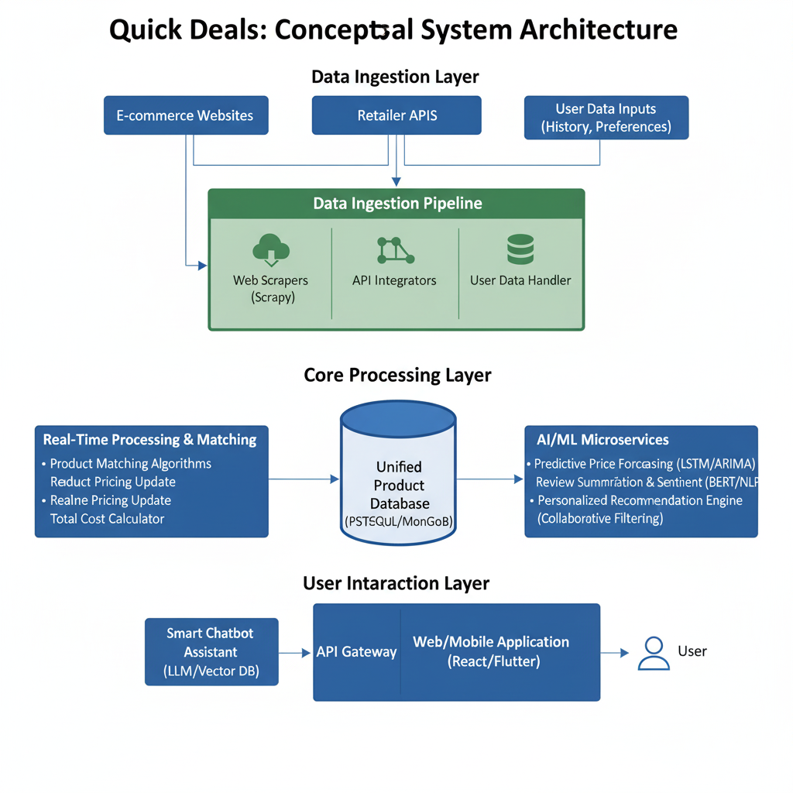
















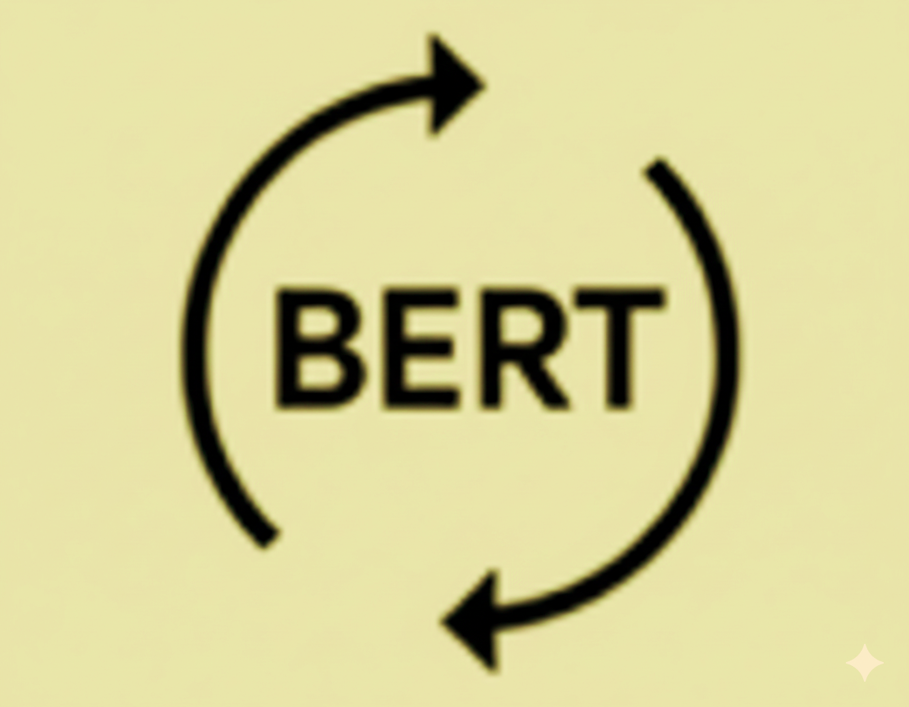
Scope Dealer
Proposed Solution: Quick Deals - The AI Smart Shopping Assistant
Our proposed solution, Quick Deals, is an AI-powered smart shopping assistant designed to solve the problem of fragmented, manual, and uninformed e-commerce purchasing. Deal Scope centralizes all necessary consumer intelligence—price, reviews, product details, and optimal timing—onto a single platform.
Problem Consequence | Quick Deals Feature | How it solves the problem
Financial Loss/Sub-Optimality | Predictive Price Forecasting | Prevents impulse purchases by advising users on the best time to buy
Wasted Time & Cognitive Load | AI Review Summarization | Reduces hours of manual searching to a single summary or query
Lack of Market Transparency | Visual Search & Recommendations | Ensures users find equivalent products across all sites
Features & Core Technologies
Real-Time Price Aggregation
Web scraping with Beautiful Soup/Scrapy and API integration to fetch real-time price data across e-commerce platforms
Predictive Price Forecasting
Employs XGBoost models to forecast future price movements based on historical data
AI Review Summarization
Uses NLP models like BERT to extract key pros/cons and sentiment from hundreds of reviews
Python
APIs
XGBoost
NLP
BERT
Personalized Recommendations
Employs Collaborative and Content-Based Filtering with TensorFlow or PyTorch to suggest alternative products
Smart Chatbot Assistant
Generative AI model (fine-tuned LLaMA) with Vector Database (Pinecone) for natural conversational interface
Tech Stack
TensorFlow
PyTorch
Generative AI
Vector DB

Slide 5








Scope Dealer
Objectives and Expected Outcomes
Measurable Goals
Intended impact
Reduce research time by 93% – from 30+ minutes to under 2 minutes per purchase
Enable 15-20% average cost savings – through comprehensive comparison and optimal timing
Reduce fraud exposure by 90% – protecting users from $48B annual e-commerce fraud
Generate $5M+ in cumulative user savings during first year
Decrease cart abandonment from 48% to below 20% – through transparent total cost display
Promote market transparency – expose 25% average price disparities across platforms
Drive fair competition – incentivize sellers to maintain competitive pricing and quality
Create informed marketplace – reduce information asymmetry between buyers and sellers
Reduce impulse purchases by 40% – encourage thoughtful, sustainable consumption
Lower product return rates by 25% – decrease reverse logistics carbon footprint
Combat seller fraud – flag 95% of fraudulent vendors, creating safer marketplace
Advance AI/ML research – publish findings on price forecasting and trust prediction
85%+ accuracy in XGBoost price forecasting for 1-14 day predictions
50+ e-commerce platforms aggregation with <5-minute latency
Deliver product comparison results in under 2 seconds
99.5% uptime and handle 10,000+ concurrent users
Seller trust scores with 90%+ reliability using 8+ trust signals
Process 1000+ reviews per product in under 5 seconds with 80%+ sentiment accuracy
4.5+/5 user satisfaction rating and 60%+ user retention rate after 3 months

Slide 6








Scope Dealer
Implementation Plan / Methodology
6-Phase Systematic Development Approach (18 Months)
Model Training
Duration: 4 months
React/Flutter UI
Flask backend
ML integration
Duration: 4 months
Testing (UAT)
Beta (10K users)
Duration: 2 months
Market validation
Platform analysis
Requirements doc
Duration: 2 months
Scrapy/API setup
50+ platforms
6+ months history
Duration: 2 months
Data cleaning
Product matching
Duration: 4 months
XGBoost/BERT
85%+ accuracy
Validation testing
Development
Launch
Research
Data Collection
Preprocessing
Feature engineering
Full launch (100K)
Data Collection and Processing
System Architecture
System Workflow: User Query to Response
ML Model Development
Price Forecasting
XGBoost Regressor
Features: 7/30/90-day prices, seasonality, competitors
Target: 85%+ accuracy
Backend
Flask/FastAPI APIs
PostgreSQL, MongoDB, Redis
User Search Web/Mobile App
Response Dashboard (less than 2s)
API Gateway Route request
ML Inference XGBoost + BERT
Data Fetch Cache/DB/Scrape
Aggregation Combine results
Web Scraping
Scrapy, BeautifulSoup, Selenium
50+ platforms, 4-hour refresh
Frontend
React.js (web), Flutter (mobile)
Responsive, less than 2 sec load time
API Integration
REST/GraphQL, OAuth 2.0
Official retailer partnerships
Seller Trust
XGBoost Classifier
Features: Ratings, reviews, delivery, returns
Target: 90%+ reliability
Preprocessing
Pandas, NumPy, spaCy
Cleaning, normalization, matching
Chatbot
GPT-4 + Pinecone Vector DB
LangChain framework
Review Summary
BERT (fine-tuned)
Sentiment + aspect extraction
Target: 80%+ accuracy
DevOps
Docker, Kubernetes, AWS
CI/CD with GitHub Action

Slide 7






Scope Dealer
Feasibility and Scalability
Human Recourses
Core Team: 15 people
Backhand (3) Frontend (2)
ML / AI (3) Data Eng (2)
DevOps (2) PM, UX , QA (3)
Financial Resources
Technical Resources
Initial Setup: ₹2.1 Cr
Hardware, legal, cloud setup
Cloud: AWS / GCP
20+ instances, MongoDB, Redis
Monthly: ₹71L - ₹1 Cr
Cloud (₹33L-₹50L), APIs (₹12L-₹21L), Marketing (₹12L-₹25L)
Stack:
Python, React, Flutter , XGBoost, GPT-4
Data: 1TB -> 10TB(Year 1)
6-12 mo. price history , 1M + SKUs, 100+ reviews’
₹1 Cr - ₹1.5 Cr/year
18-Month Total: ₹30 Cr - ₹42.5 Cr
Technical Scalability
Microservices , auto-scaling, 90 % cache hit rate
Replication Potential ( 5+ Verticals)
Users Responses Cost/mo.
100k 2s $85K
1M 2.5s $400K
10M 3s $2M
B2B E-commerce ($200K - $400K)
Real Estate ($300K - $500K)
Financial Services ($350K - $550K)
Healthcare ($400K - $600K)
Travel/Hotels ($250K - $450K)
Geographic Expansion
Future Use Cases
Phase 1: North America Mo 1-18
White-Label (₹67L
Browser Ext (₹67L)
Phase 2: Europe Mo 19-30 | ₹4-6.7 Cr
Voice Commerce (₹1 Cr)
Social Features (₹83L)
Phase 3: Asia-Pacific Mo 31-42 | ₹5.8-8.3 Cr
Sustainability (₹67L)
Crypto Integration (₹83L)

Slide 8



Scope Dealer
Impact Assessment
Social Impact
Economic Impact
Environment Impact
Consumer Saving
15 – 20% cost reduction per purchase
₹41Cr + saved (Year 1, 100K users )
₹ 1,230Cr + saved (Year 5,10M users)
Market Efficiency
Promotes competitive pricing through transparency
3-5% overall e-commerce price reduction
₹ 15.7T - ₹ 26.2T market savings
(in $6.4T global market at scale)
Reduced Impulse Buying
40% reduction via “Wait” recommendations
400K unnecessary purchases prevented
(Year 1, 100K users avoiding 4 impulse buys/year)
Fraud Prevention
90% reduction in fraud exposure
₹ 3,540Cr + fraud prevented annually
(1% of 2.77B global shoppers)
Lower Return Rates
25% reduction (30% to 22.5% rate)
250K fewer returns (Year 1)
25M fewer returns (Year 5)
Carbon Savings:
21,000 tons CO2/year (Year 1)
2.1M tons CO2 (Year 5)
Job Creation
Direct: 15 jobs (Year 1) to 100+ (Year 3)
Indirect: 50+ contractors/consultants
Annual payroll: ₹10Cr - ₹15Cr (Year 1)
₹125Cr + tax contribution (5 years)
Time reclaimed
93% reduction (30min to 2min)
88 years saved collectively (Year 1)
8,800+ years (Year 5)
Packing Waste Reduction
60% fewer reductant shipments
180 tons/year (Year 1)
18,000 tons (Year 5)
Additional Benefits:
Ecosystem Health:
Cart abandonment: 48% to 20% (58% improvement)
Return costs reduced by 25%
Customer service costs down 30%
E-Waste Prevention:
User satisfaction: 4.5+/5 rating
10-15% higher shopping frequency
Market transparency: Exposes 25% price gaps
35% longer product lifespan (quality focus)
100 tons/year | 10,000 tons (5 years)

Slide 9



Scope Dealer
Challenges and Mitigation Strategies
CHALLENGES
MITIGATION STRATEGY
Website Anti-Scrapping & API Rate Limits
Rotate Proximus/user agent, implements respectful scraping delays, use official APIs where available. fallback caching mechanisms
Multi-Approach
Partner with price tracking services, leverage public datasets (Kaggle) , implement continuous data collection from day one.
Limited Historical Price Data
Data Strategy
Model Accuracy & Forecast Reliability
Ensemble models (LSTM + ARIMA OR XGBOOST), continuous retraining , A/B testing predictions, confidence intervals for recommendations.
ML Optimization
Real-Time Processing Latency
Cloud-based serverless architecture (AWS Lambda), Redis caching, CDN integration, load balancing for peak traffic
Infrastructure

Slide 10



Scope Dealer
Conclusion
The Problem Today
• 30+ minutes wasted per purchase across 50+ platforms
• ₹4 lakh crore lost annually to e-commerce fraud
• 48% cart abandonment due to hidden costs
• Massive carbon footprint from returns and impulse buying
Our Solution: Quick Deals
• Predictive AI: 85% accuracy forecasting when to buy
• Trust Scoring: 90% reliability protecting from fraud
• Total Cost: True comparison including all fees
• AI Insights: BERT summaries + GPT-4 guidance
5-Year Impact (10 Millions Users)
₹150M+
Consumer Savings
2.1M
Tons CO2 Prevented
8,800+
Years Reclaimed
90%
Fraud Reduction
Massively Impactful
Real-World Transformation
Uniquely Intelligent
Proven Feasible
Beyond price lists—we tell you WHEN to buy, WHO to trust, and WHAT the total cost really is.
Measurable transformation across social, economic, and environmental dimensions.
Single Mother, Mumbai
Saves ₹8,000/year -> Invest in daughter’s educations
Built on mature tech with clear path to profitability and measurable milestones.
Investment: ₹30-42.5 Cr (18 months)
Break-even: Month 18
ROI: 600% over 5 years
Scalability: 100K to 10M users
Social: ₹150M+ saved, 90% fraud reduction
Economic: ₹192B market efficiency
Environmental: 2.1M tons CO₂ prevented
College Student, Delhi
Avoid ₹50,000 fraud-> Protected identity & Savings
No Competitor Offers:
Predictive timing + Trust scoring + Context awareness in one platform
Small Startup, Bangalore
30% Cost reduction -> Hires second employee

Slide 11

Scope Dealer
References
Market Statistics
Technology Frameworks
Statista. (2024). Global retail e-commerce sales worldwide from 2021 to 2027. https://www.statista.com/
Meta. (2024). React: JavaScript library for building user interfaces. https://react.dev/
Baymard Institute. (2024). 46 cart abandonment rate statistics. https://baymard.com/
Google. (2024). Flutter: Build apps for any screen. https://flutter.dev/
eMarketer. (2024). Worldwide ecommerce forecast 2024. Insider Intelligence.
Pallets. (2024). Flask: Web development framework. https://flask.palletsprojects.com/
Fraud & Security
Data Collection
Juniper Research. (2024). Online payment fraud: Market forecasts 2024-2029. https://www.juniperresearch.com/
Scrapy. (2024). Web crawling and scraping framework. https://scrapy.org/
Federal Trade Commission. (2024). Consumer sentinel network data book 2023. https://www.ftc.gov/
Richardson, L. (2024). Beautiful Soup documentation. https://www.crummy.com/software/BeautifulSoup/
Machine Learning & AI
Cloud Infrastructure
Chen, T., & Guestrin, C. (2016). XGBoost: A scalable tree boosting system. KDD '16, 785-794. https://doi.org/10.1145/2939672.2939785
Amazon Web Services. (2024). AWS cloud computing services. https://aws.amazon.com/
OpenAl. (2023). GPT-4 technical report. arXiv:2303.08774.
Docker, Inc. (2024). Docker: Container platform. https://www.docker.com/
Environment Impact
CNCF. (2024). Kubernetes: Container orchestration. https://kubernetes.io/
World Economic Forum. (2023). The carbon footprint of global e-commerce. https://www.weforum.org/

Slide 12
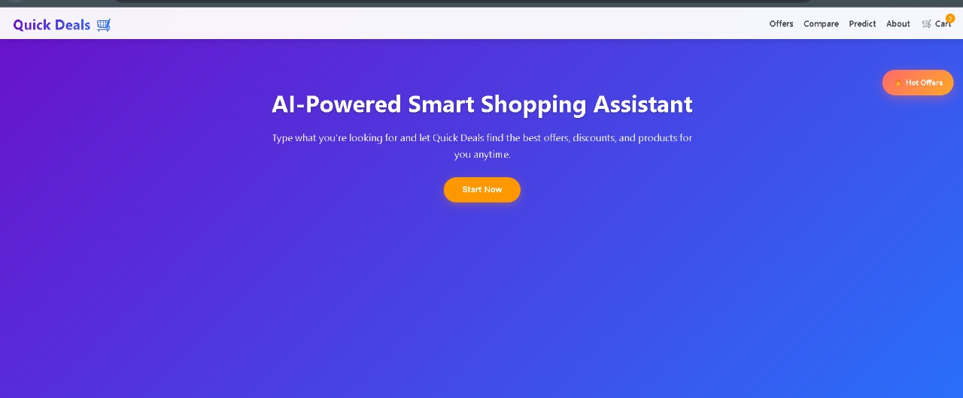
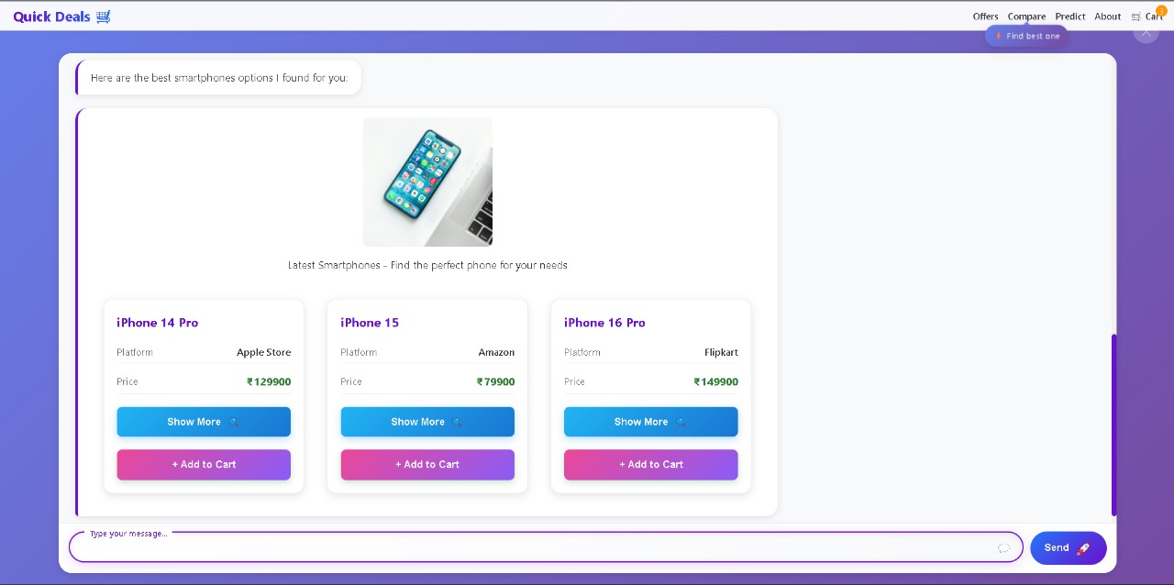
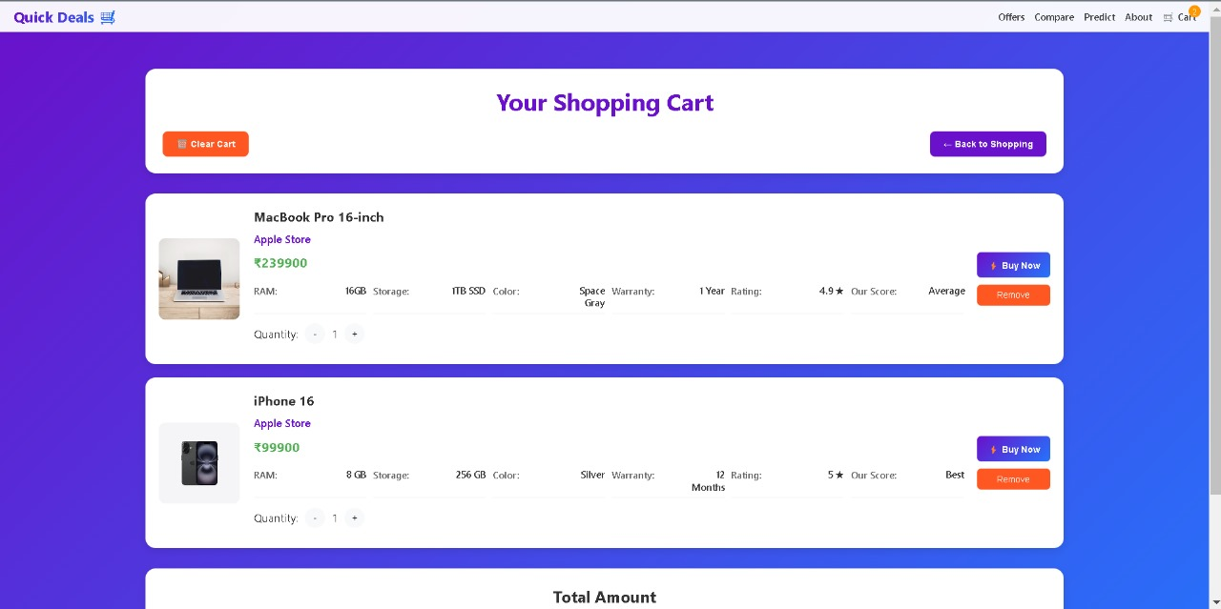
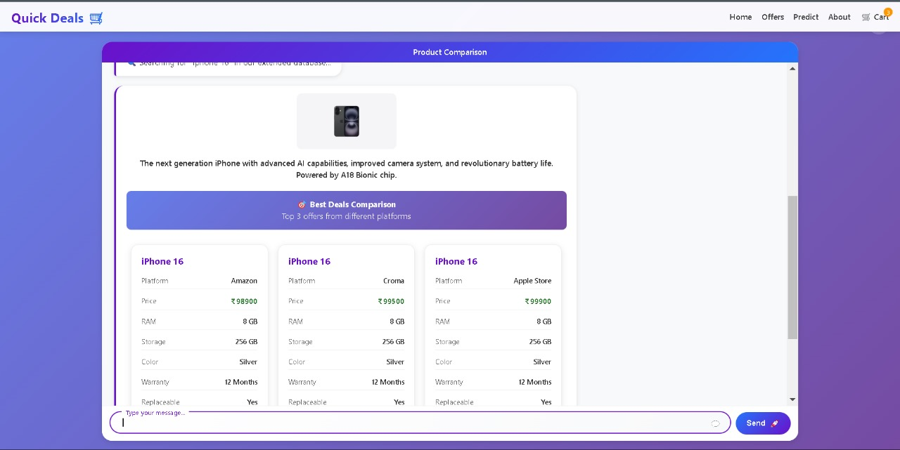
Scope Dealer
References
Main Screen
Product Discovery Assistant
Shopping Cart
Product Comparison
Summary :
This e-commerce application provides a complete shopping workflow, from Product Discovery via an AI assistant and side-by-side Product Comparison of vendor deals, to final purchase management within a Shopping Cart.
Model link 🔗 : (Works only for Desktop)
https://quick-delas-ai-powerd-smart-shopping-ivks.onrender.com/

