Slide 1
ITEC 8000 Re-write
Kansas Data Review Board
Data Governance

Slide 2
Background
ITEC Policy 8000 was initially approved as a policy of the Kansas Information Resource Council (KIRC) – a precursor to ITEC – on August 27, 1996 – almost 25 years ago.
It set aggressive deadlines for implementation, requiring agencies to establish a Data Administration policy and report on it in within a year (1997).
It also required agencies to report annually on the status of their Data Administration program and the percent of data sets that were being managed under it.
This policy was adopted by ITEC in 1999, but no steps have been taken to support or implement it.

Slide 3
Goals for the rewrite
Create a modern policy which adheres to best practices and provides clear guidance to agencies.
Align with KITO & KITA objectives.
Incorporate modern Data Governance and Data Compliance policies for agencies to follow.
Improve agency participation in data ownership and accountability.
Increase visibility to the data types and owners of that data to state leadership.
Align policies to future Data Governance strategies.
(# the actual development of a framework document is beyond the scope of this policy)

Slide 4
Working Policy Team
Duncan Friend [INK]
Eric Theel [LAS]
Ethan Anderson [KSHS]
John Cahill [KPERS]
Kenneth Nelson
Megan Rohleder [KSHS]
Bill Hoyt [PitState EDU]
David Wright [Wichita EDU]
Mark Abraham [KISO & OITS]

Slide 5
The New ITEC 8000 - Summary
8000 Kansas Data Review Board Charter
8010 KDRB Policy
8010A KDRB Standards
8010B Data Sensitivity Worksheet
Cancels old policy and replaces it with a new series that aligns to the ITEC 7000 series policies.
Enables KITO to assign a Chief Data officer as the states Data Governance champion. Current draft assumes CITA inherits this role.
Provides proactive basic Data Governance and Data Compliance policy.
Notes:
The policy structure has changed, also clean drafts will be sent out after the meeting today given there has been a significant amount of change and reorganizing since the initial drafts went out. Going forward redline versions will be maintained if further changes are needed.
We are not asking for approval today, we would like everyone to have an opportunity to review the current drafts and ask for a vote at the next meeting. This will also allow us to incorporate any feedback received from todays meeting.

Slide 6
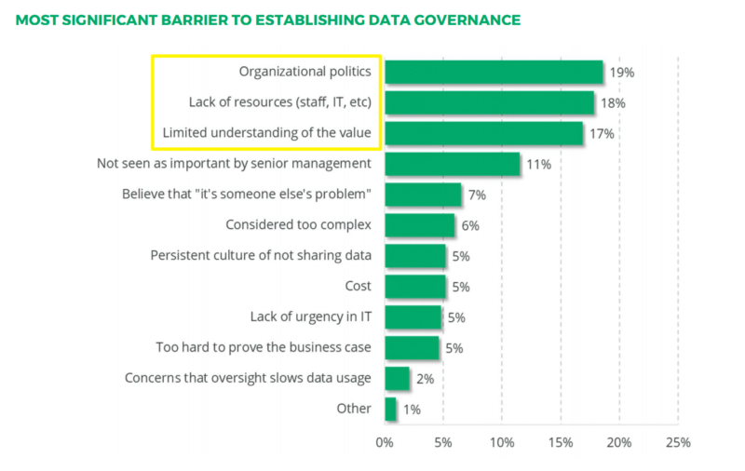
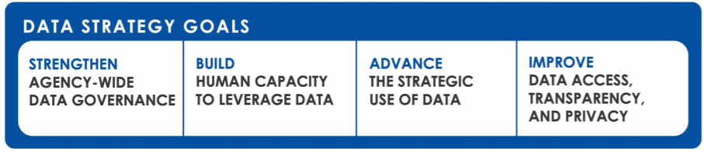
Why Data Governance?
There are many questions agencies have today about managing data;
Who is accountable for my data?
Do I have to classify my data?
What legal instruments should I have in place for data?
Are there processes I should have in place for data?
How do I become more organized and proactive in managing my agencies data assets?
Notes:
Data governance encompasses the people, processes, and technologies required to create, manage, and protect an organization’s information throughout its lifecycle.
By implementing a data governance program, an agency is able to ensure consistent, secure data is available to multiple departments as well as other state agencies.
This increased efficiency allows agencies to more effectively fulfill their missions while ensuring the safety and privacy of their agency, employees, and constituents.

Slide 7
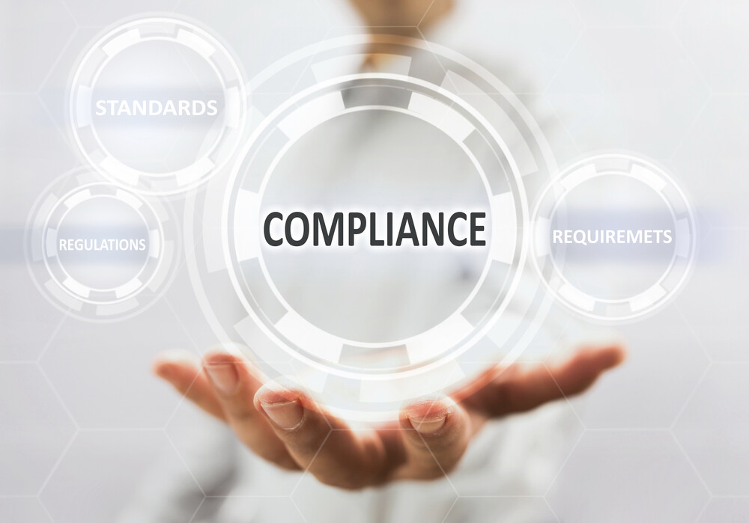


Why Data Compliance?
There are many questions agencies have today about Data Privacy and Compliance;
What kinds of sensitive data does my agency have?
What liability and exposure does the data my agency manages represent?
What risk does my agency have for breaches?
How do I need to safeguard my agencies data?
Does my agency follow applicable compliance regulations and laws with respect to the way it manages sensitive data?
No funding but regulations
and laws say I MUST do it!

Slide 8
ITEC 8000 Overview
8000 Charter
Overall Charter and Responsibilities
8010 Governance
Roles & Policy
8010A Standards
Data Protection Standards
Classification Standards
Privacy Standards
Retention Standards
8010B Assessment and Analysis (worksheets)
Data Assessment
Privacy Impact Assessment
Notes:
This body of policy really forms the minimal foundations that agencies should be following to manage their data. We have adopted the walk first before we attempt to run. This is a solid foundation to build upon.
ITAB Reviewed & Feedback

Slide 9
Risks
Crafting a revised / new policy for a data administration in the current situation risks that:
It becomes a mandate without buy-in, training and resources (technical / human).
We will miss best practices and lessons learned (as well as unique needs / capabilities) from our own environment.
One-size-fits-all represents a compromise and therefore may fall short for larger, more complex agencies.
May require significant updates as we incorporate wider state participation and involvement.
Data is a commodity, and the state will miss the opportunities for new efficiencies if it fails to embrace Data Governance.
Notes:
This new policy and set of standards represent a lot of new information for agencies to digest and follow. Our approach was not to stand on the mountain and bark orders, rather we wanted to also provide the knowledge base and references to better enable them to actually implement the policies and standards. It will take time for agencies to fully adopt the new policy and the Board can work in the interim to digest agency feedback, propose adjustments and or additions over the next 1-2 years where updates may be required.
Also the Board can work towards flushing out a Data Governance model for the state to better prepare us for the next decade.

Slide 10
Proposed Next Steps
Complete the new policy and publish so those agencies that need guidance have immediate best practice direction while also aligning to the future.
Propose a statewide effort to create a Data Governance program and roadmap sponsored by ITEC, solicit feedback, and confirm sponsorship
Solicit broader committee membership from Regents and from agencies with existing data administration programs
Focus on a “seek first to understand” approach through outreach and surveys to generally assess the maturity of data administration across state agencies and collect best practices, identify champions
Solicit and collect input from the technical and business community
Integrate that into a roadmap and business case with recommendations on governance and funding using a phased implementation
Incorporate feedback from the Data Governance Program/Framework as relevant into a future update of the policy.
Seek ITEC approval at the next meeting.

Slide 11



Three-phase blueprint for building a business-aligned, enabling data governance program (courtesy of Info-Tech)
Phase 1
Phase 2
Phase 3
Build a Collaborative Data Governance Engine Plan
Develop the Data Governance Implementation Roadmap
Drive the Data Governance Program Engine
Unite Under the Data Governance Business Rationale
Inputs
Organization-specific pains and drivers for DG
Outputs
Organization needs and clear rationale for DG
Create and Communicate Policies
Inputs
Prioritized initiatives, roadmap, current policies
Outputs
Understand what makes a good policy and how to enforce them
YOU ARE HERE
Structure the Shared Data Governance Program
Inputs
Current state and rationale
Business context
Outputs
Scope and vision of the project
Develop Initiatives
Inputs
Current and future states, gap analysis
Vision for “to be” environment
Outputs
List of prioritized initiatives
Create Roadmap for DG Initiatives
Inputs
Prioritized Initiatives
Outputs
Plan for communicating and implementing the DG project
Communicate and Maintain the DG Program
Inputs
Roadmap, organization’s data environment
Outputs
Communication plan
Business Data Glossary
Data Policies
Assess the Maturity of DG in the Organization
Inputs
Current state evaluations in the capability areas of Info-Tech’s DG framework
Outputs
Current state of IT around DG
Business Case and Roadmap Template
Put the People in Place
Inputs
Roadmap, identified roles needed
Outputs
Clear understanding of roles and responsibilities
DG Project Charter
DG Initiative Planning and Roadmap Tool
Data Policies
DG Initiative Planning and Roadmap Tool
Position Descriptions, RACI
Project scoping
Resource and project planning
Defined terms of service
Plan Specific Project Initiatives
Align outcomes with initial expectations and success criteria
Communication plan and change management
Complete project steps
Maintain stakeholder involvement and project momentum
Manage timelines
Project Positioning
Project Completion

Slide 12


Data Governance Roadmap
How do we get there?
PHASE 4
Tuning for Full compliance
Update Roadmap
Evergreen with
Continuous
Improvement
PHASE 3
Phase 2 Tuning
Tighten Audit Trails
Institute Continuous Improvement
SELF Assessment
Update Roadmap
PHASE 2
Announce and Publish Framework
# Establish a GRC Council & Process
High-level Data Inventory
Self-Assessments
Assessment Readout
Update Roadmap
PHASE 1
Assign a Chief Data Officer
Release New Policy
Provide Templates and Resources
Data Awareness Training
Preliminary Data Governance Assessment
Governance Council
Framework Draft
Documentation Review
Update ITEC 8000
GO
PHASE 0
New ITEC 8000
Initial Baseline
Not Initiated
Critical Objective
In-flight
Complete
Priority – slow moving
Header Category
# Outside the scope of data governance, however, related and essential
Mark Abraham
02/9/2021

Slide 13

Questions
Please feel free to leave feedback at the link below:
8000: https://bit.ly/36WjHlM

