Slide 1
Evaluation of Models

Slide 2
If there are more than two possible predictors, many different decision trees are possible for a given data set.
What makes one better than another?
Choosing the right combination of features as predictors.
Knowing when to stop splitting.

Slide 3
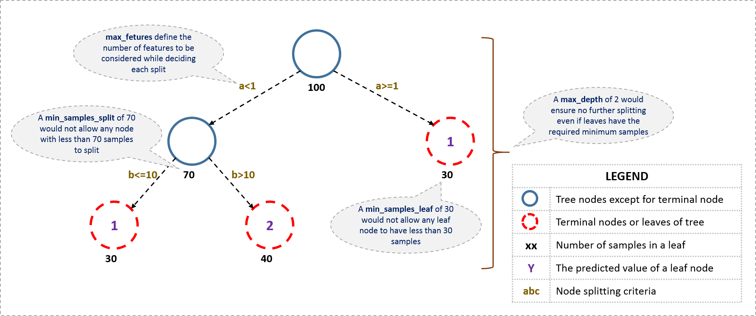
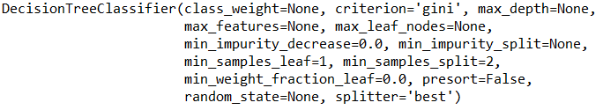
https://www.analyticsvidhya.com/wp-content/uploads/2016/02/tree-infographic.png
clf = DecisionTreeClassifier(criterion = 'gini’) As seen in documentation, other parameters can be used to specify the stopping points.
https://scikit-learn.org/stable/modules/generated/sklearn.tree.DecisionTreeClassifier.html

Slide 4
Once we have created a model, how can we evaluate it?
Given the choice between two different models, how would we know which is best?
Data
We can split (partition) our data into two different sets.
We will call one of the sets our training set.
We will call the other one our test set.
We usually have around 80% of the data in our training set and the rest in the test set and we choose the sets at random.
Training Set
80%
Test Set
20%
We build our model using only the training set.
Then we use the model to make predictions for our test data.
Since we already know the value of each feature in our test data set, we compare our predictions to the actual values and calculate the model’s accuracy.

Slide 5
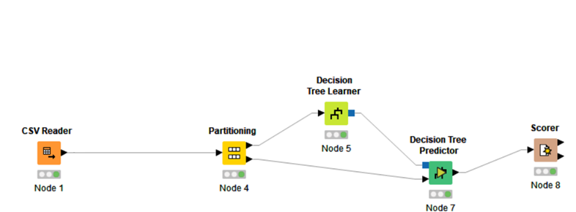
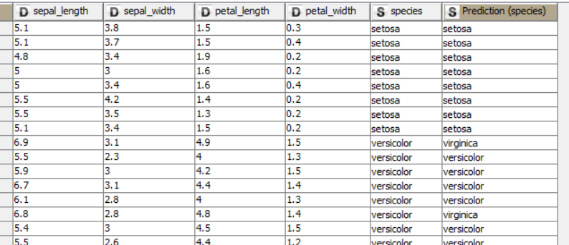
How did this model do? Let’s count how many predictions were right and divide by the total number of data points. That will be our accuracy score.
Our Test Data
Actual Species Predicted Species
Wrong
With this particular partition, our model made 28 correct predictions out of 30.
Accuracy: 28/30 = 0.933 = 93.3%

Slide 6


We can use KNIME to create WorkFlows like this:

Slide 7
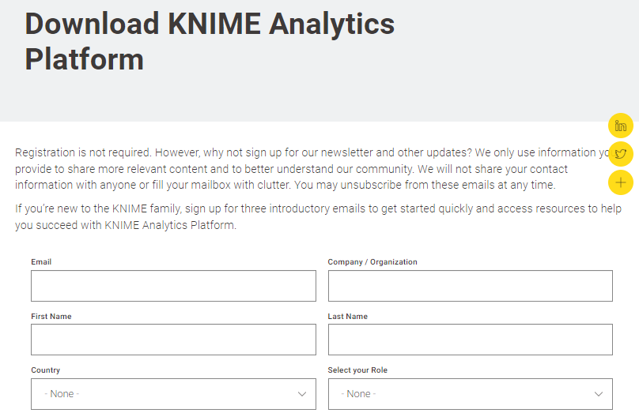
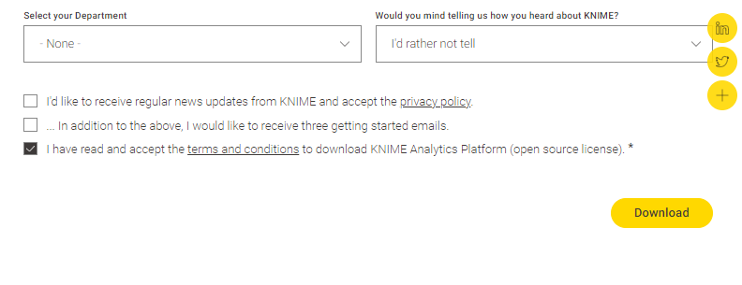
https://www.knime.com/downloads

Slide 8

Let’s use KNIME to read in the Iris dataset, create a decision tree model, and evaluate the accuracy of the model.
With this particular partition, our model made 28 correct predictions out of 30.
Accuracy: 28/30 = 0.933
Confusion Matrix
Predicted
Actual
Accuracy Statistics

Slide 9
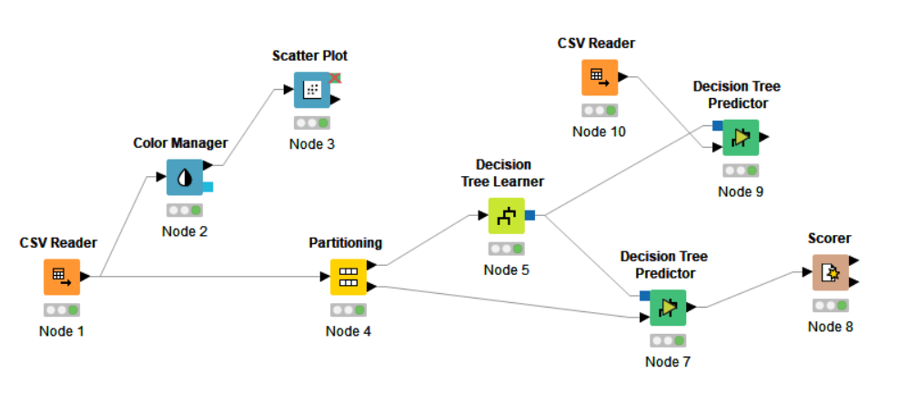
If we are satisfied with our model, we can add an extra predictor node and send in some new data. Then right-click on the node and look at the Classified Data. You will find predictions there.
Predict the species of an iris that has the following measures: sepal_length is 0.7, sepal_width is 3.1, petal_length is 4.5, petal_width is 1.4

Slide 10
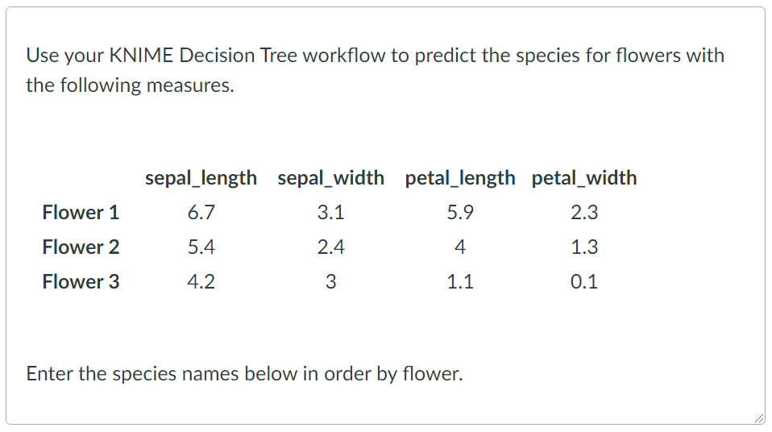

Slide 11
Now that you see how this is done, let’s do the same thing again but with Python.
import pandas as pd
from sklearn.tree import DecisionTreeClassifier
from sklearn import tree
df = pd.read_csv('titanicsimplified.csv')
df['Sex'] = df['Sex'].map( {'female': 0, 'male': 1} ).astype(int)
#replace null ages with mean
df.Age = df.Age.fillna(df.Age.mean())
# Mapping Age
df.loc[ df['Age'] <= 16, 'Age'] = 0
df.loc[(df['Age'] > 16) & (df['Age'] <= 32), 'Age'] = 1
df.loc[(df['Age'] > 32) & (df['Age'] <= 48), 'Age'] = 2
df.loc[(df['Age'] > 48) & (df['Age'] <= 64), 'Age'] = 3
df.loc[ df['Age'] > 64, 'Age'] = 4
X = df.values[:, 2:4]
Y = df.values[:, 6]
Y=Y.astype('int’)
clf = DecisionTreeClassifier(criterion = 'gini’)
clf.fit(X,Y)
dot_data = tree.export_graphviz(clf, out_file='TitanicDT.dot’, max_depth = 3, feature_names = ['Sex', 'Age’], class_names = ['Died', 'Survived'],
rounded = True, filled= True )
#use http://www.webgraphviz.com/ Open TitanicDT.dot in Notepad, copy and paste in window on website.
#Make Prediction clf.predict([[1,4]])
Earlier, we wrote some code that would create a decision tree to predict survival.
We will add some lines to split up the data into a training set and a test set and then to eventually determine the accuracy of the model.
Here is what we had before …

Slide 12

Now that you see how this is done, let’s do the same thing again but with Python.
import pandas as pd
from sklearn.tree import DecisionTreeClassifier
from sklearn import tree
df = pd.read_csv('titanicsimplified.csv')
df['Sex'] = df['Sex'].map( {'female': 0, 'male': 1} ).astype(int)
#replace null ages with mean
df.Age = df.Age.fillna(df.Age.mean())
# Mapping Age
df.loc[ df['Age'] <= 16, 'Age'] = 0
df.loc[(df['Age'] > 16) & (df['Age'] <= 32), 'Age'] = 1
df.loc[(df['Age'] > 32) & (df['Age'] <= 48), 'Age'] = 2
df.loc[(df['Age'] > 48) & (df['Age'] <= 64), 'Age'] = 3
df.loc[ df['Age'] > 64, 'Age'] = 4
X = df.values[:, 2:4]
Y = df.values[:, 6]
Y=Y.astype('int’)
X_train, X_test, Y_train, Y_test = train_test_split(X, Y, test_size=0.20, random_state=100)
clf = DecisionTreeClassifier(criterion = 'gini’)
clf.fit(X,Y) clf.fit(X_train,Y_train)
result = clf.score(X_test, Y_test)
result
dot_data = tree.export_graphviz(clf, out_file='TitanicDT.dot’, max_depth = 3, feature_names = ['Sex', 'Age’], class_names = ['Died', 'Survived'],
rounded = True, filled= True )
#use http://www.webgraphviz.com/ Open TitanicDT.dot in Notepad, copy and paste in window on website.
#Make Prediction clf.predict([[1,4]])
We need another import statement for sklearn.
from sklearn.model_selection import train_test_split
We need to add a line to create the train and test sets
We alter the “fit” statement to send in X_train and Y_train.
We call the “score” method and save the result.

