Slide 1
Python Data Management Workshop
Edina Harsay
February 19, 2026

Slide 2
Python in Data Science
Python is a general-purpose programming language.
Released in 1991, Python was designed to be readable and flexible, not specifically for data analysis. Its data science ecosystem (NumPy, pandas, matplotlib, scikit-learn) was built by the community starting ~10-15 years later.
This generality is Python's biggest strength, and also its biggest source of complexity. You have choices. That means you also have to make them.

Slide 3
Ways to Use Python
In this workshop: Google Colab
Runs in your browser, no installation needed
Free GPU access for machine learning
Good for learning, sharing, and collaboration
Not ideal for large datasets or sensitive/private data
For a “real” project: best to set up a local environment
Use either venv/virtualenv or conda
Use a Unix-like setup: macOS, Linux, or WSL (Windows)

Slide 4
Environments
The core idea
Each project gets its own isolated environment with pinned package versions.
Very easy to rebuild an identical package environment.
Benefits
Reproducibility
Avoid dependency conflicts

Slide 5
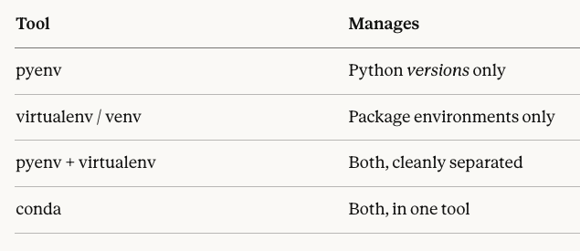
Environments

Slide 6
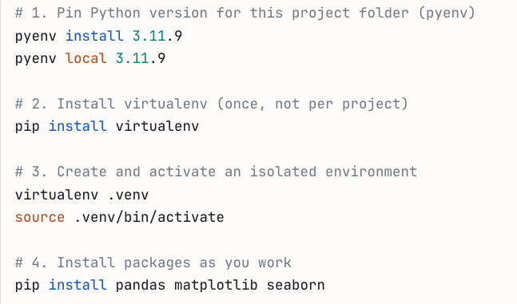
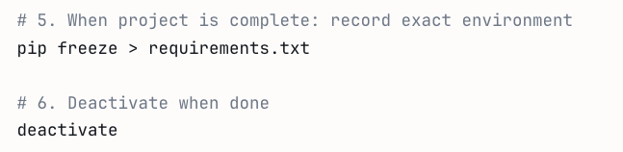
Virtualenv/Venv Steps
You first have to install pyenv.
On macOS, use the Homebrew package manager in your Terminal app.
On Windows (WSL) or Linux (Debian/Ubuntu) use `apt`.
You can share your requirements.txt file along with your code. Run:
pip install –r requirements.txt
This is similar to renv.lock file in R.

Slide 7
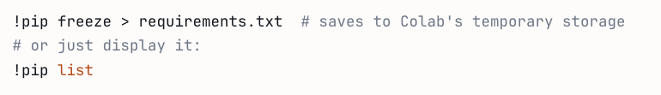
Virtualenv/env
Colab equivalent

Slide 8
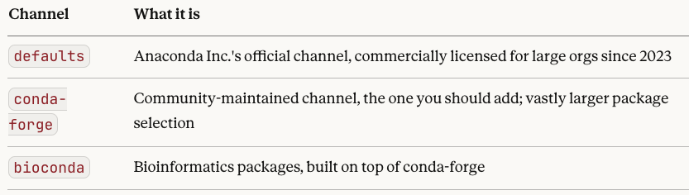
Tips for Conda
The parallel with pip: both fetch Python modules from repos
pip fetches from PyPI (pypi.org) (does not manage environment)
conda fetches from channels, most importantly conda-forge

Slide 9
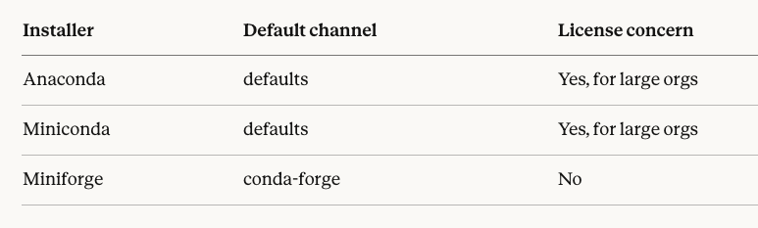
Tips for Conda
Avoid Anaconda (~3 GB, management issue, licensing issue).
Avoid Miniconda (licensing issue). Install Miniforge!

Slide 10
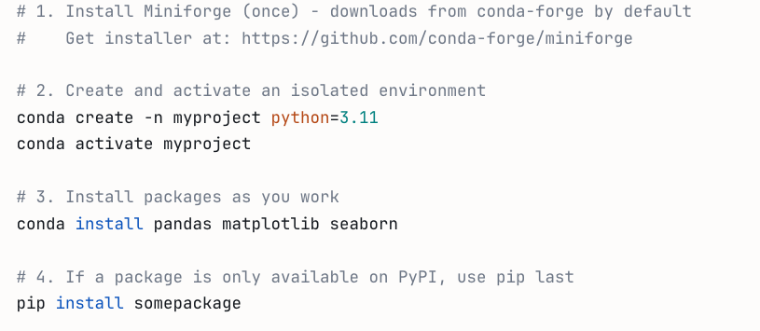
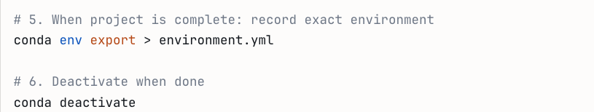
Conda Steps
You can also turn a Miniconda install into a Miniforge install simply by changing the default channel to mini-forge and adding nodefaults to your .condarc file.
The two are functionally identical, other than default channel.

Slide 11
Tip to keep in mind for Conda
Install everything you can via conda first..
If a package only exists on PyPI, install it with pip after your conda installs are done.
Never go back and `conda install` something after you have used pip in the same environment. This is where the dependency solver gets confused because conda cannot see or reason about what pip has done, so it may overwrite or break pip-installed packages

Slide 12
Mac, Linux, WSL
Why? Unless you are developing Windows software, a Unix-like setup makes your life easier.
Most data science tooling assumes a Unix-like environment.
Conda is fine on native Windows for a pure data science workflow (pandas, numpy, scikit-learn, matplotlib). But…
On Linux or WSL (or Mac), you have compilers and C libraries available, so pip can build packages from source when needed.
WSL is not strictly necessary in Windows, but it is a genuinely better setup for a career in data science or software engineering.

Slide 13
Code Editors (Near-IDE)
IDE = Integrated Development Environment. Traditionally includes compilers/interpretes, debuggers, build systems, etc.
XCode, Visual Studio, PyCharm, RStudio, etc. are traditional IDEs.
Text editors these days are sufficient for most coding work. Many are near-IDE after you add extensions. The distinction is largely obsolete.
The label matters less than understanding what the tool provides and what it delegates to external tools, because that determines what you need to install alongside it.
VS Code is a popular text editor that can work with Jupyter Notebook files (with appropriate extensions added).
Even better: Positron = VS Code + RStudio (kind of)

Slide 14
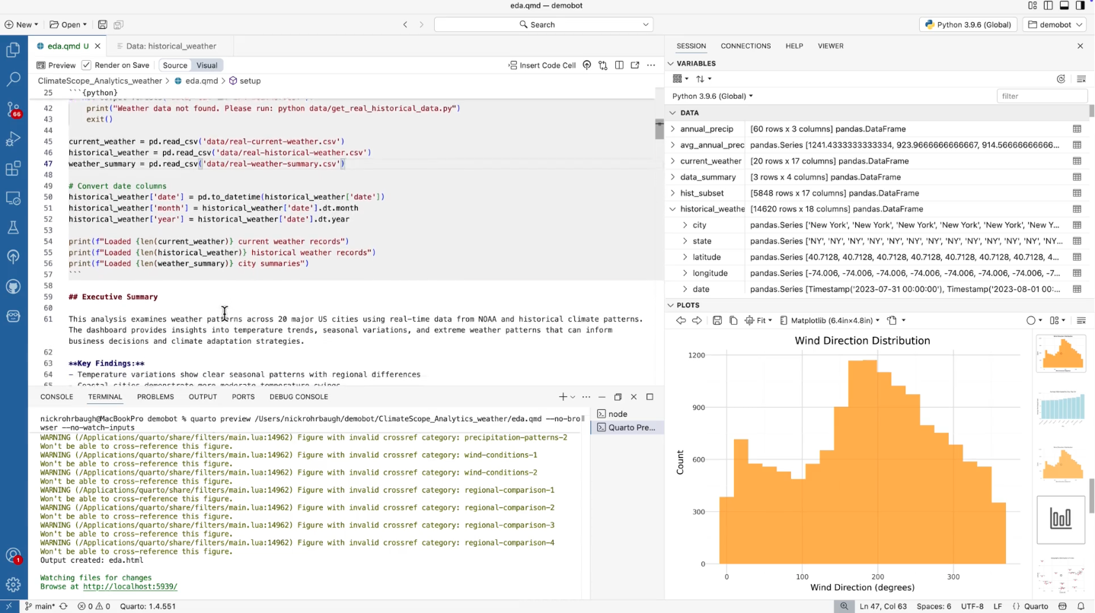
Positron for Python and R

Slide 15
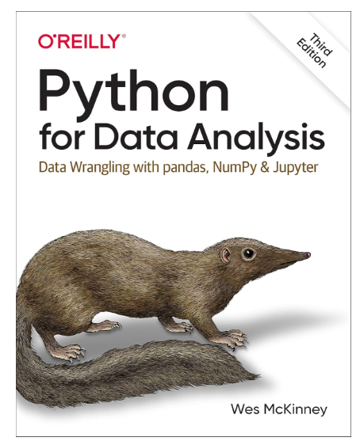
Recommended Resource
Author is first Pandas developer
3rd edition is available for free
Brief overview/review of Python
Things move fast. It is 2022 ed. But look for updates.
Introduces key packages for data science in Python
https://wesmckinney.com/book/

Slide 16
Some key Python Packages
Numpy (Numerical Python) provides the data structures, algorithms, and library glue needed for most scientific applications involving numerical data in Python.
pandas provides high-level data structures and functions for working with structured or tabular data (wrangling).
Polars is a new alternative to Pandas.
matplotlib is the most popular Python library for producing plots and other two-dimensional data visualizations.
Others: SciPy, Scikit-learn, statsmodels

Slide 17
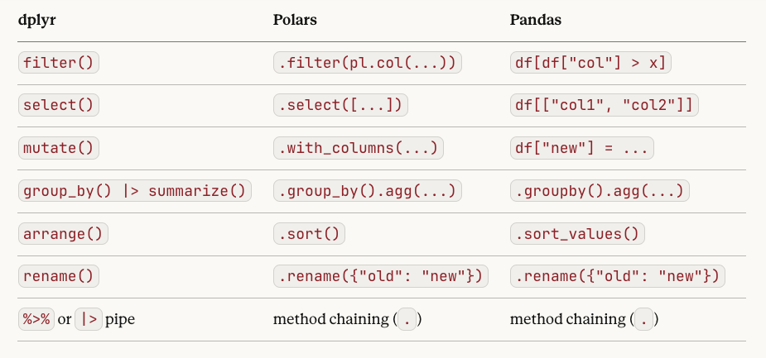
Polars or Pandas (syntax)
Follows the style of SQL, dplyr, datascience (Berkeley Data 8)

Slide 18
Polars Syntax
Readability: reads like a sentence, consistent style, verb-based approach (inspired by SQL, dplyr)
The “One Way” rule: encourages one clear, consistent way using expressions
No "Index" Headaches: no row labels; similar to SQL, dpyr, etc. Rows are identified by their natural order.

Slide 19
Polars or Pandas (performance)
The context: Pandas creation began in 2008 (intro 2010) when datasets were smaller and single-core CPUs were the norm. Polars was introduced in 2021, in the era of multicore processors and much bigger data sets.
The Rust Advantage: Polars is written in Rust. This means it’s not just "faster"; it’s inherently safer with memory and can do things in parallel (using all cores) without you writing any extra code. Pandas is built on Python and NumPy (C extensions).
Lazy evaluation: Polars can optimize the query before running it. Pandas can do only “eager evaluation” (runs immediately).
Memory efficient: Polars consumes less RAM than Pandas for the same datasets and operations.

Slide 20
Workshop with BRFSS Data
On to Colab
Behavioral Risk Factor Surveillance System (BRFSS),
a CDC-administered health survey
Mostly wrangling today. Why?
R's survey analysis ecosystem is more mature than Python's.

