Slide 1
Analysis for rush hour
Zeying Wu 40257530
Winyul yin 40176217

Slide 2
Q1
Compare and analysis the length of the solutions across algorithms and heuristics. When do you have the lowest-cost solution?

Slide 3
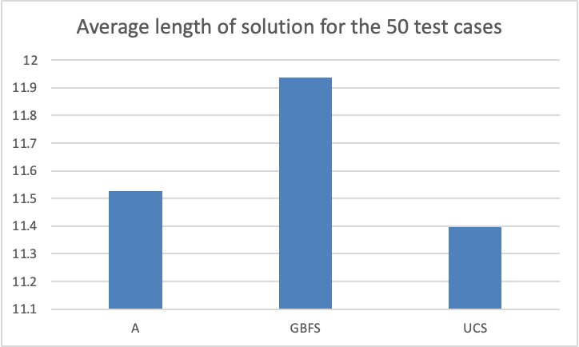
Uniform Cost Search (UCS) guarantees the finding of the lowest-cost solution path as it searches by cost.

Slide 4
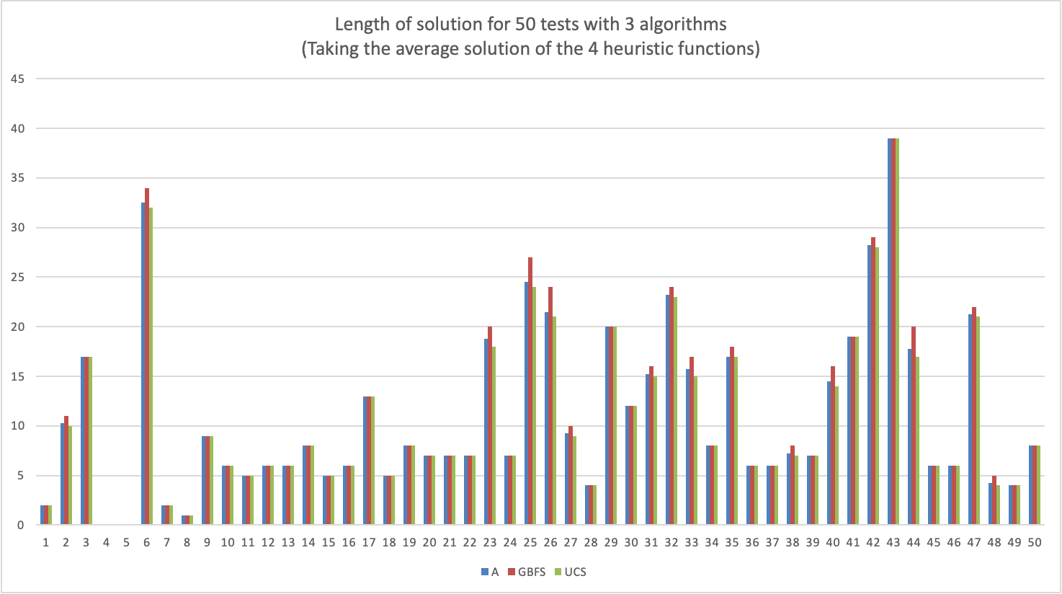

Slide 5
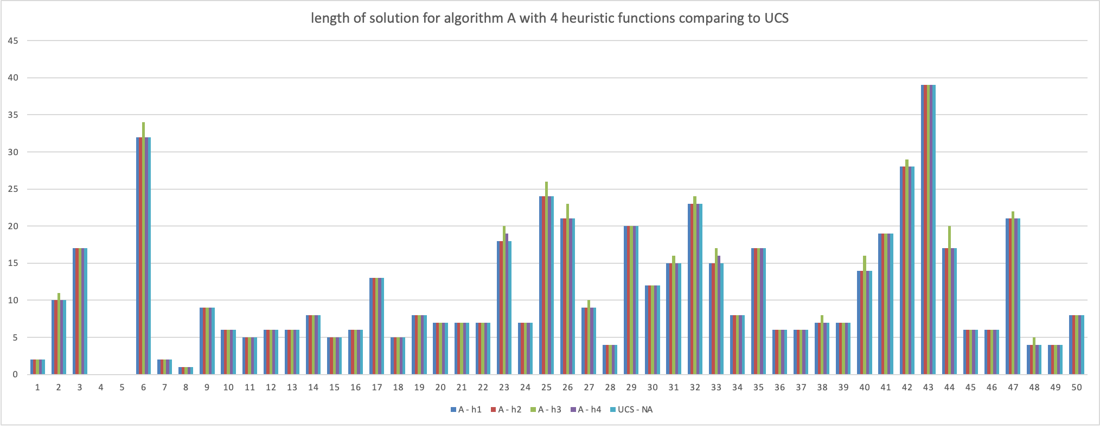
Algorithm A with 4 heuristic function comparing to UCS
h1 and h2 are the better performing heuristic function for algorithm A, they gave the same length of solutions as UCS for the 50 test cases.
h4 comes second, it is almost as good as h1 and h2 except for test 23 and 33.
h3 is the worst.

Slide 6
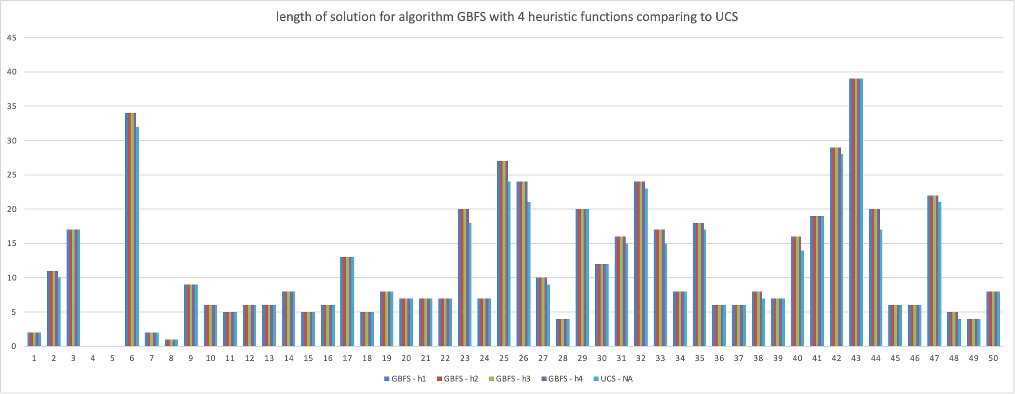
Algorithm GBFS with 4 heuristic function comparing to UCS
h1, h2, h3 and h4 gave equally bad solution for 50 test cases

Slide 7
Q2
The admissibility of each heuristic and its influence on the optimally of the solution.

Slide 8
h1 - admissible
h1 is the number of blocking vehicles.
It is admissible because it is non-negative and it is not an overestimate of the cost to reach the goal state.
This is because for each blocked vehicle, we need to move it at least once to clear the path for vehicle A to move to the exit.

Slide 9
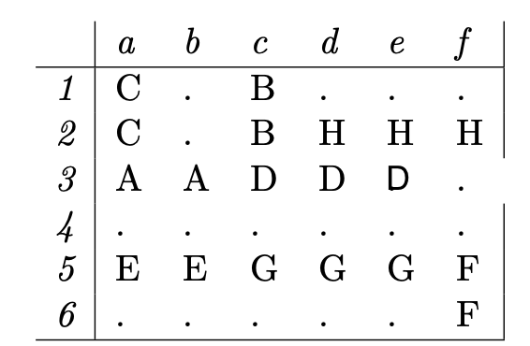
h2 - not admissible
h2 is the number of blocked positions.
It is non-negative but it may be an overestimate of the cost to reach the goal state.
This is because a vehicle parking horizontally on row 3 can blocked multiple positions depending on its size but it may only need one move to clear its blockage using the valet service.
For example, h2 = 3 in the below game board because vehicle D occupies 3 space horizontally on row 3.
However, this is an overestimate of the actual cost of 2. This is because despite D blocked 3 positions, it only needs 1 move by moving to the right to leave the gameboard via valet service.

Slide 10
H3 and H4
H3 and h4 were both derived from the previous heuristic h1 and h2 but they were multiplied by a constant.
This is not admissible as it could very easily overestimate the cost to reach the goal state. With h2 being non admissible without even having a constant multiplied on it.
As for h1, it was admissible but having a constant multiplied to it could cause overestimate of the cost to reach the goal state.
For example, if the constant was 3 and only 1 car was blocking. It would have a heuristic of 3 but along with the valet service, it only needs a cost of 2. One to move the car out of the way and 1 to get a to the goal state.

Slide 11
Q3
The execution time across algorithms and heuristics. Is an informed search always faster?

Slide 12
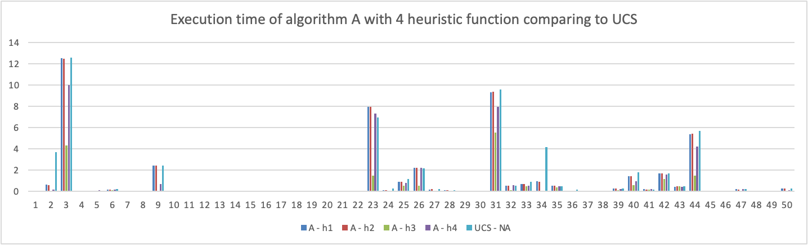
No, informed search is not always faster.
For example, the execution time of algorithm A with h1, h2 and h4 heuristic function for test case 23 is slower than UCS algorithm.
This could because of the overhead of f(n) calculation and the inaccuracy of prediction of the f(n) function.

Slide 13
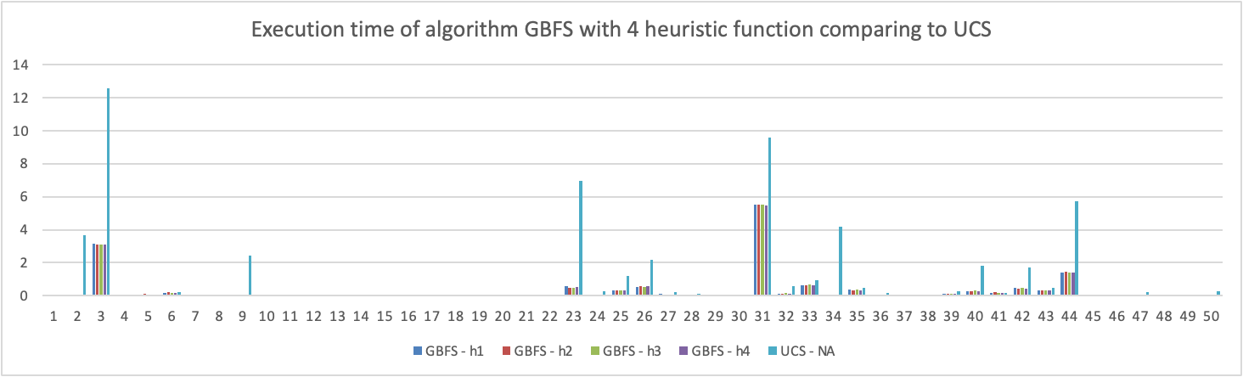
For all 50 test cases, GBFS is always faster than UCS with the 4 heuristic function.
This could because the overhead of h(n) calculation is way smaller comparing to the time needed to explore the much larger number of nodes needed to be explored by UCS.

Slide 14

The sum of all execution times shows that GBFS is the is by far faster than the other 2 algorithms with h4 having the quickest execution time

Slide 15
Q4
Other interesting facts that you deem worthy of describing

Slide 16
Impact of heuristics
Within GBFS, the heuristic had very little impact on the search both in the solution length and the search path length with marginal difference in execution time. But that might have to do with other processes going on in the computer.

Slide 17
Algorithm A with h1 and h2
Despite having different heuristics. H1 and h2 performed very similarly with the only differences being a 3 nodes searched more in h1 than h2 over close to 300,000 total nodes searched and minor execution time differences which could be due to the cpu having to deal with other processes

