Slide 1
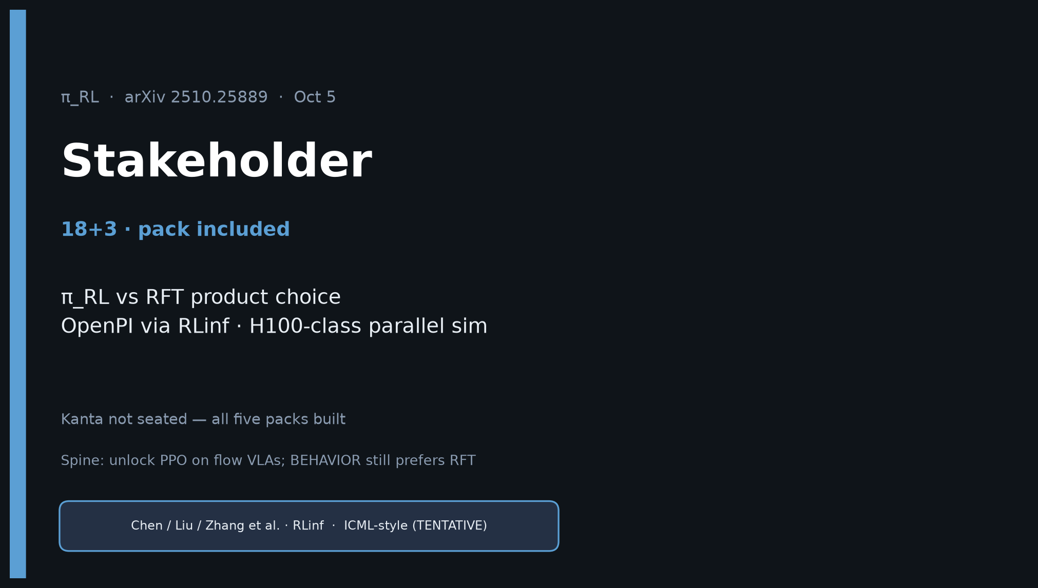
Stakeholder · 18+3 · 1/18
Notes:
STAKEHOLDER — 18+3. Product / lab leadership lens.
π_RL vs RFT product choice; OpenPI via RLinf; H100-class parallel sim needed.
Kanta not seated — pack still complete. Do NOT plan a Stakeholder redo later.

Slide 2
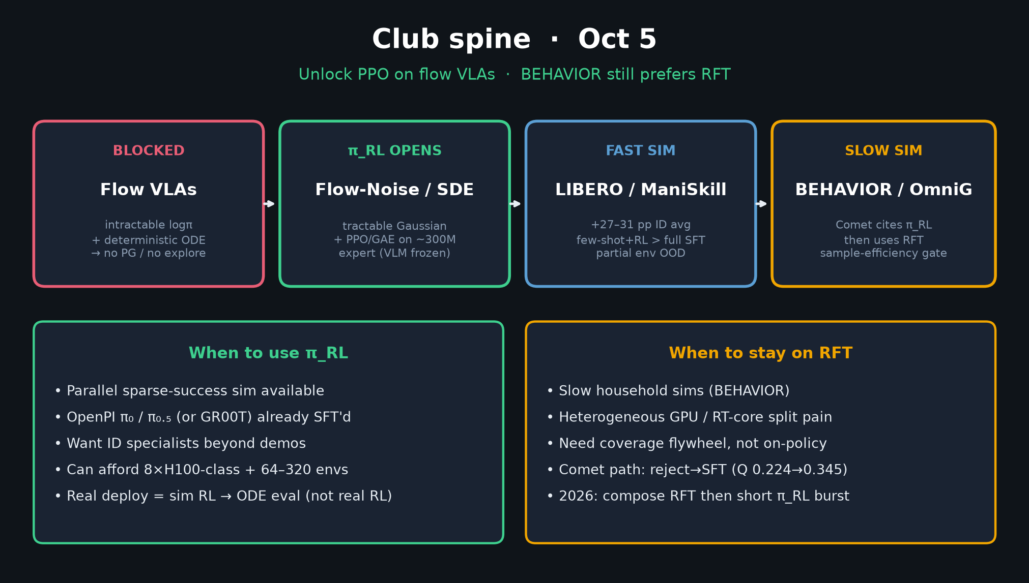
Stakeholder · 18+3 · 2/18
Notes:
SPINE — open with the fork. Fast sim → π_RL; slow BEHAVIOR → RFT. Comet already chose.

Slide 3
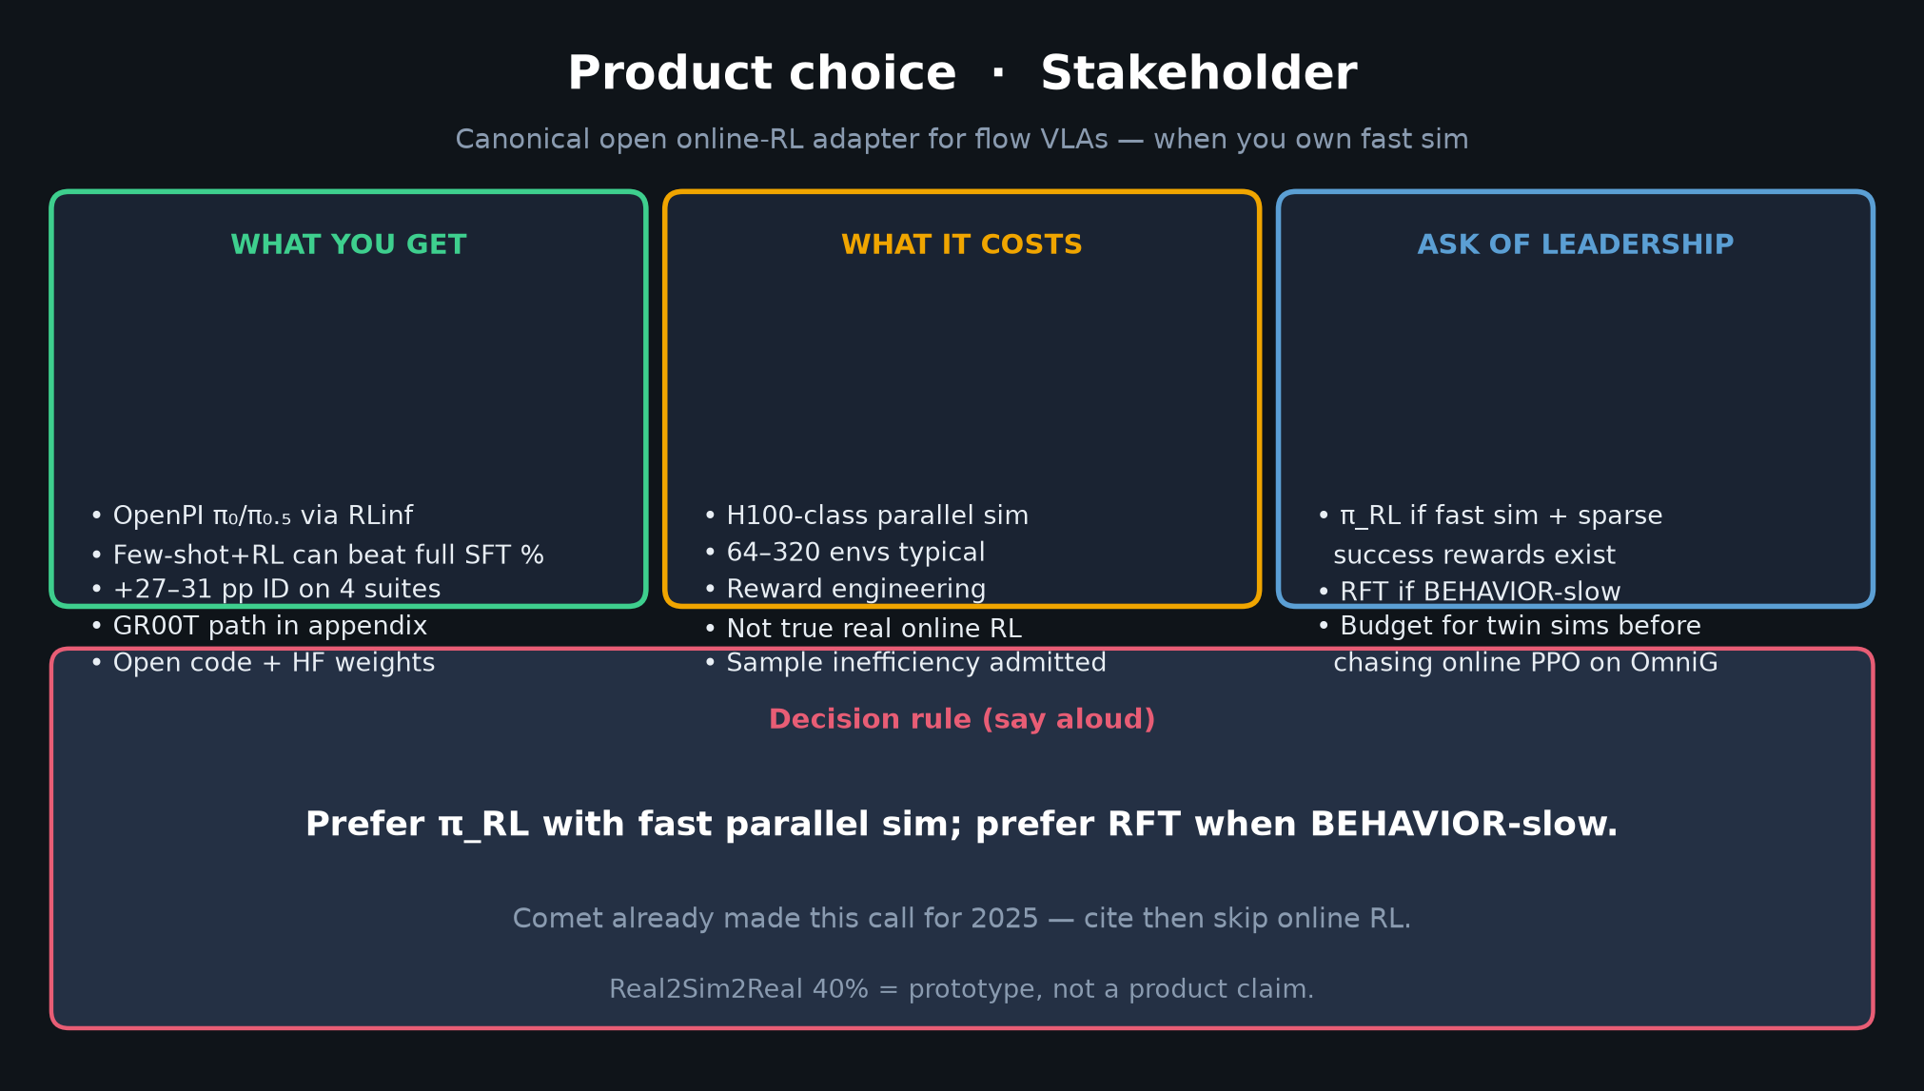
Stakeholder · 18+3 · 3/18
Notes:
PRODUCT CHOICE — densest Stakeholder slide (~2 min).
What you get / costs / ask of leadership. Decision rule at bottom.

Slide 4
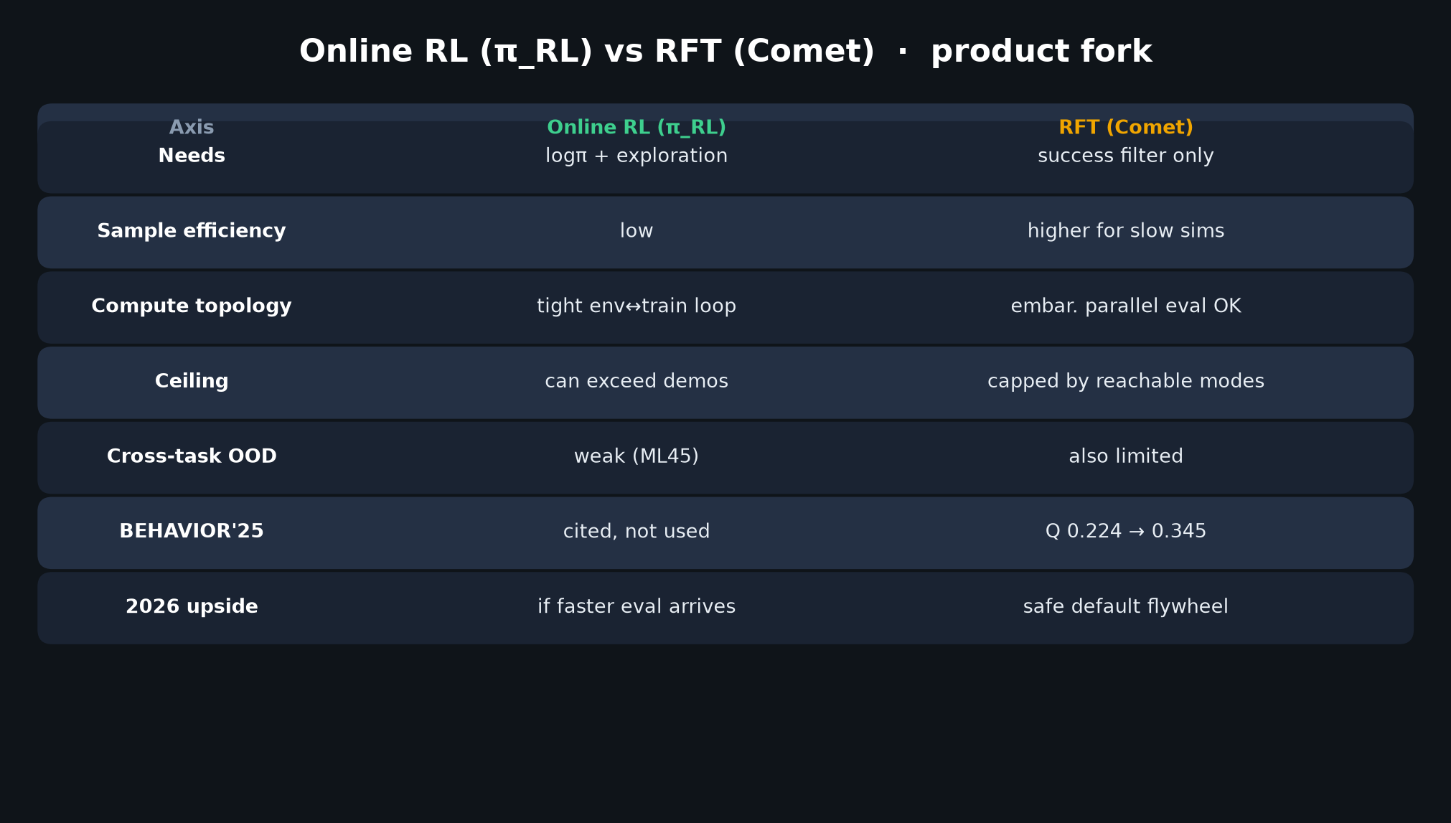
Stakeholder · 18+3 · 4/18
Notes:
RL vs RFT comparison table — shared with Visionary. Stakeholder framing: buy vs build post-train.

Slide 5
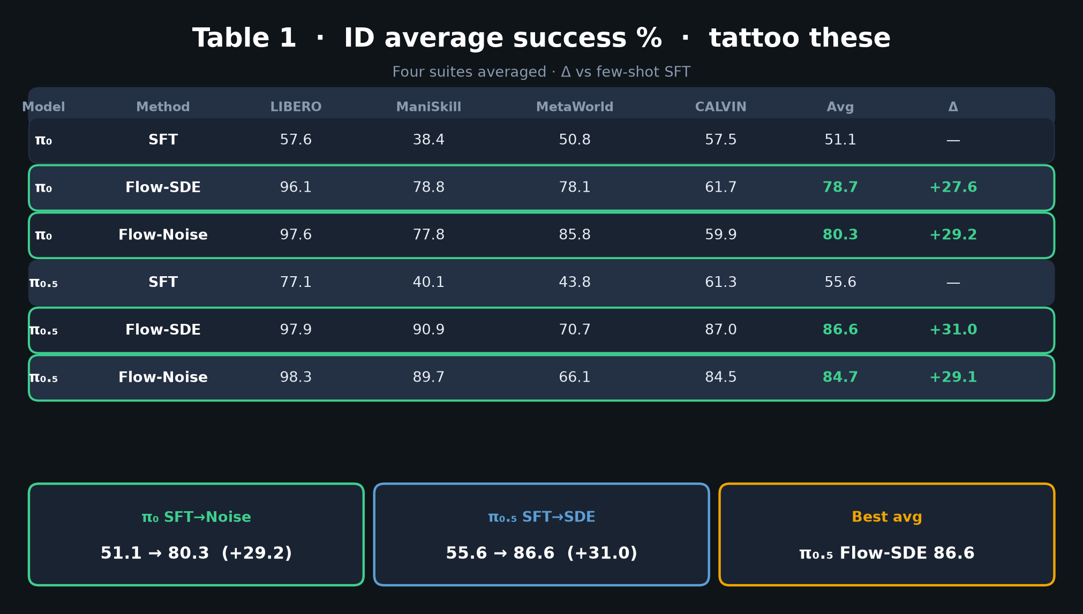
Stakeholder · 18+3 · 5/18
Notes:
TABLE 1 — headline ROI story. +27–31 pp. Few-shot narrative for demo-expensive labs.

Slide 6
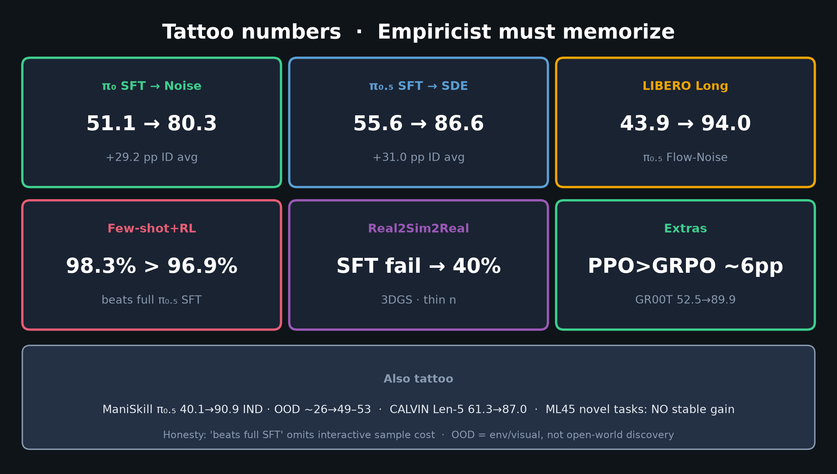
Stakeholder · 18+3 · 6/18
Notes:
TATTOO NUMBERS — stakeholder-friendly. 98.3>96.9 pitch; 40% real = prototype caveat.

Slide 7
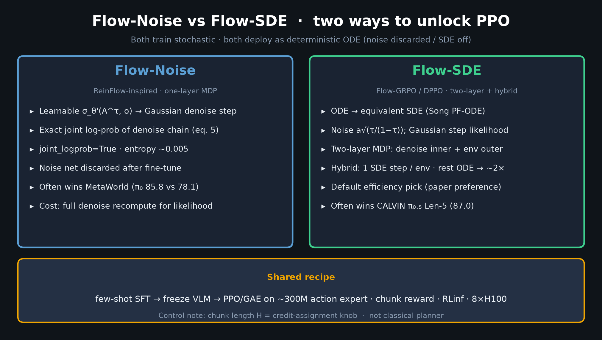
Stakeholder · 18+3 · 7/18
Notes:
FLOW-NOISE vs SDE — what the team actually implements. Prefer SDE hybrid for wall-clock.

Slide 8
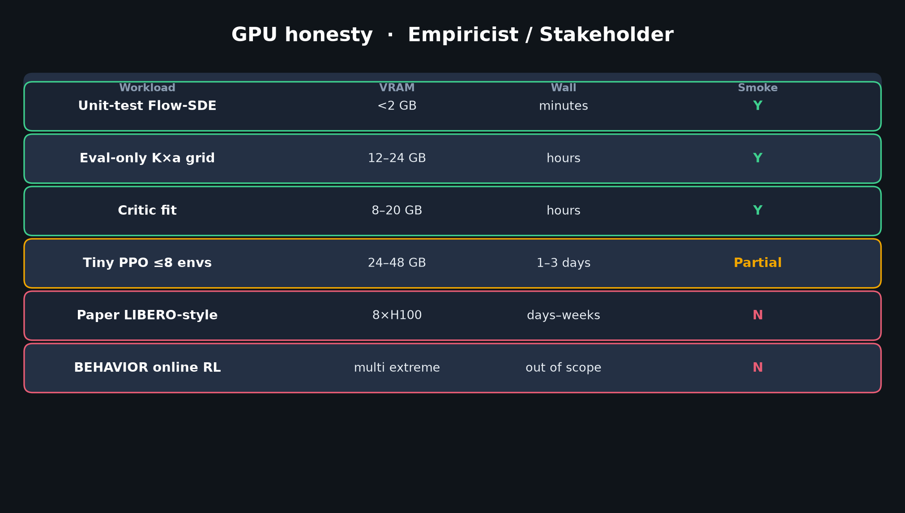
Stakeholder · 18+3 · 8/18
Notes:
GPU BUDGET — budget slide. Don't greenlight 8×H100 BEHAVIOR RL without twin sims.

Slide 9
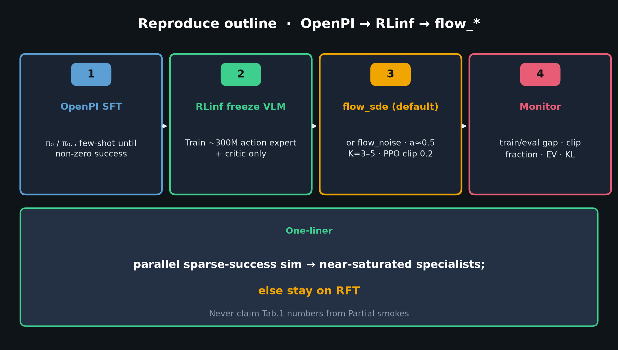
Stakeholder · 18+3 · 9/18
Notes:
REPRODUCE / ADOPTION PATH — OpenPI → RLinf → flow_*. Lower friction than closed VLA-RL.

Slide 10
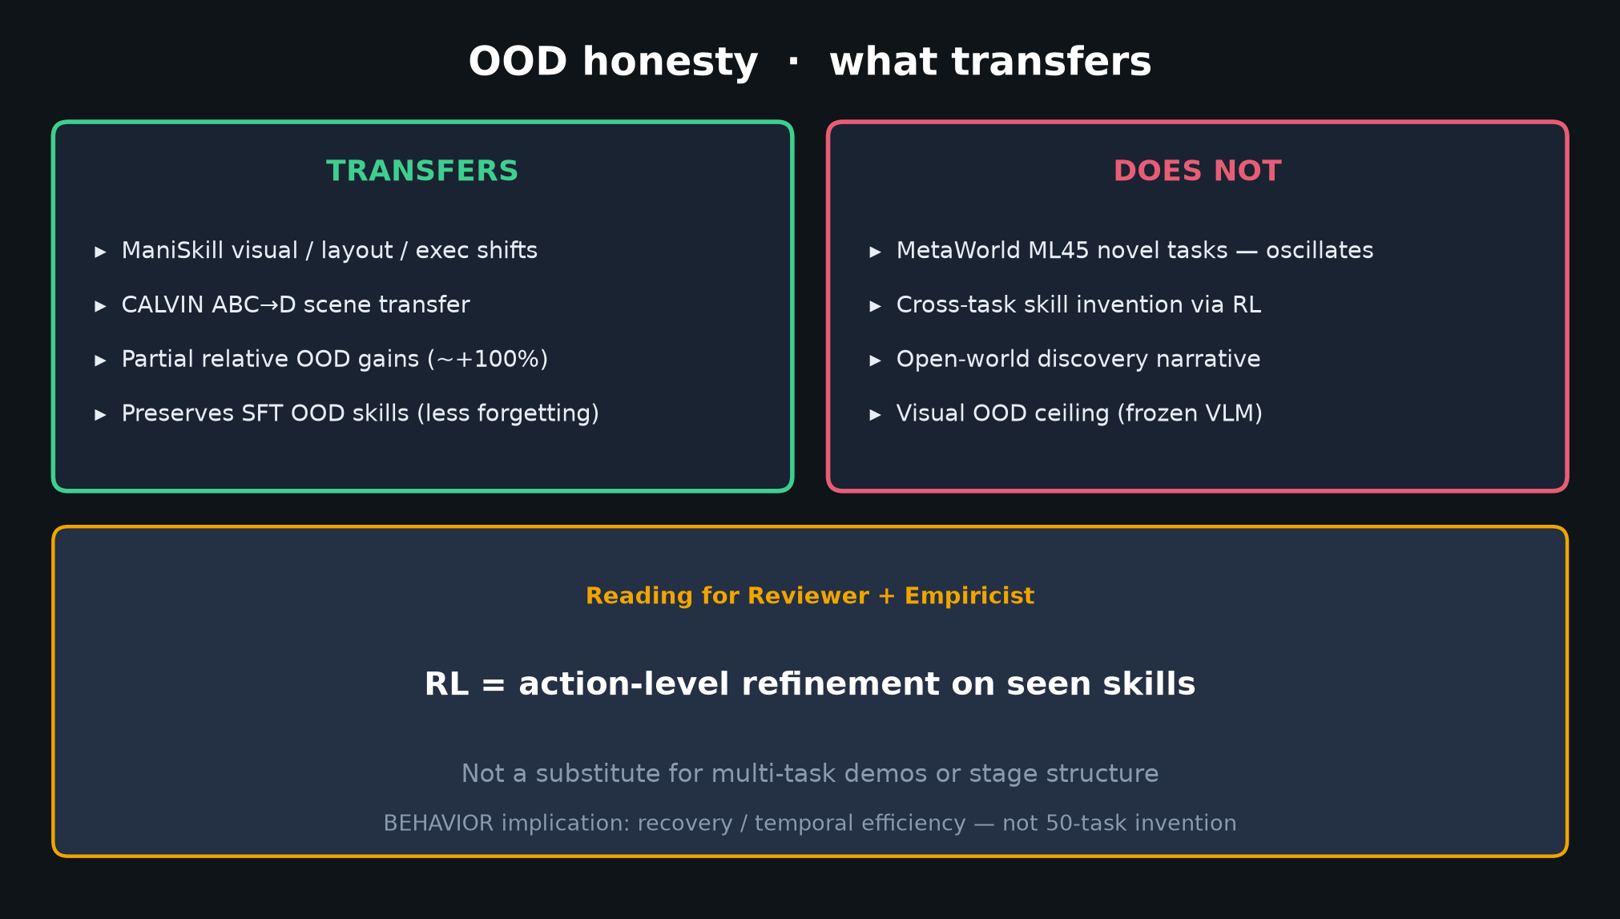
Stakeholder · 18+3 · 10/18
Notes:
OOD honesty for leadership — don't sell open-world. Sell ID specialists + partial env robustness.

Slide 11
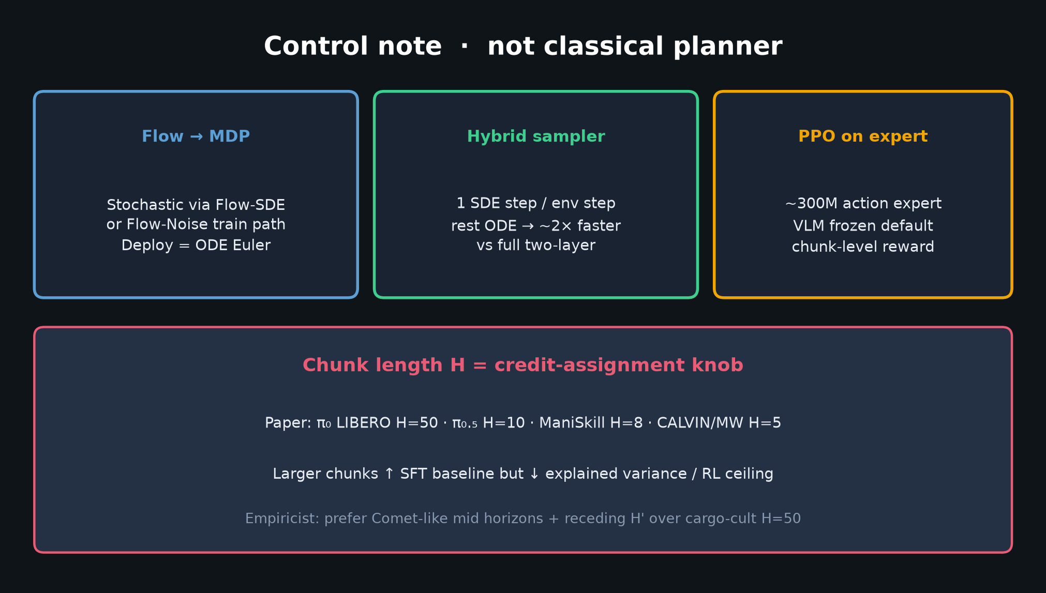
Stakeholder · 18+3 · 11/18
Notes:
CONTROL NOTE — chunk/replan as operational HPs; deploy ODE. Not a planner purchase.

Slide 12
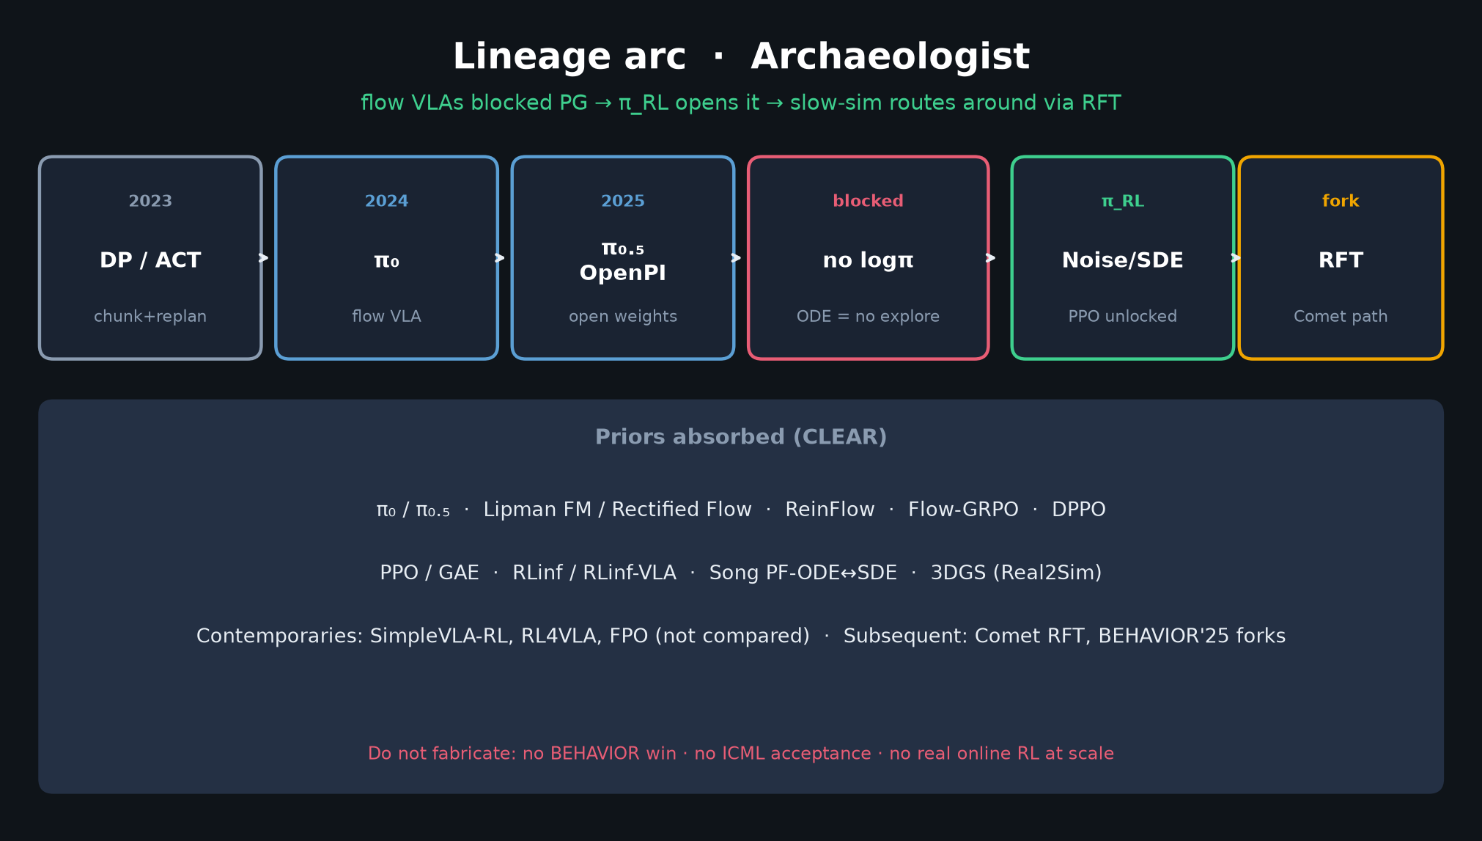
Stakeholder · 18+3 · 12/18
Notes:
LINEAGE — why this exists now; Comet fork. Adoption gated by simulator economics.

Slide 13
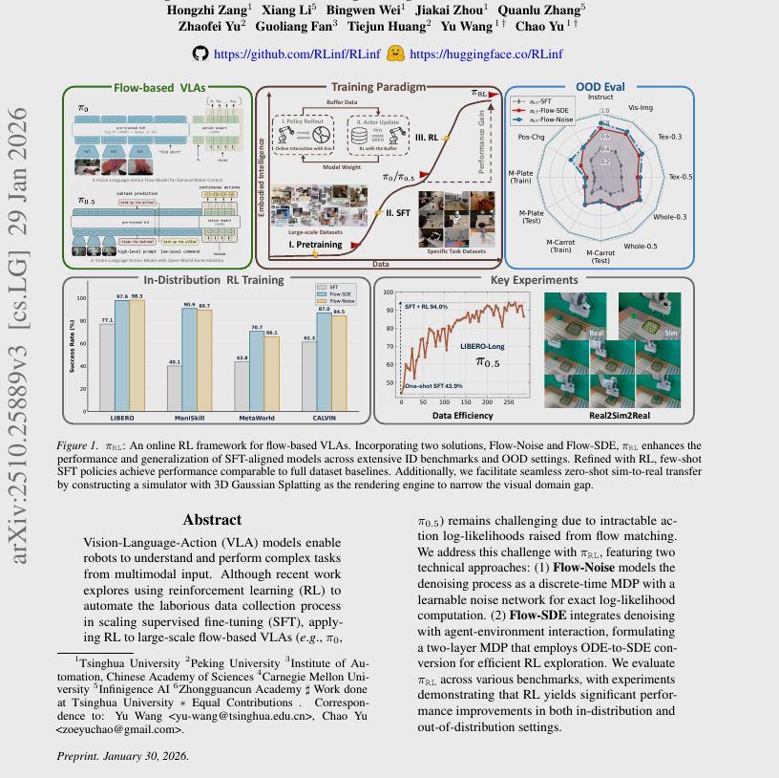
Stakeholder · 18+3 · 13/18
Notes:
PAPER FIG 1 — visual for exec audience. Pipeline story.

Slide 14
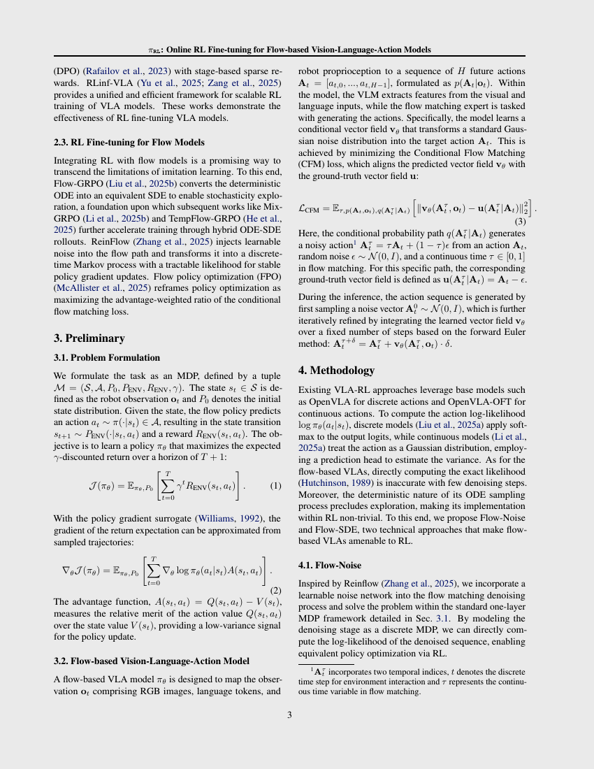
Stakeholder · 18+3 · 14/18
Notes:
PAPER page with method figures — glance at architecture if asked.

Slide 15
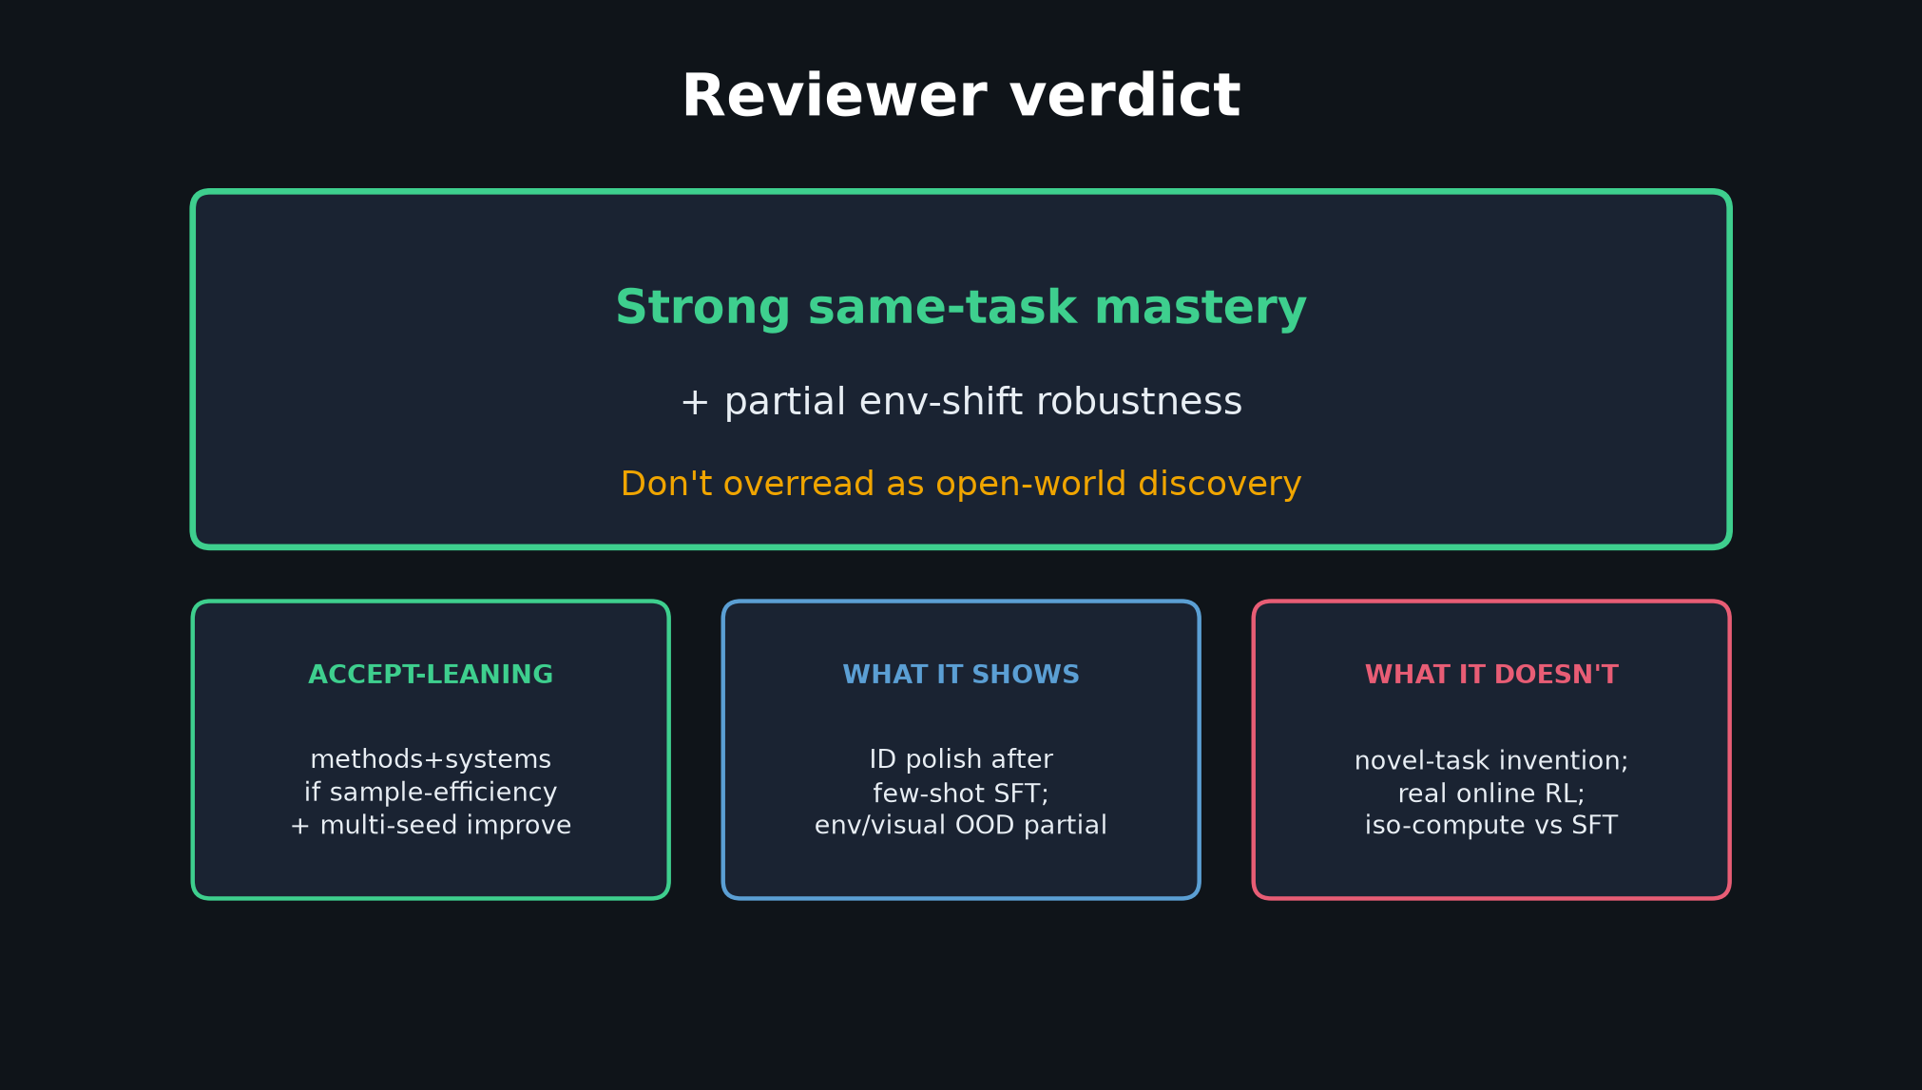
Stakeholder · 18+3 · 15/18
Notes:
REVIEWER VERDICT preview for leadership risk — accept-leaning methods; don't overclaim.

Slide 16
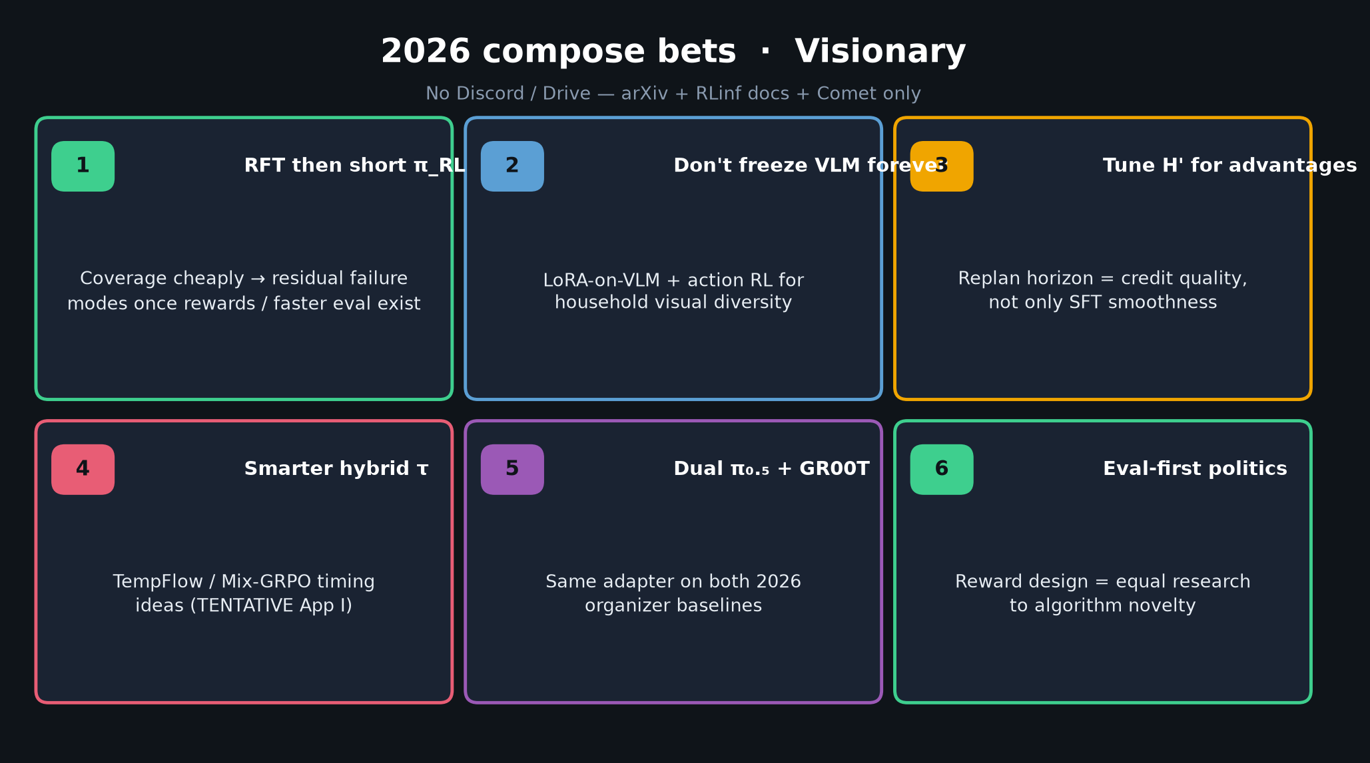
Stakeholder · 18+3 · 16/18
Notes:
2026 compose hint — RFT then short π_RL if infra improves. Stakeholder bridge to Visionary.

Slide 17
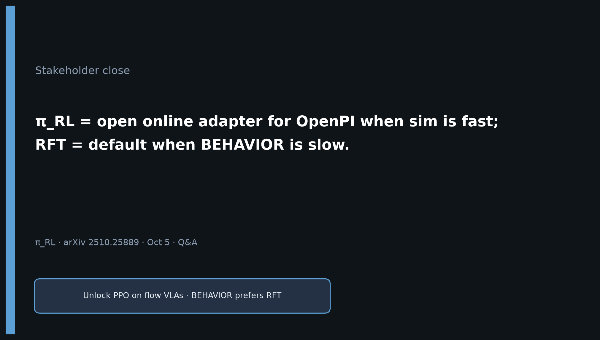
Stakeholder · 18+3 · 17/18
Notes:
CLOSE / Q&A: Prefer π_RL with fast sim; RFT when BEHAVIOR-slow. Open adapter via RLinf; H100 parallel needed.

Slide 18
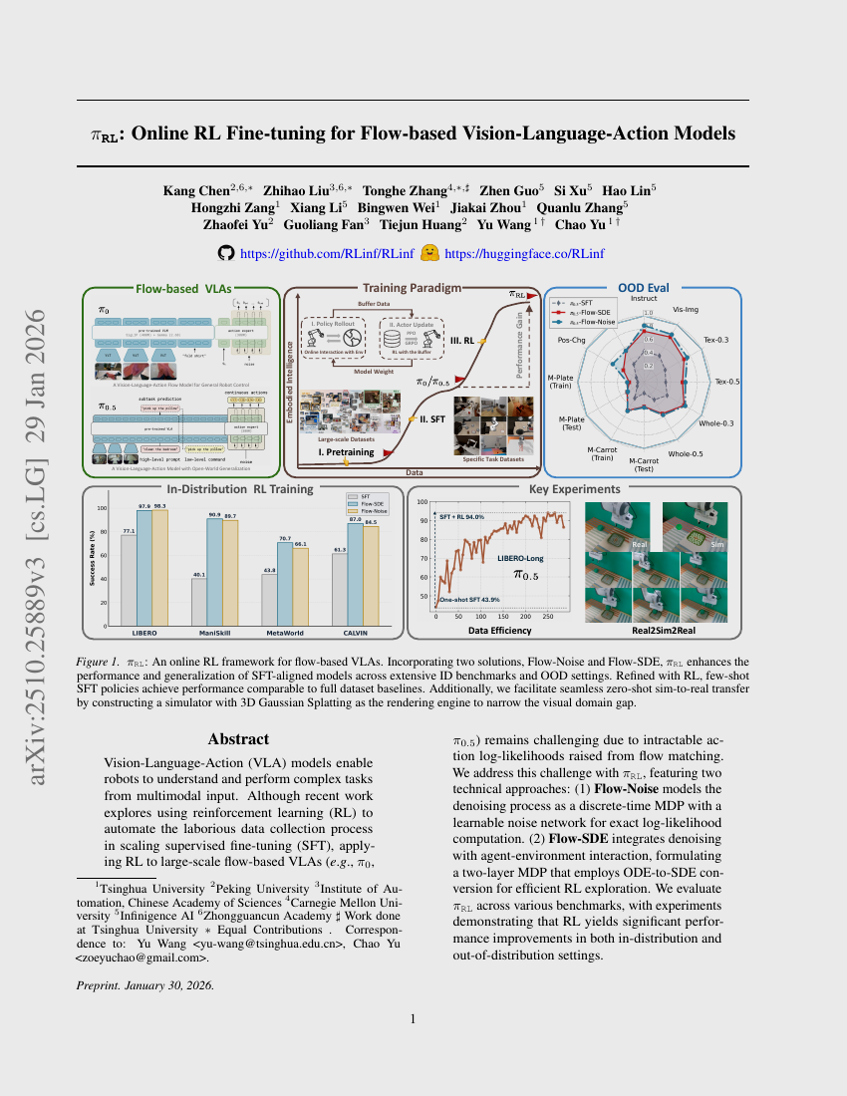
Stakeholder · 18+3 · 18/18
Notes:
BACKUP cover.

