Slide 1
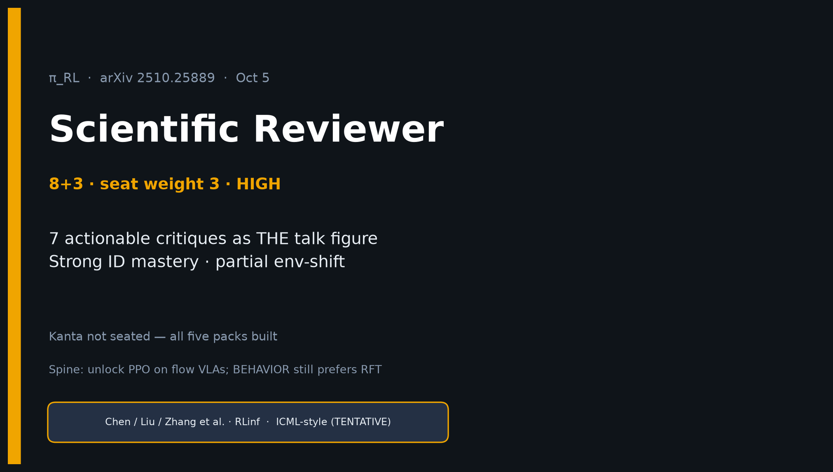
Scientific Reviewer · 8+3 · 1/11
Notes:
SCIENTIFIC REVIEWER — 8+3 · seat weight 3 · HIGH priority deck.
Kanta not seated this session — still deliver meaty critique.
ONE SENTENCE: Strong same-task mastery + partial env-shift; don't overread as open-world discovery.
You own: strengths, THE 7 actionable critiques talk figure, OOD honesty, verdict.
Pair densest with Empiricist tattoo numbers / smoke deferrals.
Timing discipline: 8 min talk + 3 Q&A. Lead with critiques, not abstract praise.

Slide 2
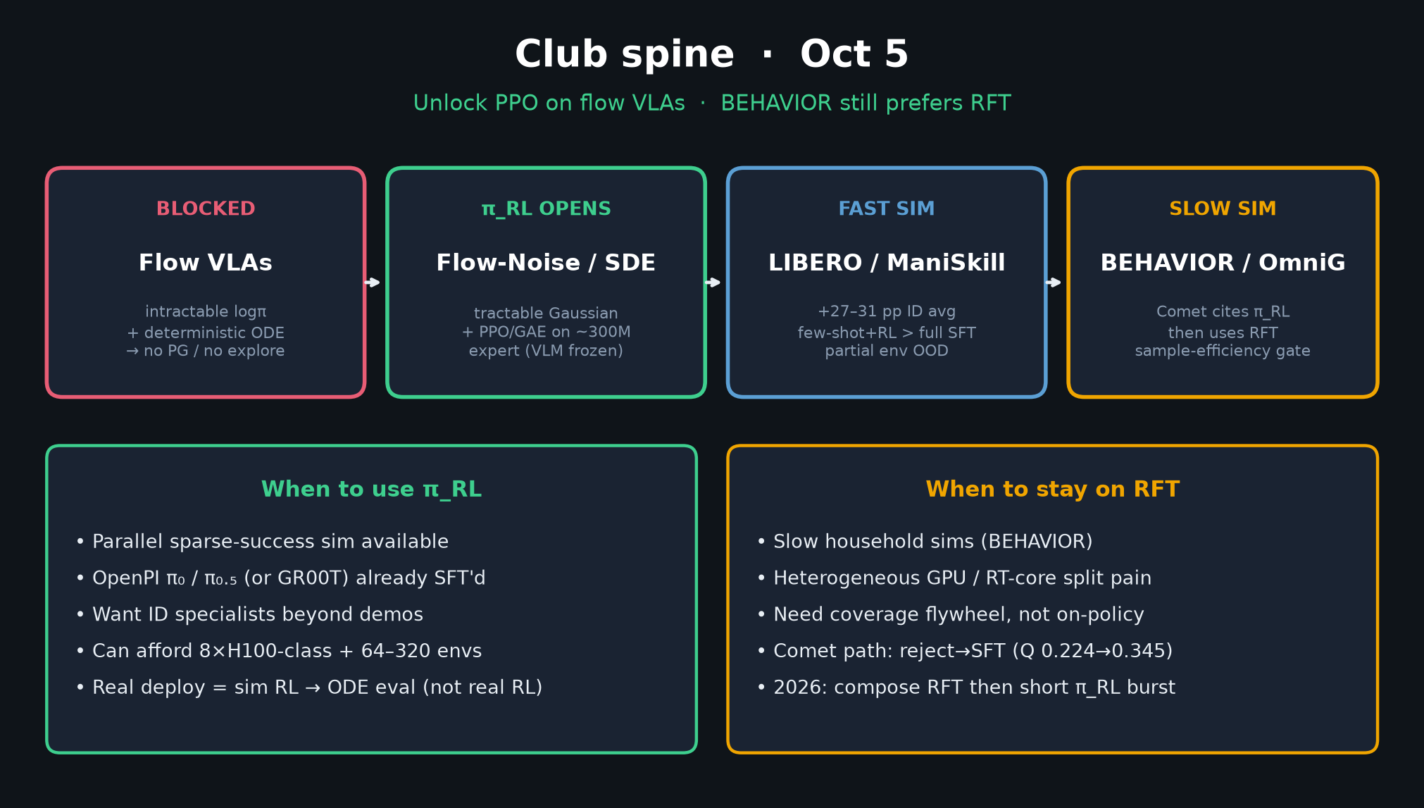
Scientific Reviewer · 8+3 · 2/11
Notes:
SPINE — 30s. Unlock PPO on flow VLAs (Flow-Noise / Flow-SDE); BEHAVIOR still prefers RFT.
Comet cites π_RL then uses RFT. Your job is pressure-test the online-RL claim, not sell it.

Slide 3
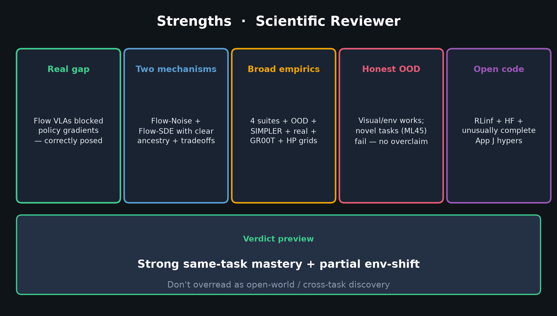
Scientific Reviewer · 8+3 · 3/11
Notes:
STRENGTHS — 60–75s. Hit all five cards briefly:
1) Real gap (flow VLAs blocked PG) — correctly posed
2) Two mechanisms with ancestry (ReinFlow, Flow-GRPO, DPPO) + honest efficiency tradeoffs
3) Broad empirics: 4 suites + OOD + SIMPLER + real + GR00T + App J hypers
4) Honest OOD split: visual/env works; novel tasks fail
5) Open code / RLinf / HF
Then preview verdict line at bottom.

Slide 4
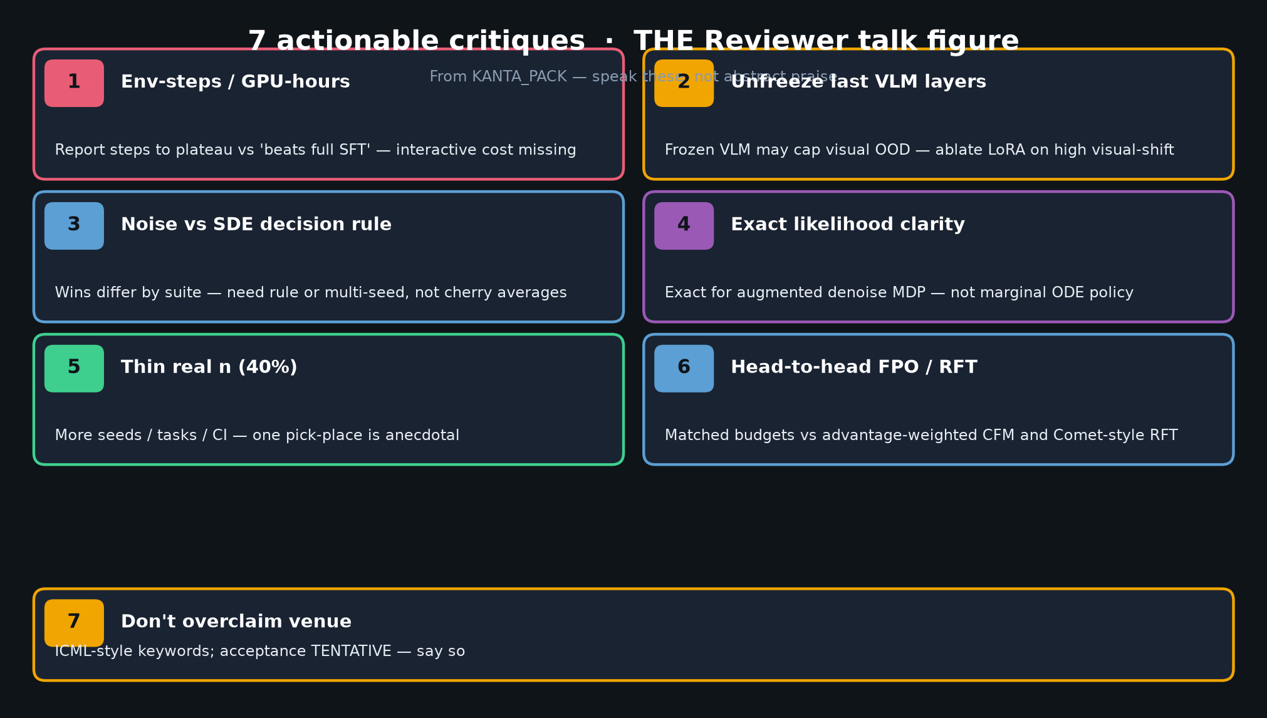
Scientific Reviewer · 8+3 · 4/11
Notes:
7 ACTIONABLE CRITIQUES — THE TALK FIGURE. Spend ~3.5–4 min here. Speak each:
1. Env-steps / GPU-hours to plateau vs 'beats full SFT' — interactive cost missing
2. Ablate unfreeze last VLM layers — frozen VLM may cap visual OOD
3. When to pick Noise vs SDE — wins differ by suite; need decision rule / multi-seed
4. 'Exact likelihood' is of augmented denoise MDP, not marginal ODE policy — say so
5. Thin real n (40%) — more seeds/tasks/CI
6. Head-to-head vs FPO / RFT under matched budgets
7. Don't overclaim venue — ICML-style keywords; acceptance TENTATIVE
Do NOT soft-pedal. These are the pack's Reviewer meat.

Slide 5
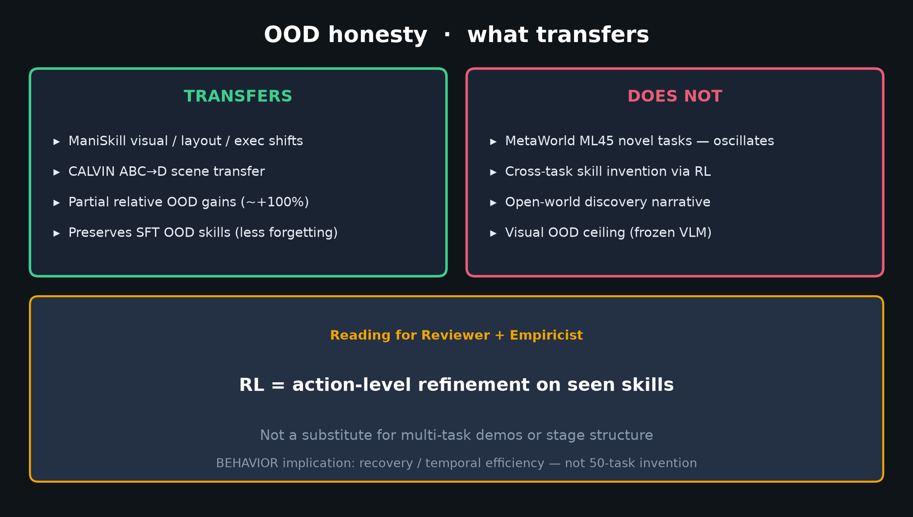
Scientific Reviewer · 8+3 · 5/11
Notes:
OOD HONESTY — 45–60s. Supports critique framing.
TRANSFERS: ManiSkill visual/layout/exec; CALVIN ABC→D; partial relative OOD; preserves SFT skills.
DOES NOT: ML45 novel tasks; cross-task invention; open-world discovery; visual ceiling (frozen VLM).
Reading: RL = action-level refinement on seen skills — not 50-task invention for BEHAVIOR.

Slide 6
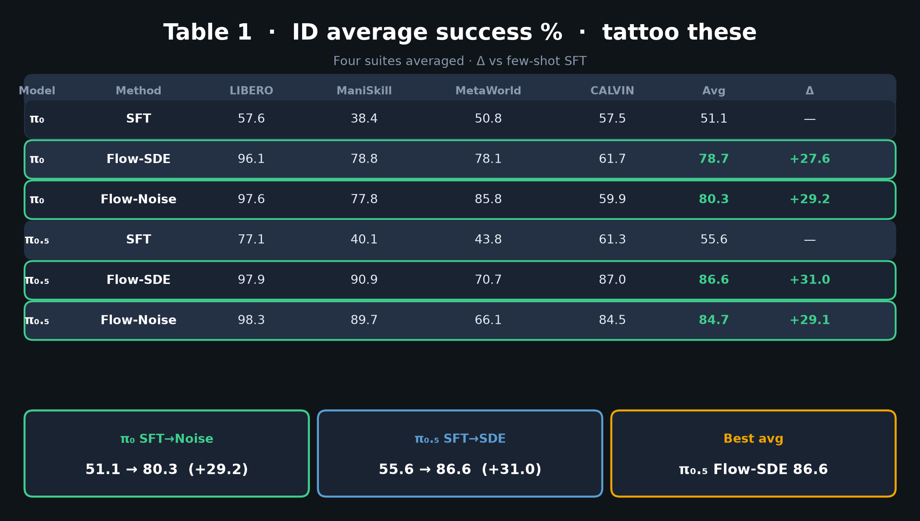
Scientific Reviewer · 8+3 · 6/11
Notes:
TABLE 1 glance — 30s. Point Empiricist tattoo numbers as shared evidence.
π₀ 51.1→80.3; π₀.₅ 55.6→86.6. Gains are real for ID. Your critique is about what they mean (iso-compute, OOD limits).

Slide 7
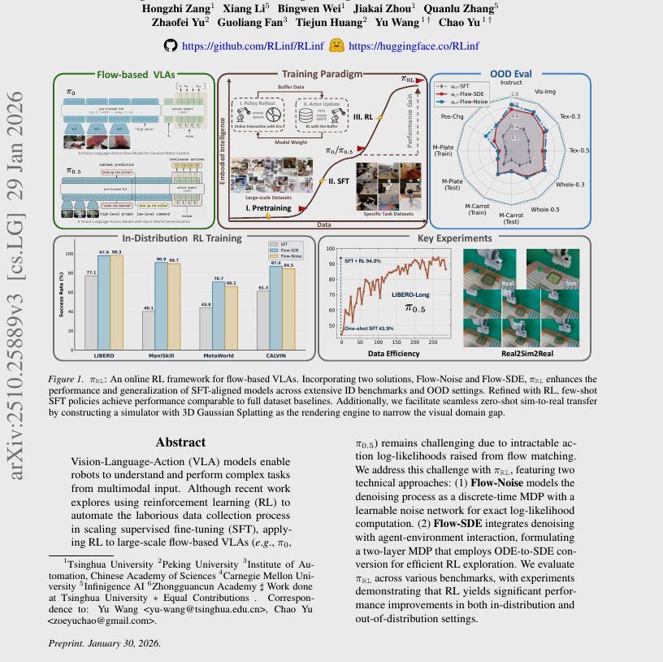
Scientific Reviewer · 8+3 · 7/11
Notes:
PAPER FIG 1 crop — optional visual of pipeline + claims. 20s if time.
Don't let banner overclaim distract from your critiques.

Slide 8
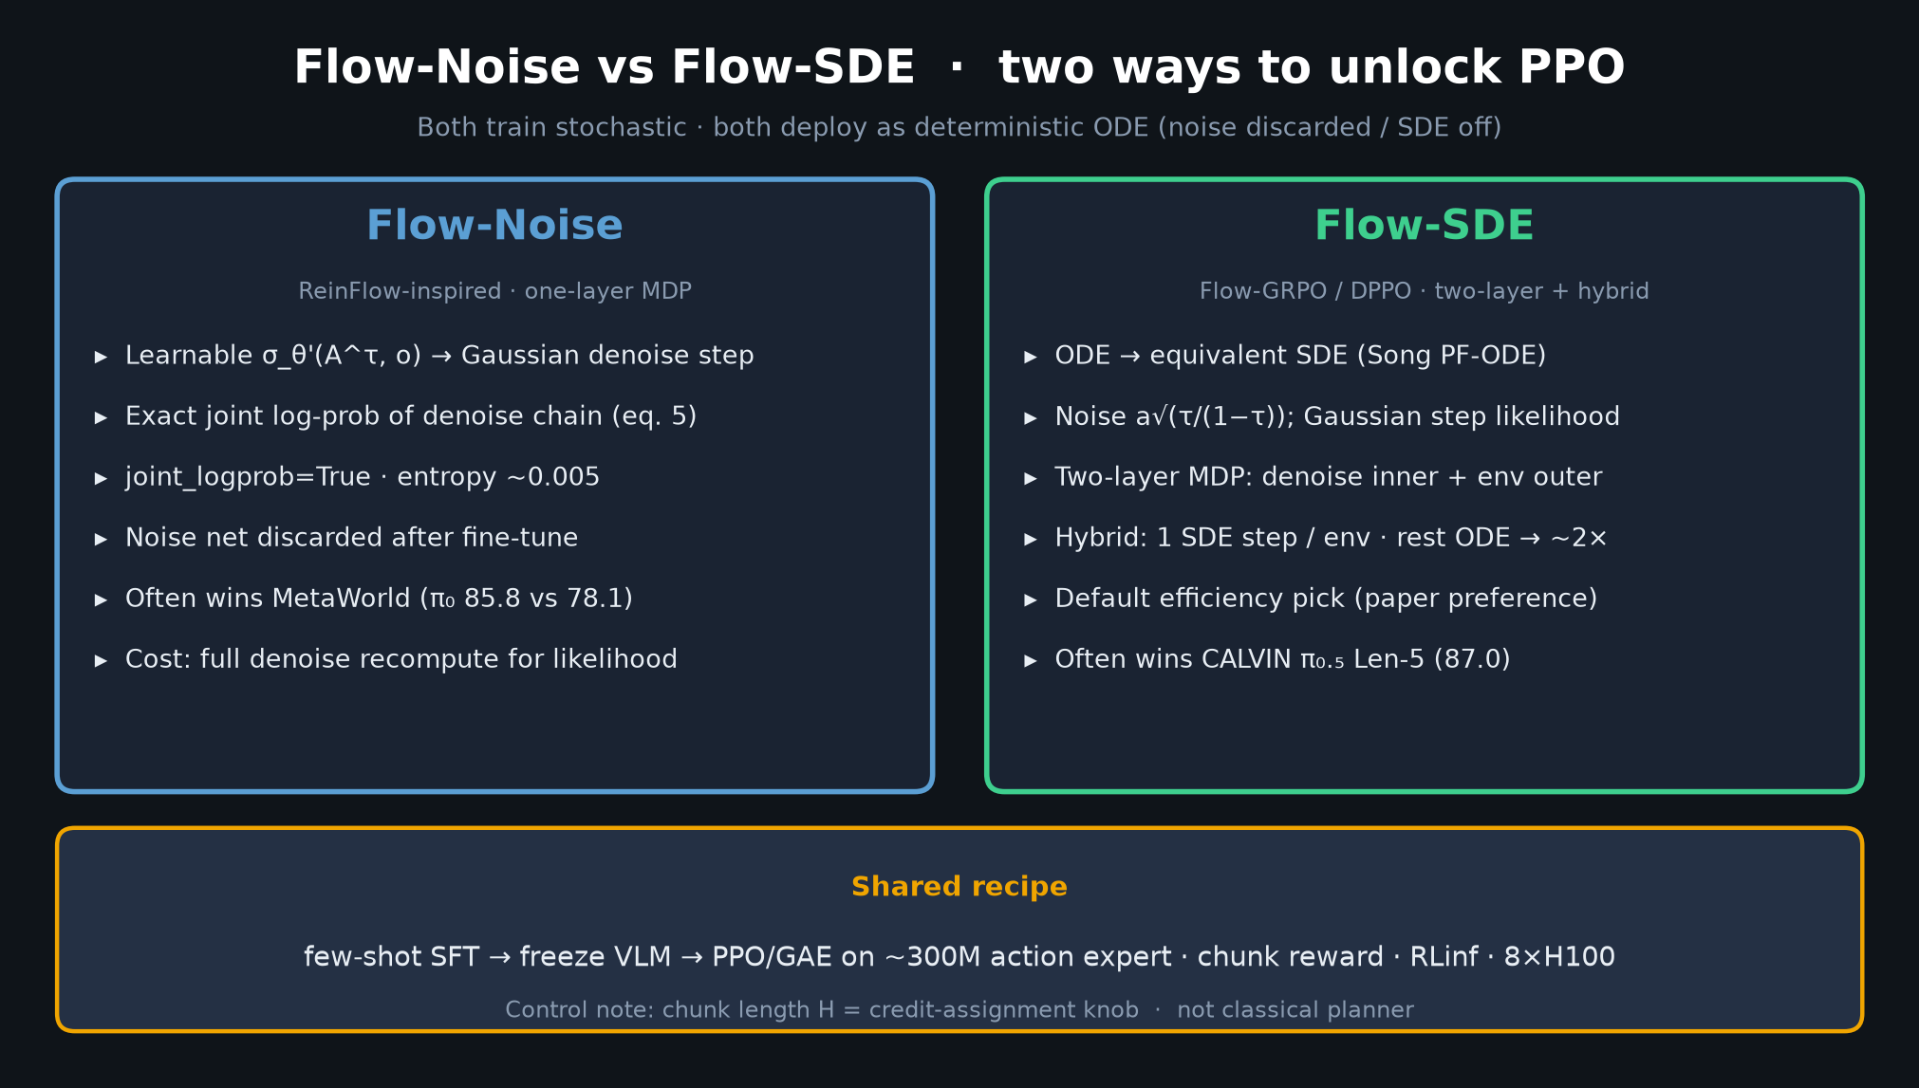
Scientific Reviewer · 8+3 · 8/11
Notes:
FLOW-NOISE vs FLOW-SDE — supports critique #3 (decision rule) and #4 (likelihood clarity).
Hybrid ~2×; suites disagree on winner. Exact logprob for Noise = augmented process.

Slide 9
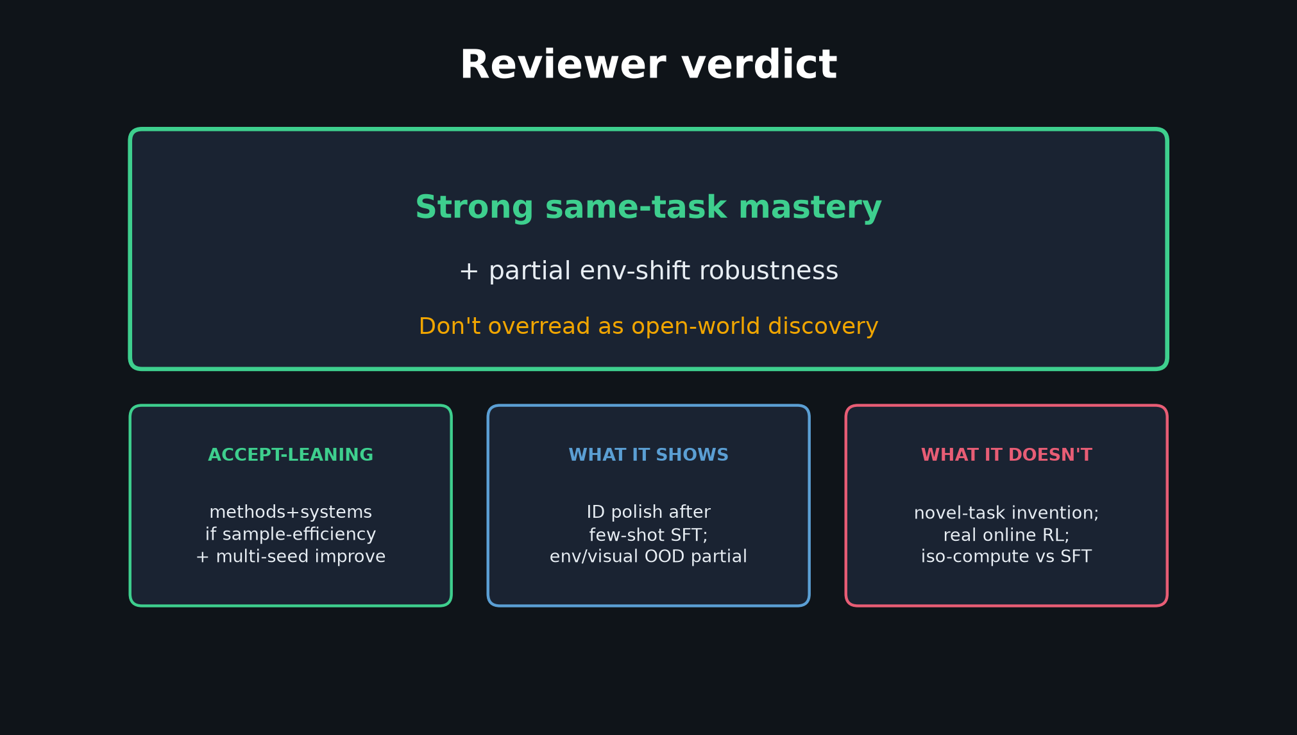
Scientific Reviewer · 8+3 · 9/11
Notes:
VERDICT SLIDE — leave this up. Say aloud:
'Strong same-task mastery + partial env-shift. Don't overread as open-world discovery.'
Accept-leaning for methods+systems IF sample-efficiency + multi-seed improve.
What it shows / doesn't — three cards.

Slide 10
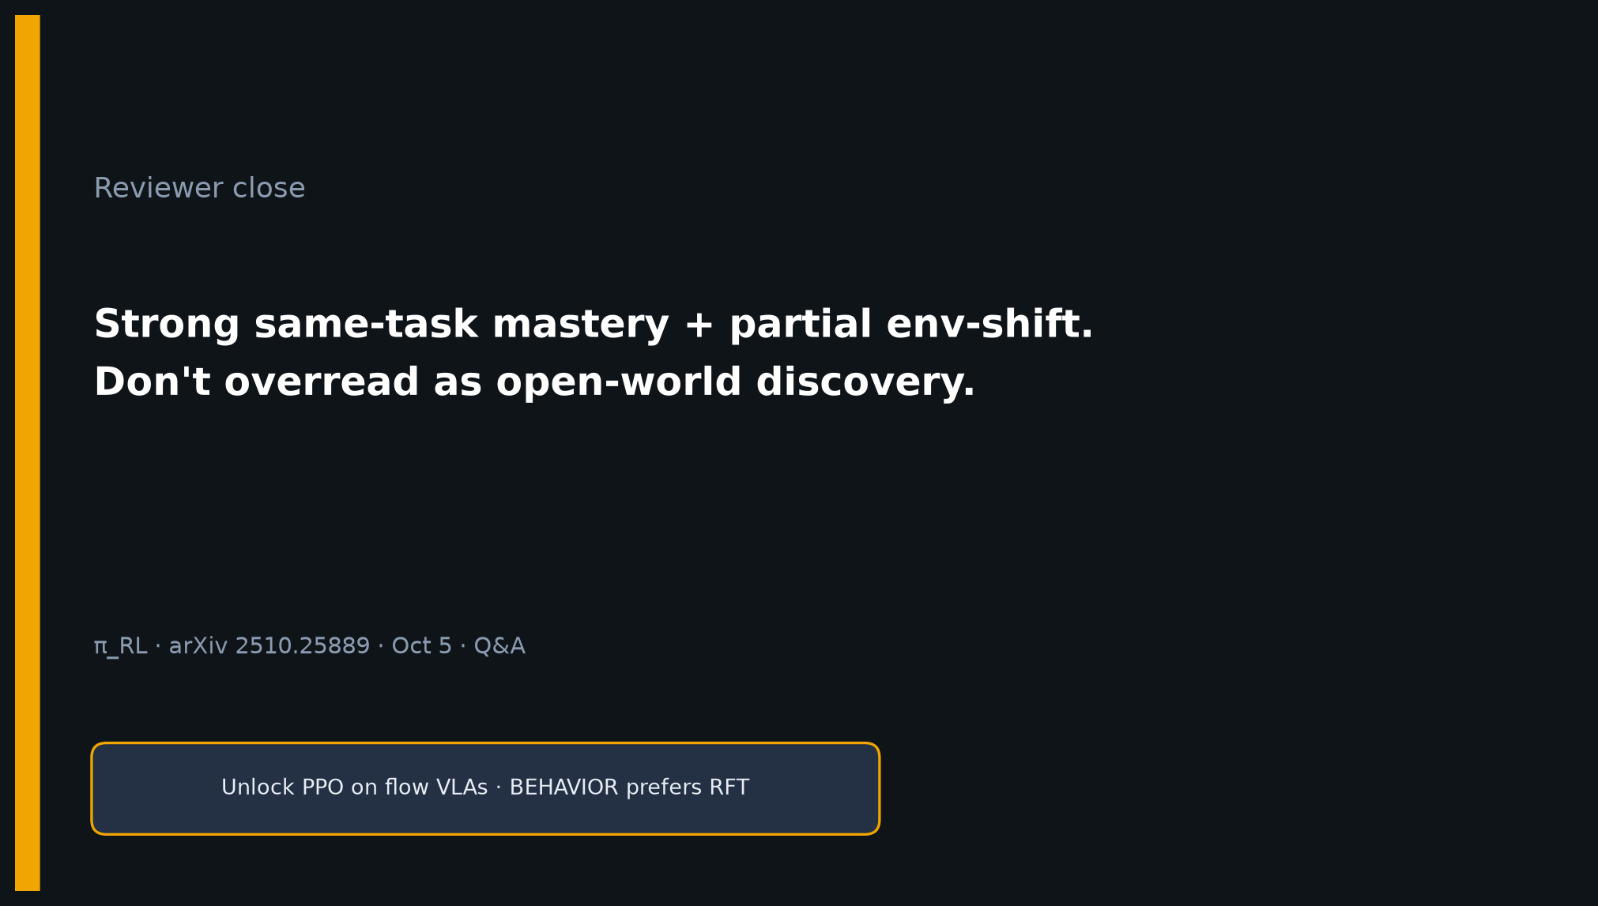
Scientific Reviewer · 8+3 · 10/11
Notes:
CLOSE / Q&A prompts (3 min):
• 'Is this open-world RL?' → No; ID polish + partial env OOD.
• 'Does it beat full SFT fairly?' → On reported % yes; interactive cost missing.
• 'Should BEHAVIOR use this?' → Comet cited then chose RFT; sim economics gate.
• Venue? → ICML-style keywords; acceptance TENTATIVE.
Leave on verdict line.

Slide 11
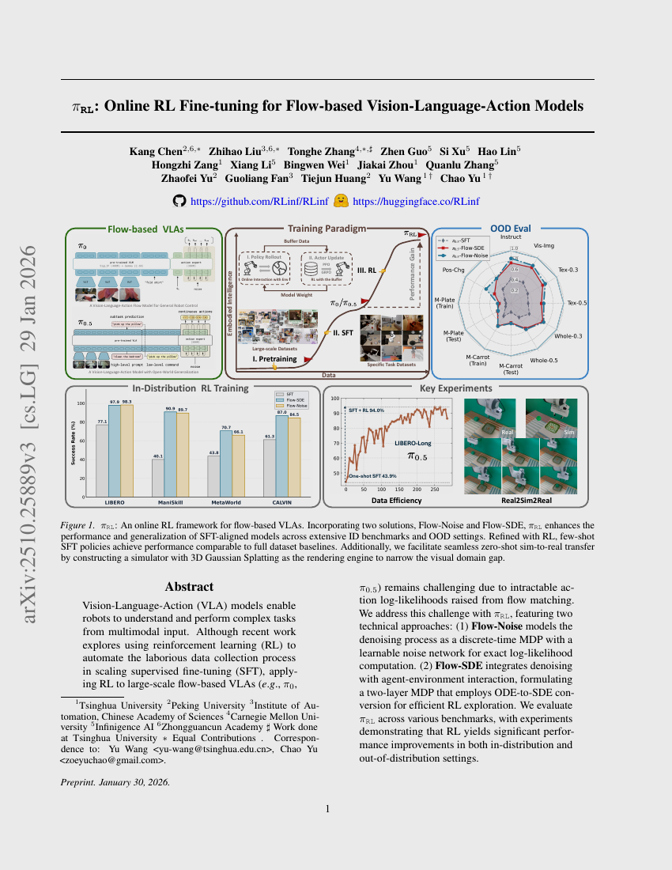
Scientific Reviewer · 8+3 · 11/11
Notes:
BACKUP — paper cover / bibliographic if needed.
Chen/Liu/Zhang et al. arXiv 2510.25889v3 · RLinf · Jan 2026 preprint line.

