Slide 1
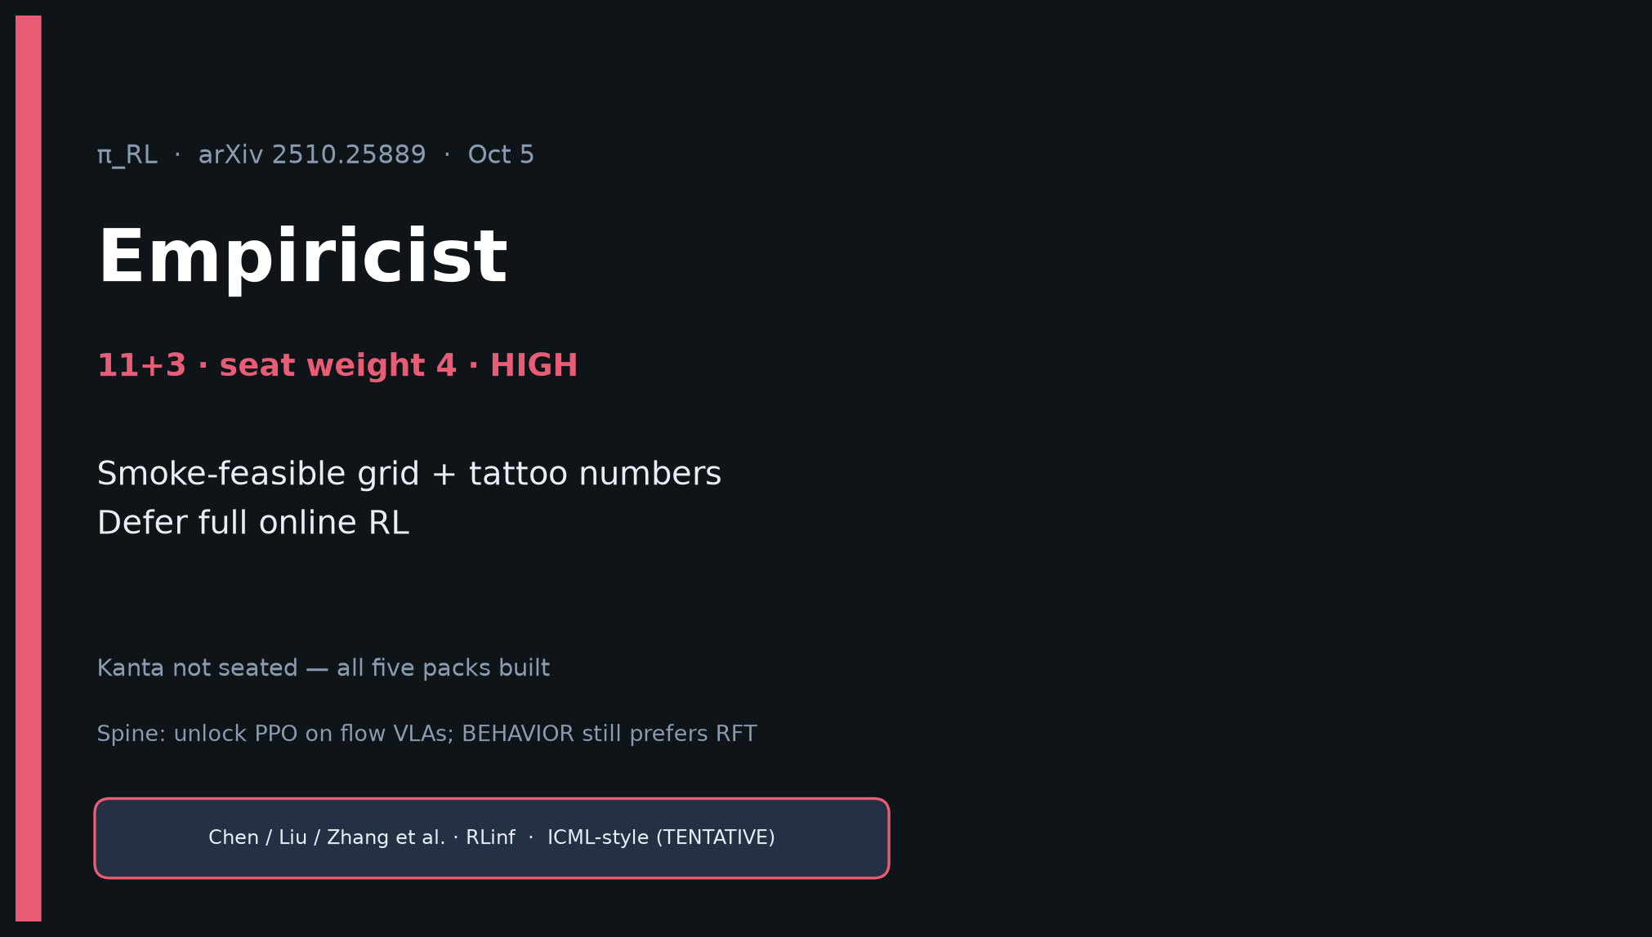
Empiricist · 11+3 · 1/14
Notes:
EMPIRICIST — 11+3 · seat weight 4 · HIGH priority.
Ruthless smoke: DEFER full online RL. You own feasibility + tattoo numbers.
ONE-LINER: parallel sparse-success sim → near-saturated specialists; else stay on RFT.
Pair with Reviewer: their critiques #1/#6 about compute & baselines are your smoke-matrix justification.
Kanta not seated — still deliver the meaty experiment track.

Slide 2
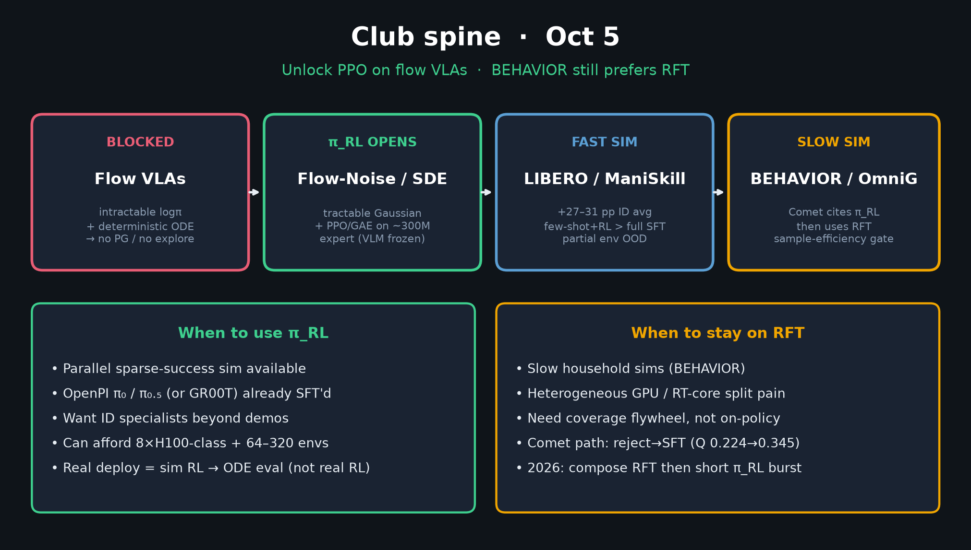
Empiricist · 11+3 · 2/14
Notes:
SPINE — 20s. Unlock PPO when fast sim; BEHAVIOR prefers RFT. Your job is what we can actually run.

Slide 3
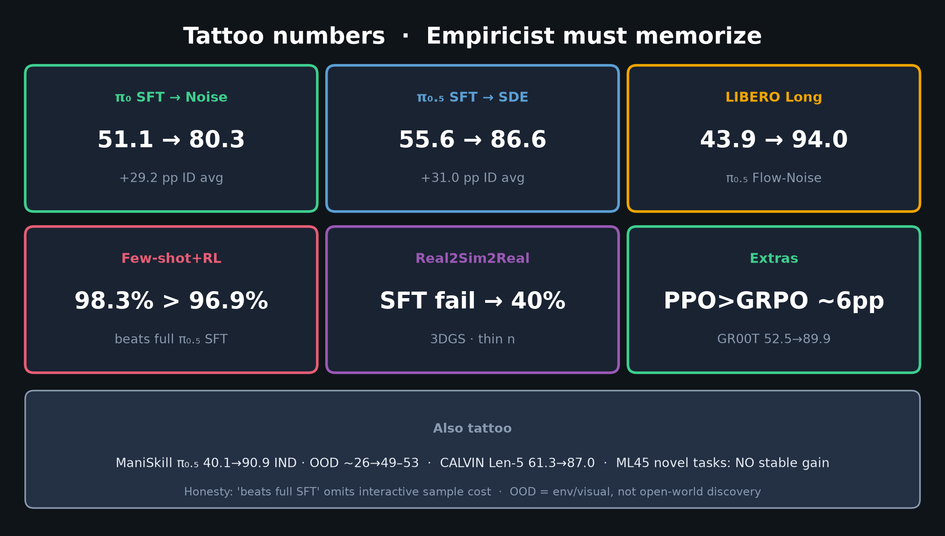
Empiricist · 11+3 · 3/14
Notes:
TATTOO NUMBERS — densest shared with Reviewer. Memorize aloud (~90s):
• π₀ SFT→Noise 51.1→80.3 (+29.2)
• π₀.₅ SFT→SDE 55.6→86.6 (+31.0)
• LIBERO Long 43.9→94.0
• Few-shot+RL 98.3% > full SFT 96.9%
• Real2Sim2Real 40% (thin n)
• PPO>GRPO ~6pp · GR00T 52.5→89.9
Honesty: 'beats full SFT' omits interactive sample cost; OOD ≠ open-world.

Slide 4
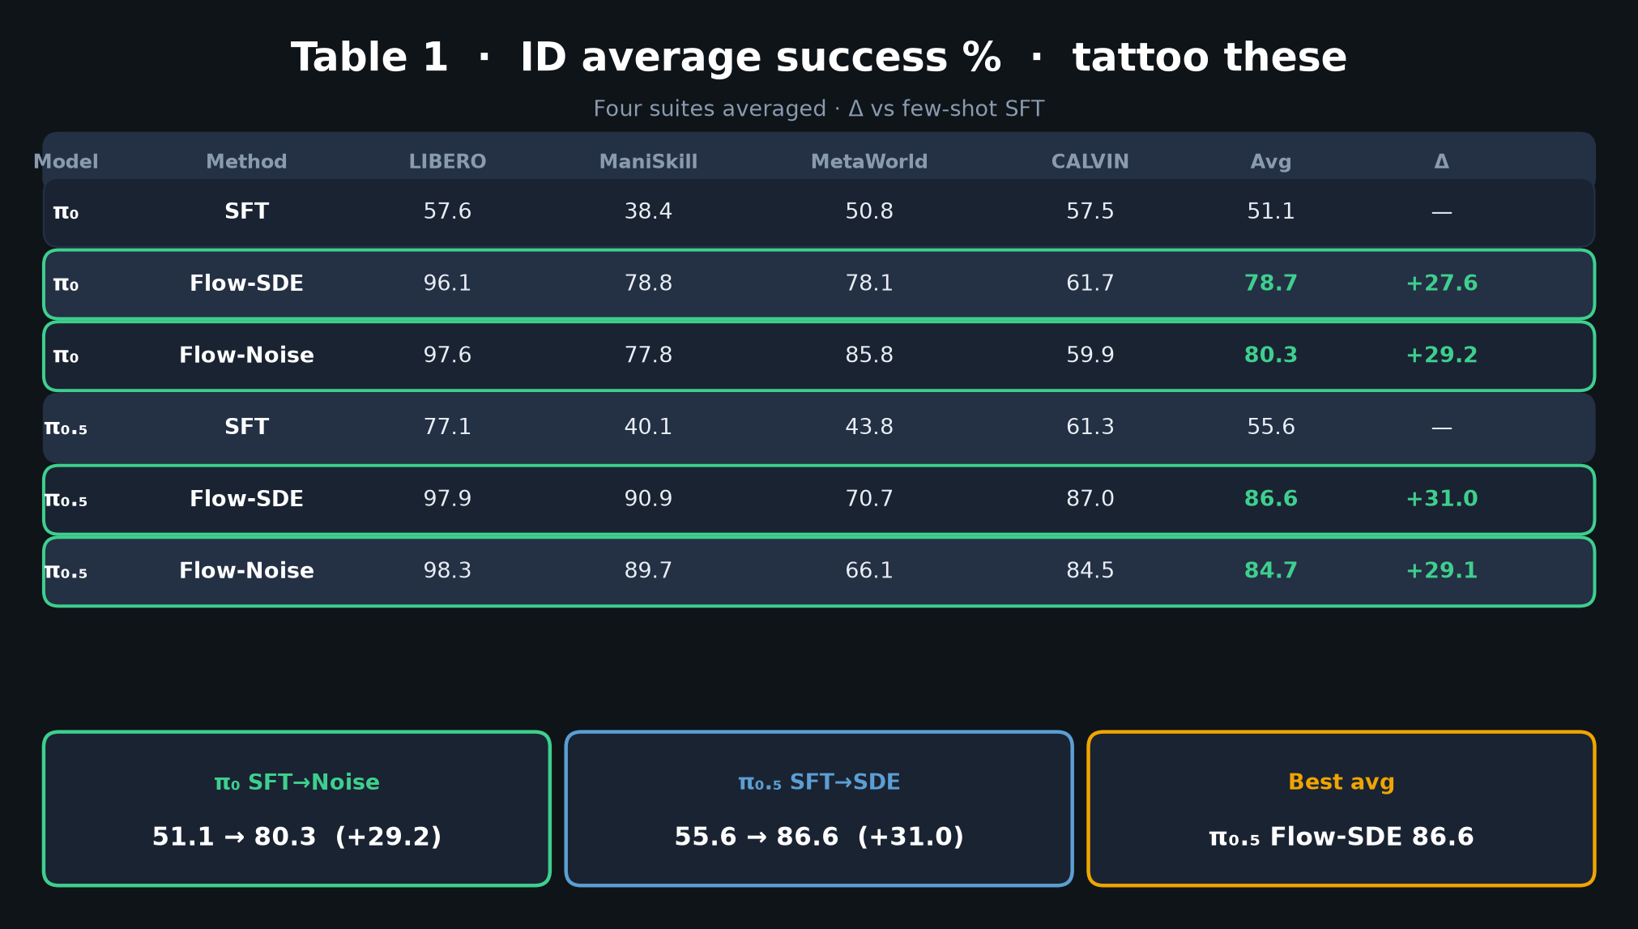
Empiricist · 11+3 · 4/14
Notes:
TABLE 1 full leaderboard — reinforce tattoos with suite columns. 45s.
Point: Noise vs SDE winners differ (supports Reviewer critique #3).

Slide 5
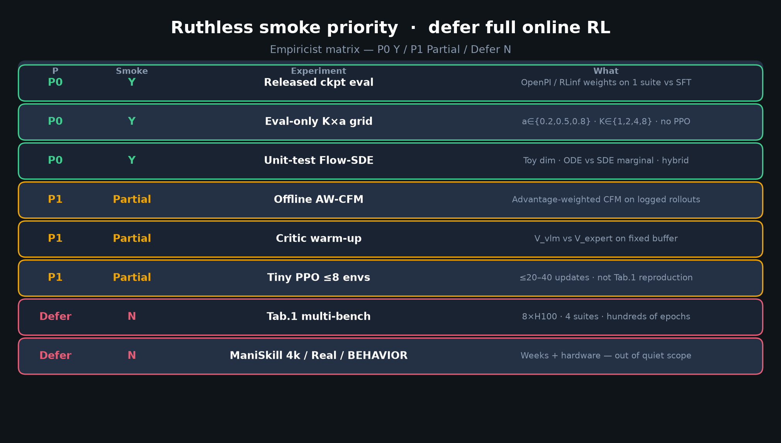
Empiricist · 11+3 · 5/14
Notes:
SMOKE PRIORITY MATRIX — THE Empiricist talk figure (~2.5 min).
P0 Y: ckpt eval; eval-only K×a grids; unit-test Flow-SDE transitions.
P1 Partial: offline AW-CFM; critic warm-up; tiny PPO ≤8 envs ≤20–40 updates.
Defer N: Tab.1 multi-bench, ManiSkill 4k, Real2Sim2Real, BEHAVIOR online RL.
RULE: never claim Tab.1 from Partial smokes.

Slide 6
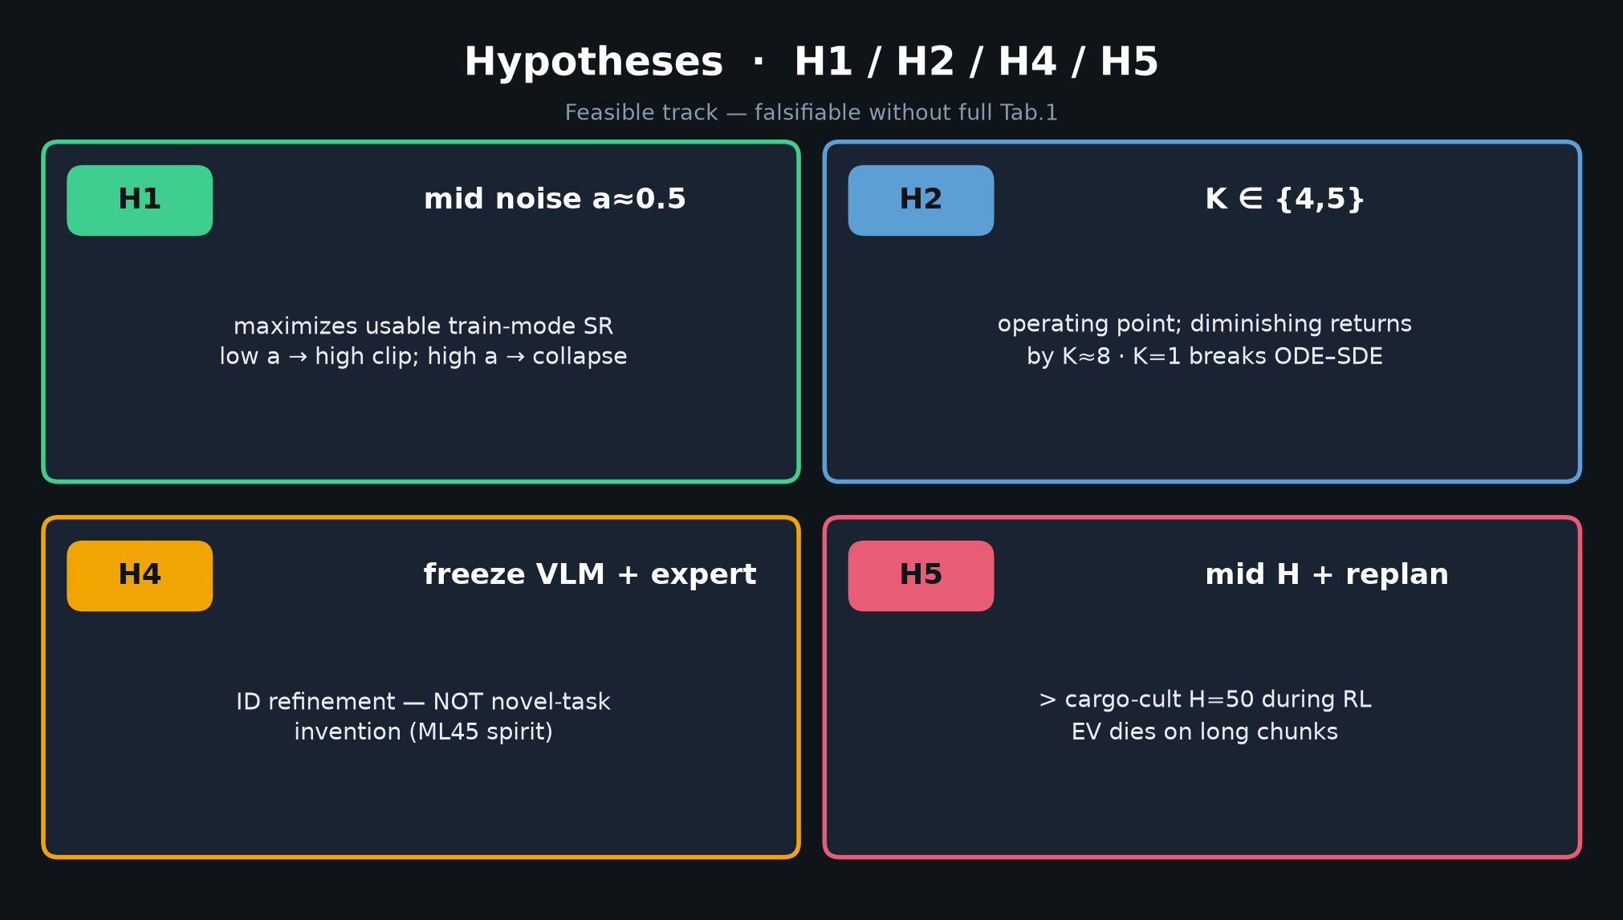
Empiricist · 11+3 · 6/14
Notes:
HYPOTHESES H1/H2/H4/H5 — 90s.
H1: mid noise a≈0.5 maximizes usable train-mode SR
H2: K∈{4,5} operating point; diminishing by ~8
H4: freeze VLM + expert = ID refinement, not novel-task invention
H5: mid horizon + replan > cargo-cult H=50 during RL
Falsifiers listed in DELIVERABLE — use if challenged.

Slide 7
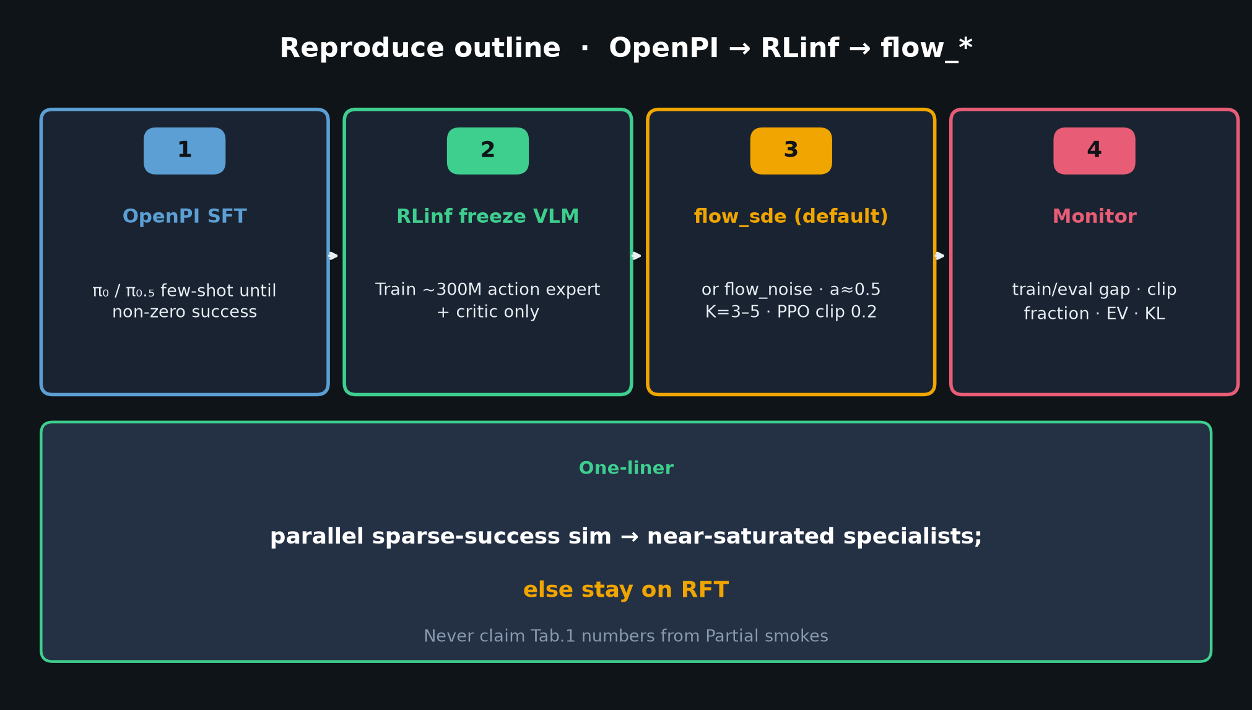
Empiricist · 11+3 · 7/14
Notes:
REPRODUCE OUTLINE — 60s.
OpenPI SFT → RLinf freeze VLM → flow_sde (default) or flow_noise → monitor train/eval gap, clip fraction, EV, KL.
One-liner at bottom: parallel sparse-success sim → specialists; else RFT.

Slide 8
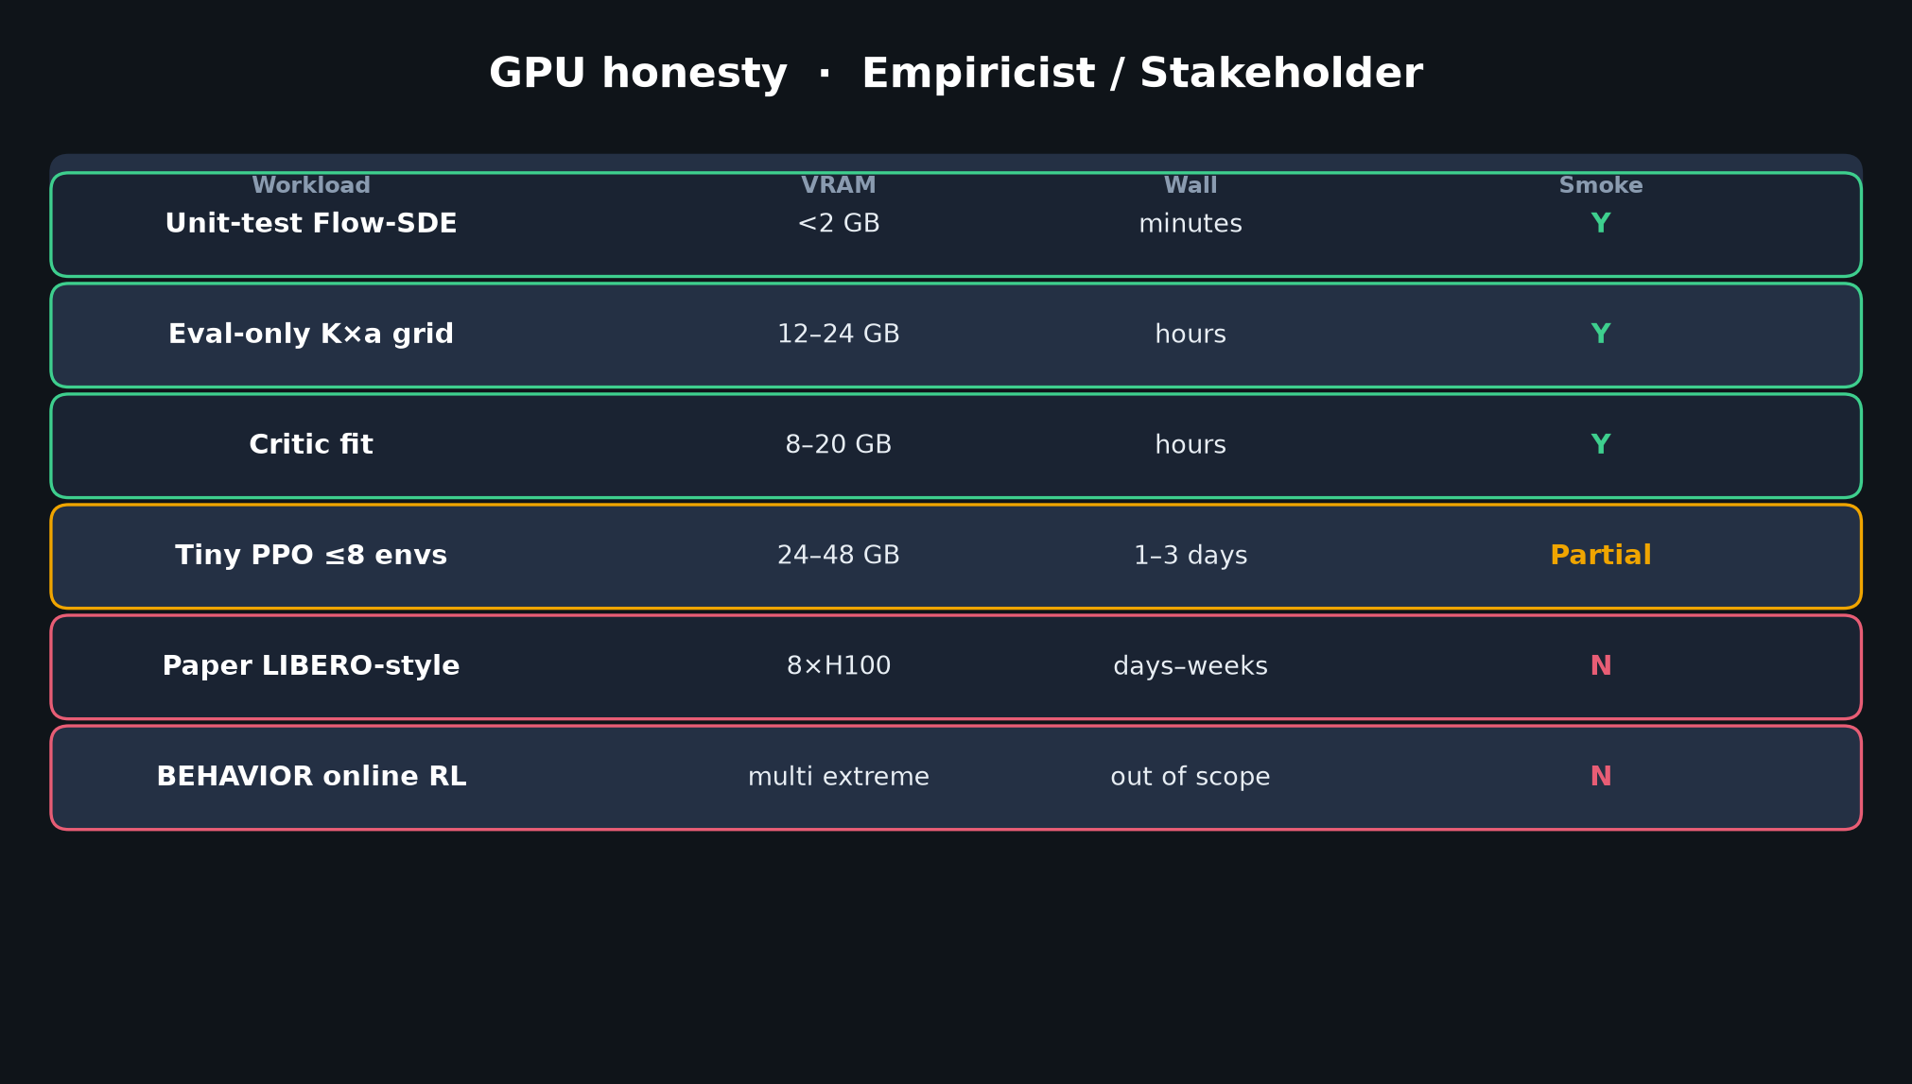
Empiricist · 11+3 · 8/14
Notes:
GPU BUDGET honesty — 45s. Stakeholder will care too.
P0 evals on 1 GPU hours; tiny PPO Partial days; paper = 8×H100 weeks. BEHAVIOR online = N.

Slide 9
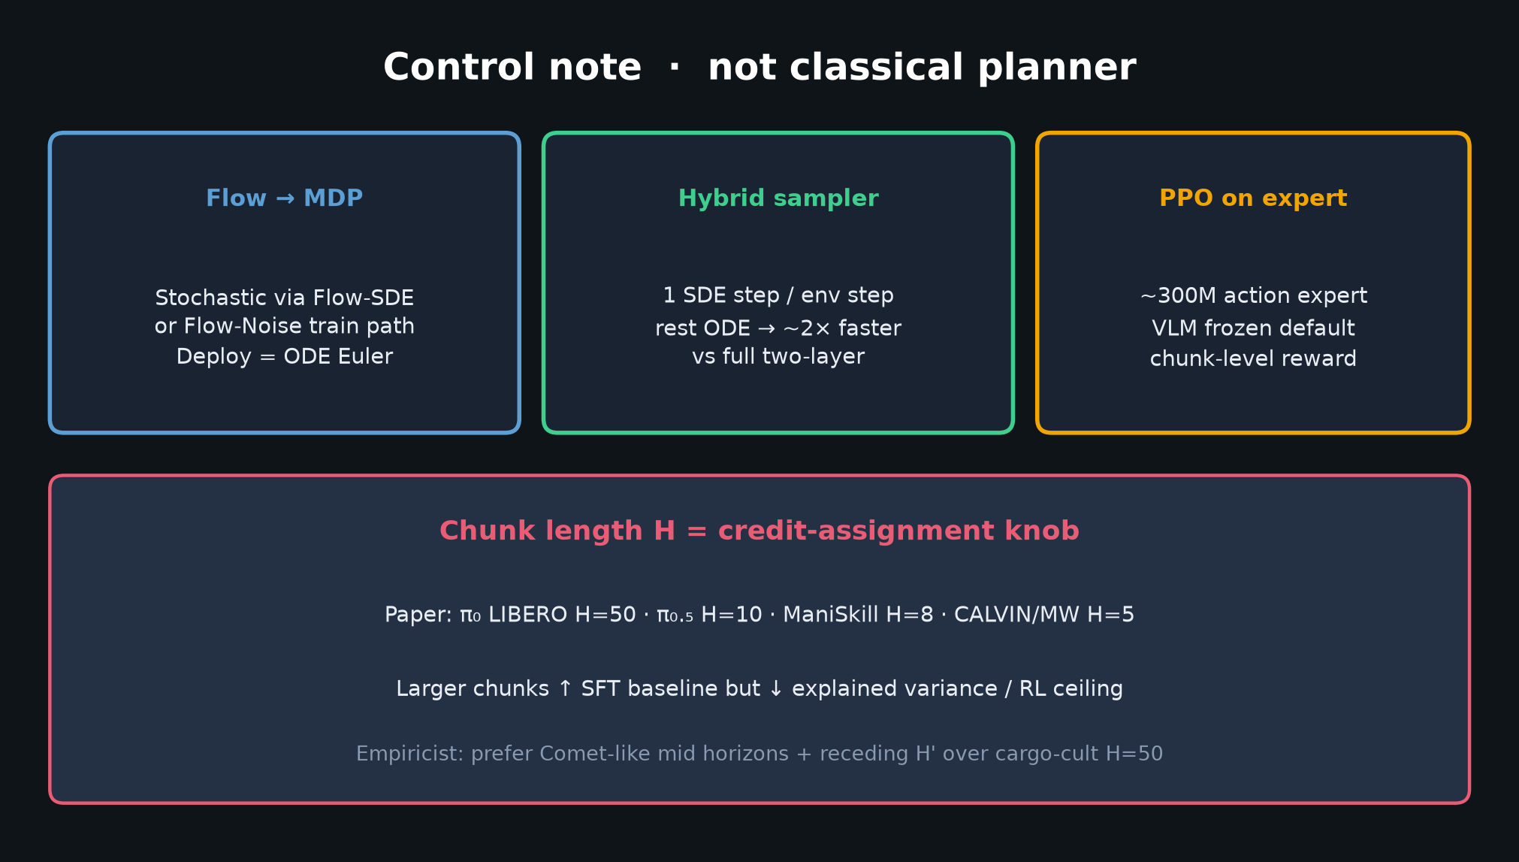
Empiricist · 11+3 · 9/14
Notes:
CONTROL NOTE — chunk H = credit knob. Link H5.
Prefer mid H + receding H' (Comet prior) during any RL smoke. Not classical planner.

Slide 10
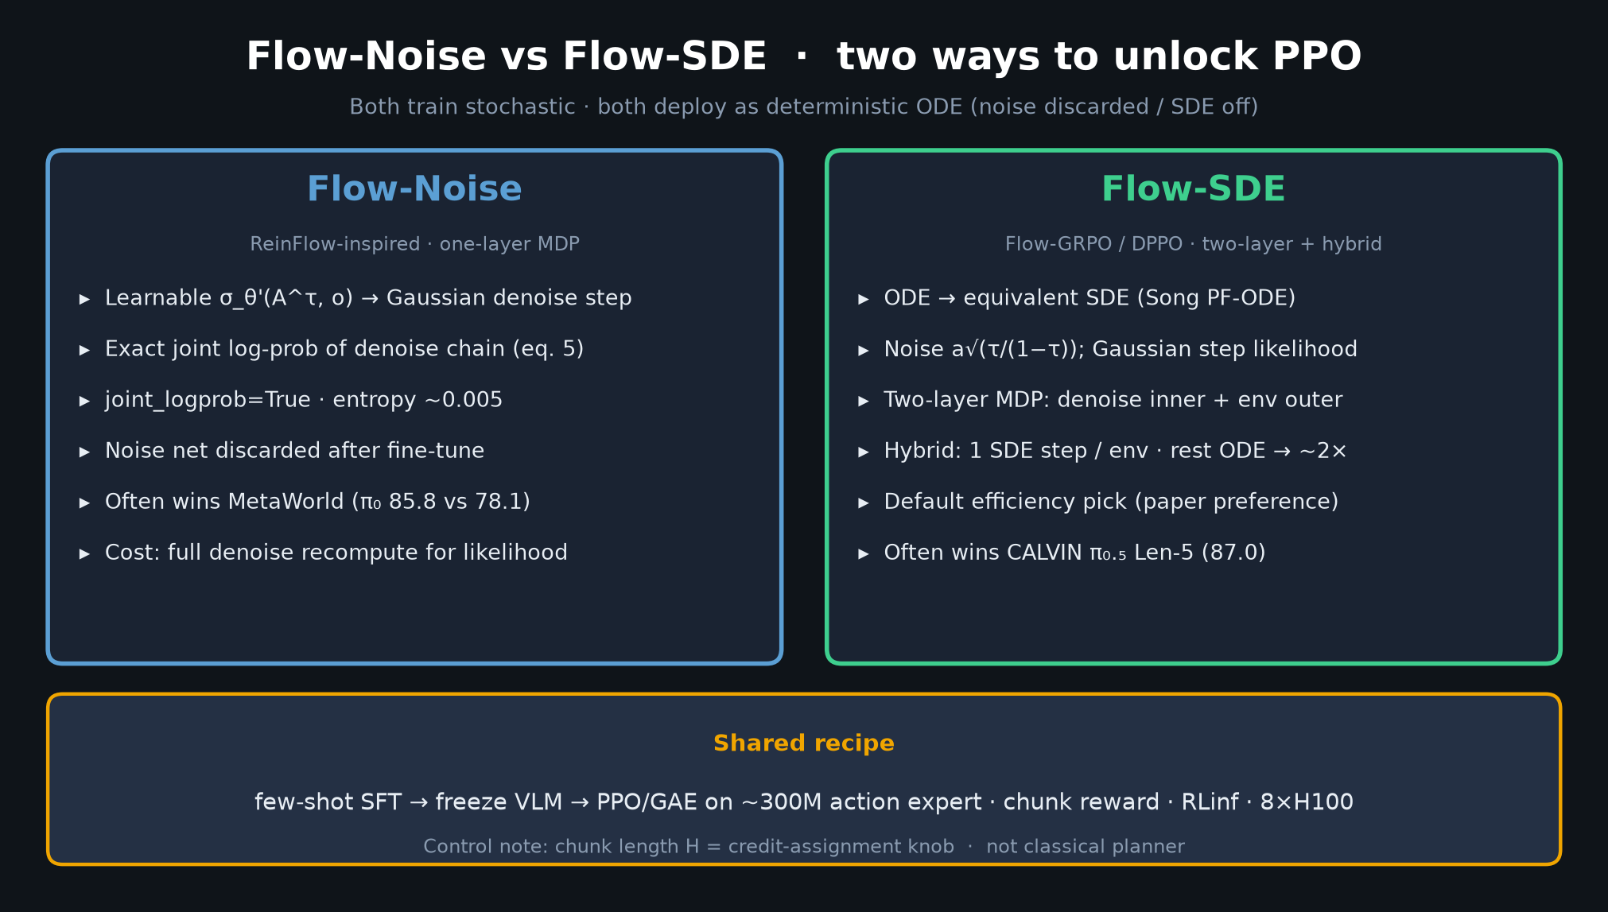
Empiricist · 11+3 · 10/14
Notes:
FLOW-NOISE vs SDE — which to smoke first?
Default Flow-SDE hybrid (paper efficiency). Noise if MetaWorld-like. Unit-test SDE transitions before PPO.

Slide 11
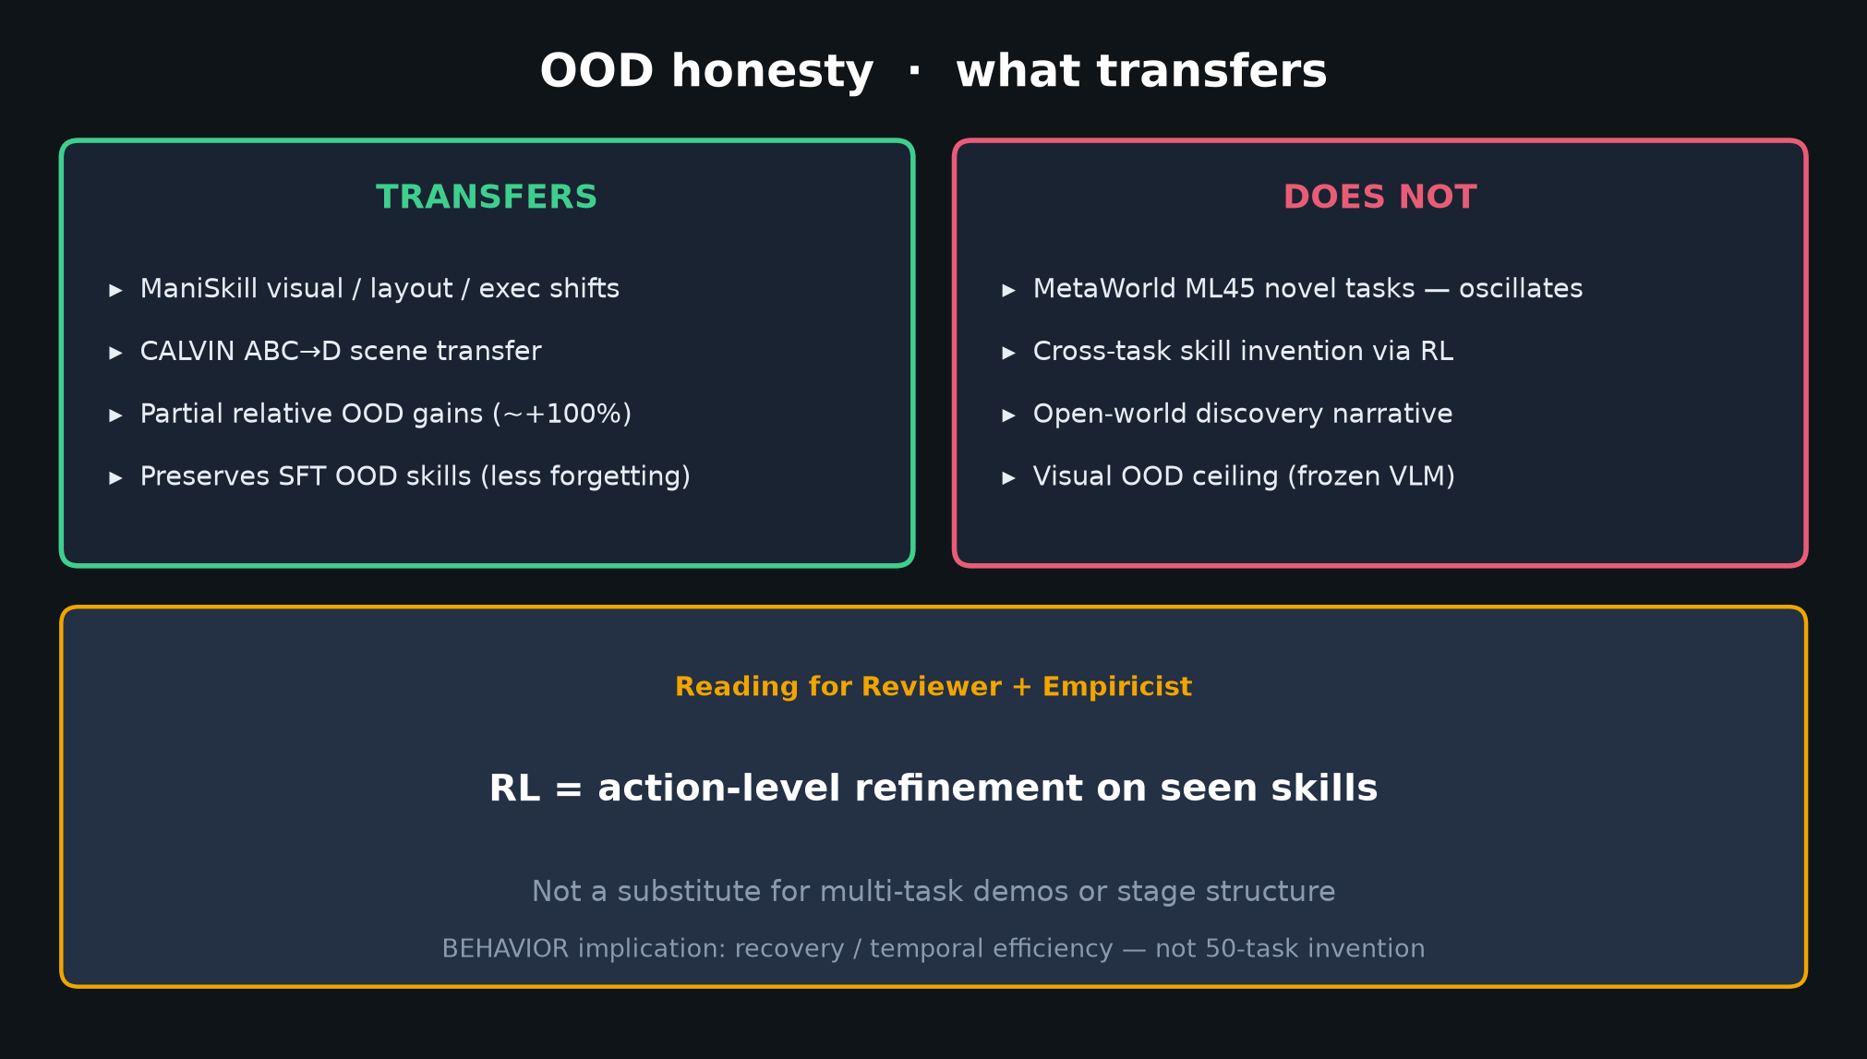
Empiricist · 11+3 · 11/14
Notes:
OOD honesty — Empiricist reading of what empirics support.
✅ ID refine · ✅ partial visual/env · ❌ novel tasks · ❌ real online RL · ⚠️ iso-compute omitted.

Slide 12
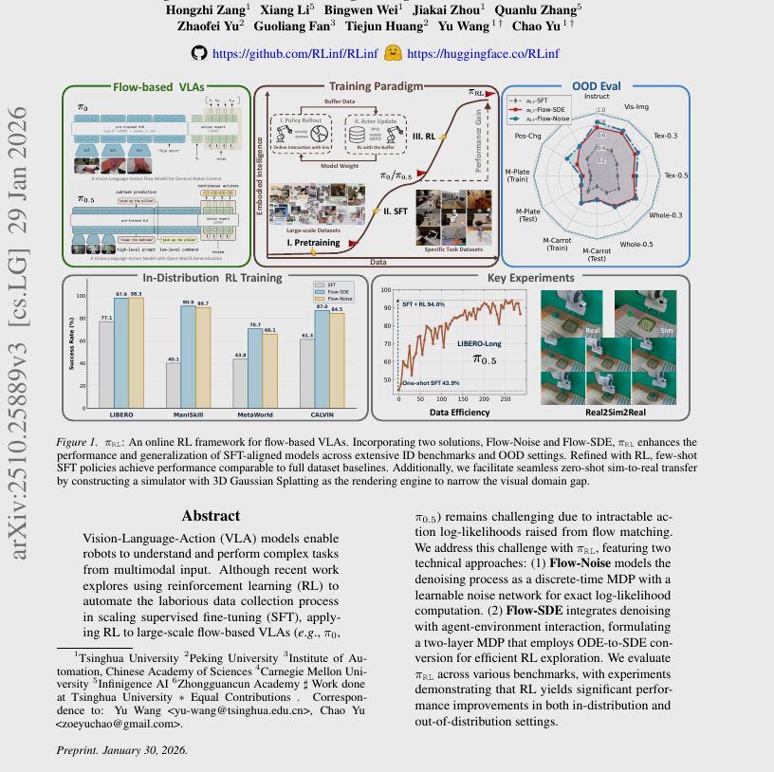
Empiricist · 11+3 · 12/14
Notes:
PAPER FIG1 — visual of pipeline claims. Glance; don't let it override smoke discipline.

Slide 13
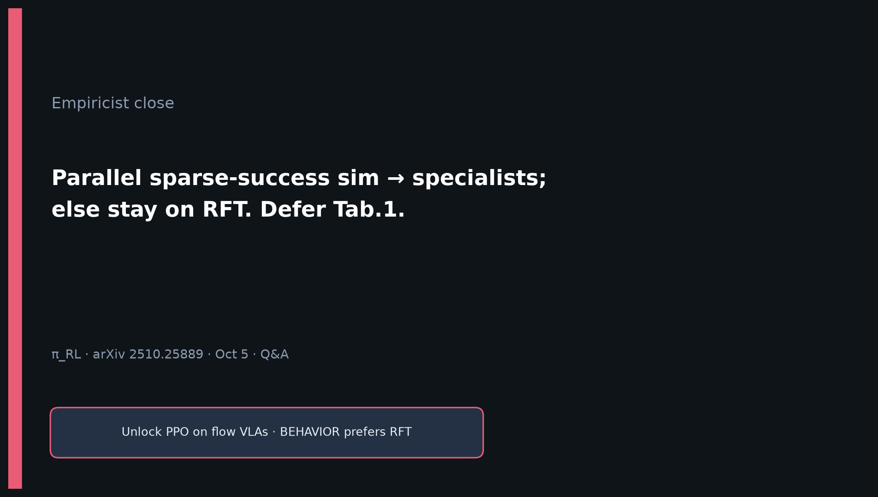
Empiricist · 11+3 · 13/14
Notes:
CLOSE / Q&A (3 min):
• Can we reproduce Tab.1 this week? → No; smoke P0/P1 only.
• Why defer BEHAVIOR RL? → Sample + GPU heterogeneity (Comet agrees).
• What if tiny PPO moves +5–10 SR? → Directional only; still not Tab.1.
Leave on one-liner.

Slide 14
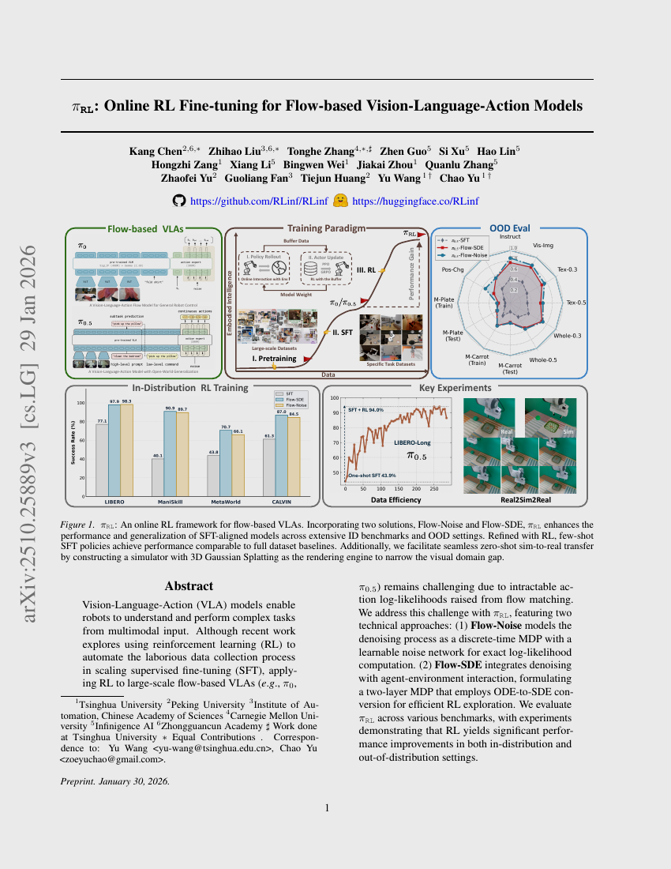
Empiricist · 11+3 · 14/14
Notes:
BACKUP cover.

