Slide 1

Archaeologist · 11+3 · 1/14
Notes:
ARCHAEOLOGIST — 11+3. Intellectual history + arc.
Priors → flow VLAs blocked PG → π_RL opens it → slow-sim routes around via RFT.
Do NOT fabricate BEHAVIOR win / ICML acceptance / real online RL at scale.

Slide 2
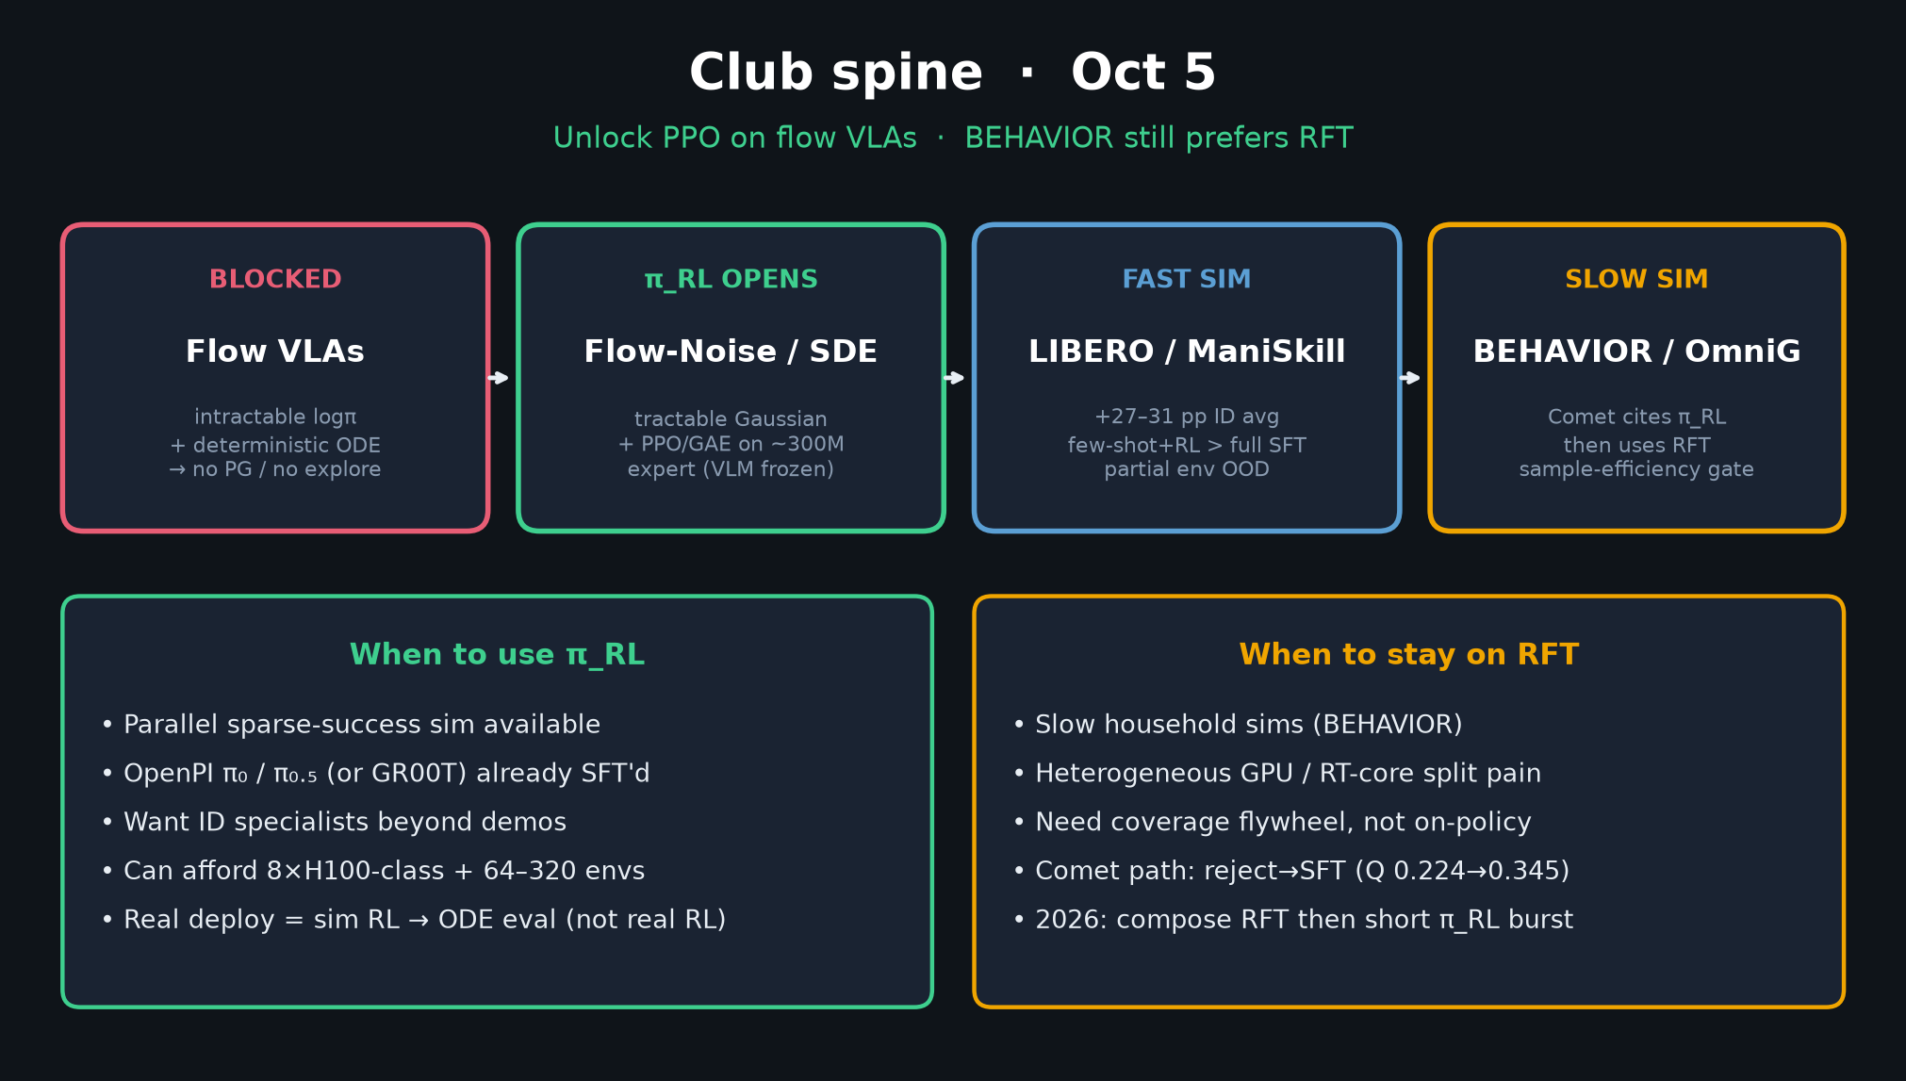
Archaeologist · 11+3 · 2/14
Notes:
SPINE = your arc in one slide.

Slide 3
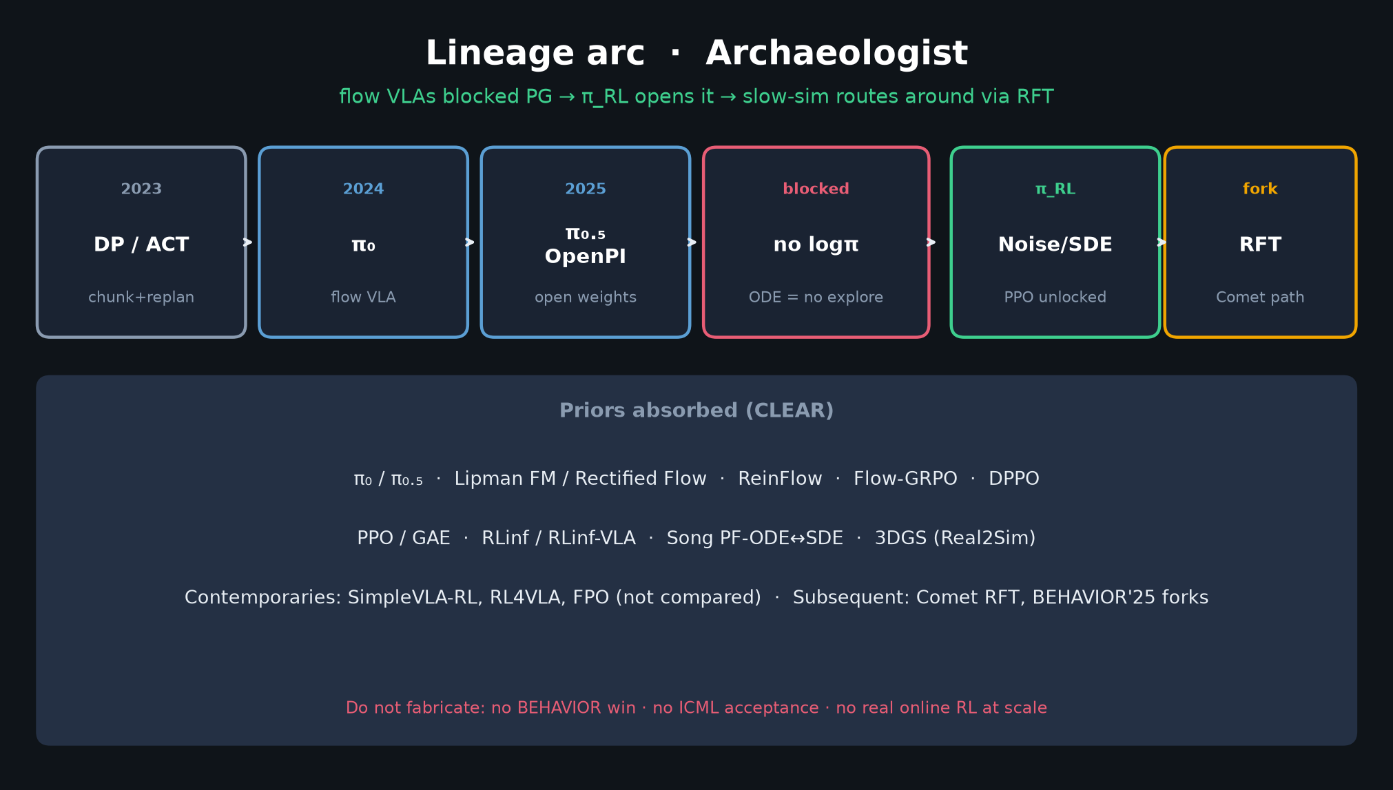
Archaeologist · 11+3 · 3/14
Notes:
LINEAGE — densest Archaeologist slide. Speak CLEAR priors only.
π₀/π₀.₅, Lipman FM, ReinFlow, Flow-GRPO, DPPO, PPO/GAE, RLinf, Song SDE, 3DGS.
Subsequent: Comet cites then RFT; BEHAVIOR'25 Pi0.5 forks different post-train.

Slide 4
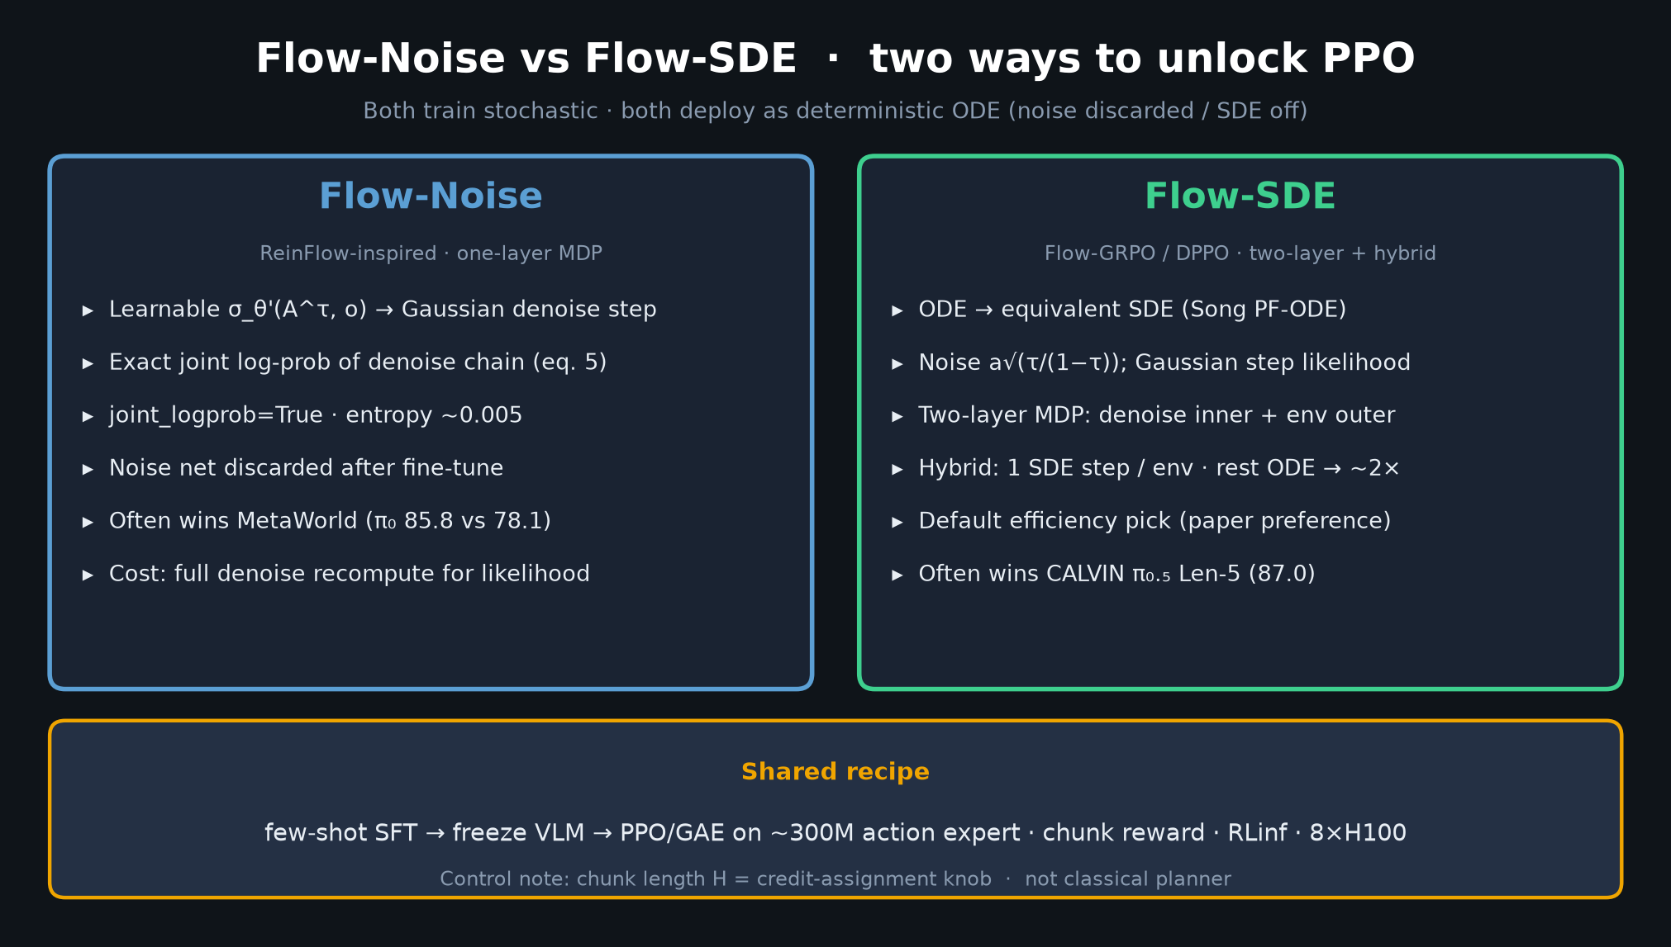
Archaeologist · 11+3 · 4/14
Notes:
FLOW-NOISE vs SDE — how the math ports ReinFlow / Flow-GRPO / DPPO into embodied chunks.

Slide 5
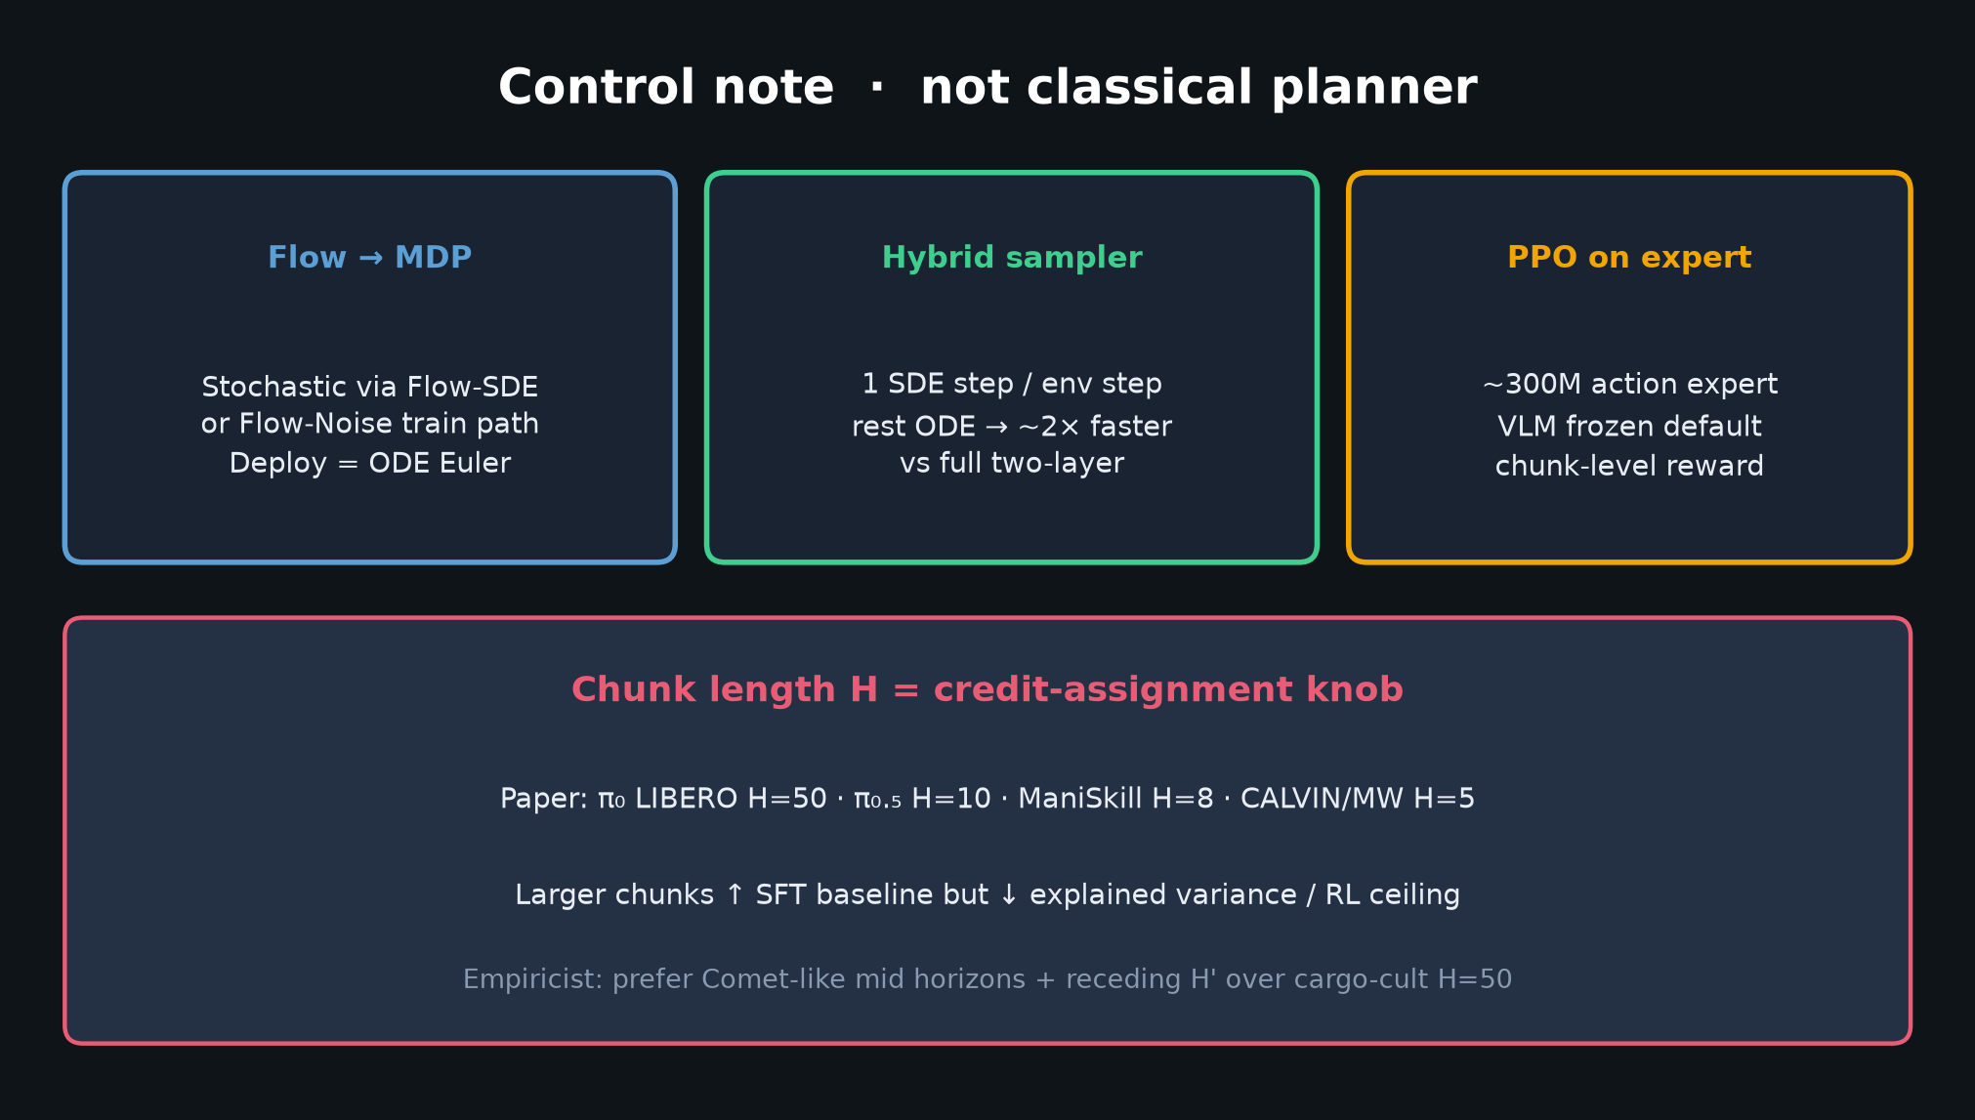
Archaeologist · 11+3 · 5/14
Notes:
CONTROL NOTE — chunked FM control substrate shared with π / OpenPI / BEHAVIOR winners.
π_RL adds online half; does not replace the control habit.

Slide 6
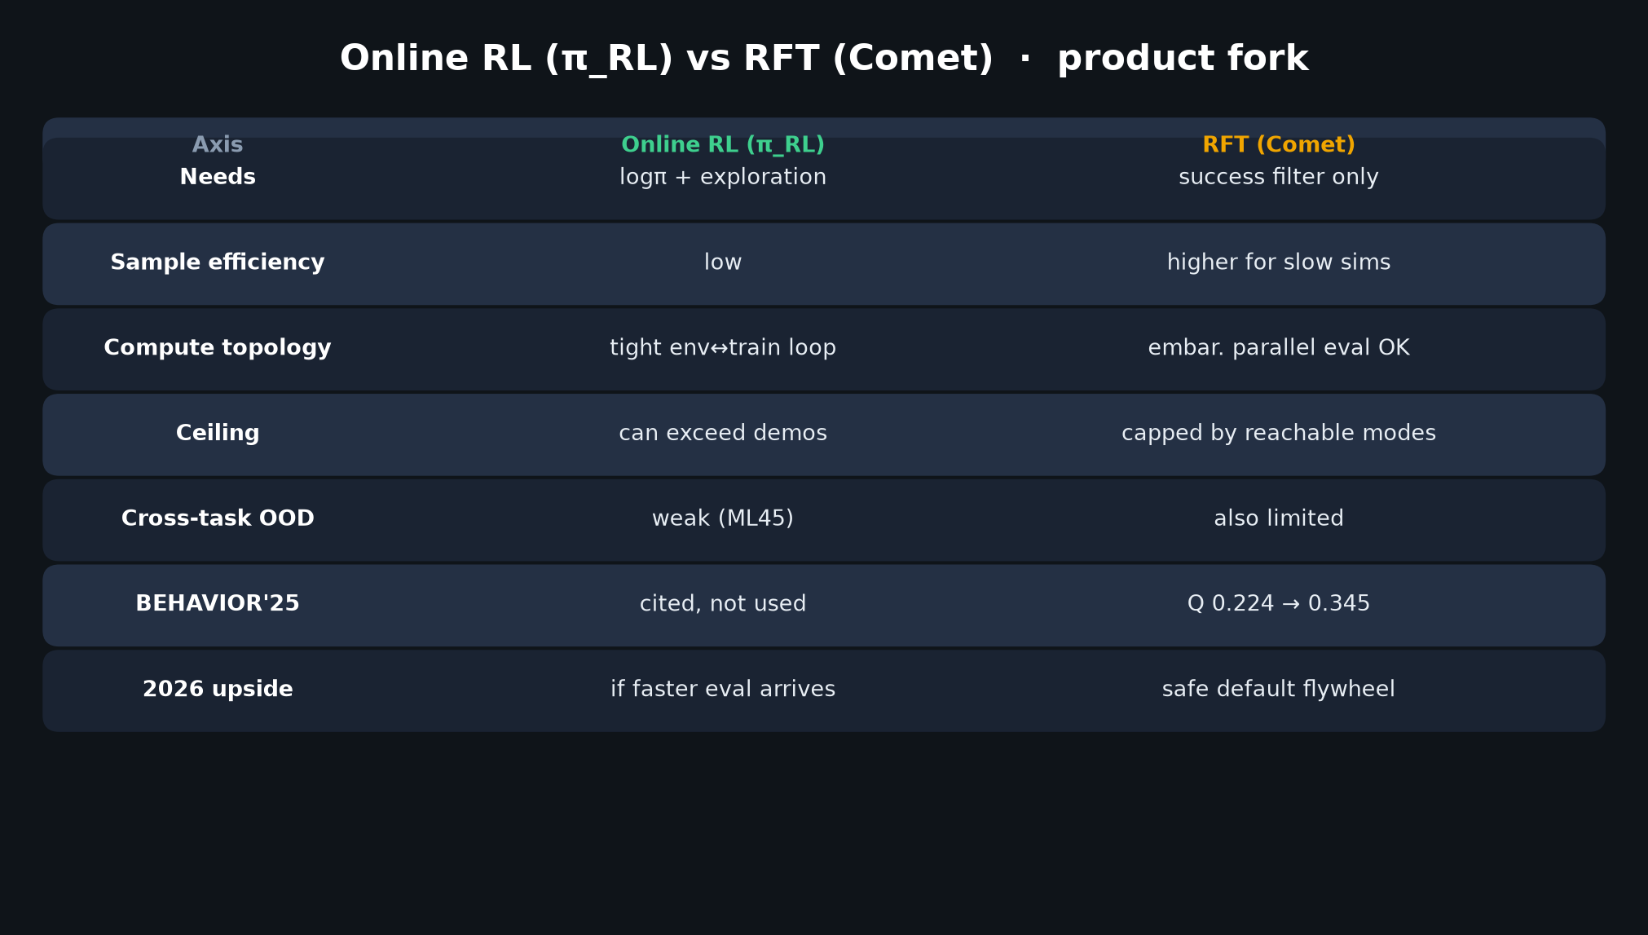
Archaeologist · 11+3 · 6/14
Notes:
RL vs RFT FORK — the subsequent history hinge. Comet = challenge economics beat math novelty.

Slide 7
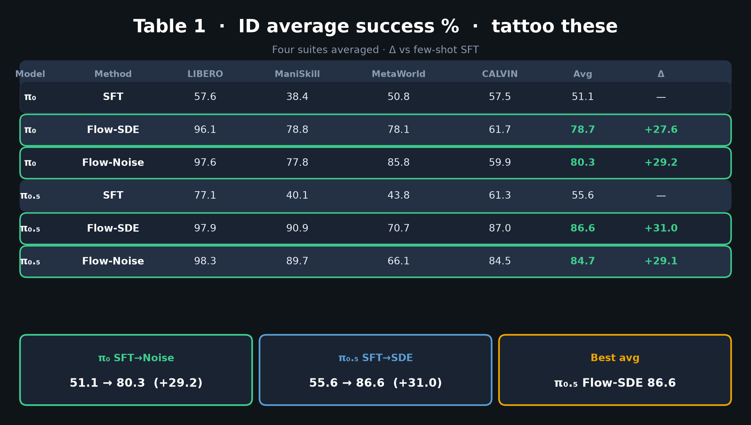
Archaeologist · 11+3 · 7/14
Notes:
TABLE 1 — what unlocking PG delivered empirically. Arc payoff numbers.

Slide 8
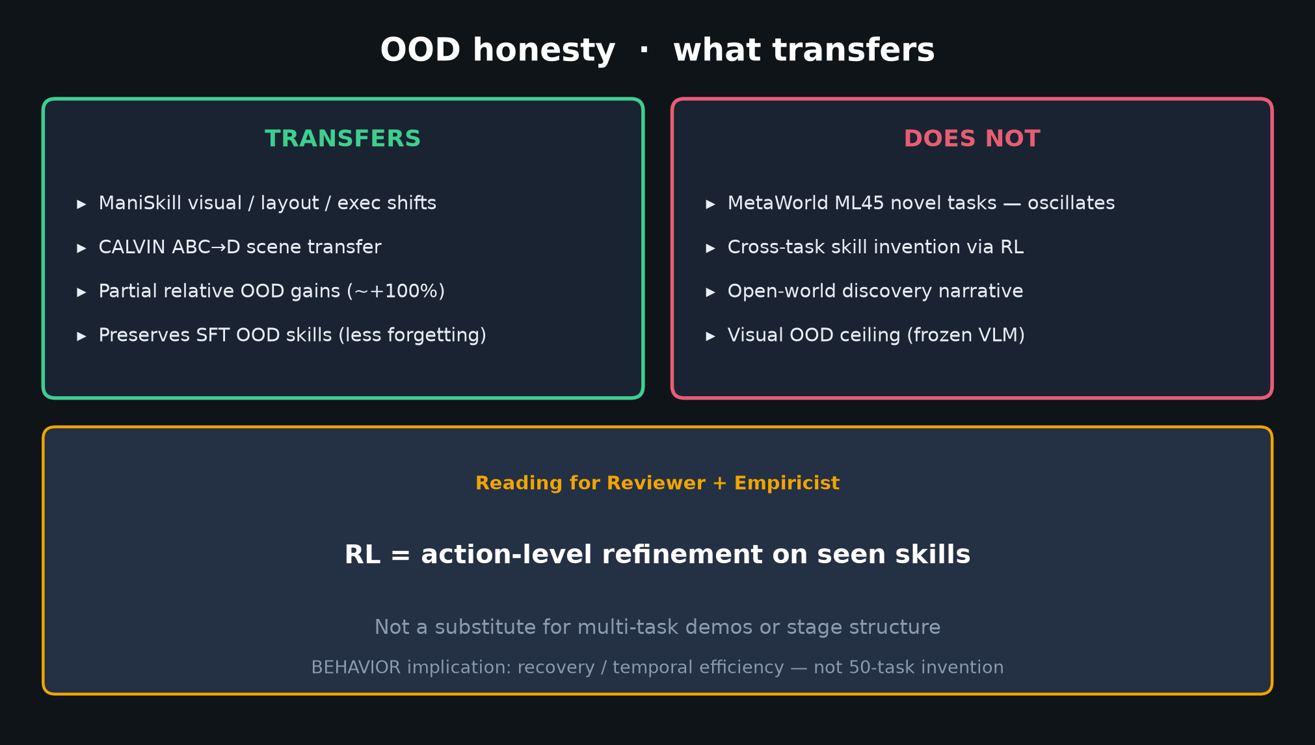
Archaeologist · 11+3 · 8/14
Notes:
OOD honesty — archaeology of claims. Paper carefully separates env vs novel-task.

Slide 9
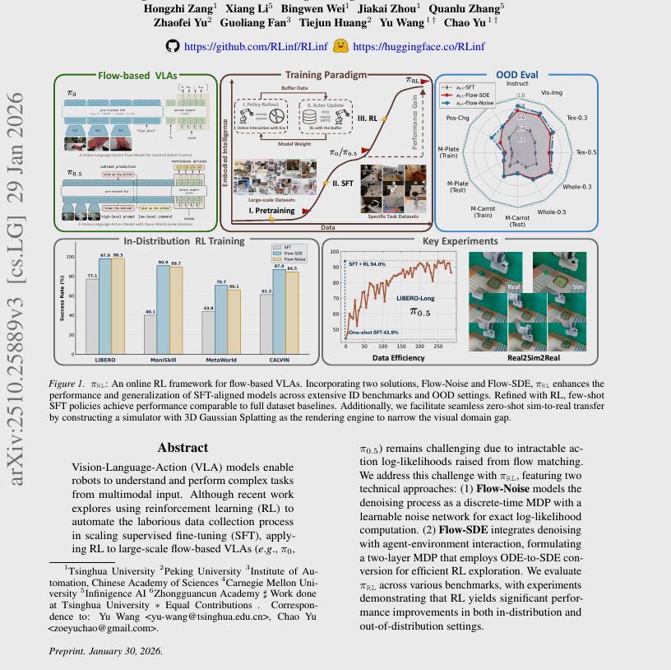
Archaeologist · 11+3 · 9/14
Notes:
PAPER FIG 1 — primary figure as historical document of the claim.

Slide 10
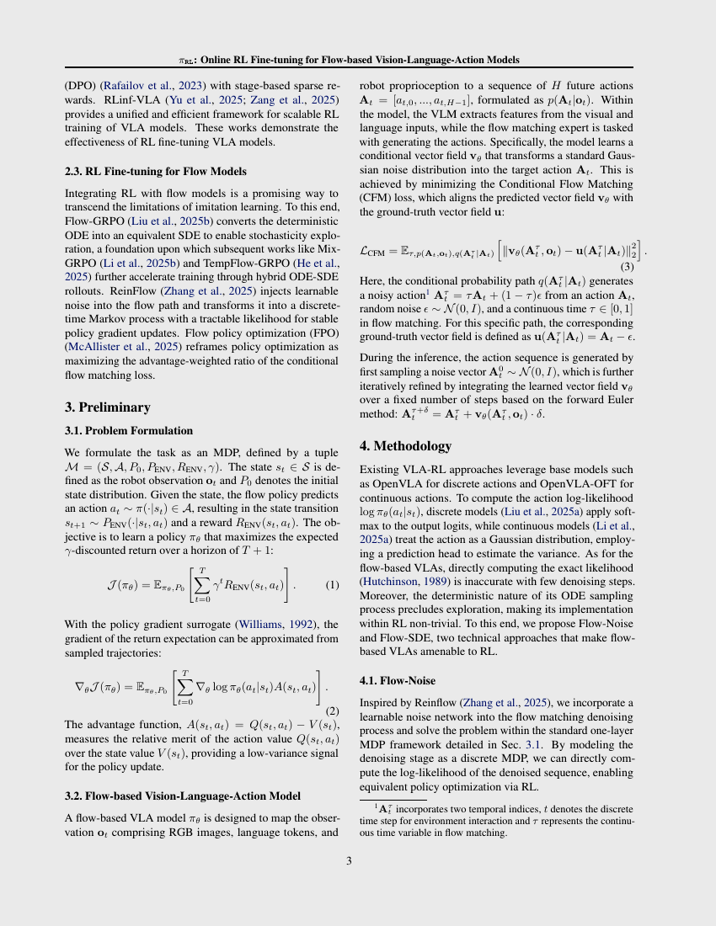
Archaeologist · 11+3 · 10/14
Notes:
Method page crop — Noise/SDE diagrams in paper.

Slide 11
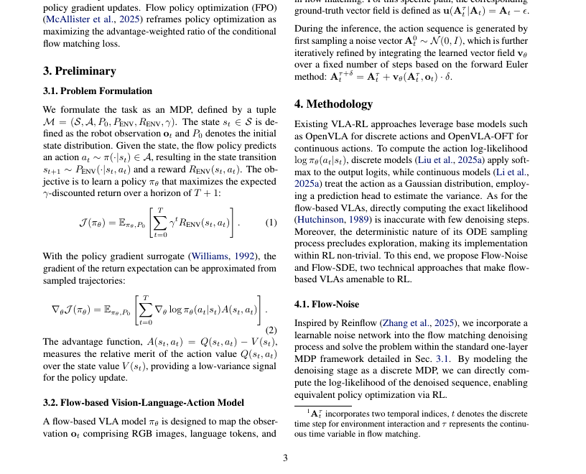
Archaeologist · 11+3 · 11/14
Notes:
PAPER Fig2-ish crop if available.

Slide 12
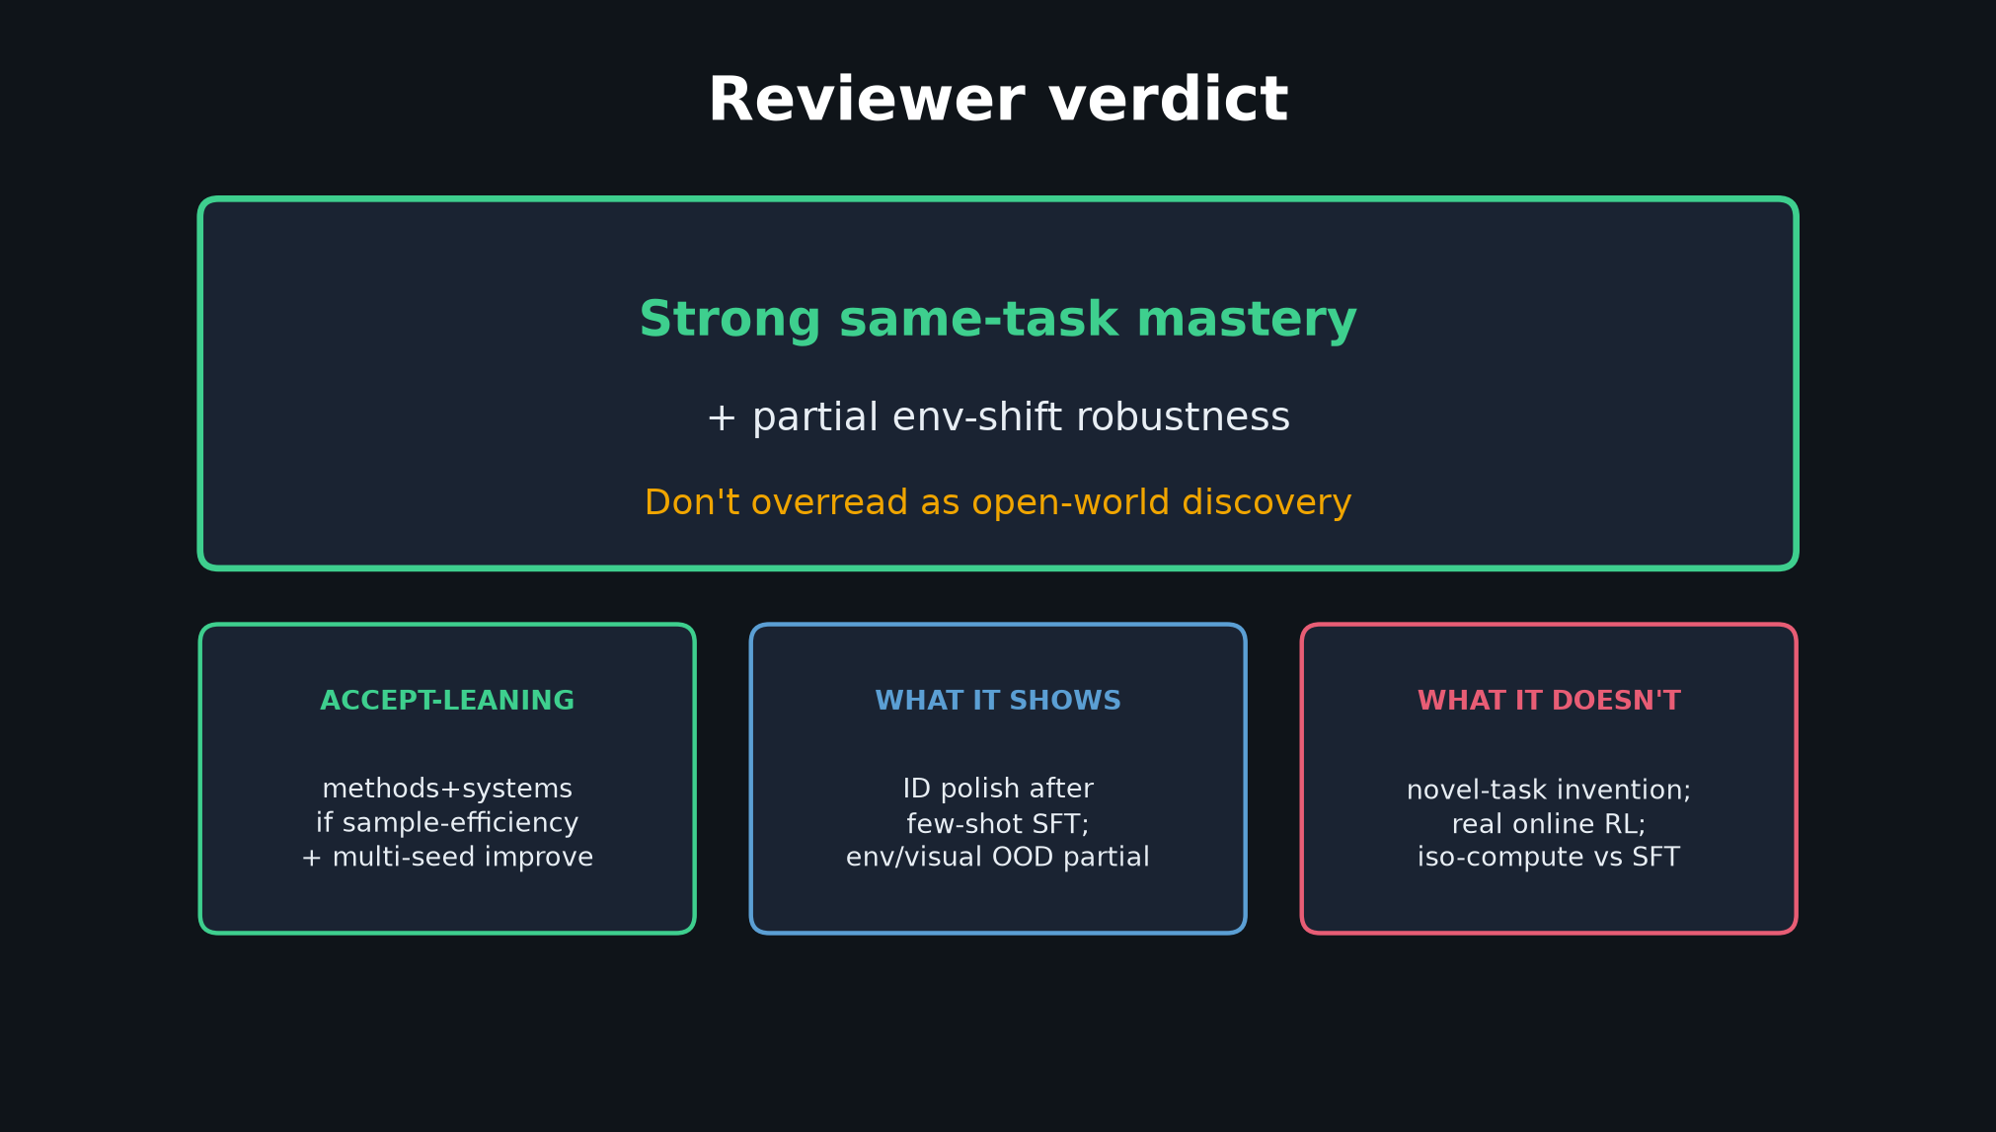
Archaeologist · 11+3 · 12/14
Notes:
VERDICT / honest close bridge to Reviewer — missing link published; adoption = sim economics.

Slide 13
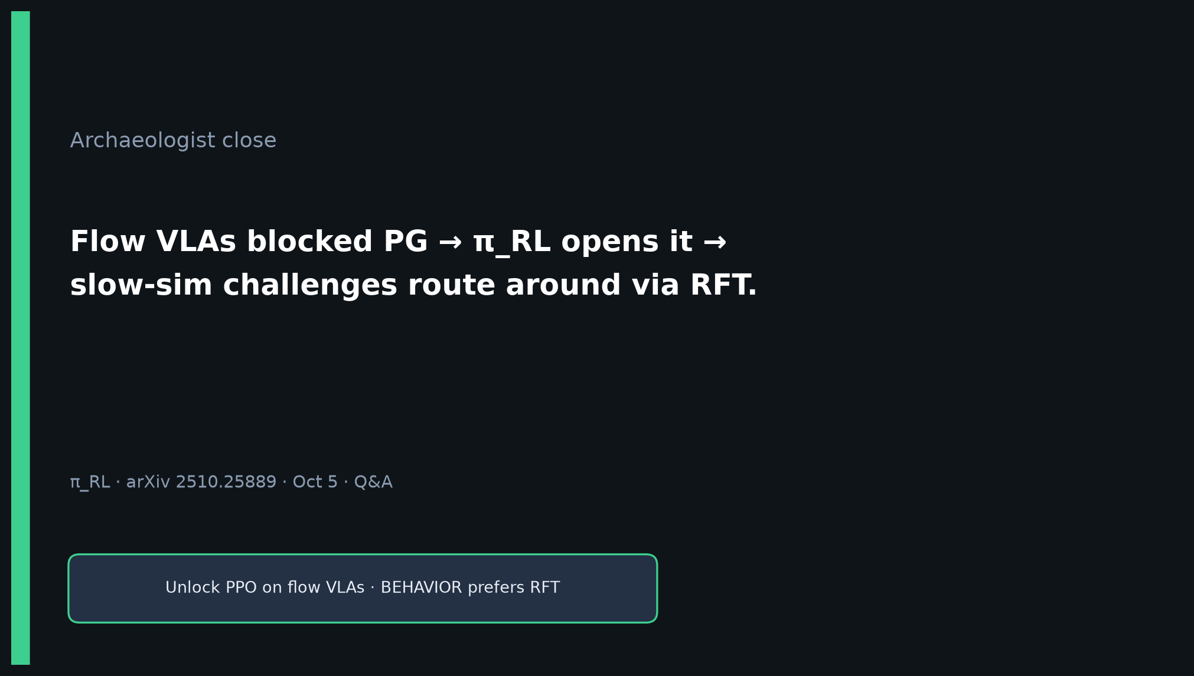
Archaeologist · 11+3 · 13/14
Notes:
CLOSE: flow VLAs blocked PG → π_RL opens it → slow-sim routes around via RFT.

Slide 14
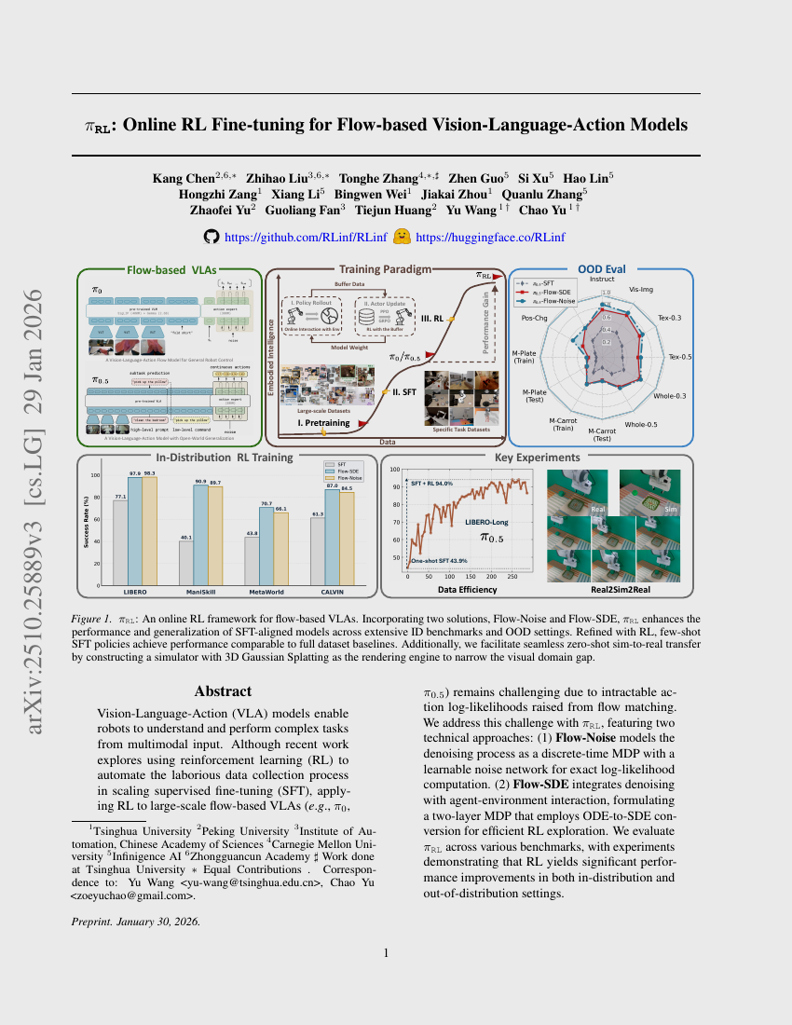
Archaeologist · 11+3 · 14/14
Notes:
BACKUP.

