Slide 1
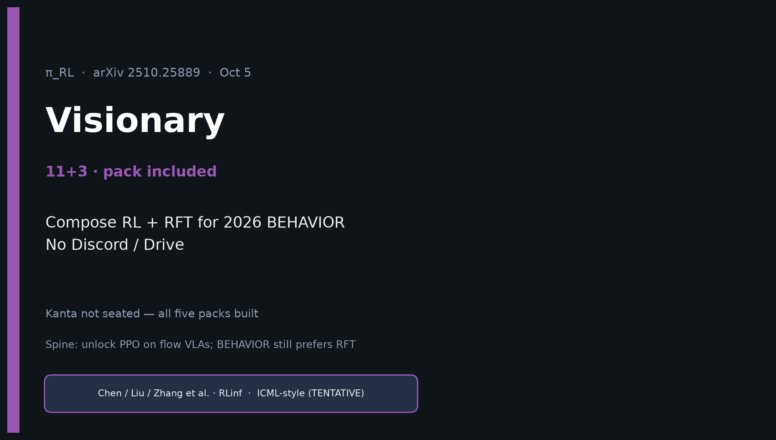
Visionary · 11+3 · 1/14
Notes:
VISIONARY — 11+3 · 2026 BEHAVIOR. NO Discord/Drive.
One-liner: π_RL = open online half; RFT = pragmatic offline half — compose them.
Sources: arXiv 2510.25889 + RLinf docs + Comet 2512.10071 + organizer pages only.

Slide 2
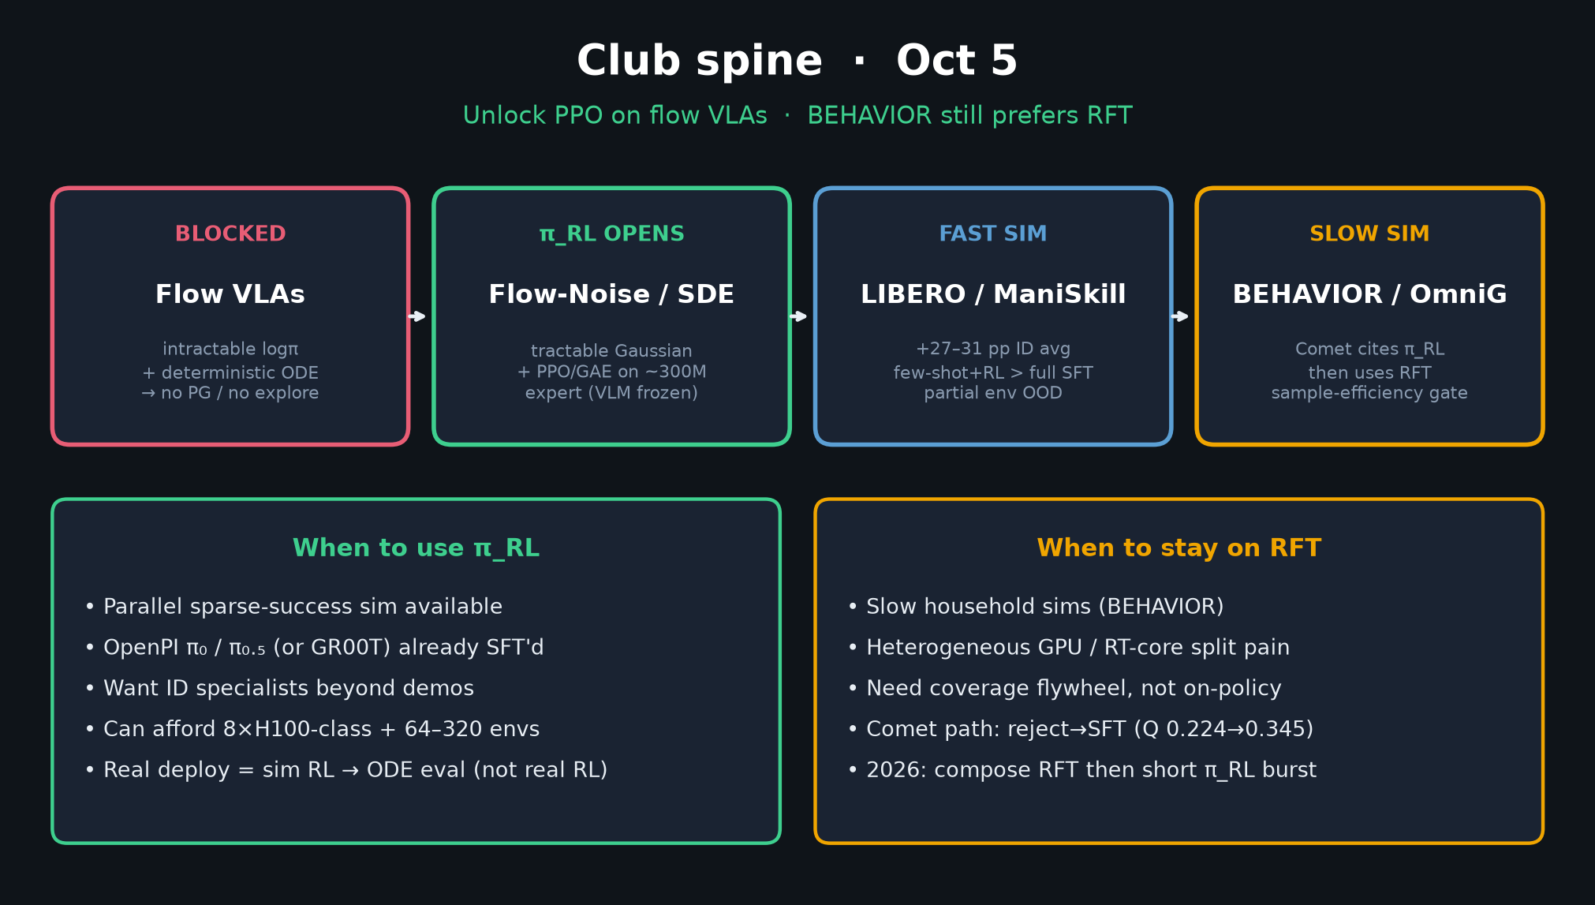
Visionary · 11+3 · 2/14
Notes:
SPINE — compose, don't tribe.

Slide 3
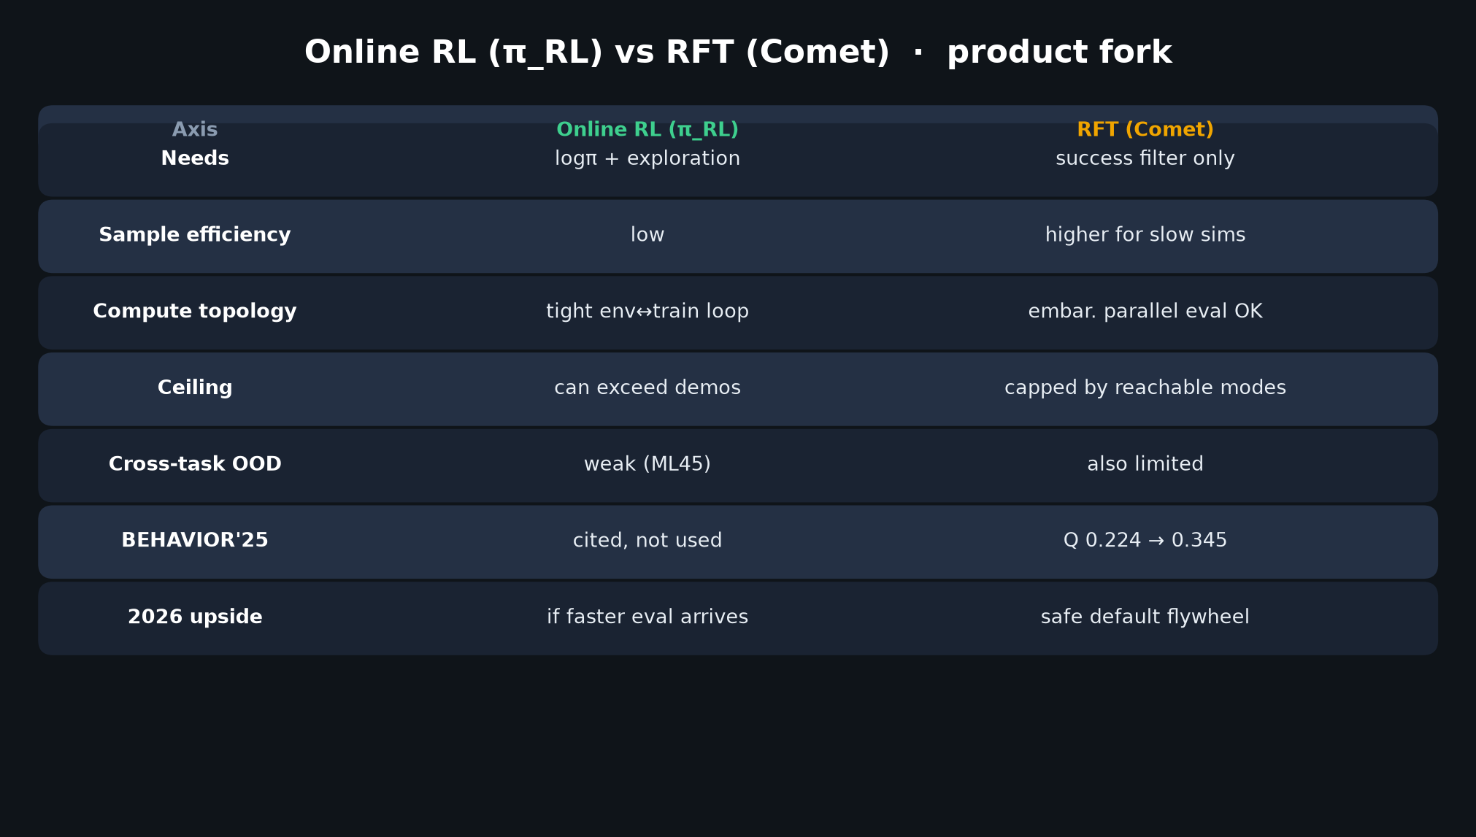
Visionary · 11+3 · 3/14
Notes:
RL vs RFT TABLE — densest Visionary comparison (~2 min). Walk every row.
BEHAVIOR'25: cited then skipped vs used (Q 0.224→0.345).

Slide 4
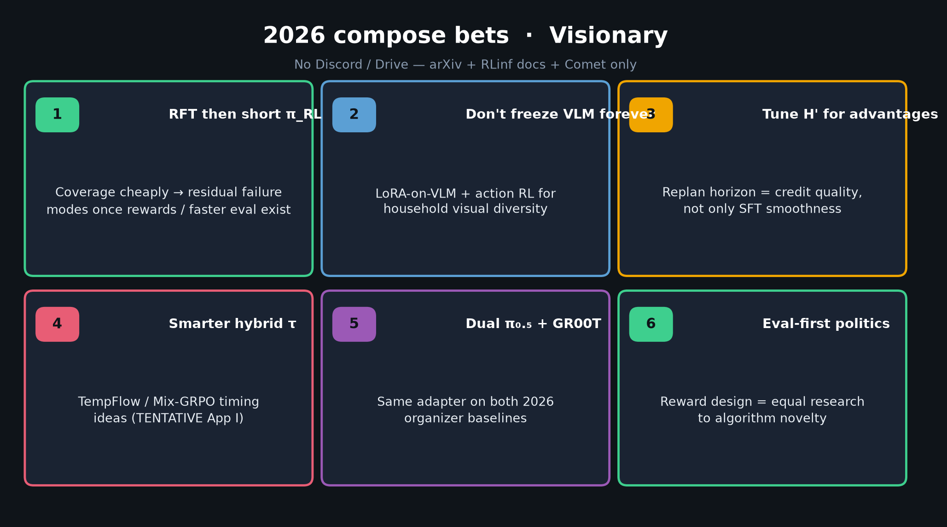
Visionary · 11+3 · 4/14
Notes:
2026 COMPOSE BETS — six cards. Speak 1–3 carefully; 4–6 if time.
1 RFT then short π_RL burst
2 Don't freeze VLM forever
3 Tune H' for advantages
4 Smarter hybrid τ (TENTATIVE)
5 Dual π₀.₅+GR00T adapters
6 Eval-first / reward design politics

Slide 5
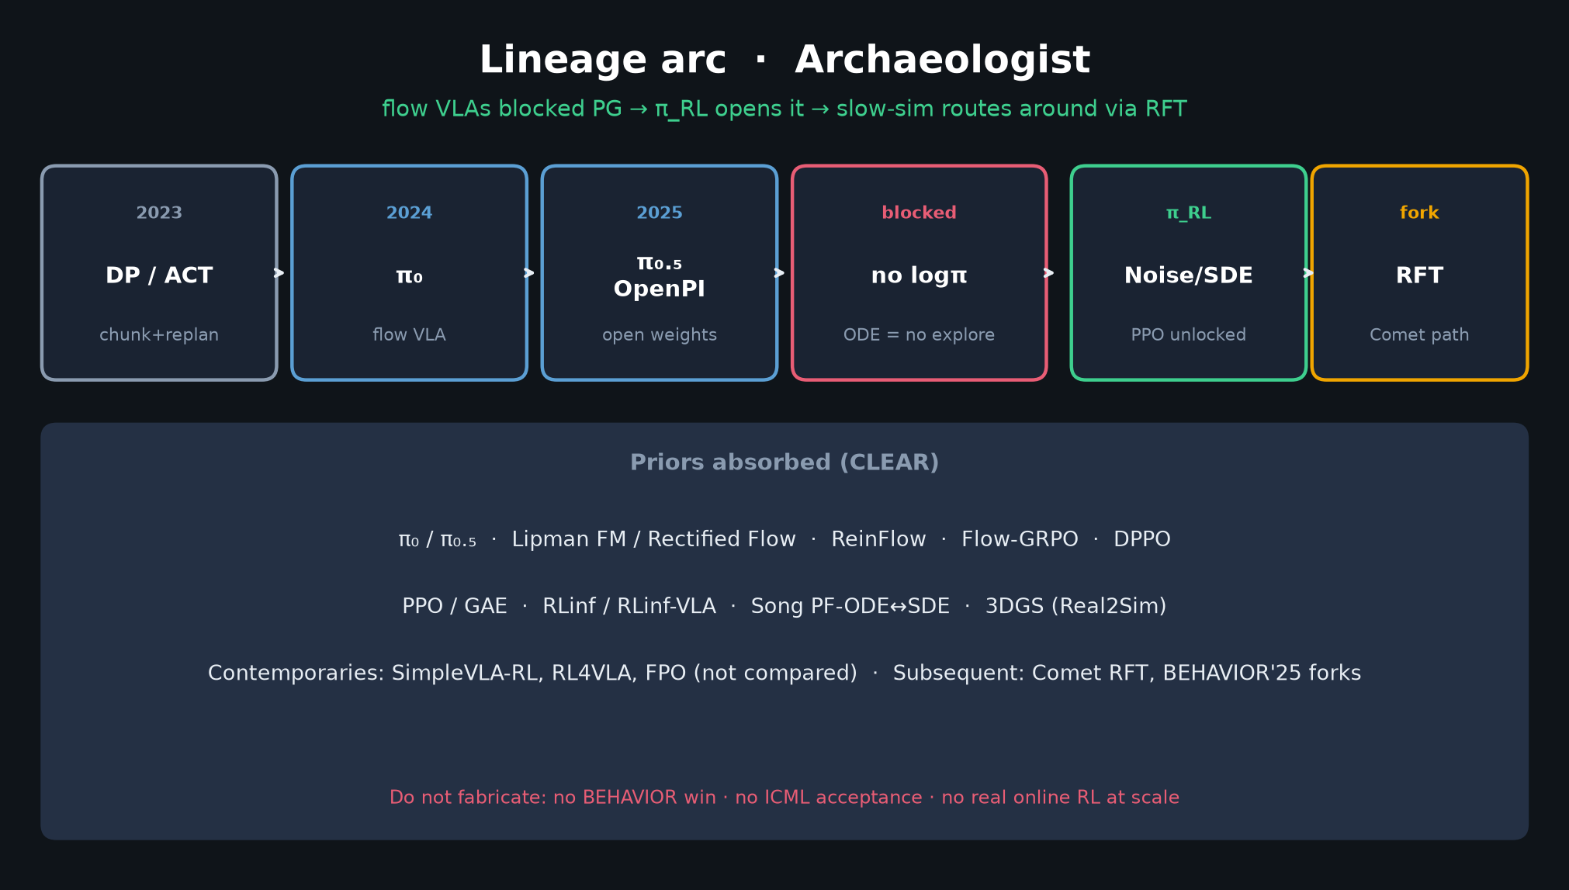
Visionary · 11+3 · 5/14
Notes:
LINEAGE bridge — where 2026 sits historically.

Slide 6
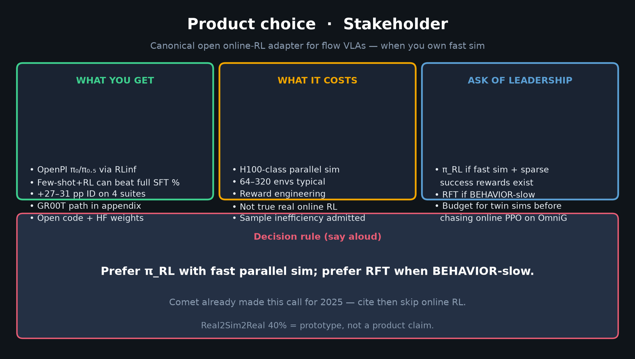
Visionary · 11+3 · 6/14
Notes:
PRODUCT / PRACTICAL fork — Stakeholder overlap; Visionary emphasis on compose.

Slide 7
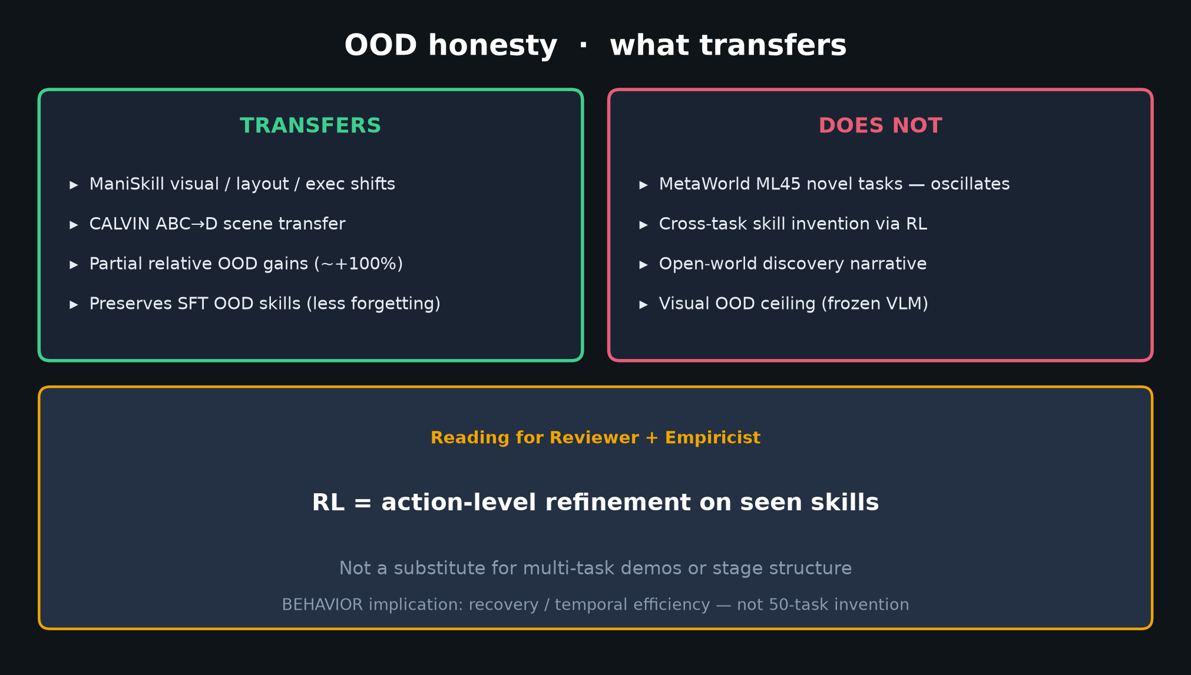
Visionary · 11+3 · 7/14
Notes:
OOD honesty — temper online-RL hype for household 50-task invention.

Slide 8
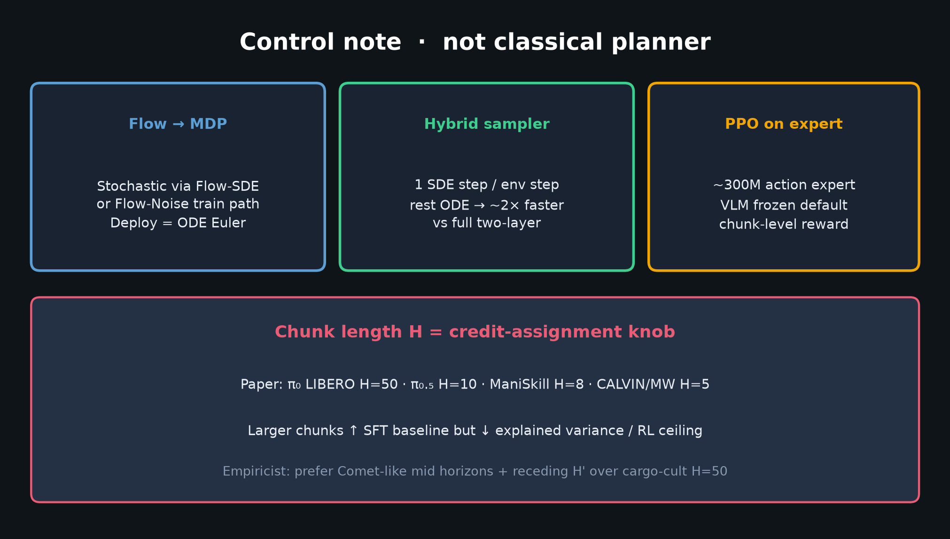
Visionary · 11+3 · 8/14
Notes:
CONTROL knobs that survive into 2026 — H/H', ODE deploy, hybrid train noise orthogonal.

Slide 9
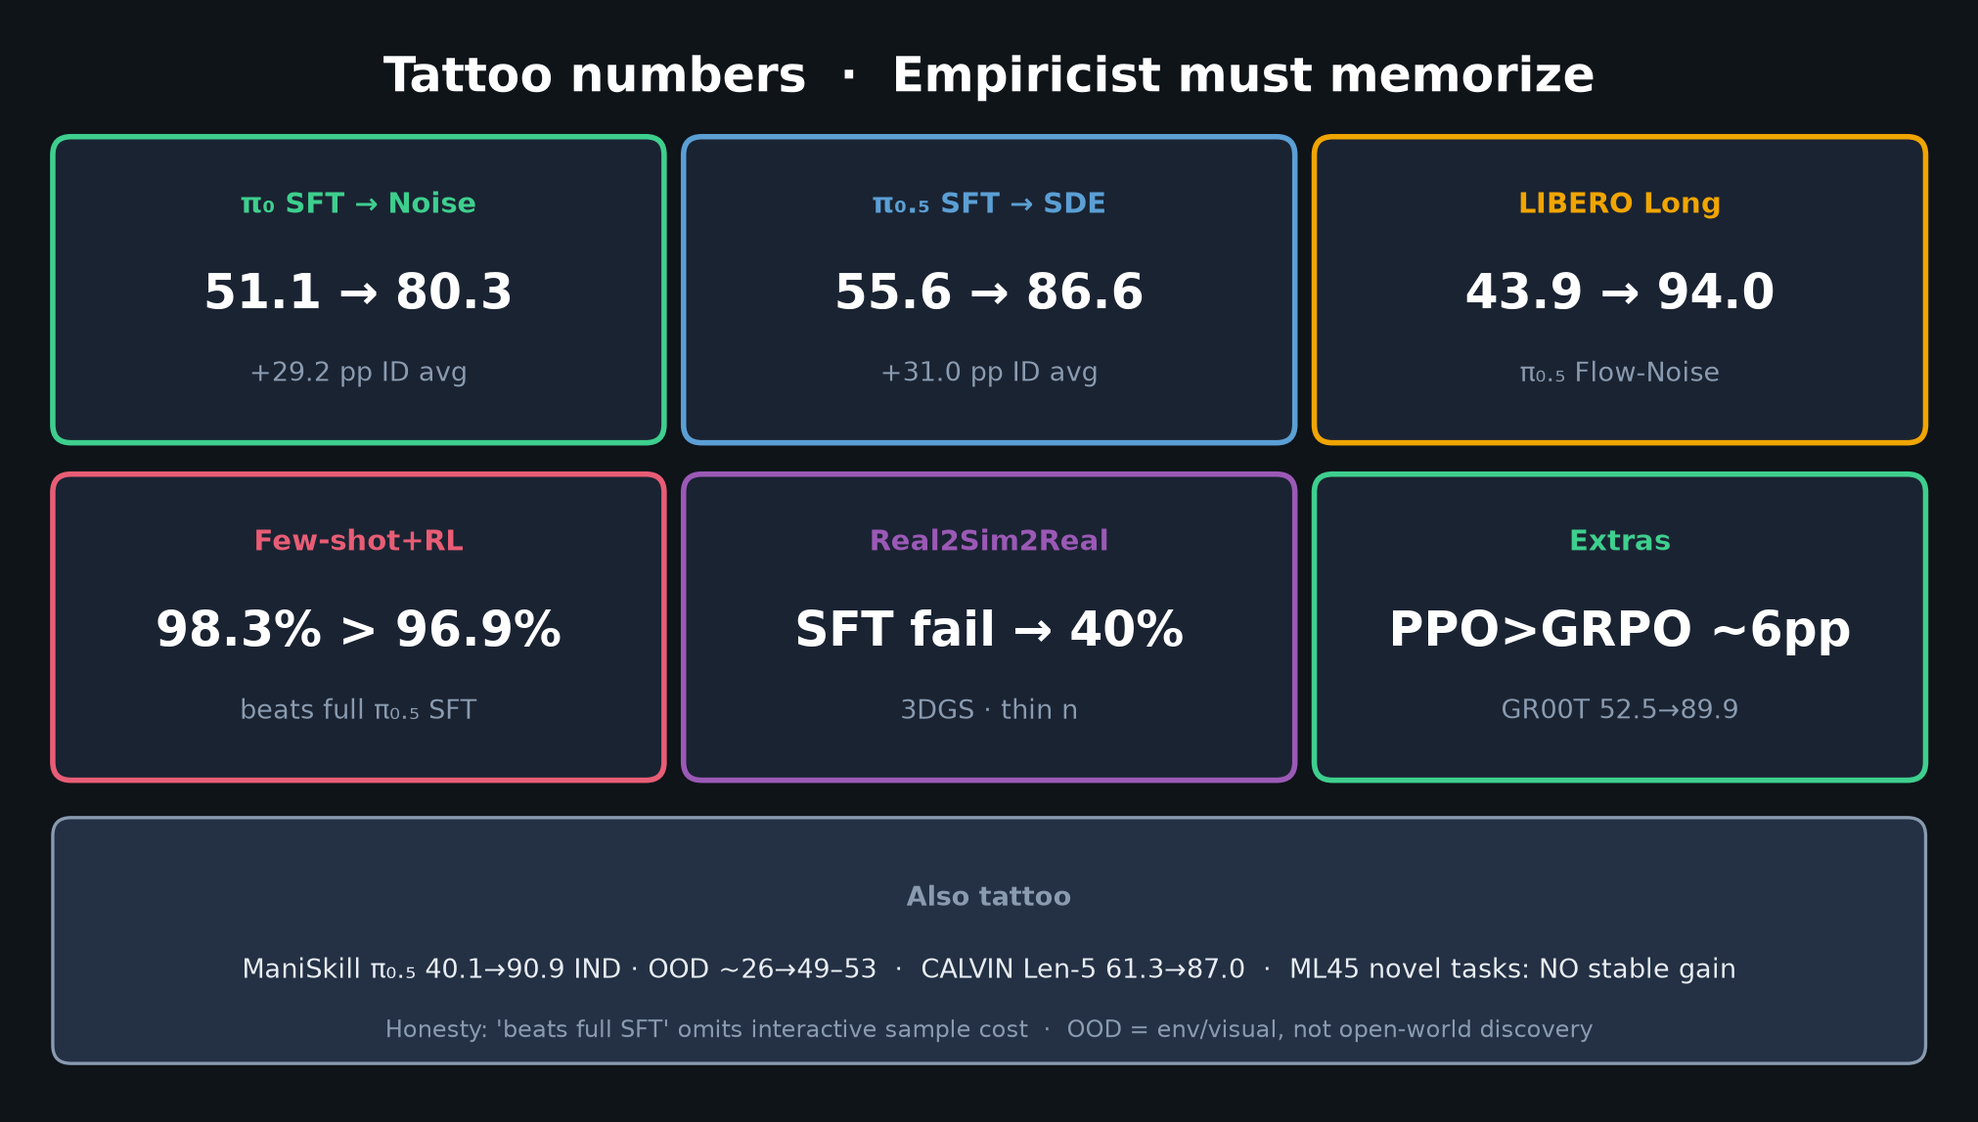
Visionary · 11+3 · 9/14
Notes:
TATTOO numbers — what online half can buy when sim allows.

Slide 10
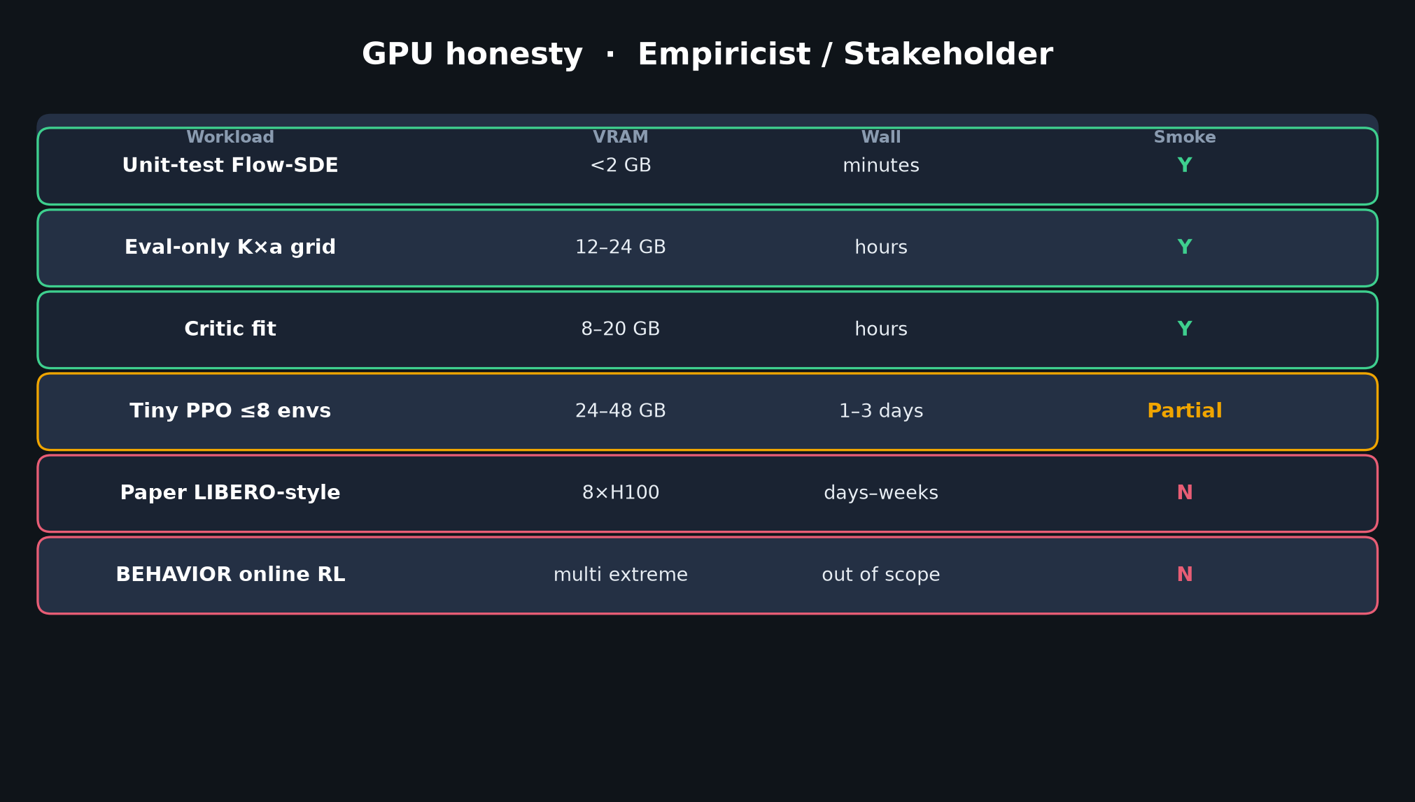
Visionary · 11+3 · 10/14
Notes:
GPU politics — why compose with RFT first.

Slide 11
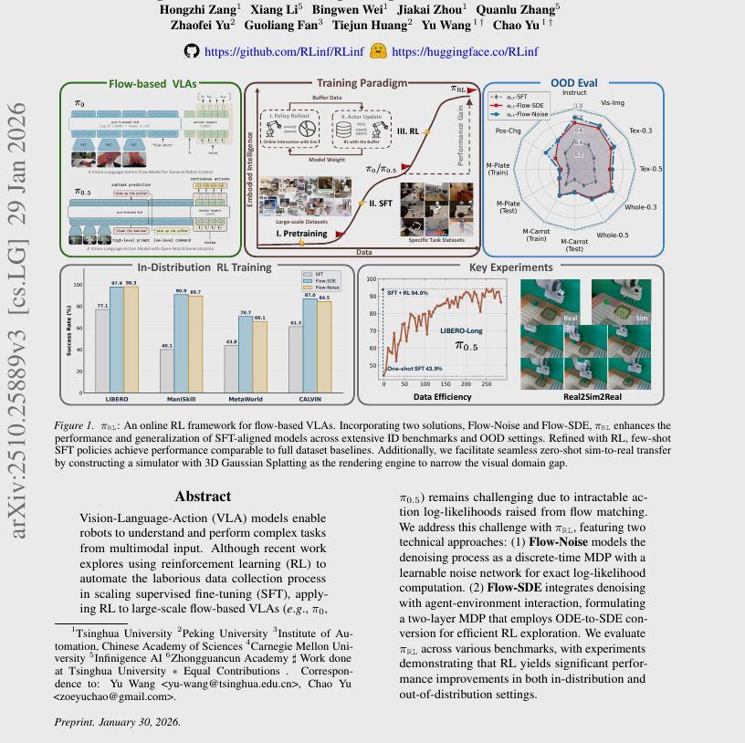
Visionary · 11+3 · 11/14
Notes:
PAPER FIG1 — aspirational pipeline; Visionary: treat online RL as scalpel in twin sims.

Slide 12
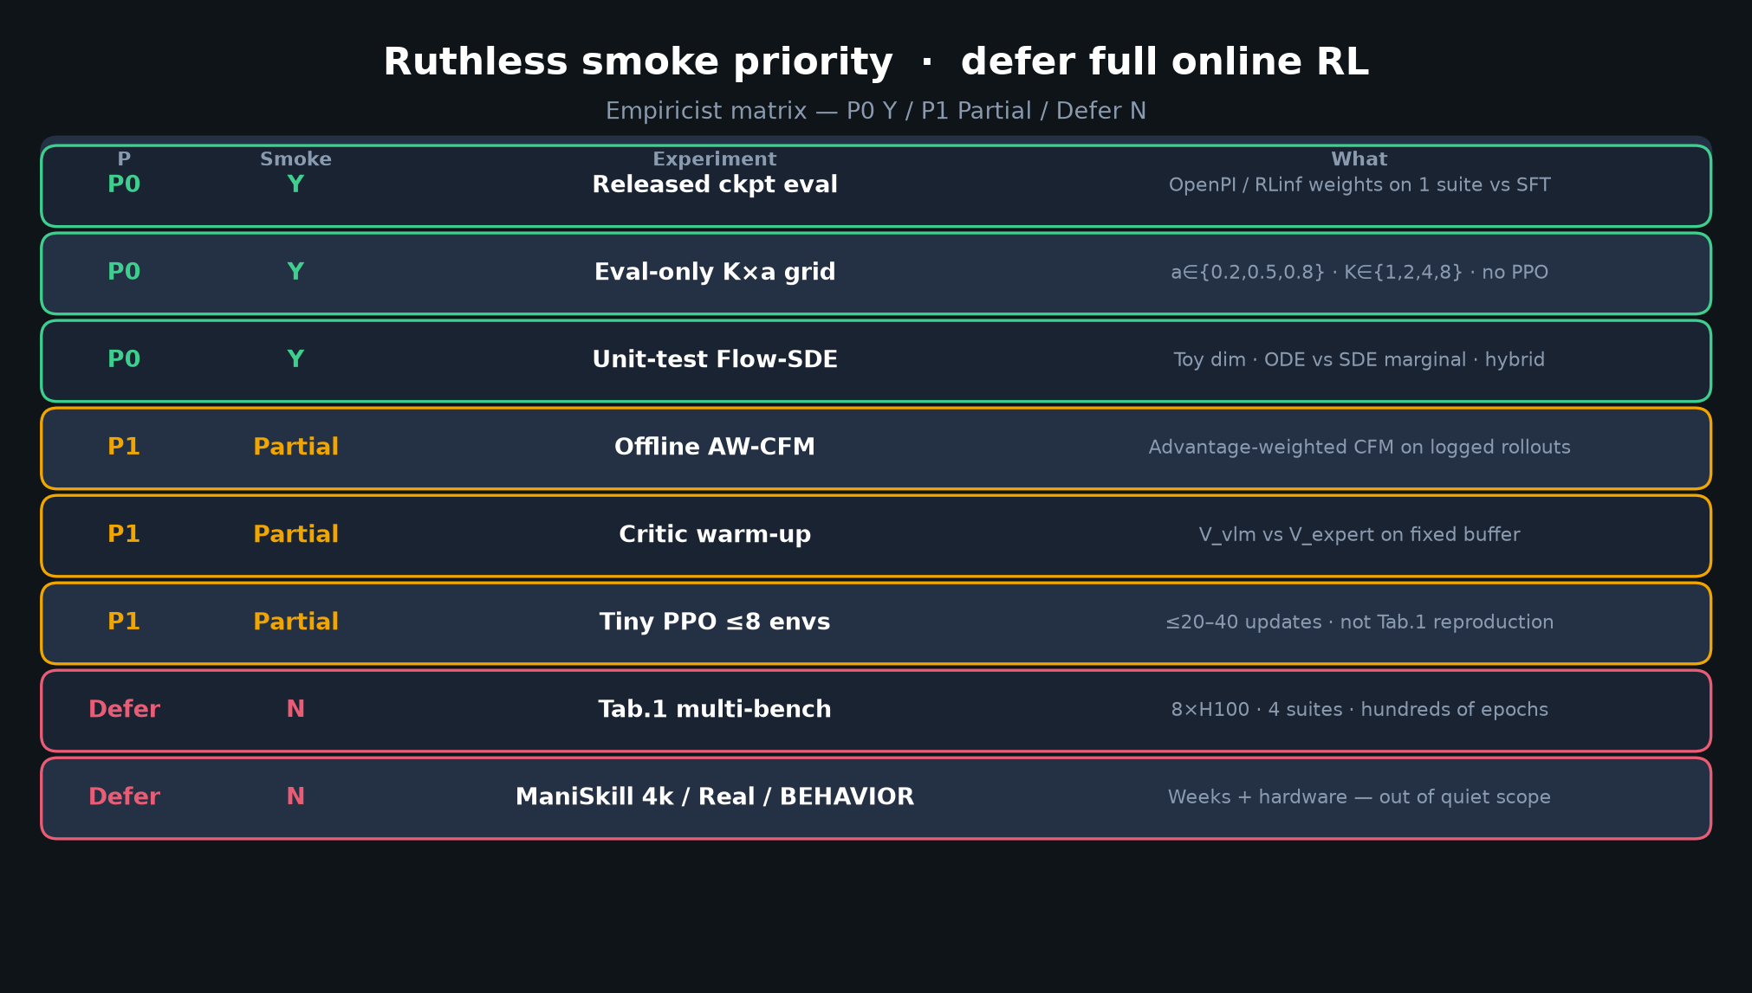
Visionary · 11+3 · 12/14
Notes:
EMPIRICIST smoke reminder — don't force full online RL on OmniGibson before proxies work.

Slide 13
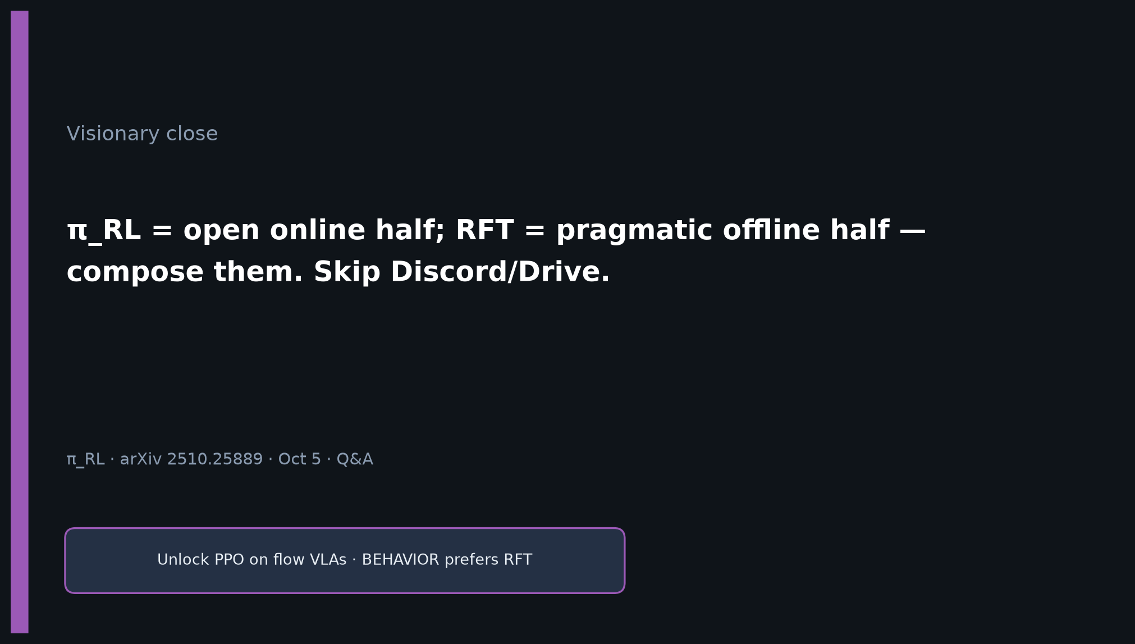
Visionary · 11+3 · 13/14
Notes:
CLOSE: compose RL + RFT. Skip Discord/Drive. Leave one-liner up.

Slide 14
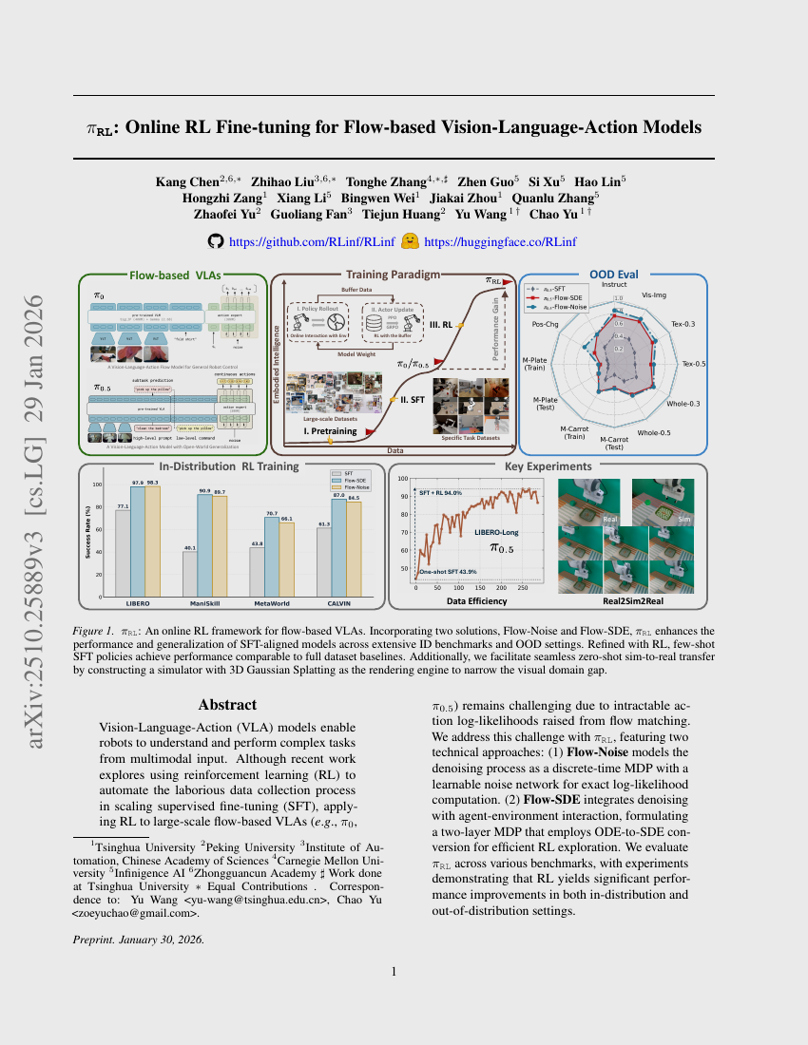
Visionary · 11+3 · 14/14
Notes:
BACKUP.

