Slide 1
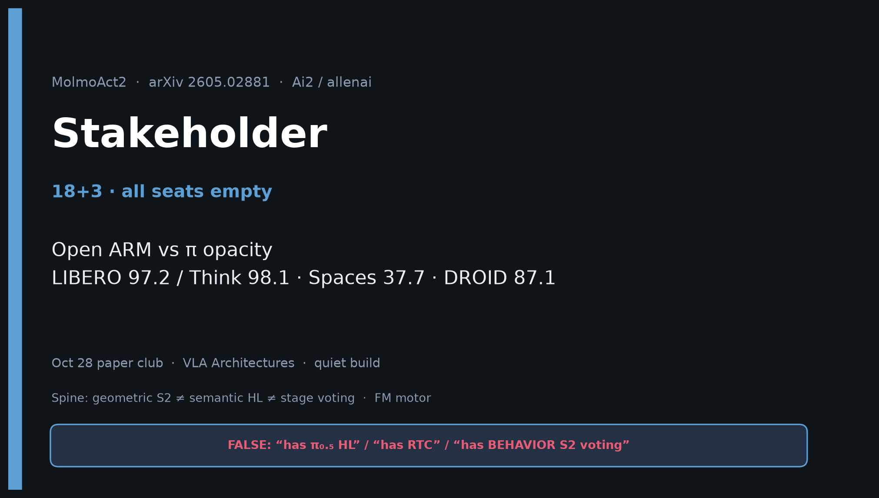
Stakeholder · 18+3 · 1/18
Notes:
STAKEHOLDER OPENING — 18+3. All seats empty; still full pack. No redo later.
Focus: Open ARM vs π opacity. Competitive KPIs. Cost ladder. Decision when π gated.
ONE SENTENCE:
Ai2’s fully open Action Reasoning Model — weights, code, 720 h bimanual data — competitive with π₀.₅ on paper protocols for labs that cannot access closed π stacks.

Slide 2
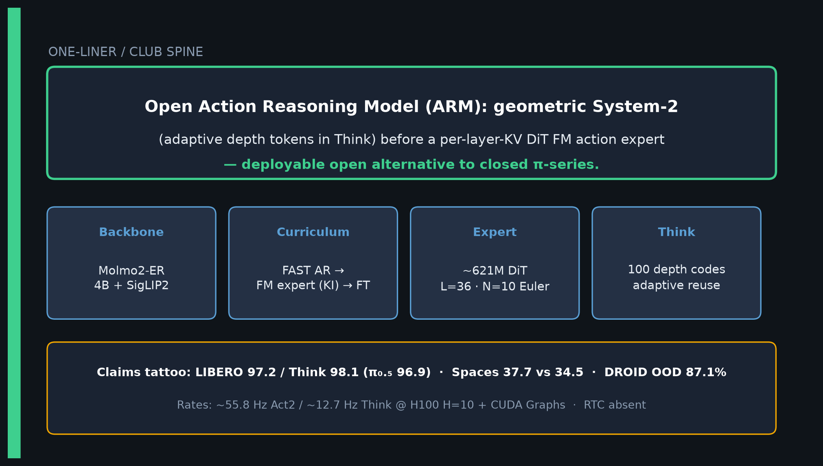
Stakeholder · 18+3 · 2/18
Notes:
ONE-LINER.
Open ARM: geometric System-2 before per-layer-KV DiT FM expert.
Deployable open alternative to closed π-series.
Tattoo numbers on next slides.

Slide 3
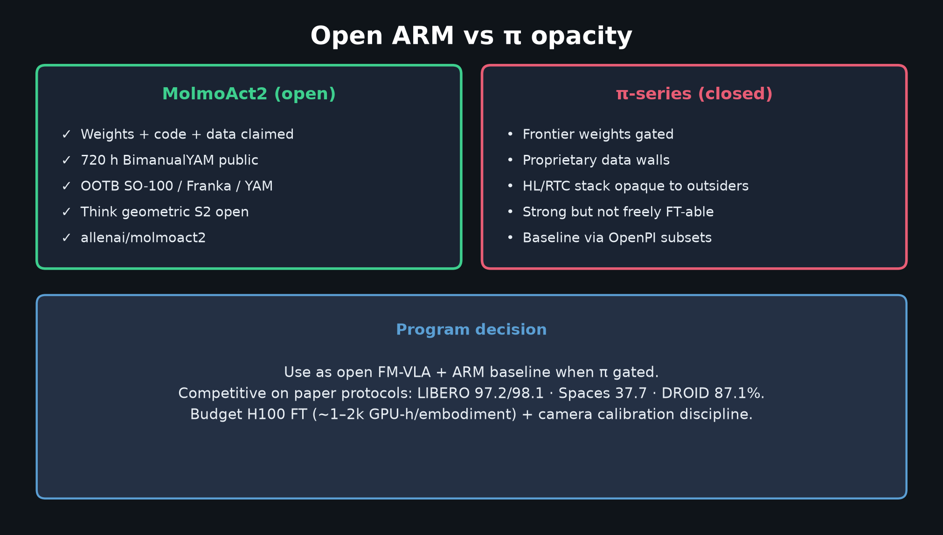
Stakeholder · 18+3 · 3/18
Notes:
OPEN vs π OPACITY — core decision slide.
MolmoAct2: weights/code/data; OOTB SO/Franka/YAM; open Think.
π-series: gated frontier; strong but not freely fine-tunable for every lab.
Program use: open FM-VLA+ARM baseline when π gated.

Slide 4
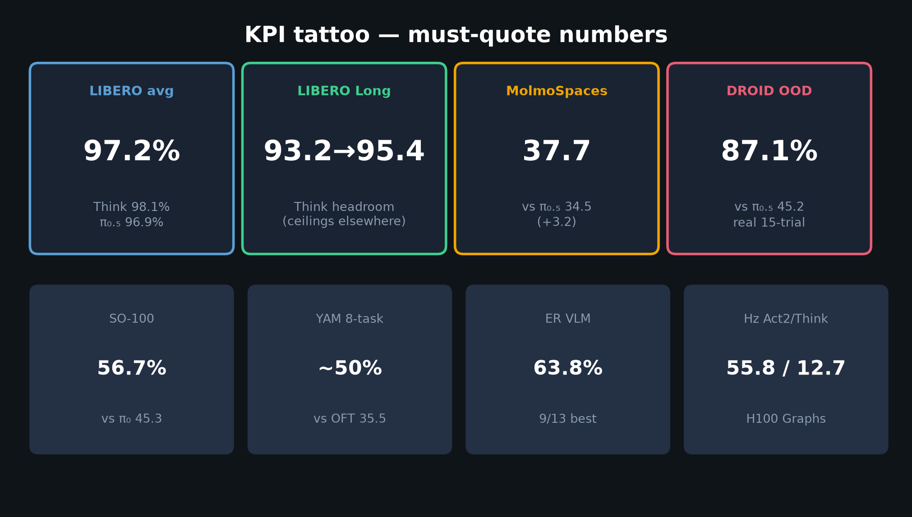
Stakeholder · 18+3 · 4/18
Notes:
KPI TATTOO — say aloud.
LIBERO 97.2 / Think 98.1 (π₀.₅ 96.9)
MolmoSpaces 37.7 vs 34.5
DROID OOD 87.1%
SO 56.7 · YAM ~50% · ER 63.8% · Hz 55.8/12.7

Slide 5
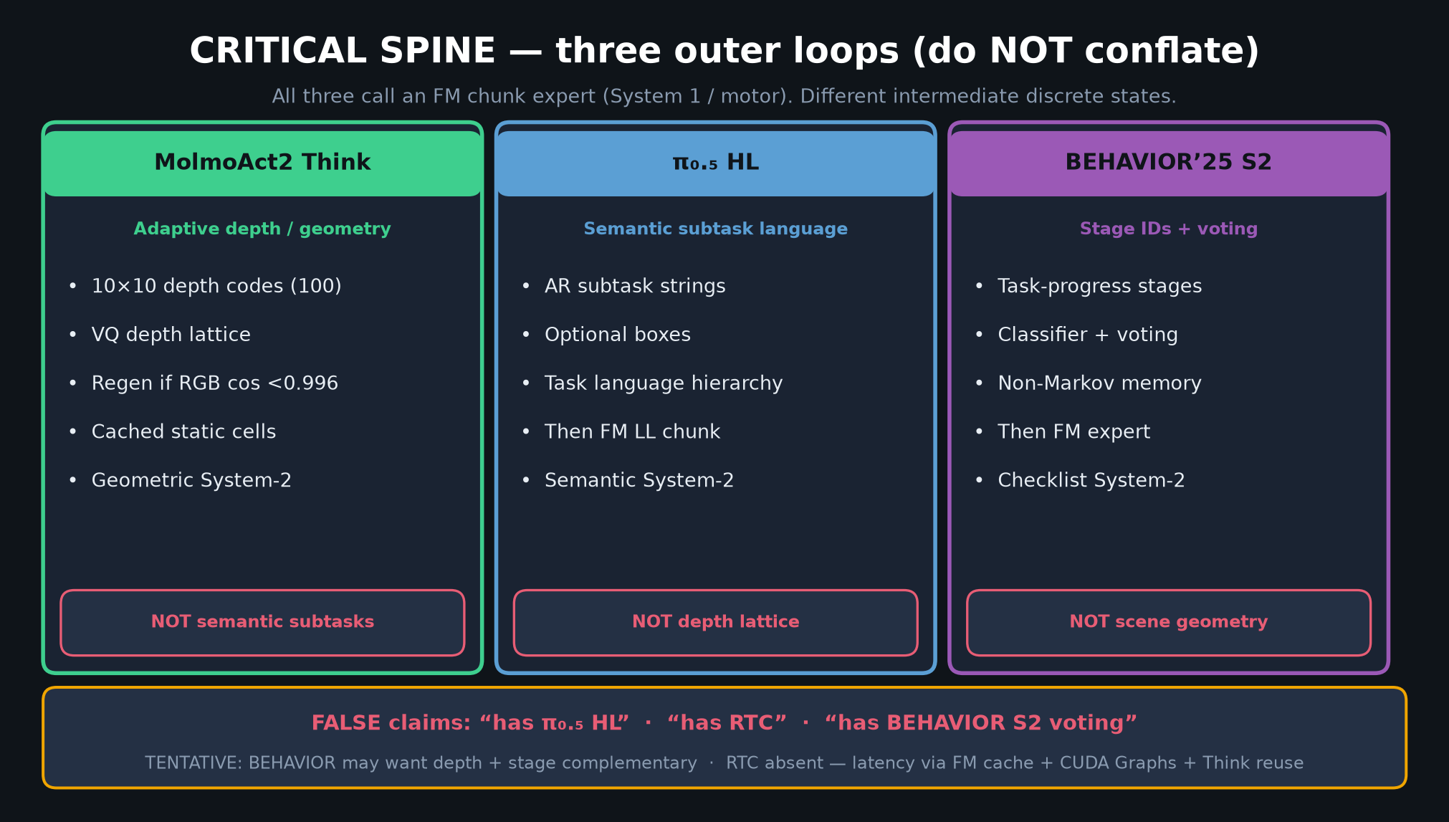
Stakeholder · 18+3 · 5/18
Notes:
THREE OUTER LOOPS — stakeholders must not conflate either.
Think = depth geometry. π₀.₅ HL = semantic. BEHAVIOR = stages.
All call FM motor. We do NOT claim Molmo has HL/RTC/stage voting.

Slide 6
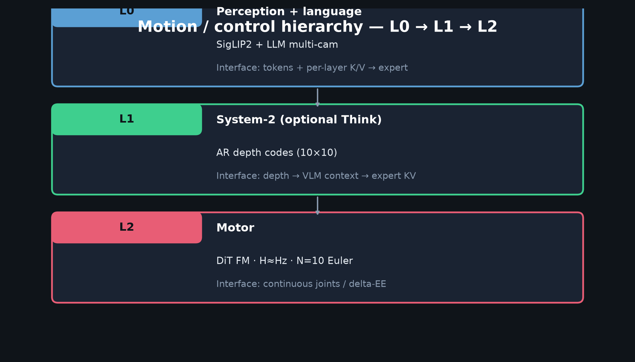
Stakeholder · 18+3 · 6/18
Notes:
HIERARCHY L0/L1/L2 — motion interface for non-specialists.
Optional Think geometric S2 → FM chunks. Same family as π₀/π₀.₅/DP chunking.

Slide 7
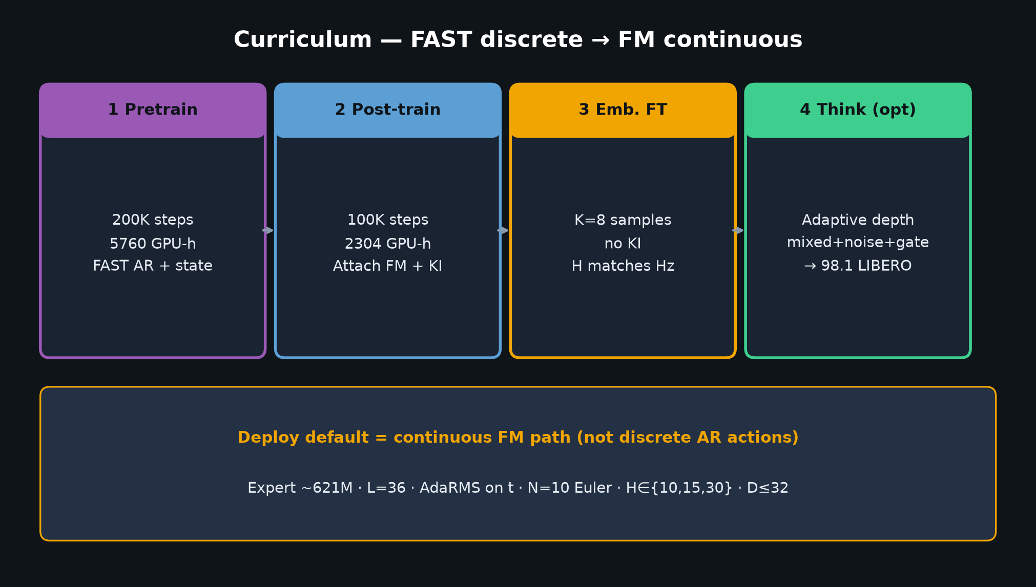
Stakeholder · 18+3 · 7/18
Notes:
CURRICULUM — FAST→FM like π₀.₅ structurally.
Pre 5760 GPU-h → Post 2304 → FT. Continuous path is deploy default.
Budget note: paper-scale 64×H100 is aspirational; use released ckpts.

Slide 8
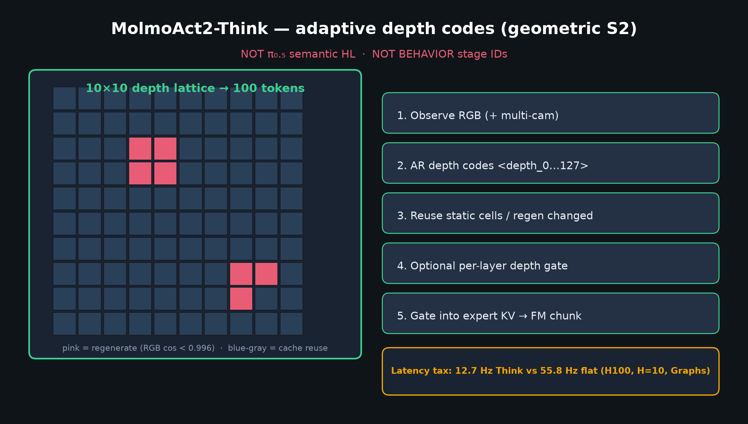
Stakeholder · 18+3 · 8/18
Notes:
THINK LATENCY STORY.
Reasoning without hundreds of tokens every step — adaptive depth reuse.
Still pays Hz tax: 12.7 vs 55.8. Product story: geometric grounding closer to real-time than dense prior.

Slide 9
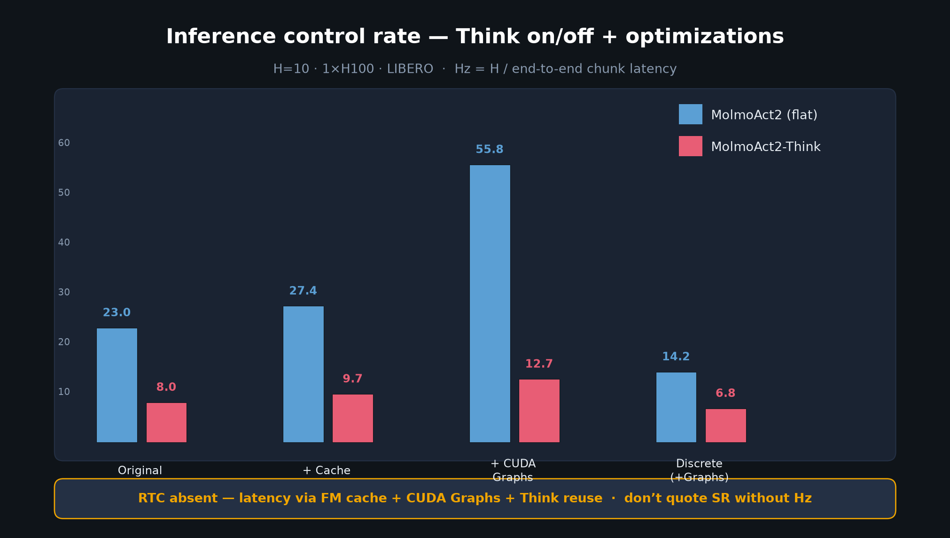
Stakeholder · 18+3 · 9/18
Notes:
HZ CHART — Fig.8 spirit.
Cache + CUDA Graphs = 2.42× on flat path. Continuous >> discrete.
RTC absent — systems story is intra-chunk, not async inpainting.

Slide 10
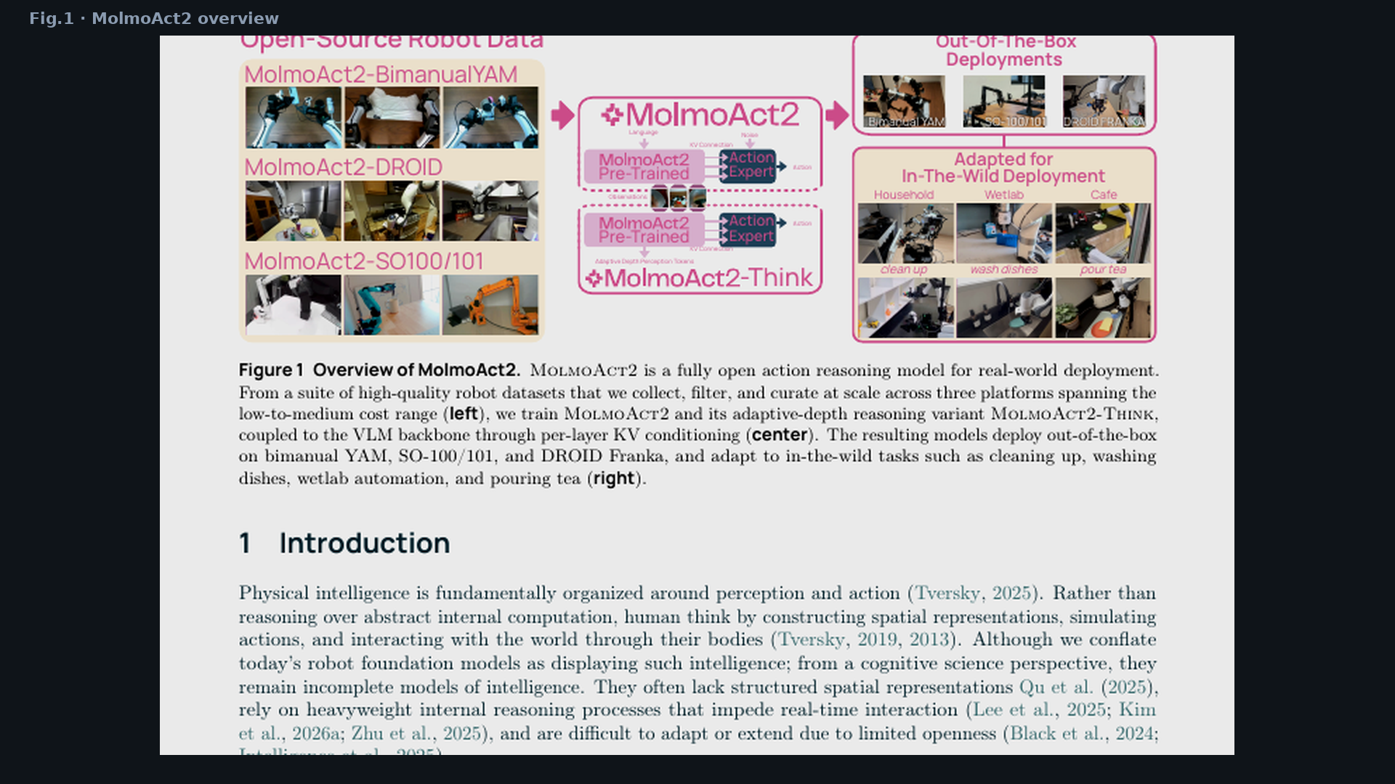
Stakeholder · 18+3 · 10/18
Notes:
PAPER FIG.1 — product overview: data → KV/Think → OOTB + in-the-wild.

Slide 11
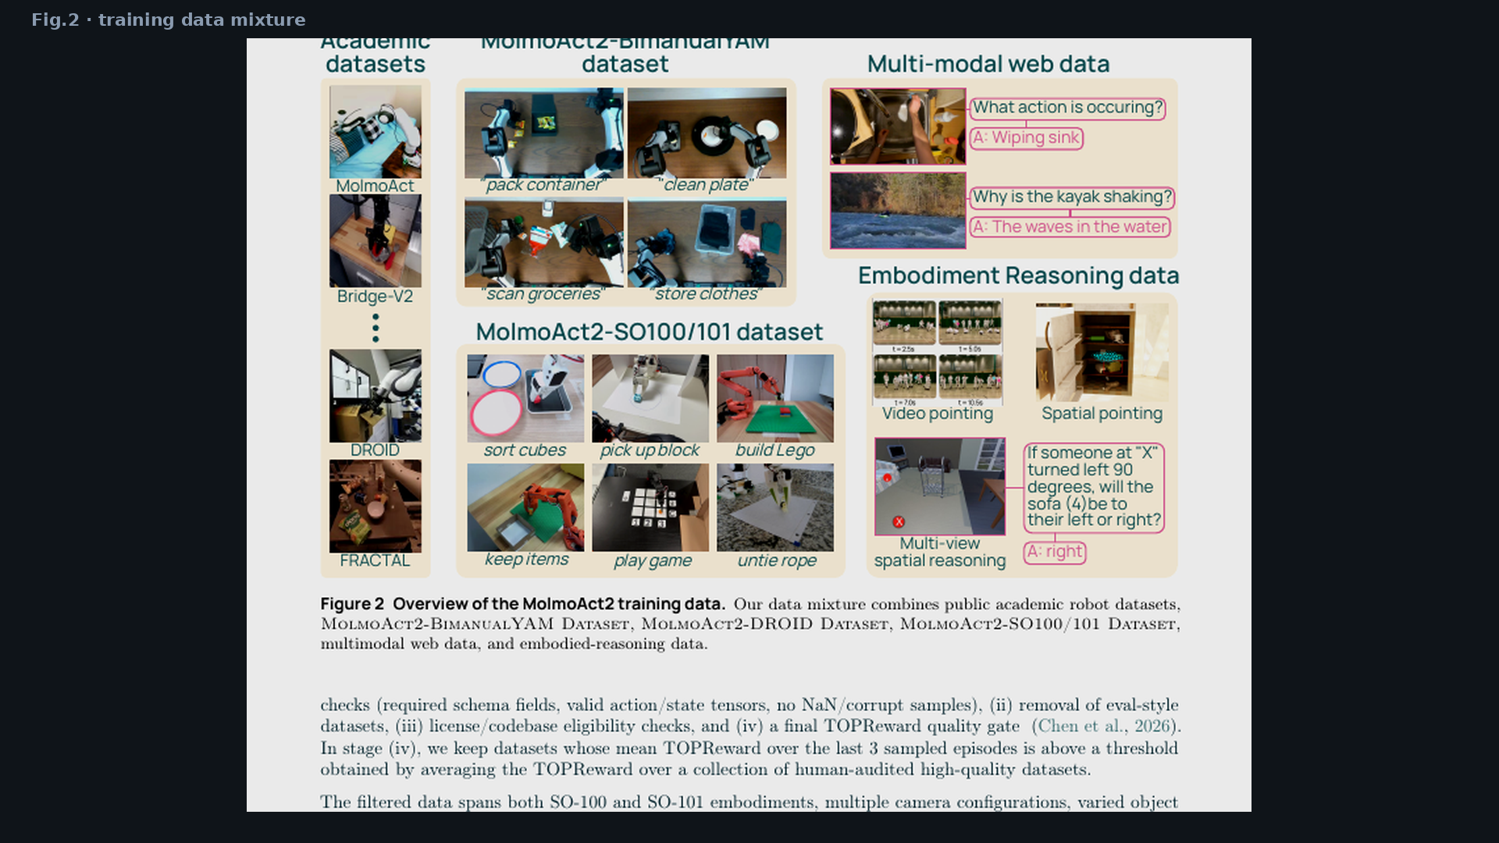
Stakeholder · 18+3 · 11/18
Notes:
PAPER FIG.2 — open data breadth including 720 h YAM.

Slide 12
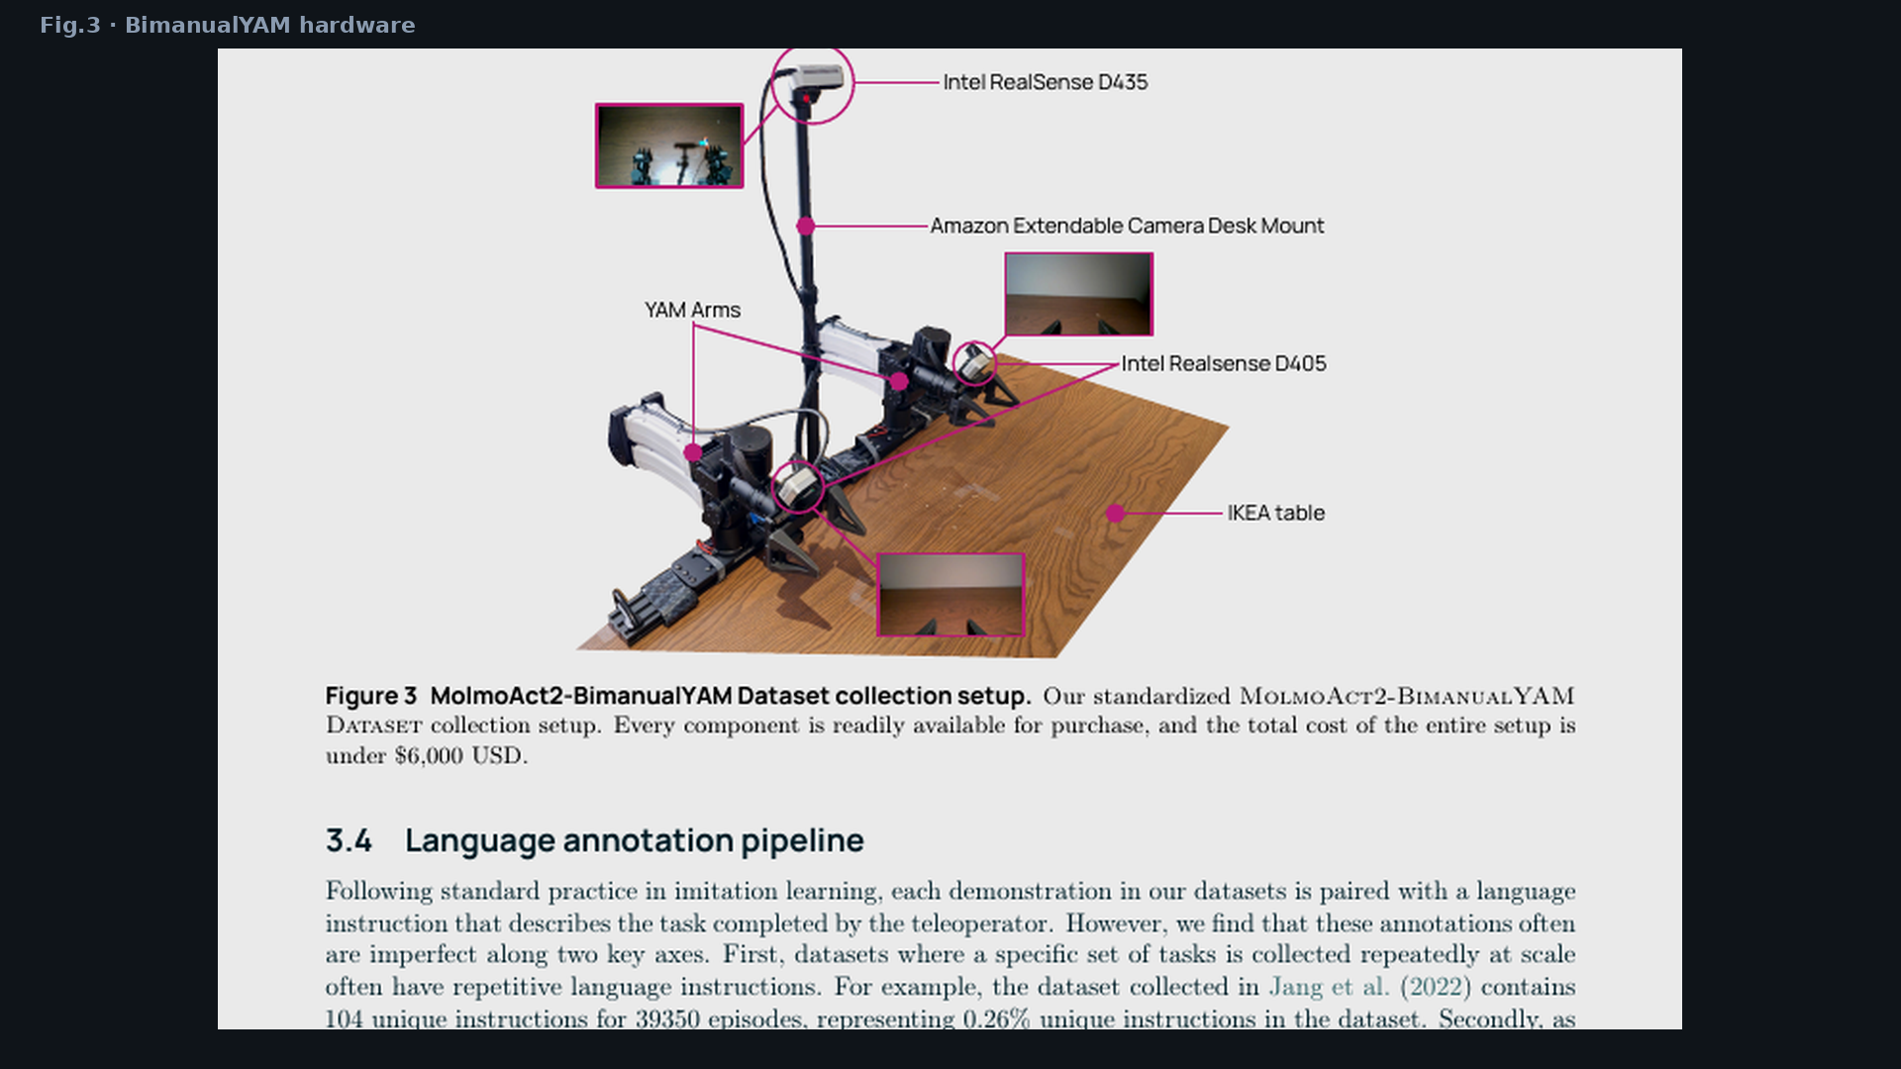
Stakeholder · 18+3 · 12/18
Notes:
PAPER FIG.3 — BimanualYAM hardware. Reproducible medium-cost platform.

Slide 13
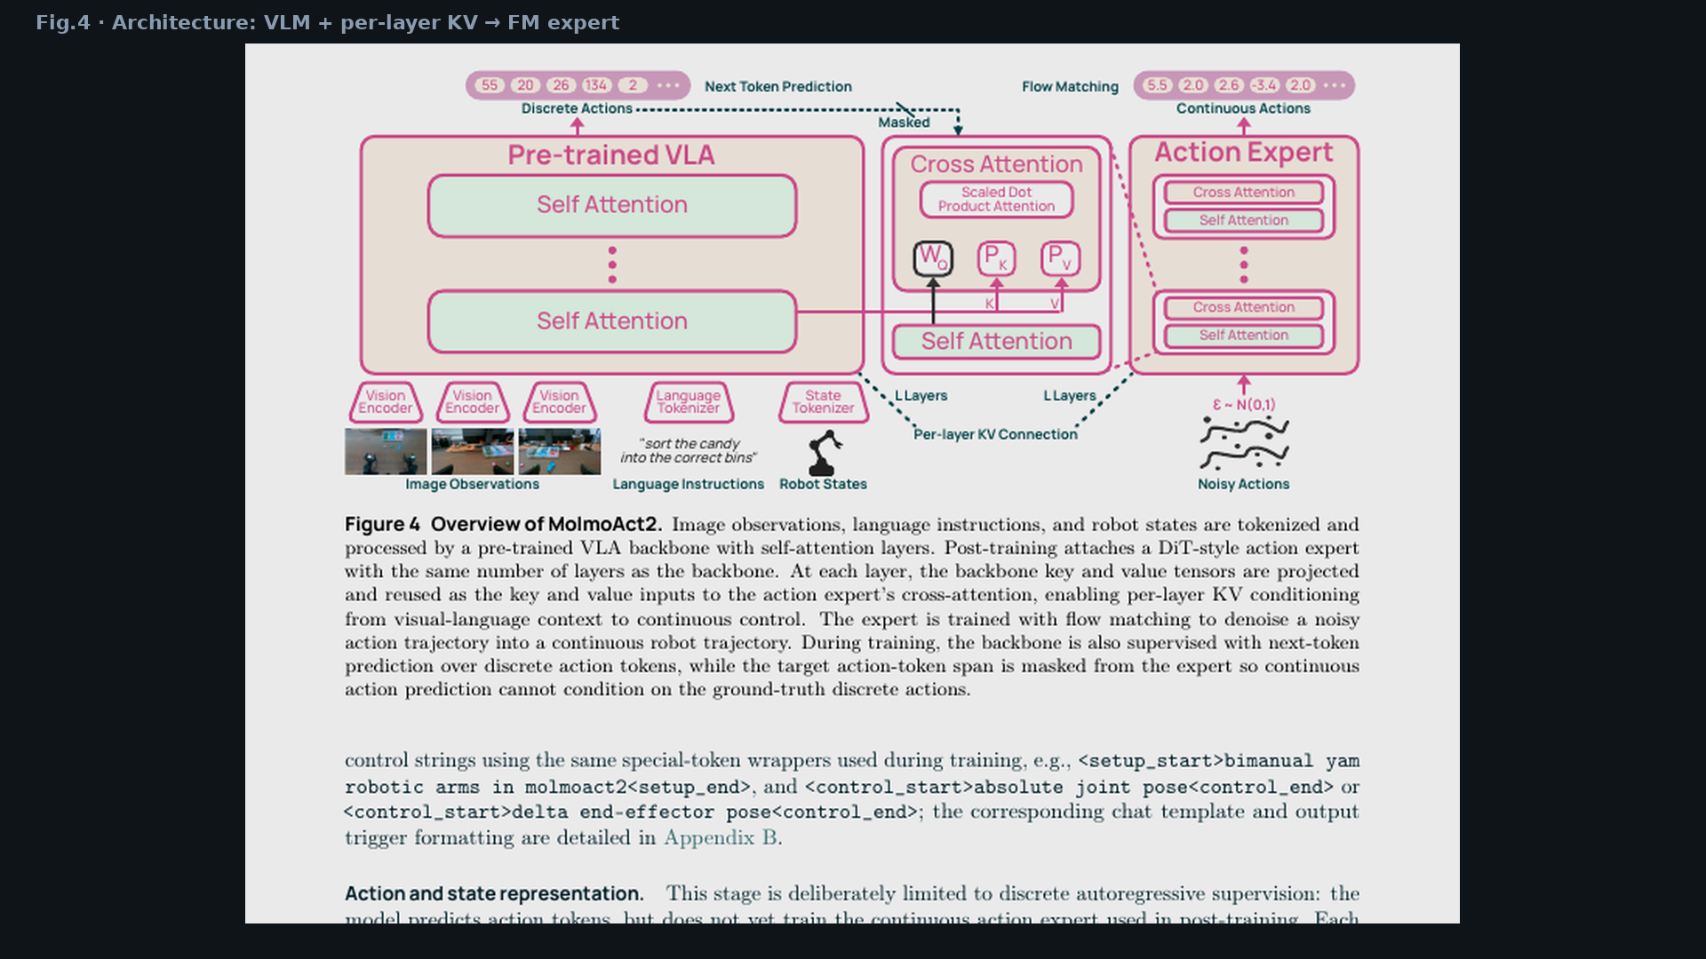
Stakeholder · 18+3 · 13/18
Notes:
PAPER FIG.4 — architecture money slide for stakeholders who want “how it works.”

Slide 14
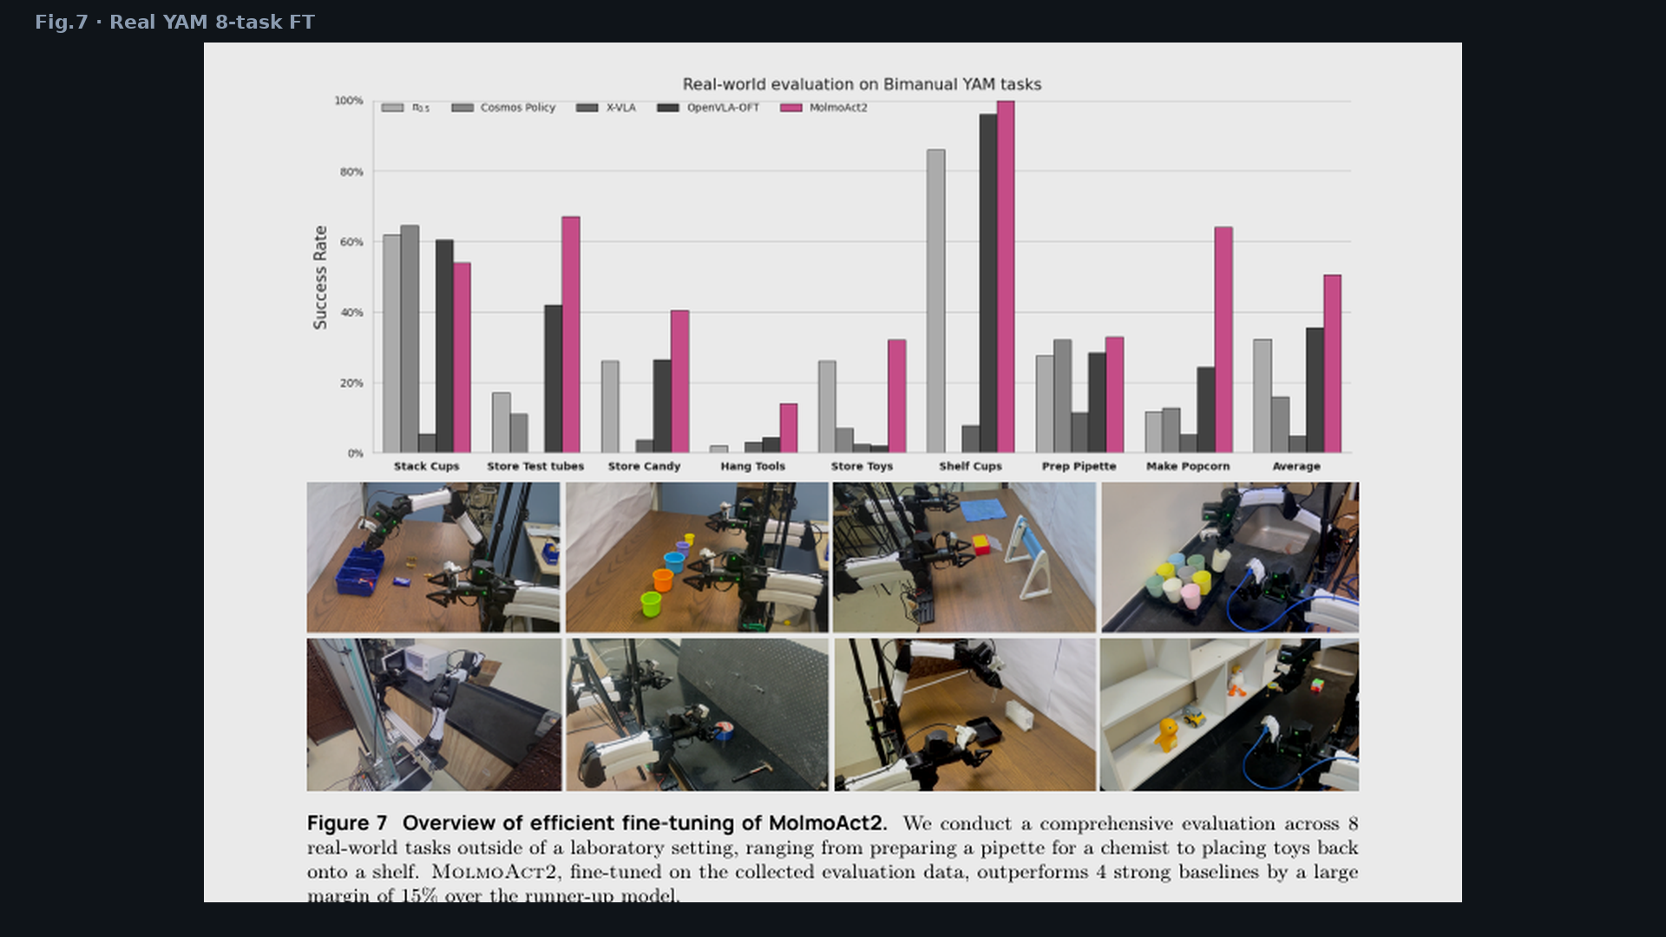
Stakeholder · 18+3 · 14/18
Notes:
PAPER FIG.7 — real YAM 8-task ~50% FT — in-the-wild deploy narrative.

Slide 15
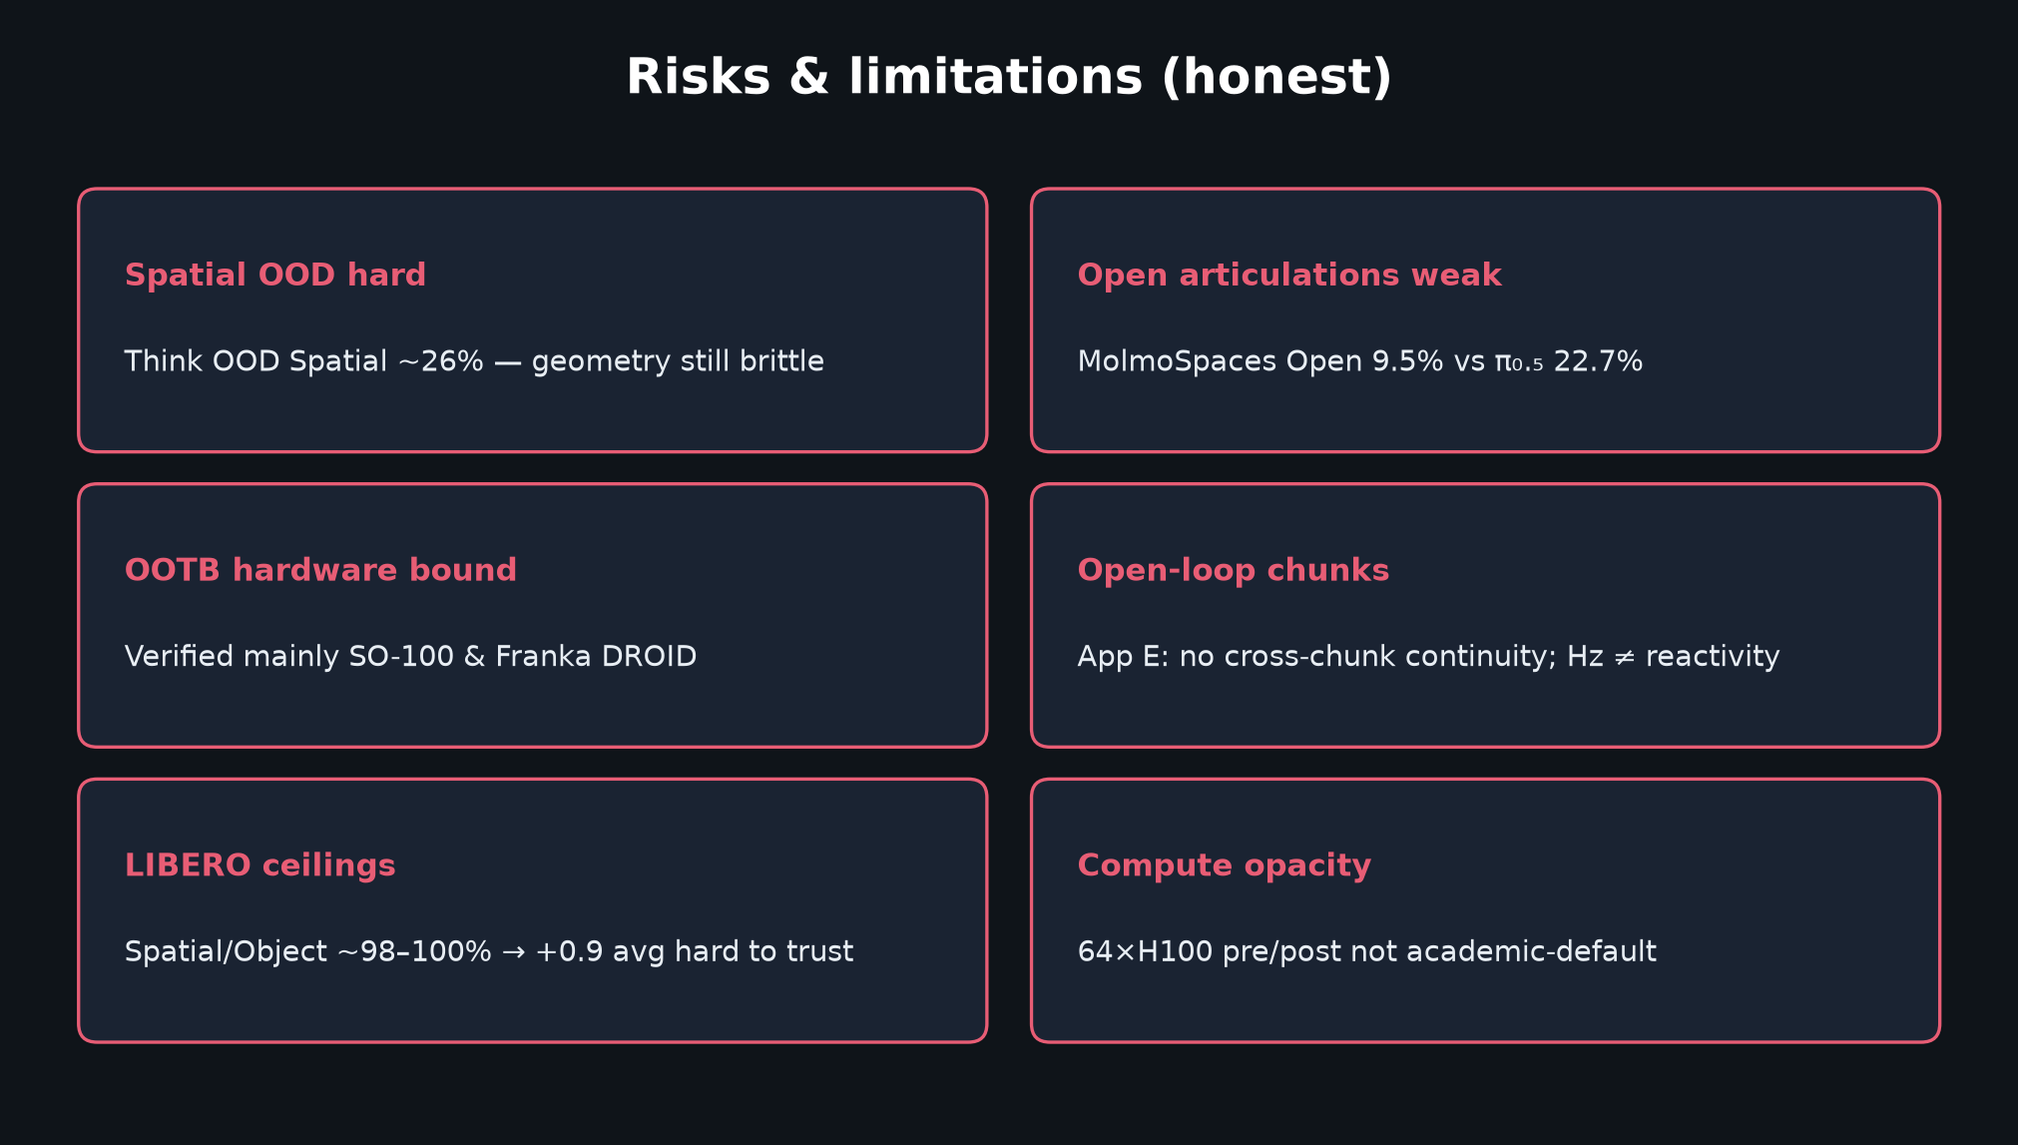
Stakeholder · 18+3 · 15/18
Notes:
RISKS — say honestly.
Spatial OOD; Open articulations weak; OOTB mainly SO/Franka; open-loop chunks; LIBERO ceilings; 64-GPU story.
Still strongest open ARM package on the table for Oct architecture reviews.

Slide 16
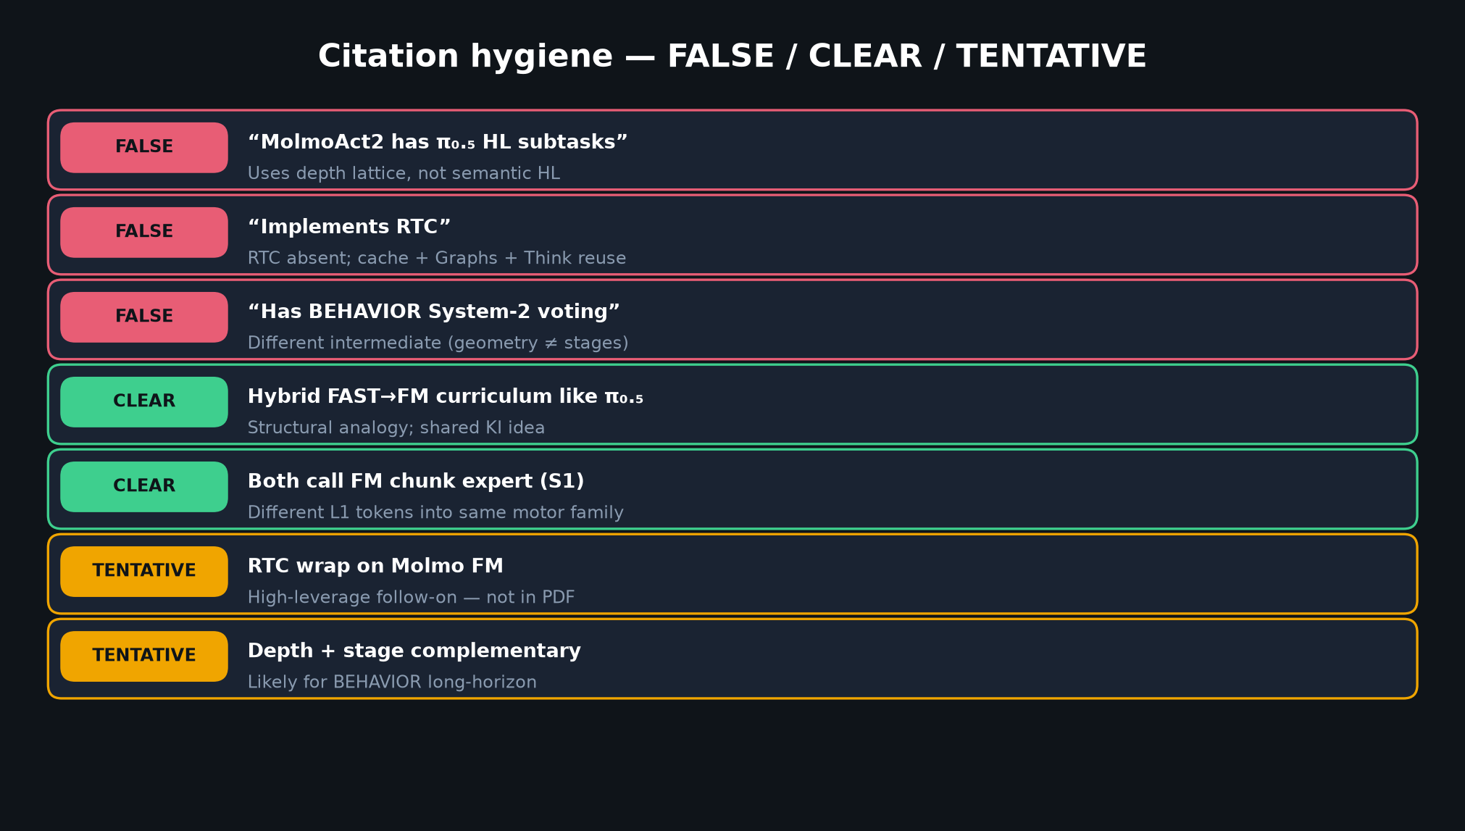
Stakeholder · 18+3 · 16/18
Notes:
FALSE CLAIMS WALL — protect the brand in Q&A.
We do not claim HL, RTC, or BEHAVIOR voting. We claim open depth ARM + FM.

Slide 17
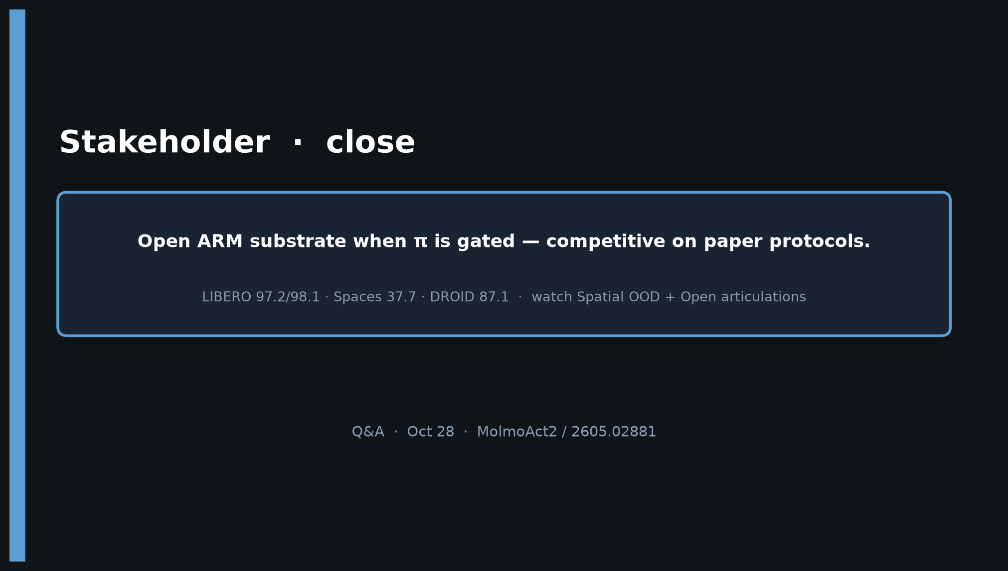
Stakeholder · 18+3 · 17/18
Notes:
CLOSE.
Open ARM substrate when π gated — competitive on paper protocols.
Watch Spatial OOD + Open articulations. Prefer released ckpts over retrain.

Slide 18
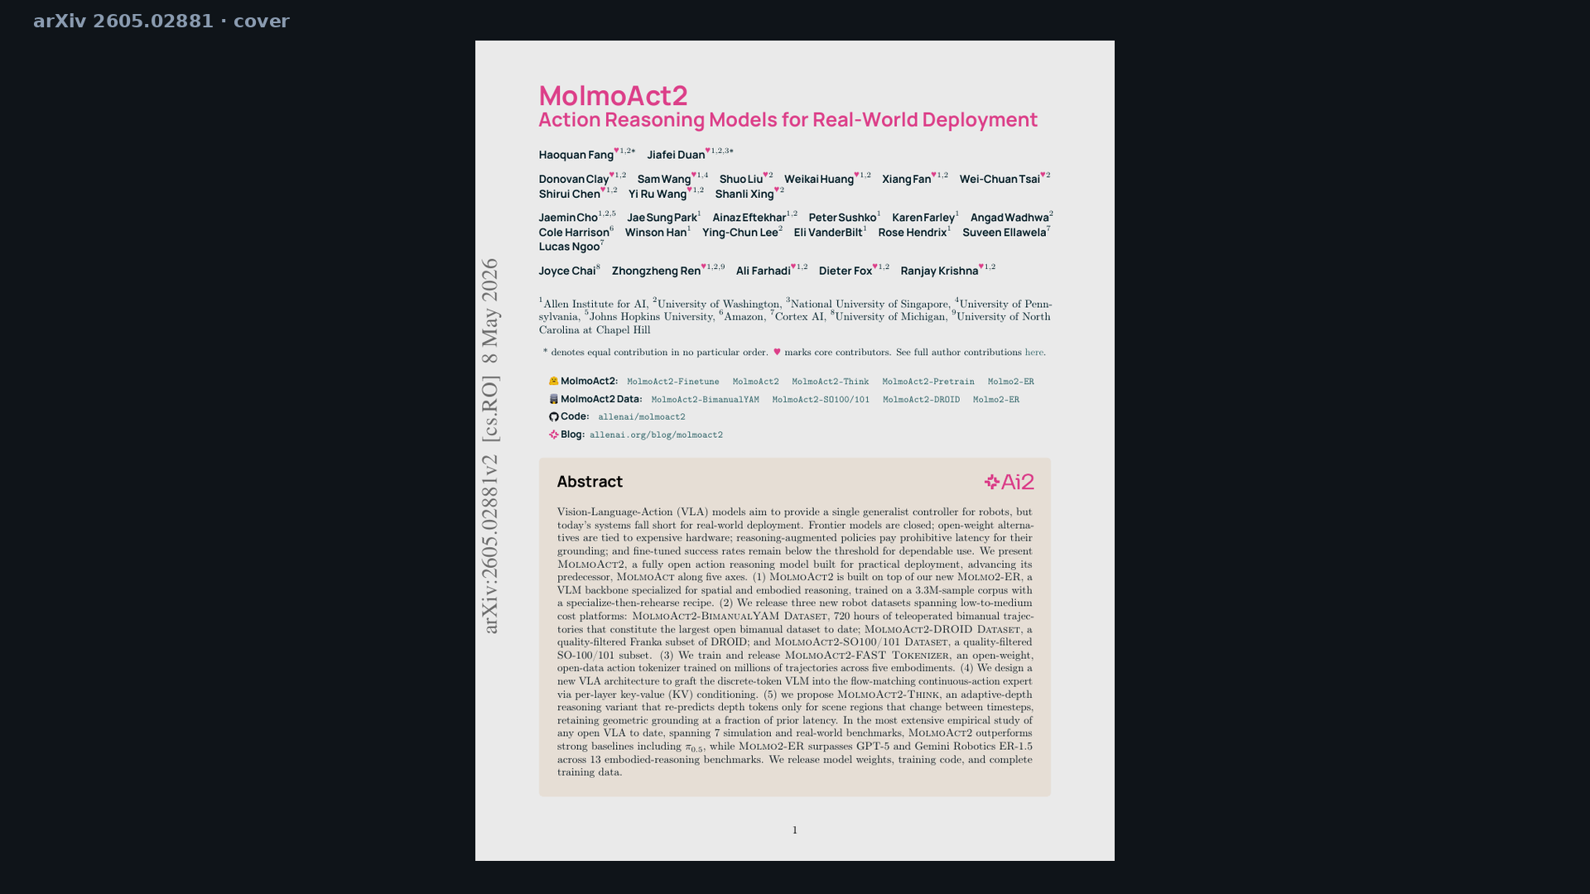
Stakeholder · 18+3 · 18/18
Notes:
BACKUP cover / title page for handoff.

