Slide 1
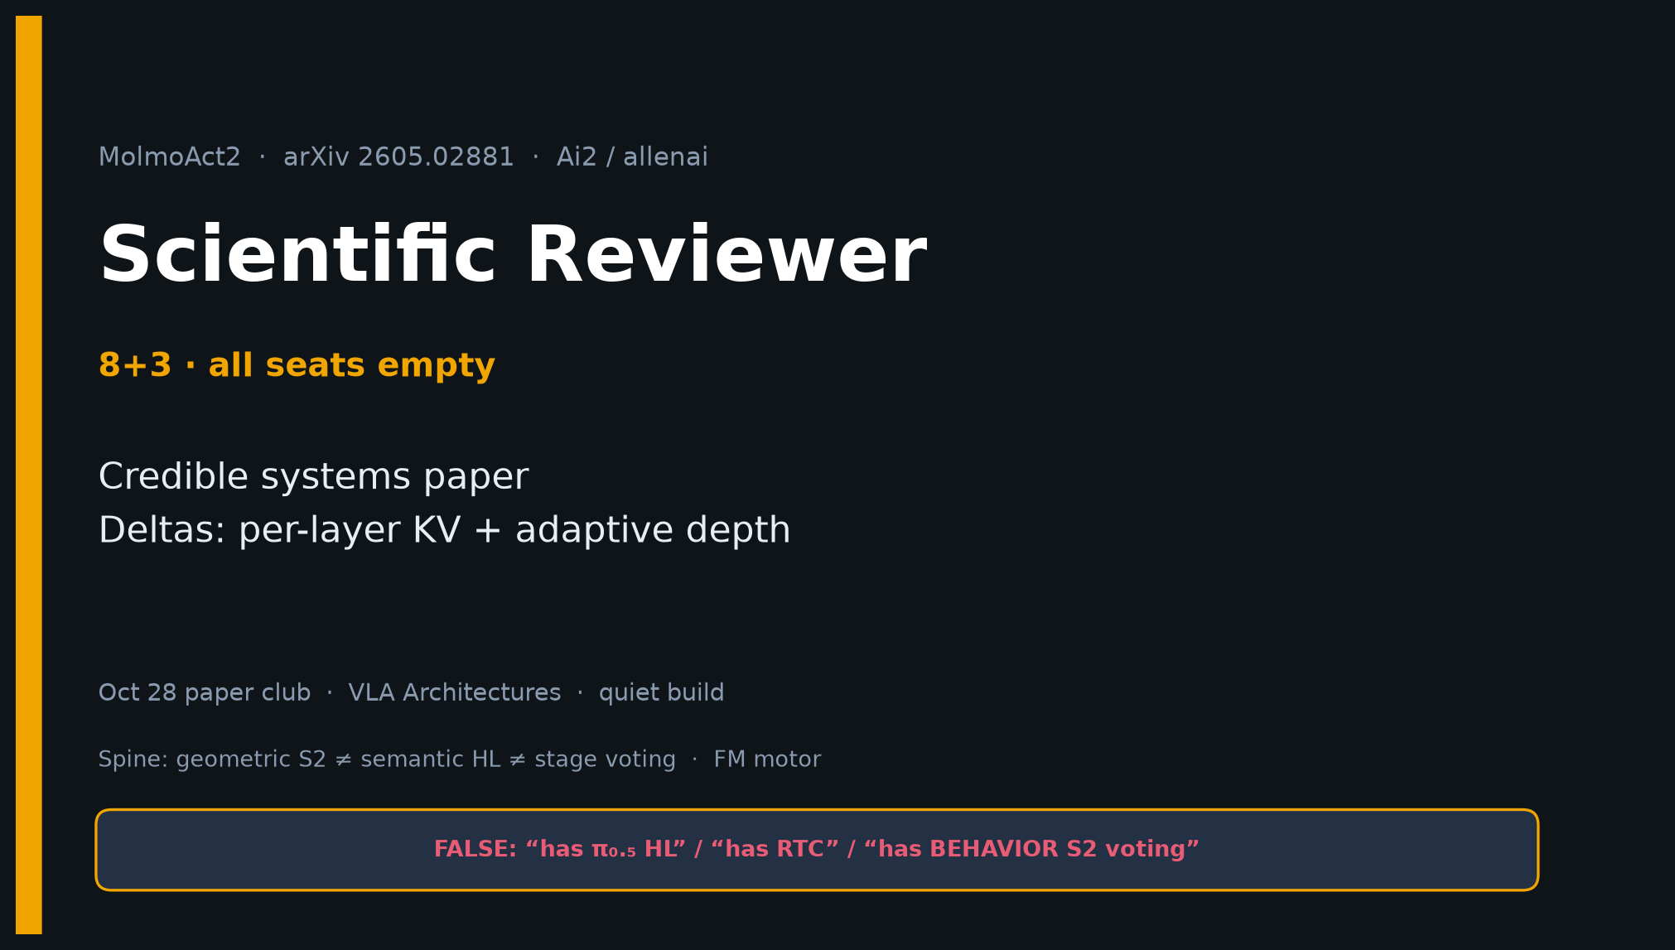
Scientific Reviewer · 8+3 · 1/11
Notes:
SCIENTIFIC REVIEWER — 8+3. Tight timing. Cite hygiene + deltas.
Verdict preview: credible systems paper; deltas = per-layer KV + adaptive depth; not a theorem paper.

Slide 2
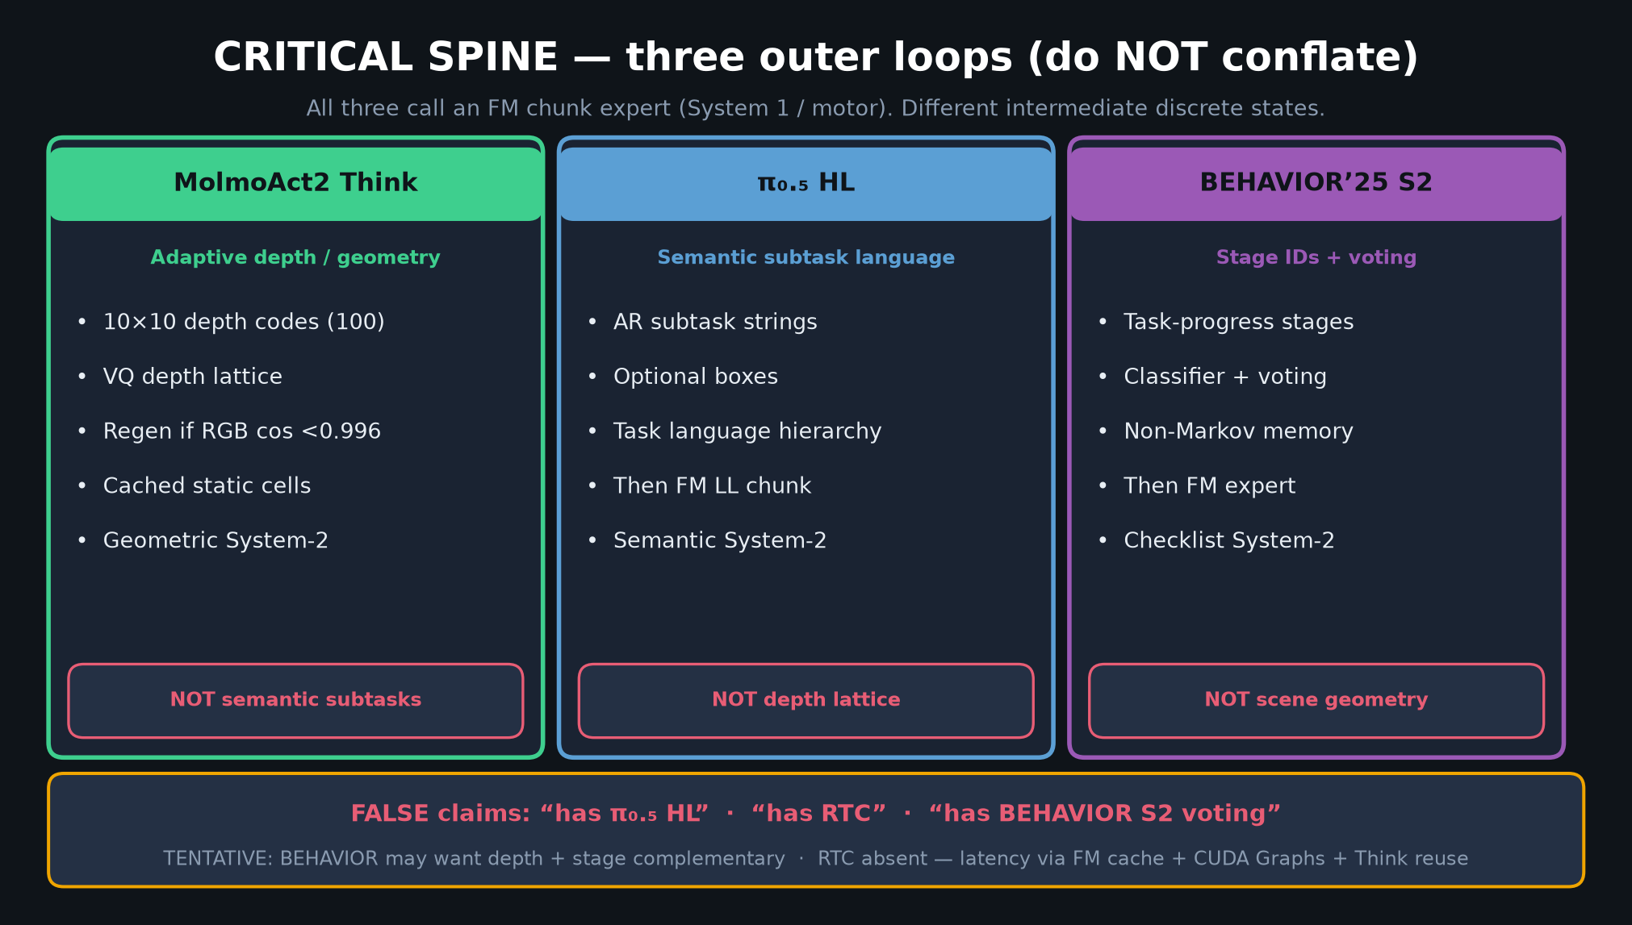
Scientific Reviewer · 8+3 · 2/11
Notes:
SPINE REMINDER — reviewers must police conflation.
Think ≠ HL ≠ stage voting. FM motor shared.
FALSE attributions kill credibility in club discussion.

Slide 3
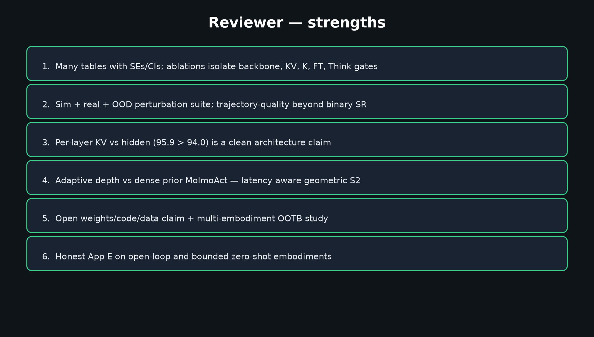
Scientific Reviewer · 8+3 · 3/11
Notes:
STRENGTHS — evidence quality positives.
Ablations, SE/CI tables, sim+real+OOD, trajectory quality, open release claim, App E honesty.

Slide 4
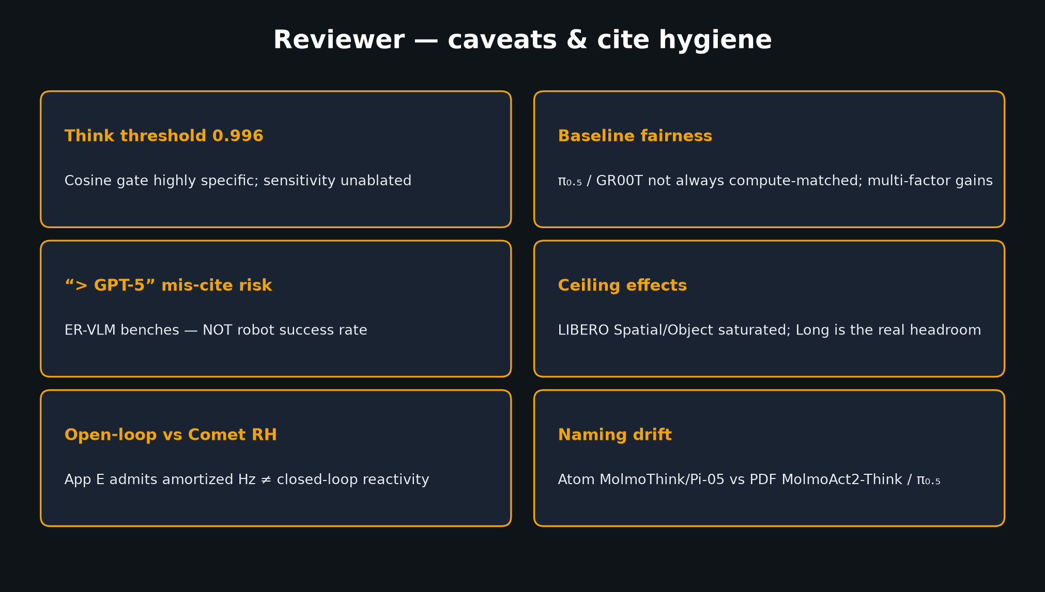
Scientific Reviewer · 8+3 · 4/11
Notes:
CAVEATS — threshold unablated; baseline fairness; GPT-5 mis-cite risk; ceilings; open-loop; Atom naming drift.

Slide 5
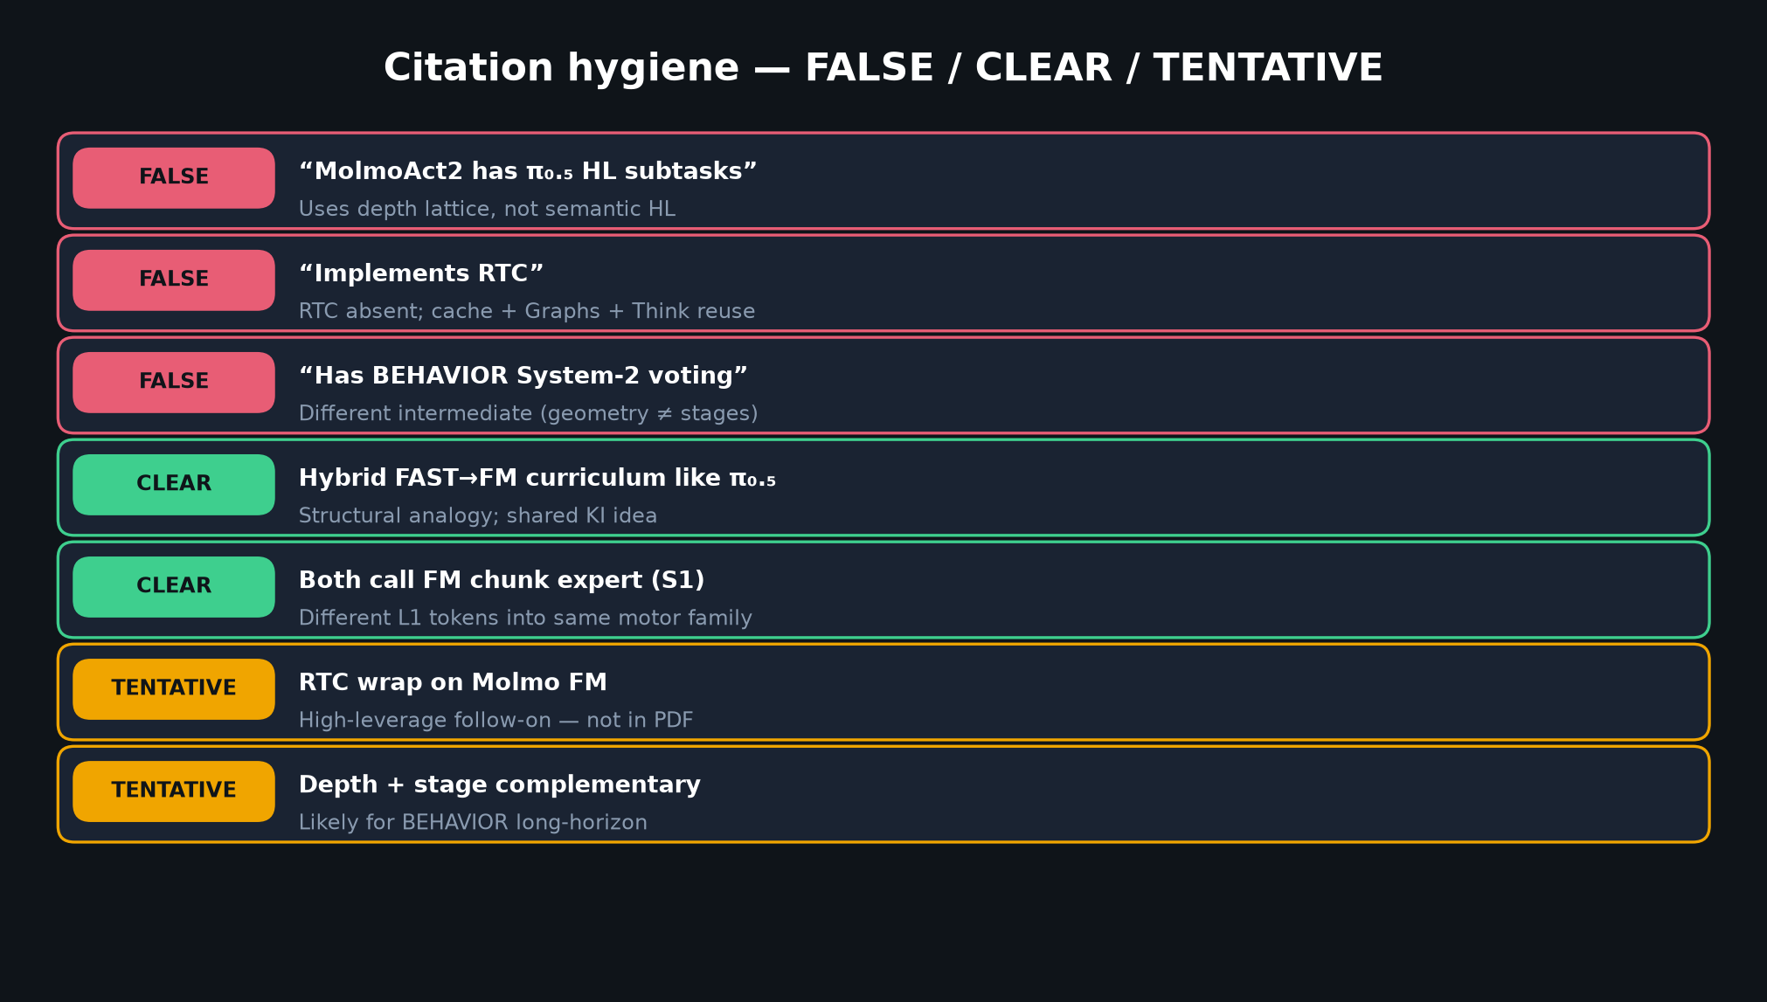
Scientific Reviewer · 8+3 · 5/11
Notes:
CITATION HYGIENE TABLE — FALSE/CLEAR/TENTATIVE.
Spend 45–60s. Prevents room cargo-culting HL/RTC onto Molmo.

Slide 6
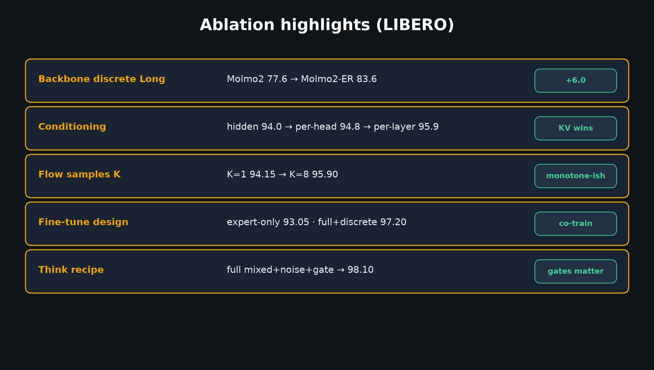
Scientific Reviewer · 8+3 · 6/11
Notes:
ABLATIONS — scientific deltas with numbers.
Per-layer KV 95.9 > hidden 94.0. ER backbone +6 Long. Think gates → 98.10.

Slide 7
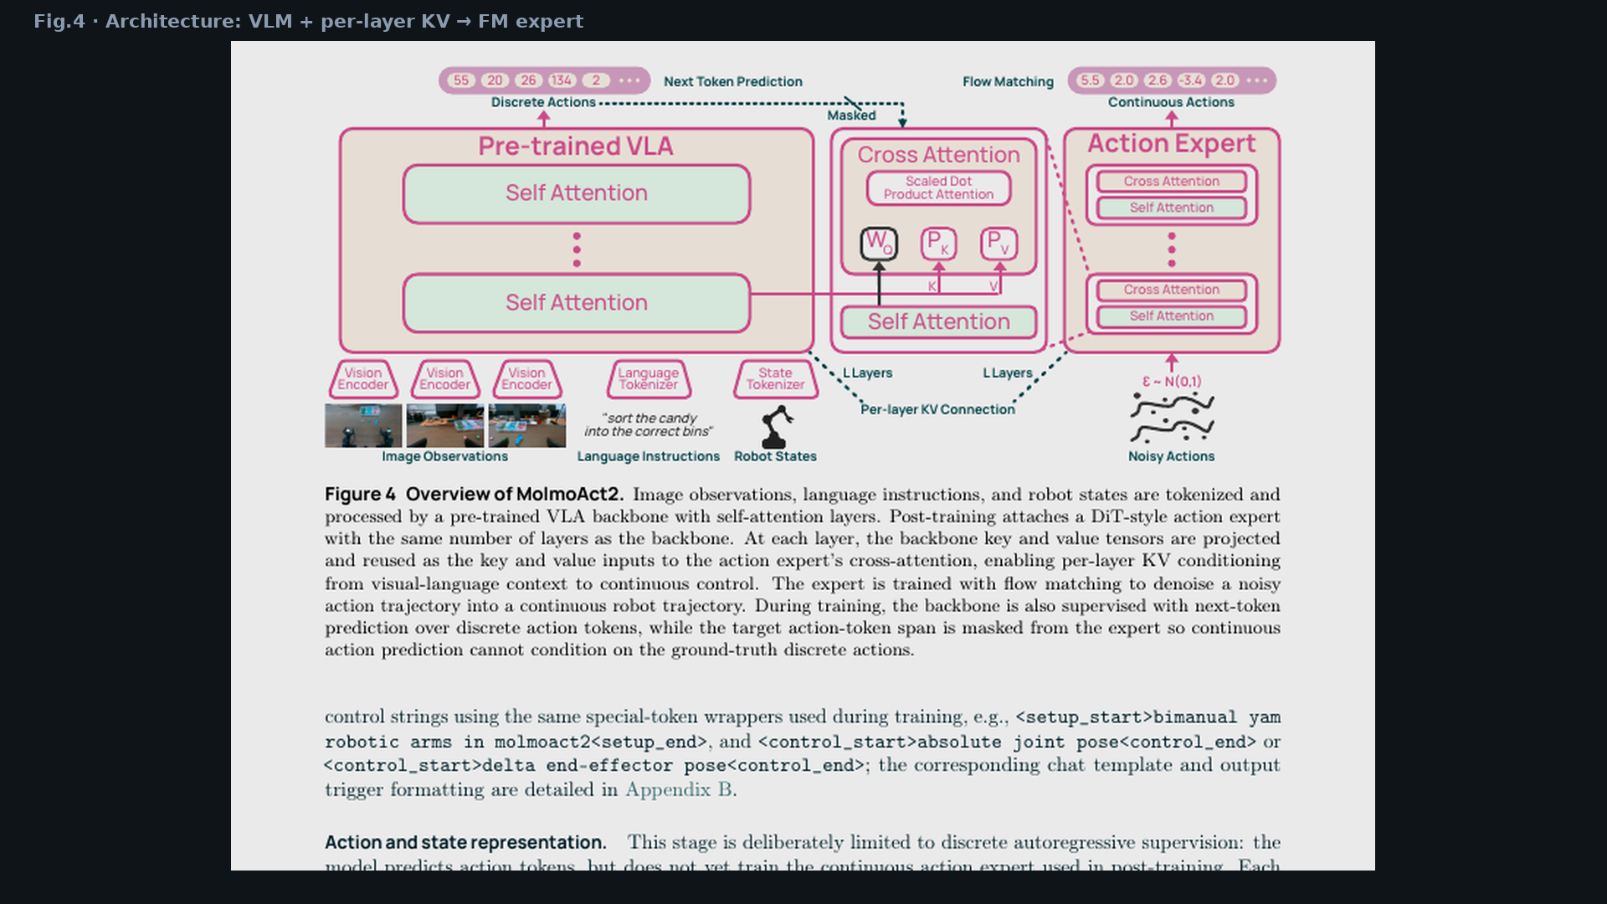
Scientific Reviewer · 8+3 · 7/11
Notes:
PAPER FIG.4 — architecture under review.
Per-layer KV graft is the interface claim vs hidden-state experts.

Slide 8
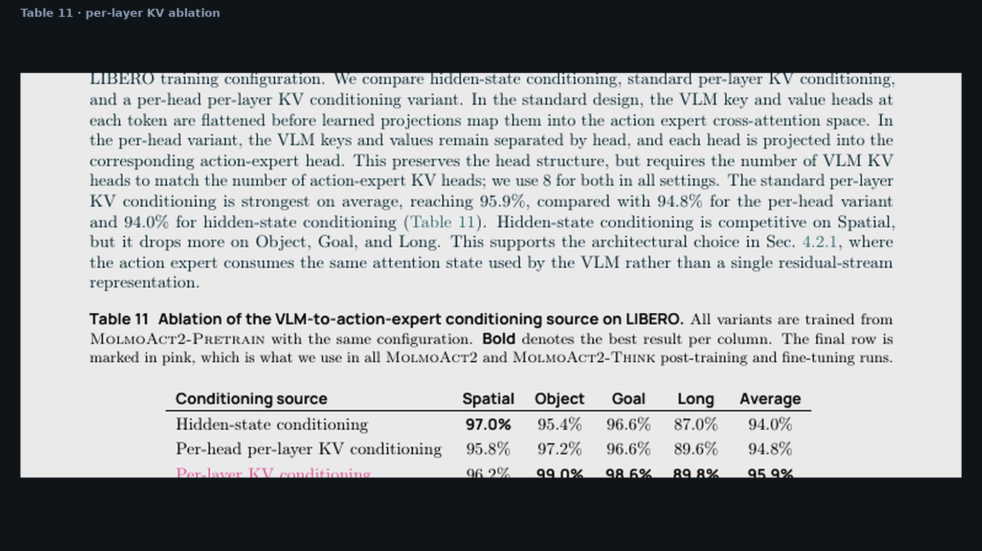
Scientific Reviewer · 8+3 · 8/11
Notes:
TABLE 11 CROP — conditioning ablation visual.

Slide 9
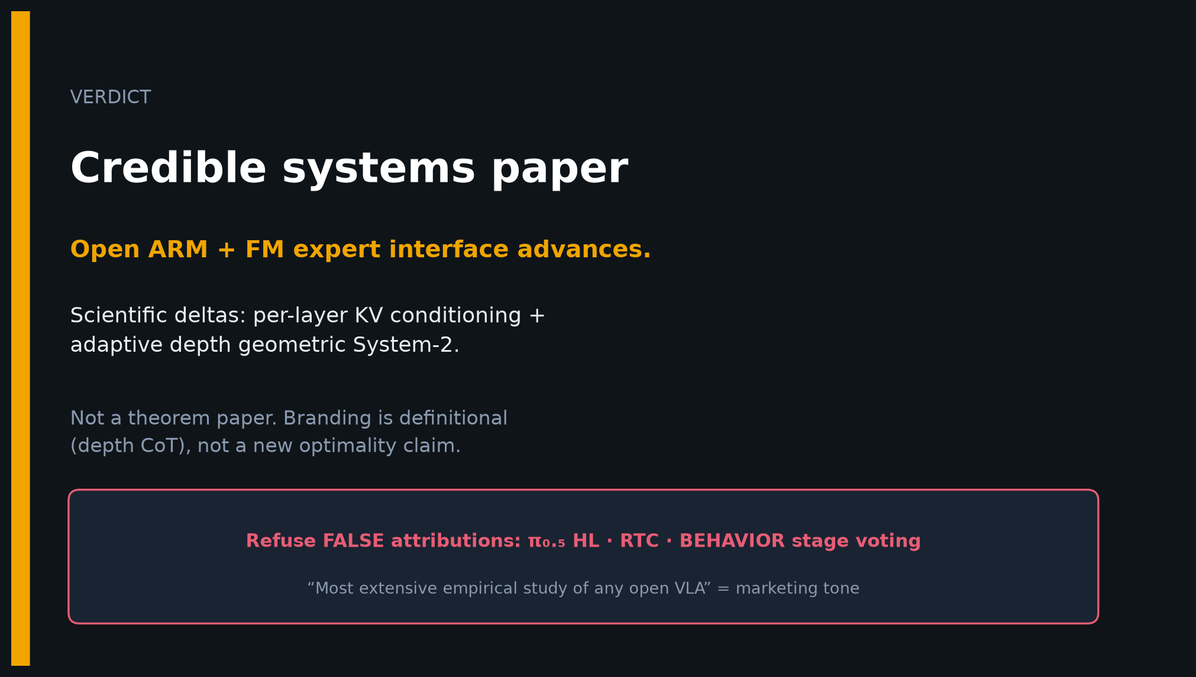
Scientific Reviewer · 8+3 · 9/11
Notes:
VERDICT SLIDE.
Credible systems paper advancing open ARM + FM interface.
Not a theorem paper. Refuse FALSE attributions.

Slide 10
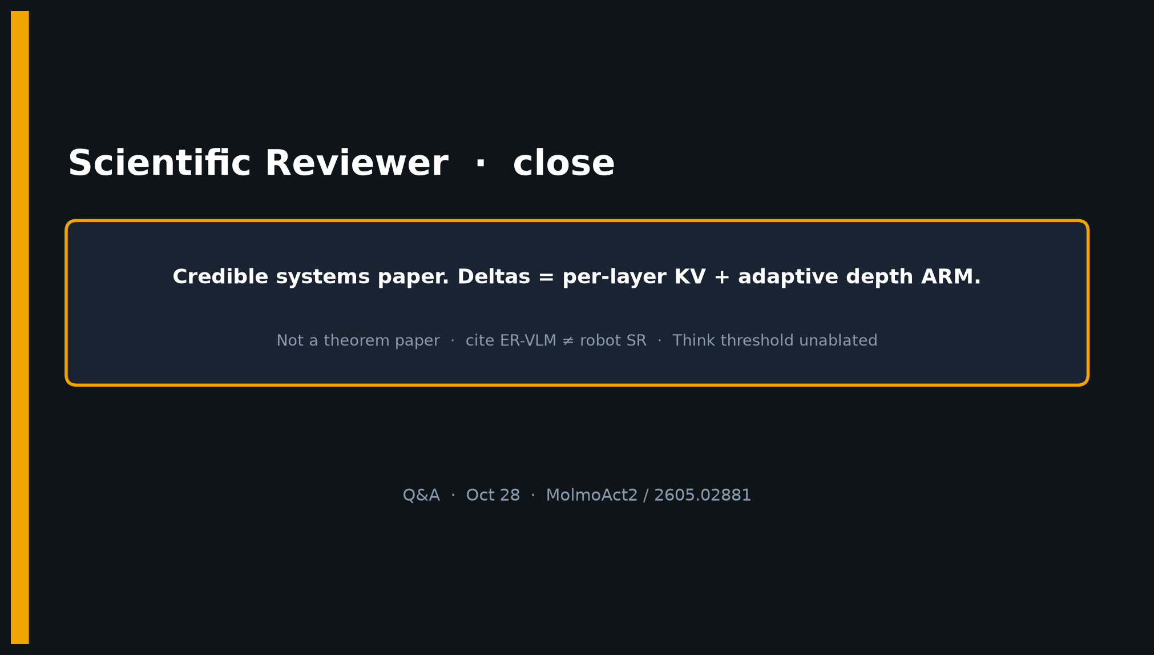
Scientific Reviewer · 8+3 · 10/11
Notes:
CLOSE / Q&A.

Slide 11
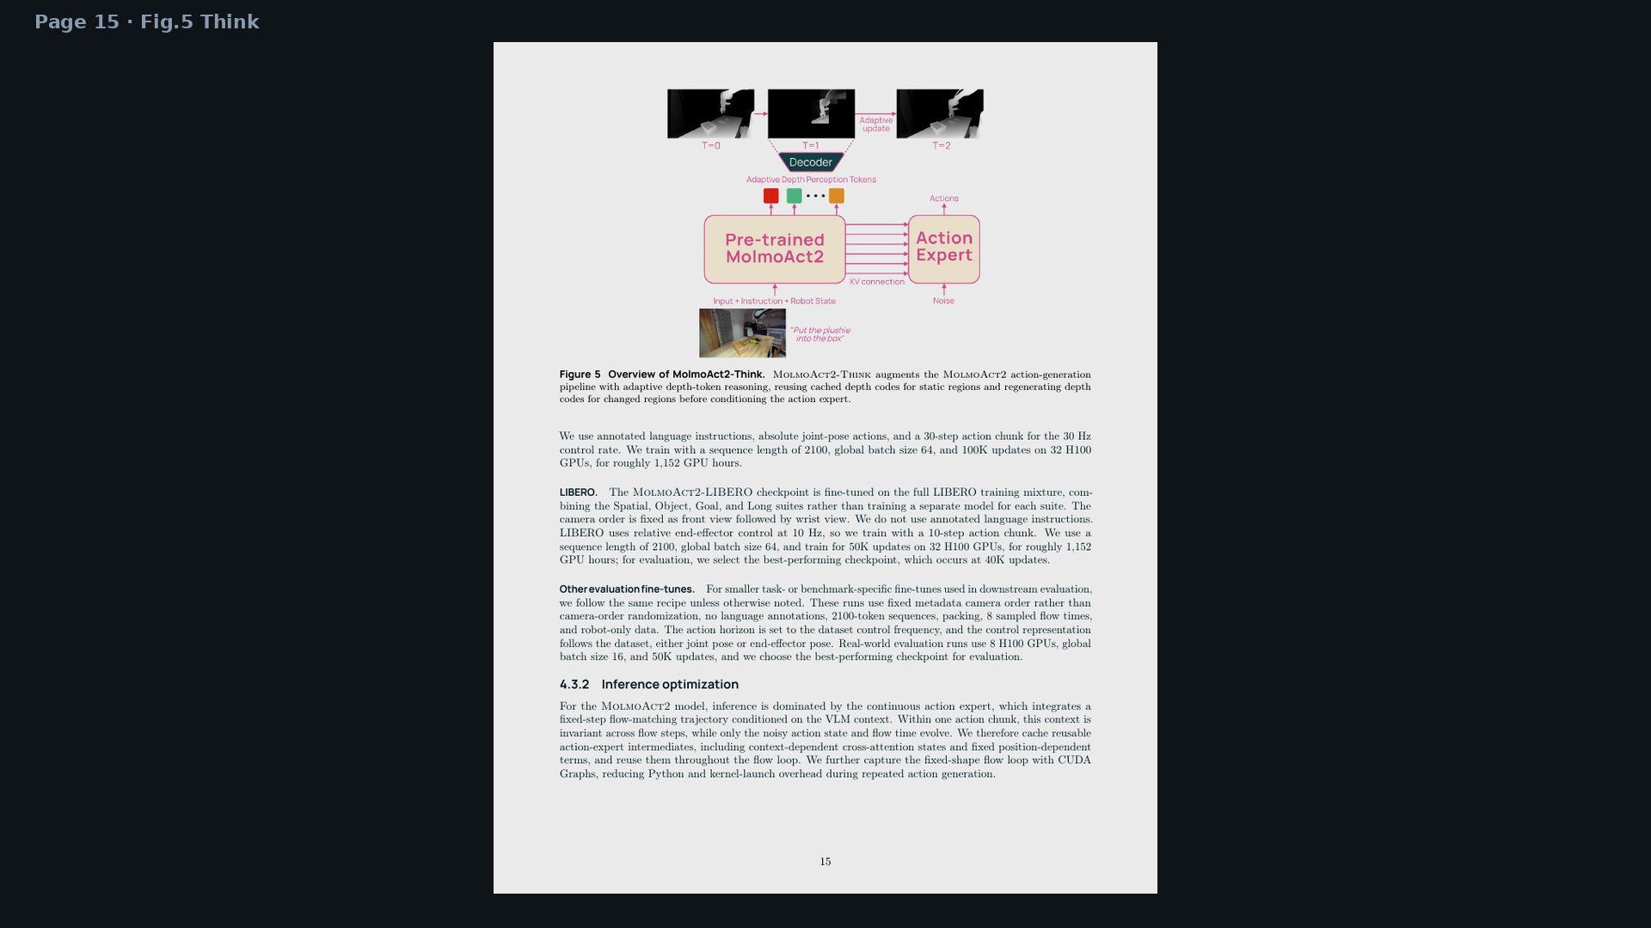
Scientific Reviewer · 8+3 · 11/11
Notes:
BACKUP — Think page for architecture Q.

