Slide 1
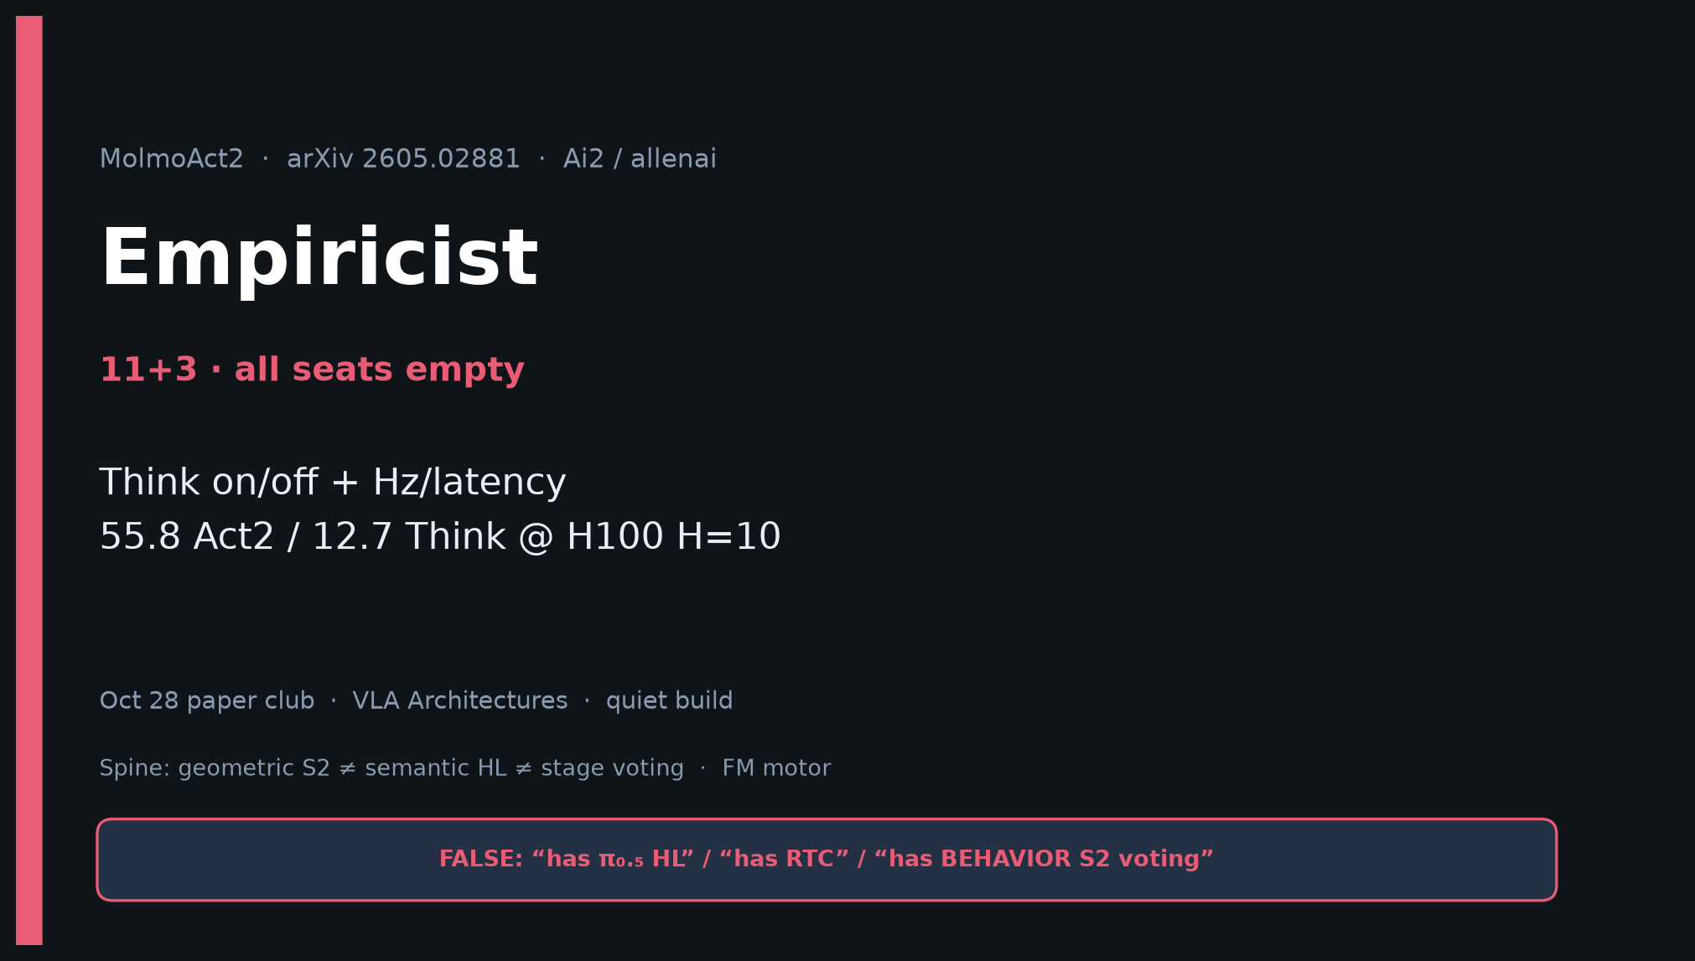
Empiricist · 11+3 · 1/14
Notes:
EMPIRICIST OPENING — 11+3. Focus: Think on/off + Hz/latency.
All seats empty — still ship full experiment plan. Env outlines only; no Slurm launched.
Tattoo: LIBERO 97.2/98.1; Spaces 37.7; DROID 87.1; KV 95.9>94.0; 55.79/12.71 Hz.

Slide 2
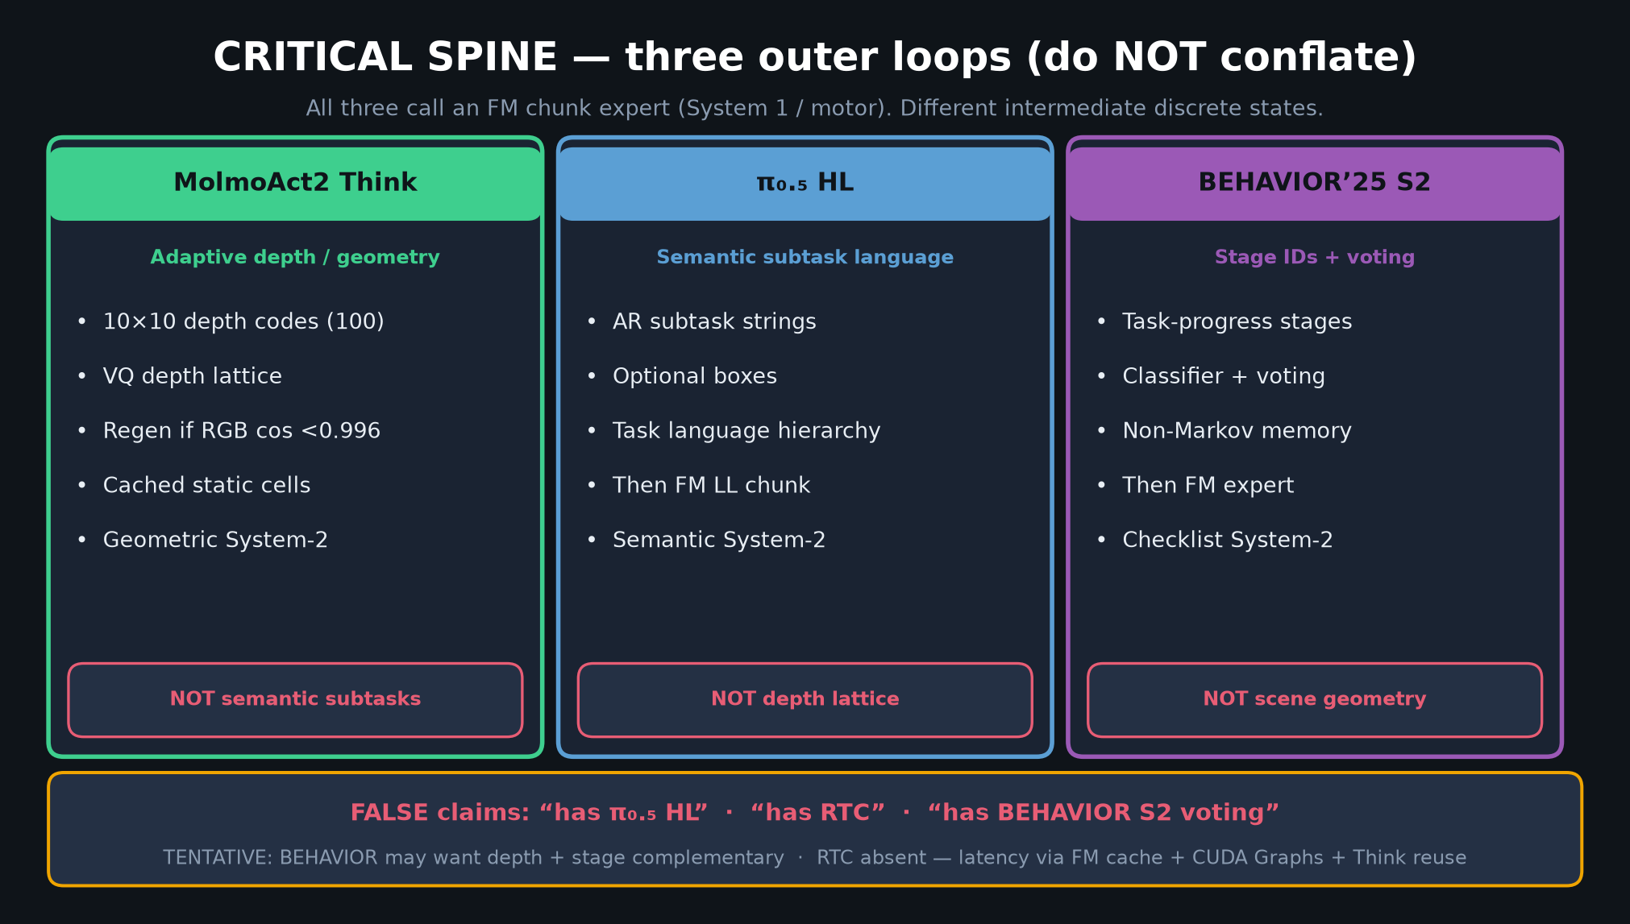
Empiricist · 11+3 · 2/14
Notes:
SPINE — pick ONE System-2 ontology per cell.
Depth vs HL vs stage. Don’t mix labels in logs.

Slide 3
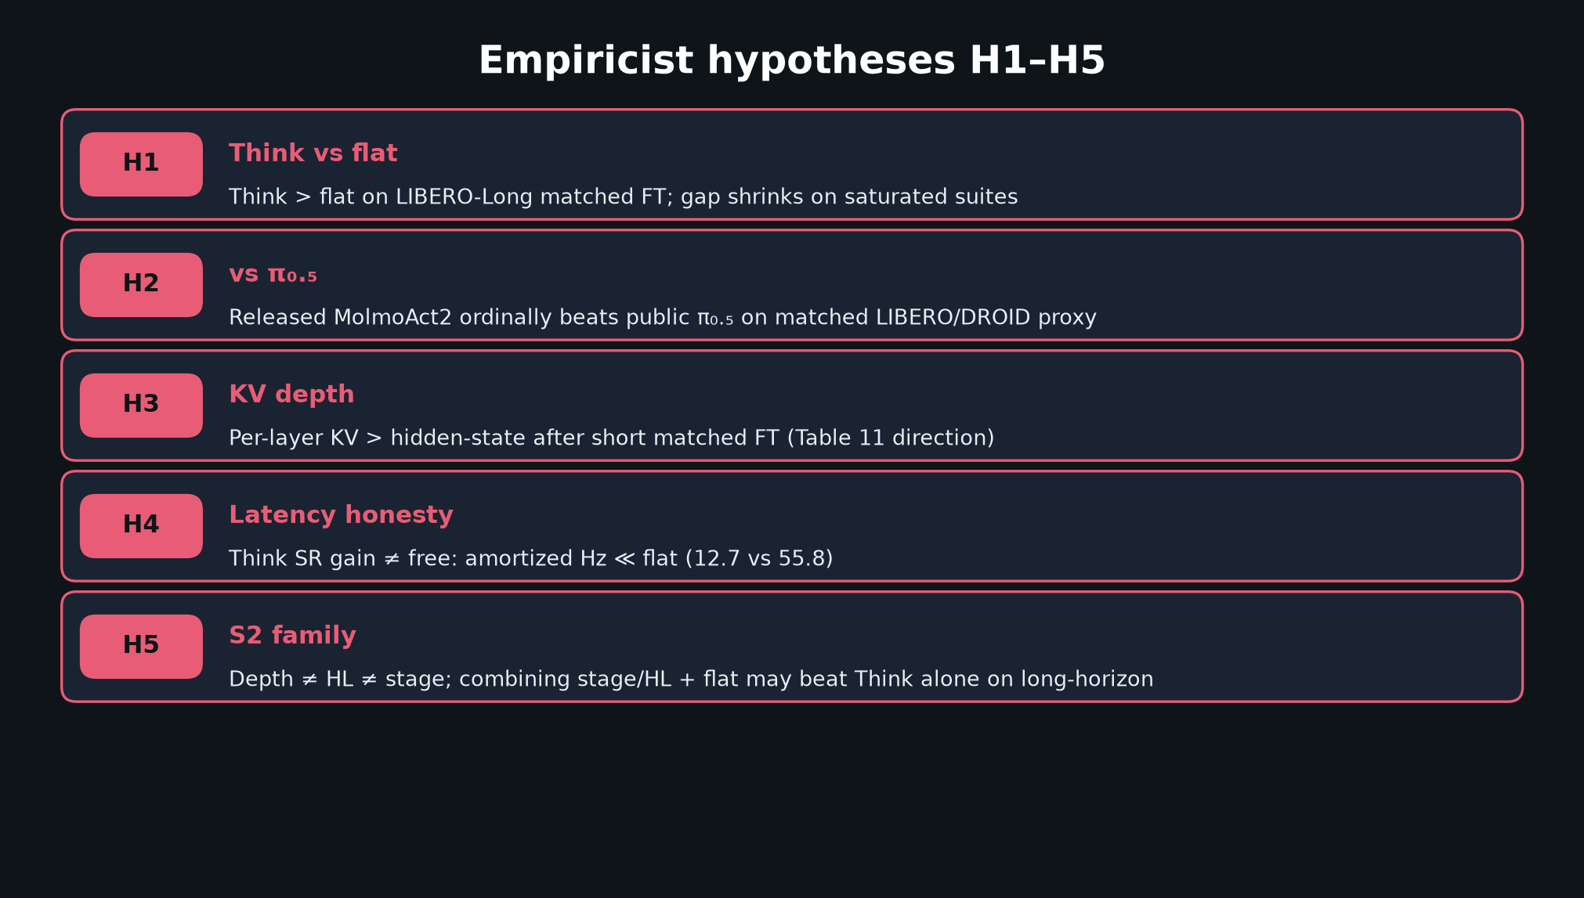
Empiricist · 11+3 · 3/14
Notes:
H1–H5 HYPOTHESES.
H1 Think>flat on Long; H2 ordinal vs π₀.₅; H3 KV; H4 latency honesty; H5 S2 family complementary.

Slide 4
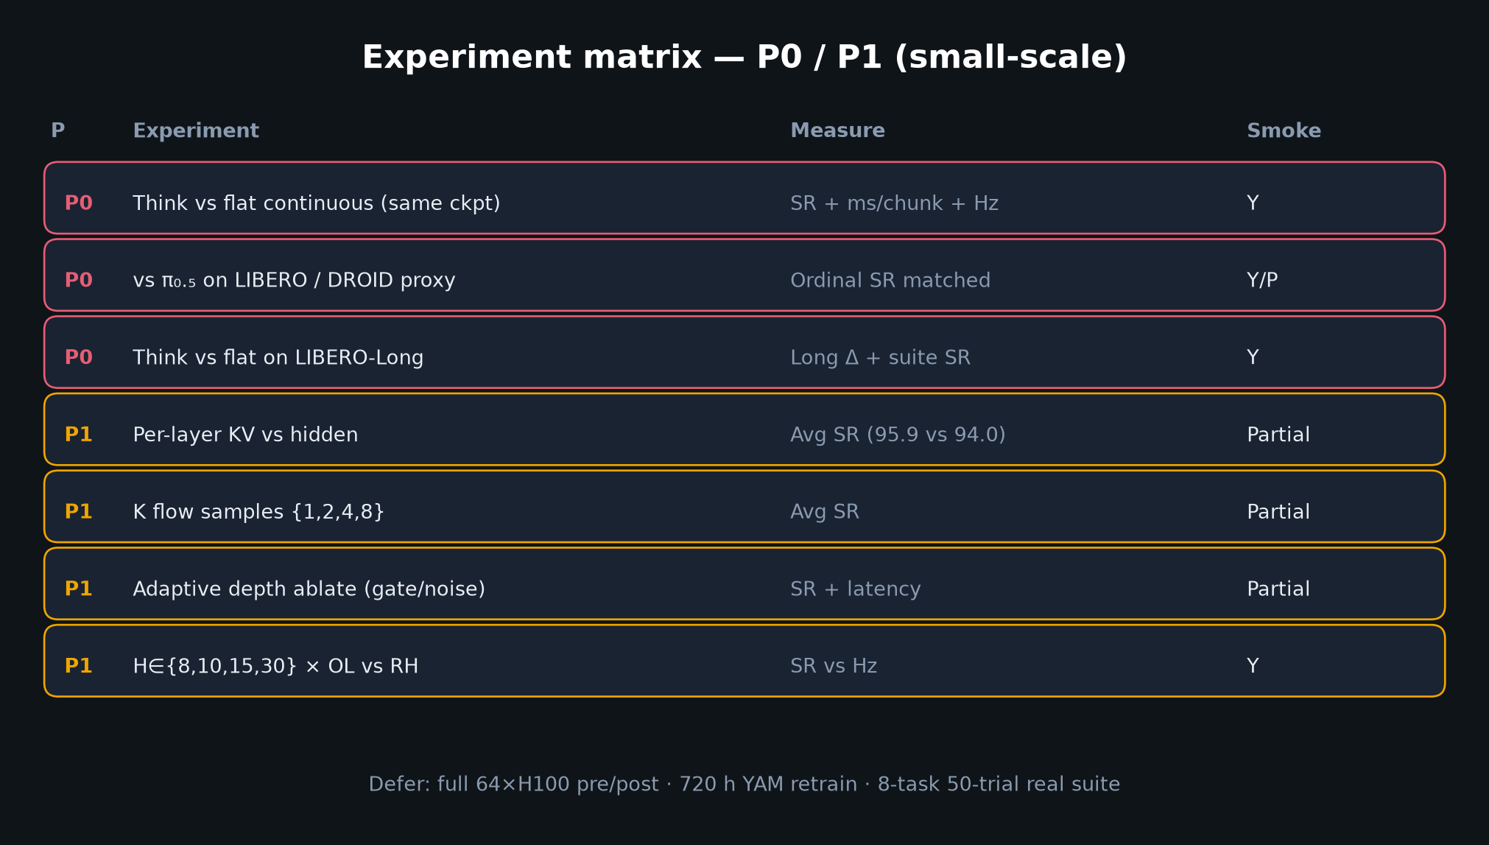
Empiricist · 11+3 · 4/14
Notes:
EXPERIMENT MATRIX P0/P1.
Minimal matrix: {molmoact2 | think | pi05} × {depth on|off} × LIBERO-Long.
Defer full pretrain / 720h retrain.

Slide 5
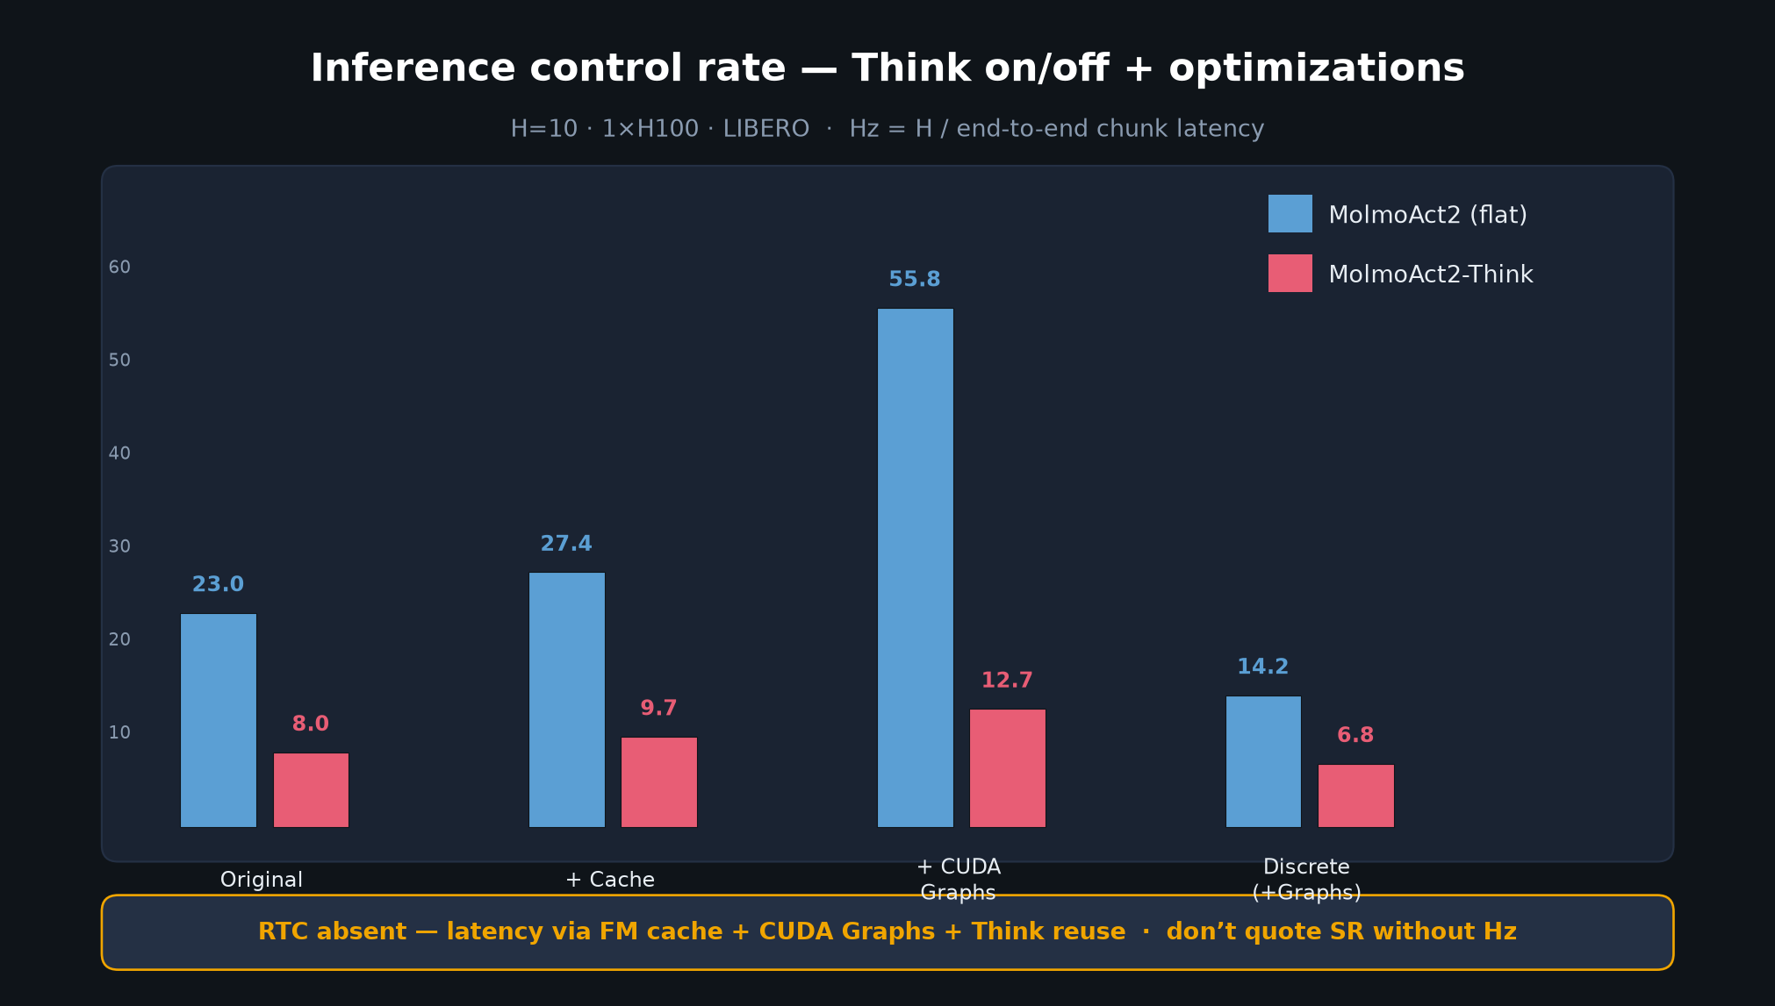
Empiricist · 11+3 · 5/14
Notes:
HZ / LATENCY MUST-SLIDE.
55.79 Act2 / 12.71 Think with cache+Graphs @ H=10 H100.
Any deployable-reasoning claim must quote Hz. RTC absent.

Slide 6
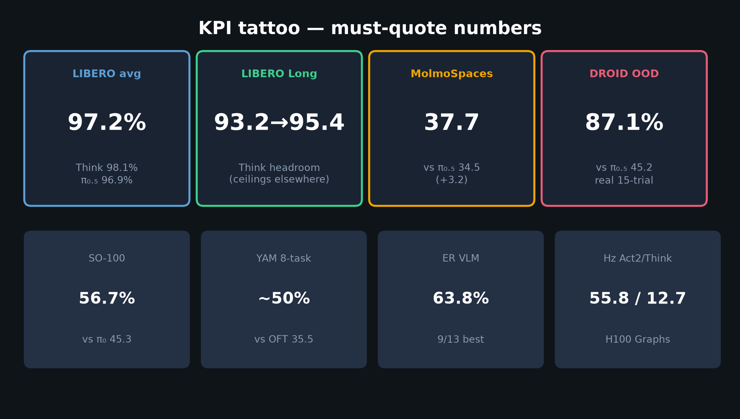
Empiricist · 11+3 · 6/14
Notes:
KPI TATTOO — paper targets for ordinal checks.

Slide 7
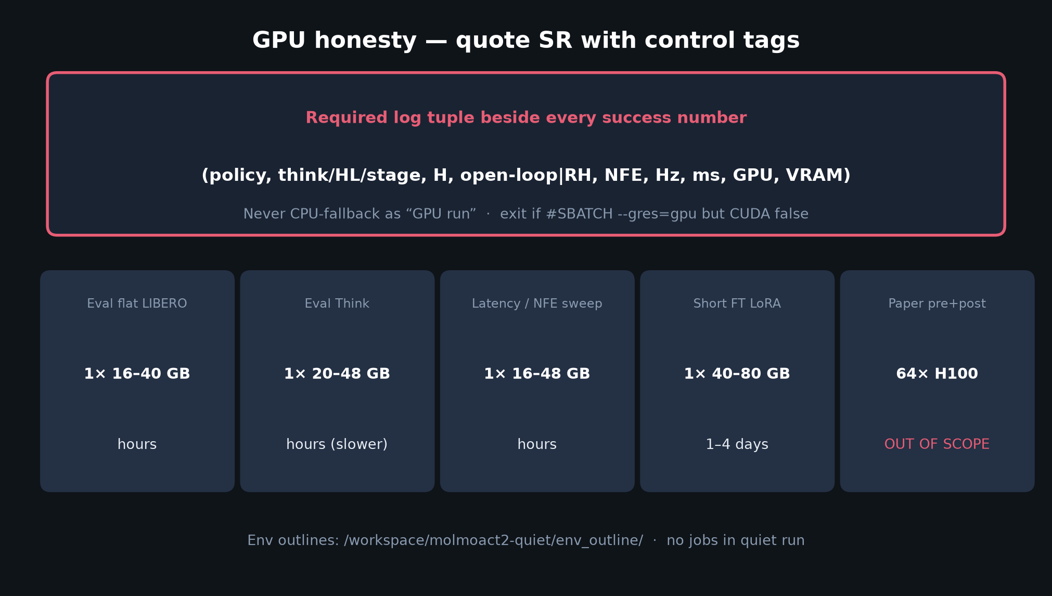
Empiricist · 11+3 · 7/14
Notes:
GPU HONESTY.
Log (policy, think/HL/stage, H, OL|RH, NFE, Hz, ms, GPU, VRAM).
Paper 64-GPU pre/post out of scope. Use env_outline/.

Slide 8
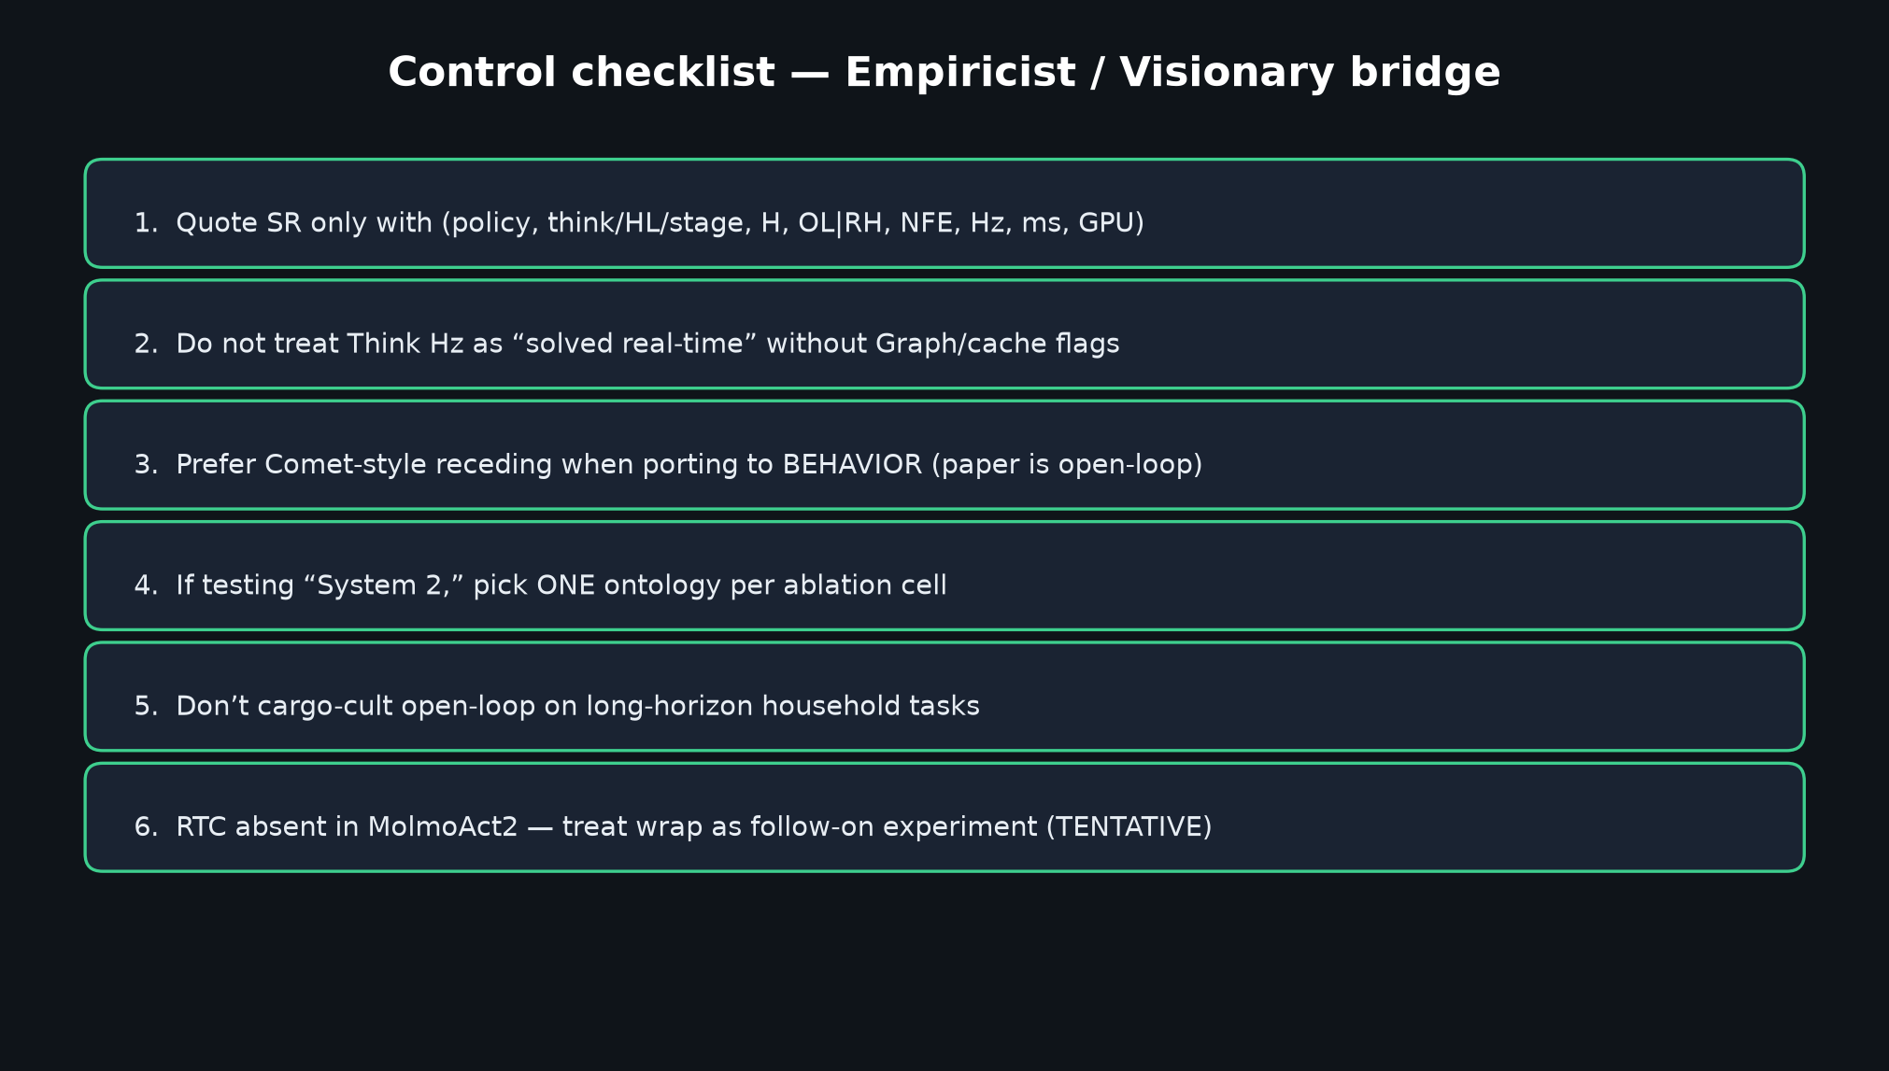
Empiricist · 11+3 · 8/14
Notes:
CONTROL CHECKLIST.
Prefer RH for BEHAVIOR ports. One ontology per cell. Don’t treat Think as free real-time.

Slide 9
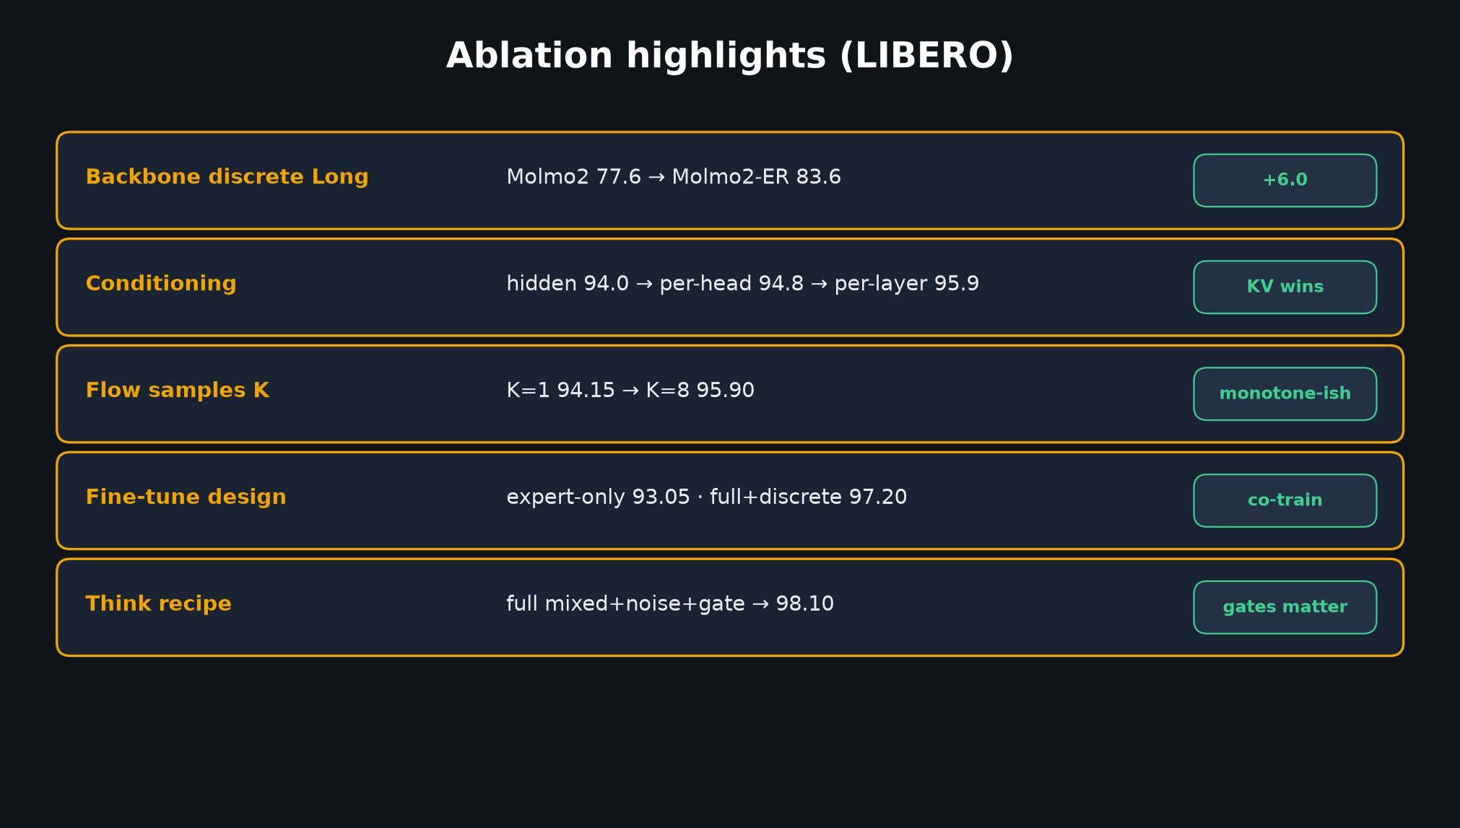
Empiricist · 11+3 · 9/14
Notes:
ABLATIONS TO REPLICATE DIRECTIONALLY (not absolute %).

Slide 10
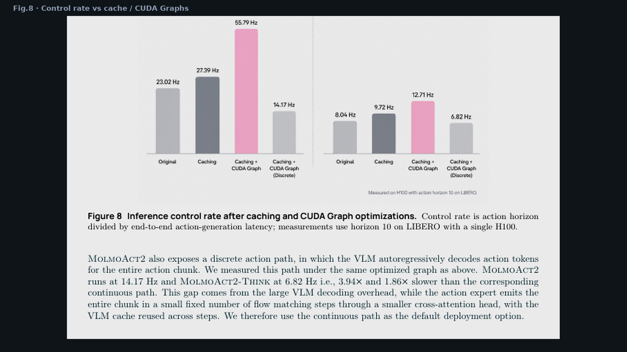
Empiricist · 11+3 · 10/14
Notes:
PAPER FIG.8 — primary latency evidence.

Slide 11
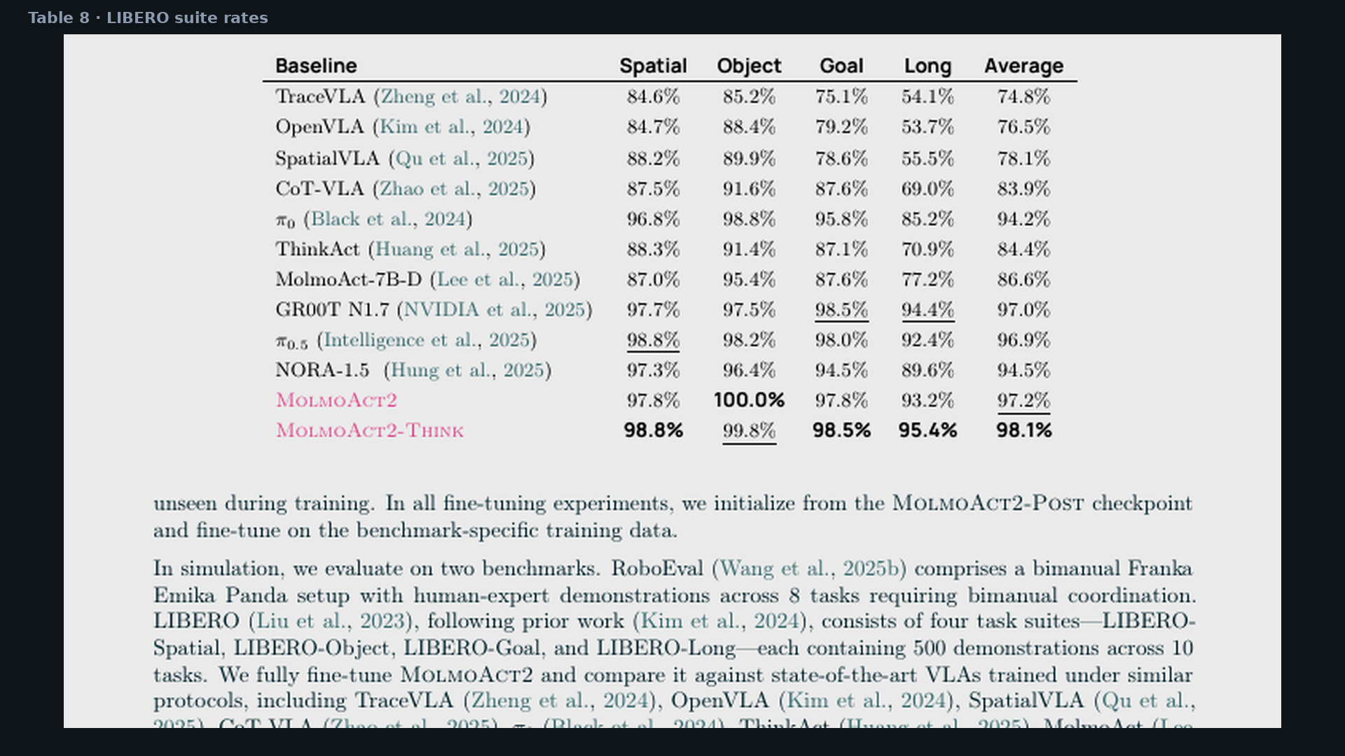
Empiricist · 11+3 · 11/14
Notes:
TABLE 8 LIBERO — suite numbers for P0 targets.

Slide 12
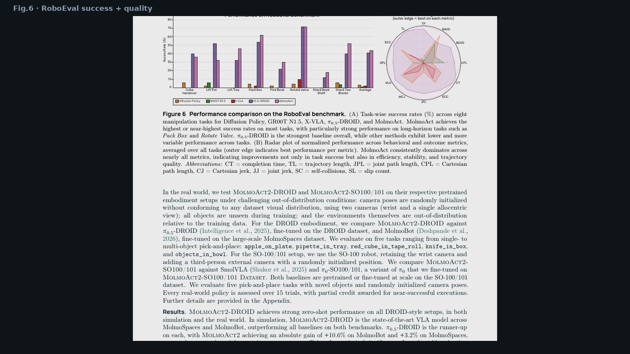
Empiricist · 11+3 · 12/14
Notes:
PAPER FIG.6 RoboEval — beyond binary SR (path/jerk/CT).

Slide 13
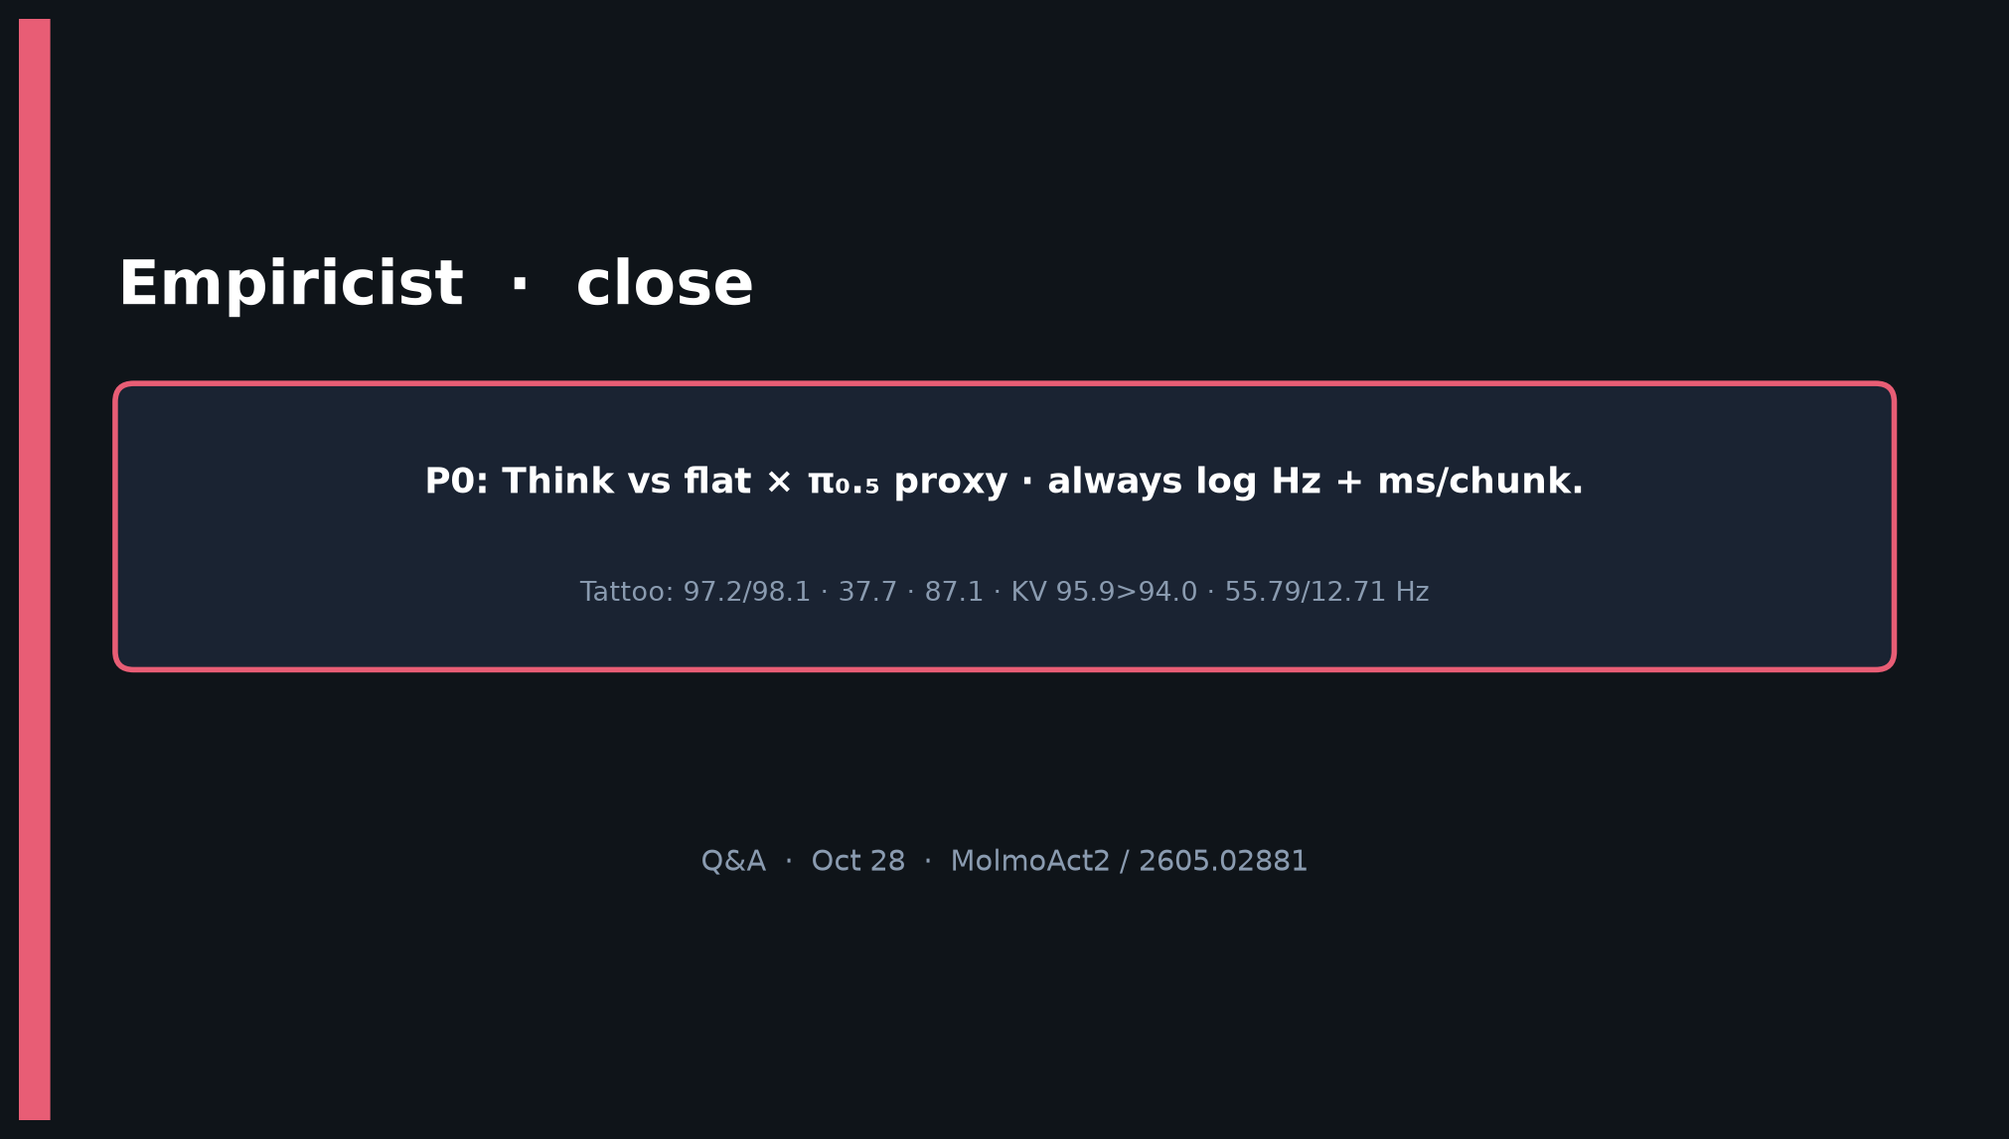
Empiricist · 11+3 · 13/14
Notes:
CLOSE.
P0: Think vs flat × π₀.₅ proxy · always log Hz + ms/chunk.
Env: /workspace/molmoact2-quiet/env_outline/

Slide 14
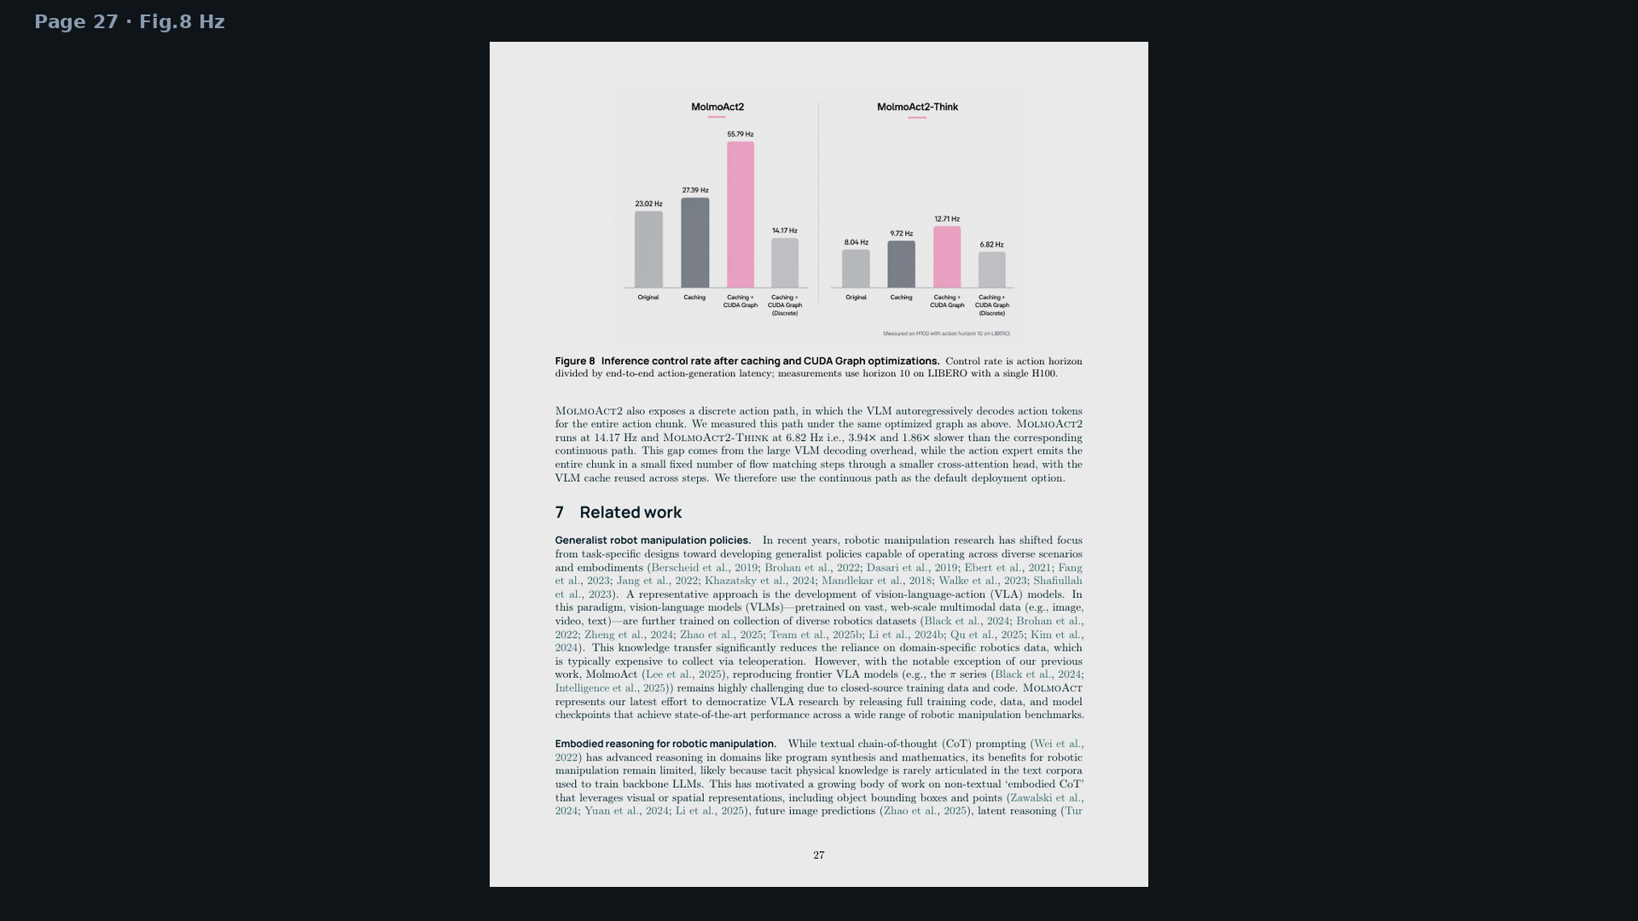
Empiricist · 11+3 · 14/14
Notes:
BACKUP — full Hz page.

