Slide 1
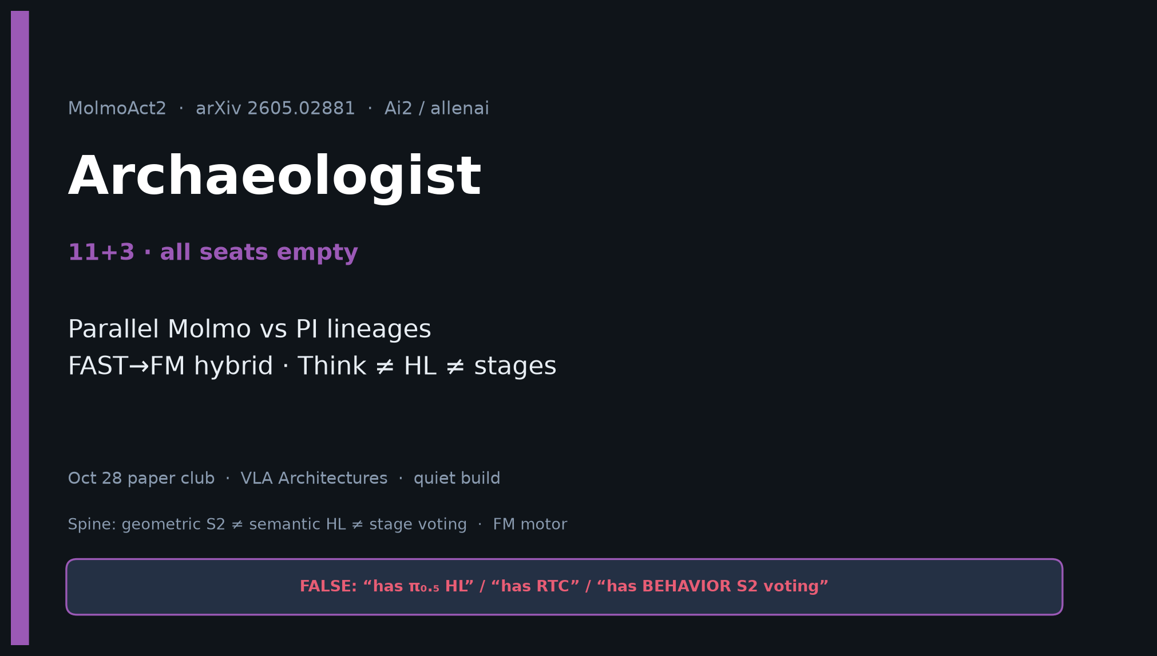
Archaeologist · 11+3 · 1/14
Notes:
ARCHAEOLOGIST OPENING — 11+3. Parallel Molmo vs PI lineages.
What’s new: ER · YAM · per-layer KV · adaptive depth.
NOT: HL · RTC · BEHAVIOR stage voting.

Slide 2
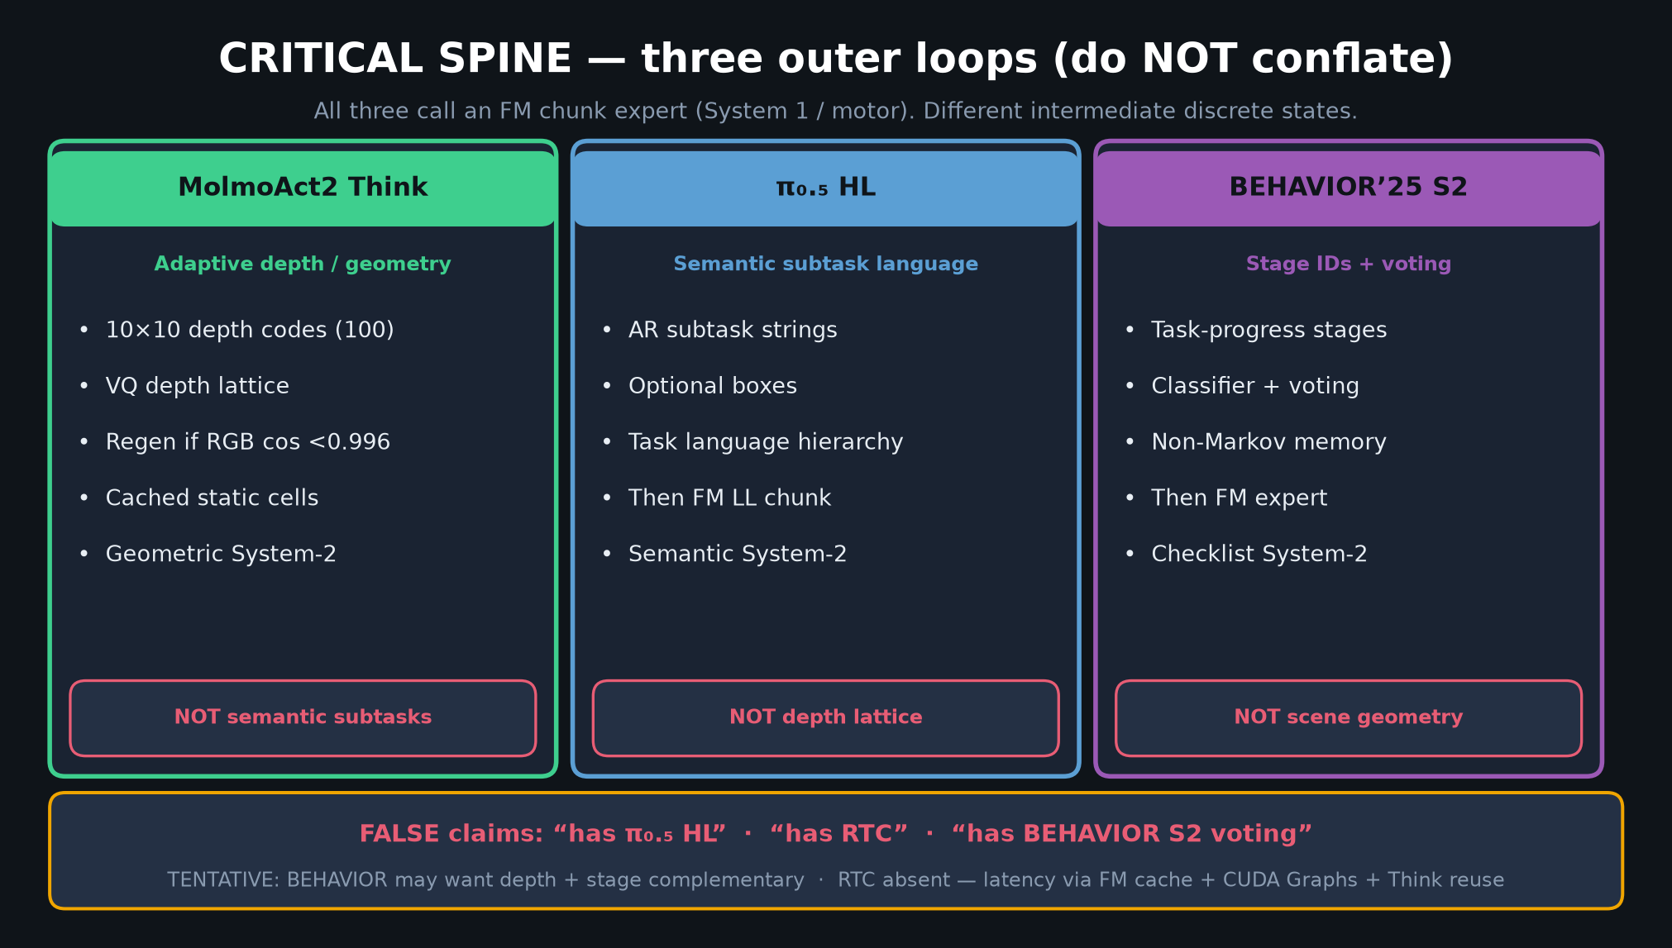
Archaeologist · 11+3 · 2/14
Notes:
SPINE — genealogy stress on three S2 styles.

Slide 3
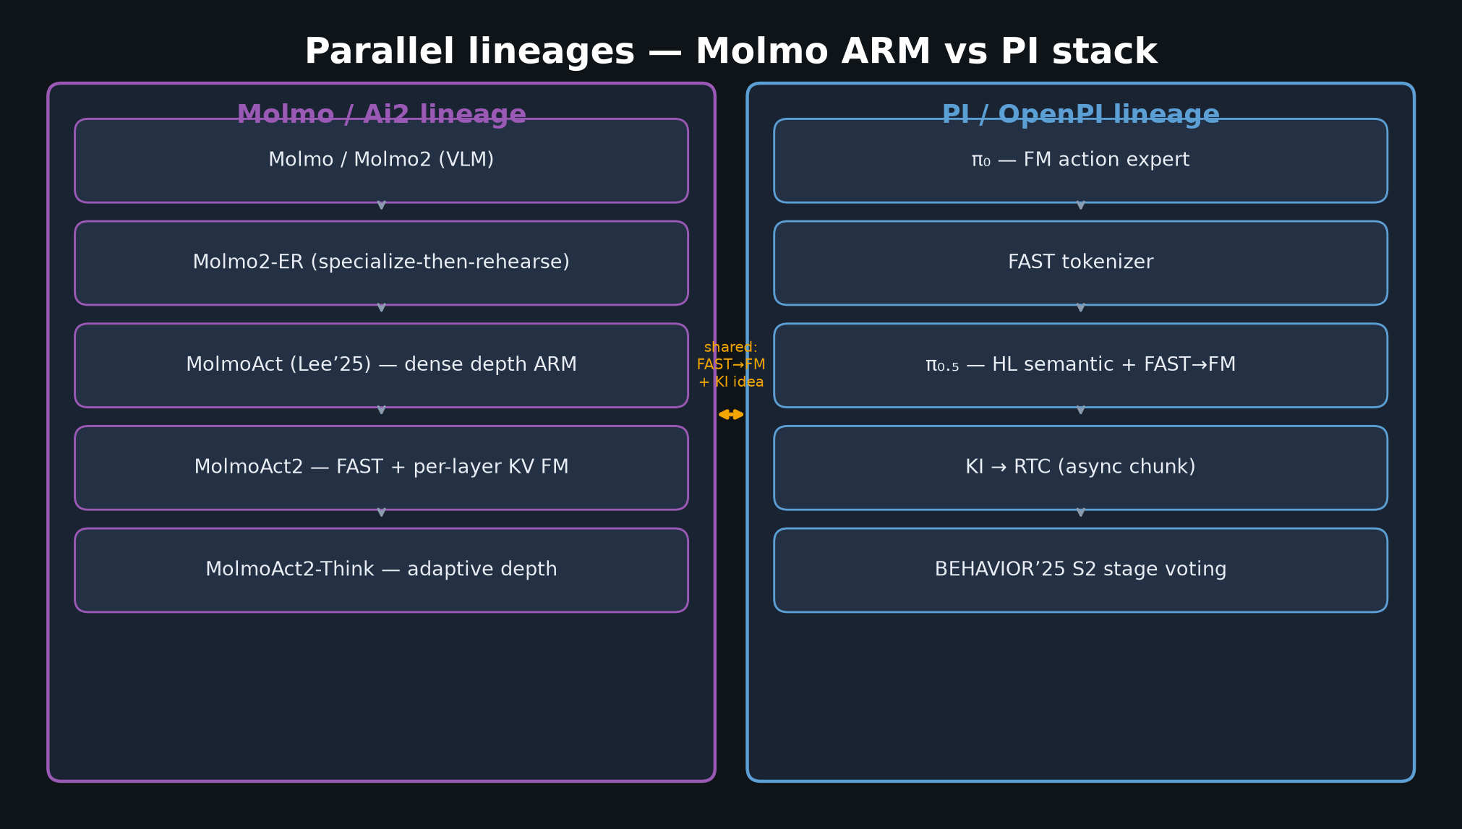
Archaeologist · 11+3 · 3/14
Notes:
PARALLEL LINEAGES MUST-SLIDE.
Molmo/Molmo2 → ER → MolmoAct → MolmoAct2 → Think
∥ π₀ → FAST → π₀.₅ → KI → RTC → BEHAVIOR S2
Bridge: shared FAST→FM + KI idea; different intermediates.

Slide 4
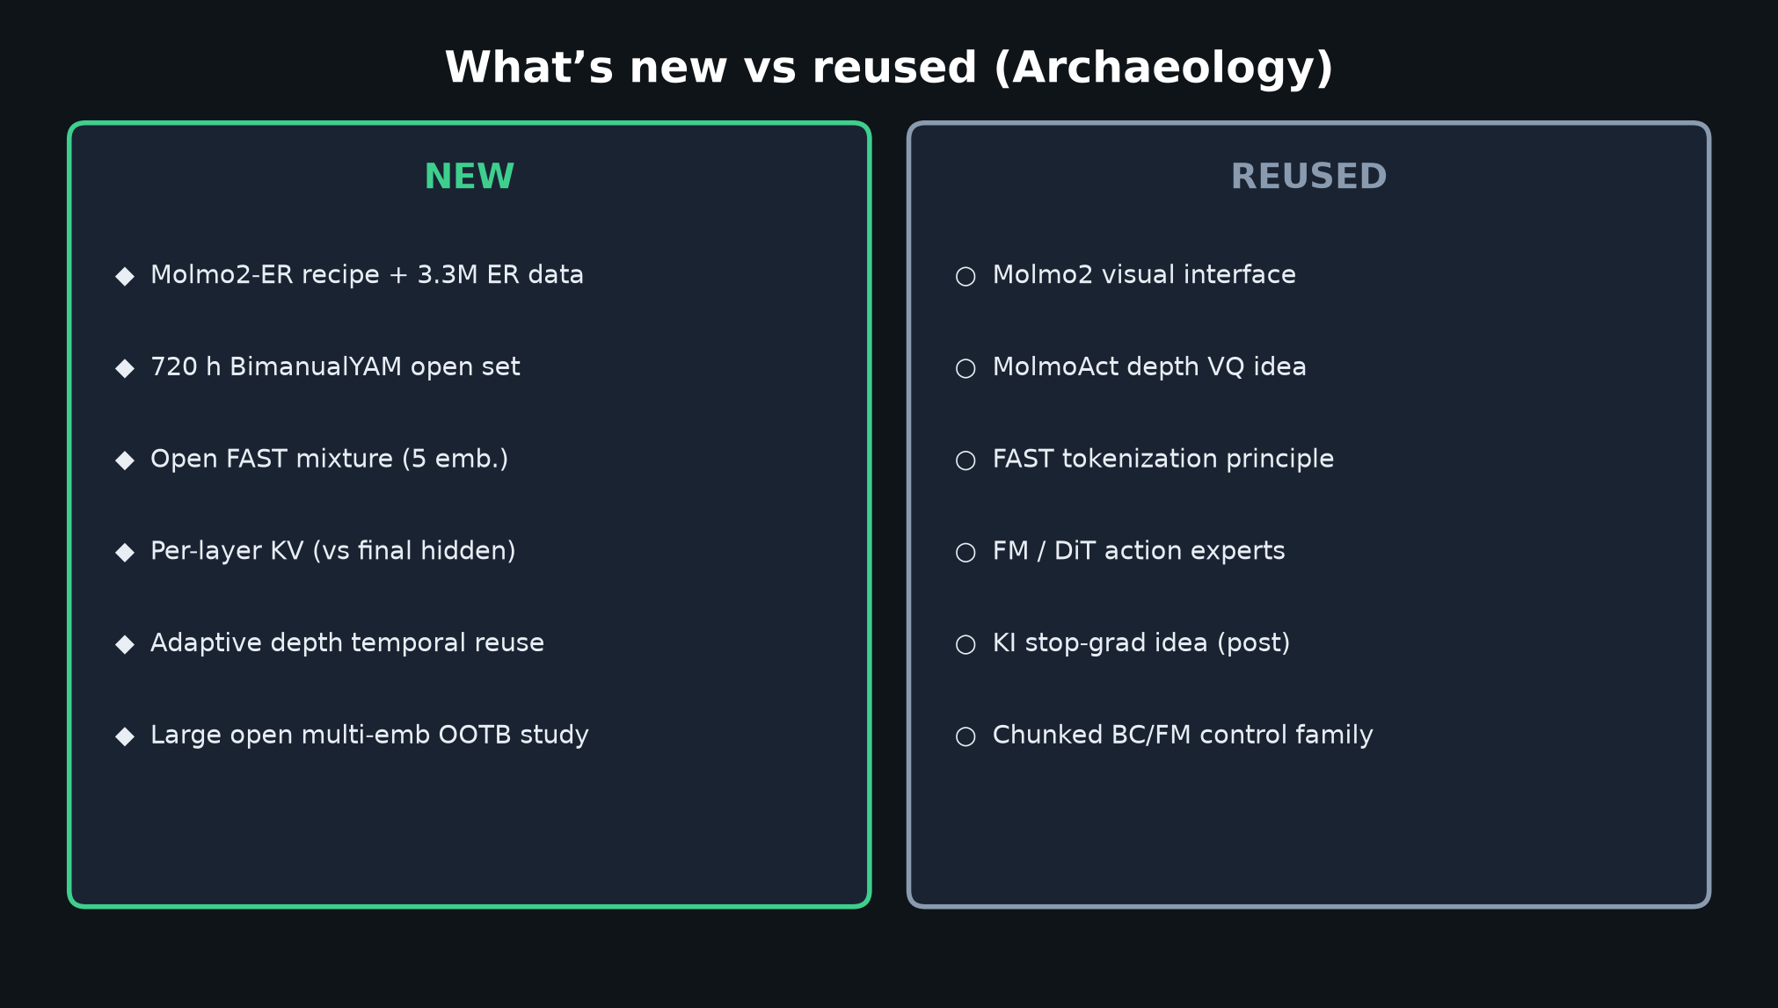
Archaeologist · 11+3 · 4/14
Notes:
WHAT’S NEW vs REUSED.

Slide 5
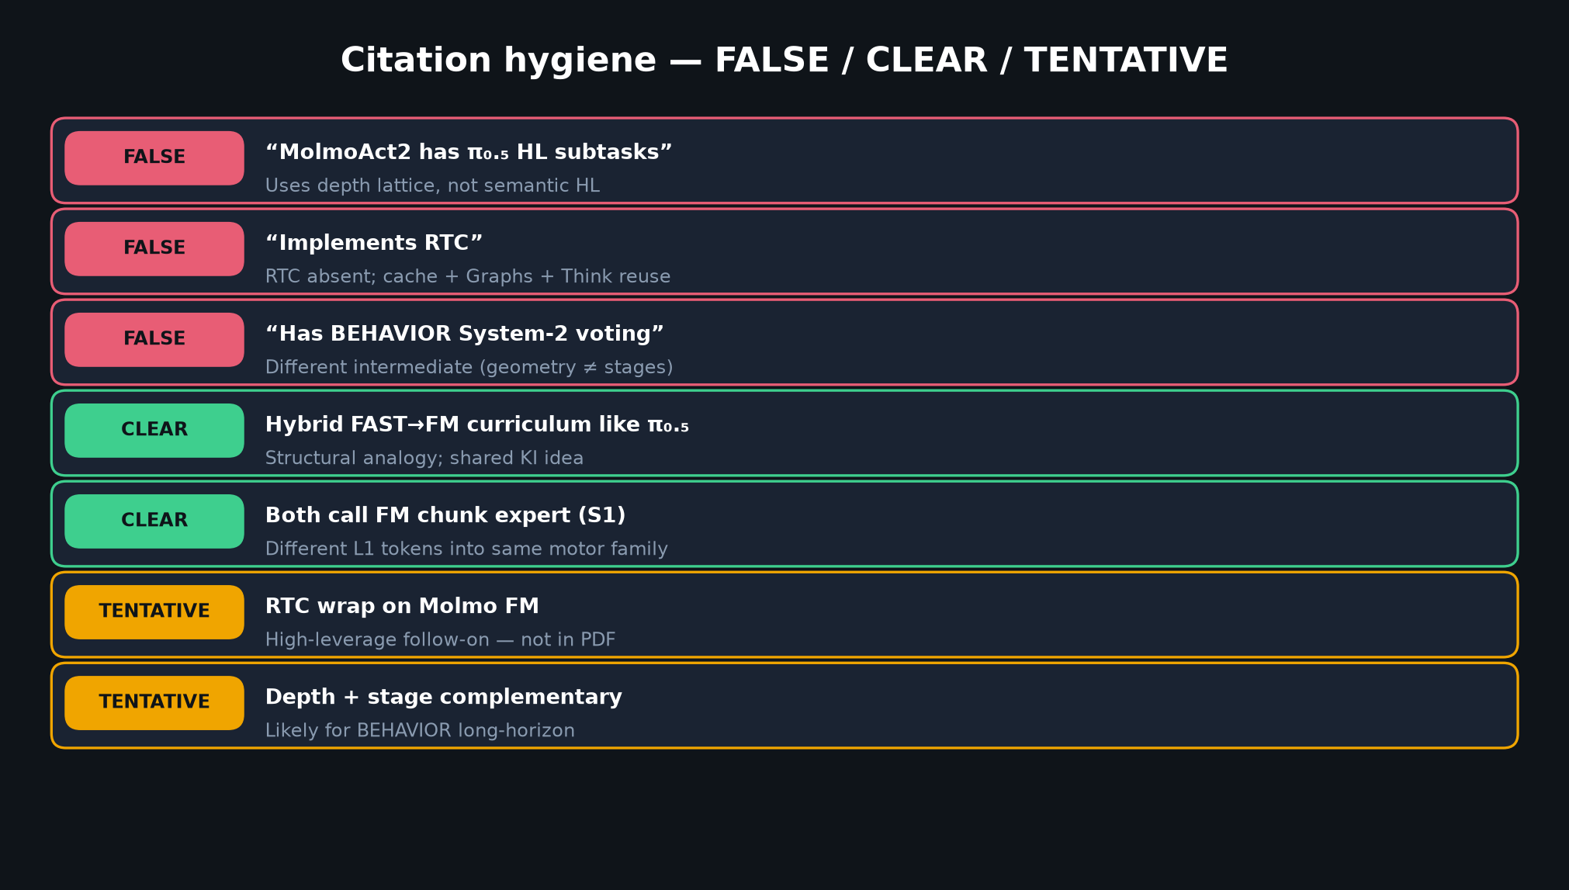
Archaeologist · 11+3 · 5/14
Notes:
FALSE / CLEAR / TENTATIVE corrections — archaeology of claims.

Slide 6
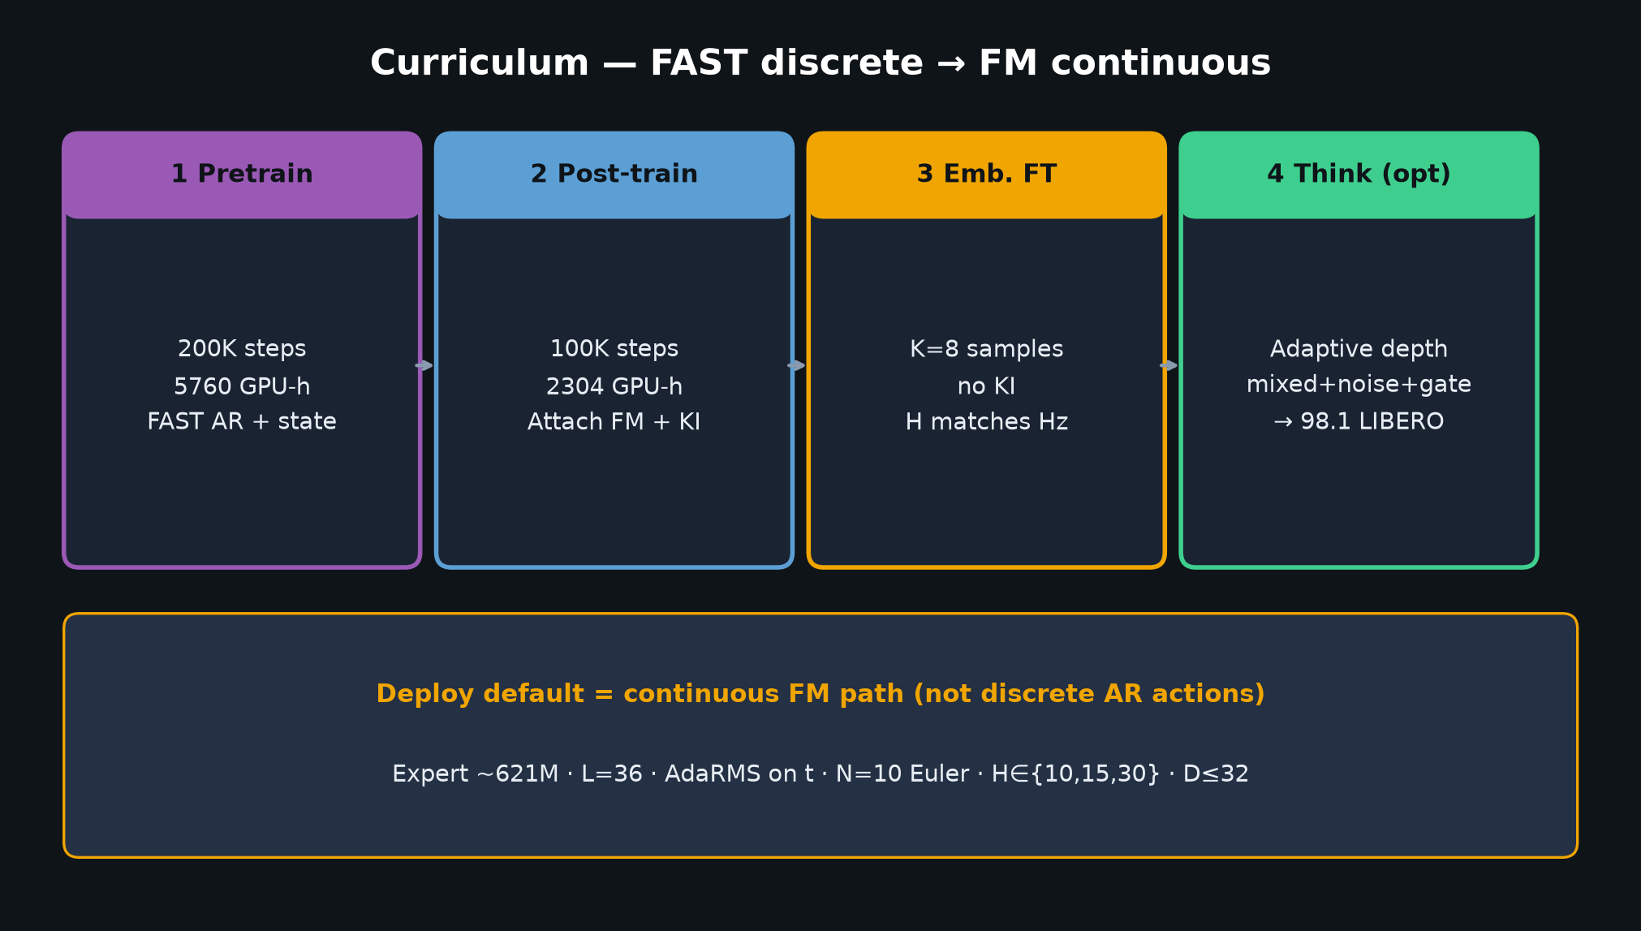
Archaeologist · 11+3 · 6/14
Notes:
CURRICULUM ARCHAEOLOGY — hybrid FAST→FM like π₀.₅ structurally.

Slide 7
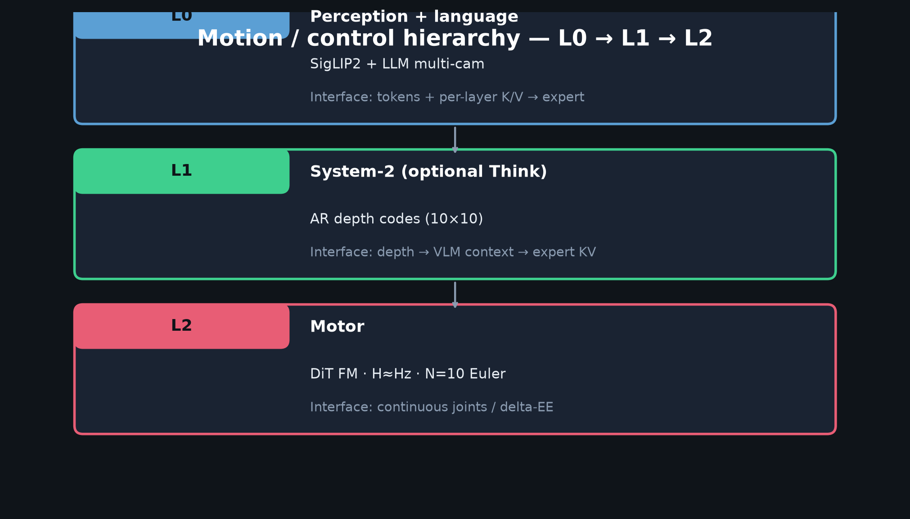
Archaeologist · 11+3 · 7/14
Notes:
HIERARCHY — where Think sits relative to HL/stages historically.

Slide 8
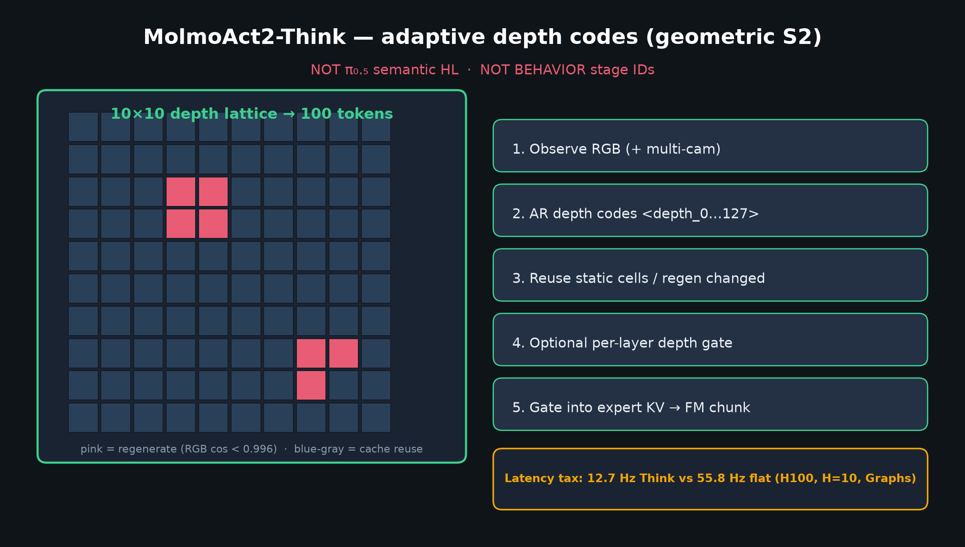
Archaeologist · 11+3 · 8/14
Notes:
THINK DEPTH — evolution from dense MolmoAct depth CoT to adaptive reuse.

Slide 9
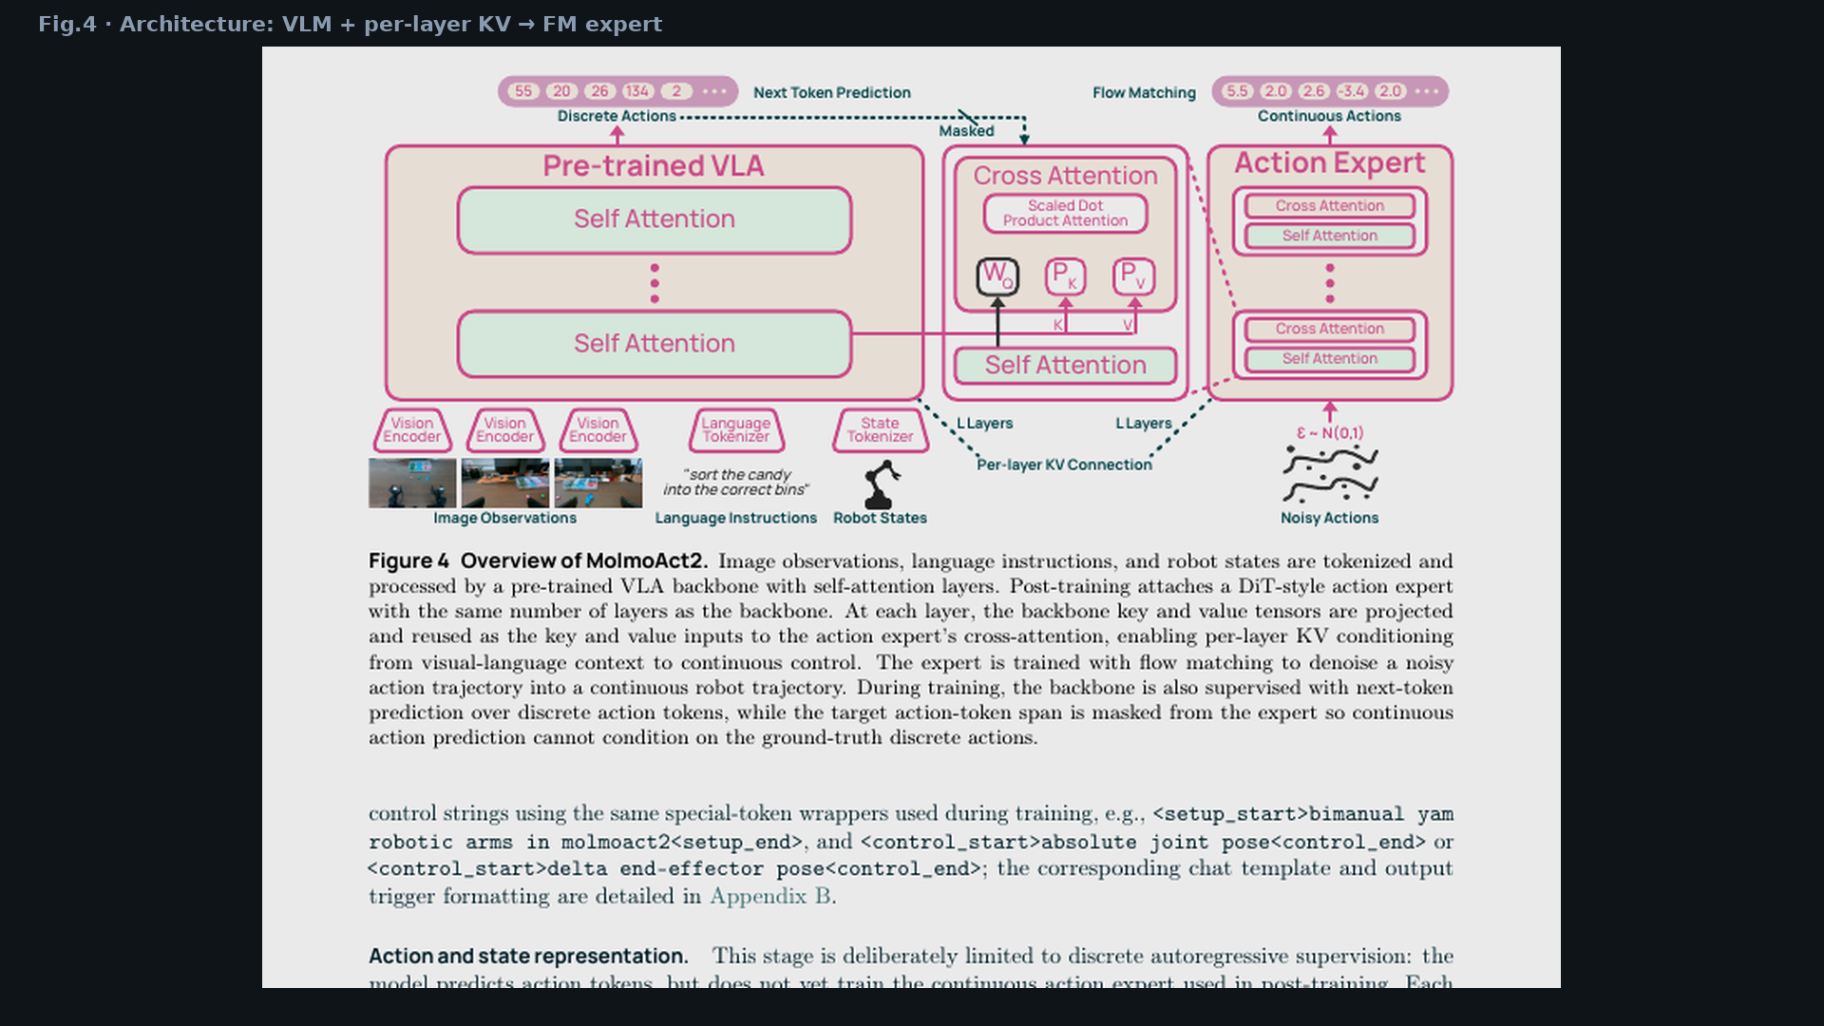
Archaeologist · 11+3 · 9/14
Notes:
PAPER FIG.4 — architecture hinge (per-layer KV new vs many hidden-state experts).

Slide 10
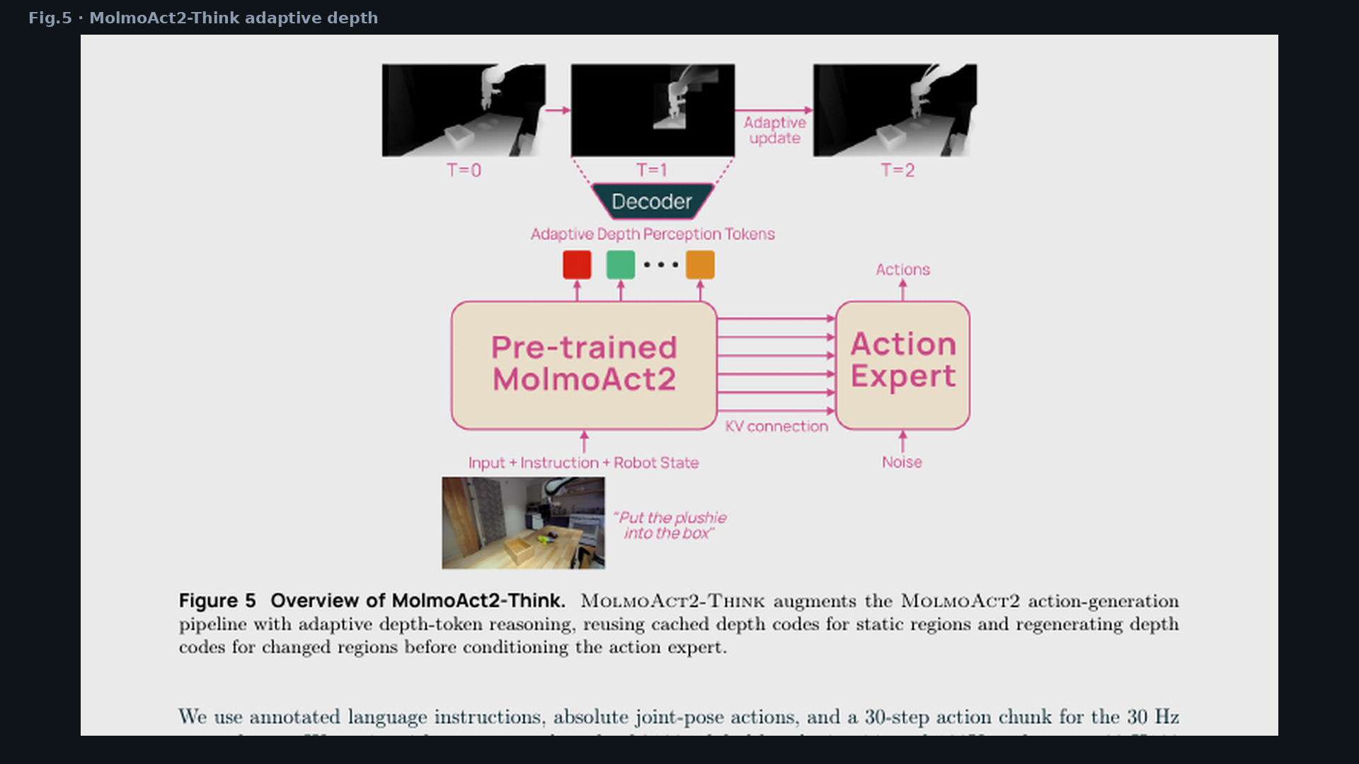
Archaeologist · 11+3 · 10/14
Notes:
PAPER FIG.5 — Think as adaptive successor to dense depth ARM.

Slide 11
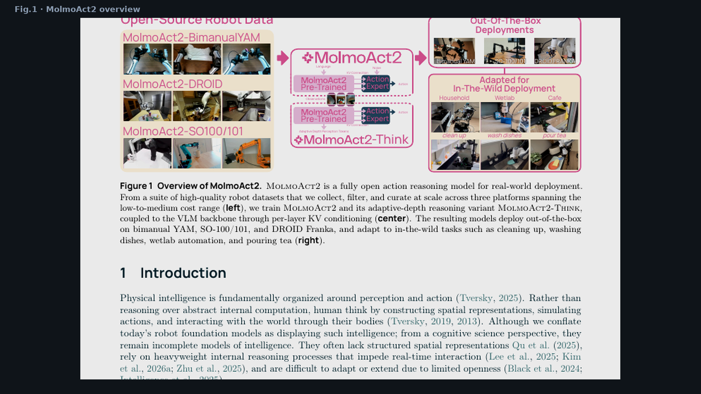
Archaeologist · 11+3 · 11/14
Notes:
PAPER FIG.1 — product framing in lineage of “open generalist VLA” claims.

Slide 12
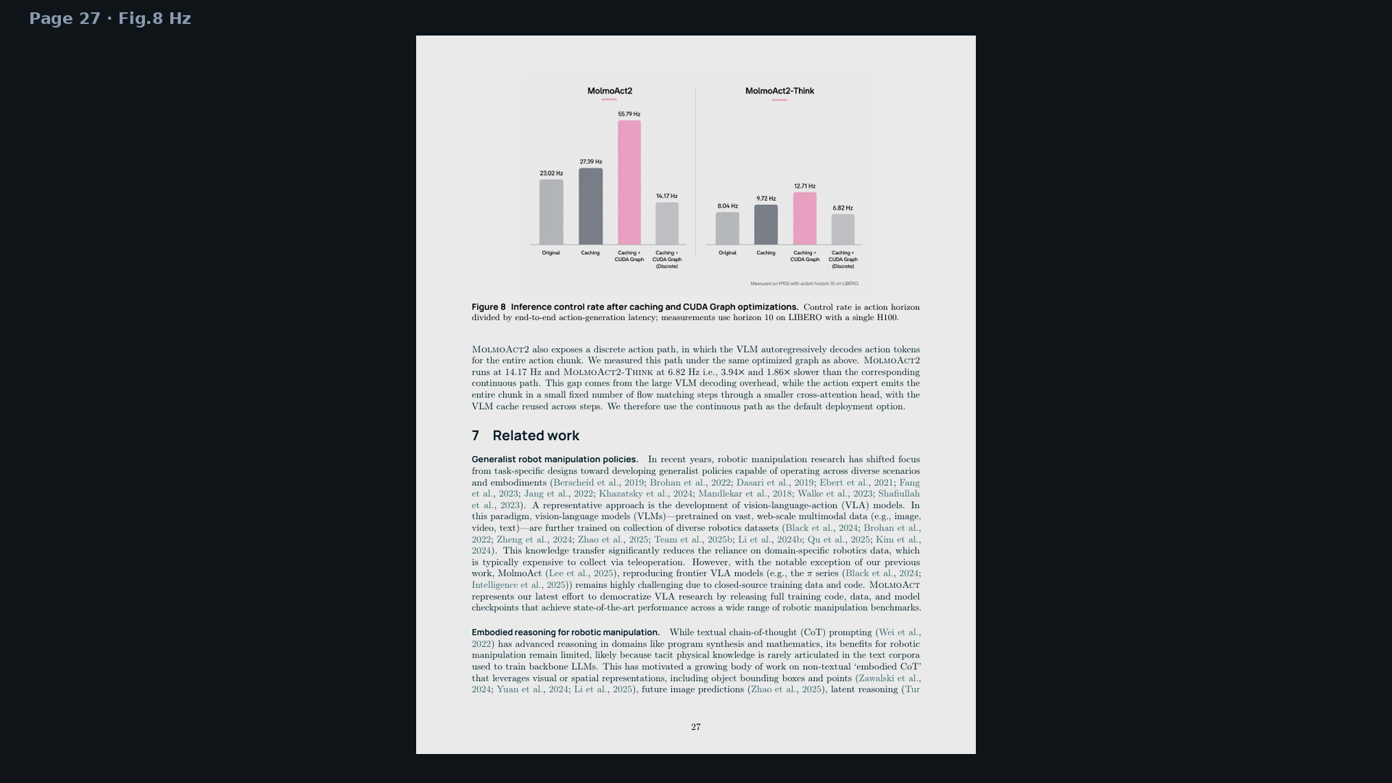
Archaeologist · 11+3 · 12/14
Notes:
RELATED-WORK PAGE CONTEXT — openness vs π closed; embodied CoT spatial not textual.

Slide 13
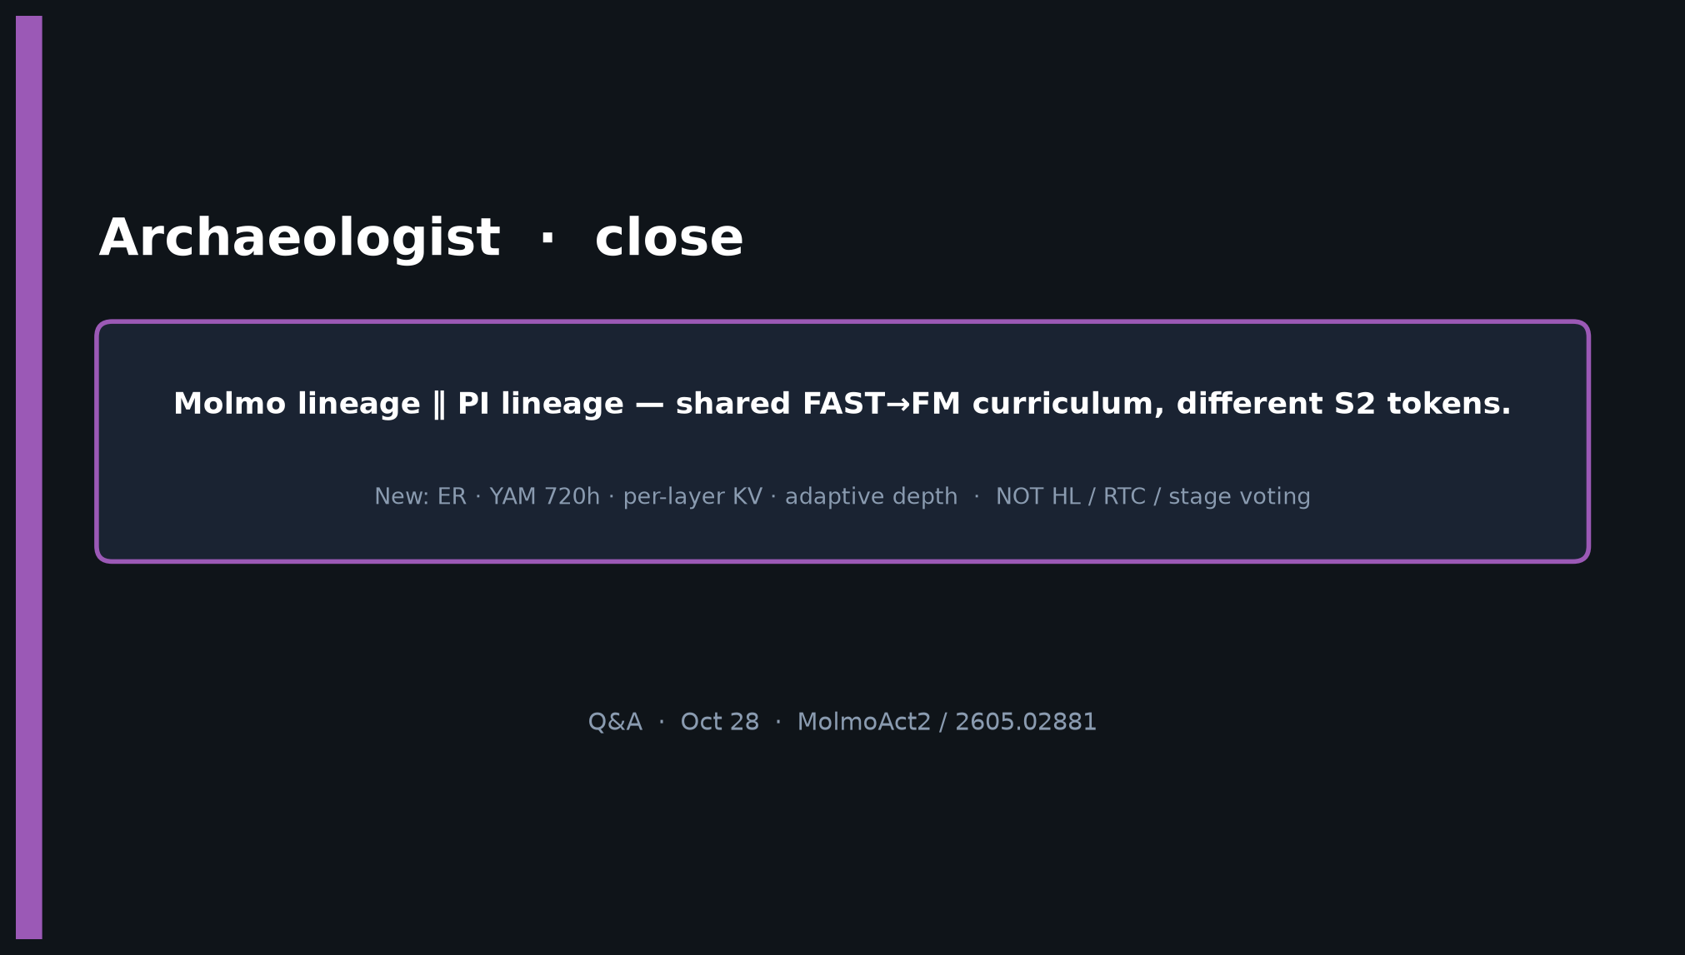
Archaeologist · 11+3 · 13/14
Notes:
CLOSE.
Molmo lineage ∥ PI lineage — shared curriculum, different S2 tokens.
New: ER · YAM 720h · per-layer KV · adaptive depth.

Slide 14
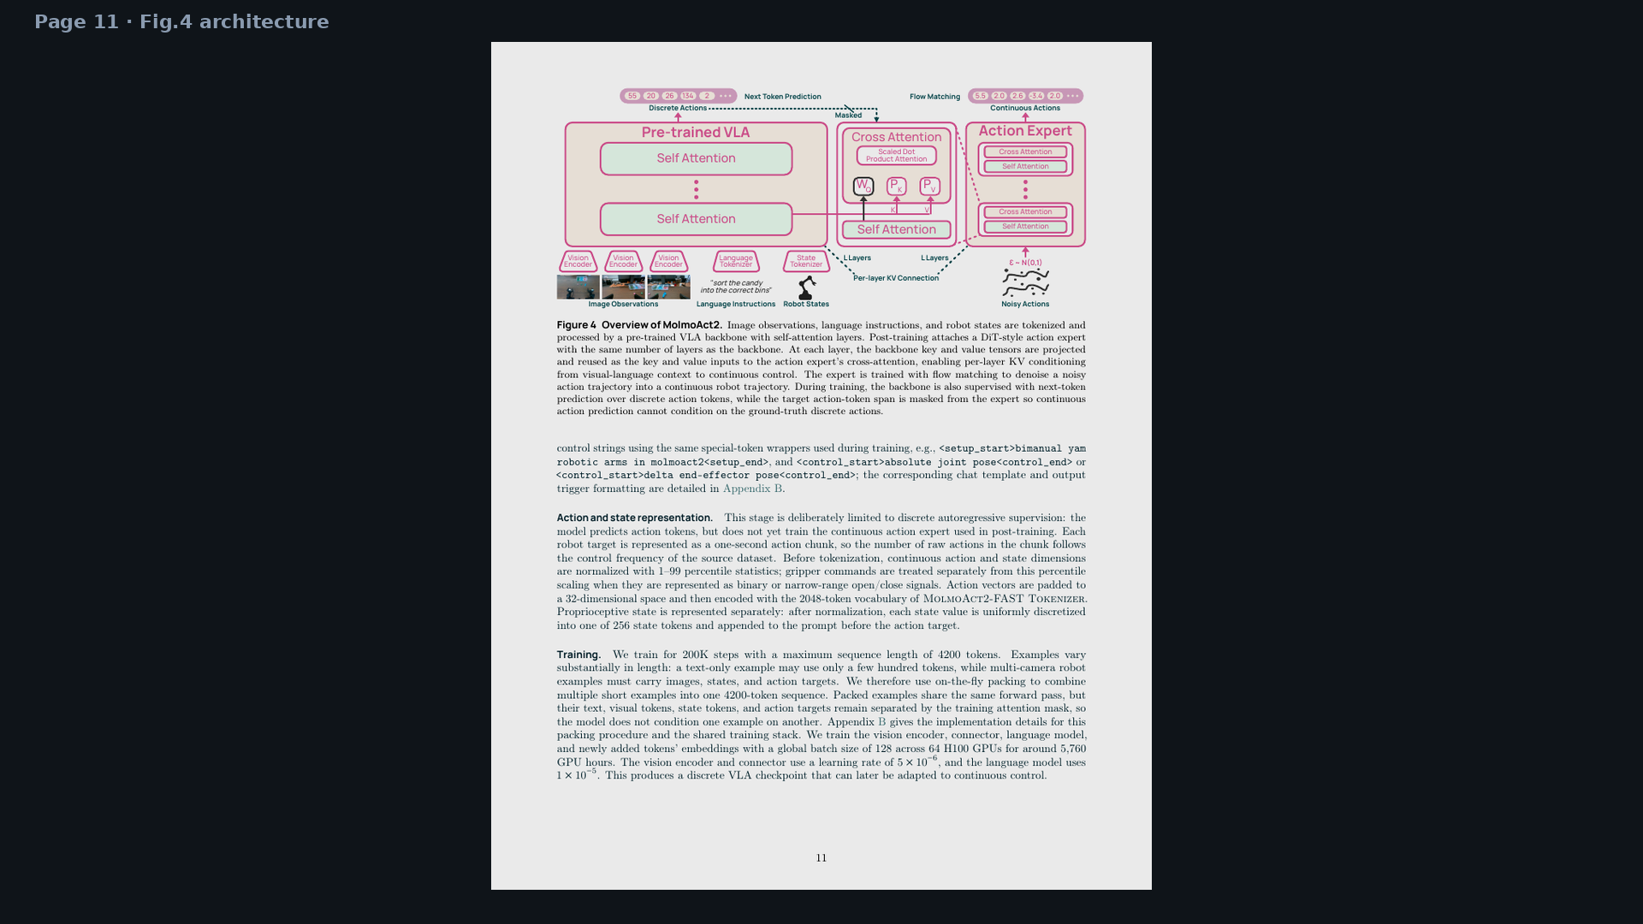
Archaeologist · 11+3 · 14/14
Notes:
BACKUP — architecture full page.

