Slide 1
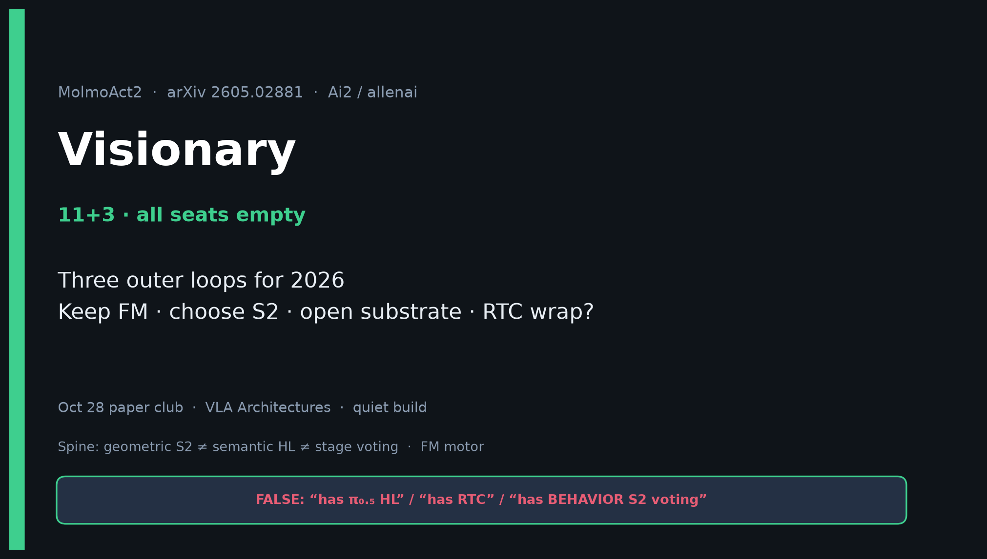
Visionary · 11+3 · 1/14
Notes:
VISIONARY OPENING — all seats empty; still deliver full strategy pack. Timing 11+3.
ONE SENTENCE:
MolmoAct2 shows open ARMs can beat π₀.₅ on standard manip suites via embodied VLM + FAST→FM + adaptive depth System-2 — but 2025 BEHAVIOR was won by stage System-2 + control on π₀.₅. Hybridize for 2026.
MUST SAY:
• Keep FM low-level (discrete AR slower).
• Choose S2 deliberately: semantic HL/stages vs depth ARM vs hybrid.
• Open substrate when π gated; don’t assume OOTB wins BEHAVIOR without stage tracking + RTC.
• RTC wrap on Molmo FM = high-leverage follow-on (TENTATIVE).
• Skip Discord/Drive.

Slide 2
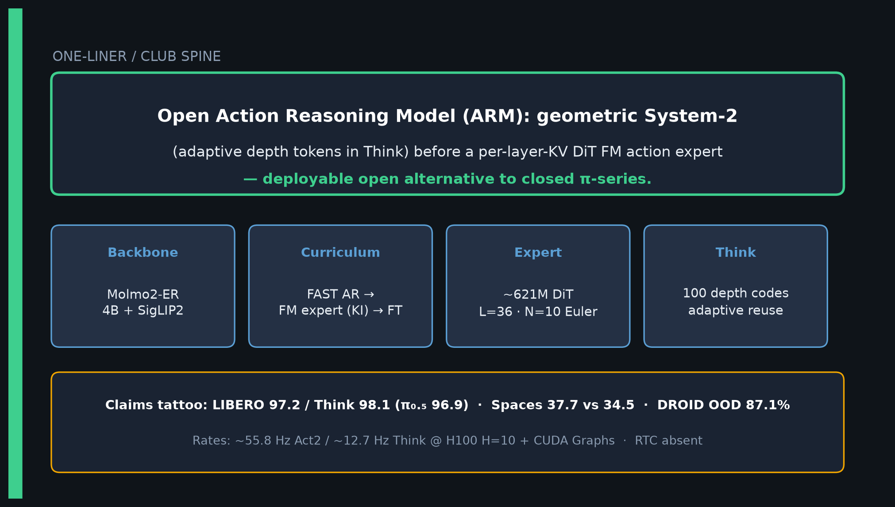
Visionary · 11+3 · 2/14
Notes:
CLUB SPINE / ONE-LINER — deliver early.
Open ARM: geometric System-2 (adaptive depth in Think) before per-layer-KV DiT FM expert — open alternative to closed π-series.
Tattoo: LIBERO 97.2/Think 98.1; Spaces 37.7; DROID 87.1; 55.8/12.7 Hz.
RTC absent — latency via FM cache + CUDA Graphs + Think reuse.

Slide 3
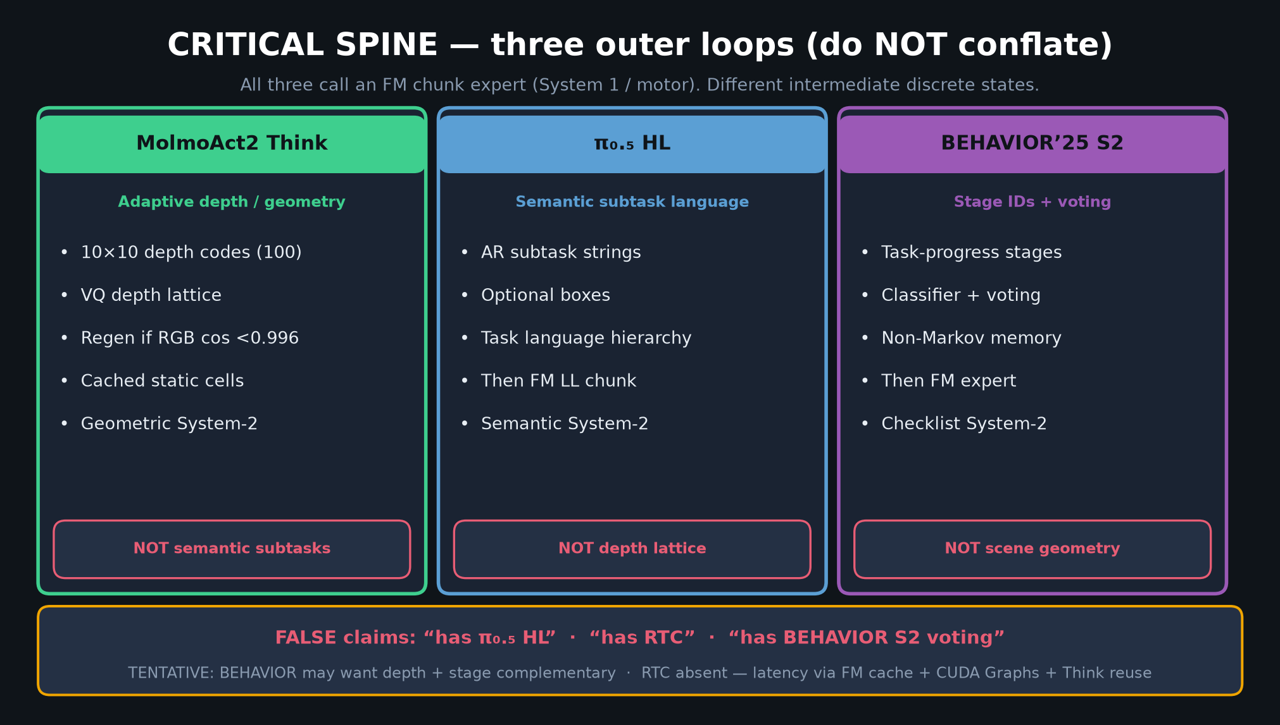
Visionary · 11+3 · 3/14
Notes:
THREE OUTER LOOPS — THE SPINE FIGURE. Spend 90–120s. Do NOT conflate.
| Outer loop | What it is | What it is NOT |
| MolmoAct2 Think | Adaptive depth/geometry codes (10×10) | π₀.₅ HL semantic subtask strings |
| π₀.₅ HL | Semantic subtask language | Depth lattice |
| BEHAVIOR’25 System-2 | Task-progress stage IDs + voting | Scene geometry |
All three call FM chunk expert (System 1).
FALSE: “has π₀.₅ HL” / “has RTC” / “has BEHAVIOR S2 voting.”
TENTATIVE: BEHAVIOR may want depth + stage complementary.

Slide 4
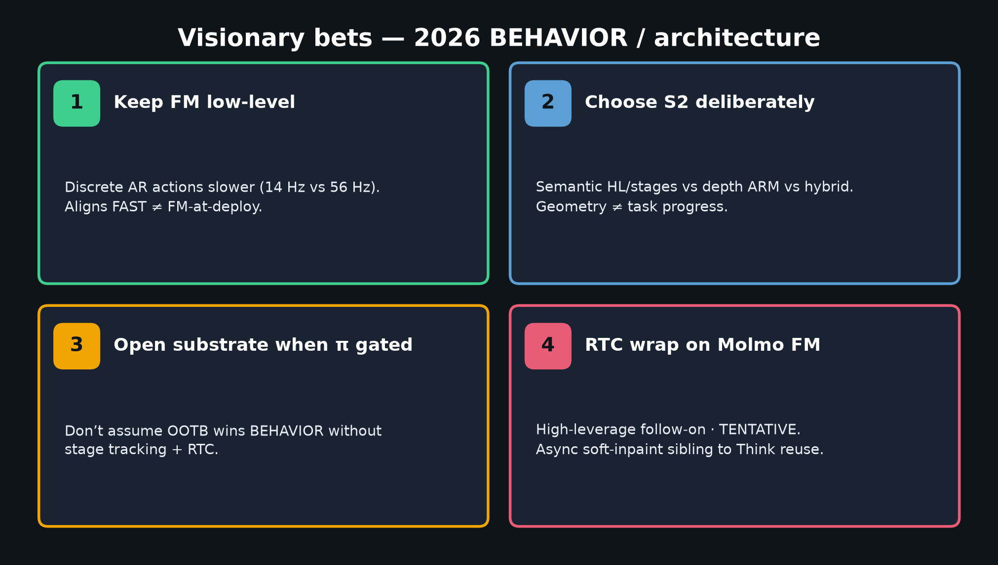
Visionary · 11+3 · 4/14
Notes:
BET 1–4 CARD — Visionary musts.
1 Keep FM low-level — discrete AR 14 Hz vs continuous 56 Hz.
2 Choose S2 deliberately — semantic vs depth vs hybrid.
3 Open substrate when π gated — need stage tracking + RTC for BEHAVIOR.
4 RTC wrap on Molmo FM = TENTATIVE high-leverage follow-on.
Don’t cargo-cult open-loop on long-horizon household — prefer receding horizon (Comet).

Slide 5
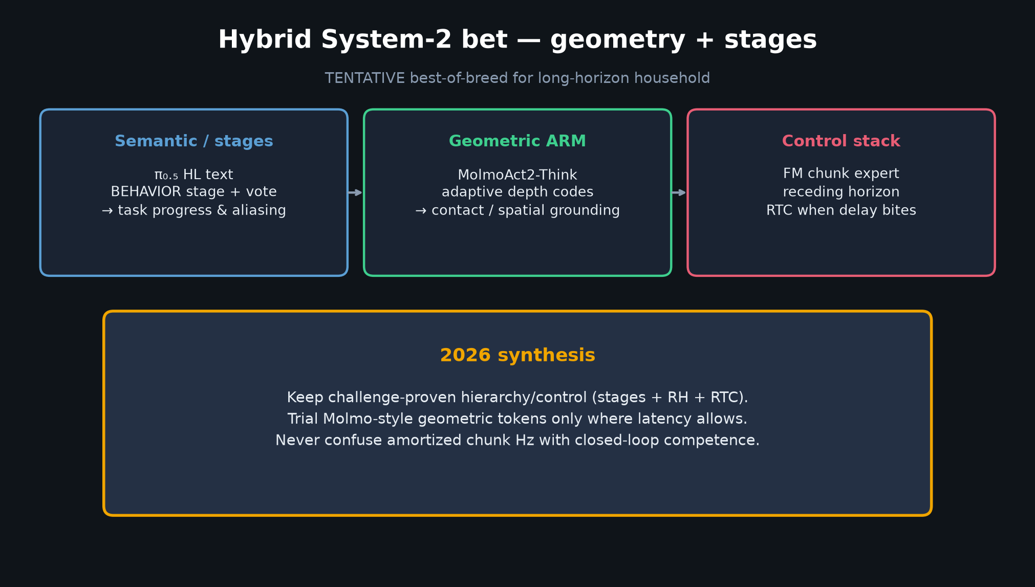
Visionary · 11+3 · 5/14
Notes:
HYBRID S2 SYNTHESIS.
Semantic/stages (π₀.₅ HL, BEHAVIOR voting) for task progress & aliasing.
Geometric ARM (Think) for contact-rich spatial grounding.
Control: FM + receding horizon + RTC when delay bites.
2026: keep challenge-proven hierarchy/control; trial Molmo geometric tokens where latency allows.
Never confuse amortized chunk Hz with closed-loop competence.

Slide 6
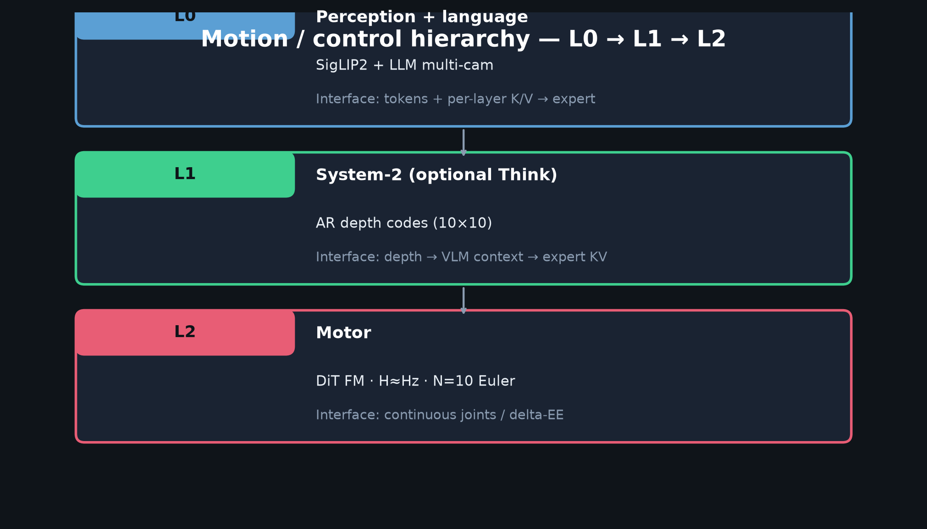
Visionary · 11+3 · 6/14
Notes:
L0/L1/L2 HIERARCHY.
L0: SigLIP2+LLM → tokens + per-layer K/V
L1 (opt Think): AR depth codes → expert KV
L2 Motor: DiT FM H≈Hz N=10 Euler → continuous joints
CLEAR vs π₀.₅: L1 is geometric depth lattice, not semantic subtask string.
CLEAR vs BEHAVIOR: depth is scene geometry, not checklist stage IDs.

Slide 7
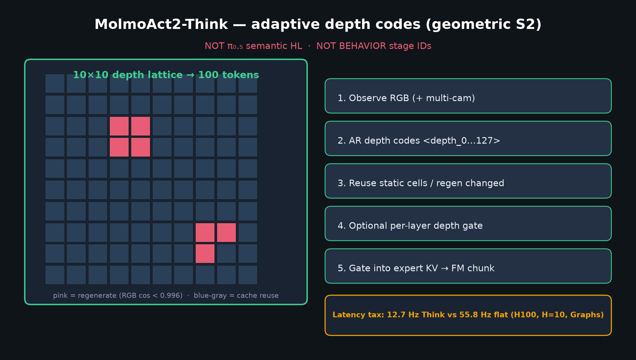
Visionary · 11+3 · 7/14
Notes:
THINK DEPTH DIAGRAM — geometric System-2.
10×10 → 100 tokens; codes depth_0…127; regen if RGB cosine <0.996; else cache.
Optional per-layer depth gate → FM chunk.
Latency tax: 12.7 vs 55.8 Hz. Quote Hz with every Think claim.

Slide 8
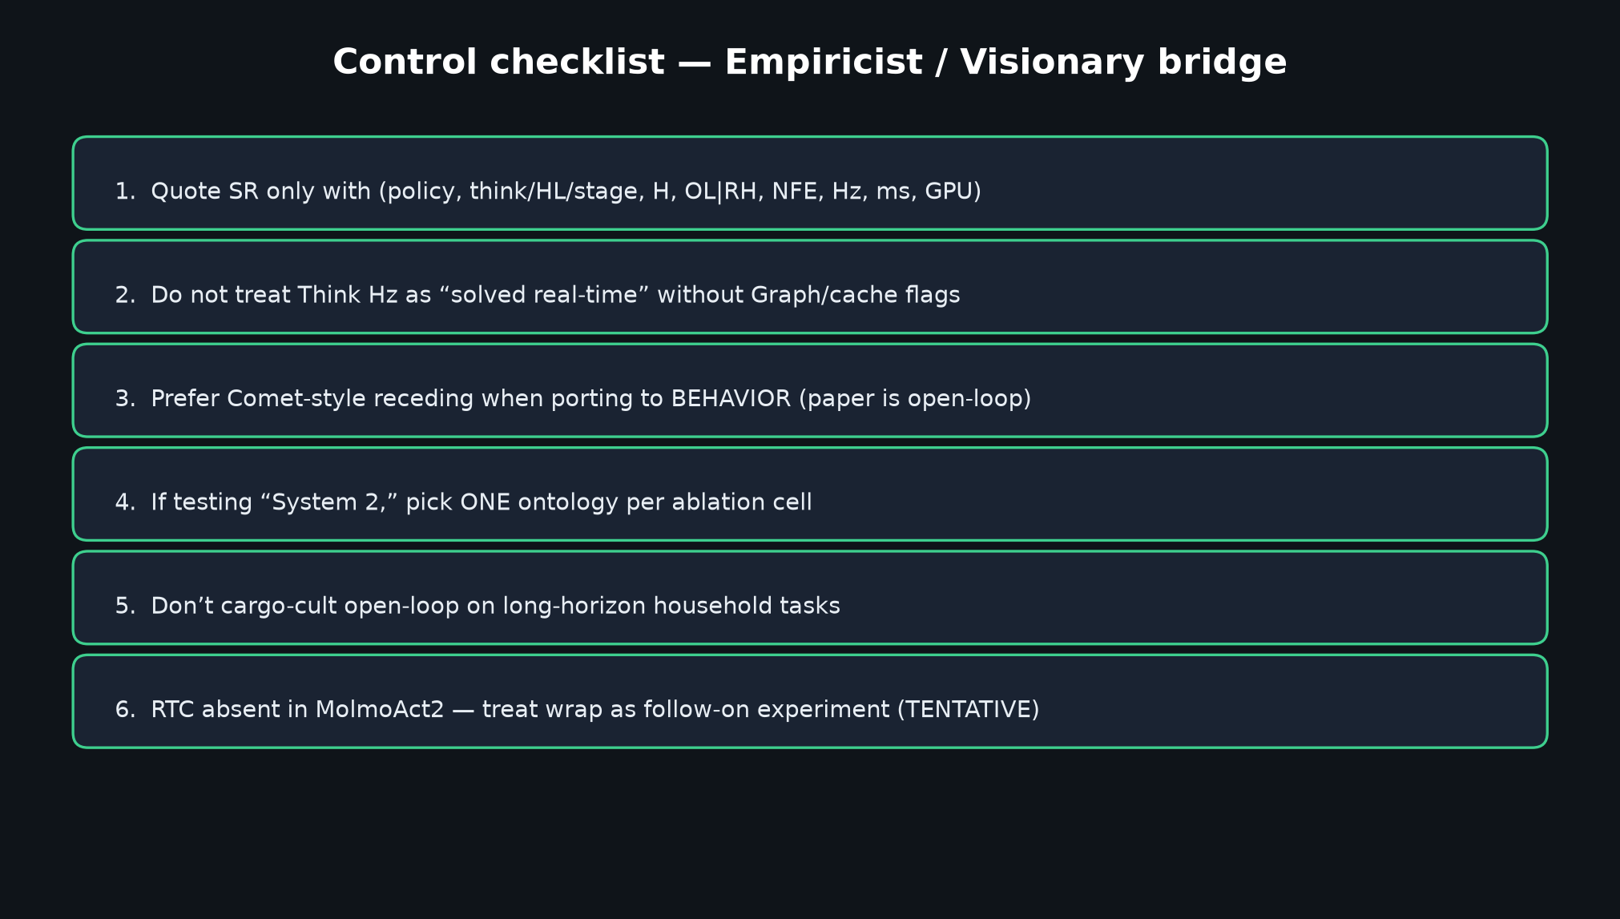
Visionary · 11+3 · 8/14
Notes:
CONTROL CHECKLIST — bridge Empiricist.
Prefer receding horizon for BEHAVIOR even if paper App E is open-loop.
Pick ONE S2 ontology per ablation cell.
RTC wrap = follow-on, not claimed feature.

Slide 9
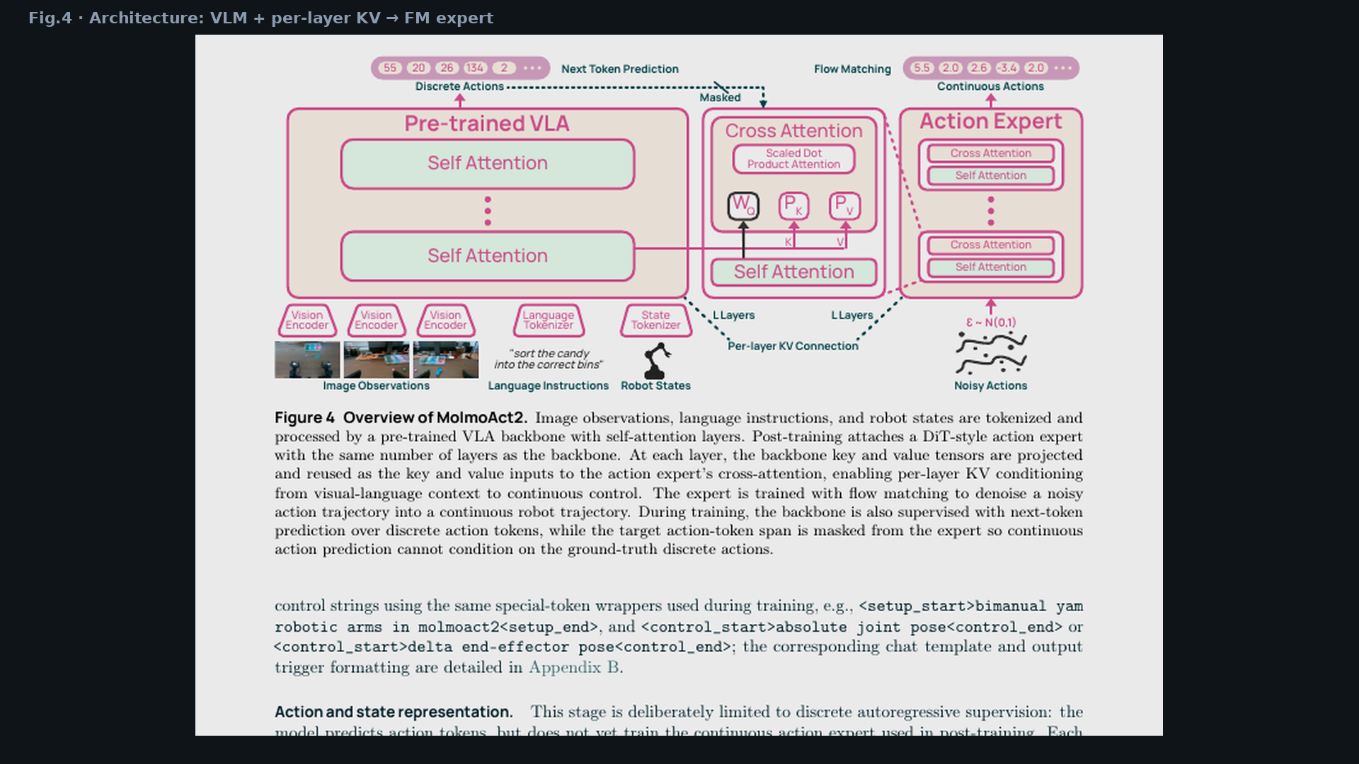
Visionary · 11+3 · 9/14
Notes:
PAPER FIG.4 — core motion interface.
VLM backbone + per-layer KV → DiT FM action expert.
Point: continuous path is deploy default; discrete FAST is curriculum.

Slide 10
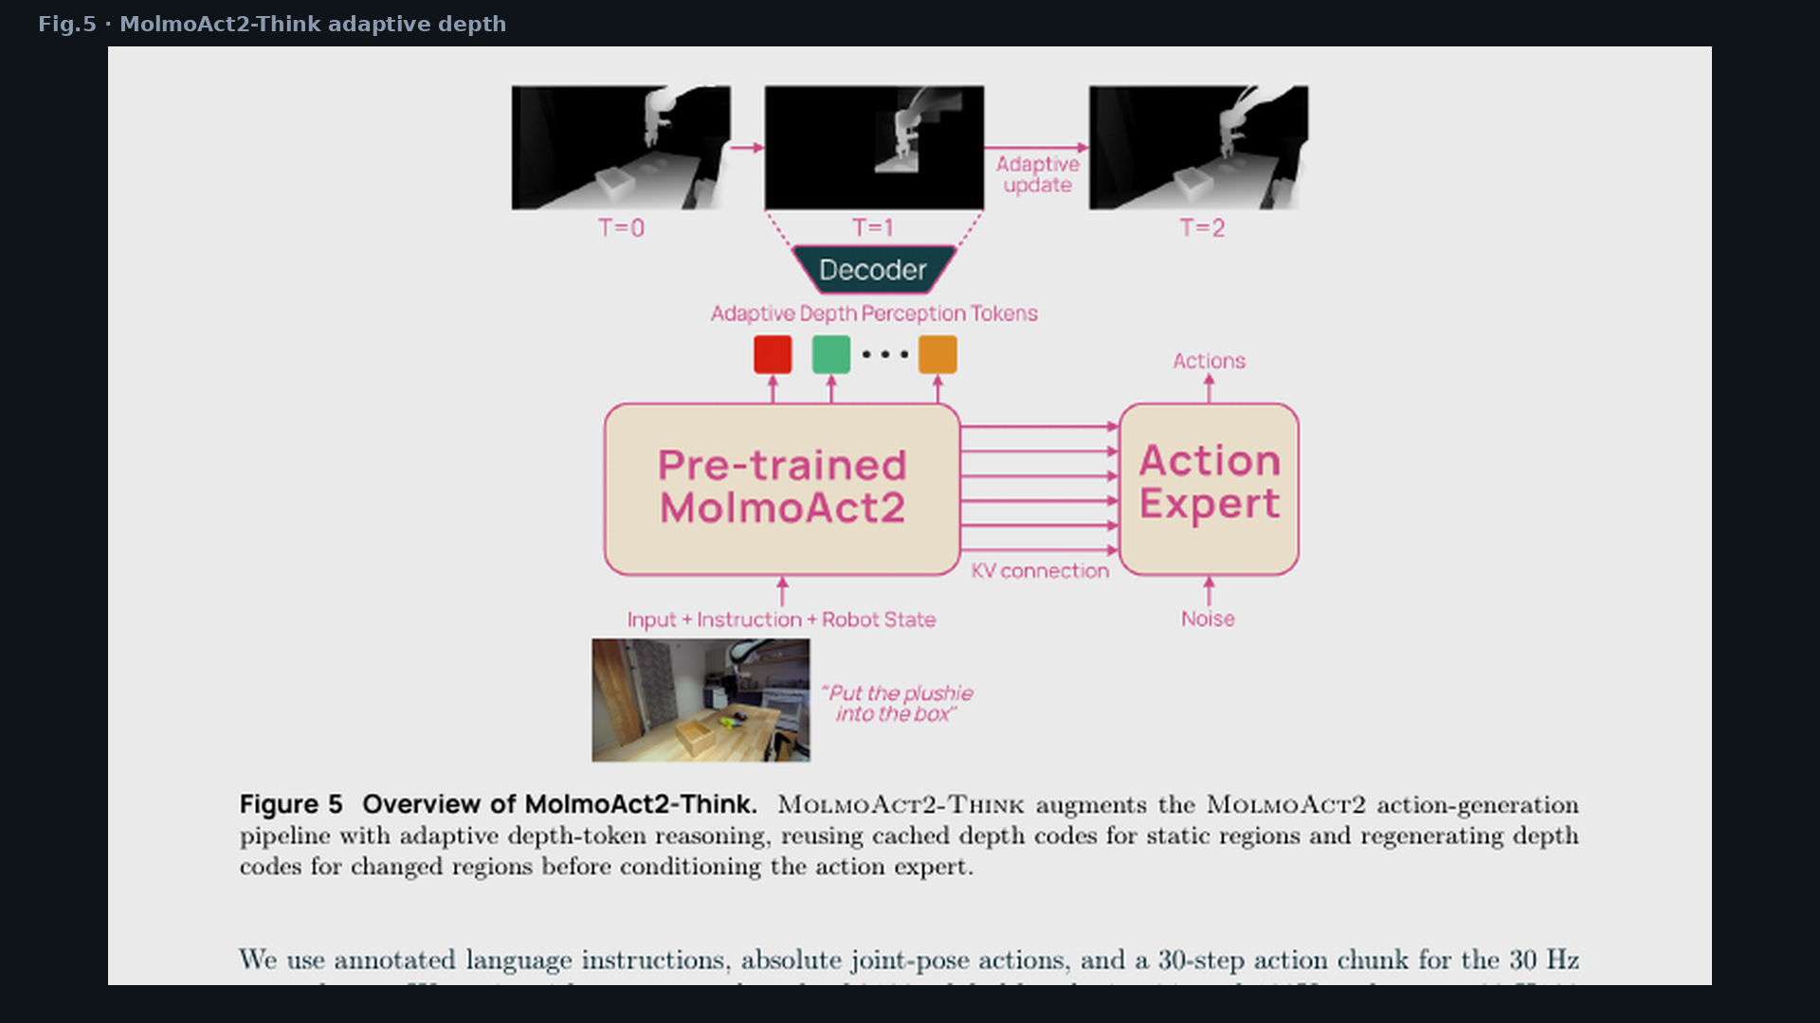
Visionary · 11+3 · 10/14
Notes:
PAPER FIG.5 — Think adaptive depth pipeline.
Reuse static cells; regenerate changed regions; then same FM expert.
Visual proof Think ≠ HL text.

Slide 11
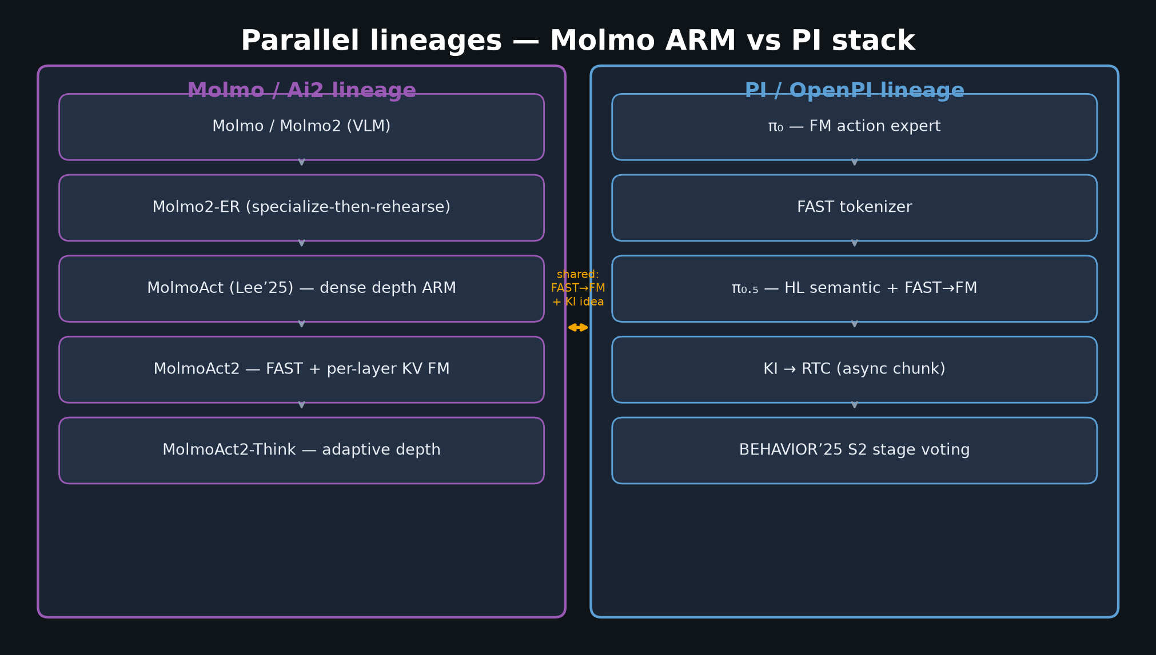
Visionary · 11+3 · 11/14
Notes:
PARALLEL LINEAGES — Molmo ARM ∥ PI stack.
Shared: FAST→FM curriculum + KI idea.
Different: depth vs HL vs stages; RTC on PI side only.
2025 medals came from stage S2 + control on π₀.₅, not depth CoT.

Slide 12
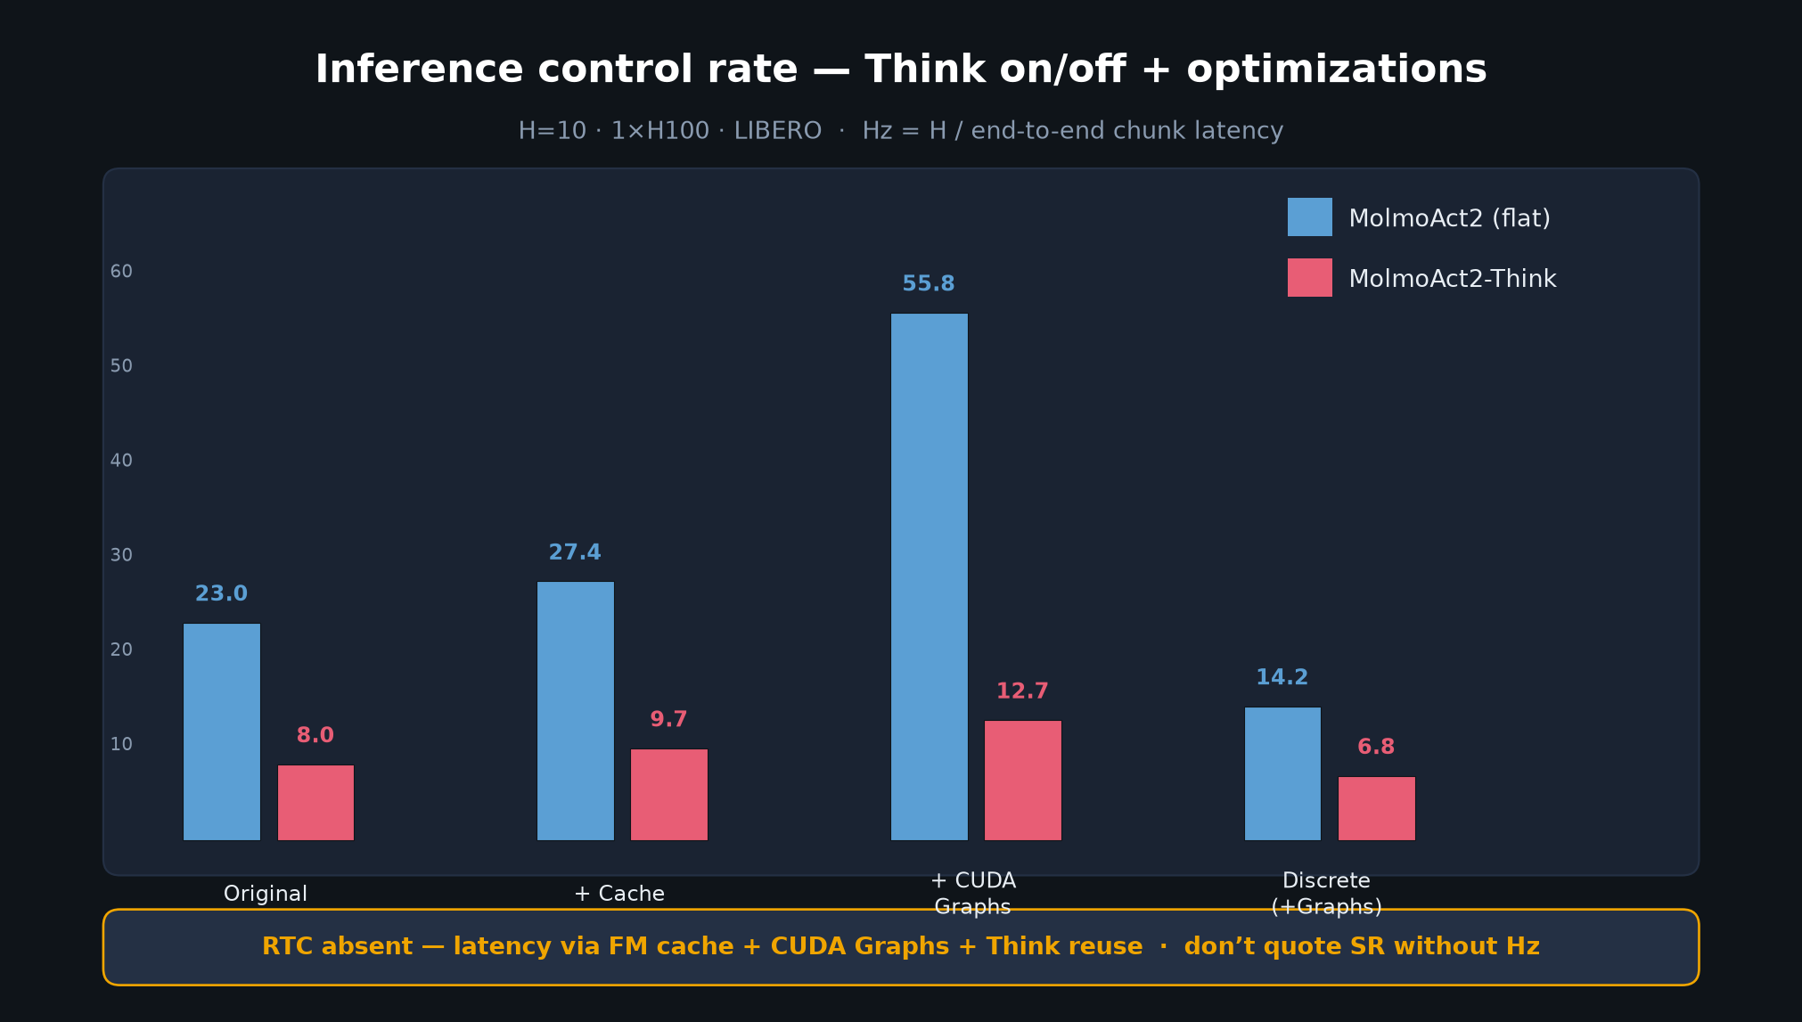
Visionary · 11+3 · 12/14
Notes:
HZ / LATENCY — deploy reality.
Act2 55.79 Hz vs Think 12.71 Hz with cache+Graphs.
Discrete path much slower — keep FM.
RTC absent.

Slide 13
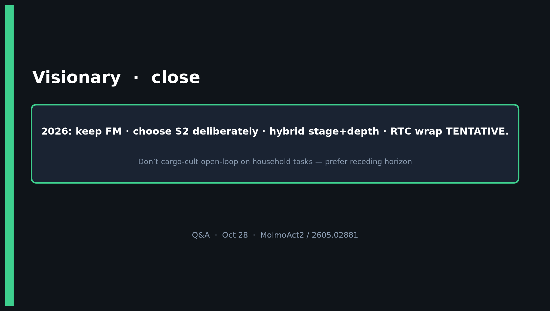
Visionary · 11+3 · 13/14
Notes:
CLOSE / Q&A.
2026: keep FM · choose S2 deliberately · hybrid stage+depth · RTC wrap TENTATIVE.
Skip Discord/Drive.
North-star: what intermediate discrete state before each FM chunk — and under the Hz budget?

Slide 14
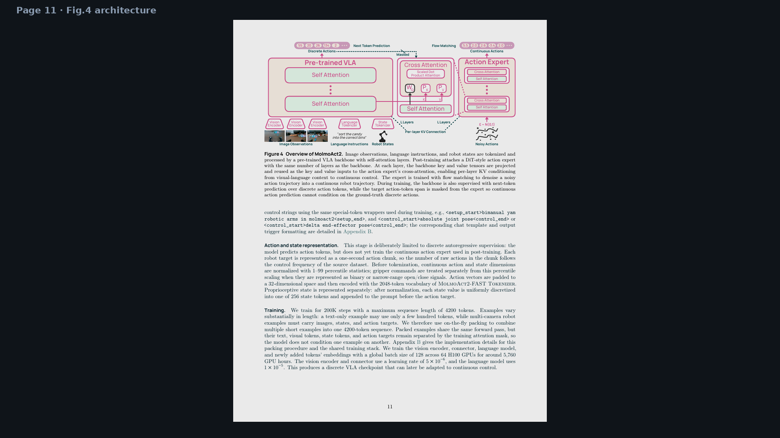
Visionary · 11+3 · 14/14
Notes:
BACKUP — full Fig.4 page for deep dive if room asks architecture detail.

