Slide 1
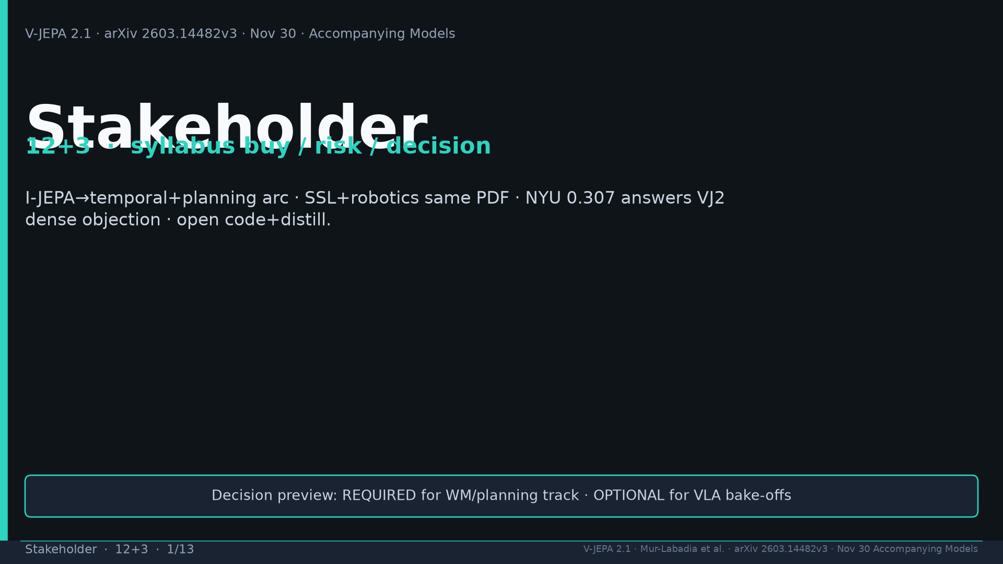
Notes:
Title. Buy: temporal+planning arc; SSL+robots same PDF; NYU 0.307; open+distill. Decision: required WM; optional VLA.

Slide 2
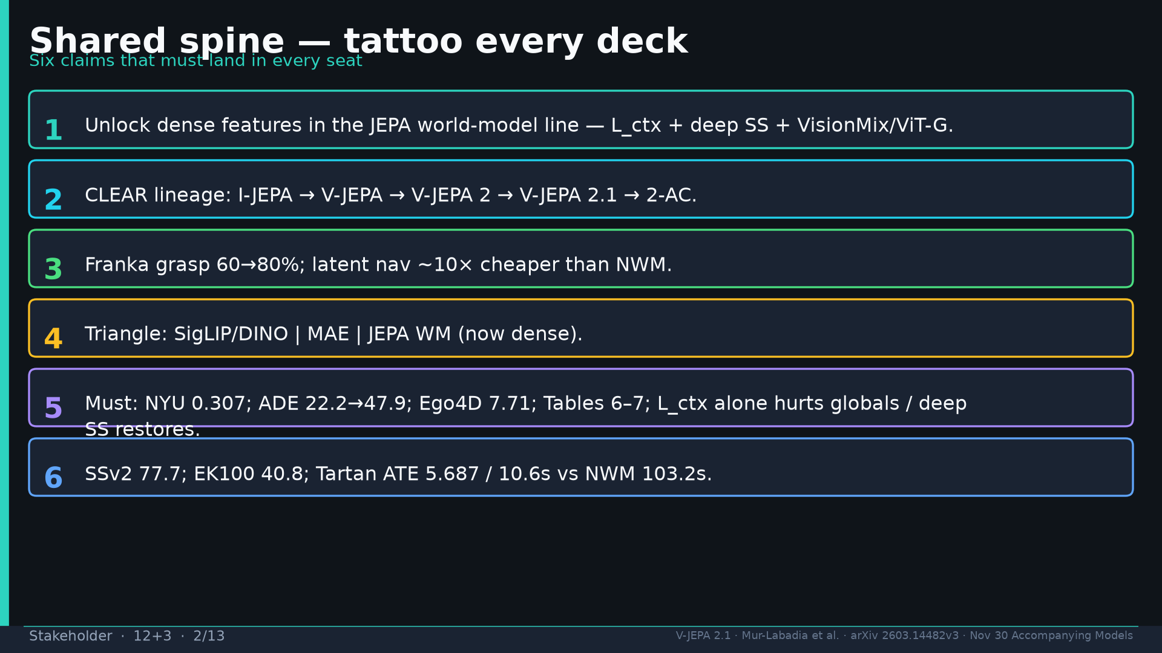
Notes:
Shared spine six claims — tattoo every deck.

Slide 3
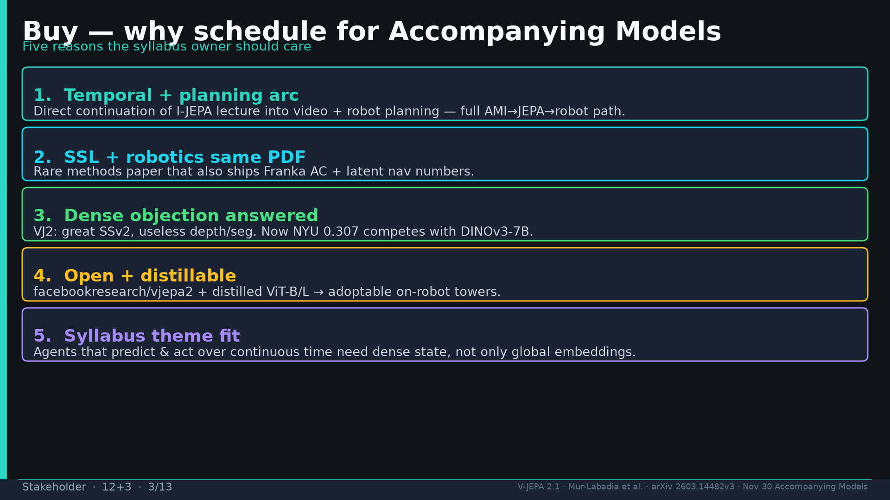
Notes:
Five buy reasons: arc, SSL+robots PDF, dense objection answered, open+distill, syllabus theme.

Slide 4
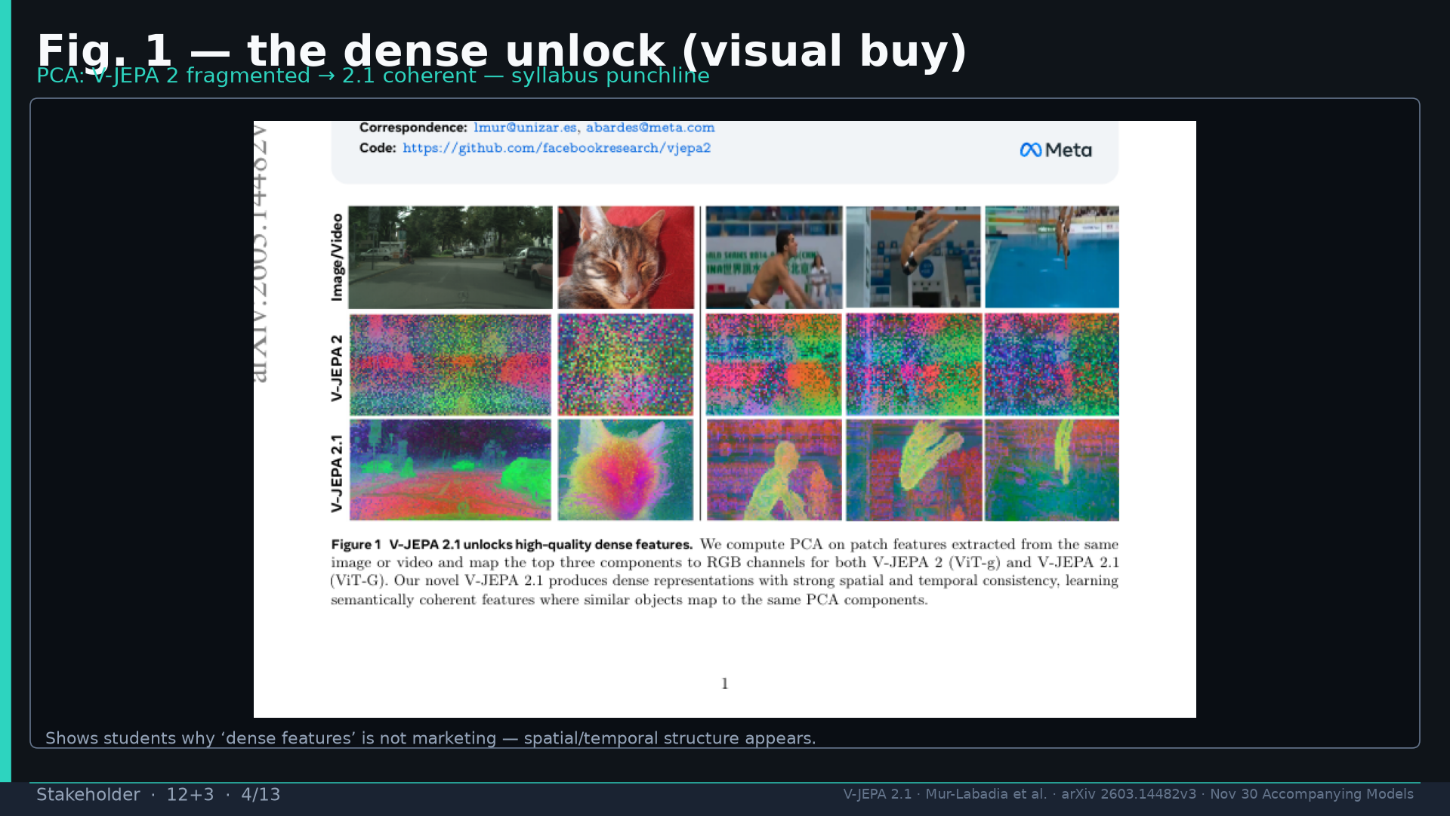
Notes:
Fig.1 PCA — visual buy for dense unlock.

Slide 5
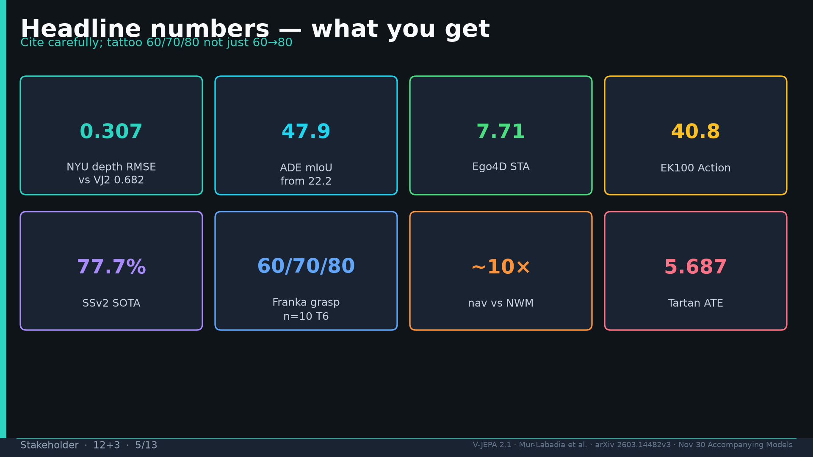
Notes:
Headline numbers: 0.307 / 47.9 / 7.71 / 40.8 / 77.7 / 60→80% / ~10× / 5.687.

Slide 6
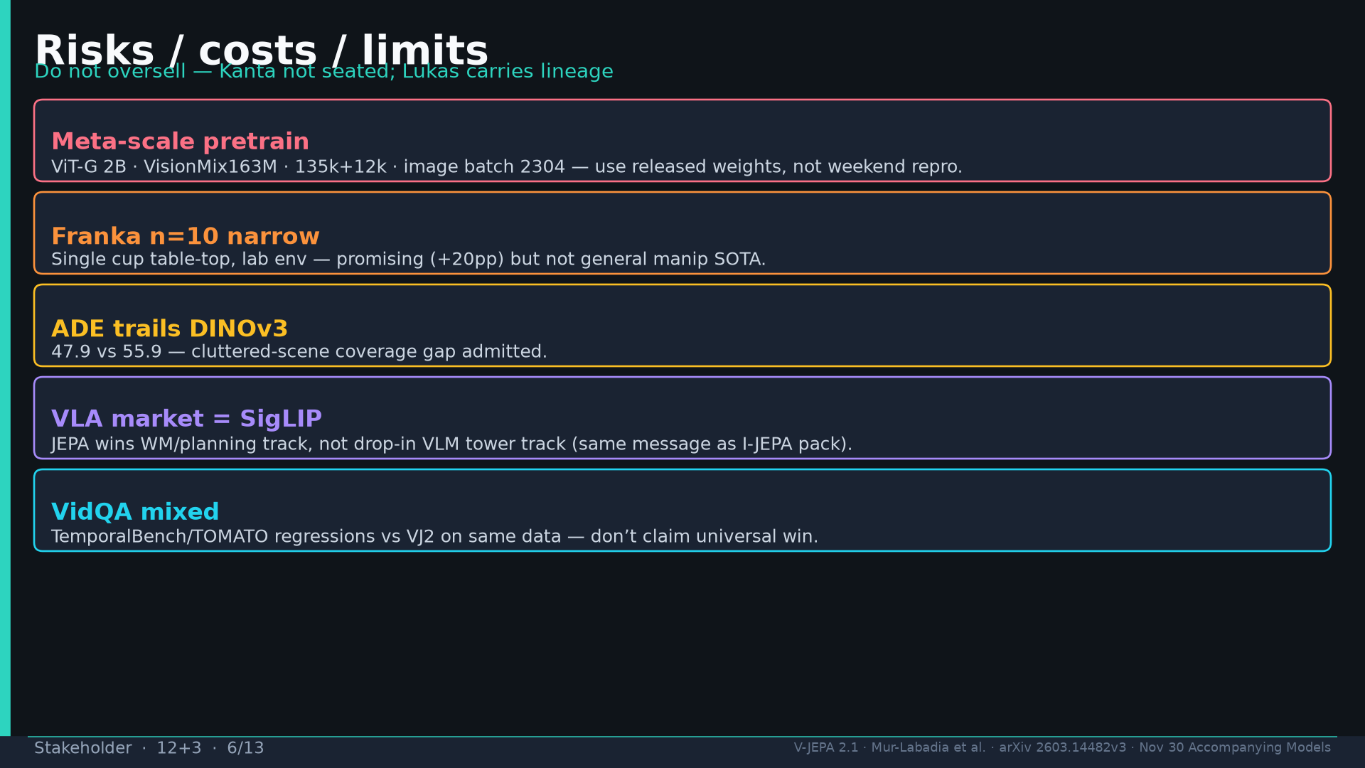
Notes:
Risks: Meta-scale; Franka n=10; ADE trails DINOv3; VLA=SigLIP; VidQA mixed.

Slide 7
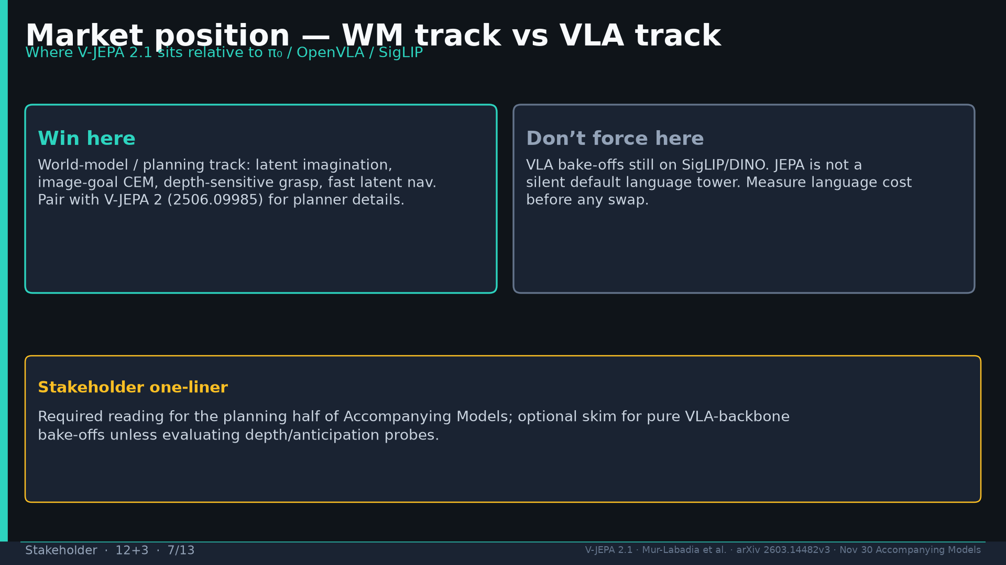
Notes:
Market: win on WM/planning; don't force VLA tower swap.

Slide 8
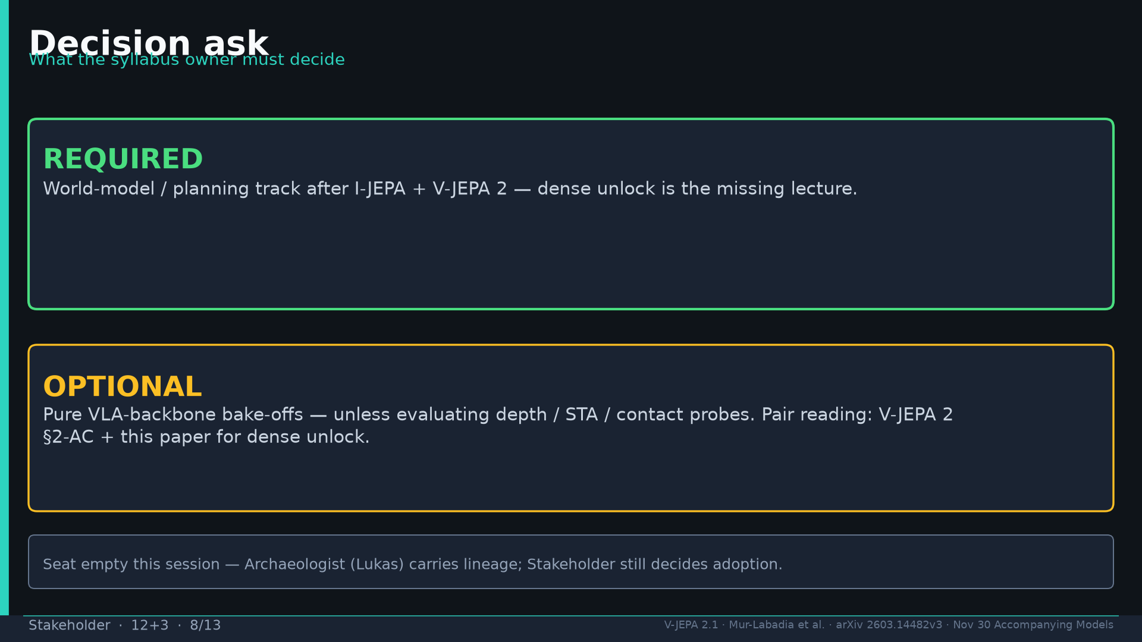
Notes:
Decision: REQUIRED WM track; OPTIONAL VLA bake-offs.

Slide 9
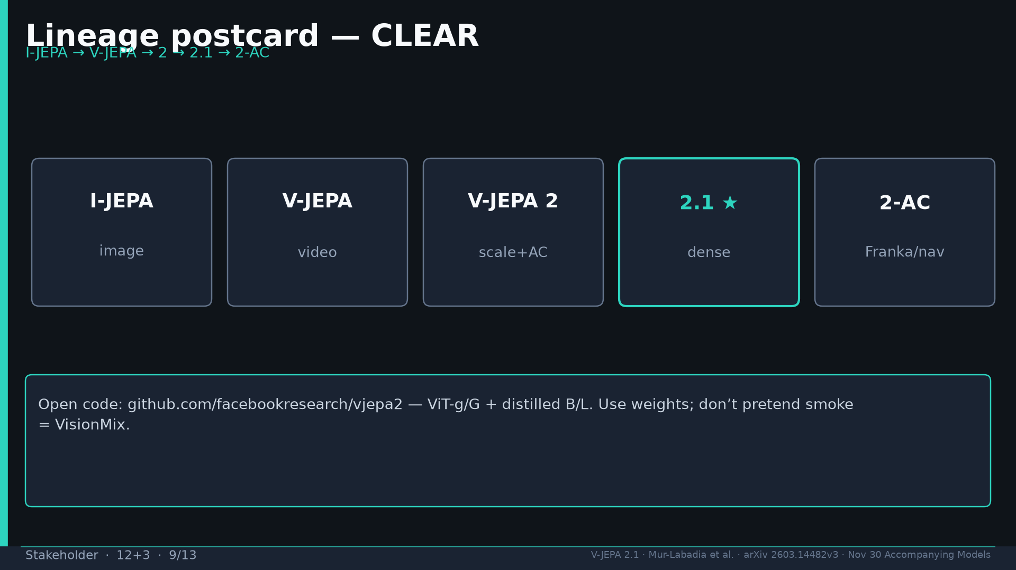
Notes:
Lineage CLEAR I-JEPA→V-JEPA→2→2.1→2-AC; use released weights.

Slide 10
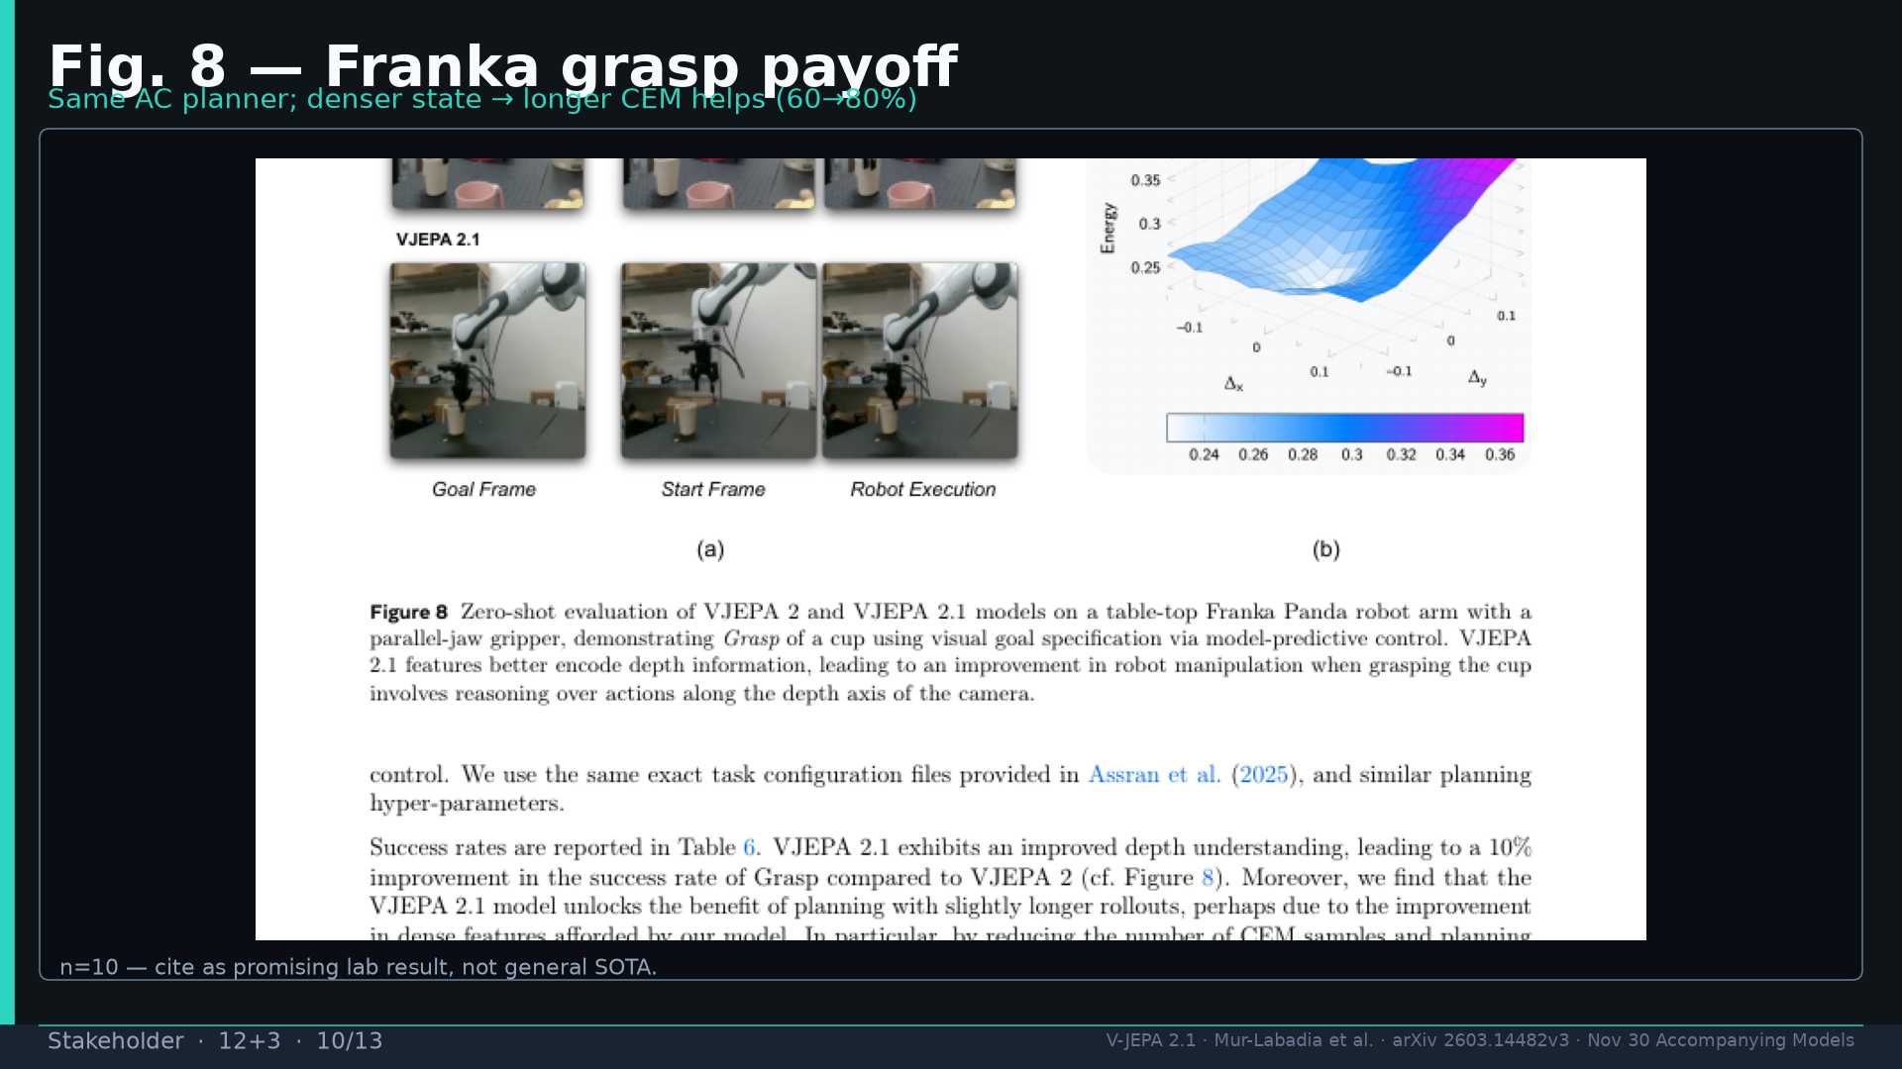
Notes:
Fig.8 Franka — n=10 promising not SOTA.

Slide 11
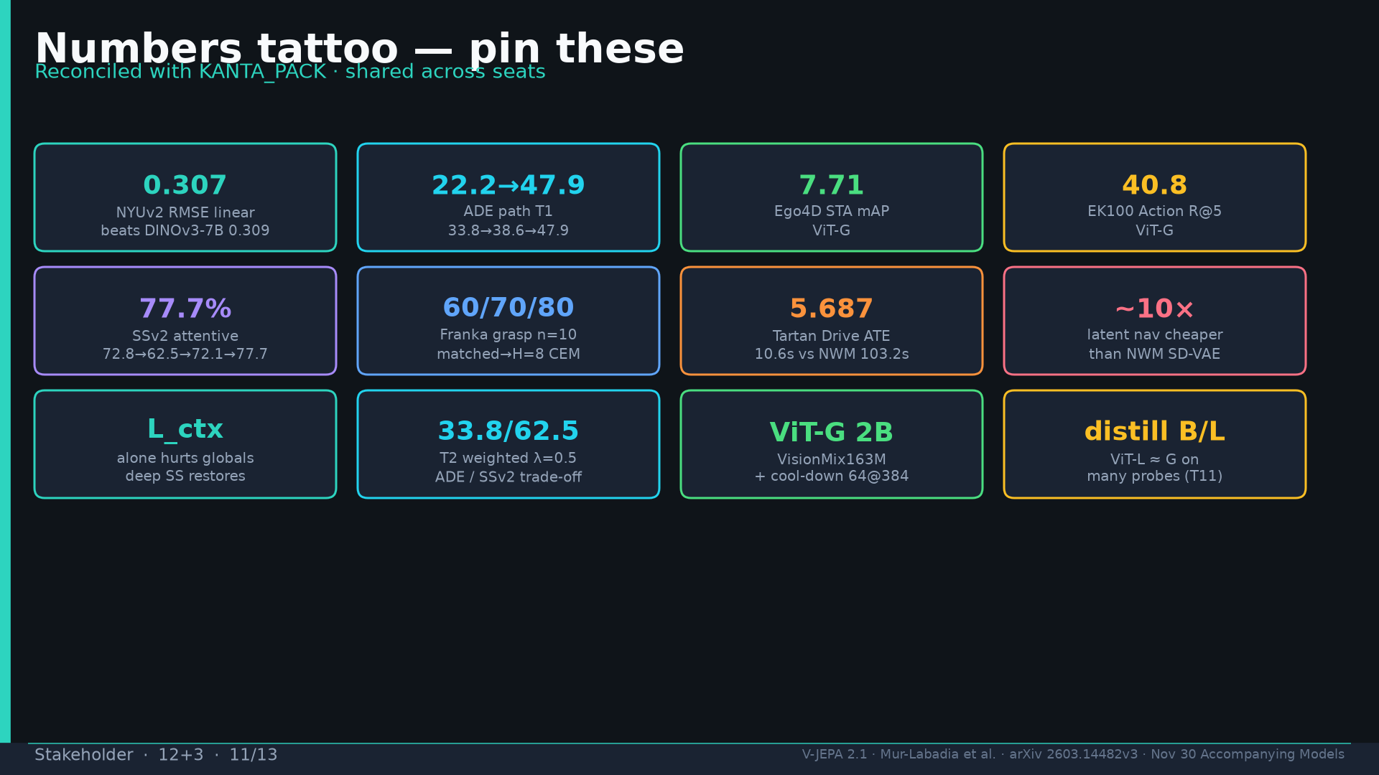
Notes:
Tattoo numbers.

Slide 12
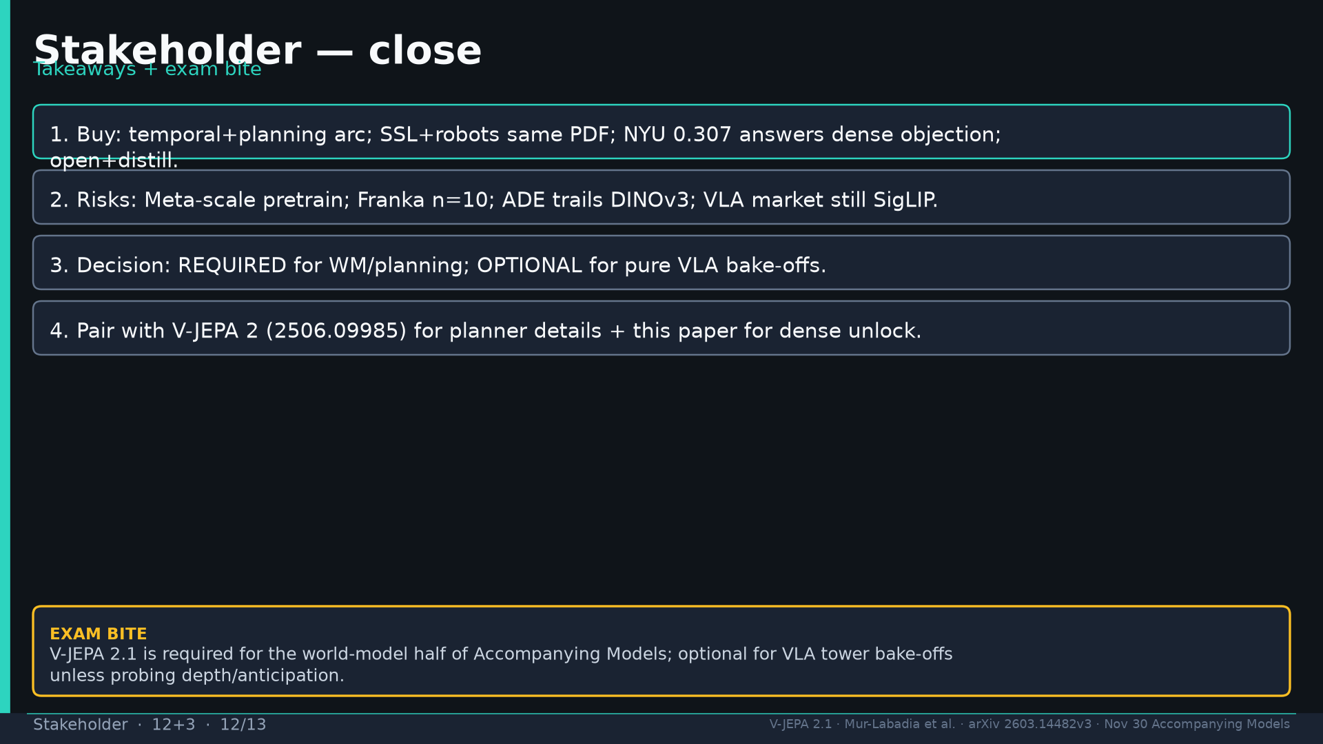
Notes:
Close four takeaways.

Slide 13
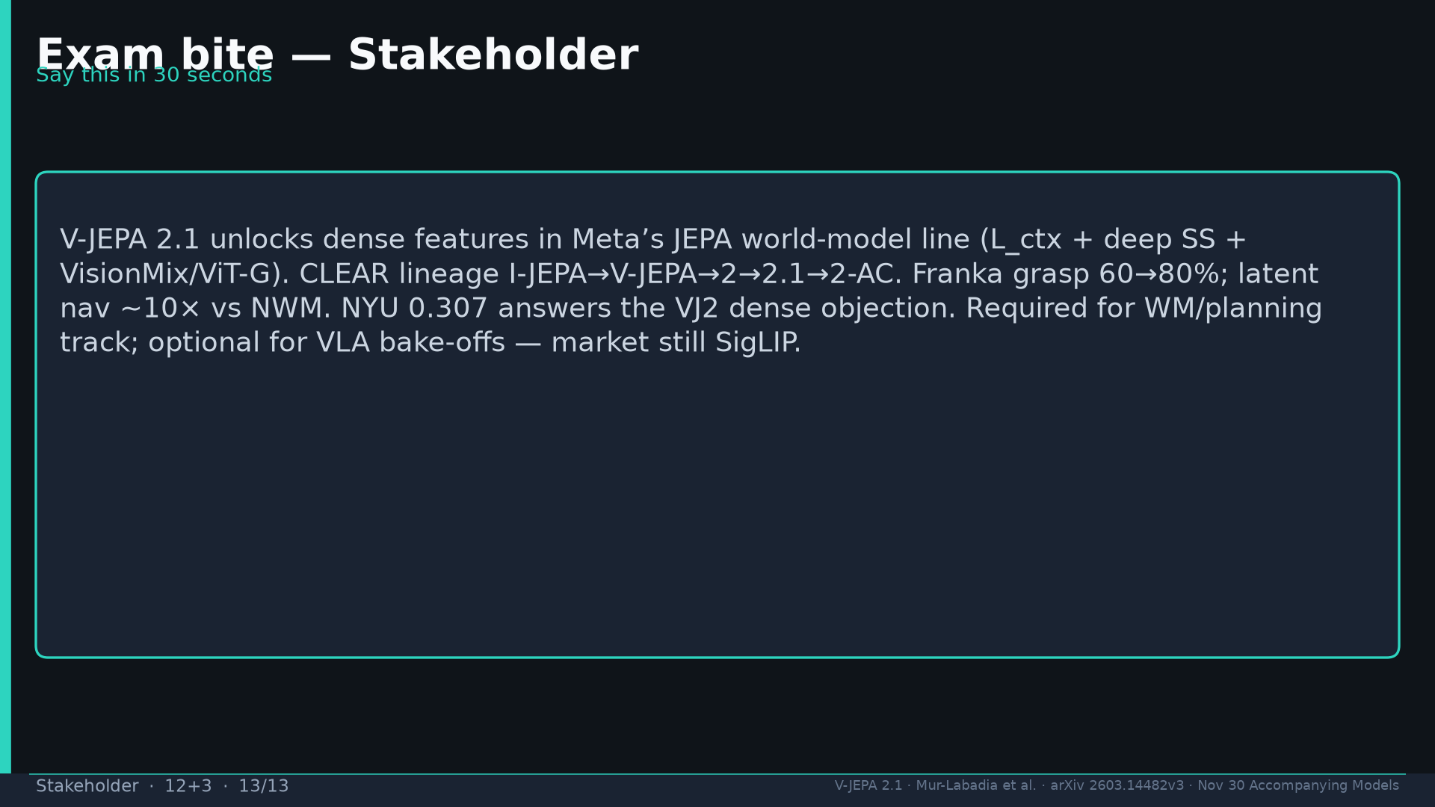
Notes:
Exam bite 30s paragraph.

