Slide 1
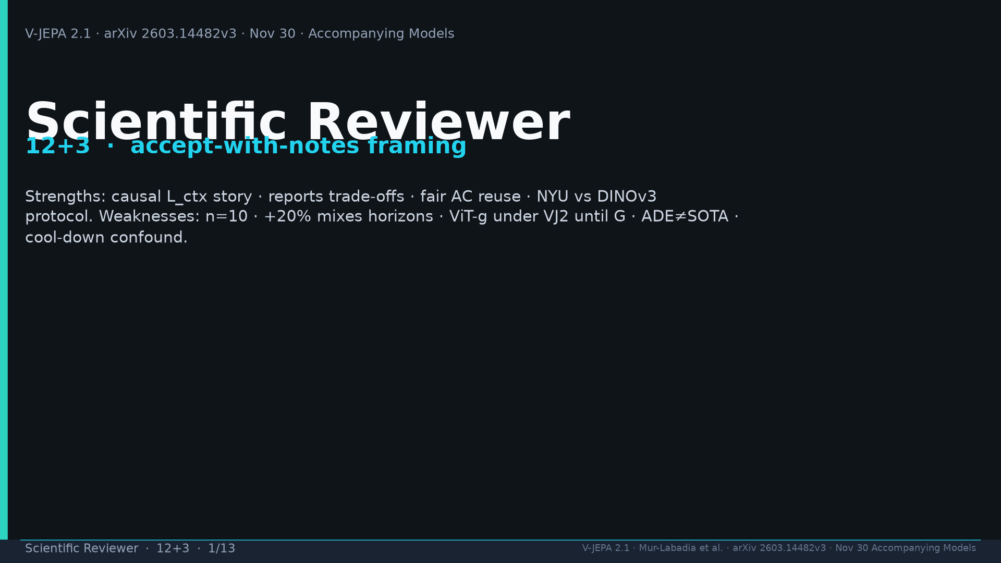
Notes:
Title. Accept-with-notes. Strengths vs weaknesses.

Slide 2
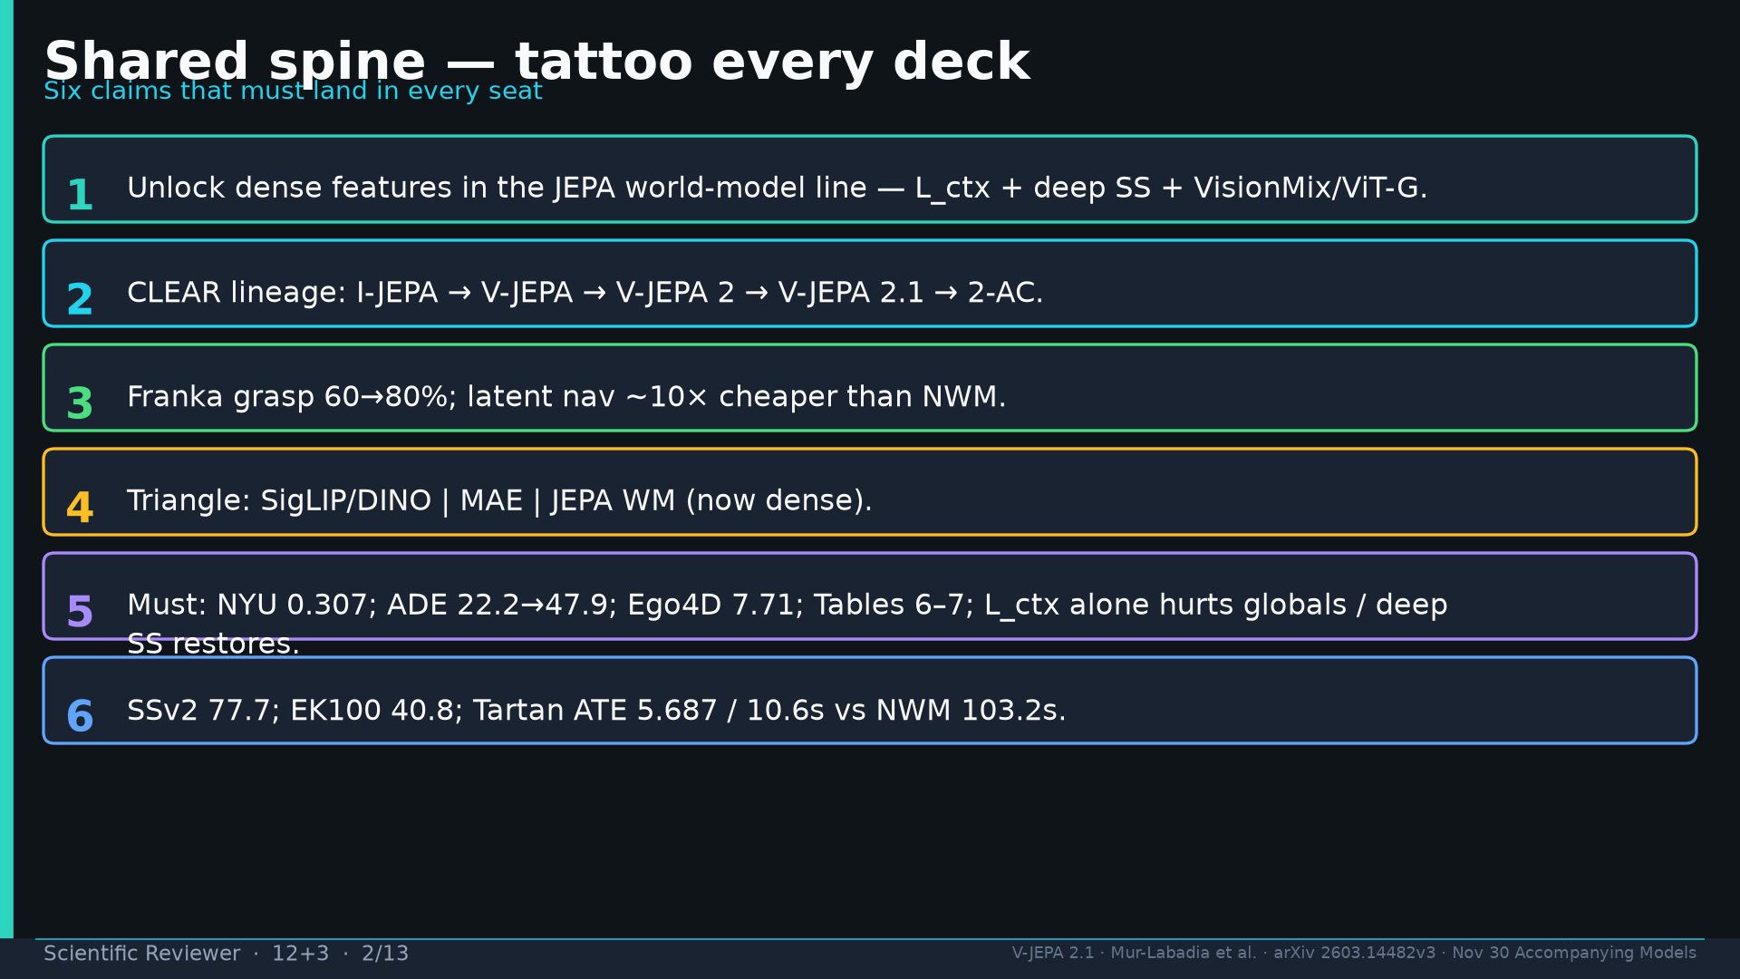
Notes:
Shared spine.

Slide 3
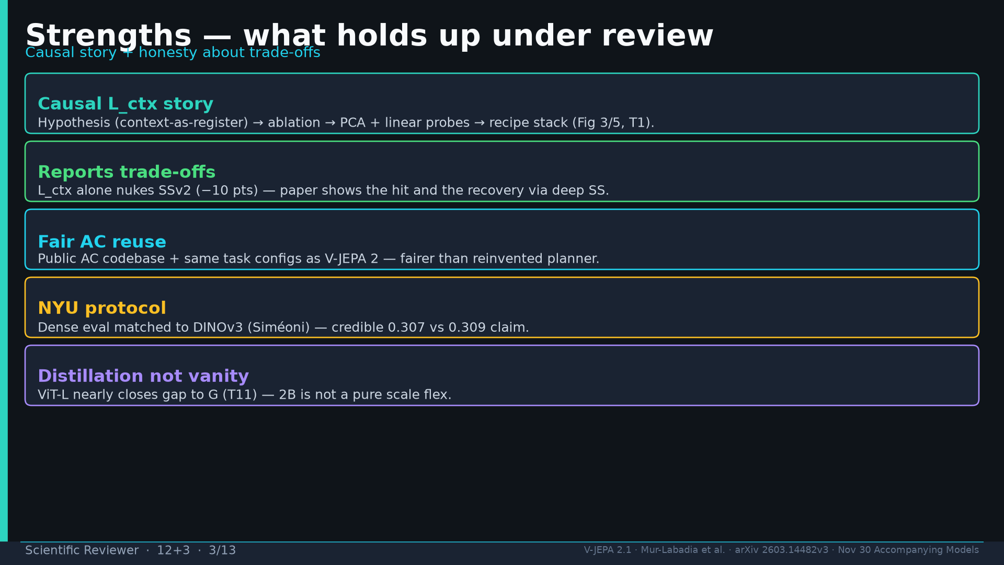
Notes:
Strengths: causal L_ctx; trade-offs; fair AC; NYU protocol; distill.

Slide 4
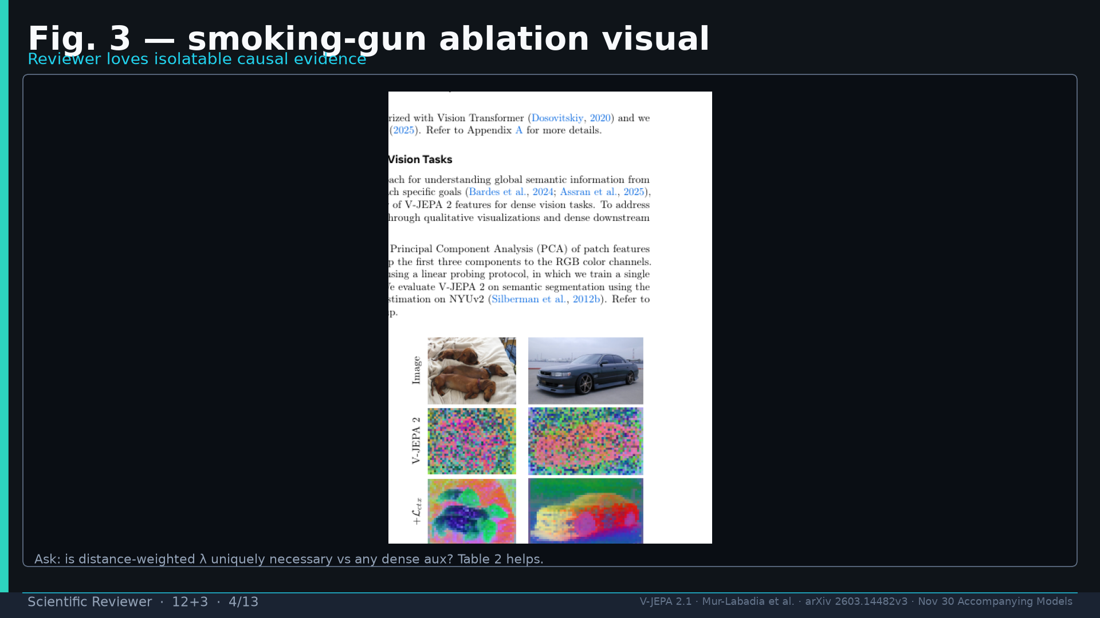
Notes:
Fig.3 smoking-gun ablation visual.

Slide 5
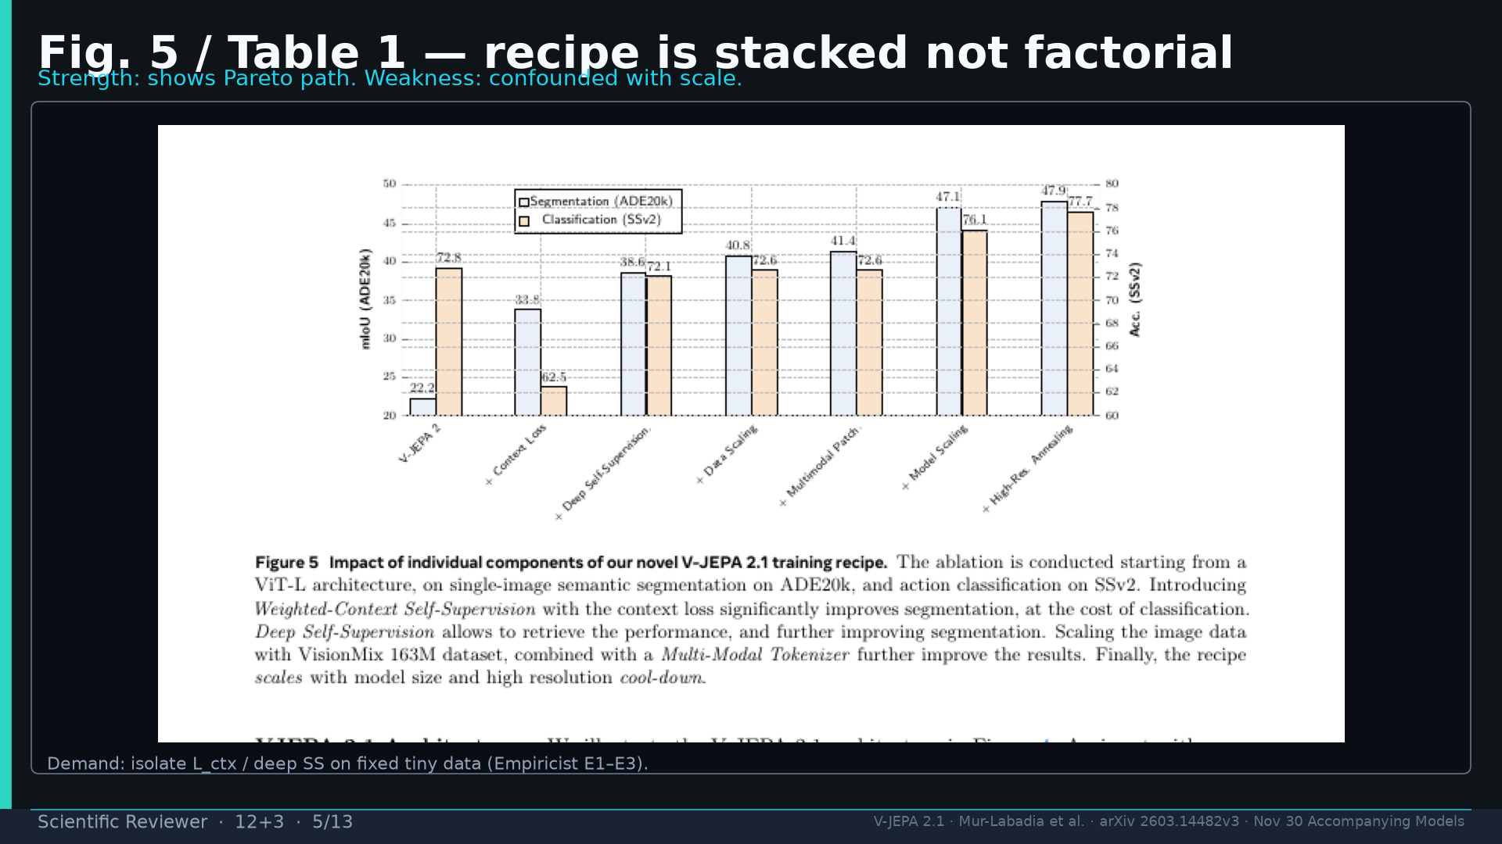
Notes:
Fig.5 stacked not factorial — demand isolate L_ctx/deep SS.

Slide 6
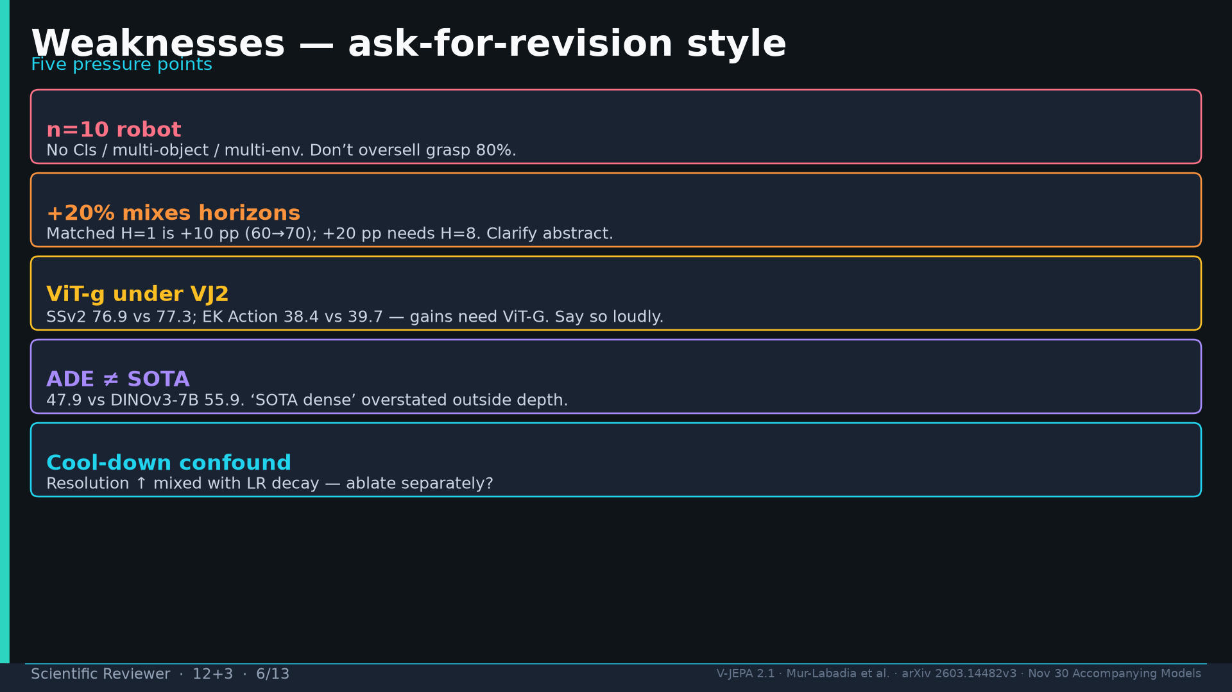
Notes:
Weaknesses: n=10; +20% mixes horizons; ViT-g under; ADE≠SOTA; cool-down.

Slide 7
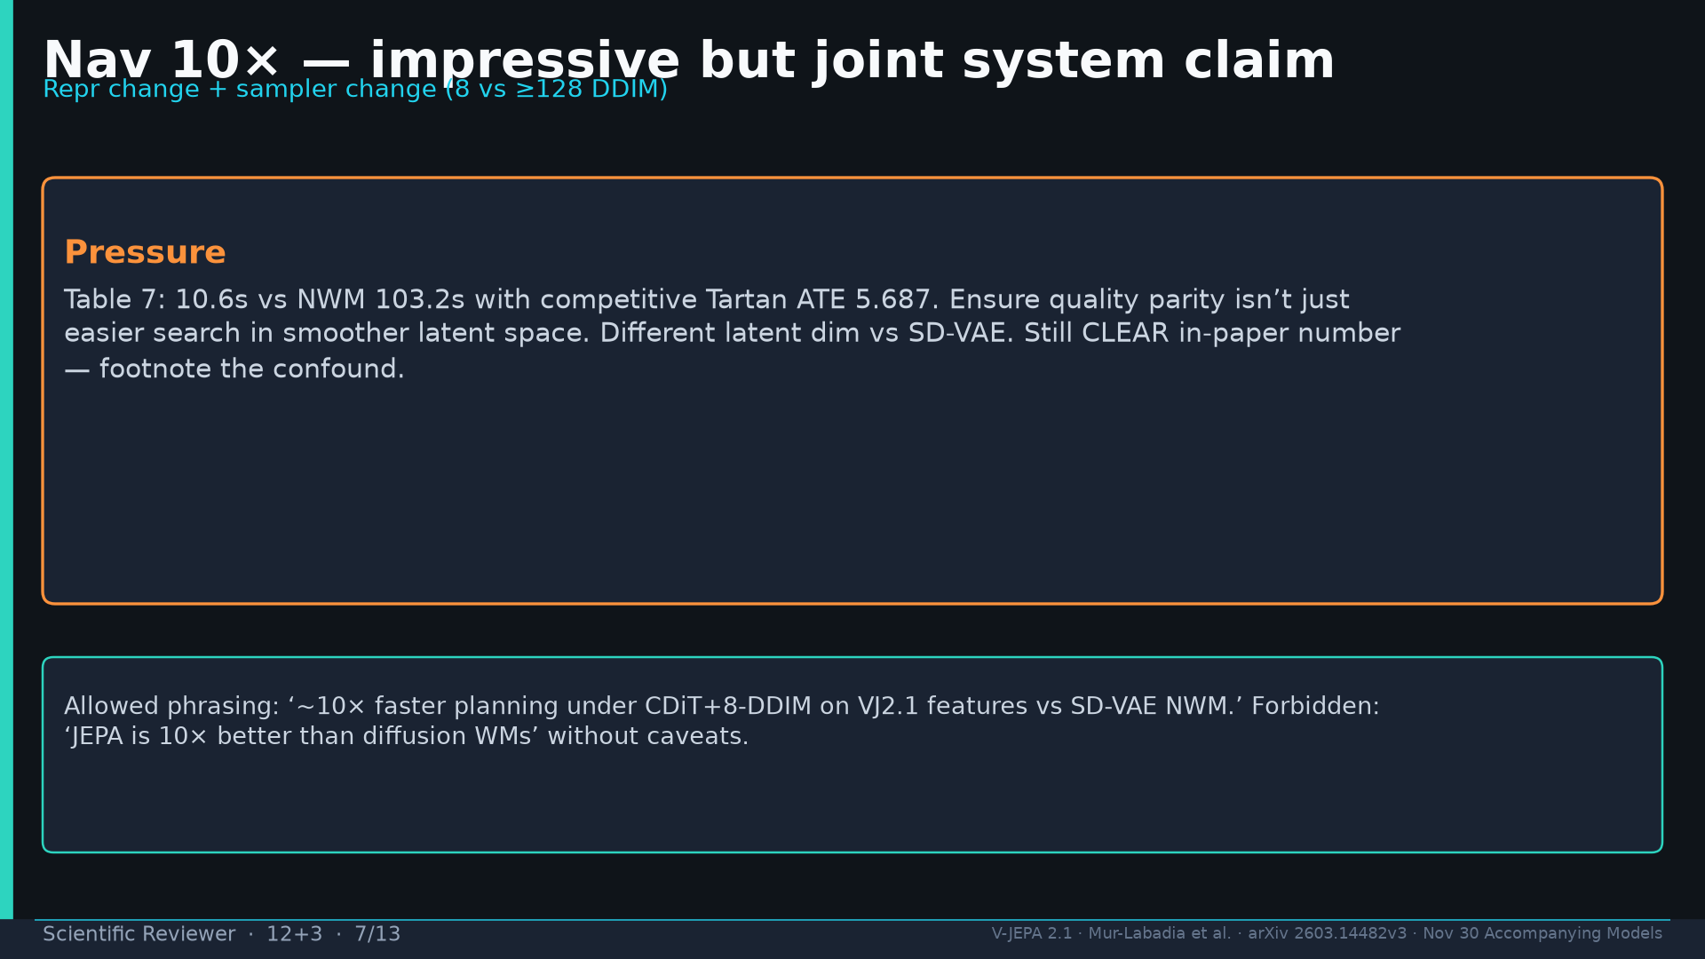
Notes:
Nav 10× joint system claim — footnote.

Slide 8
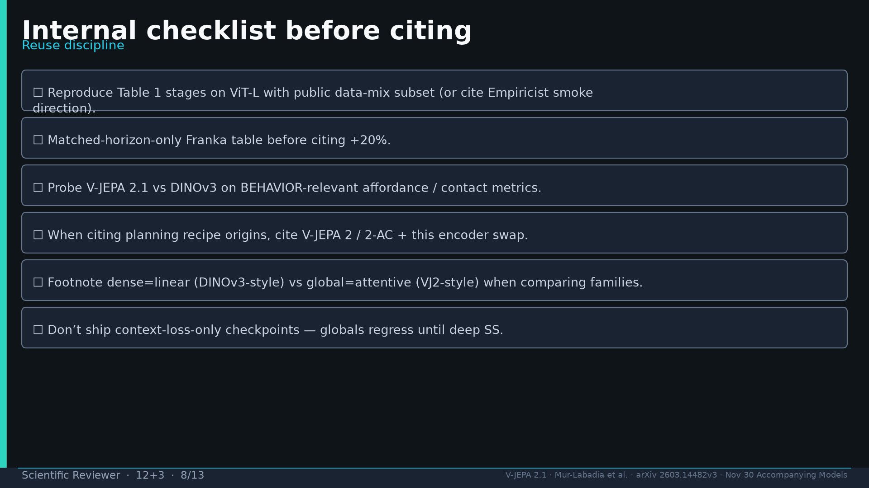
Notes:
Internal checklist before citing.

Slide 9
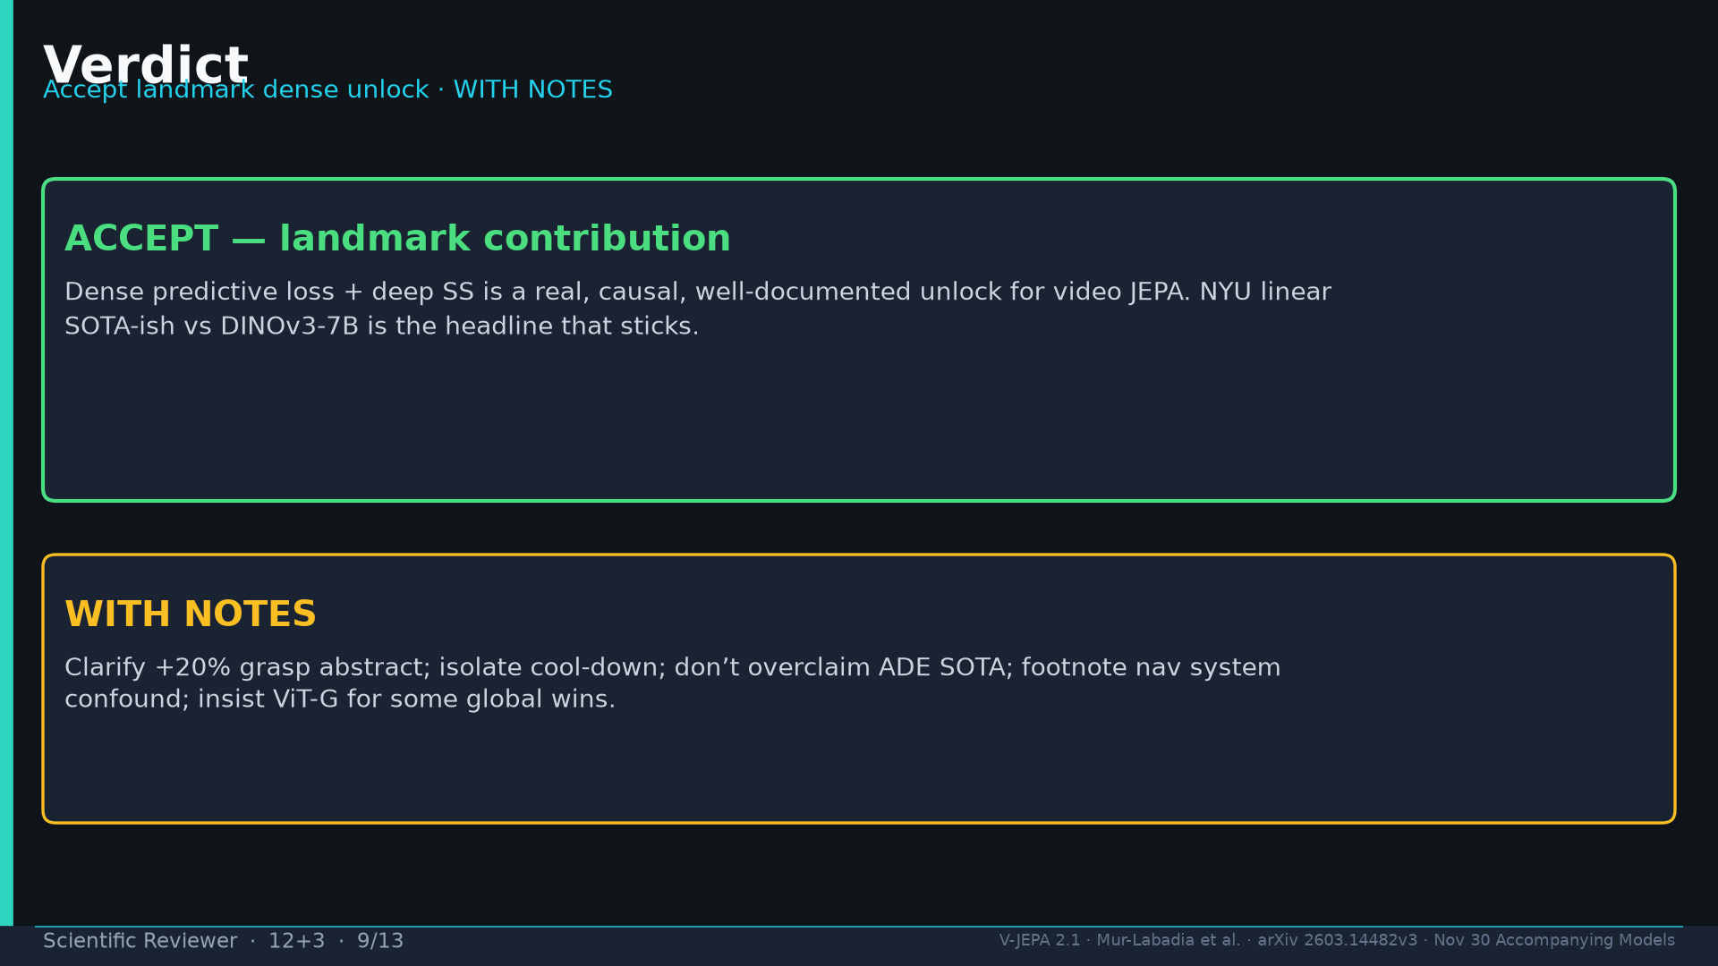
Notes:
Verdict: ACCEPT landmark WITH NOTES.

Slide 10
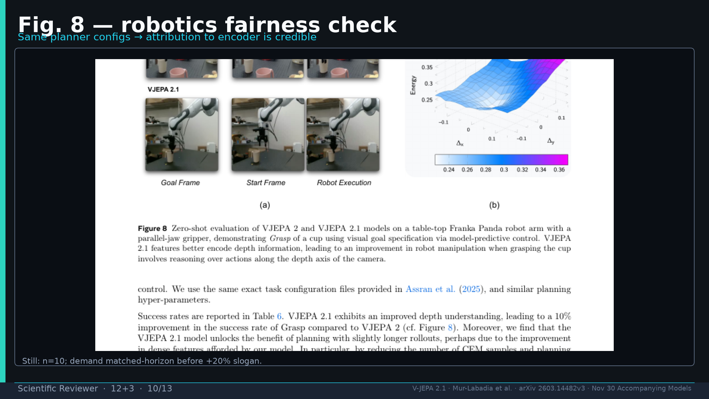
Notes:
Fig.8 robotics fairness — same planner configs.

Slide 11
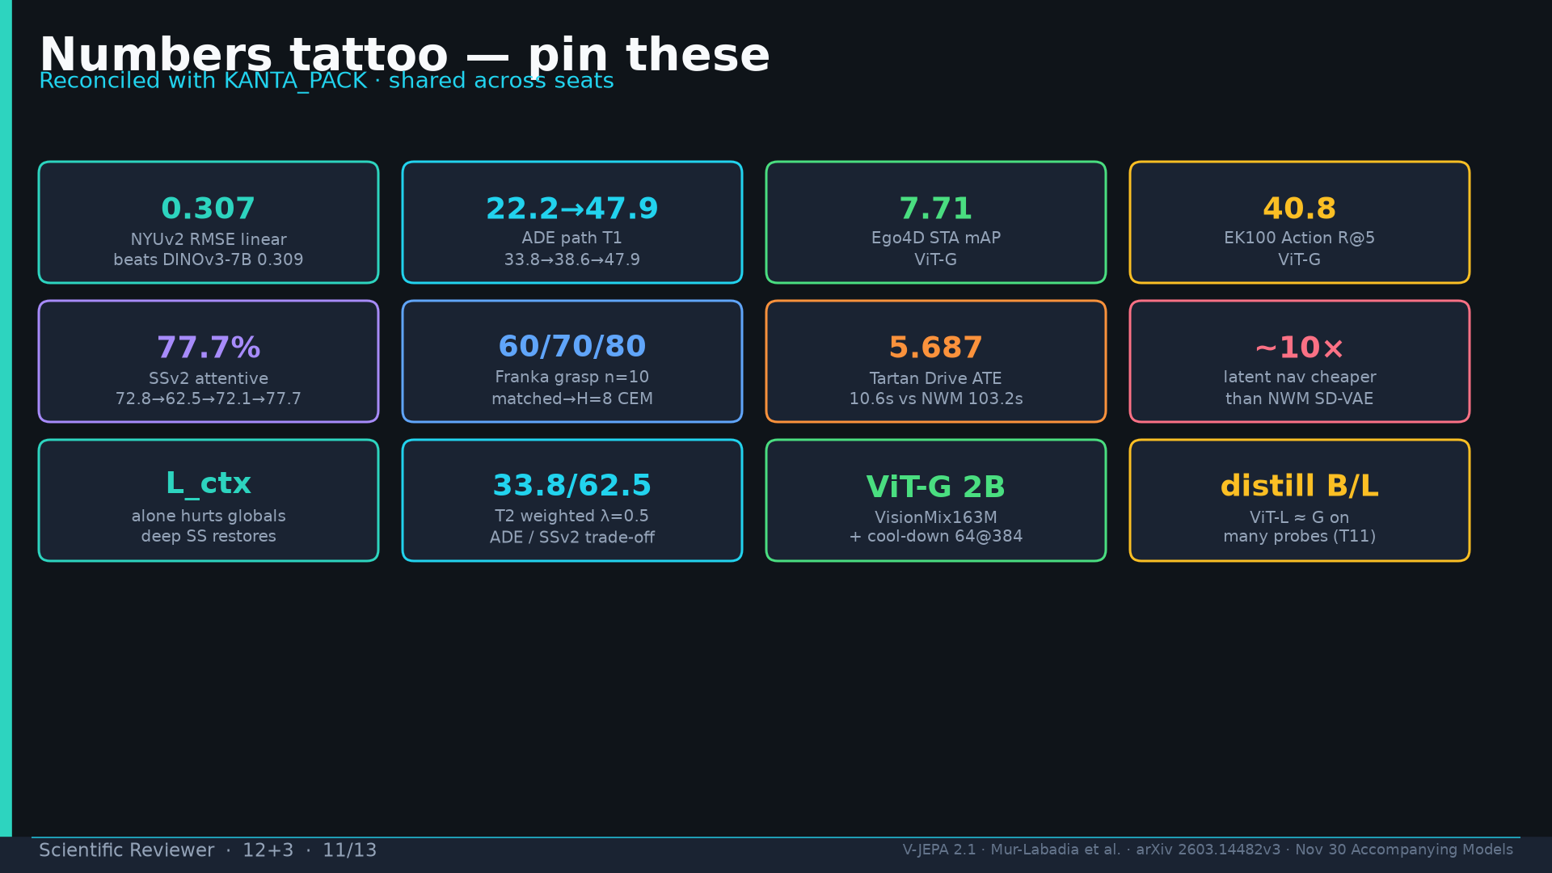
Notes:
Tattoo.

Slide 12
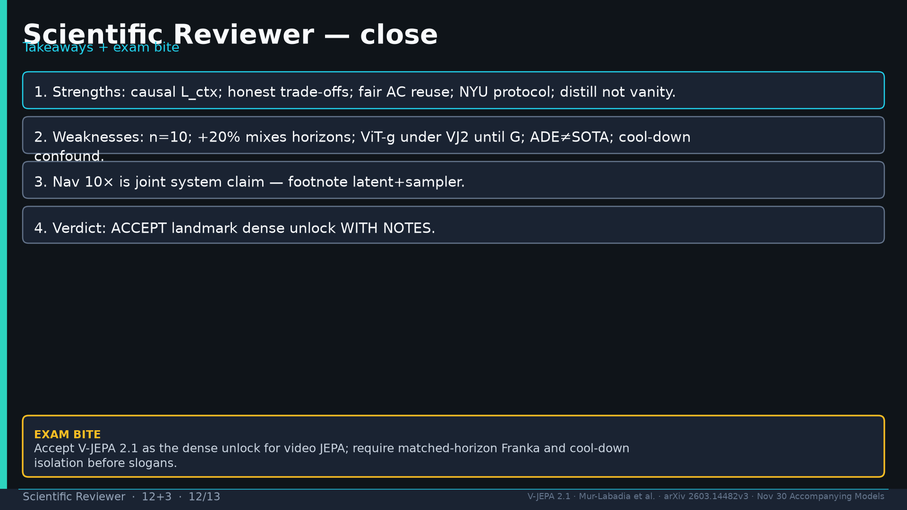
Notes:
Close.

Slide 13
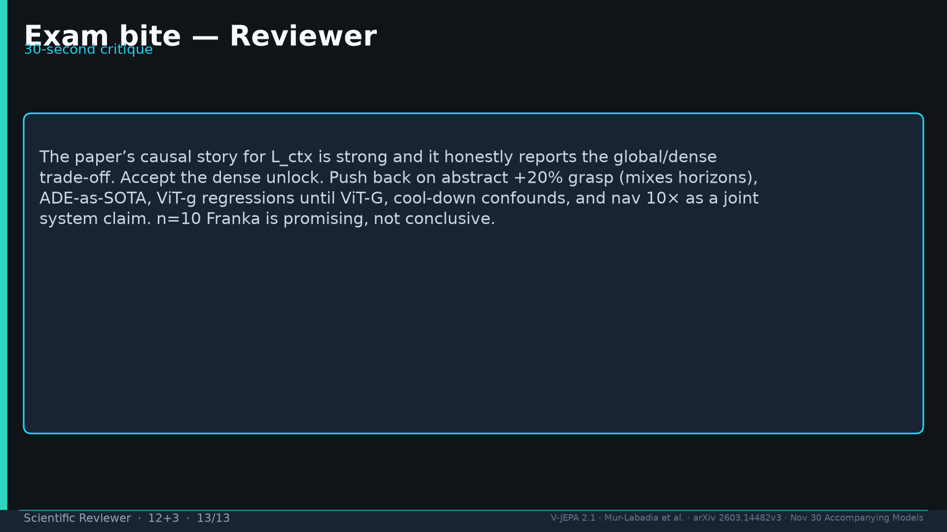
Notes:
Exam bite critique paragraph.

