Slide 1
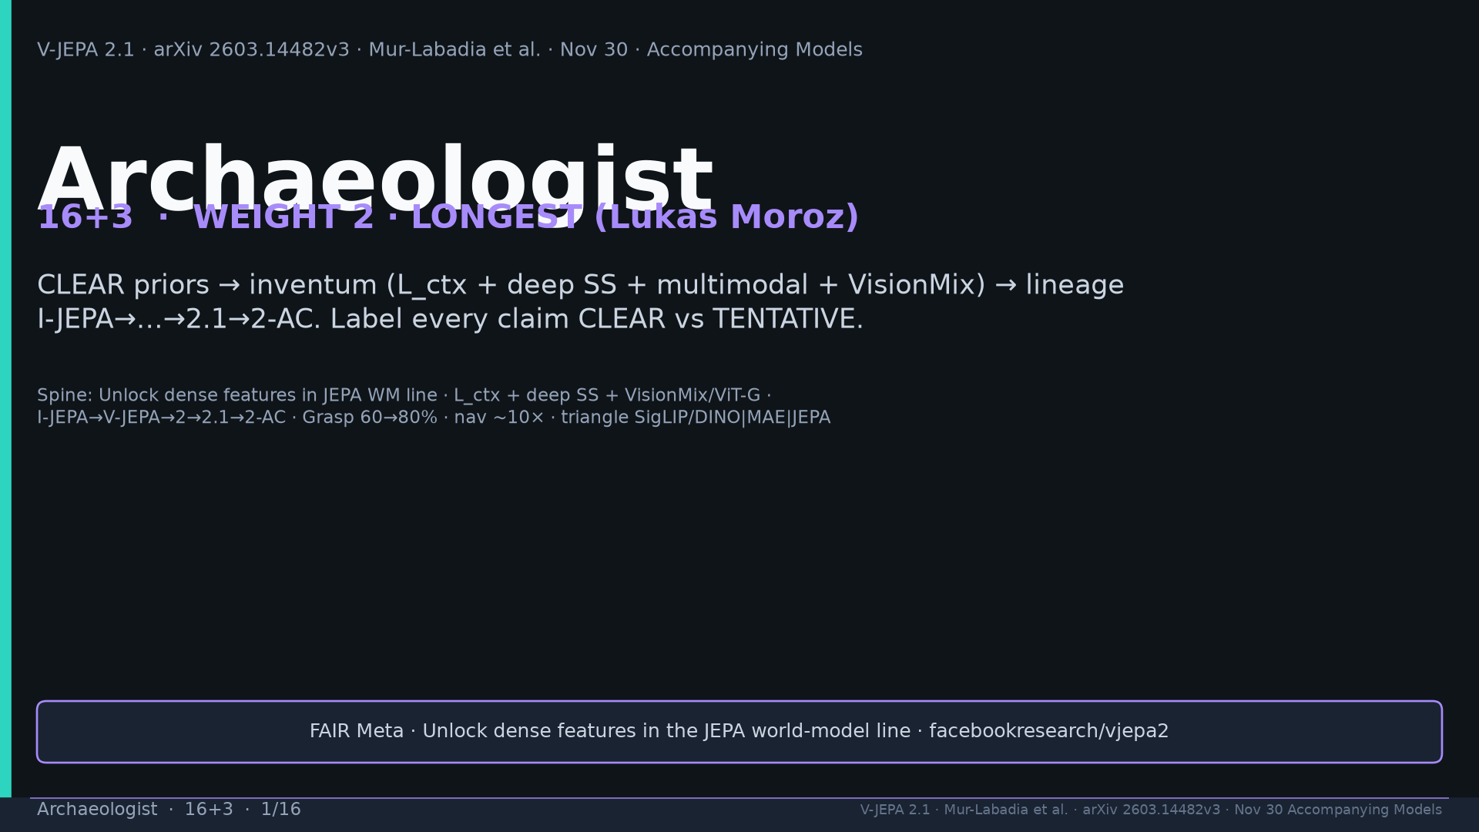
Notes:
Title. Weight 2 LONGEST Lukas. CLEAR vs TENTATIVE on every lineage claim.

Slide 2
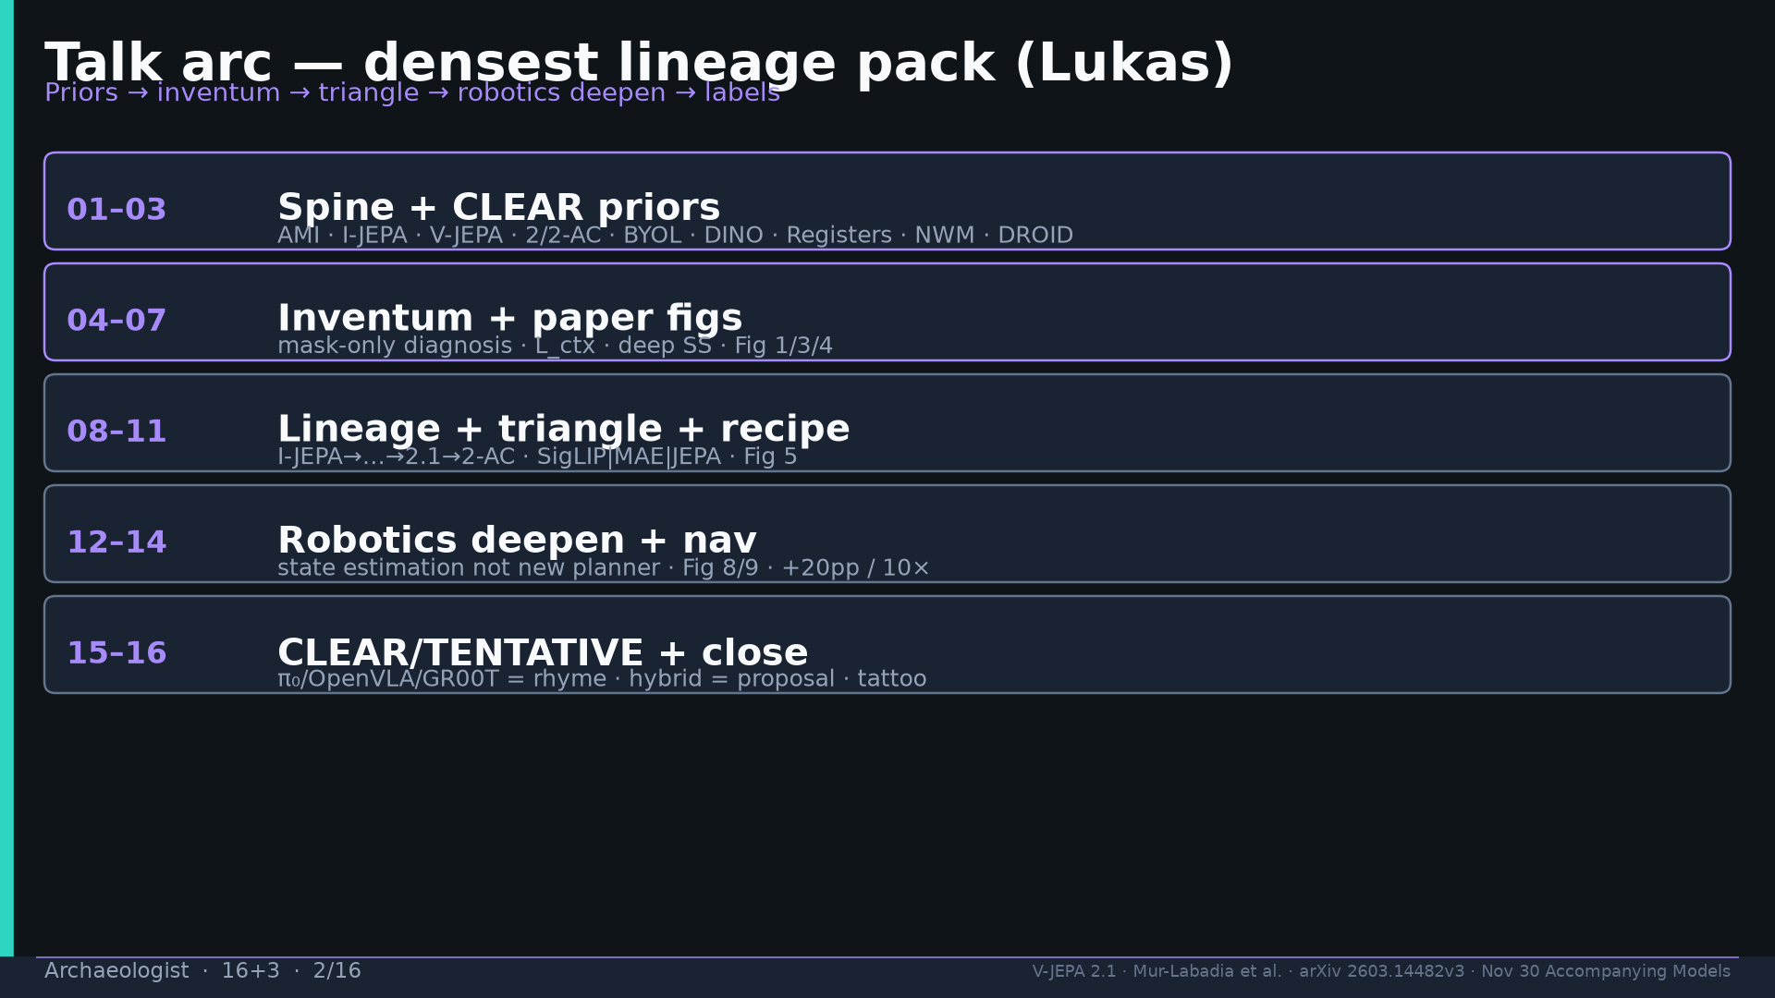
Notes:
Arc: priors → inventum → figs → lineage → triangle → robotics deepen → labels.

Slide 3
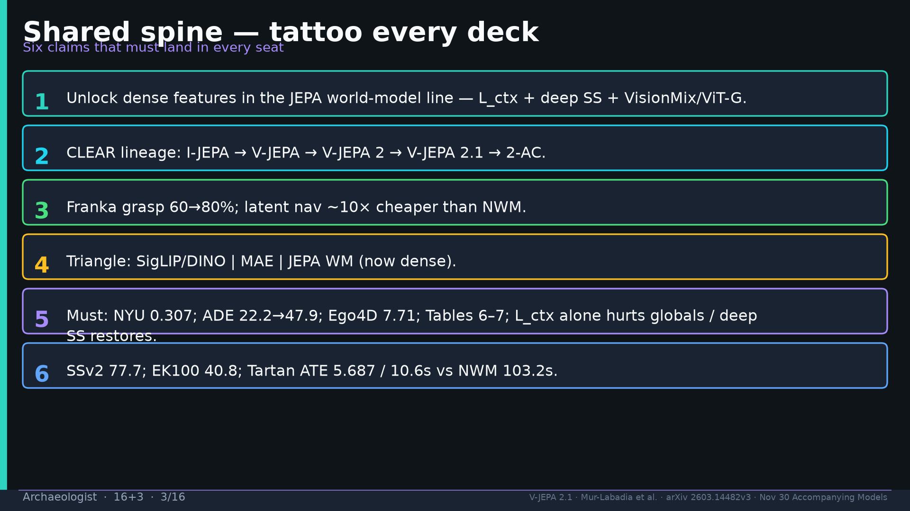
Notes:
Shared spine six claims — tattoo every deck.

Slide 4
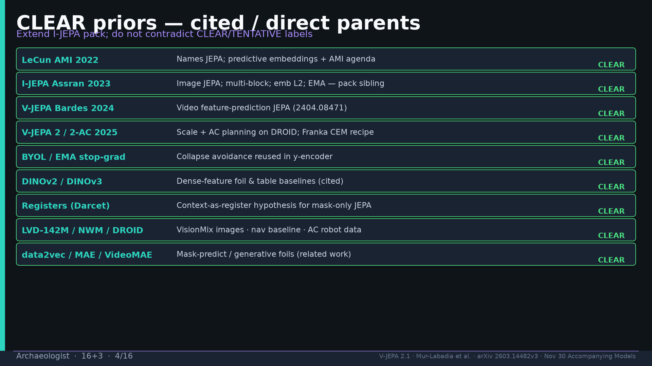
Notes:
CLEAR priors: AMI, I-JEPA, V-JEPA, 2/2-AC, BYOL/EMA, DINOv2/v3, Registers, LVD/NWM/DROID, data2vec/MAE/VideoMAE.

Slide 5
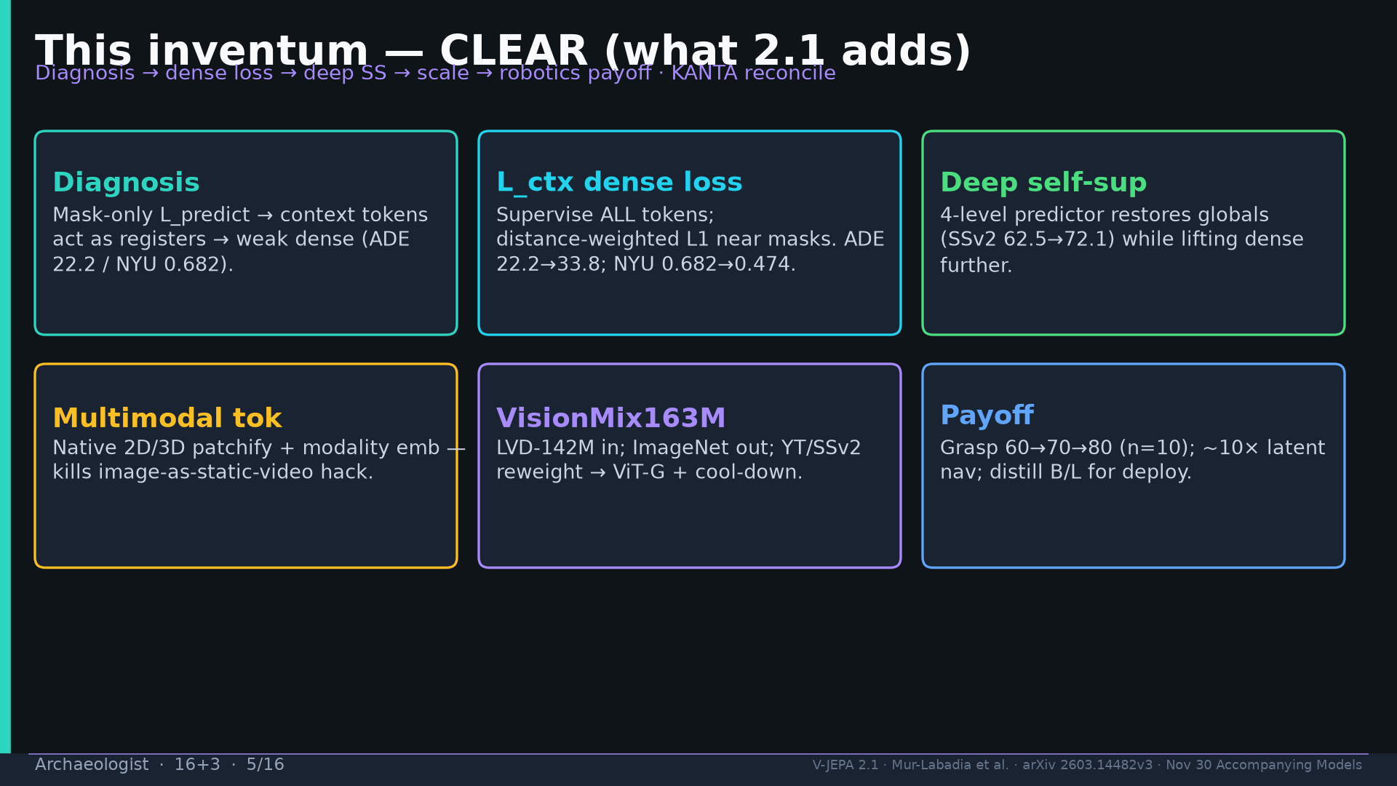
Notes:
Inventum: diagnosis mask-only→weak dense; L_ctx; deep SS; multimodal; VisionMix; +20pp/10×; distill B/L.

Slide 6
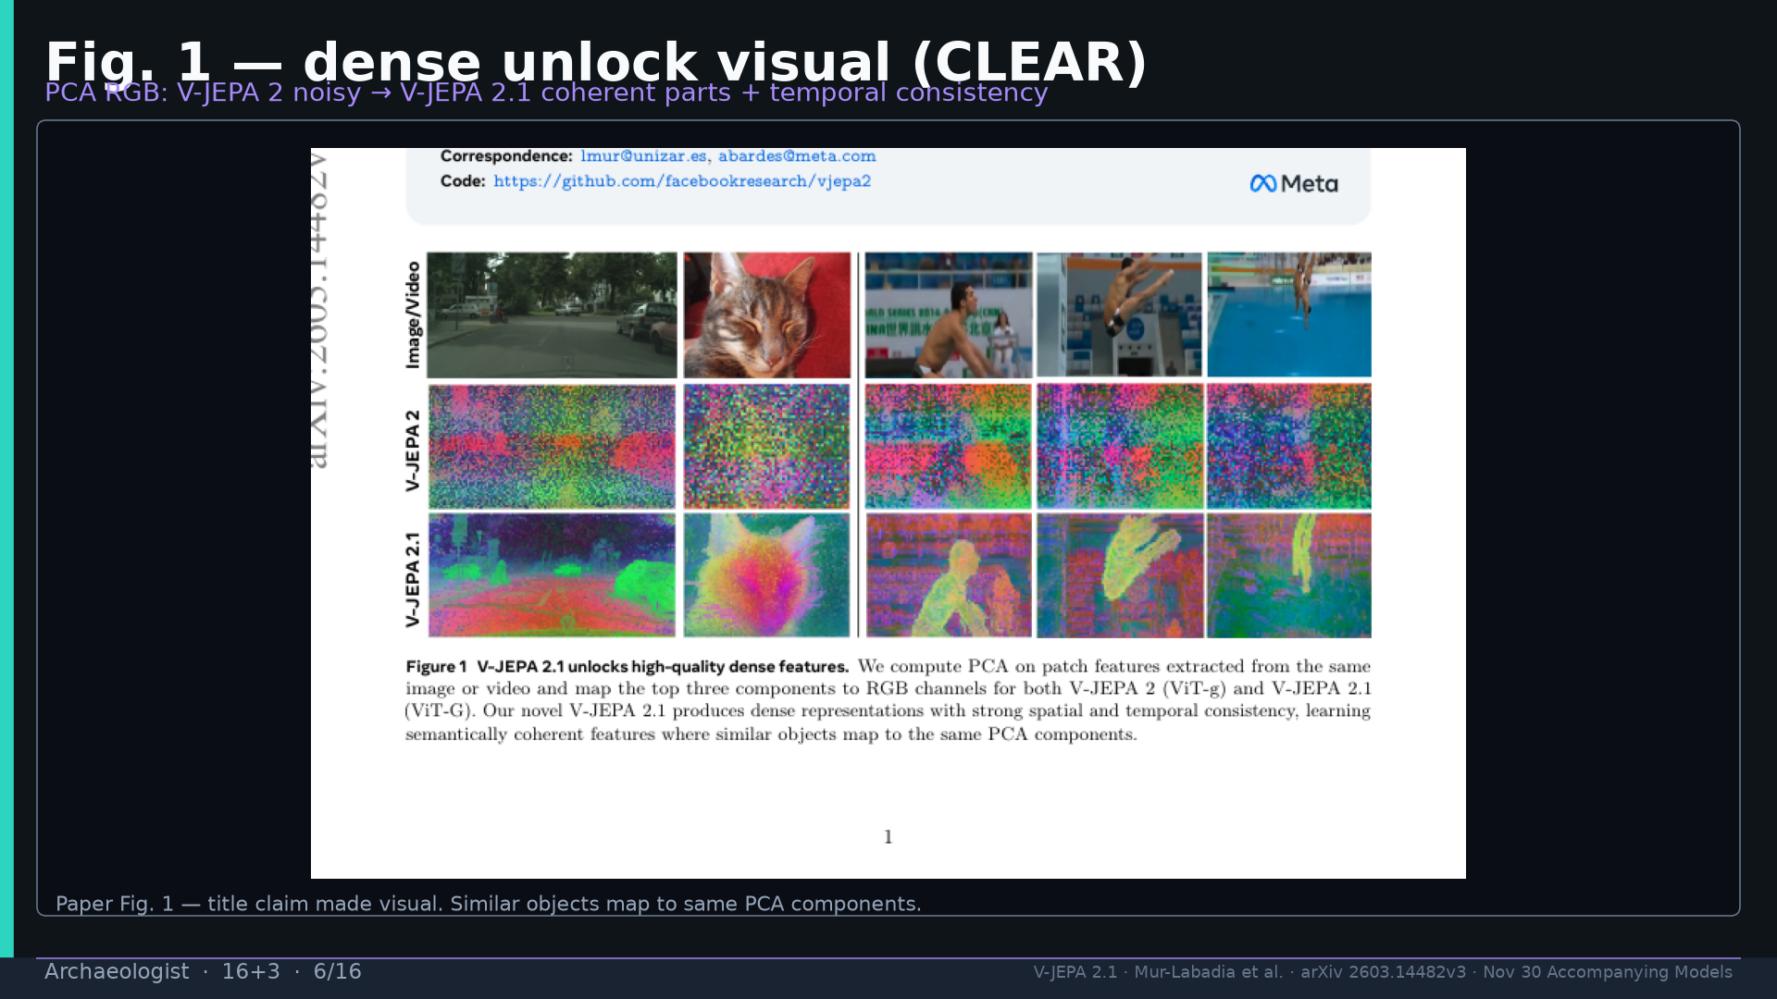
Notes:
Fig.1 PCA dense unlock visual CLEAR.

Slide 7
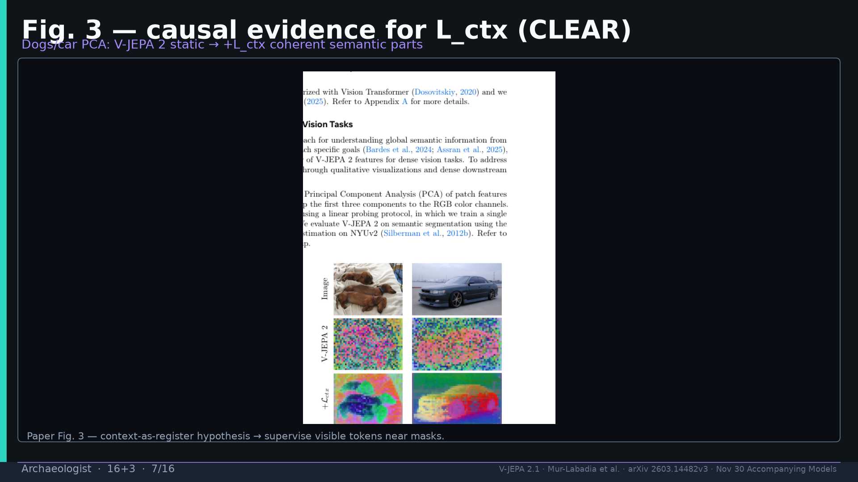
Notes:
Fig.3 L_ctx causal evidence CLEAR.

Slide 8
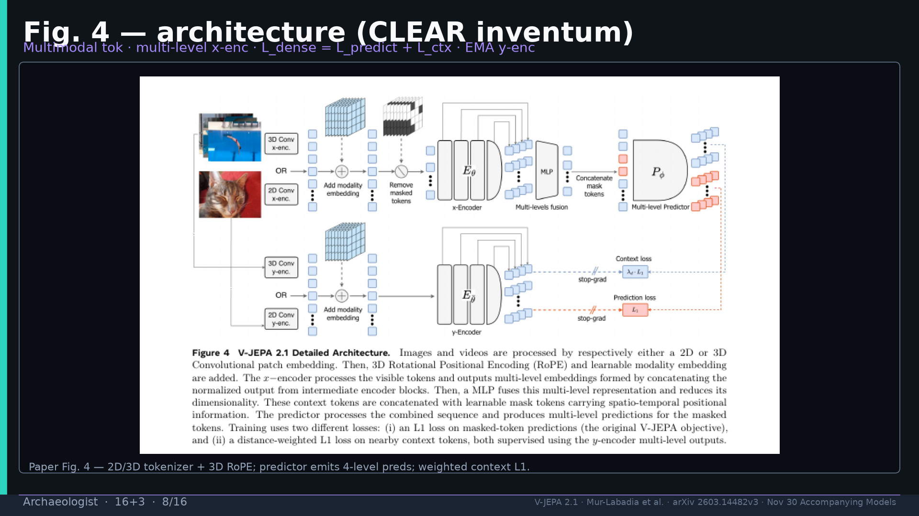
Notes:
Fig.4 architecture CLEAR inventum.

Slide 9
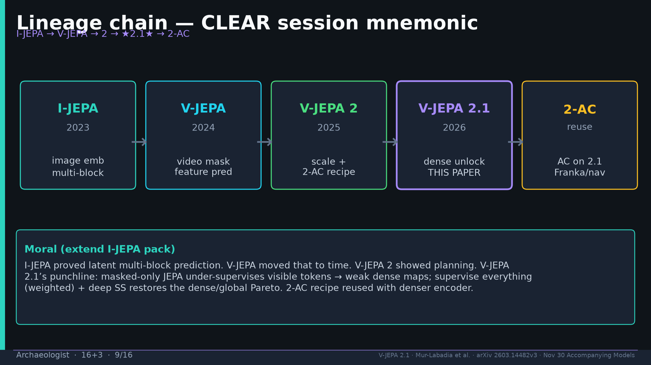
Notes:
Lineage CLEAR I-JEPA→V-JEPA→2→★2.1★→2-AC.

Slide 10
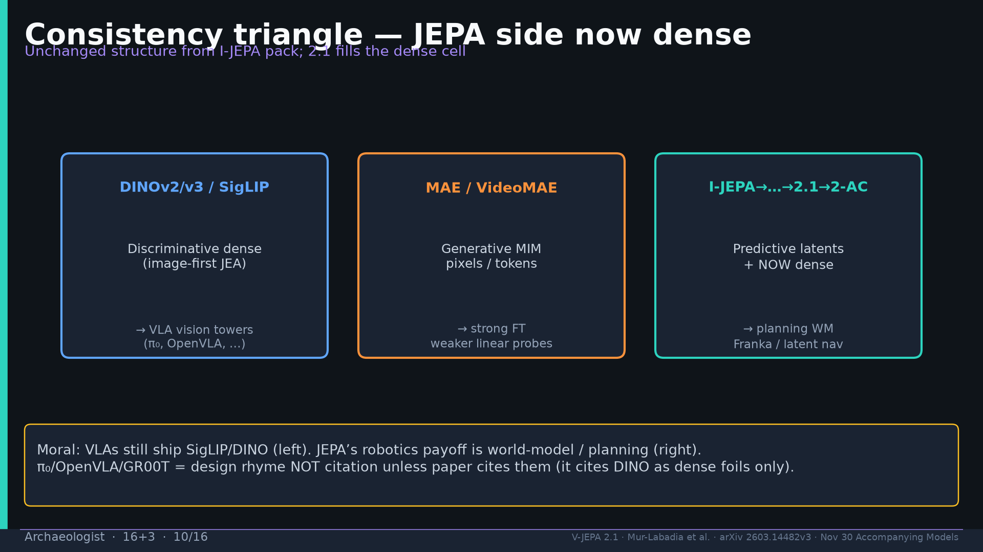
Notes:
Consistency triangle: SigLIP/DINO | MAE | JEPA-now-dense. π₀ rhyme not citation.

Slide 11
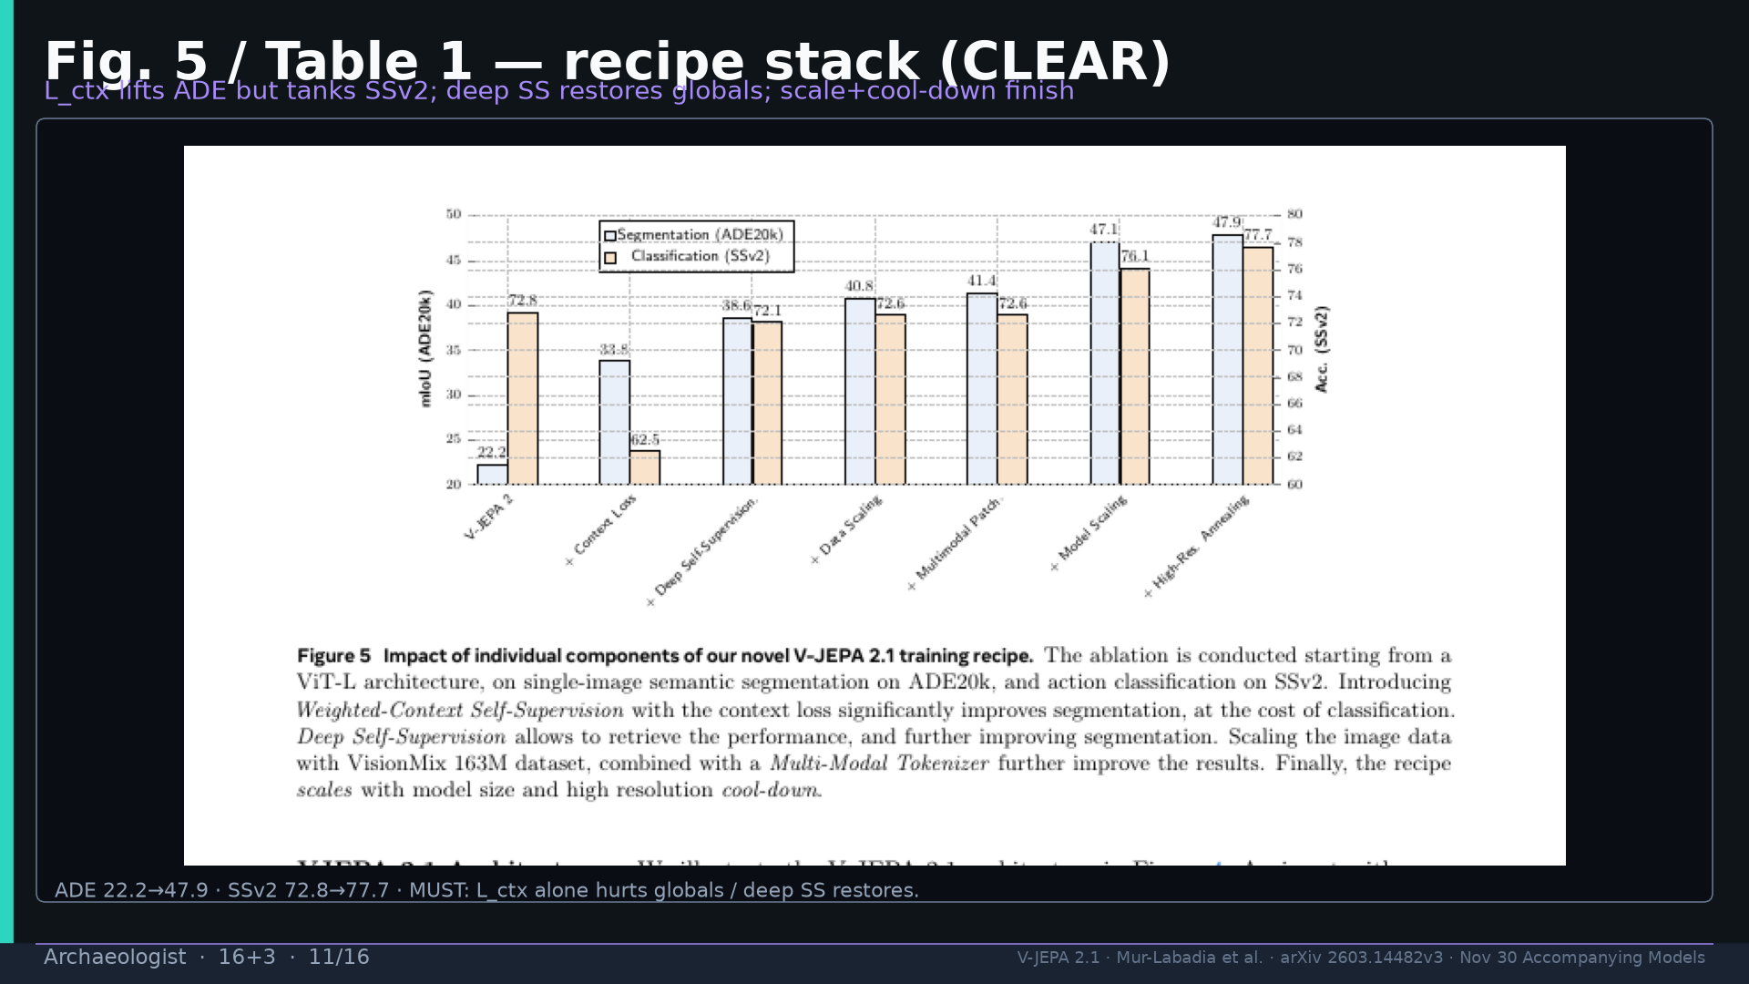
Notes:
Fig.5 recipe: L_ctx alone hurts globals / deep SS restores.

Slide 12
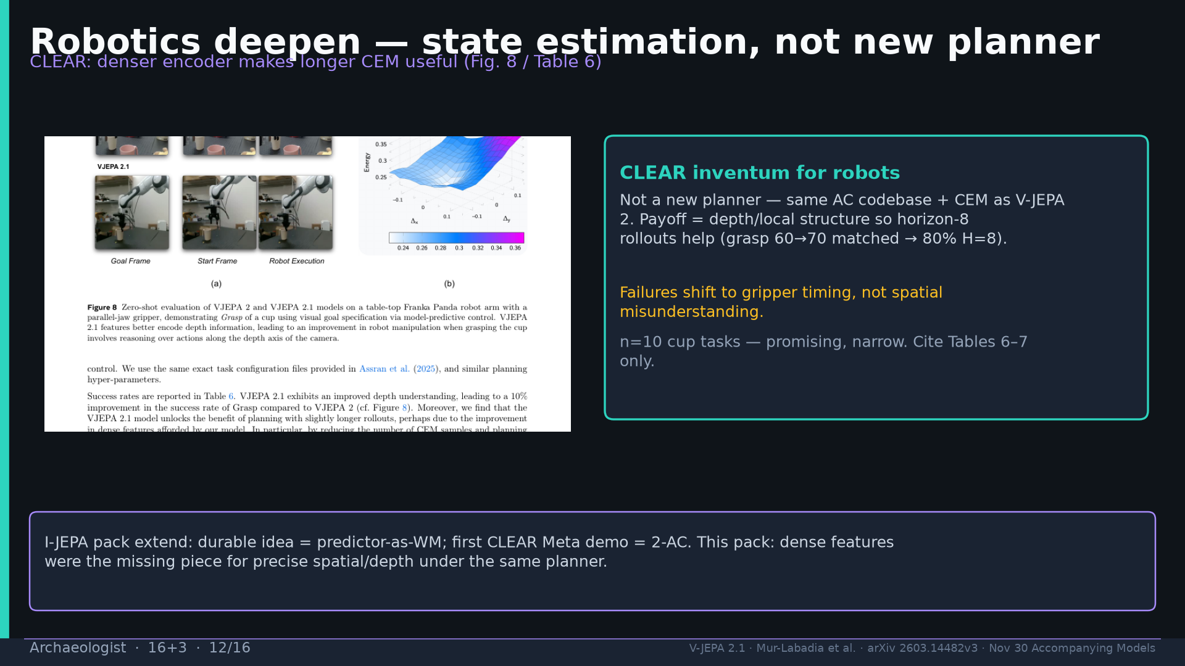
Notes:
Robotics deepen: not new planner — state estimation quality makes longer CEM useful. Fig.8 T6.

Slide 13
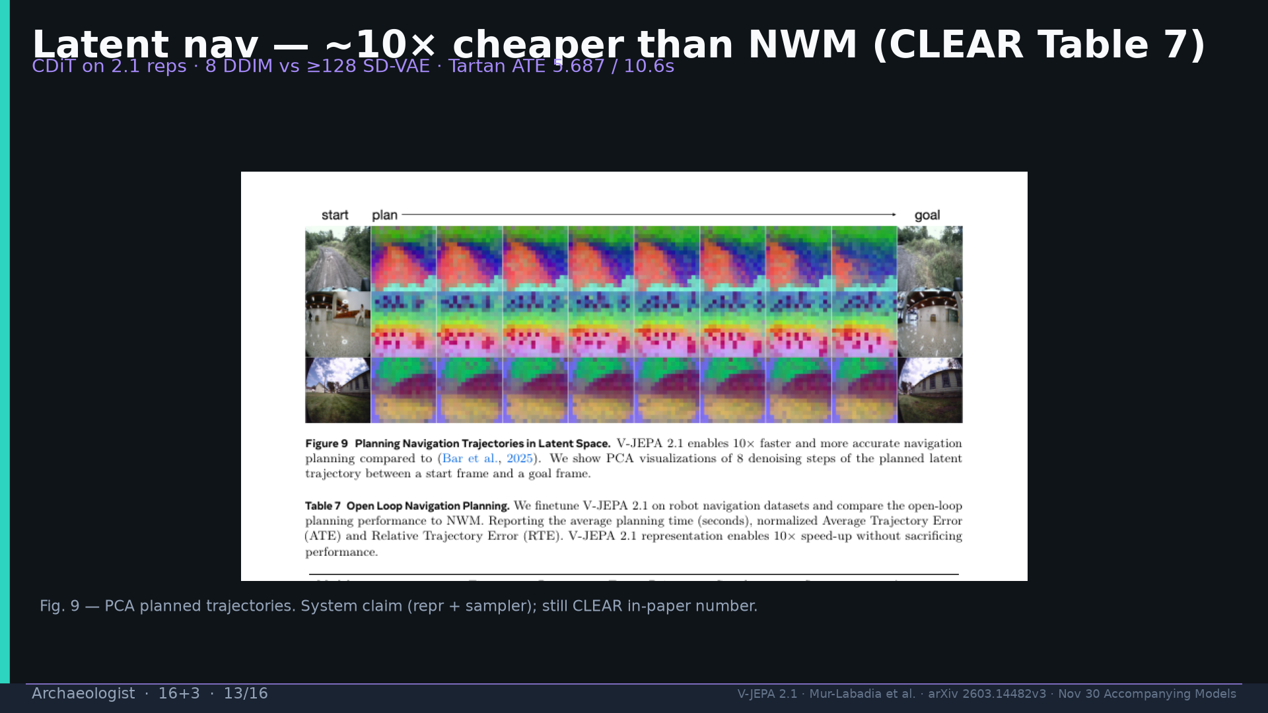
Notes:
Fig.9 nav ~10× Table 7 CLEAR with system footnote.

Slide 14
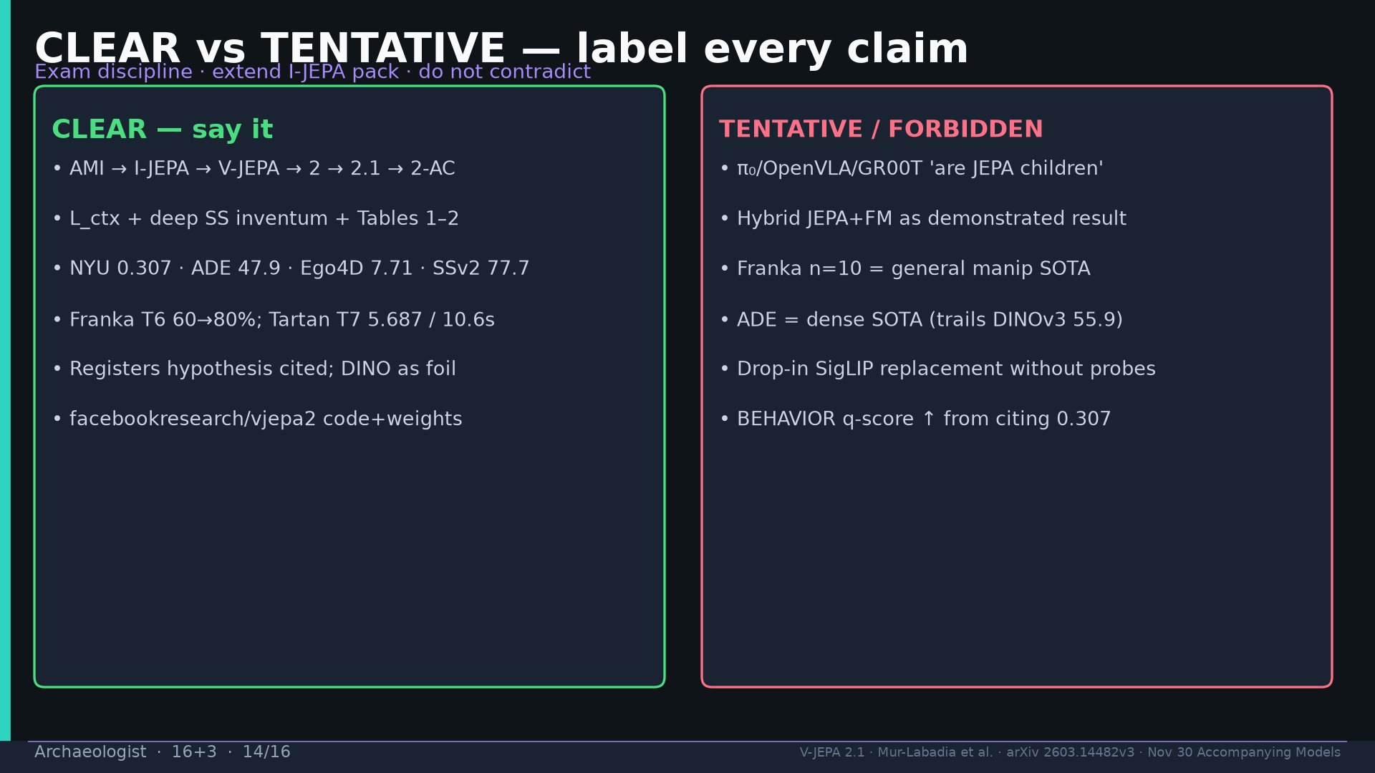
Notes:
CLEAR vs TENTATIVE discipline — hybrid JEPA+FM = proposal.

Slide 15
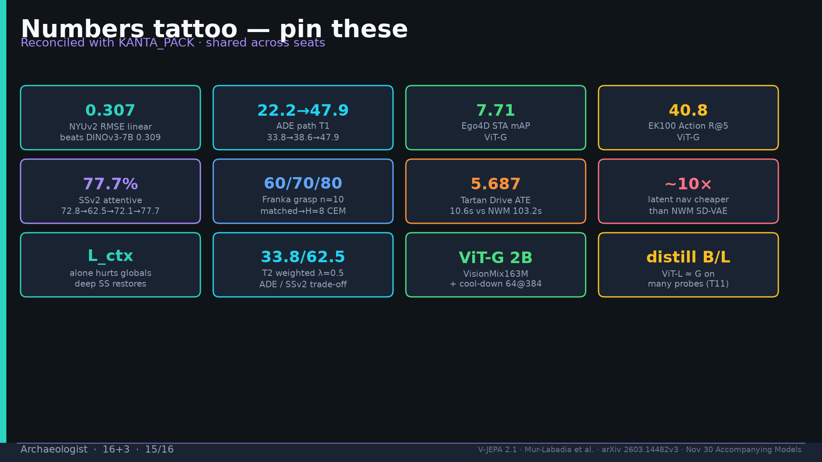
Notes:
Tattoo.

Slide 16
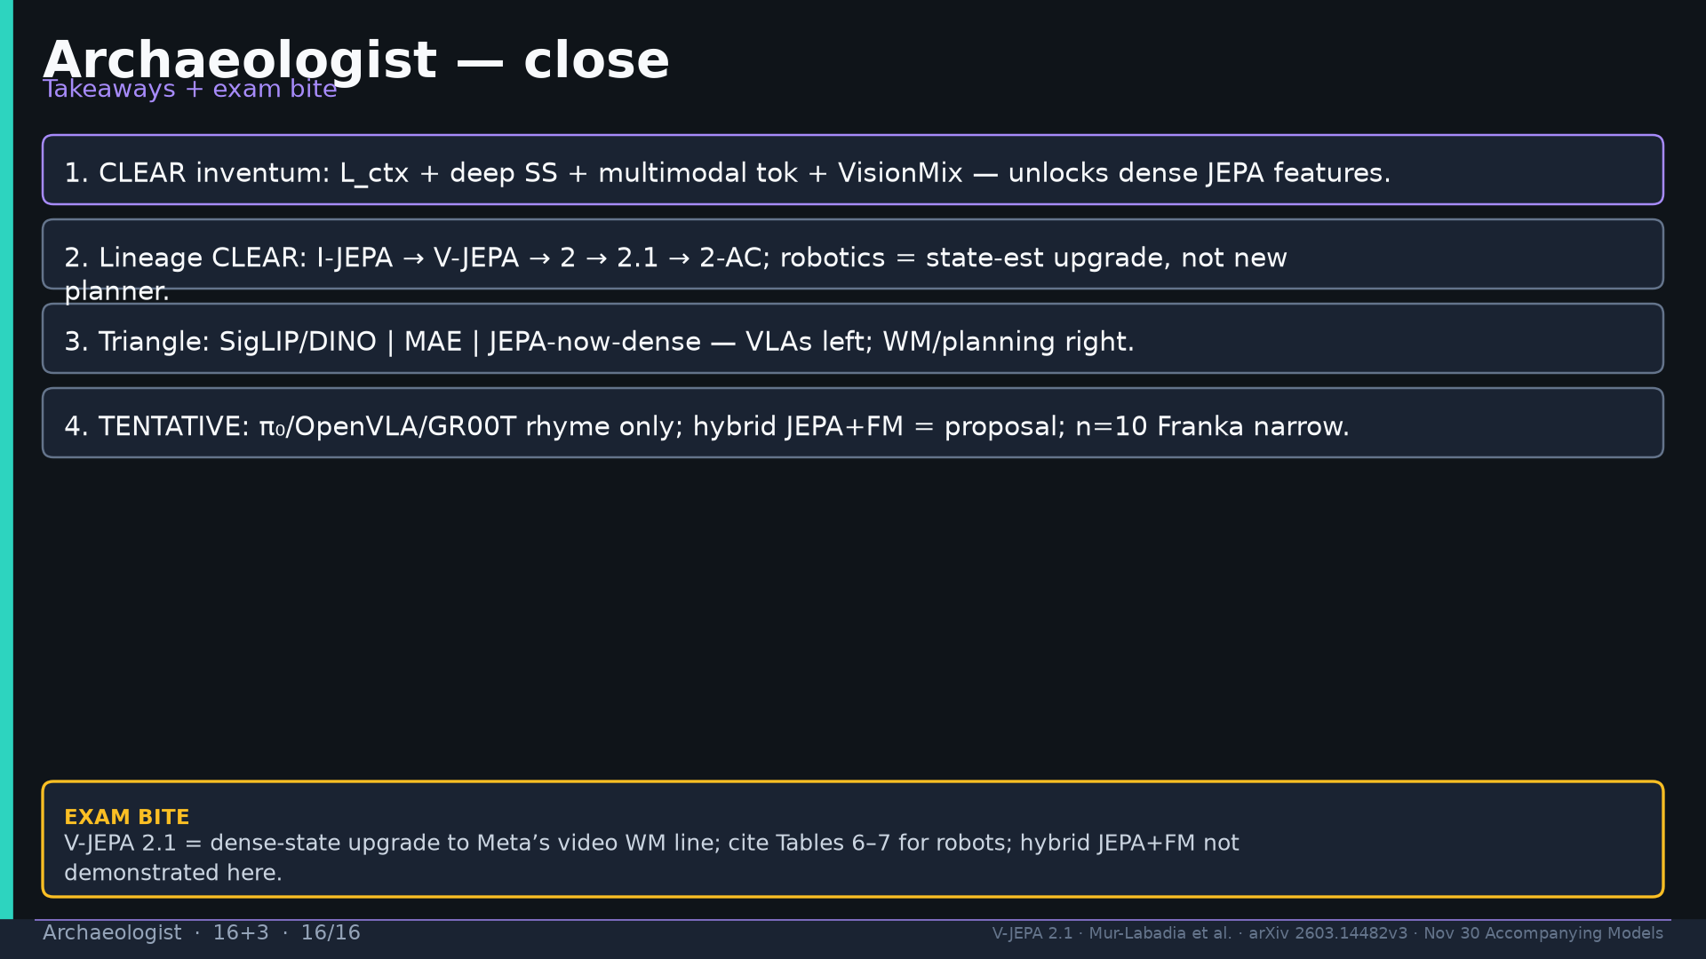
Notes:
Close + exam: dense-state upgrade; cite T6–7; hybrid proposal only.

