Slide 1
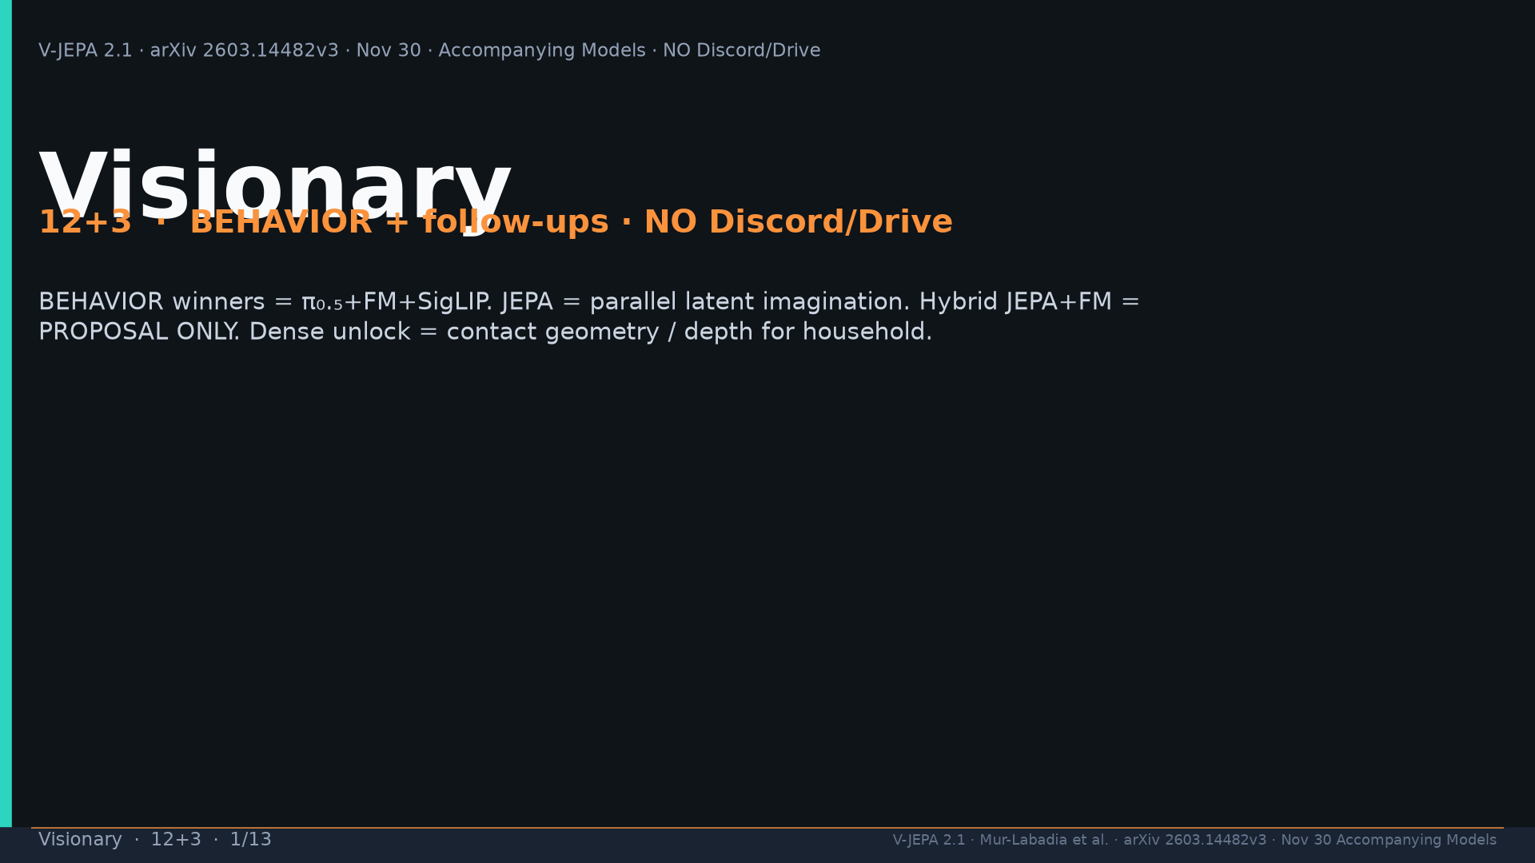
Notes:
Title. NO Discord/Drive. Hybrid JEPA+FM = proposal only.

Slide 2
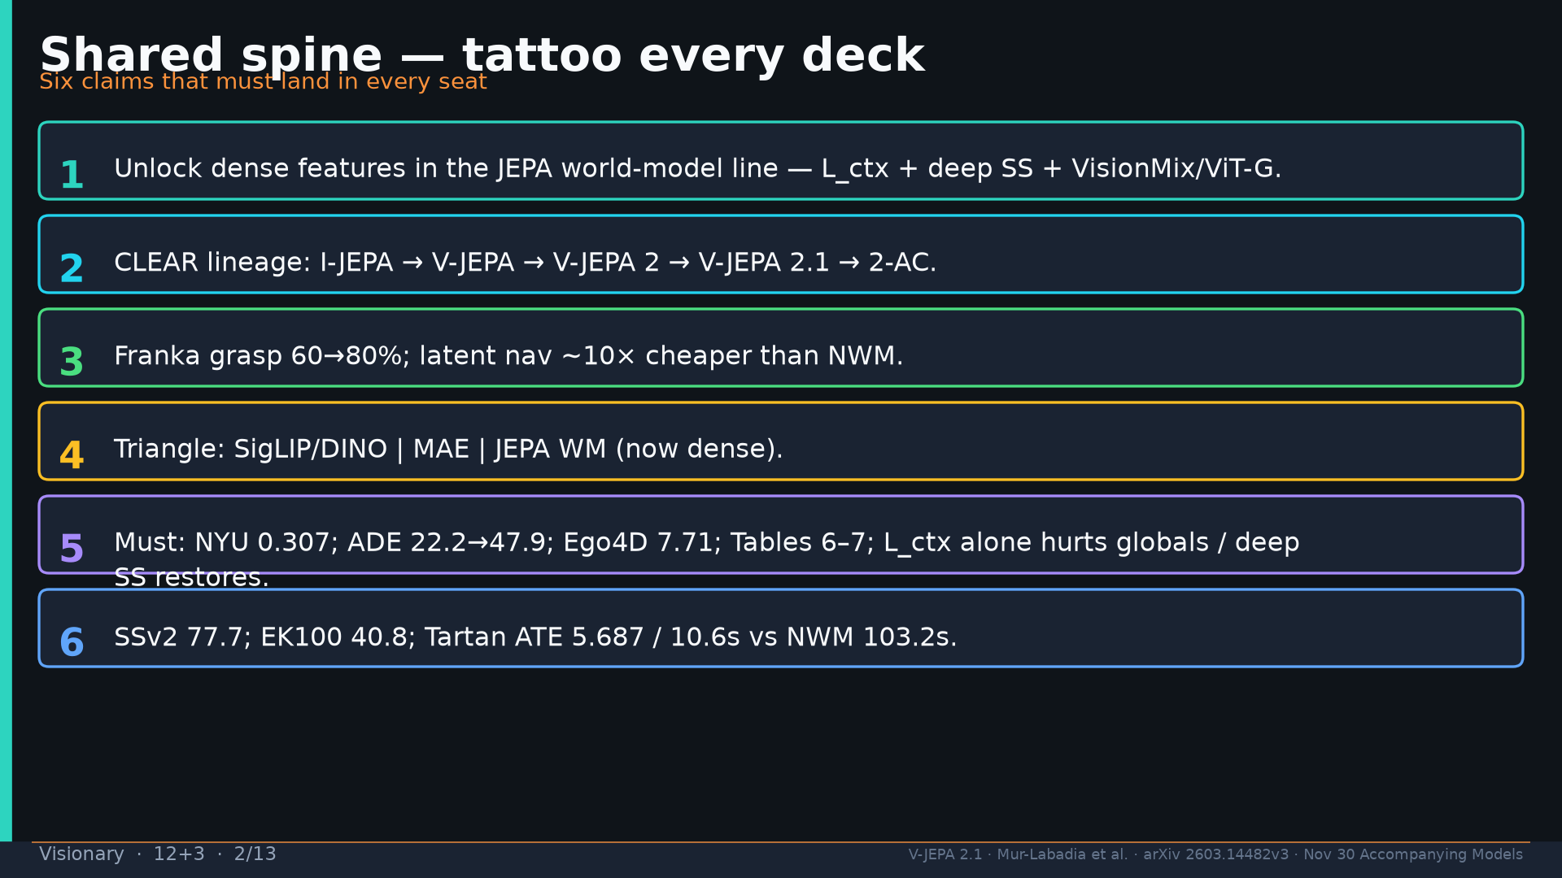
Notes:
Shared spine.

Slide 3
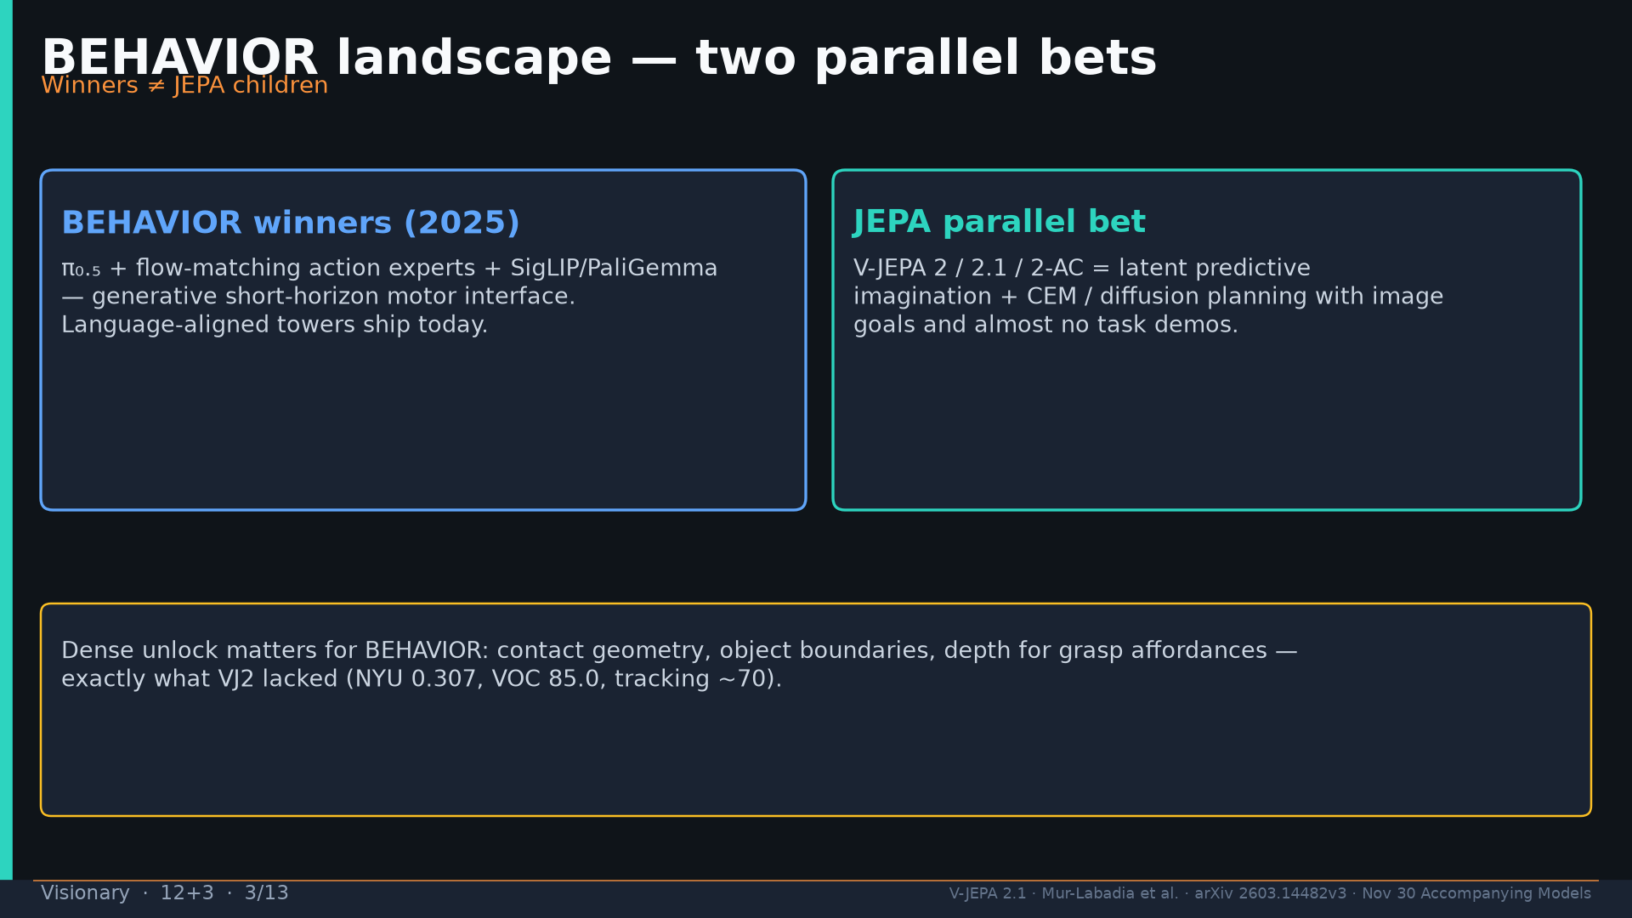
Notes:
BEHAVIOR winners = π₀.₅+FM+SigLIP; JEPA = parallel latent imagination.

Slide 4
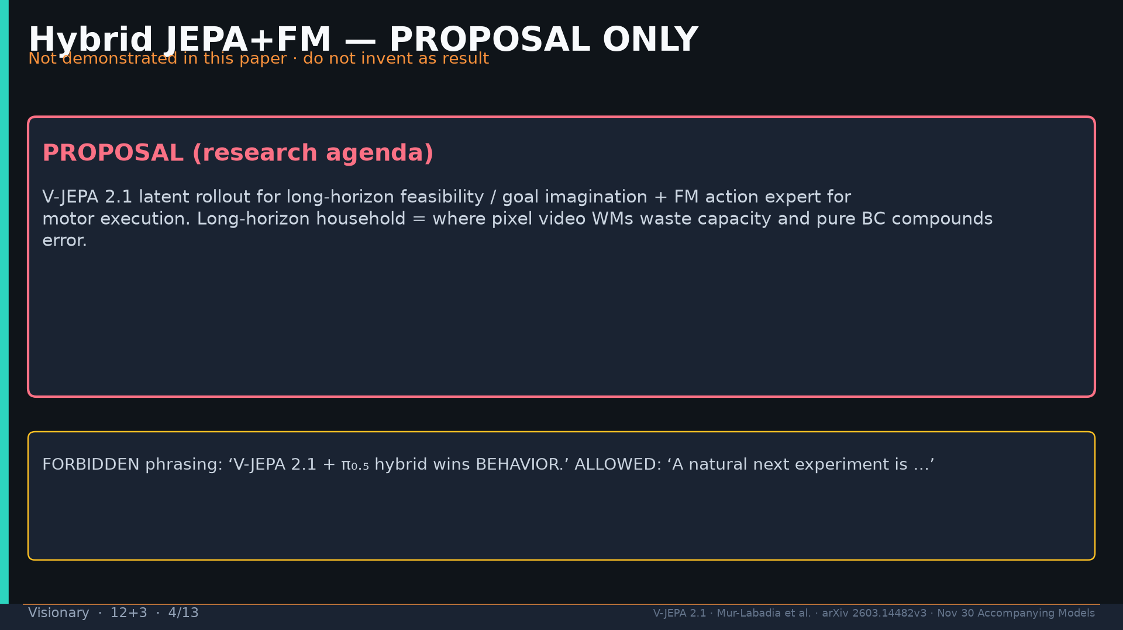
Notes:
Hybrid JEPA+FM = PROPOSAL ONLY — not demonstrated.

Slide 5
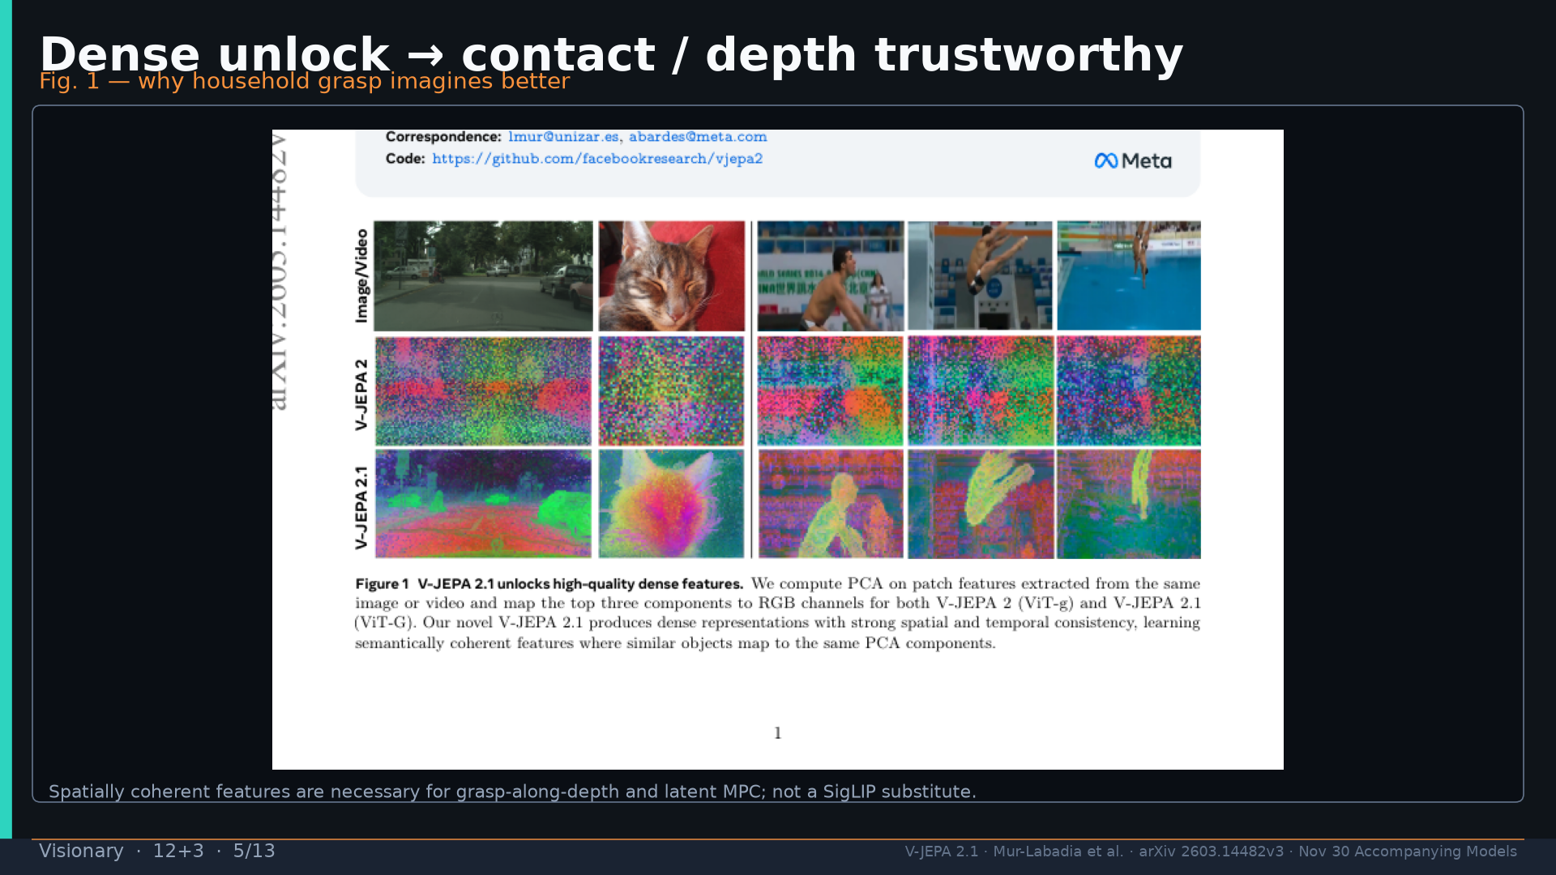
Notes:
Fig.1 dense unlock → contact/depth for household.

Slide 6
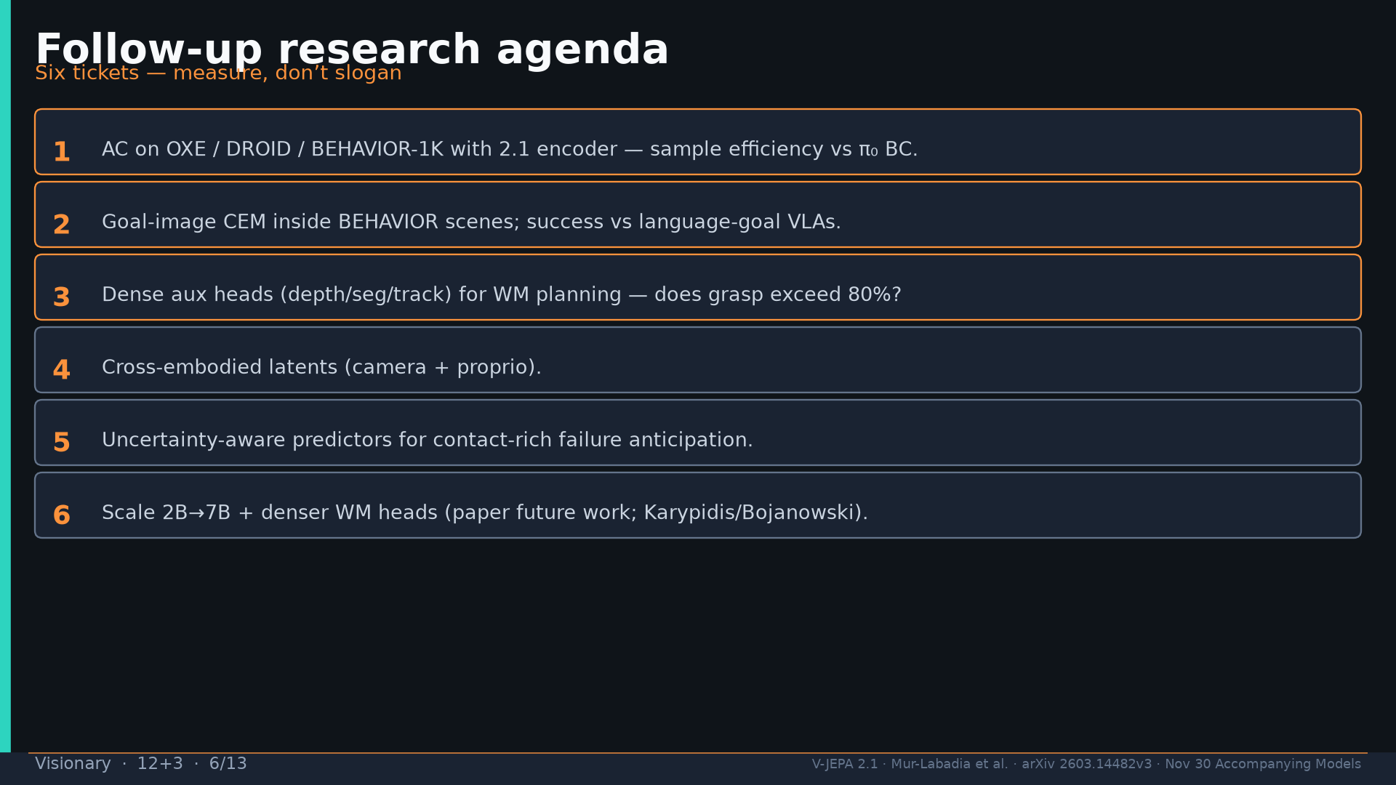
Notes:
Follow-ups: AC on OXE/BEHAVIOR; goal-image CEM; dense aux heads; etc.

Slide 7
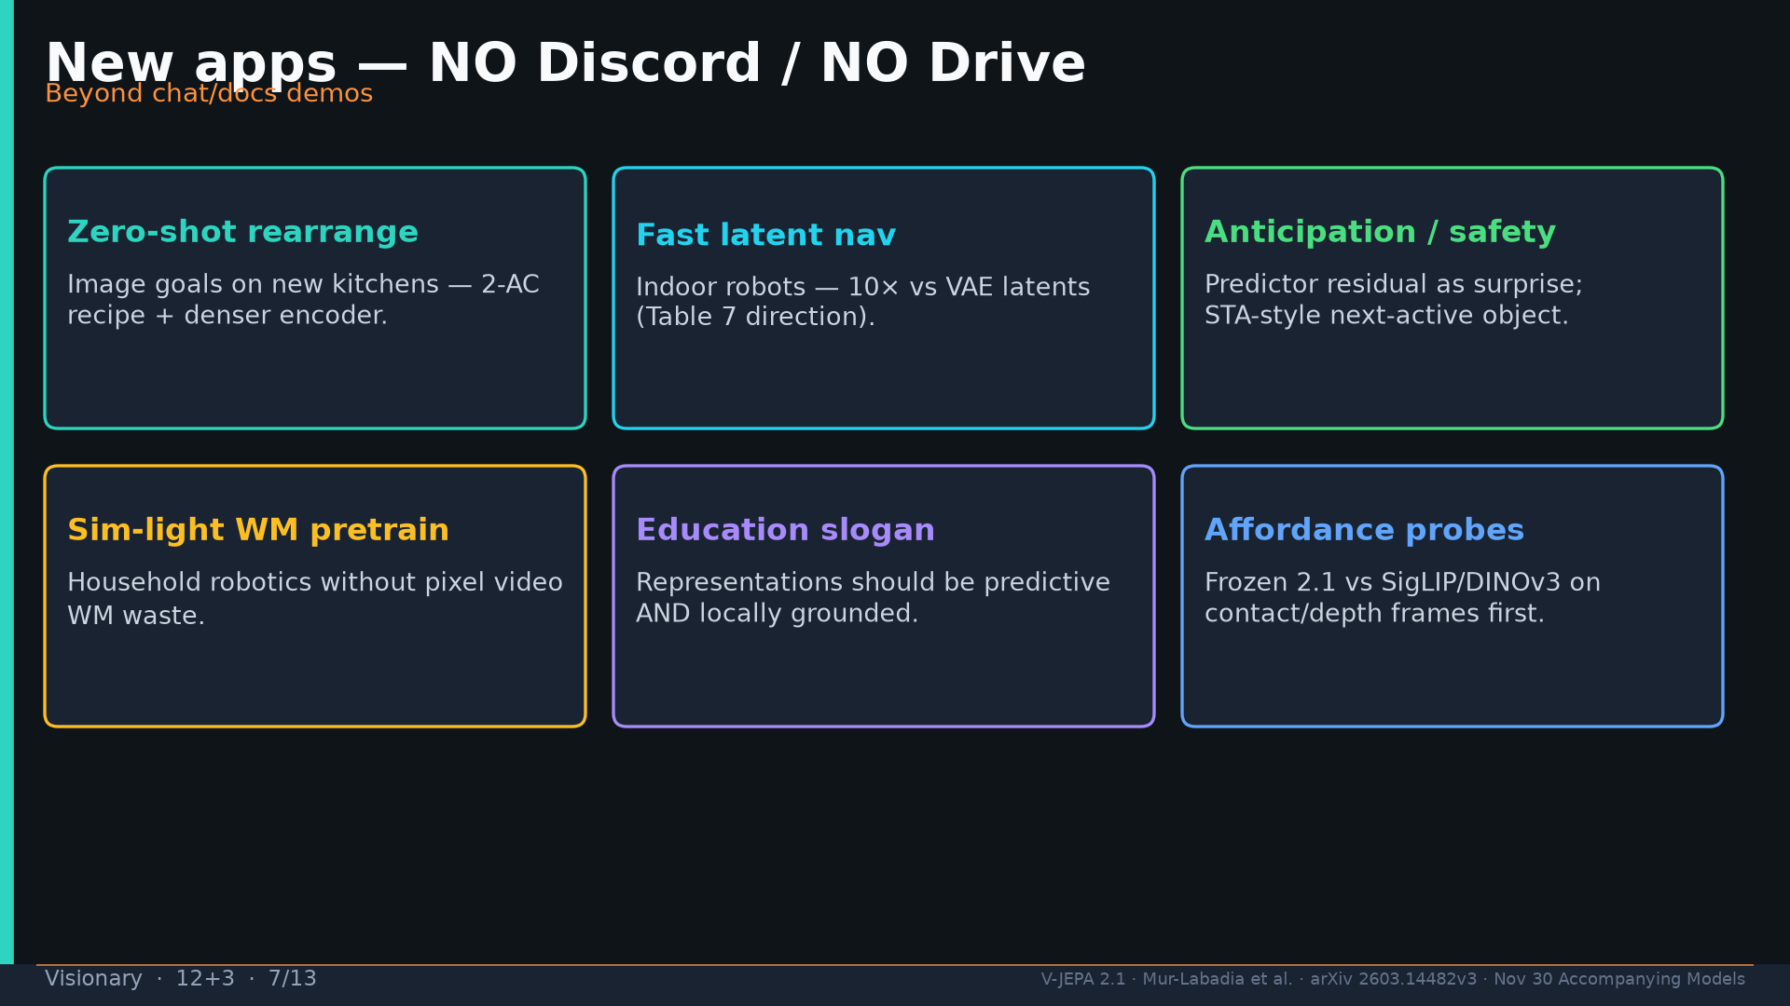
Notes:
Apps: rearrange; latent nav; safety; sim-light WM; education; affordance. NO Discord/Drive.

Slide 8
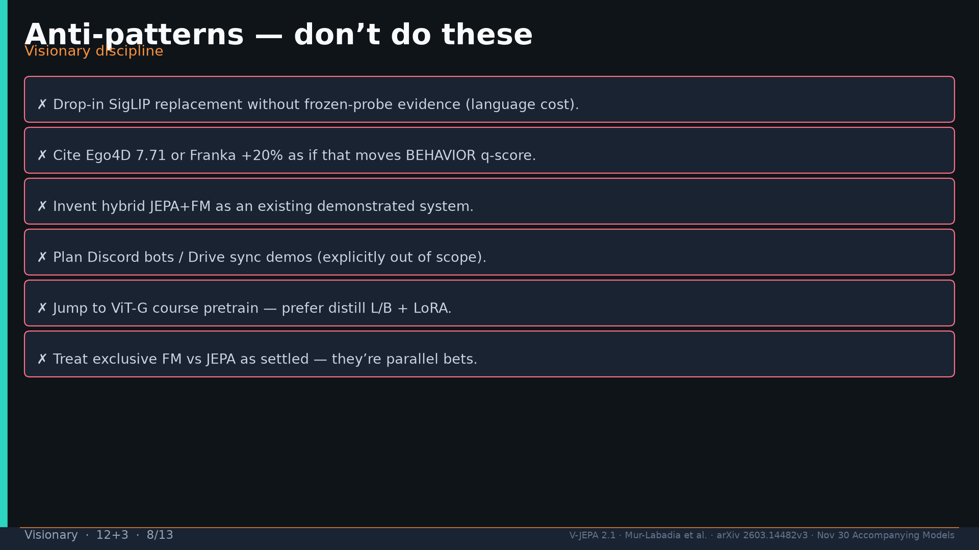
Notes:
Anti-patterns list.

Slide 9
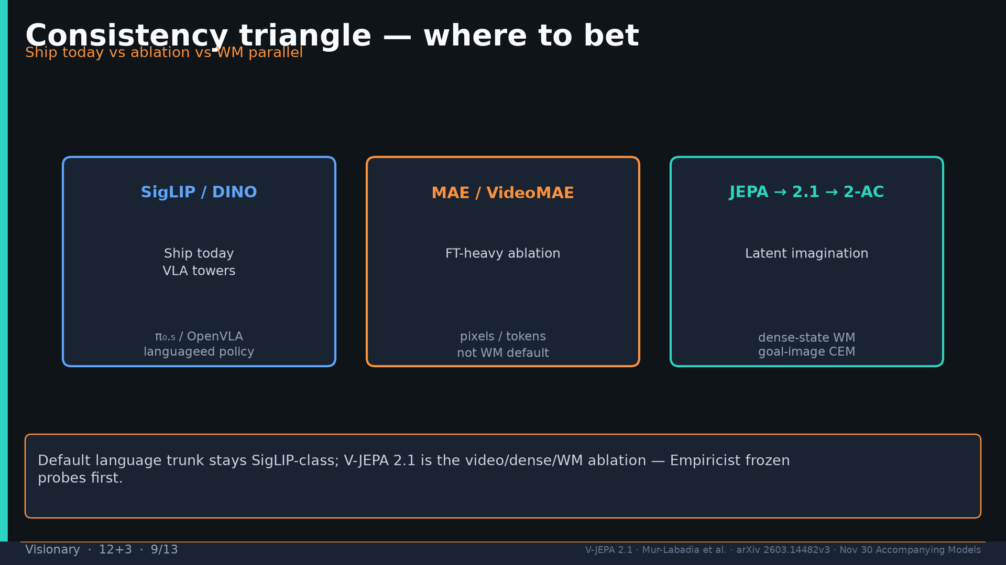
Notes:
Triangle: SigLIP ship today | MAE ablation | JEPA WM parallel.

Slide 10
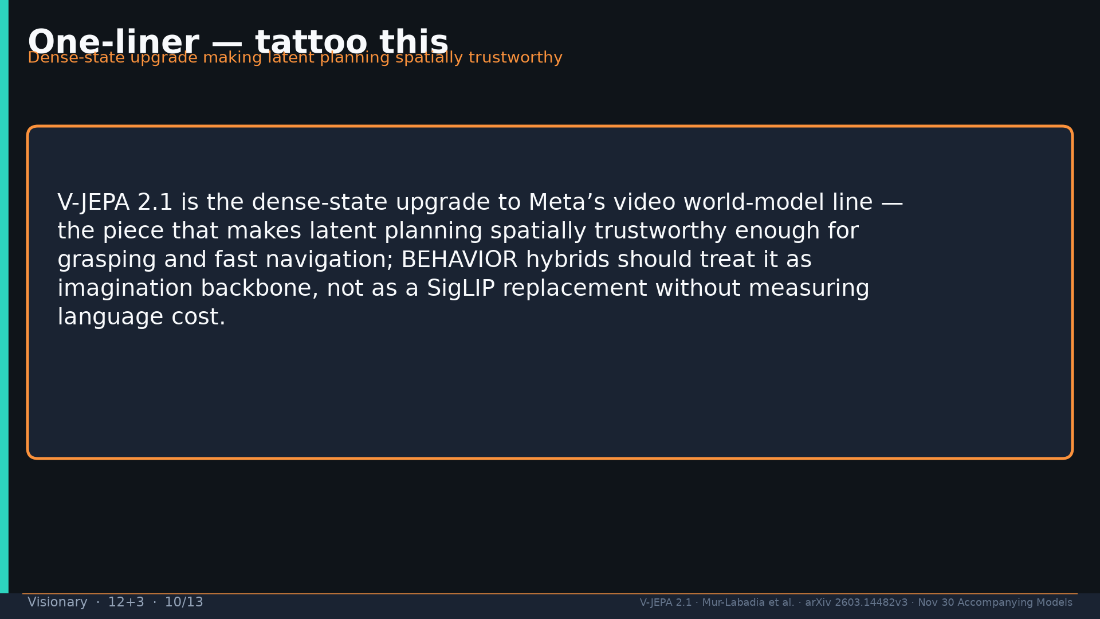
Notes:
One-liner tattoo: dense-state upgrade making latent planning spatially trustworthy.

Slide 11
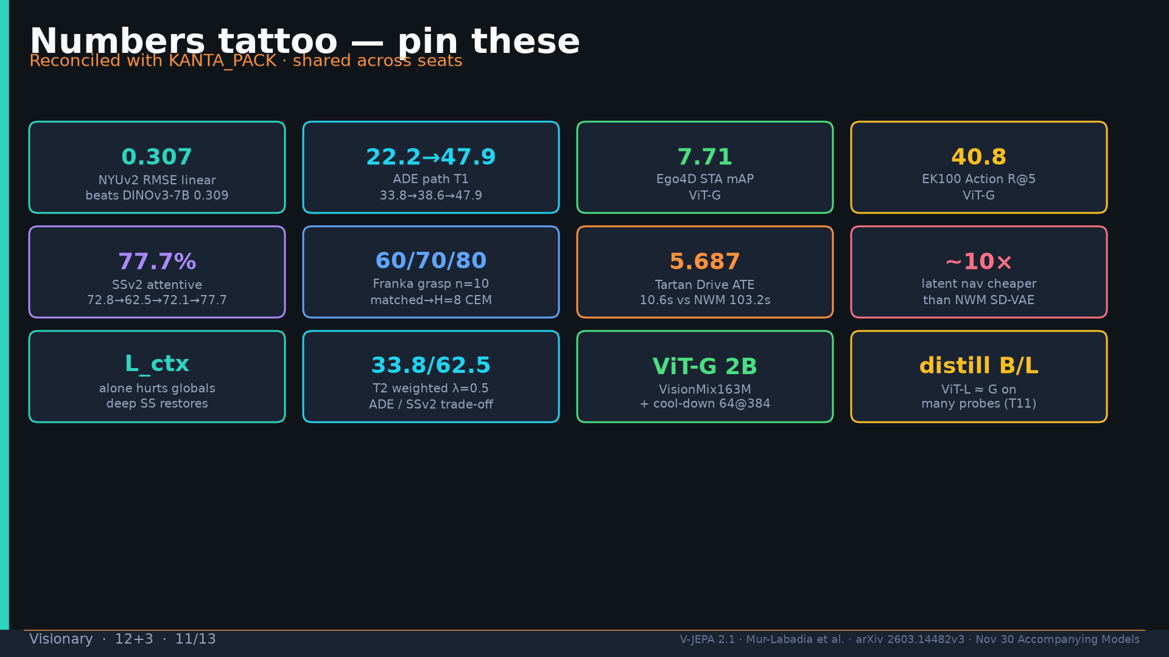
Notes:
Tattoo numbers.

Slide 12
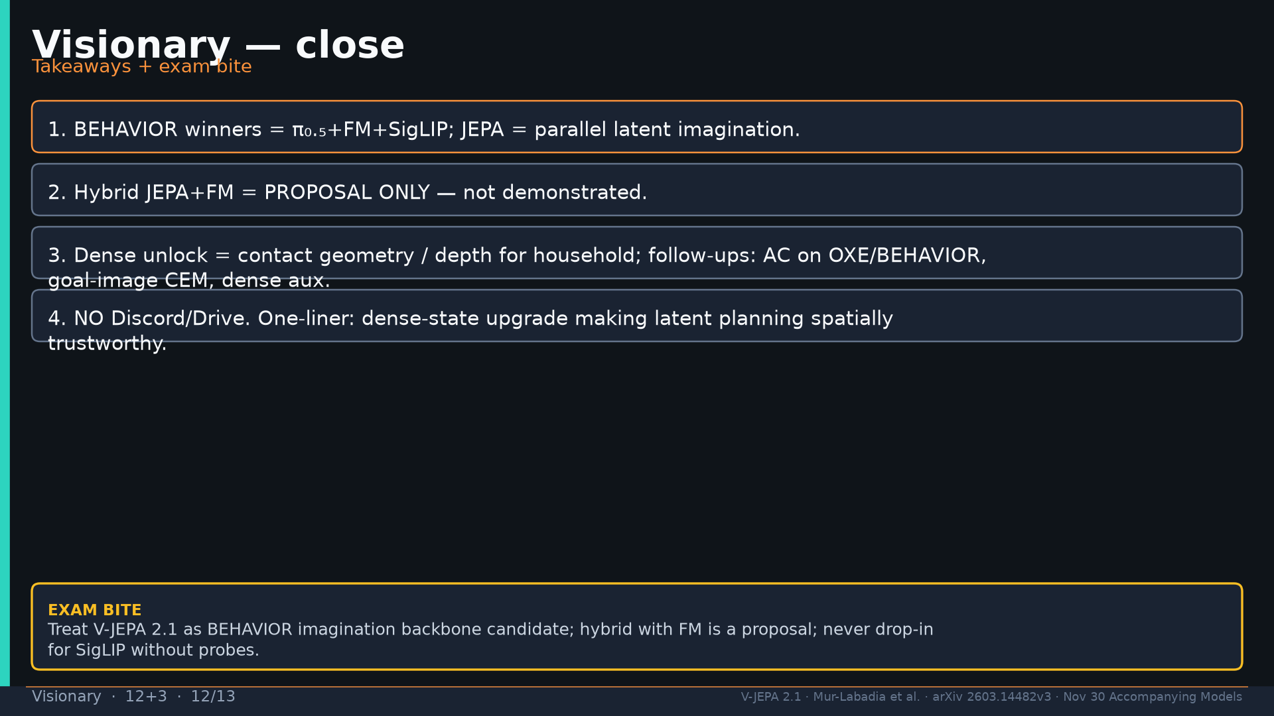
Notes:
Close four takeaways. NO Discord/Drive.

Slide 13
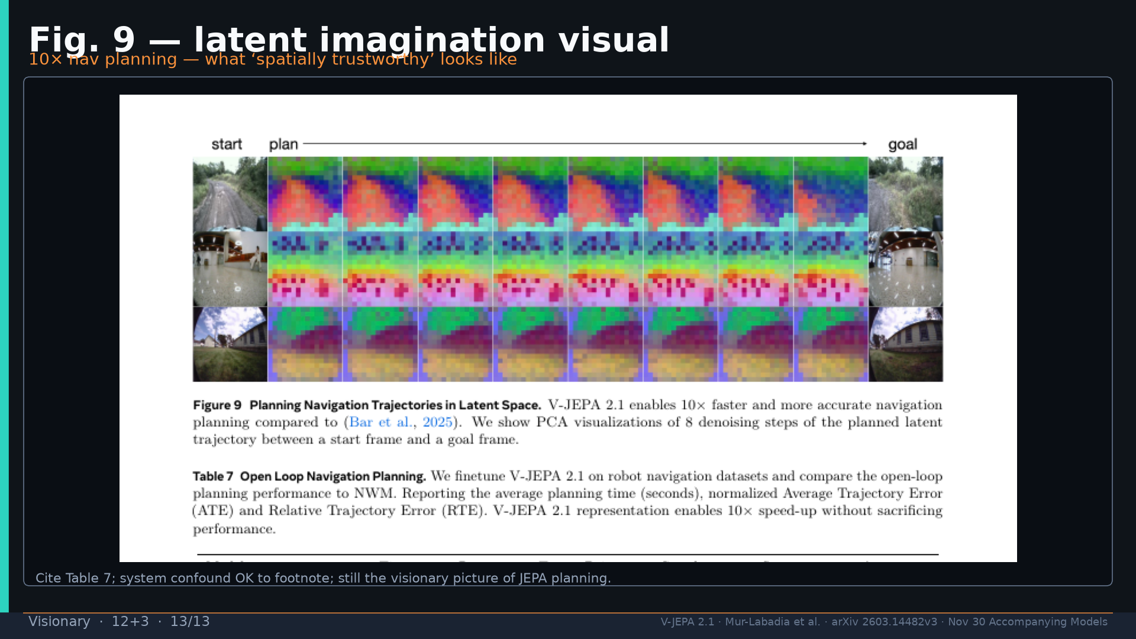
Notes:
Fig.9 latent imagination visual — cite Table 7.

