Slide 1
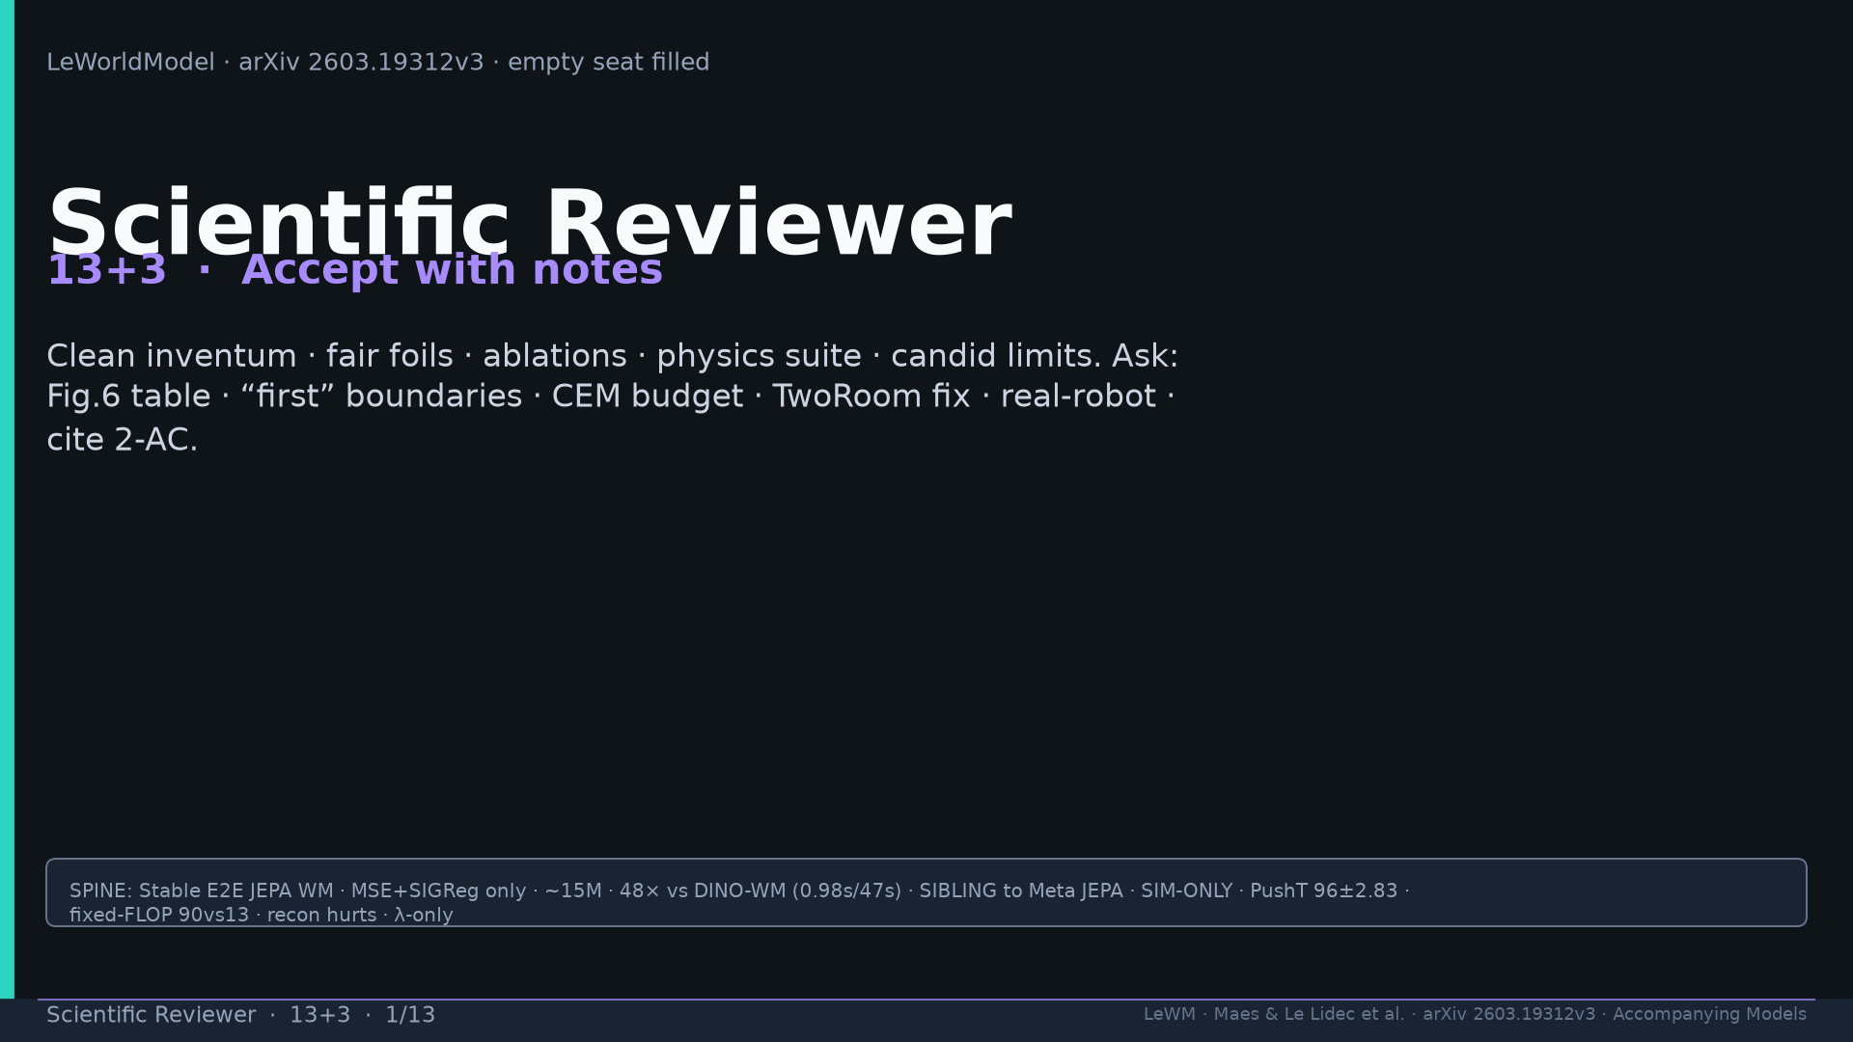
Notes:
Title. Accept with notes. Strengths vs weaknesses framing.

Slide 2
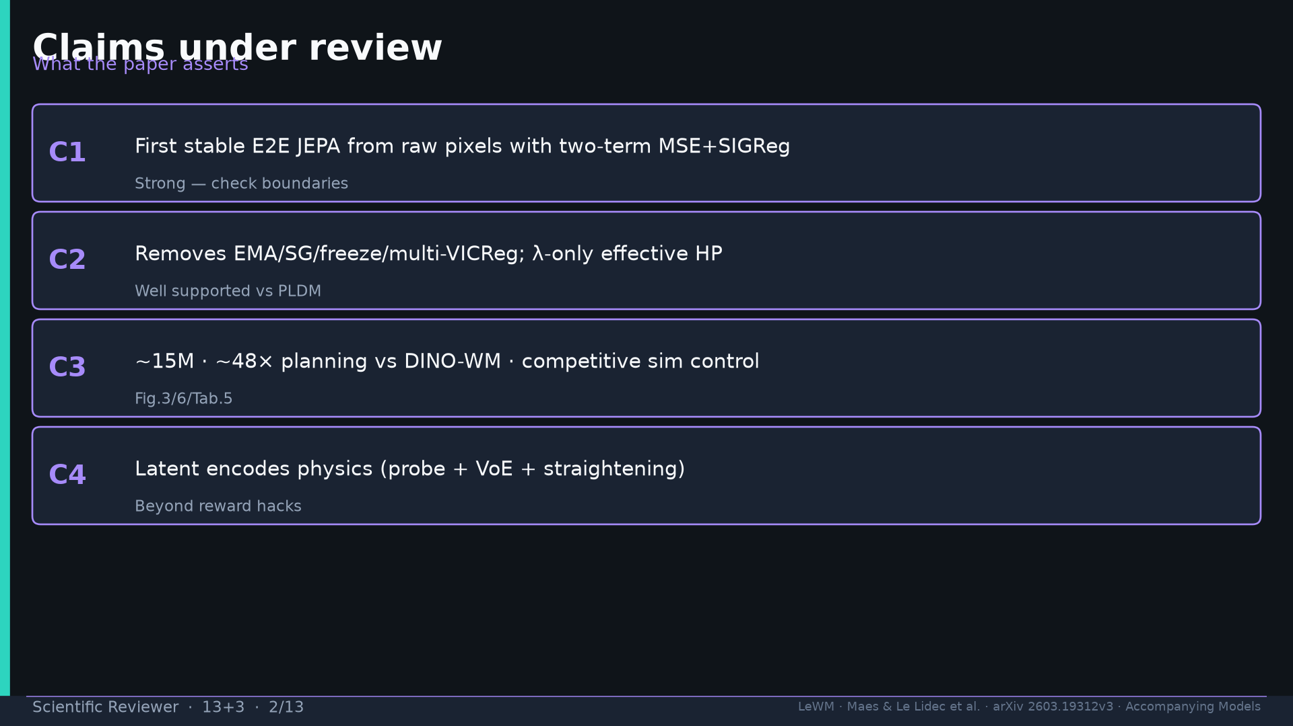
Notes:
Four claims: first E2E; λ-only; 15M/48×; physics suite. Flag “first” boundaries.

Slide 3
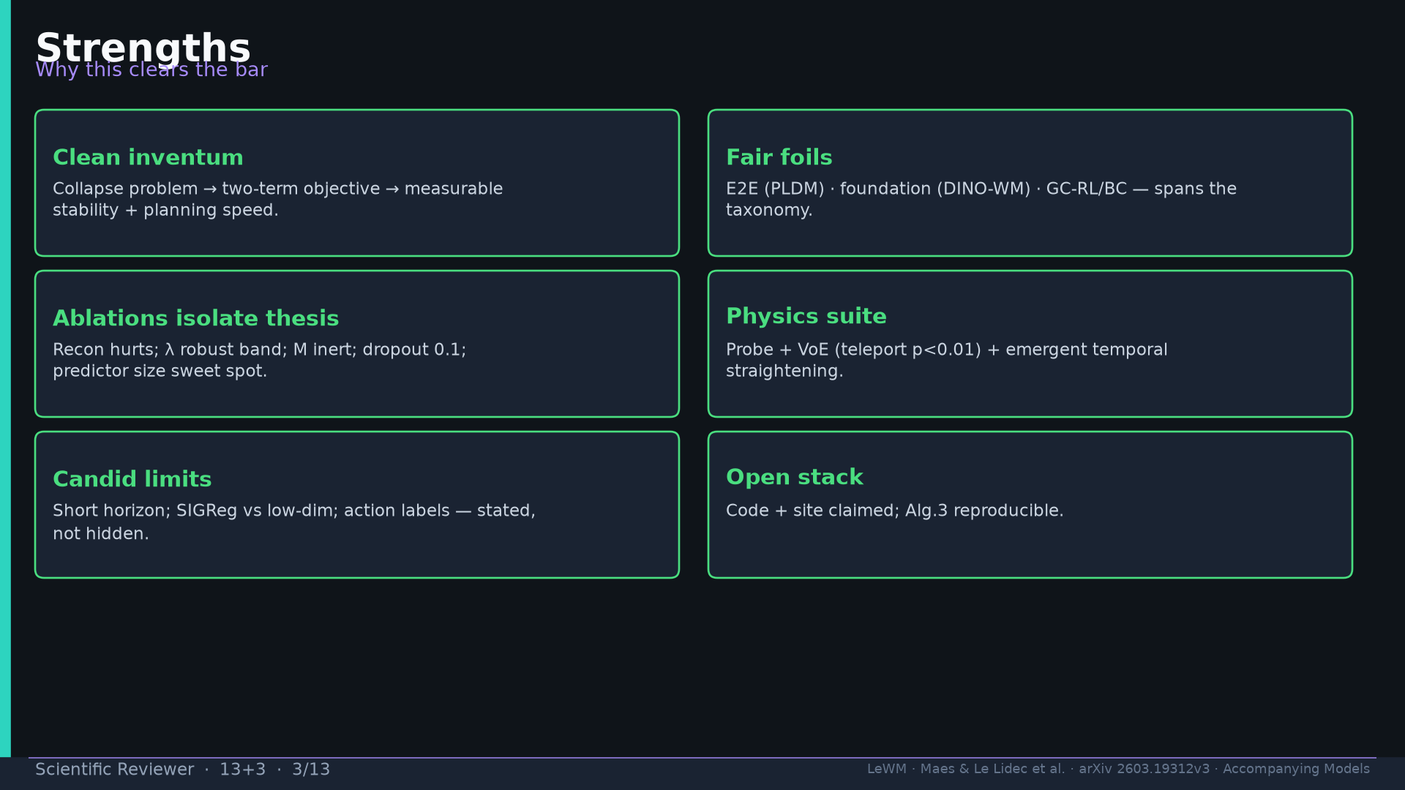
Notes:
Strengths: clean inventum; fair foils; ablations; physics; candid limits; open stack.

Slide 4
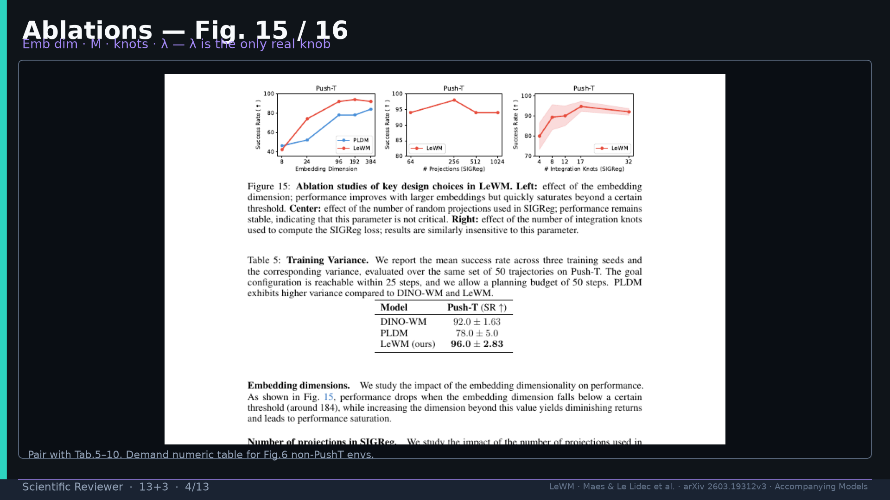
Notes:
Fig.15 ablations — λ only real knob; demand Fig.6 numeric table.

Slide 5
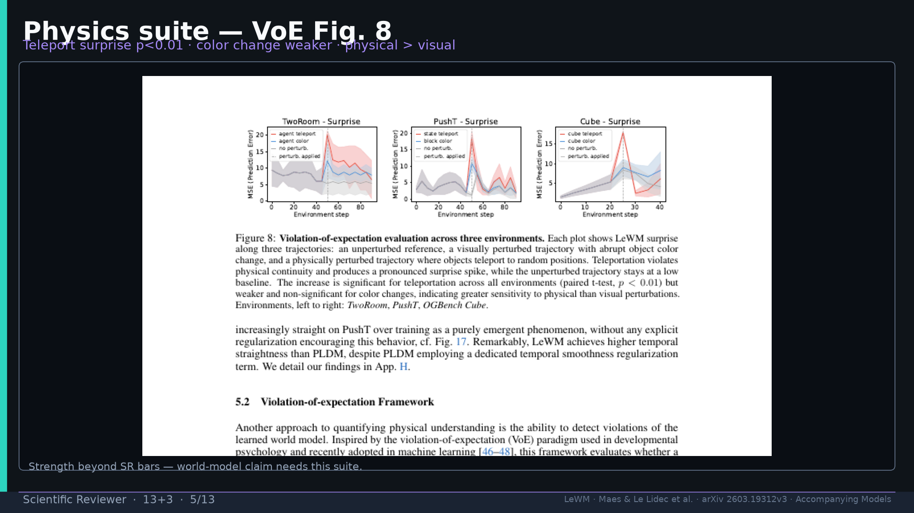
Notes:
Fig.8 VoE — teleport p<0.01; physics beyond SR bars.

Slide 6
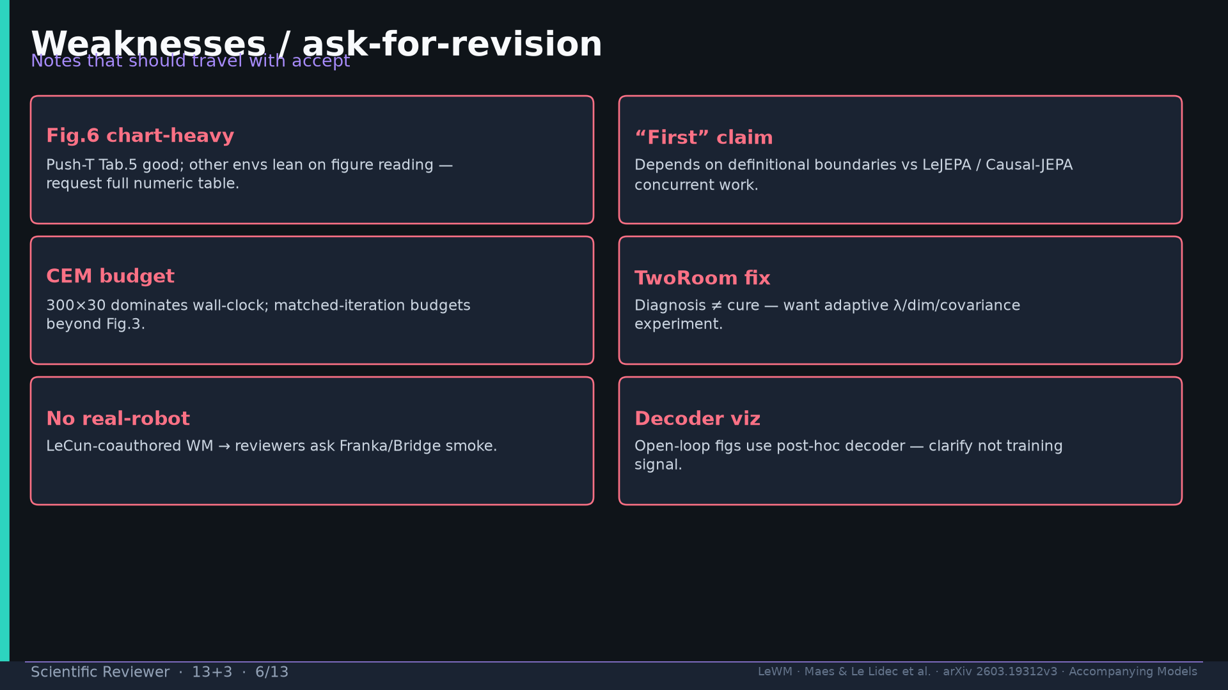
Notes:
Weaknesses: Fig.6 chart-heavy; first claim; CEM budget; TwoRoom fix; no robot; decoder viz.

Slide 7
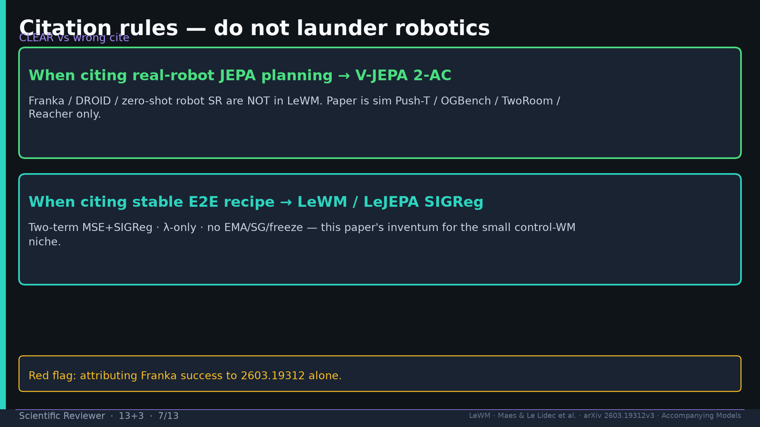
Notes:
Cite rule: robots → V-JEPA 2-AC; stable E2E → LeWM/SIGReg. Red flag Franka on 2603.19312 alone.

Slide 8
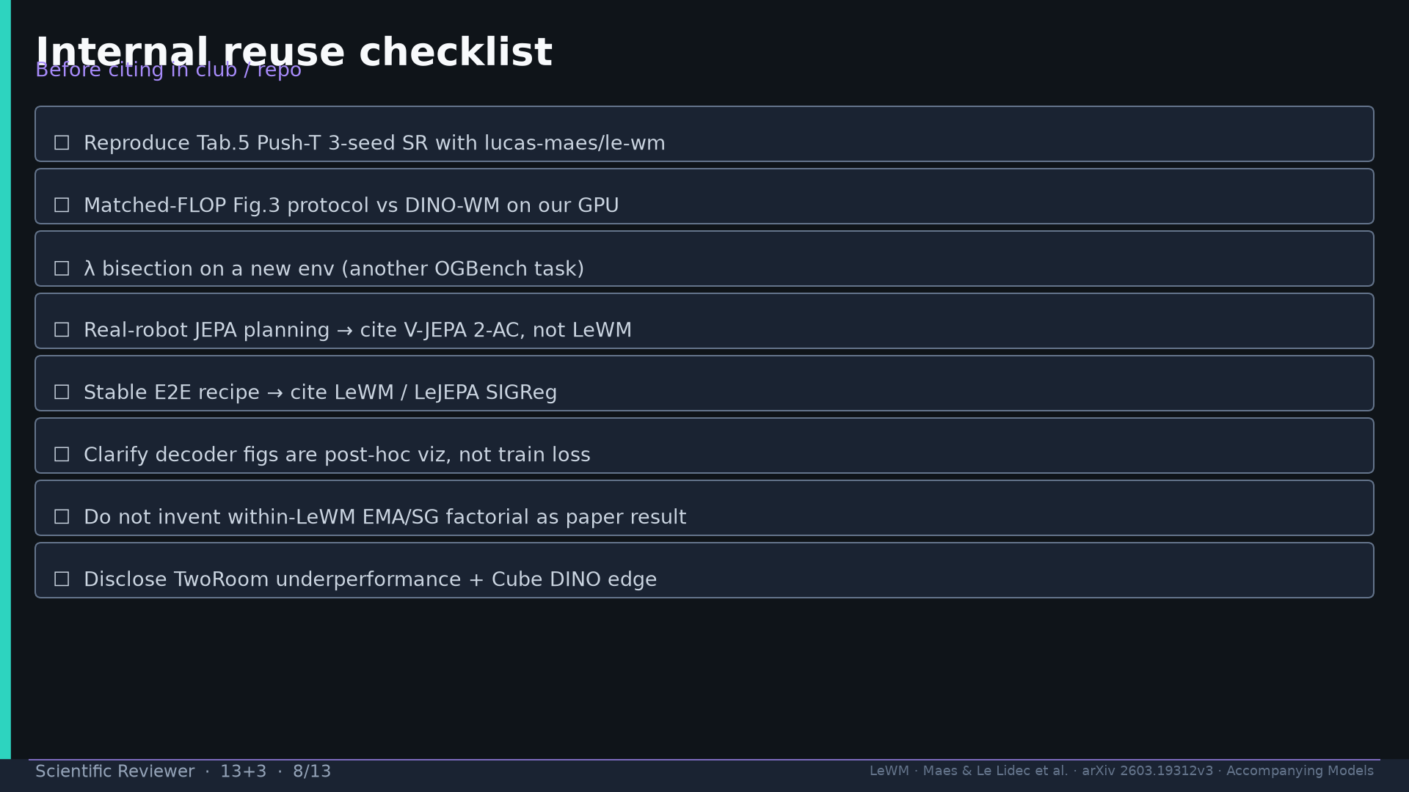
Notes:
Reuse checklist eight items — Tab.5 repro; matched FLOP; λ bisection; cite rules; GAP honesty.

Slide 9
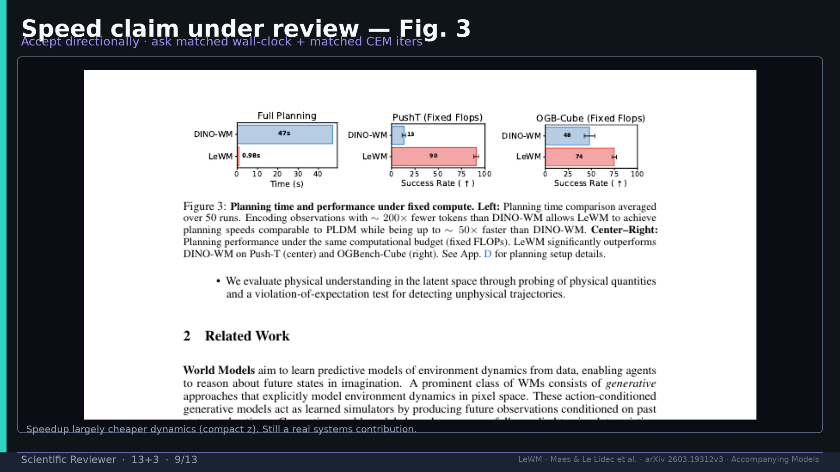
Notes:
Fig.3 speed under review — accept directionally; ask matched wall-clock + CEM iters.

Slide 10
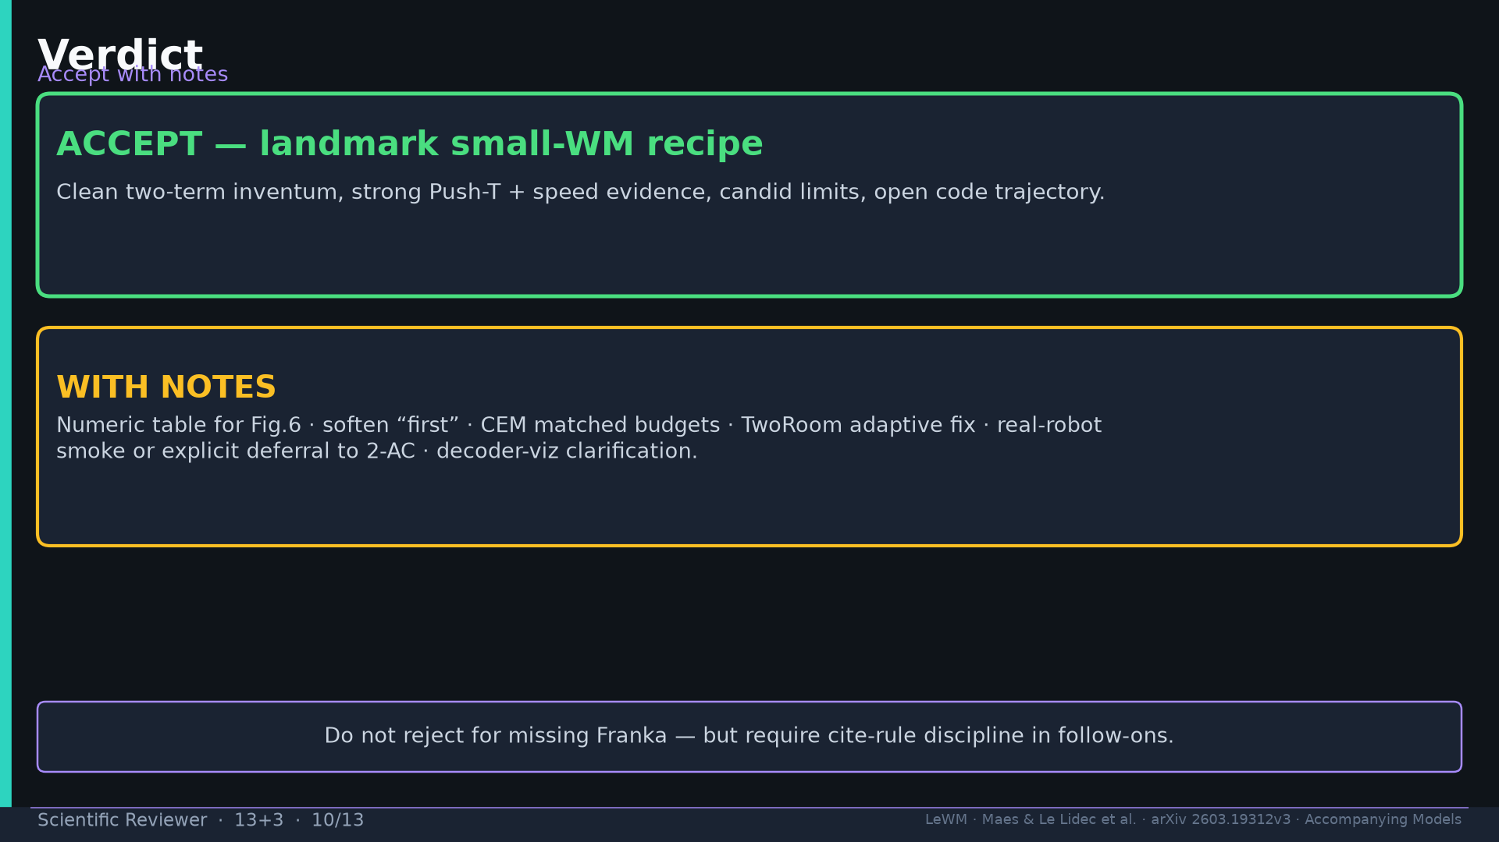
Notes:
Verdict: ACCEPT landmark small-WM + WITH NOTES.

Slide 11
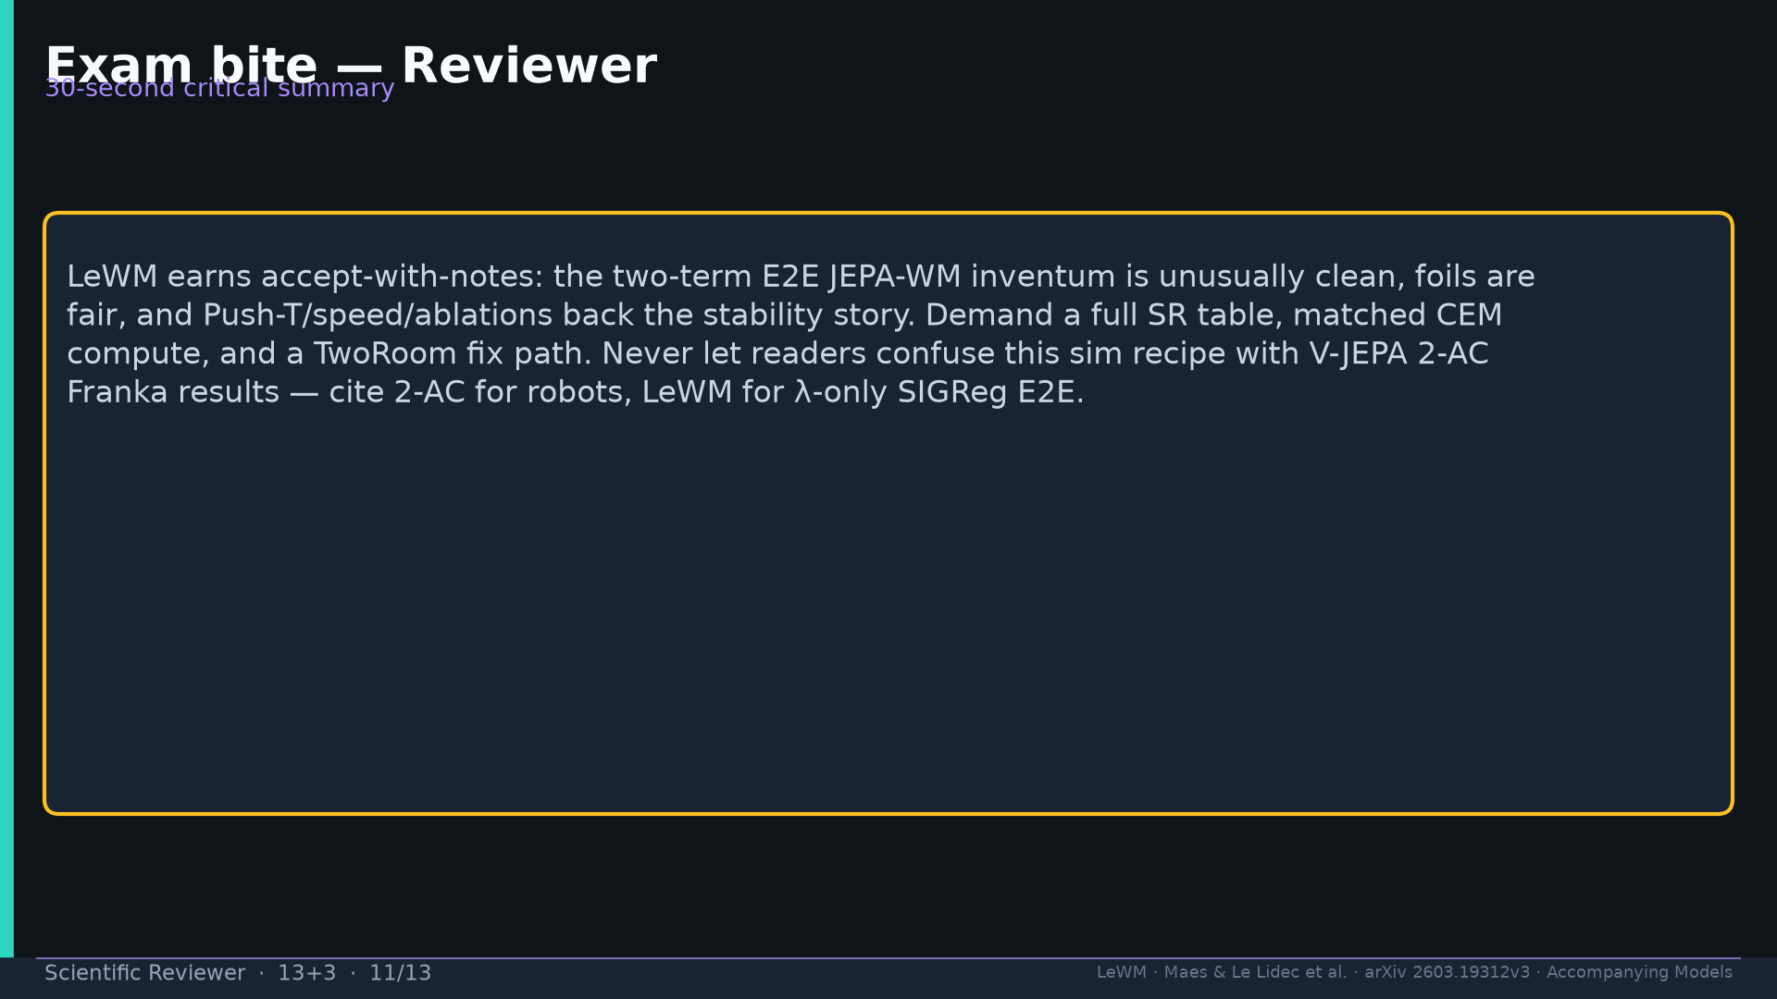
Notes:
Exam bite critical summary.

Slide 12
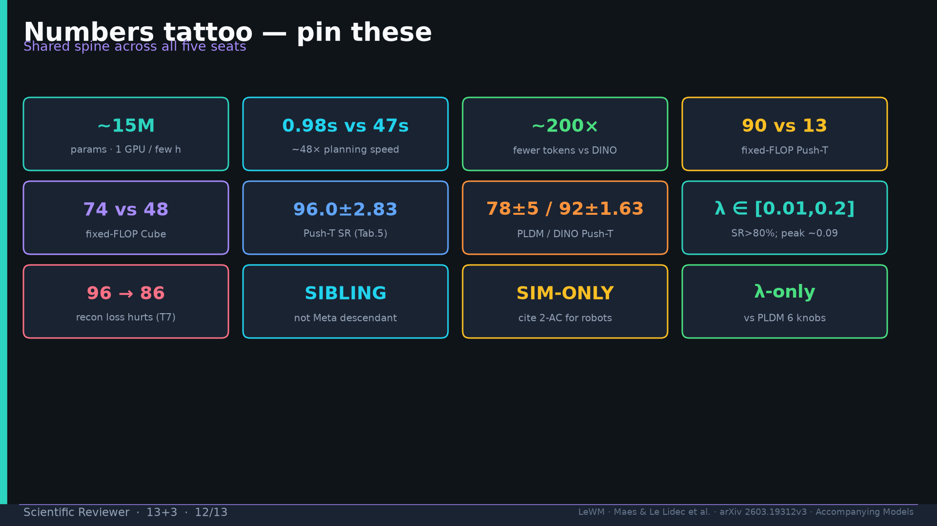
Notes:
Tattoo.

Slide 13
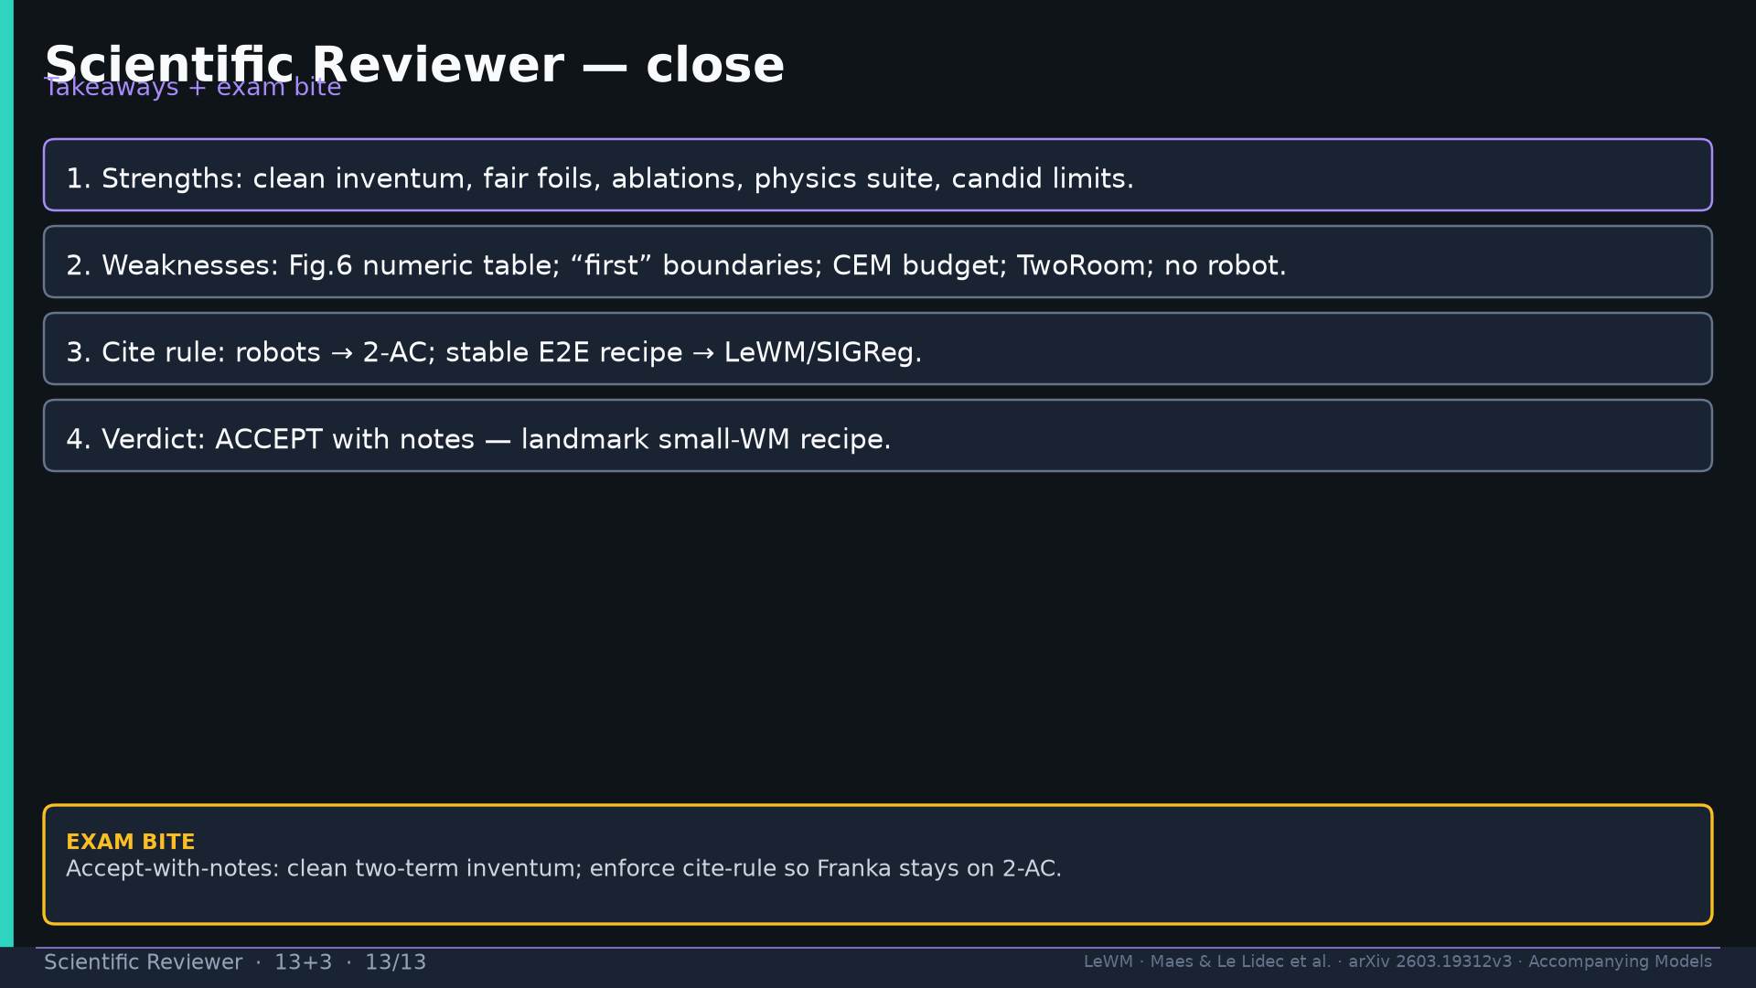
Notes:
Close + exam.

