Slide 1
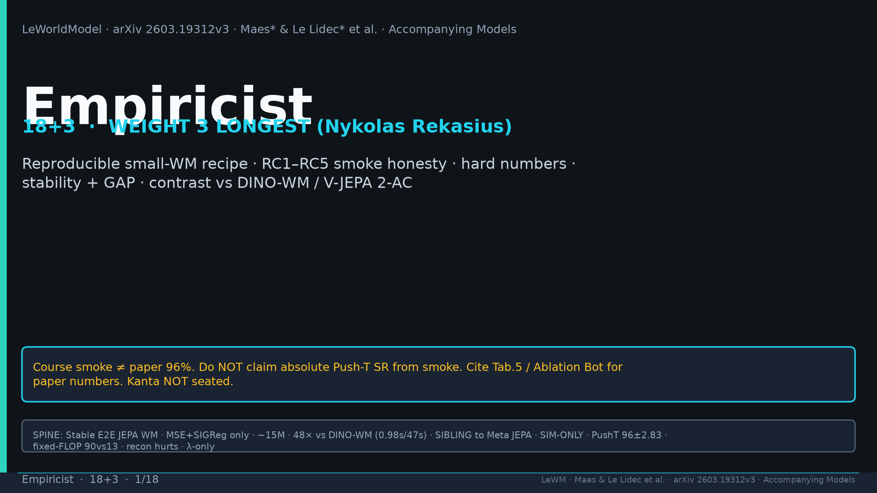
Notes:
Title. WEIGHT 3 Nykolas LONGEST. Course smoke ≠ paper 96%. Kanta NOT seated. Never claim absolute SR from smoke.

Slide 2
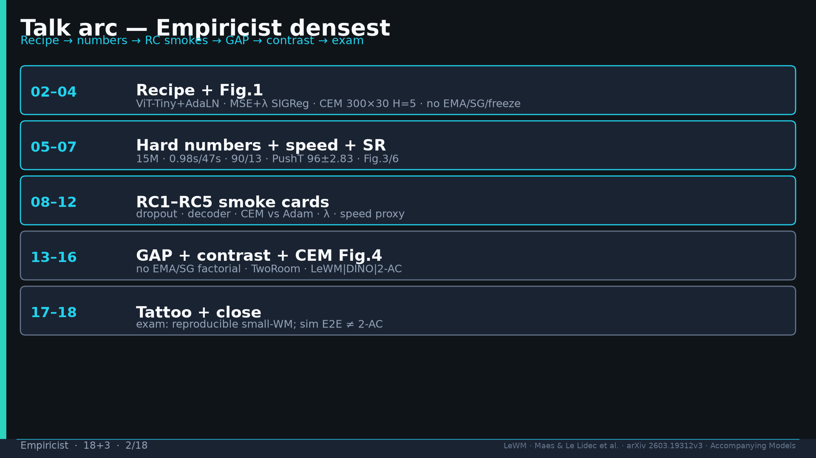
Notes:
Arc: recipe → hard numbers → RC1–RC5 → GAP → contrast → Fig.4 CEM → exam.

Slide 3
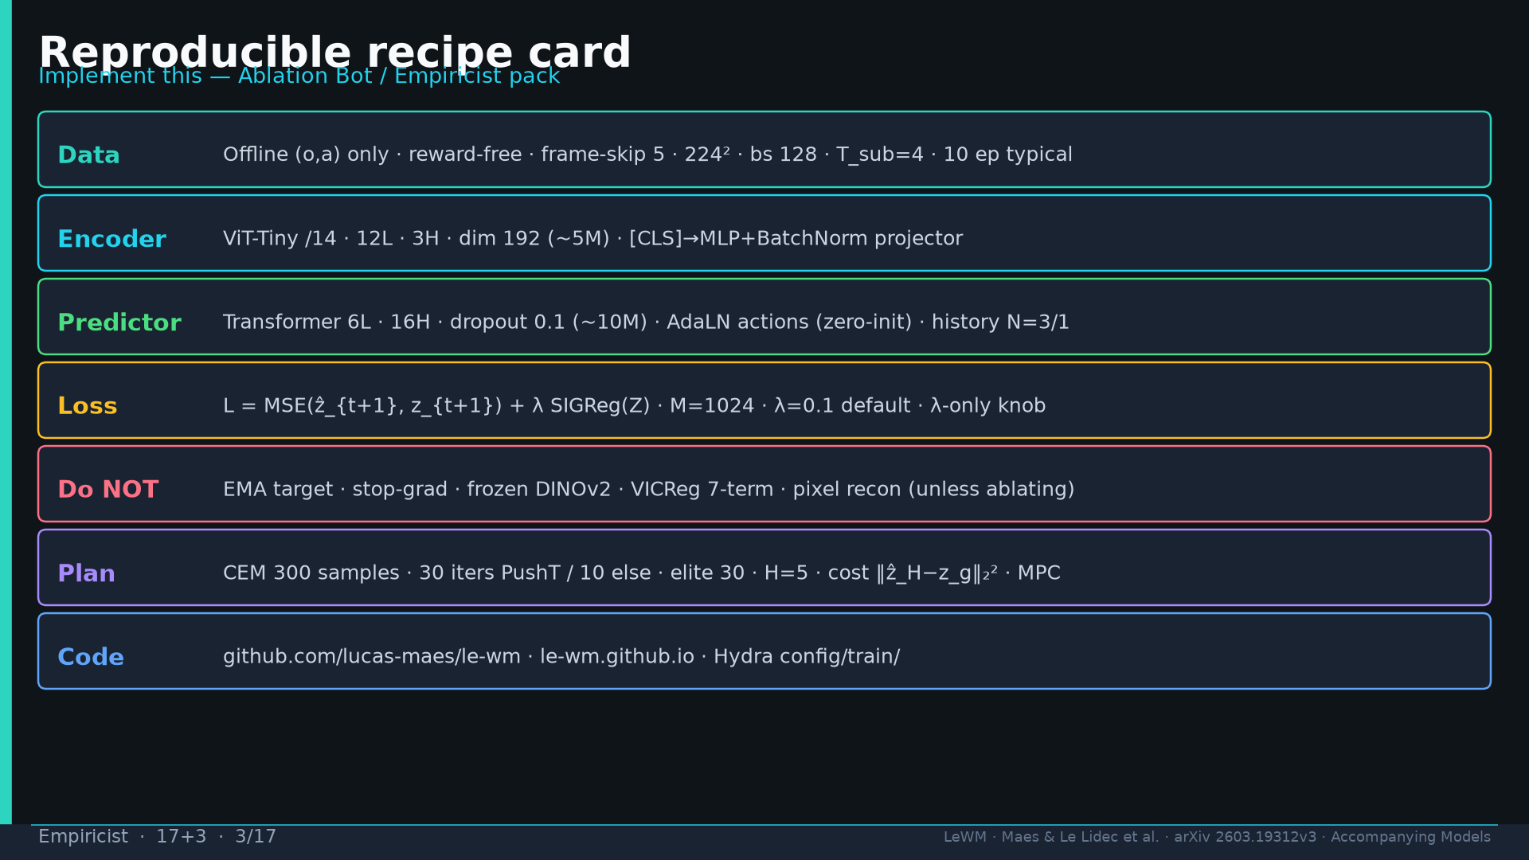
Notes:
Recipe card: ViT-Tiny+AdaLN; MSE+λ SIGReg; CEM 300×30 H=5; no EMA/SG/freeze; code le-wm.

Slide 4
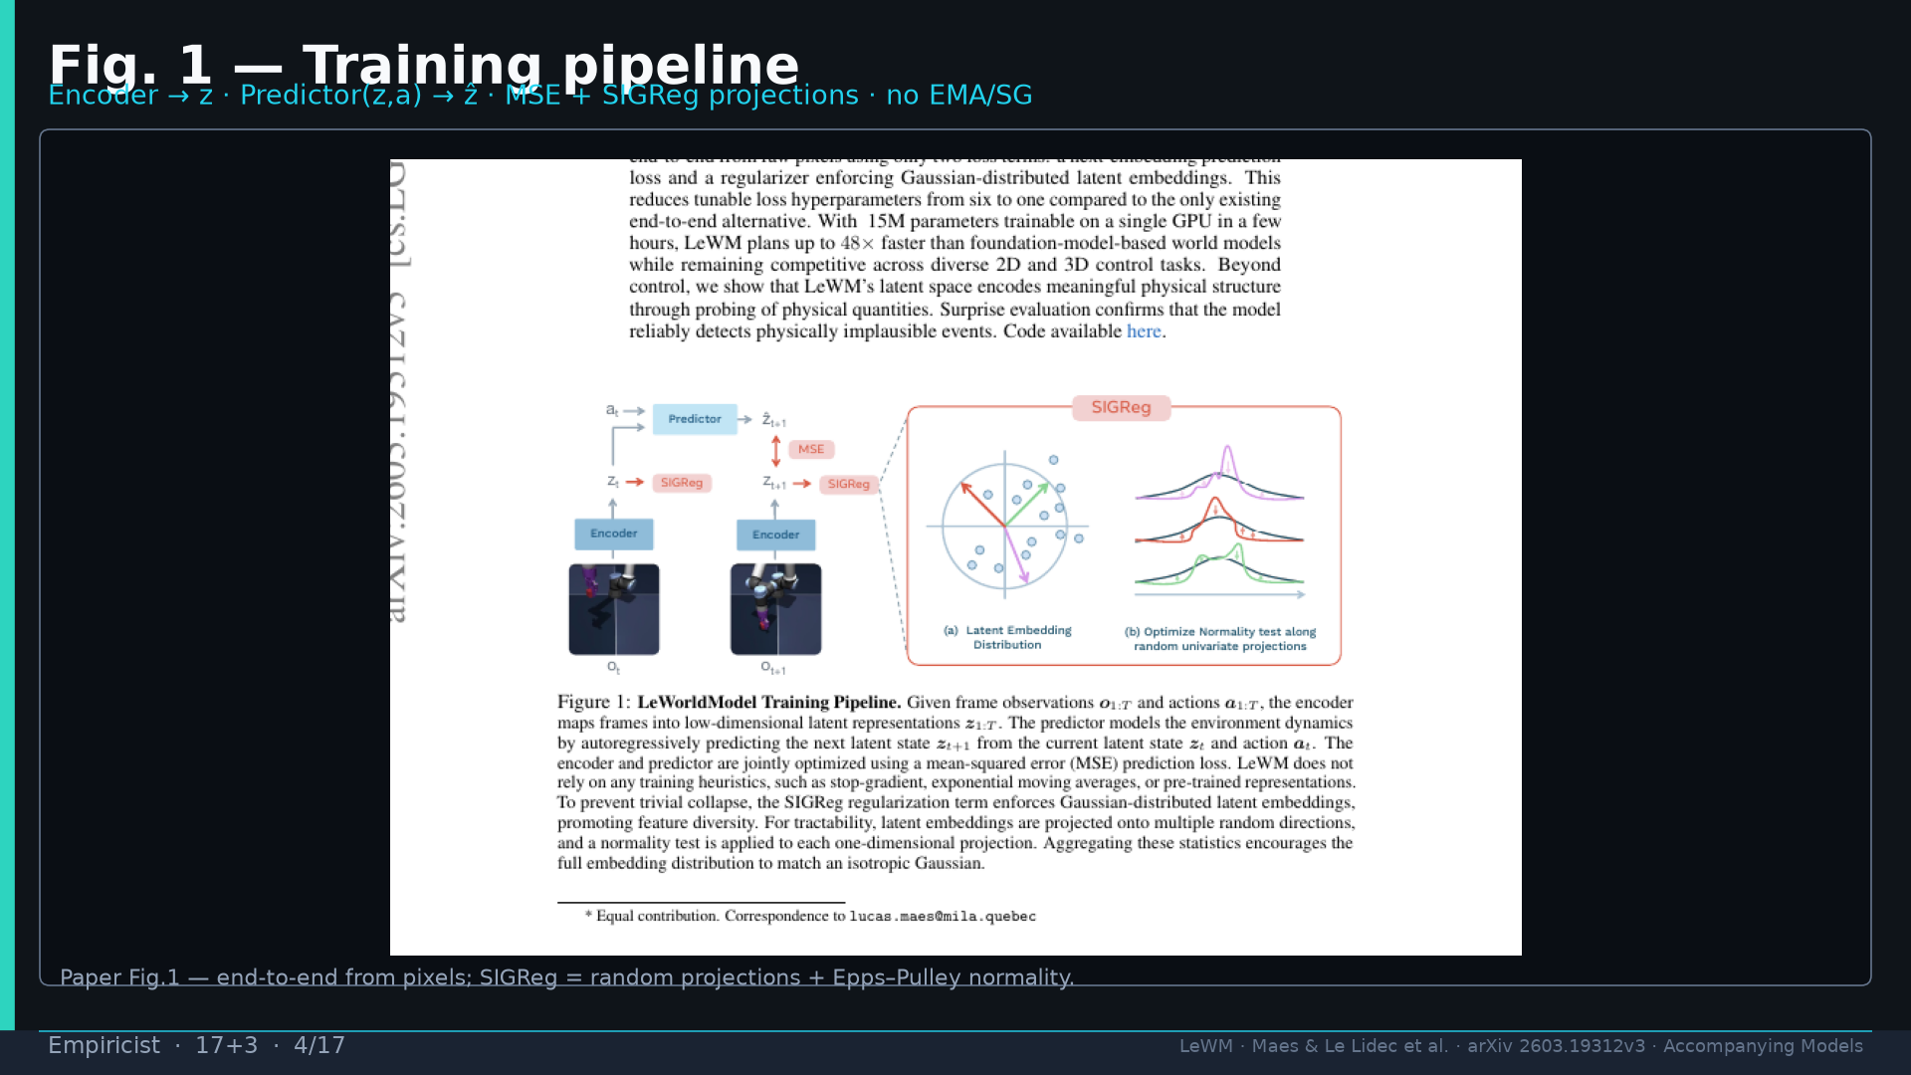
Notes:
Fig.1 pipeline — E2E pixels; SIGReg projections; inventum visual.

Slide 5
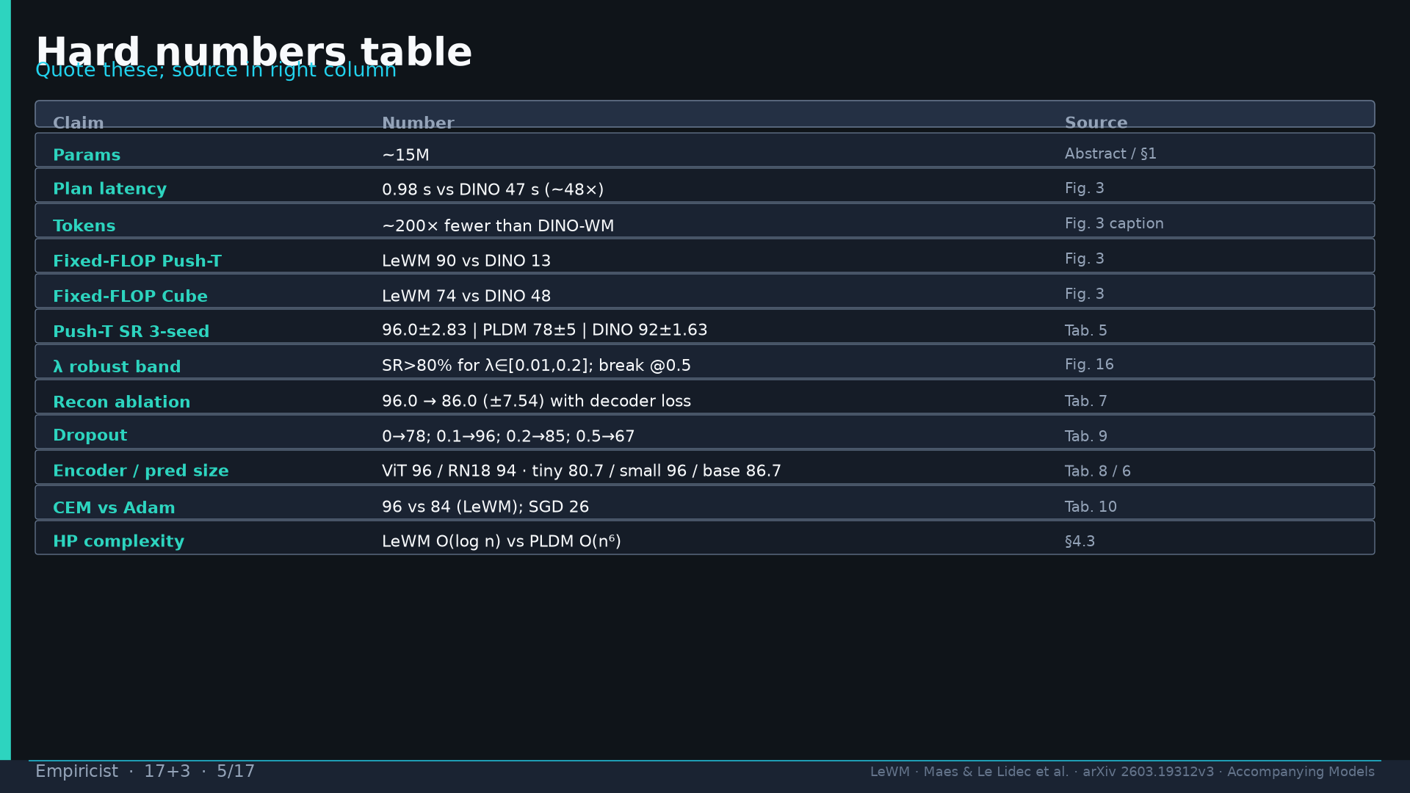
Notes:
Hard numbers table — quote Tab.5/7/9/8/6/10 and Fig.3/16. Sources in right column.

Slide 6
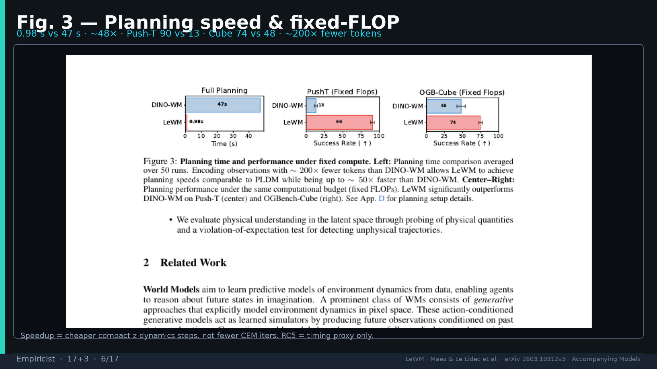
Notes:
Fig.3: 0.98s/47s; 90/13; 74/48; ~200× tokens. Speedup = cheaper z.

Slide 7
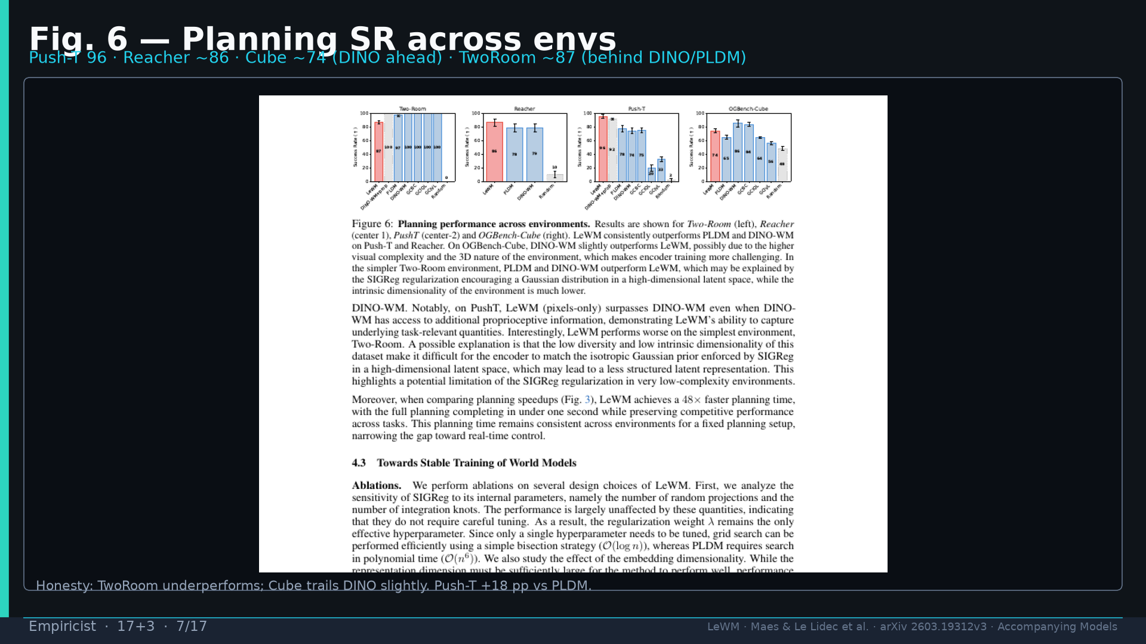
Notes:
Fig.6 SR: PushT 96; TwoRoom behind; Cube trails DINO. +18 pp vs PLDM PushT.

Slide 8
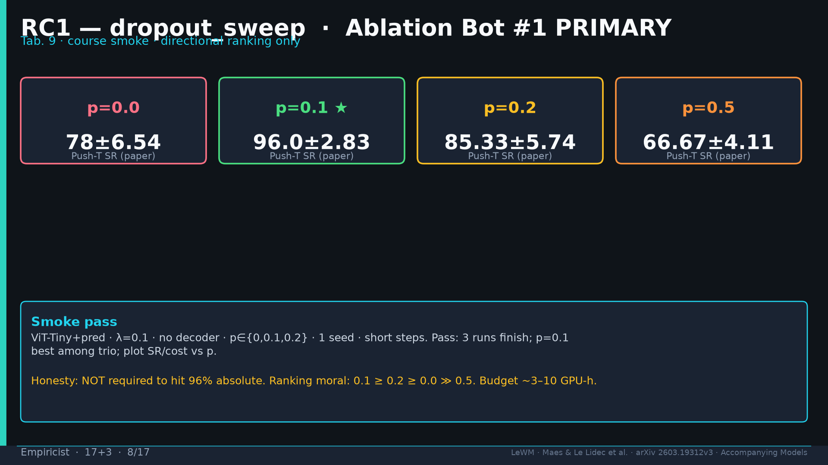
Notes:
RC1 dropout PRIMARY (DELIVERABLE): paper 0→78; 0.1→96; 0.2→85; 0.5→67. Smoke directional only.

Slide 9
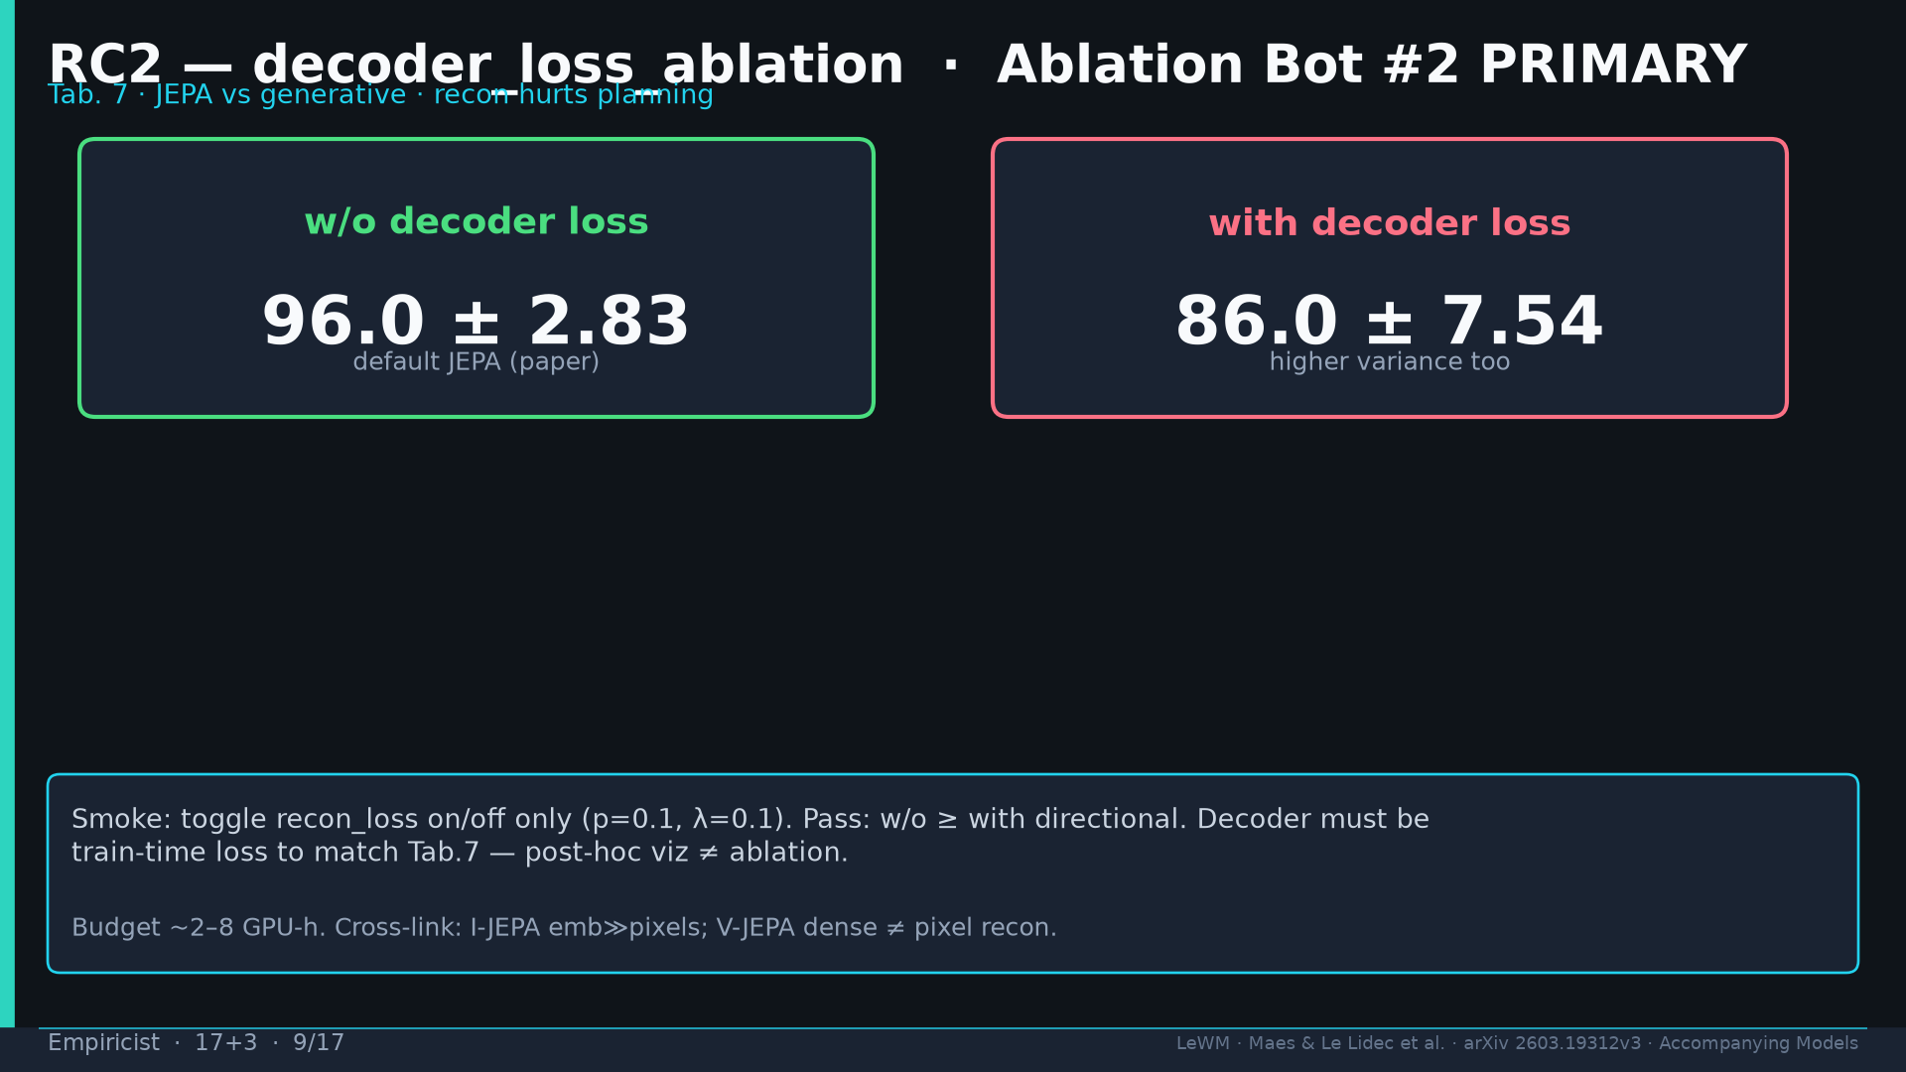
Notes:
RC2 decoder: w/o 96 vs with 86. Train-time loss required. JEPA thesis.

Slide 10
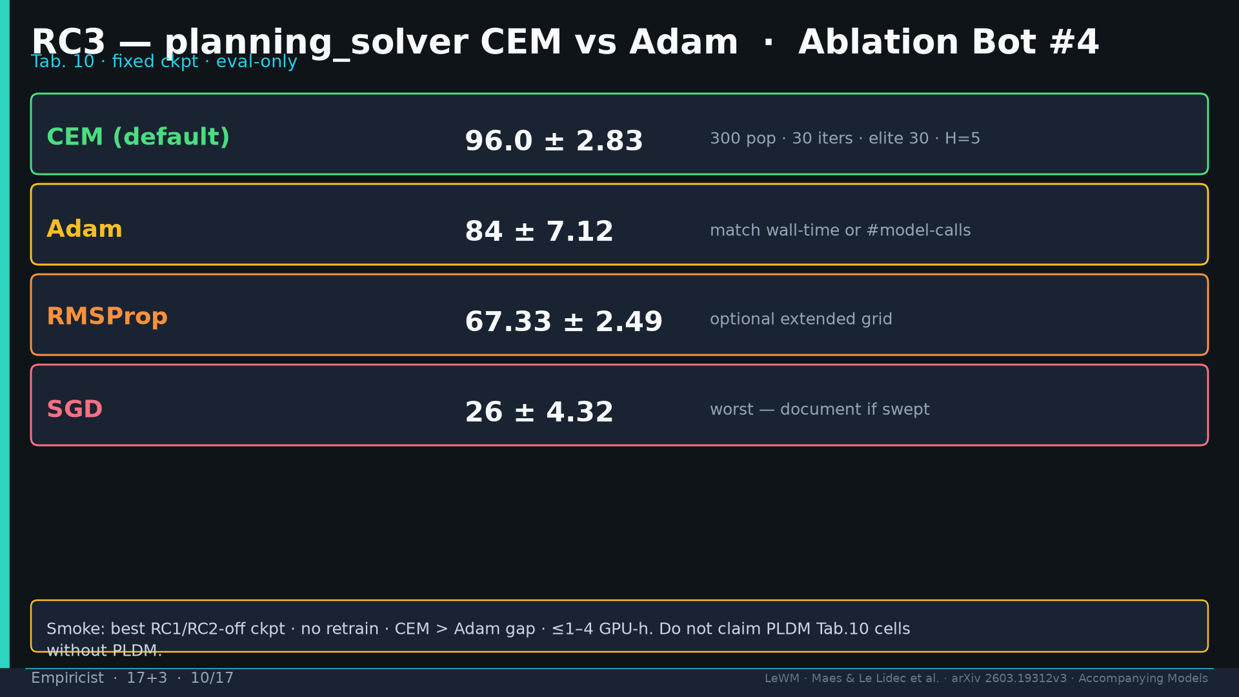
Notes:
RC3 CEM vs Adam: 96 vs 84 fixed ckpt. Optional SGD/RMSProp. ≤1–4 GPU-h.

Slide 11
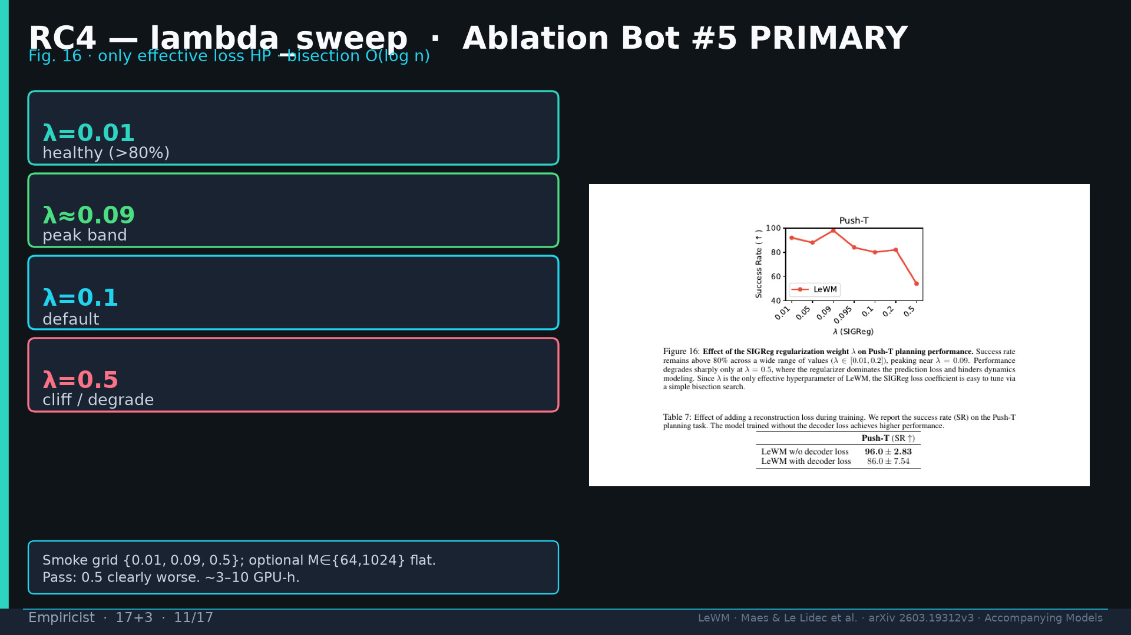
Notes:
RC4 λ: [0.01,0.2] healthy; peak ~0.09; cliff 0.5. Optional M flat.

Slide 12
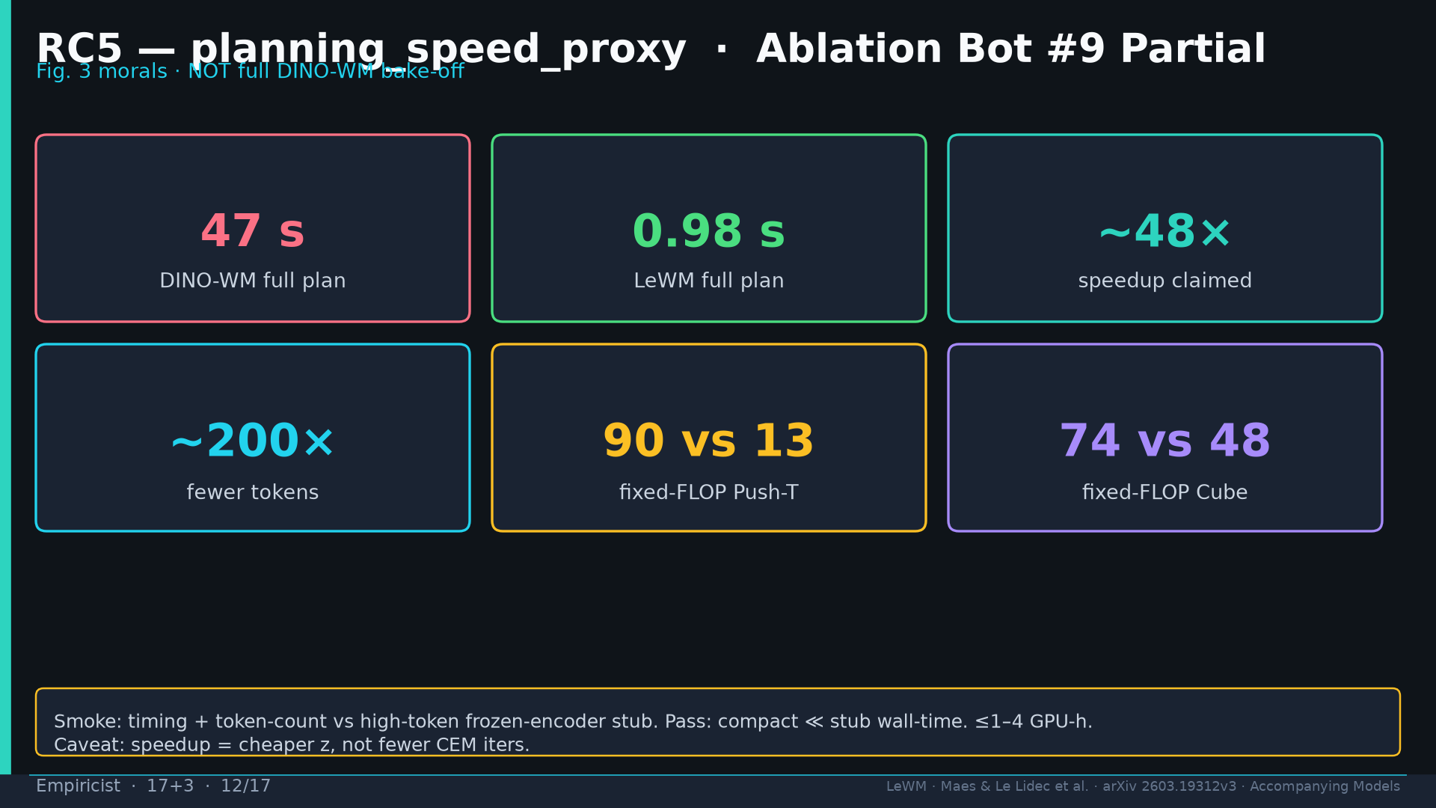
Notes:
RC5 speed proxy Partial: timing+tokens vs high-token stub — not full DINO bake-off.

Slide 13
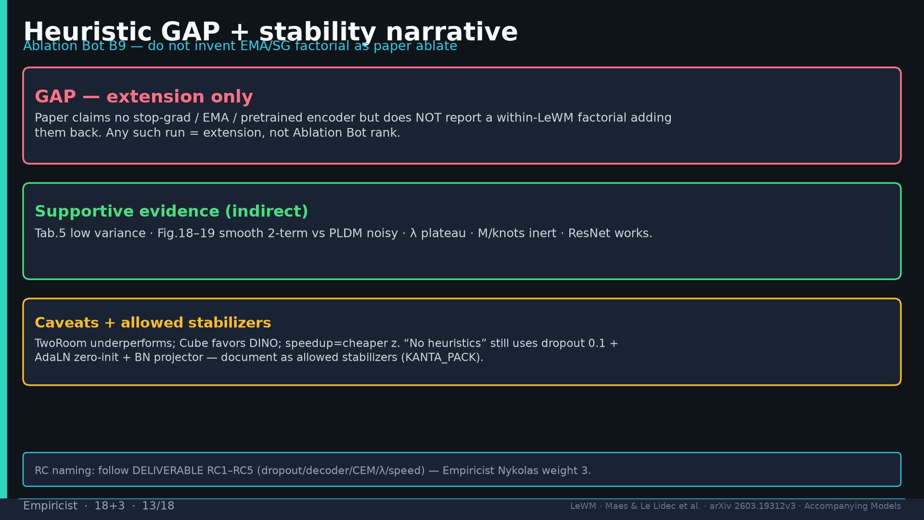
Notes:
GAP: no EMA/SG factorial — extension. Allowed stabilizers: dropout 0.1 + AdaLN + BN (KANTA_PACK).

Slide 14
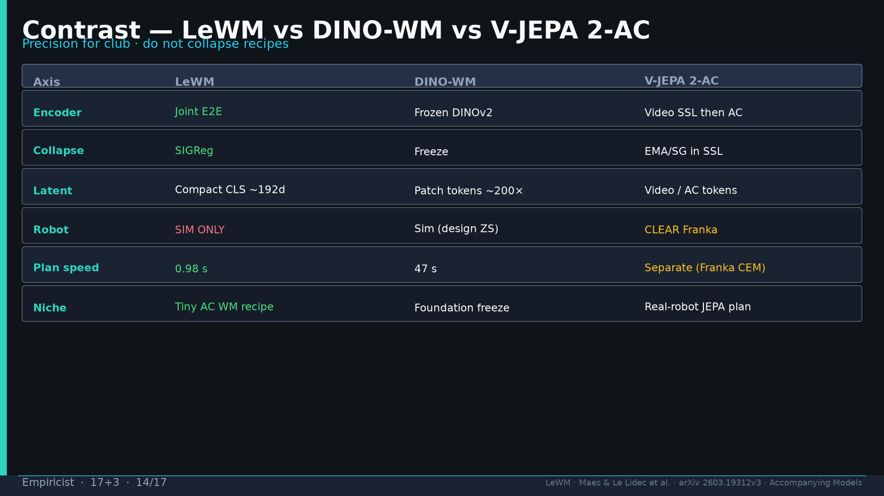
Notes:
Contrast LeWM | DINO-WM | V-JEPA 2-AC. SIM-ONLY vs CLEAR Franka.

Slide 15
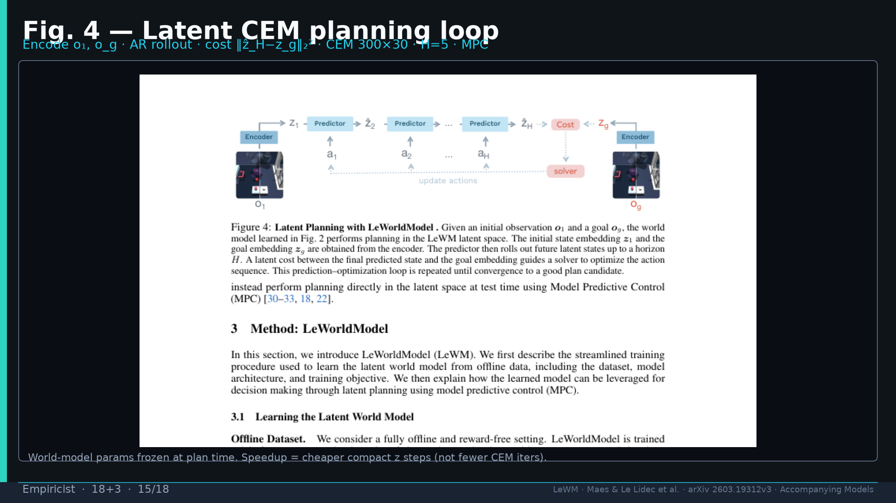
Notes:
Fig.4 CEM loop full-bleed — H=5 · 300×30 · cost ‖ẑ_H−z_g‖. Reconcile SLIDE_BRIEF.

Slide 16
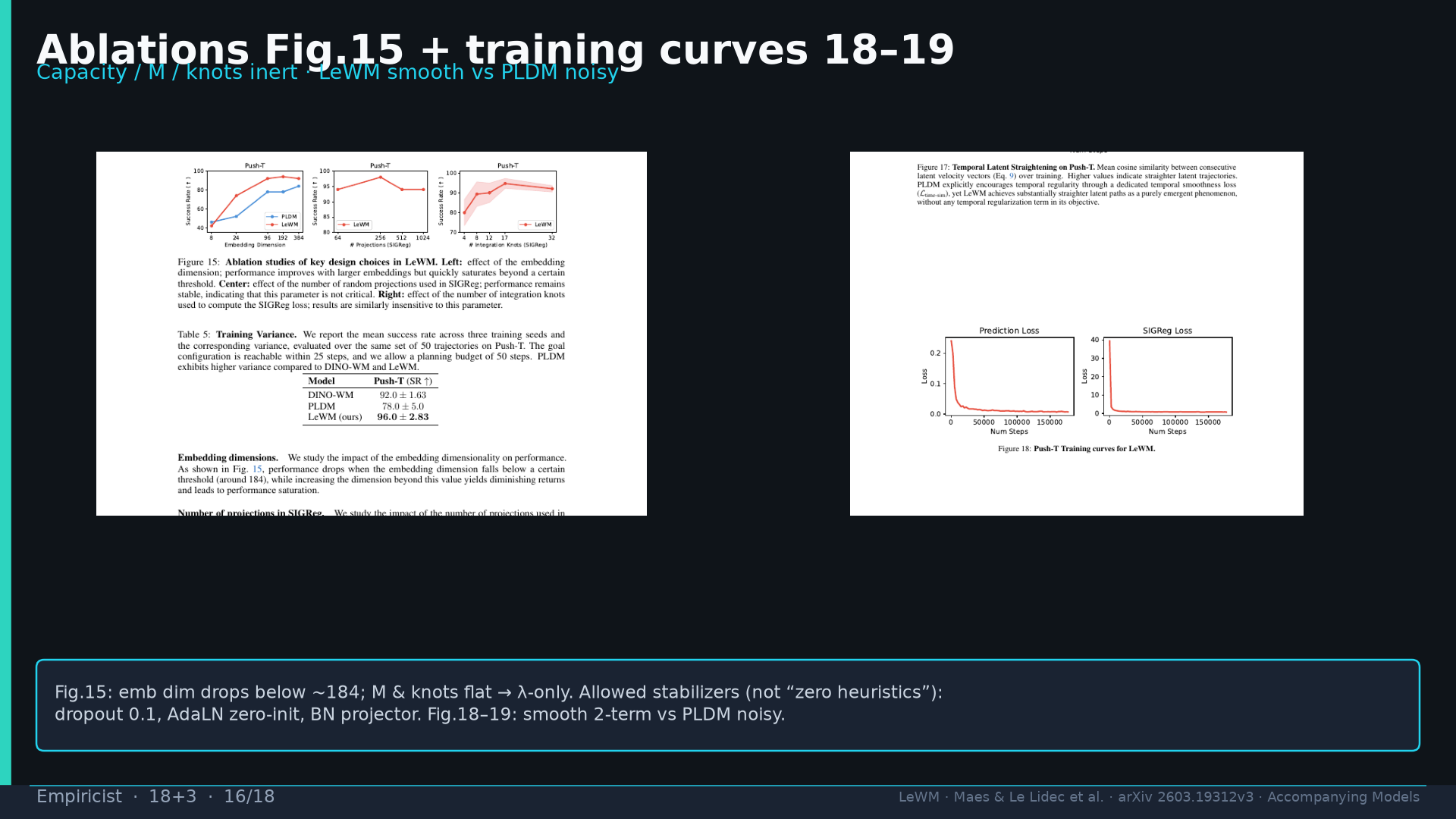
Notes:
Fig.15 + Fig.18: capacity/M inert; smooth vs PLDM noisy; allowed stabilizers note.

Slide 17
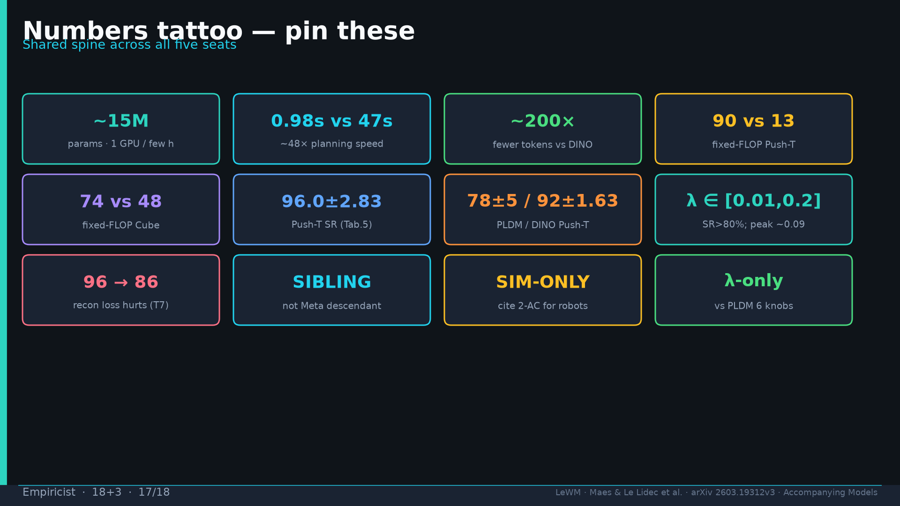
Notes:
Tattoo numbers shared.

Slide 18
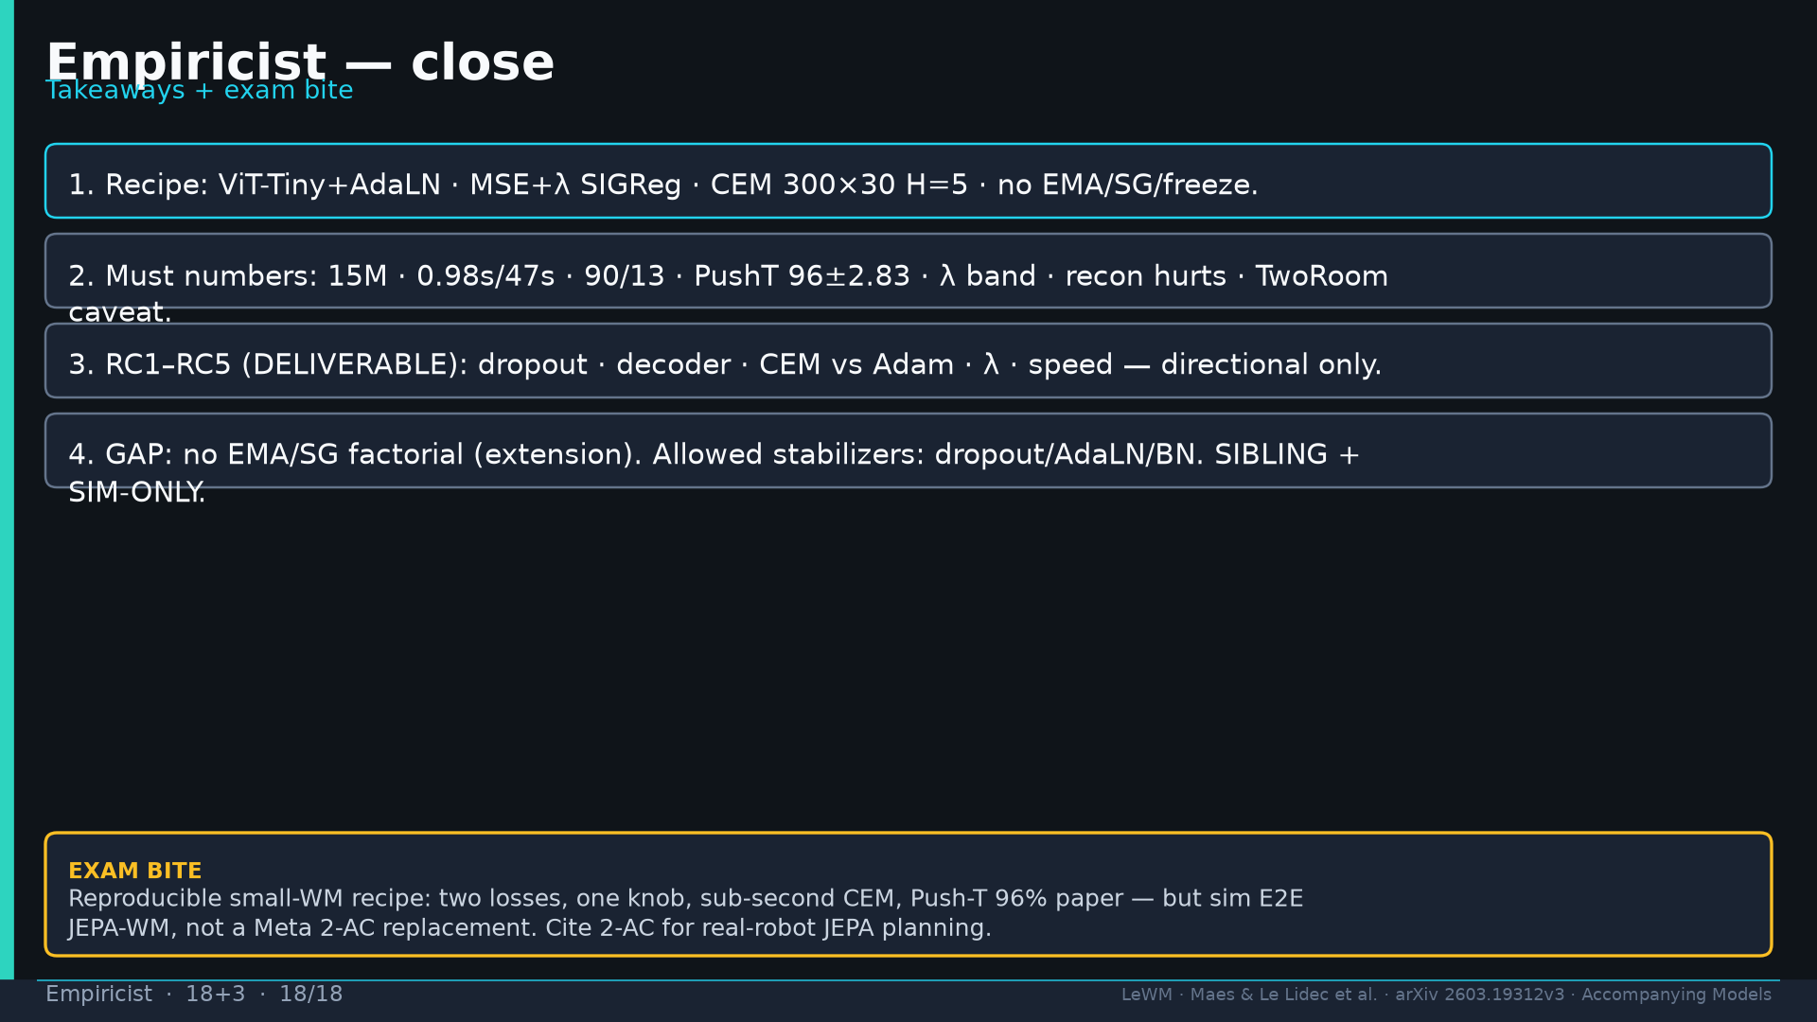
Notes:
Close + exam: reproducible small-WM; sim E2E not 2-AC replacement.

