Slide 1
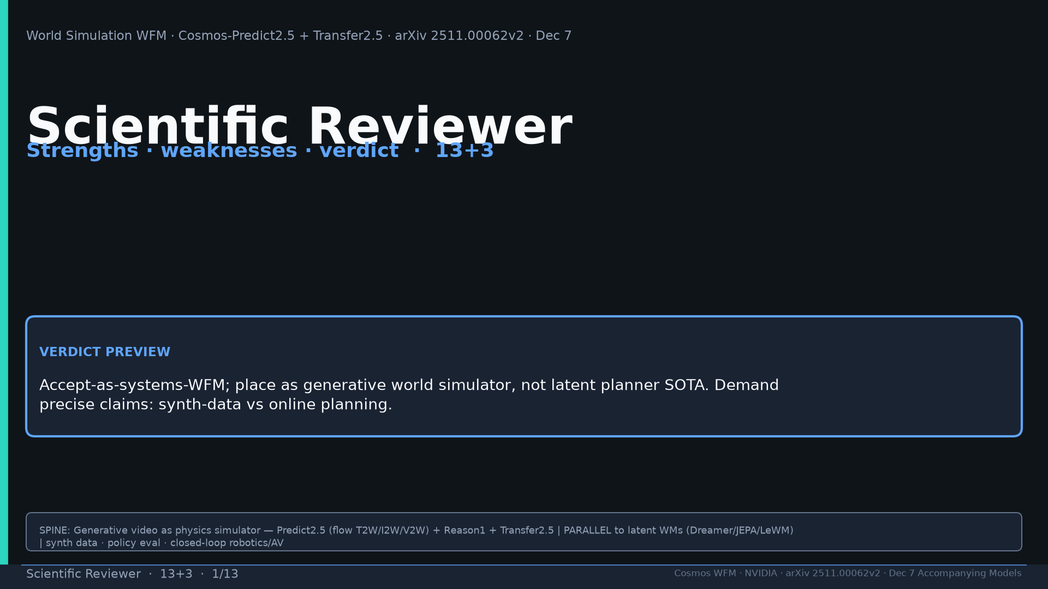
Notes:
Title. Verdict preview: accept-as-systems-WFM; generative simulator not latent planner SOTA. Tattoo: Real2Real 24/30 vs 5/30 · PAI T2W 0.768 / I2W 0.810 · Bridge PSNR 24.95 · DreamGen IF≠VLA SR · AV LET-AP 0.394 · Transfer 3.5× · 200M · 2B/14B · PARALLEL generative WFM

Slide 2
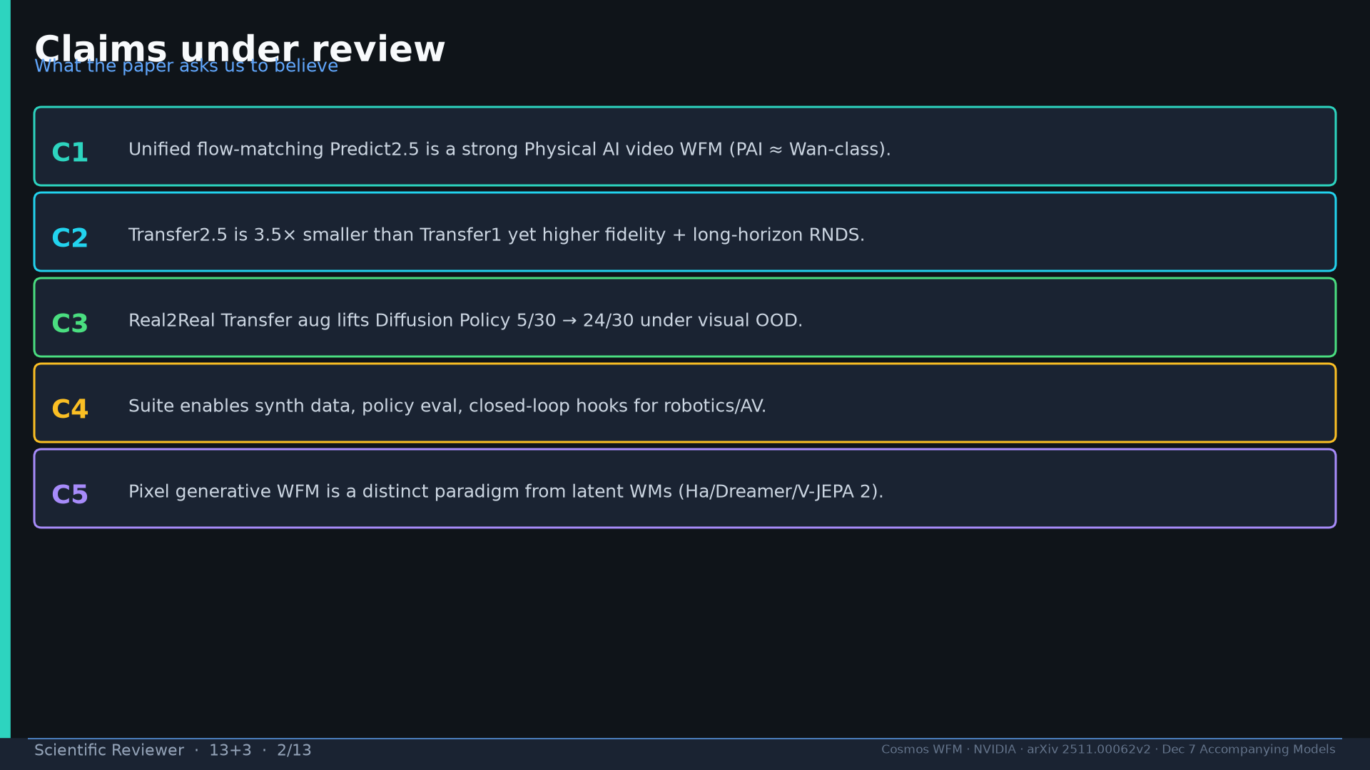
Notes:
Five claims under review C1–C5.

Slide 3
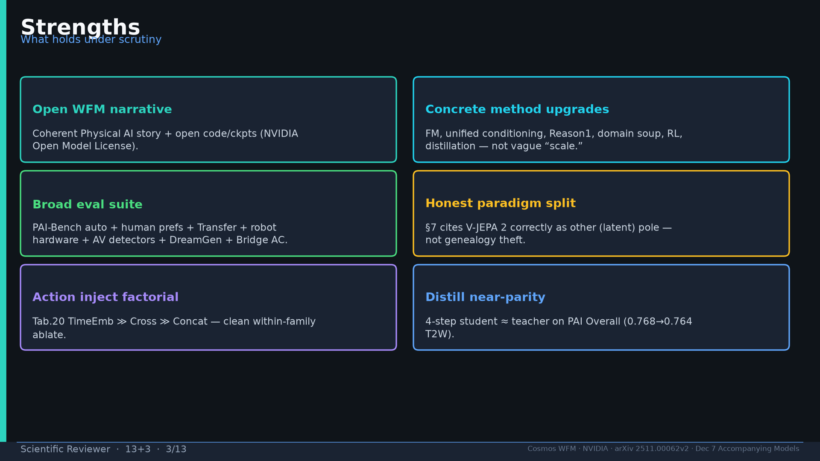
Notes:
Strengths: open narrative; concrete upgrades; broad eval; honest paradigm split; Tab.20; distill.

Slide 4
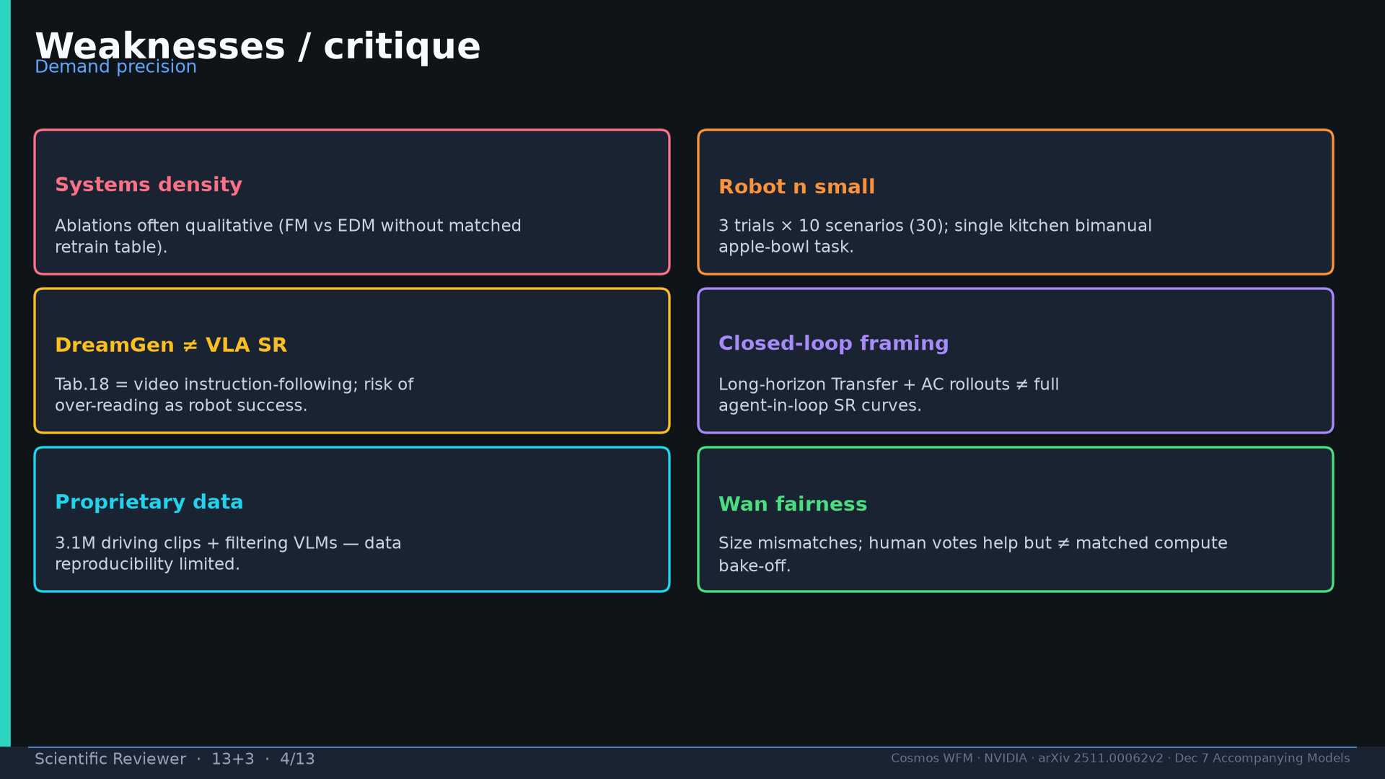
Notes:
Weaknesses: density; robot n; DreamGen≠SR; closed-loop framing; proprietary data; Wan fairness.

Slide 5
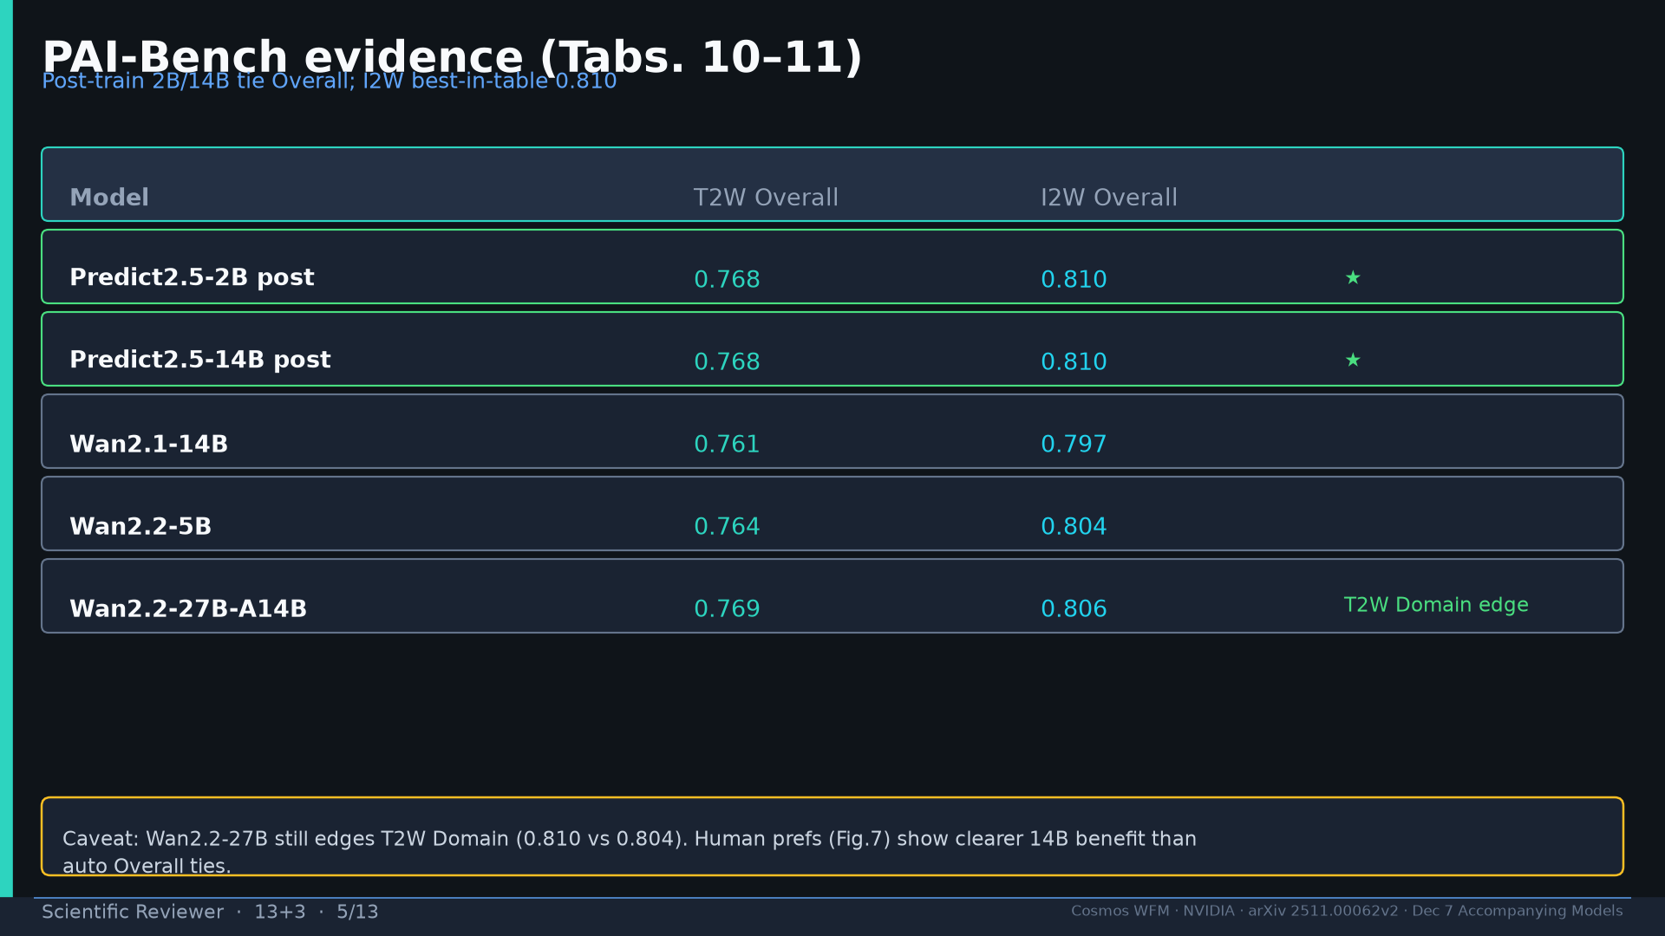
Notes:
PAI Tabs.10–11 numbers + Wan Domain caveat.

Slide 6
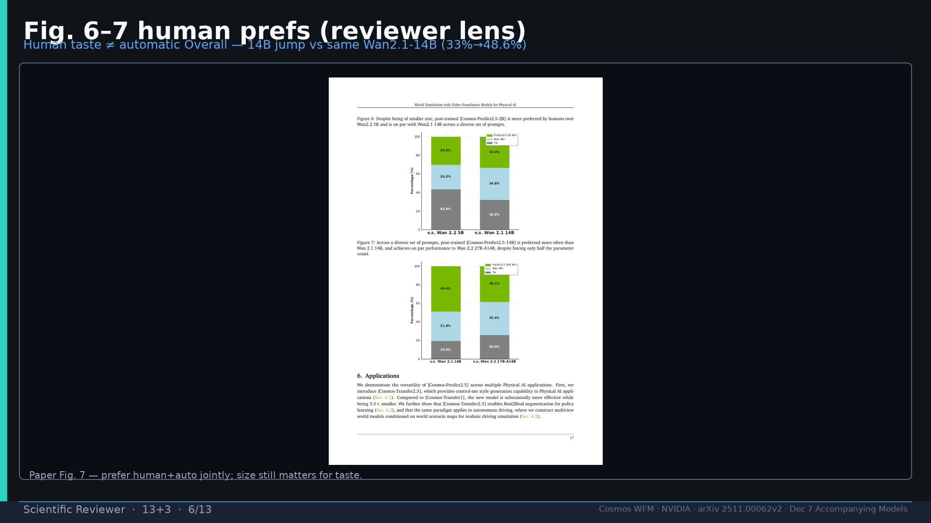
Notes:
Fig.7 human prefs — size matters for taste.

Slide 7
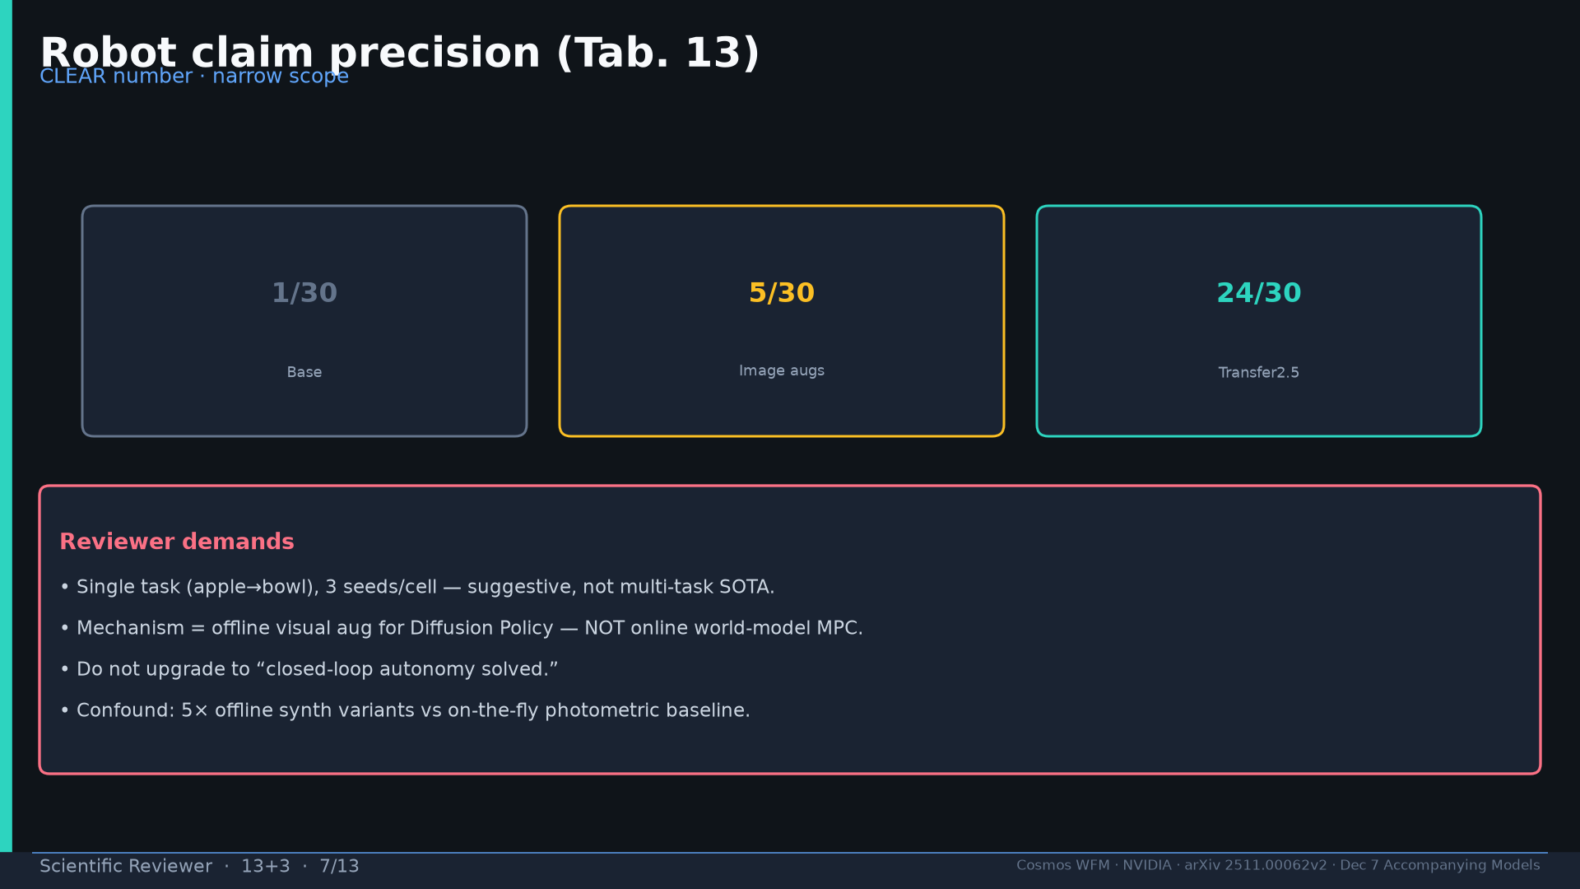
Notes:
Tab.13 precision demands.

Slide 8
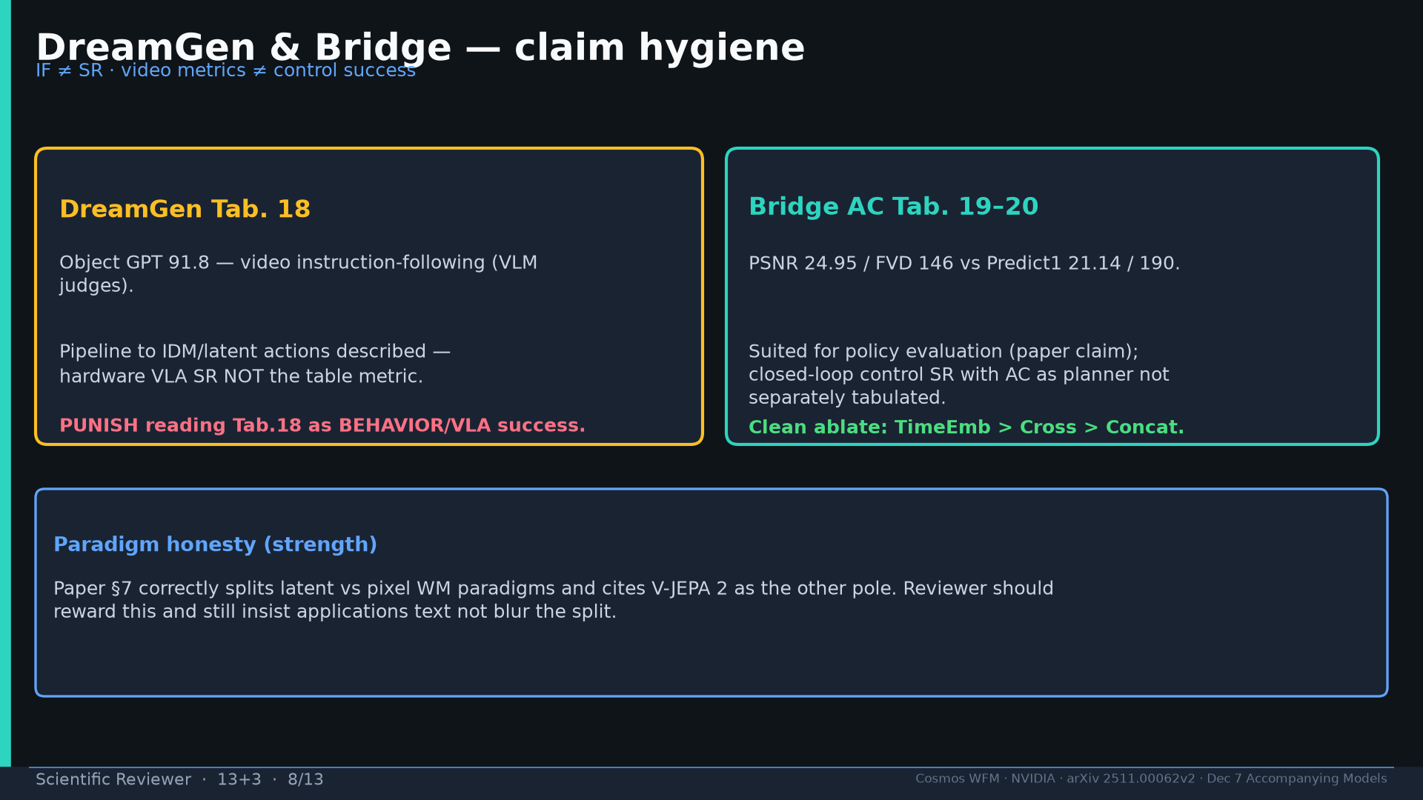
Notes:
DreamGen & Bridge claim hygiene.

Slide 9
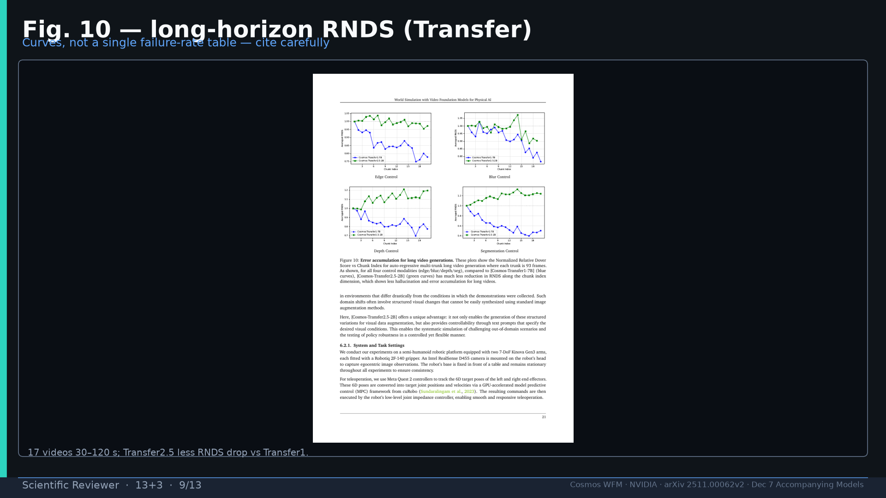
Notes:
Fig.10 RNDS curves not scalar.

Slide 10
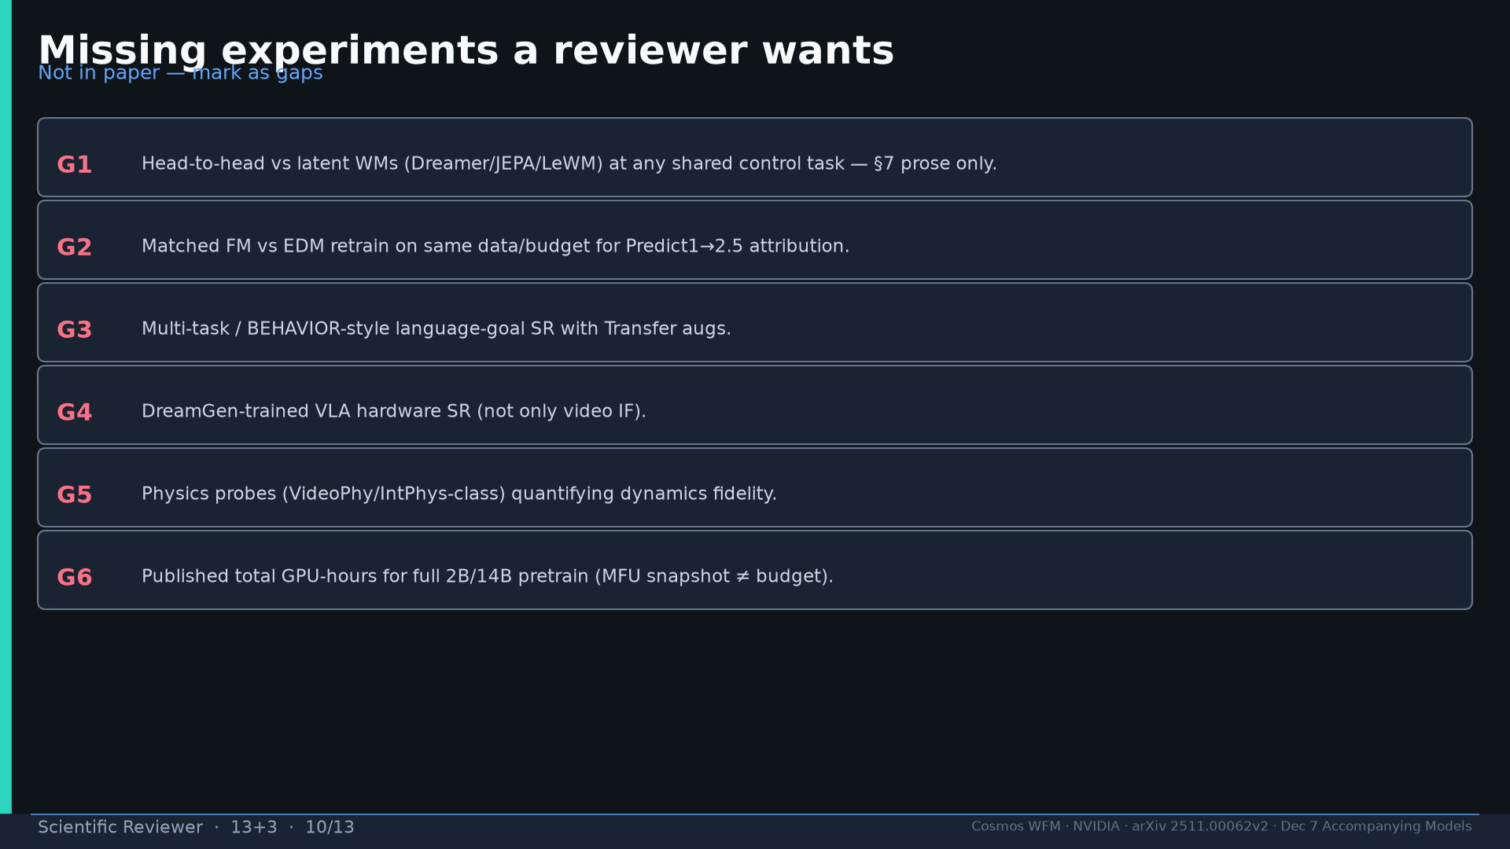
Notes:
Gaps G1–G6 reviewer wants.

Slide 11
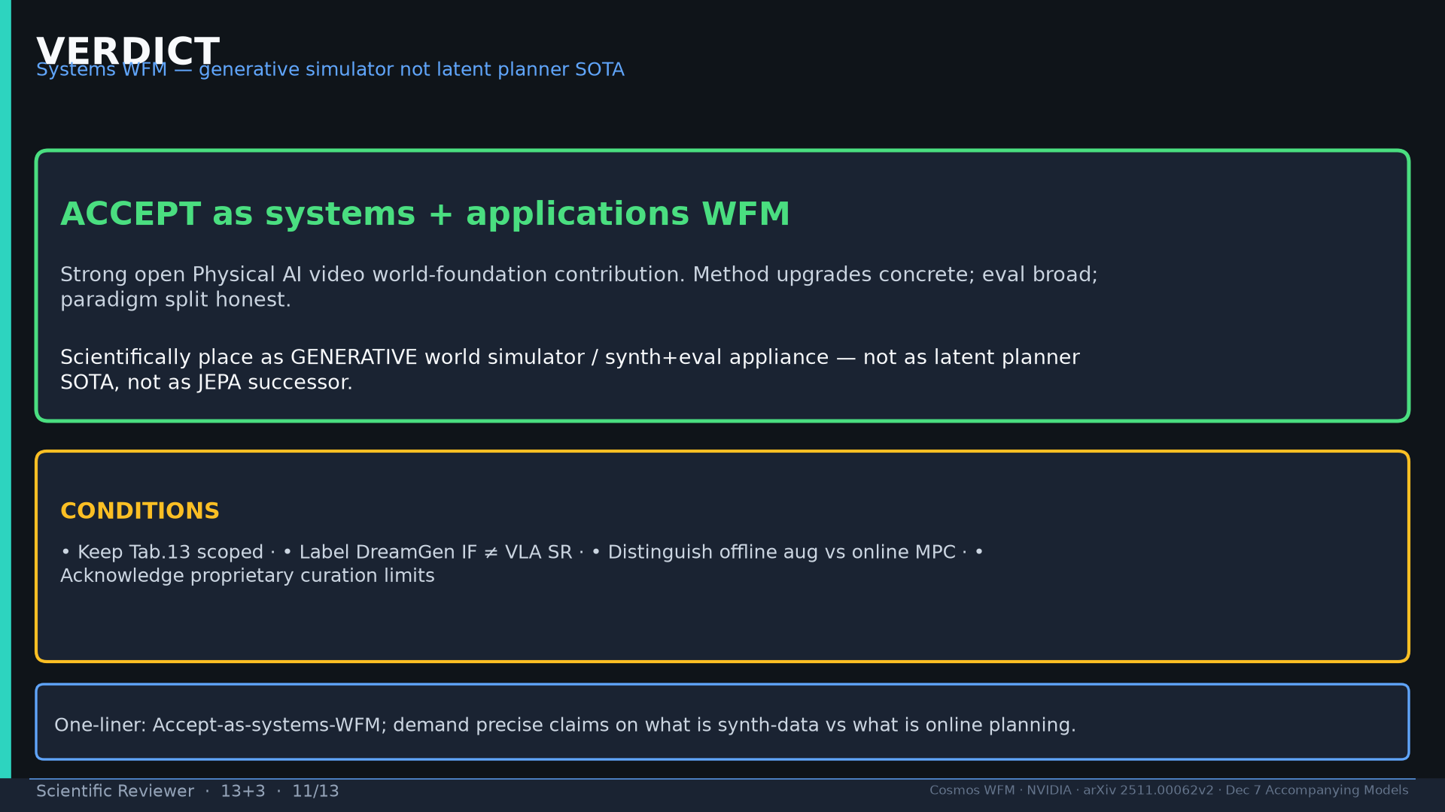
Notes:
VERDICT + conditions.

Slide 12
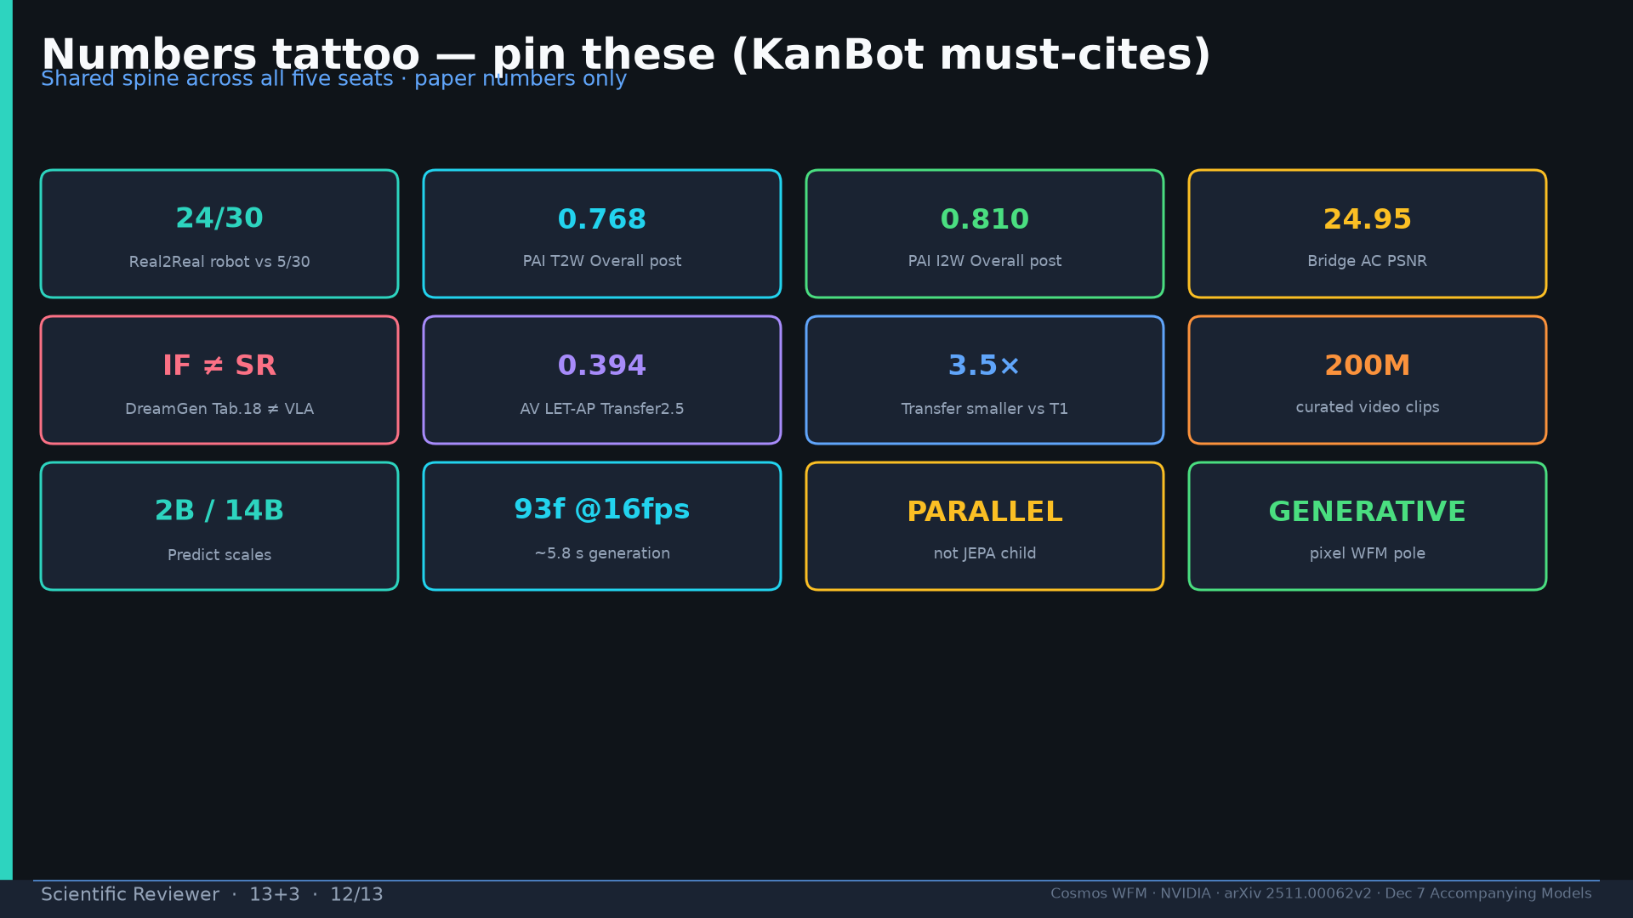
Notes:
Tattoo.

Slide 13
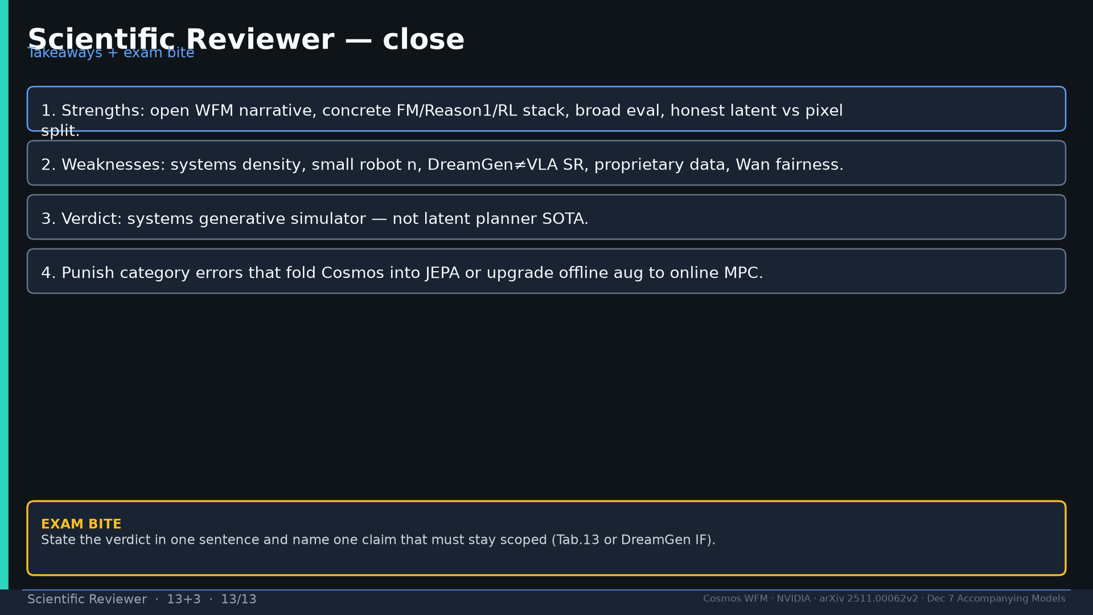
Notes:
Close + exam verdict + scoped claim.

