Slide 1
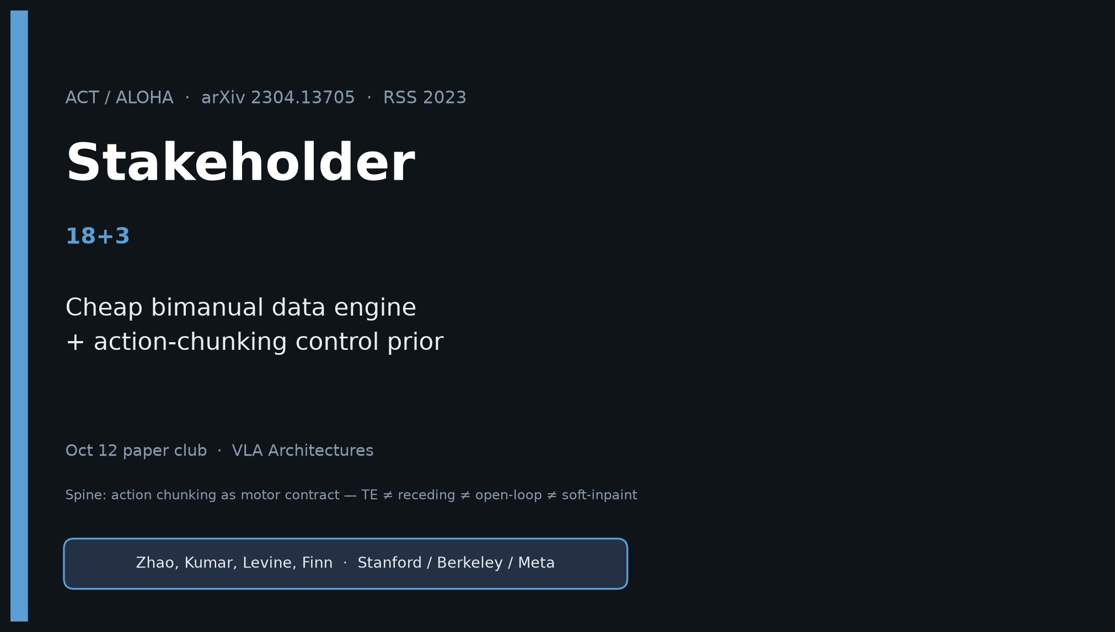
Stakeholder · 18+3 · 1/18
Notes:
STAKEHOLDER — 18+3.
You own: why this still matters for lab/product planning in 2026.
Do NOT redo Archaeologist’s full citation dig. Steal club line once; stay on value.
No Stakeholder redo later — get it right now.

Slide 2
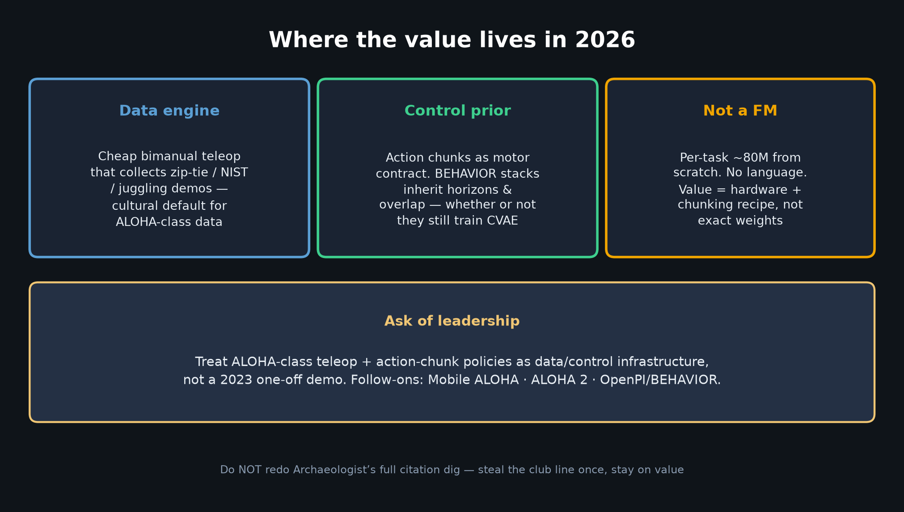
Stakeholder · 18+3 · 2/18
Notes:
WHERE VALUE LIVES.
Cheap bimanual data engine + chunking control prior.
Not a foundation model. Follow-ons Mobile ALOHA / ALOHA 2.
2026 BEHAVIOR inherits chunk horizons/overlap from this fork.

Slide 3
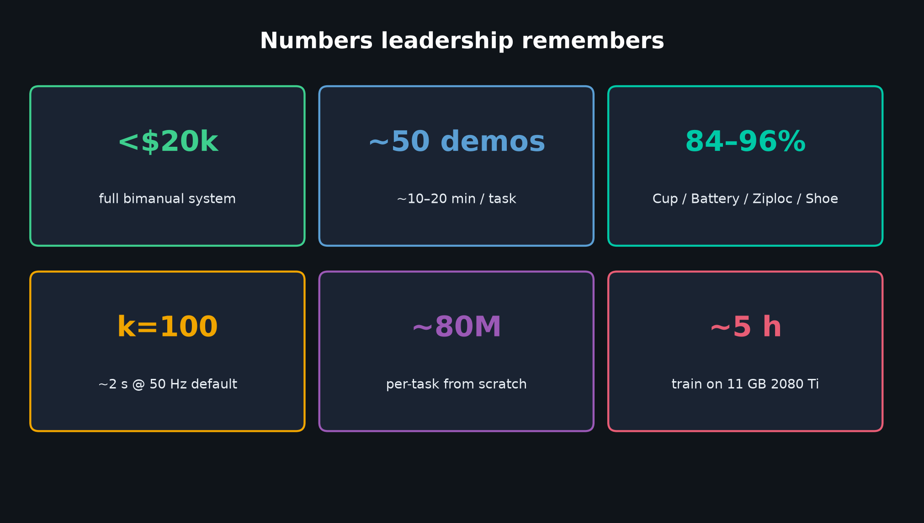
Stakeholder · 18+3 · 3/18
Notes:
NUMBERS: <$20k · ~50 demos · 84–96% easy finals · k=100 · ~80M · ~5h train.
Set expectations: Thread Velcro 20%; not a VLM.

Slide 4
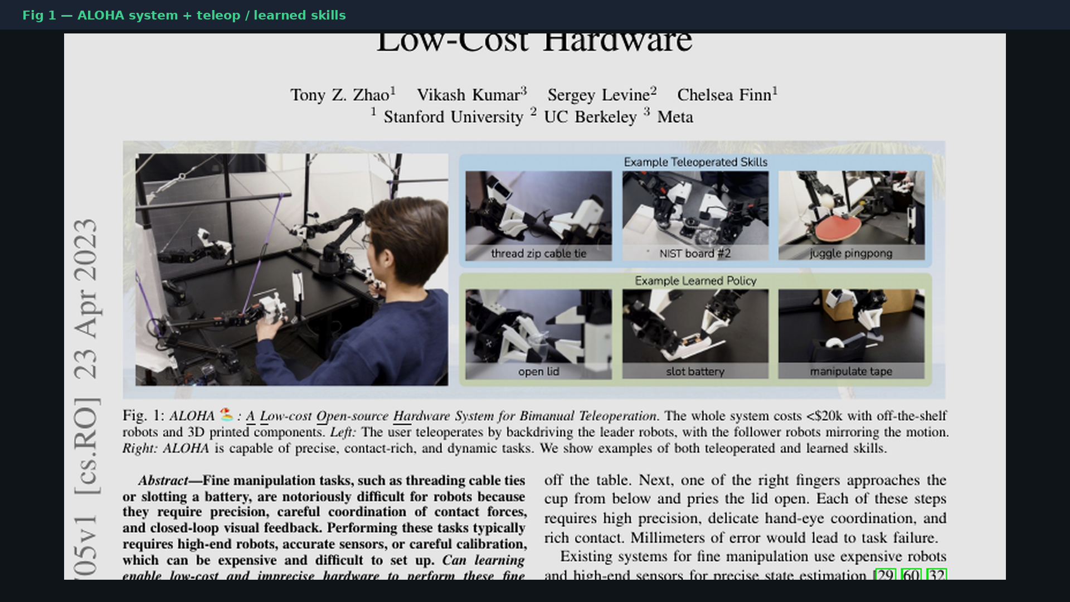
Stakeholder · 18+3 · 4/18
Notes:
FIG 1 — iconic ALOHA shot. Cheap system that collects and runs fine skills.

Slide 5
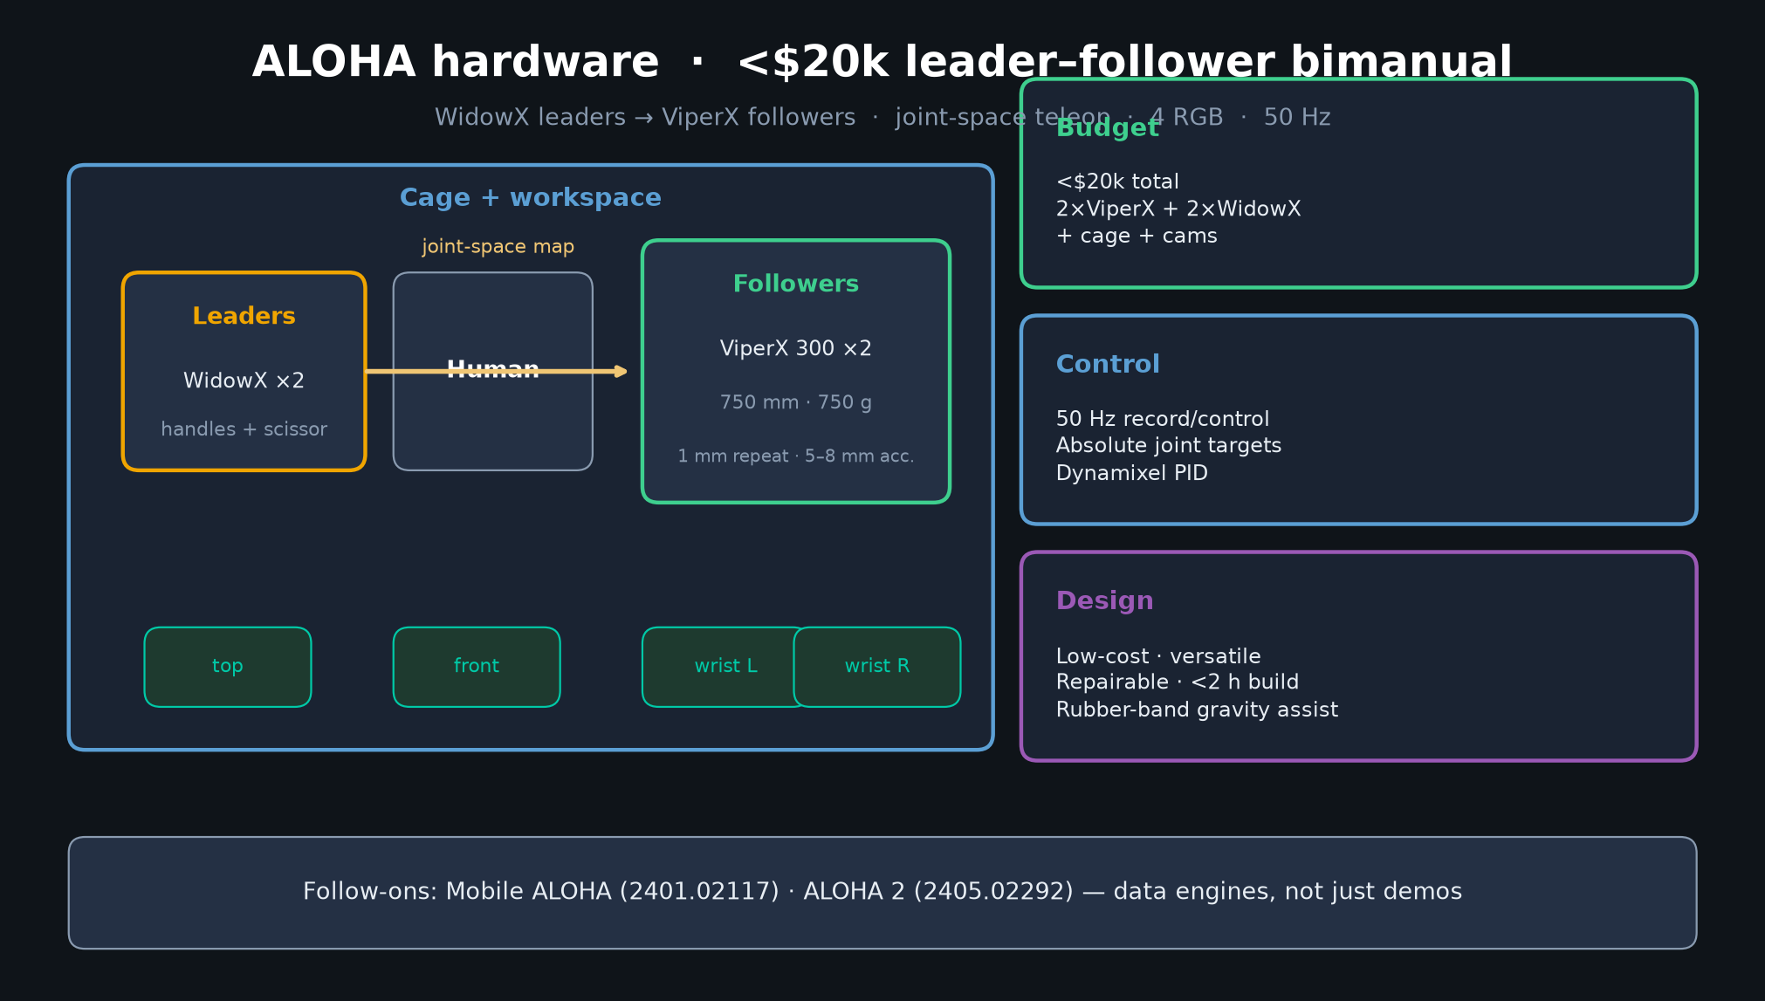
Stakeholder · 18+3 · 5/18
Notes:
ALOHA HW sketch — leader–follower, 50Hz, 4 cams. Cultural default for academic ALOHA-class data.

Slide 6
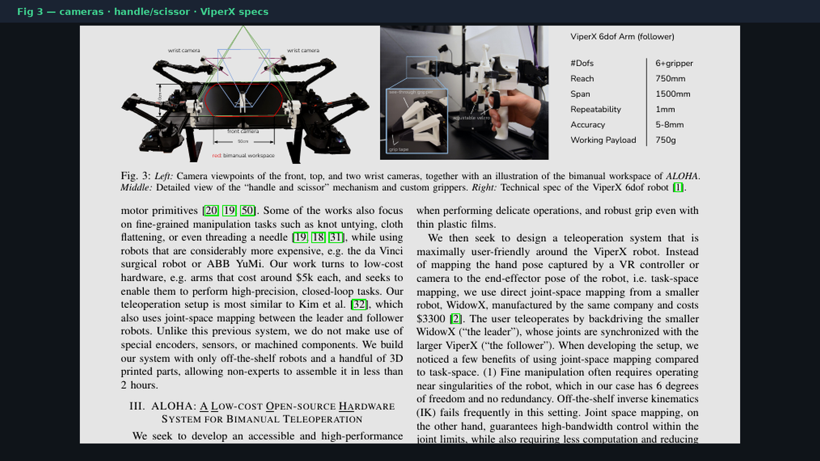
Stakeholder · 18+3 · 6/18
Notes:
FIG 3 paper crop — cameras, handle/scissor, ViperX specs. Reproducibility ethos.

Slide 7
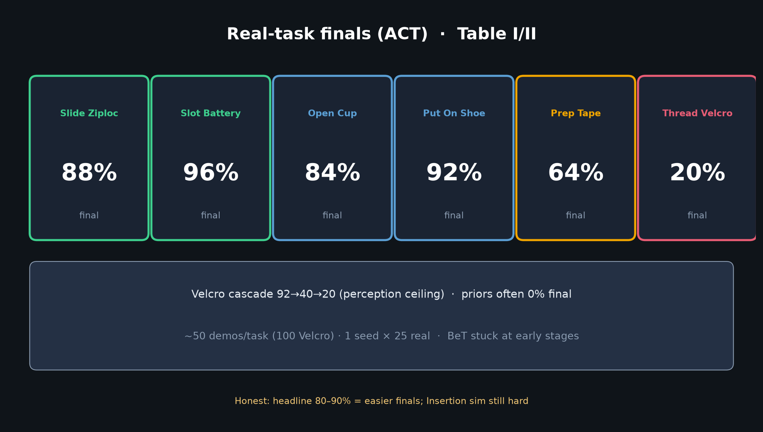
Stakeholder · 18+3 · 7/18
Notes:
REAL RESULTS — Cup 84, Battery 96, Ziploc 88, Shoe 92; Velcro 20 honest.
~10–20 min demos. Priors often 0% final.

Slide 8
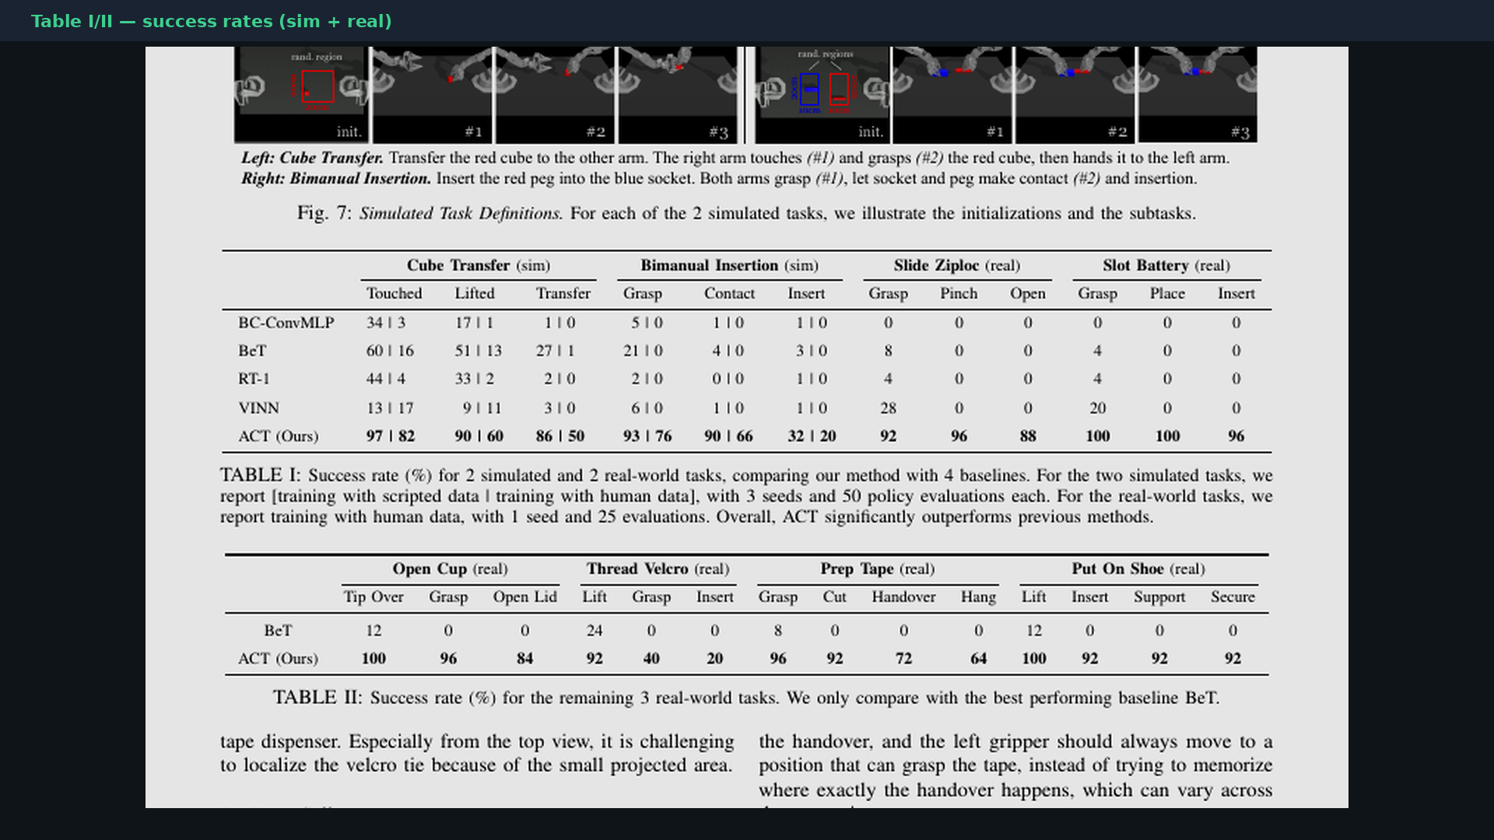
Stakeholder · 18+3 · 8/18
Notes:
PAPER TABLES — breadth proof for leadership.

Slide 9
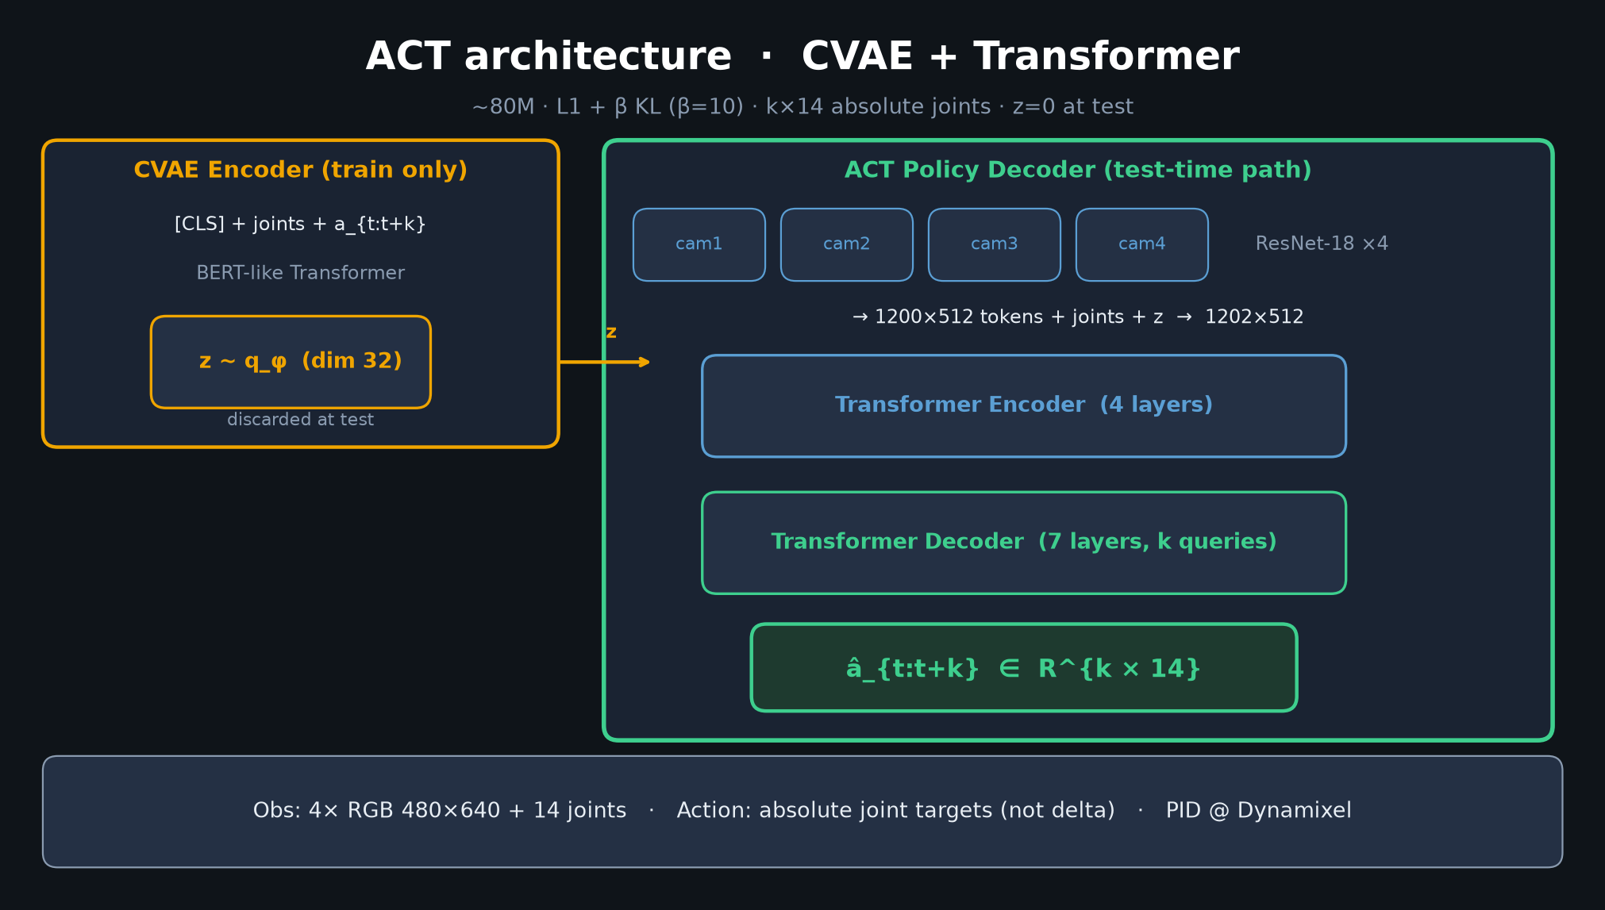
Stakeholder · 18+3 · 9/18
Notes:
ACT ARCH at a glance — chunked CVAE Transformer; absolute joints; no force/depth/language.

Slide 10
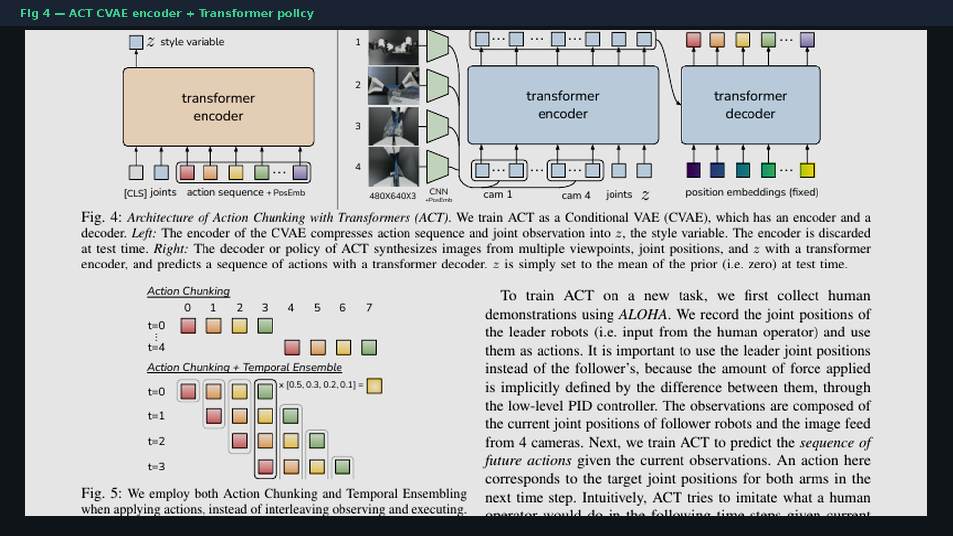
Stakeholder · 18+3 · 10/18
Notes:
FIG 4 paper — original architecture diagram.

Slide 11
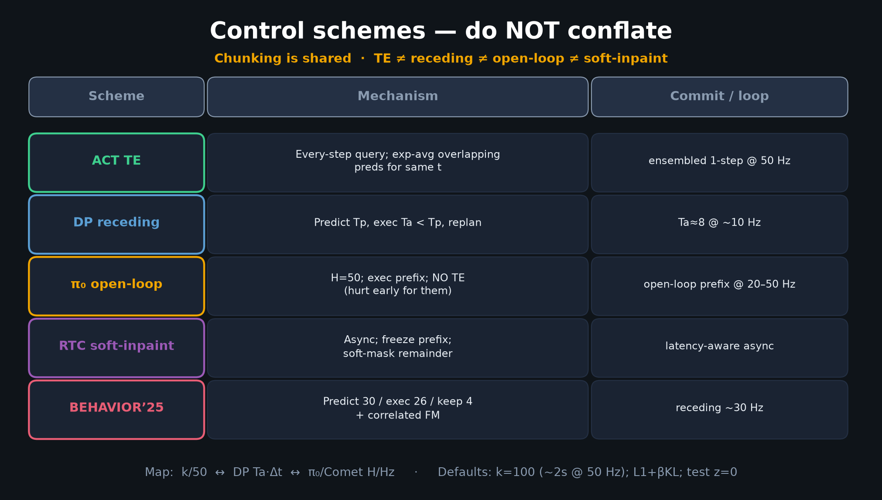
Stakeholder · 18+3 · 11/18
Notes:
SPINE for leadership — five-way control schemes.
Chunking is infrastructure. TE is one dialect; BEHAVIOR uses another.
Map: k/50 ↔ Ta·Δt ↔ H/Hz.

Slide 12
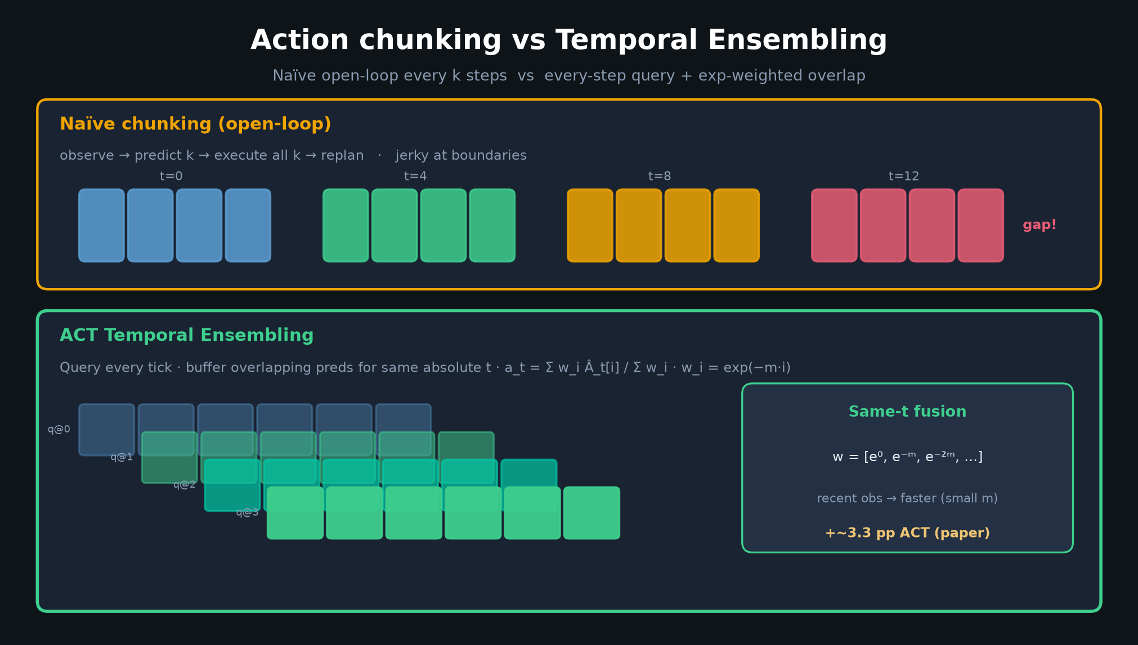
Stakeholder · 18+3 · 12/18
Notes:
TE vs naïve chunking — why overlap execution matters for product-quality motion.

Slide 13
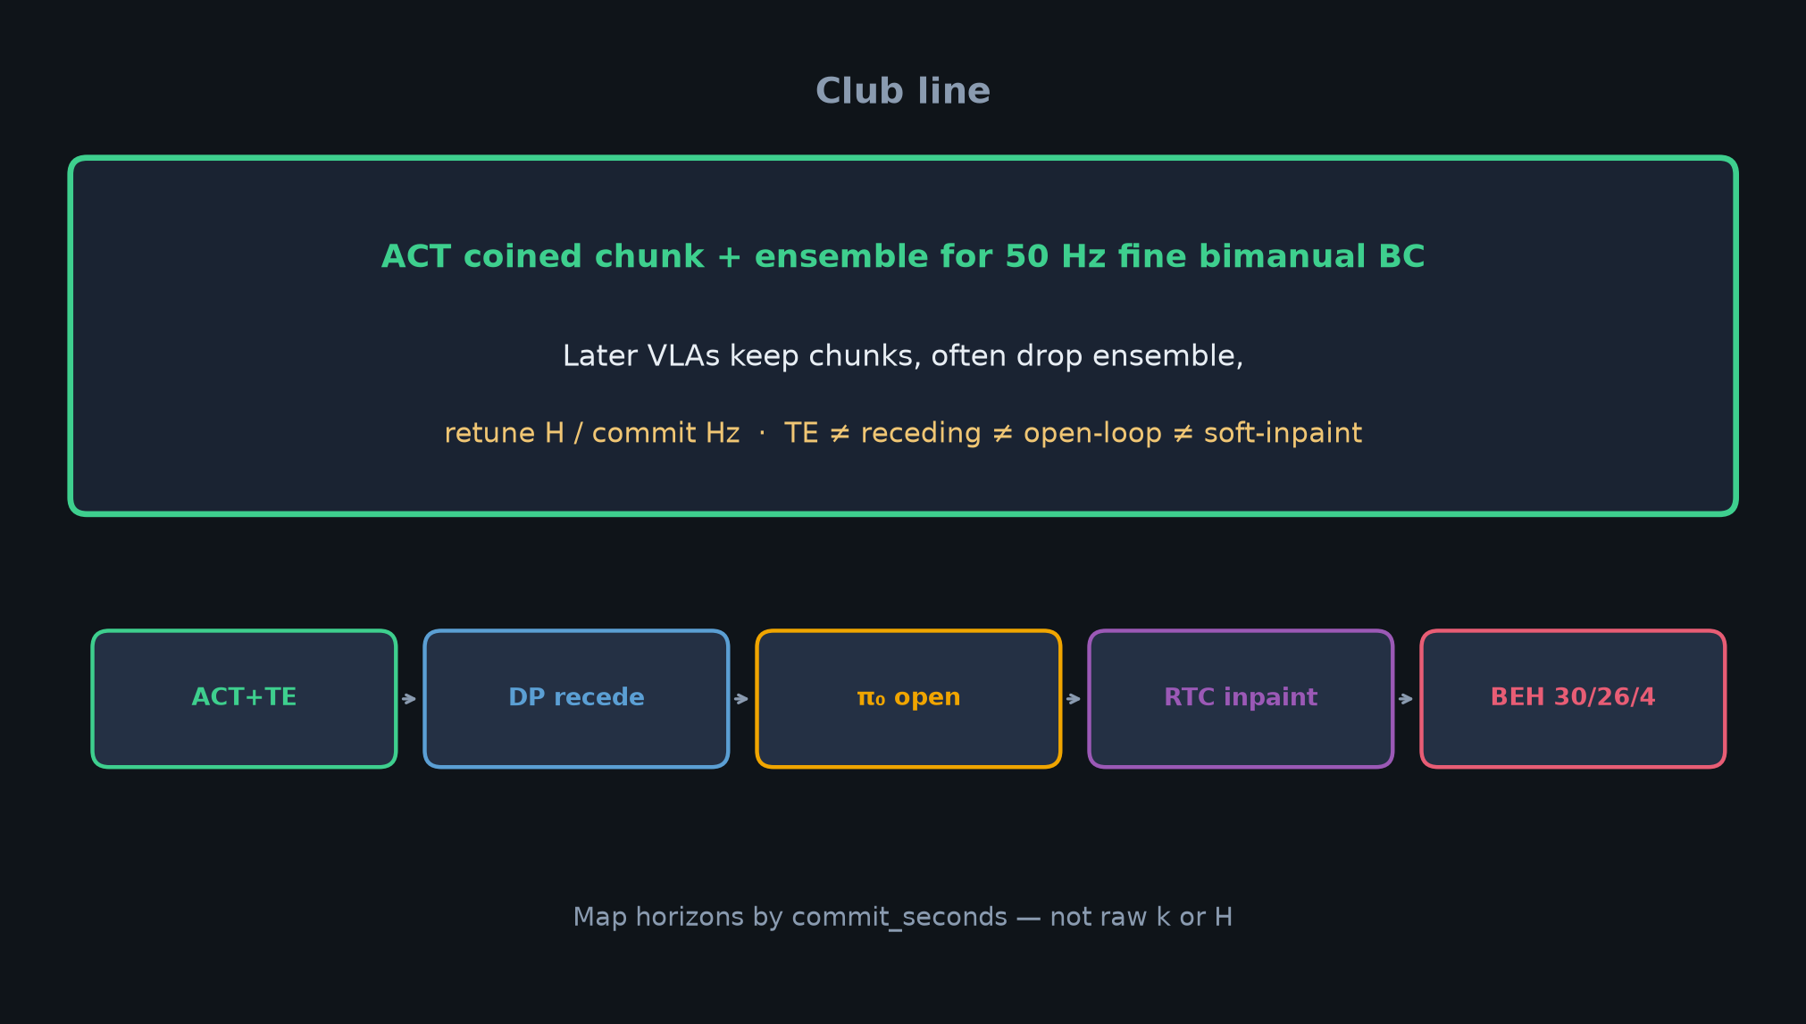
Stakeholder · 18+3 · 13/18
Notes:
CLUB LINE — strategic dependency.
If stack is OpenPI π₀.₅ / GR00T, you still inherit chunk horizons and overlap execution.

Slide 14
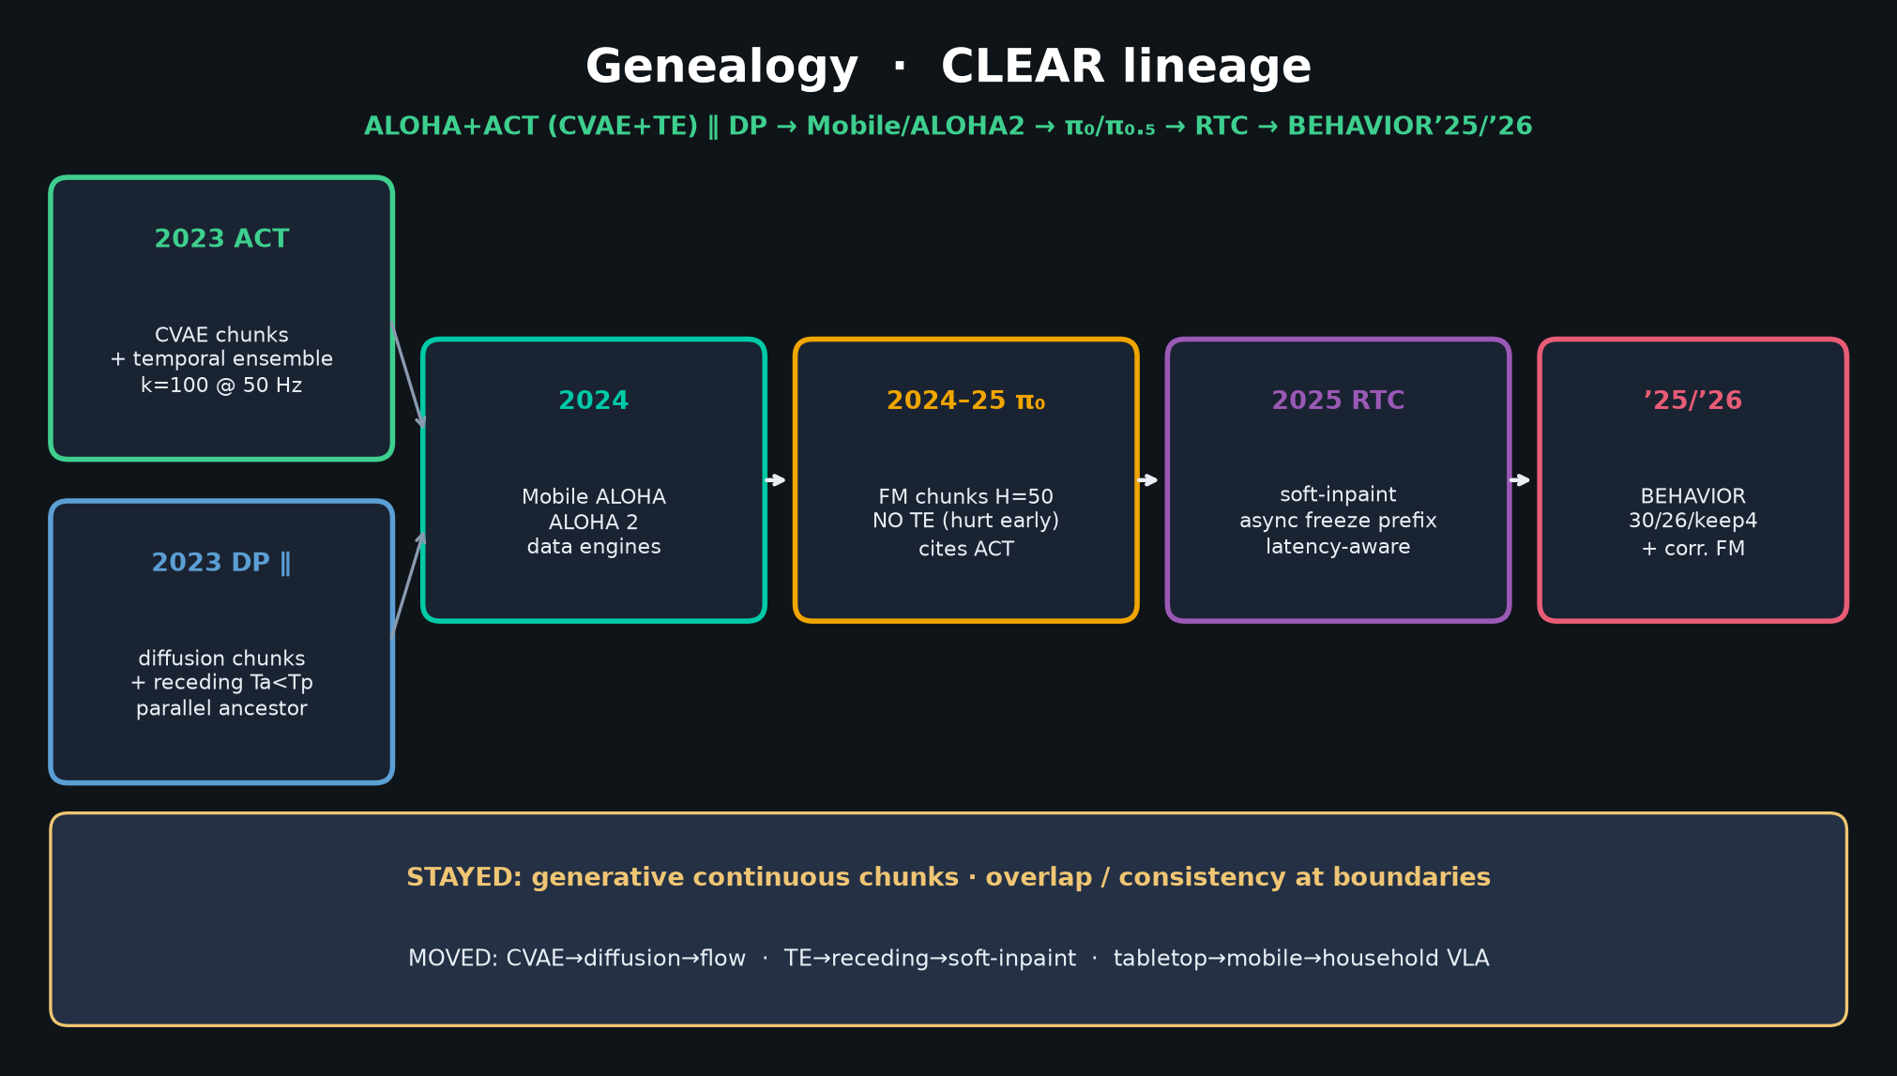
Stakeholder · 18+3 · 14/18
Notes:
GENEALOGY compressed — Mobile/ALOHA2 → π₀ → RTC → BEHAVIOR.
Denoiser moved; chunk habit stayed.

Slide 15
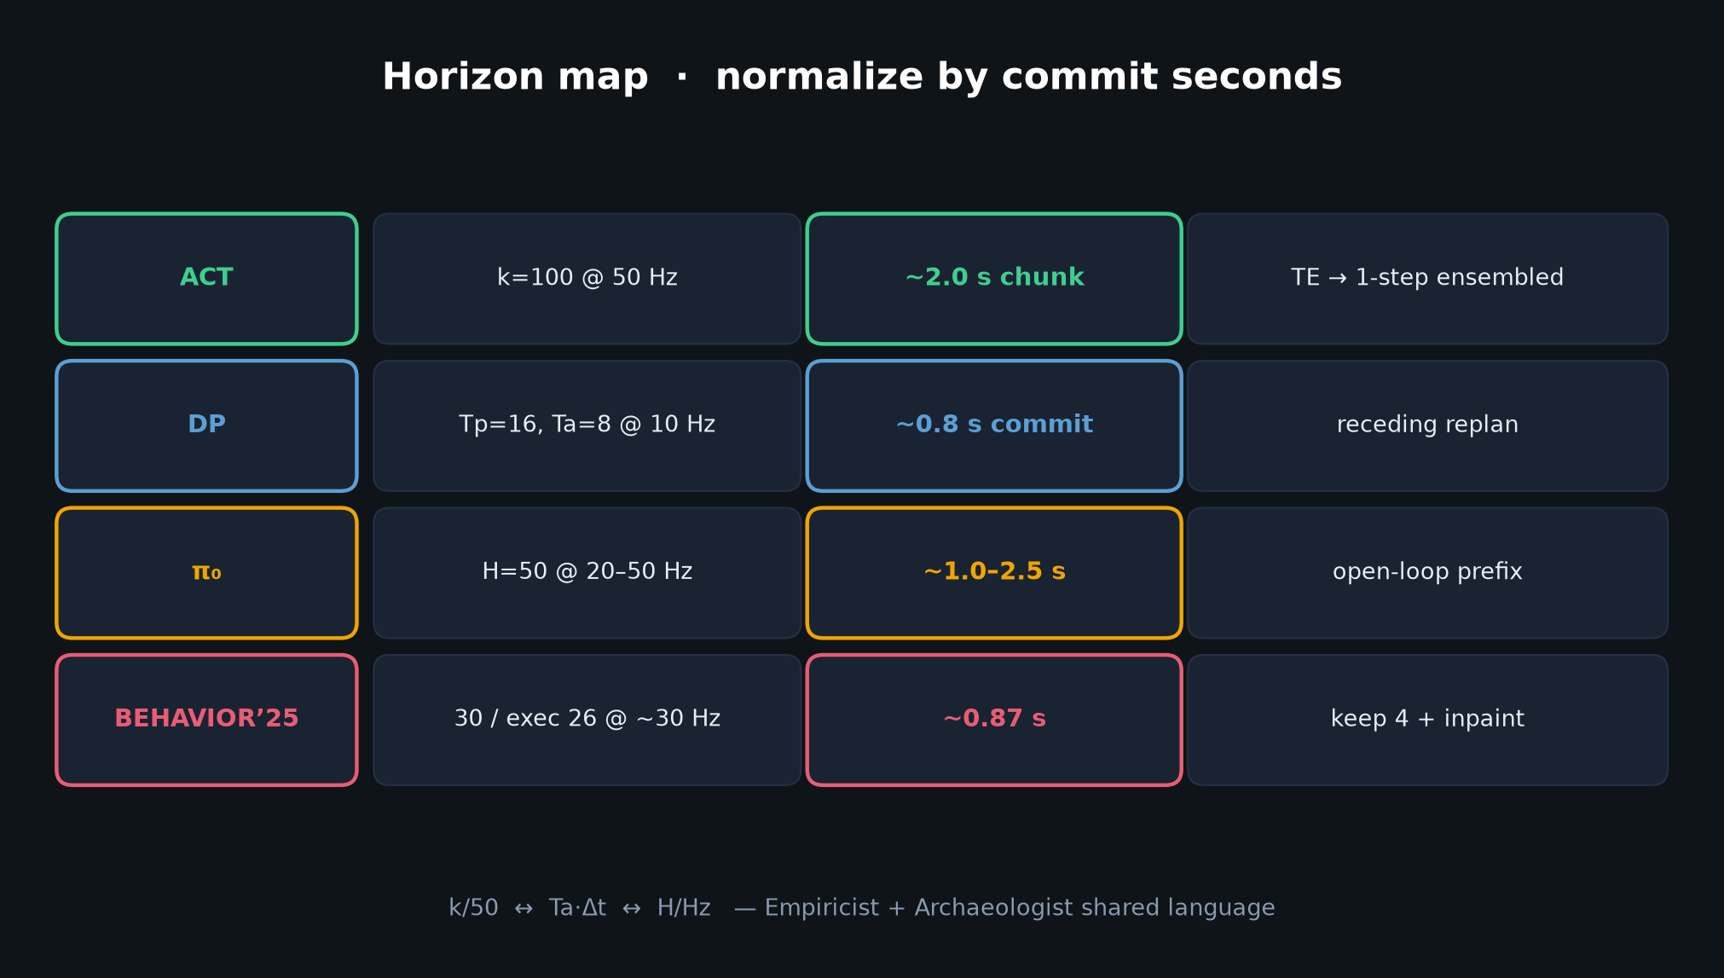
Stakeholder · 18+3 · 15/18
Notes:
HORIZON MAP — why leadership should care about commit seconds as a KPI.

Slide 16
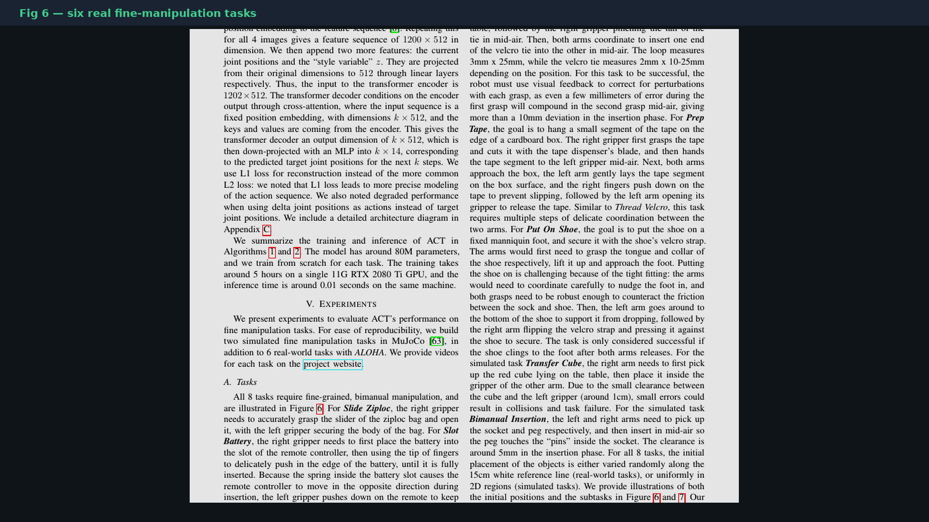
Stakeholder · 18+3 · 16/18
Notes:
SIX REAL TASKS collage — what “fine manipulation” meant in 2023.

Slide 17
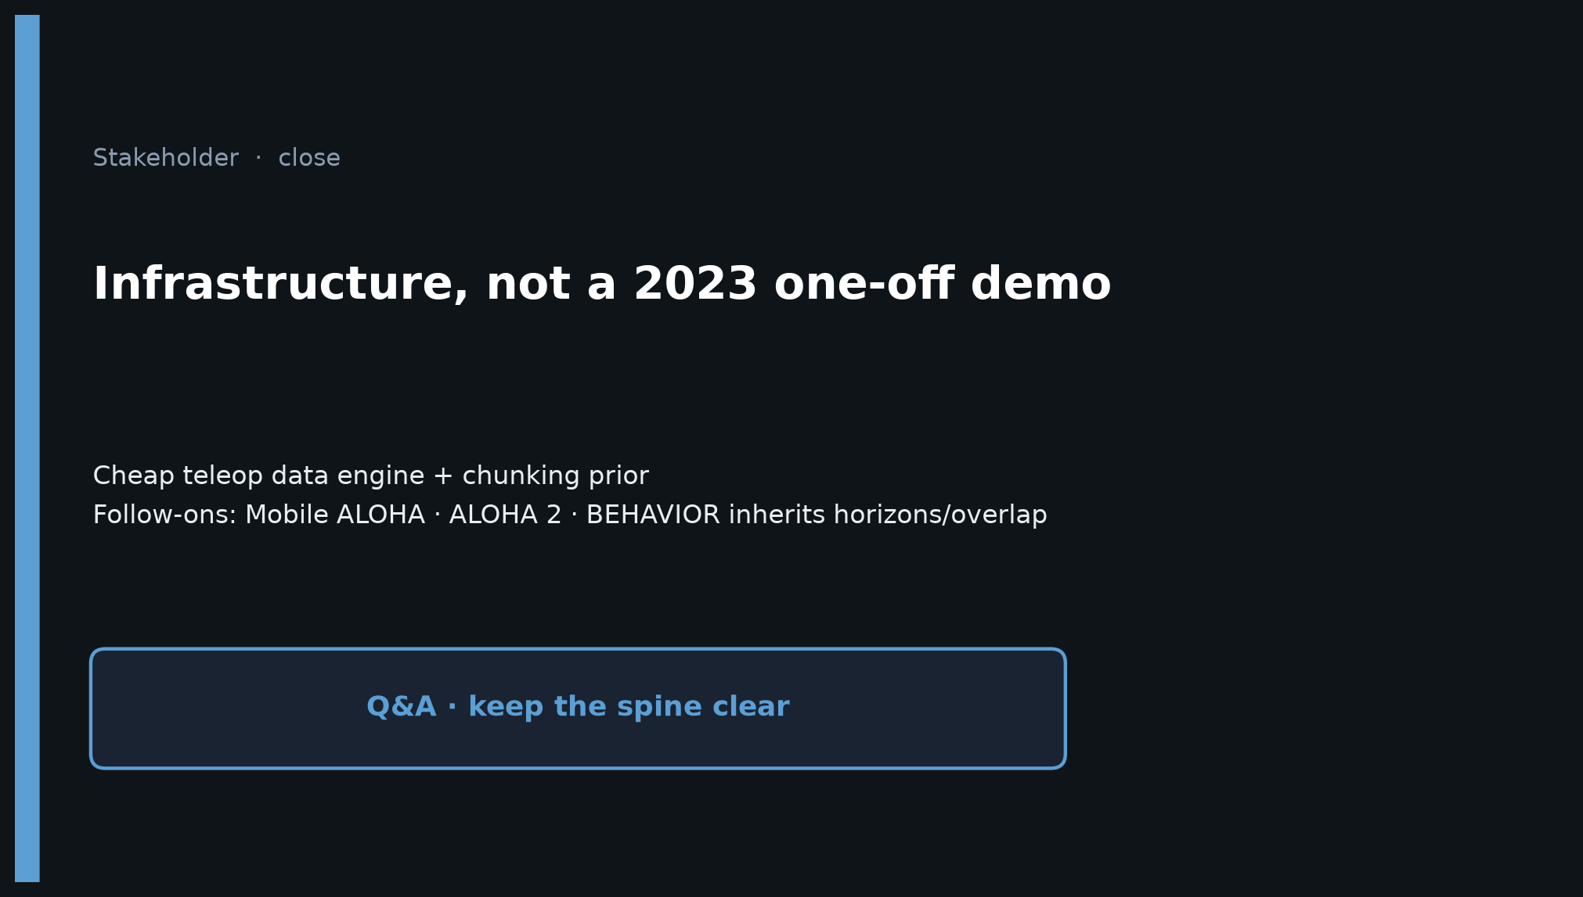
Stakeholder · 18+3 · 17/18
Notes:
ASK AGAIN: infrastructure, not a trick.
Hand off to Reviewer (hygiene) and Empiricist (k/TE/CVAE knobs).

Slide 18
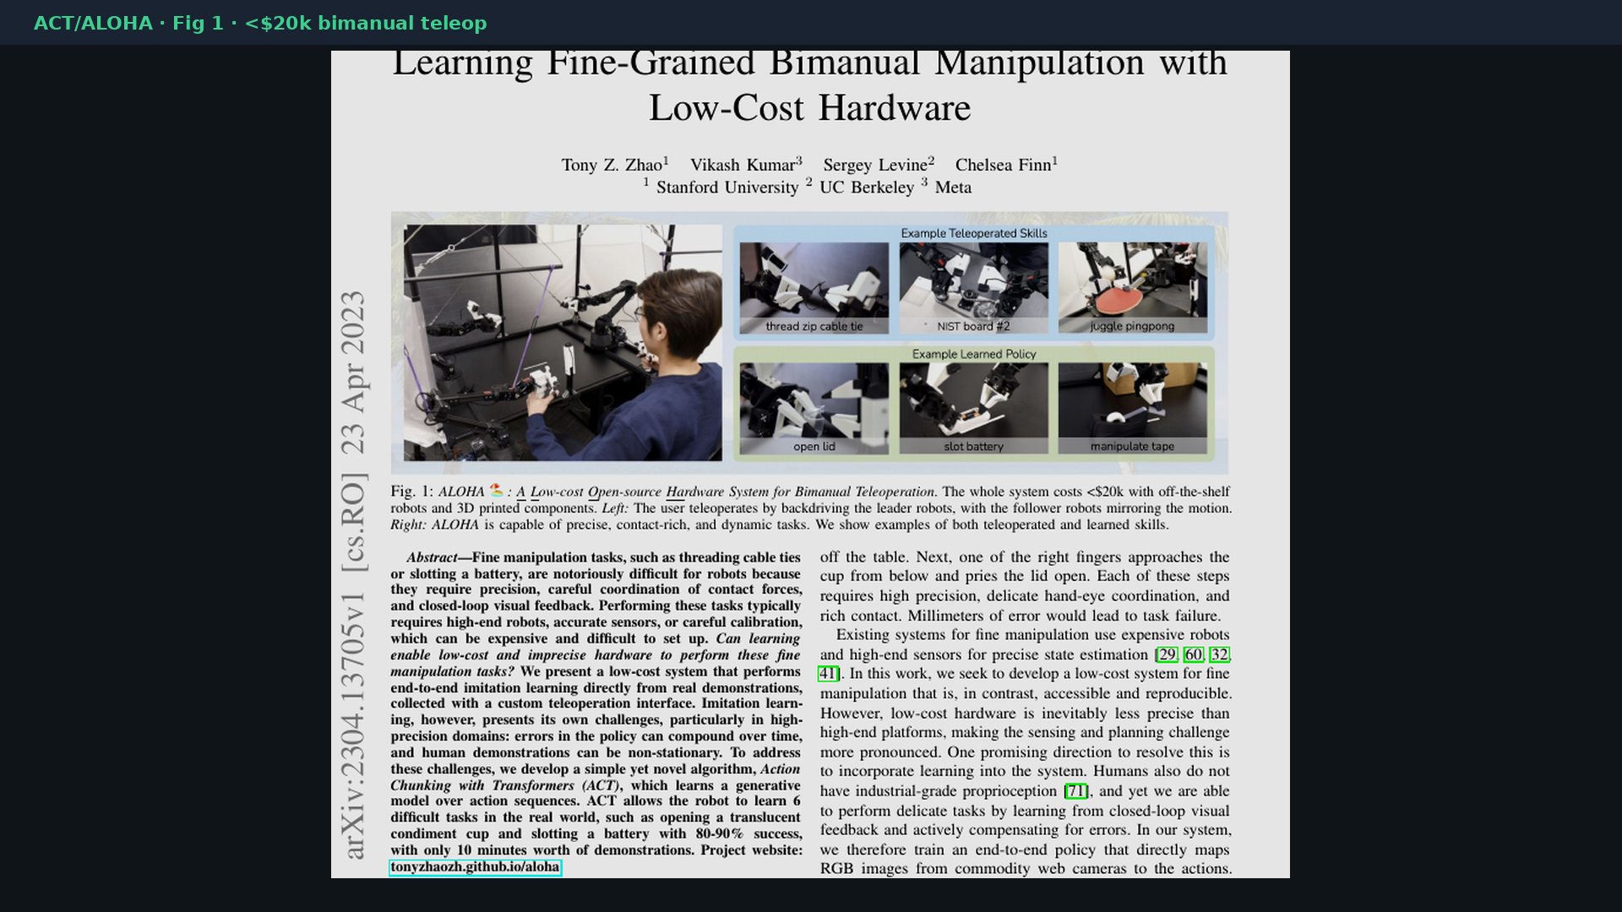
Stakeholder · 18+3 · 18/18
Notes:
Backup cover.

