Slide 1

Scientific Reviewer · 8+3 · 1/11
Notes:
SCIENTIFIC REVIEWER — 8+3. Short talk.
Strengths → actionable hygiene → verdict. Do not rehash full genealogy.

Slide 2
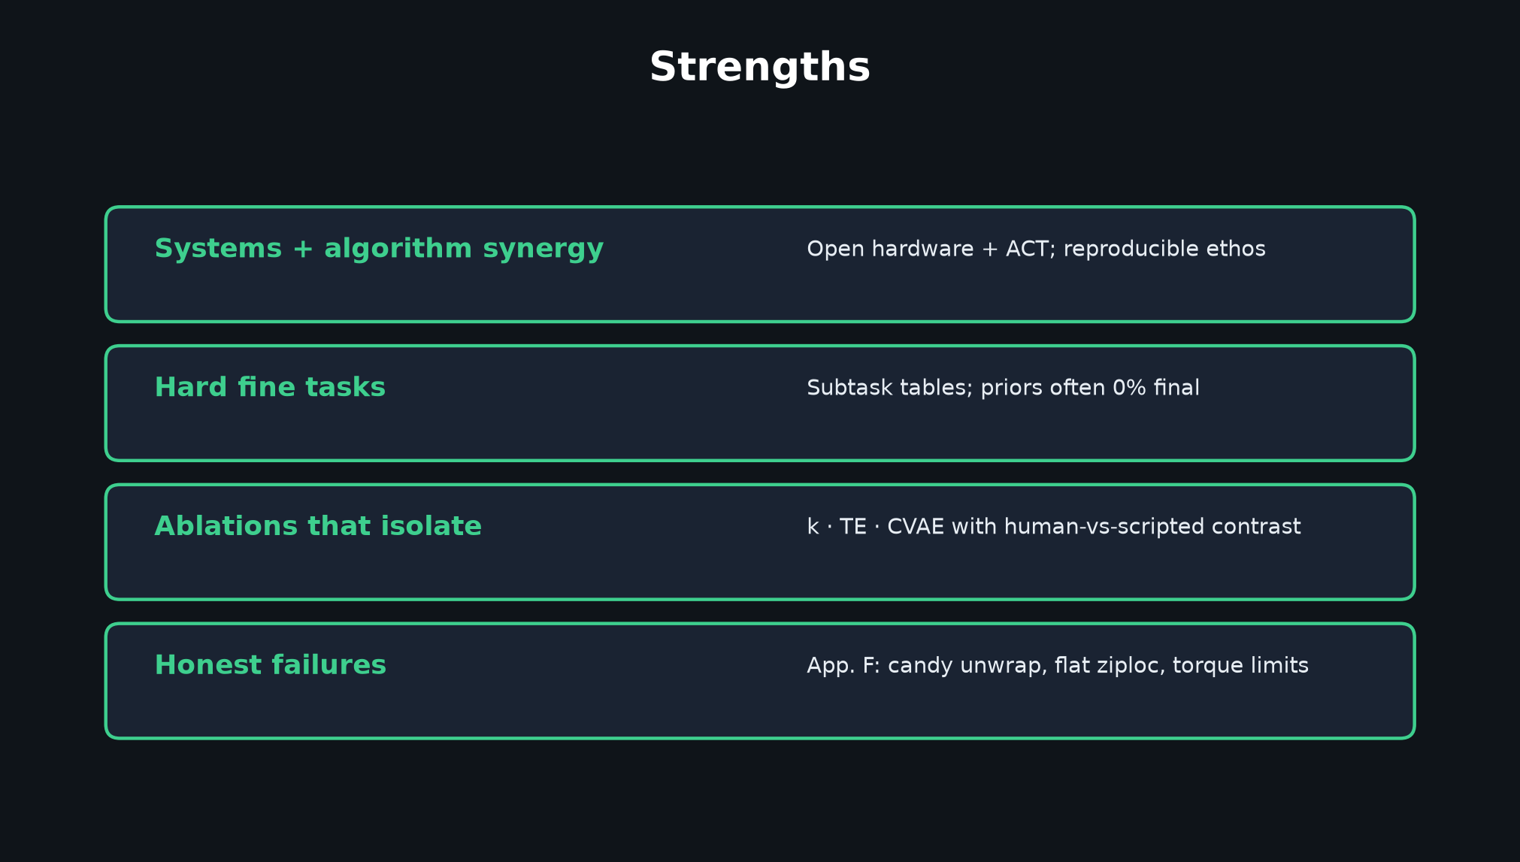
Scientific Reviewer · 8+3 · 2/11
Notes:
STRENGTHS (60–90s).
Systems+algo synergy; hard tasks with subtask tables; ablations for k/TE/CVAE; honest App. F failures.

Slide 3
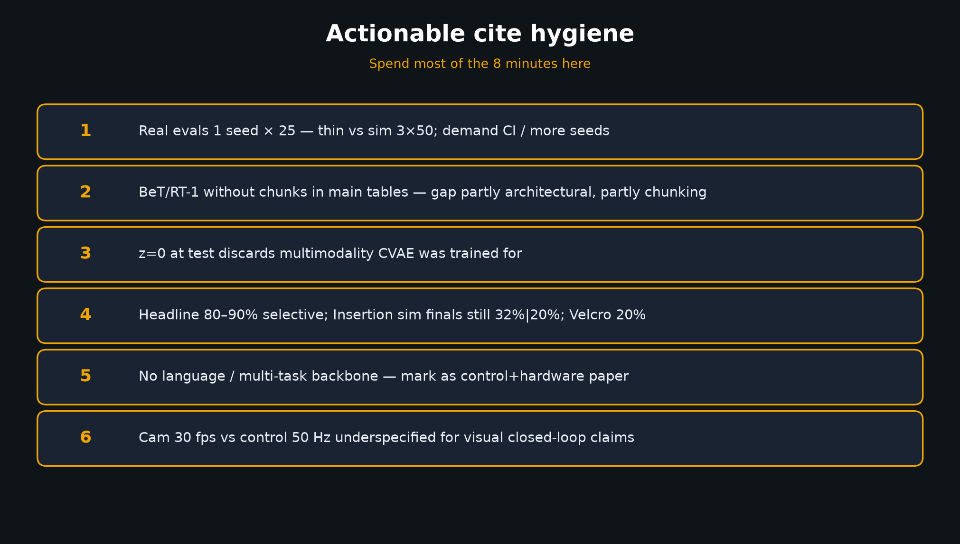
Scientific Reviewer · 8+3 · 3/11
Notes:
CITE HYGIENE — THE talk figure for this seat. Spend most of 8 minutes here.
1 Real 1×25 thin
2 BeT/RT-1 without chunks in main tables
3 z=0 discards multimodality
4 Headline 80–90% selective
5 No language — mark control+hardware
6 Cam 30fps vs 50Hz control underspecified

Slide 4
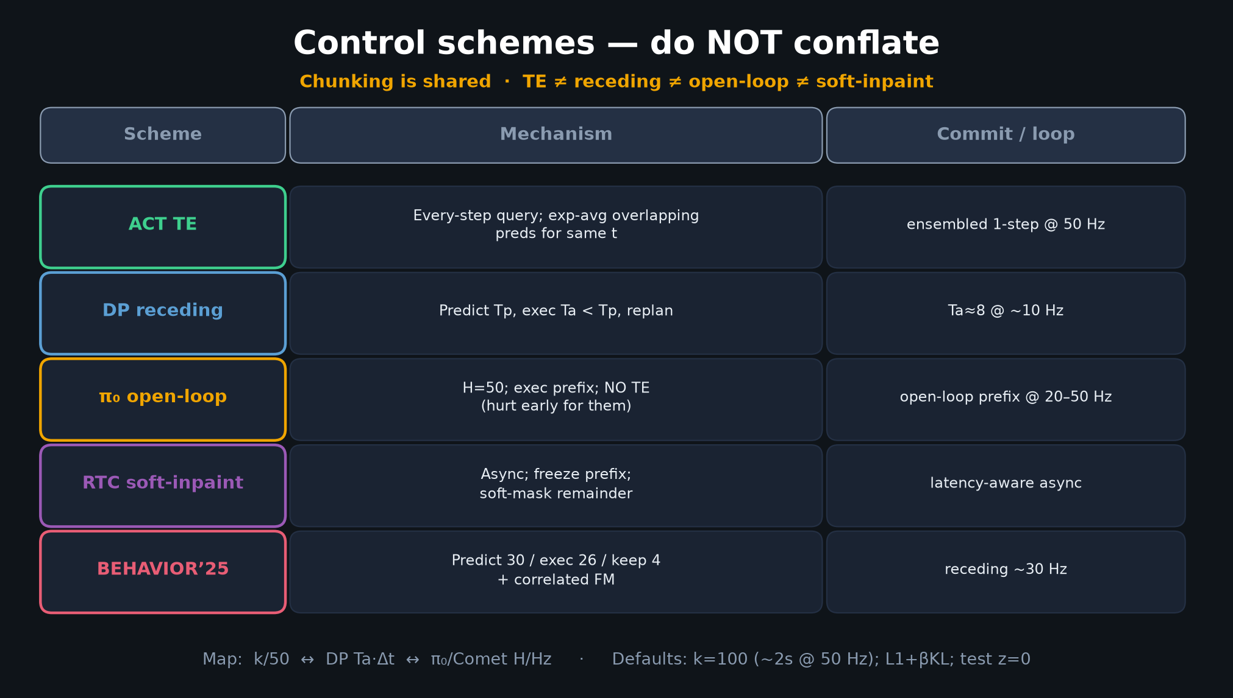
Scientific Reviewer · 8+3 · 4/11
Notes:
FIVE-WAY TABLE — also hygiene: do not mis-cite TE as receding or soft-inpaint.
Chunking shared; dialects differ.

Slide 5
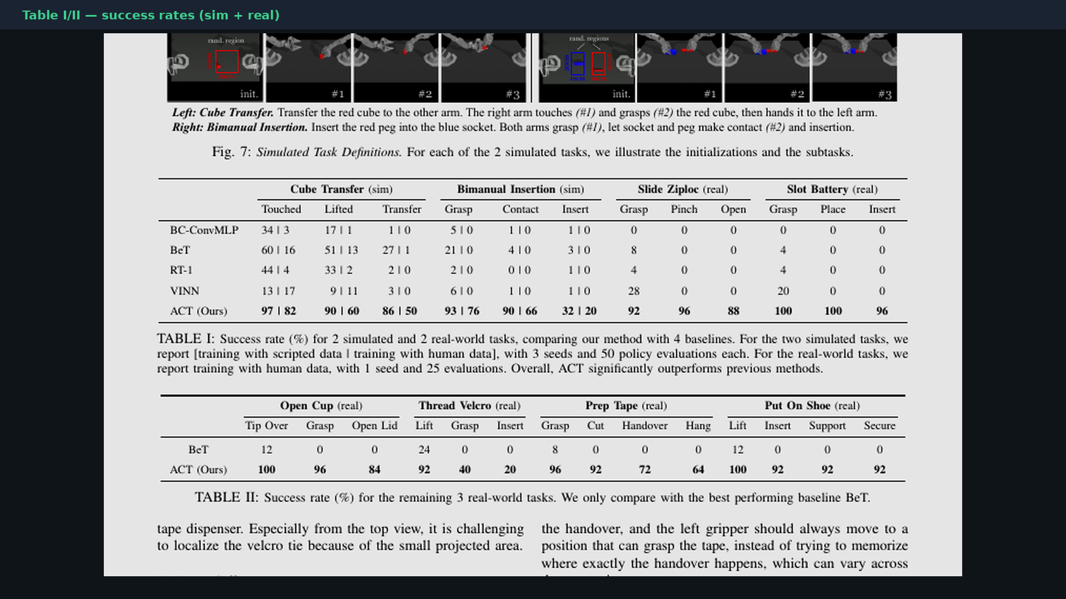
Scientific Reviewer · 8+3 · 5/11
Notes:
PAPER TABLES — when you say “cite subtask columns carefully,” gesture here.
Also: Insertion finals still low; Velcro 20%.

Slide 6
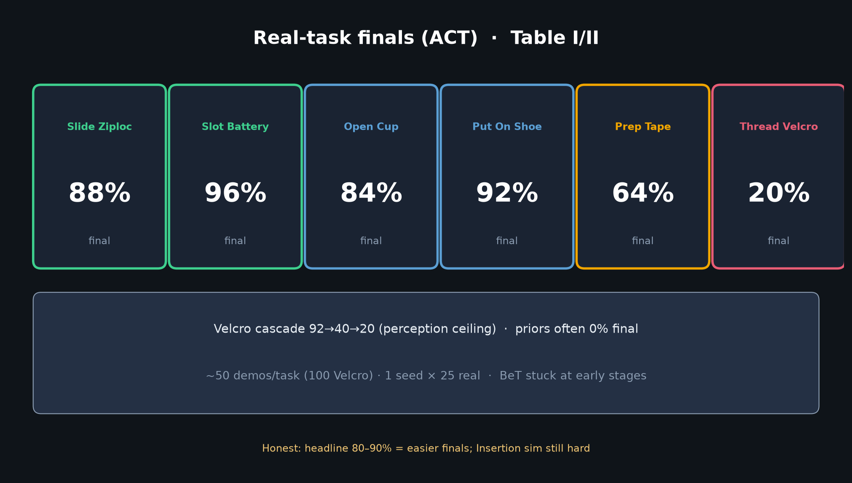
Scientific Reviewer · 8+3 · 6/11
Notes:
REAL RESULTS card — honest spread including Velcro 20% and Tape 64%.

Slide 7
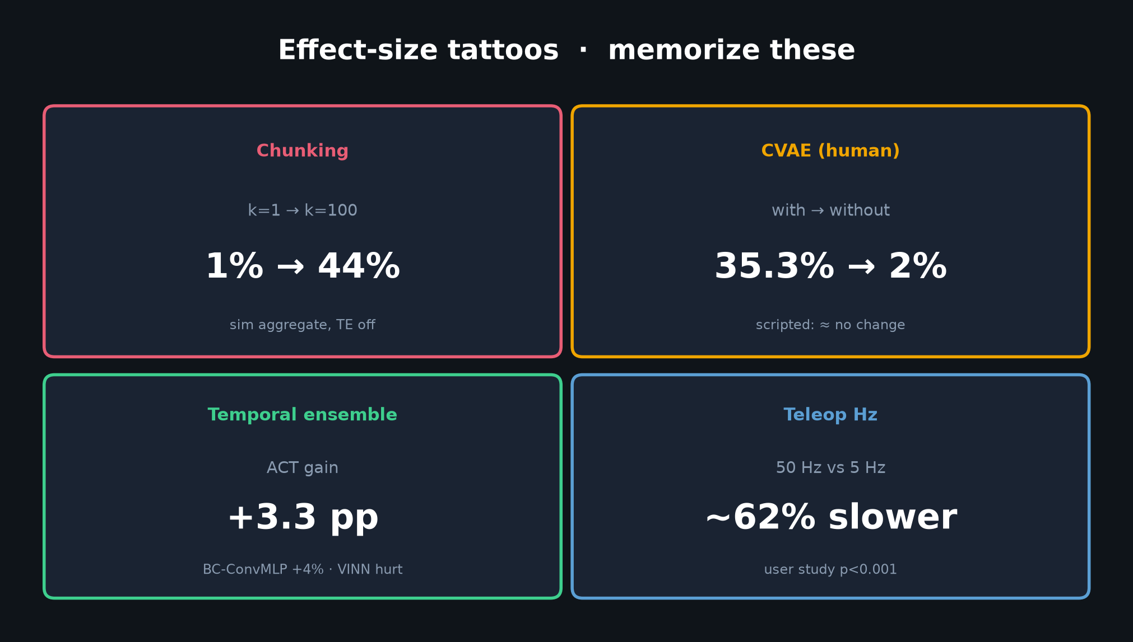
Scientific Reviewer · 8+3 · 7/11
Notes:
TATTOOS — ablations that isolate claims (k, CVAE human, TE).
These are the strong scientific core; protect them with hygiene on n and baselines.

Slide 8
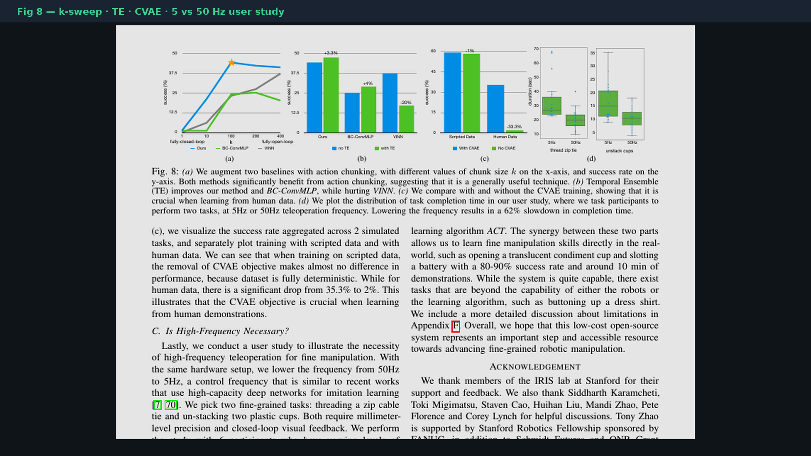
Scientific Reviewer · 8+3 · 8/11
Notes:
FIG 8 region — where ablations live; curves may need PDF cross-check (text extract noisy).

Slide 9
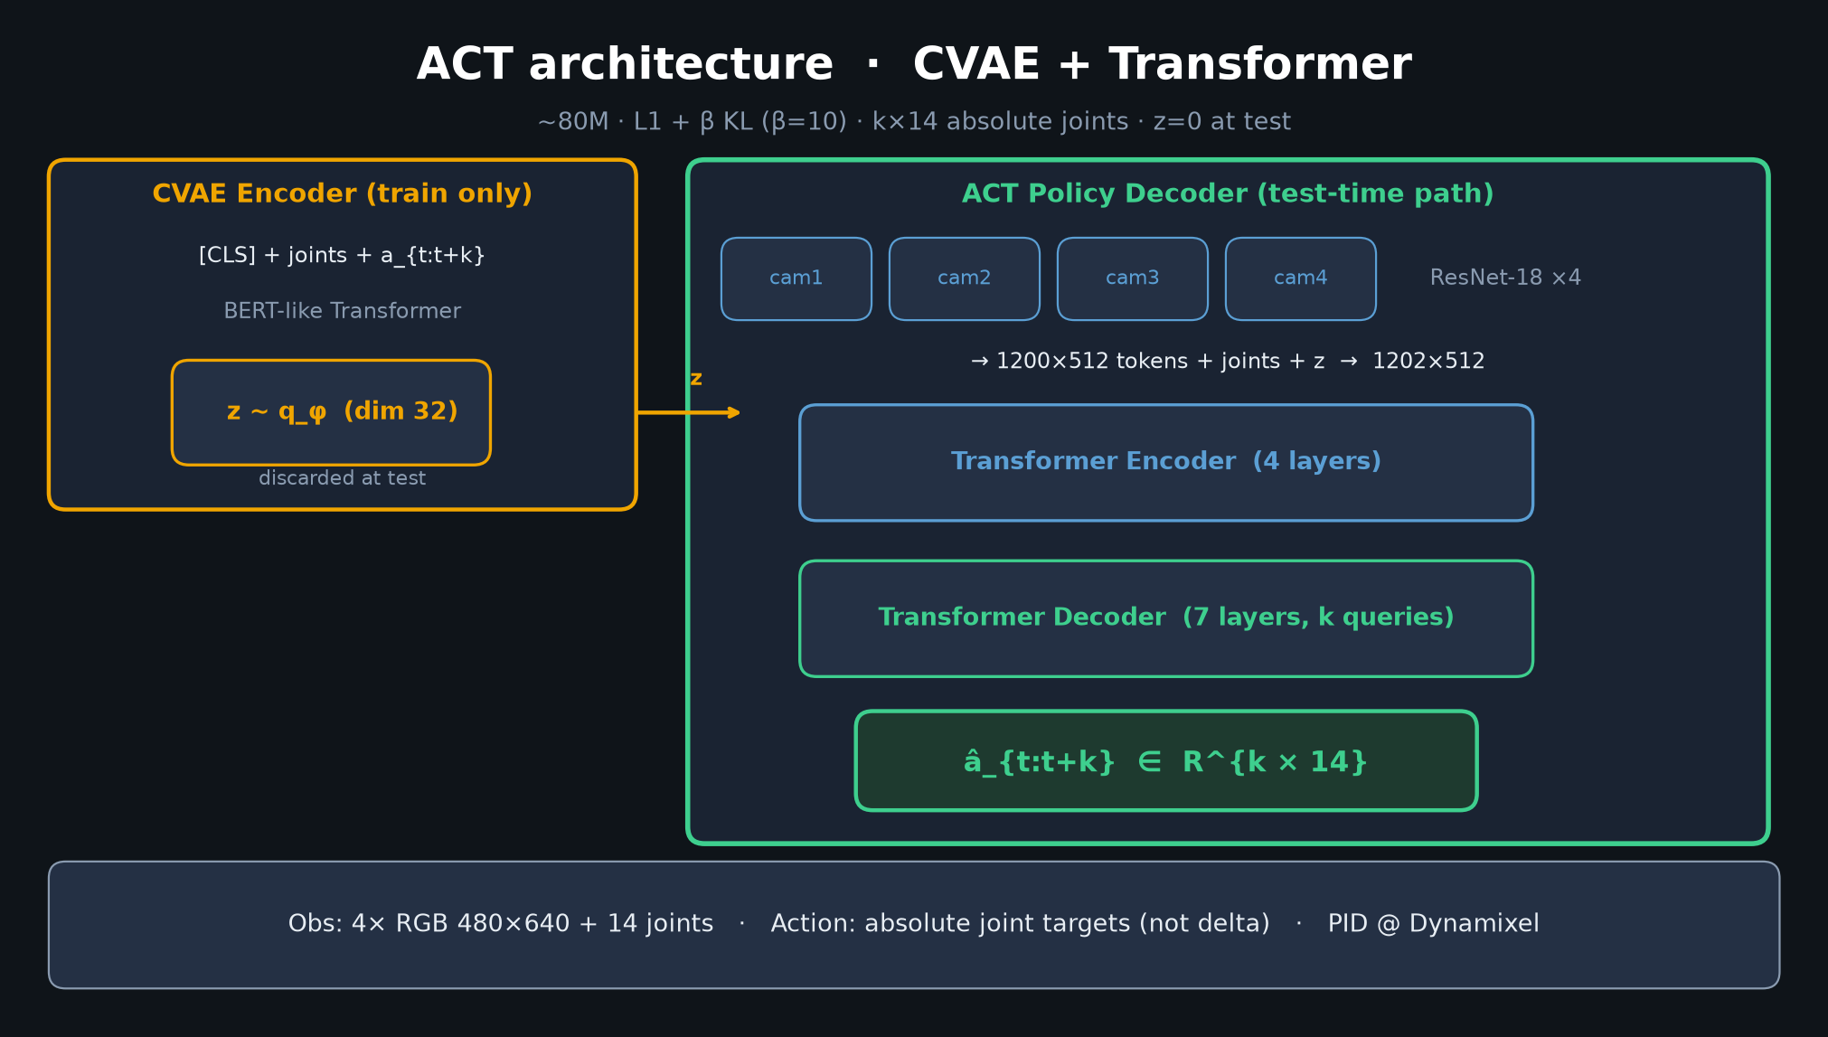
Scientific Reviewer · 8+3 · 9/11
Notes:
ARCH reminder — ~80M CVAE+TF; z=0 test is a design choice with a cost (multimodality discarded).

Slide 10
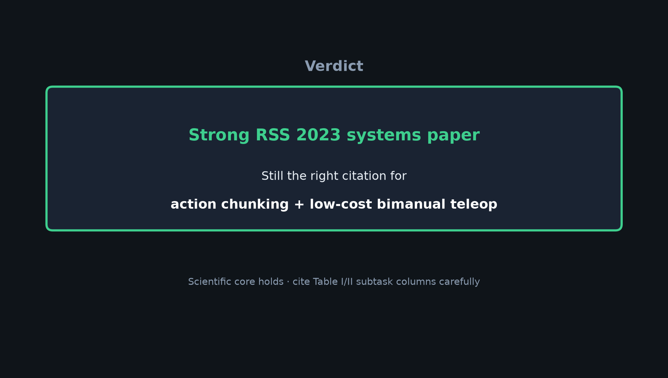
Scientific Reviewer · 8+3 · 10/11
Notes:
VERDICT: Strong RSS 2023 systems paper; still the right cite for action chunking + low-cost bimanual teleop.
Demand hygiene when others reuse 80–90% or ignore thin real-n.

Slide 11

Scientific Reviewer · 8+3 · 11/11
Notes:
Close / Q&A prompts.

