Slide 1
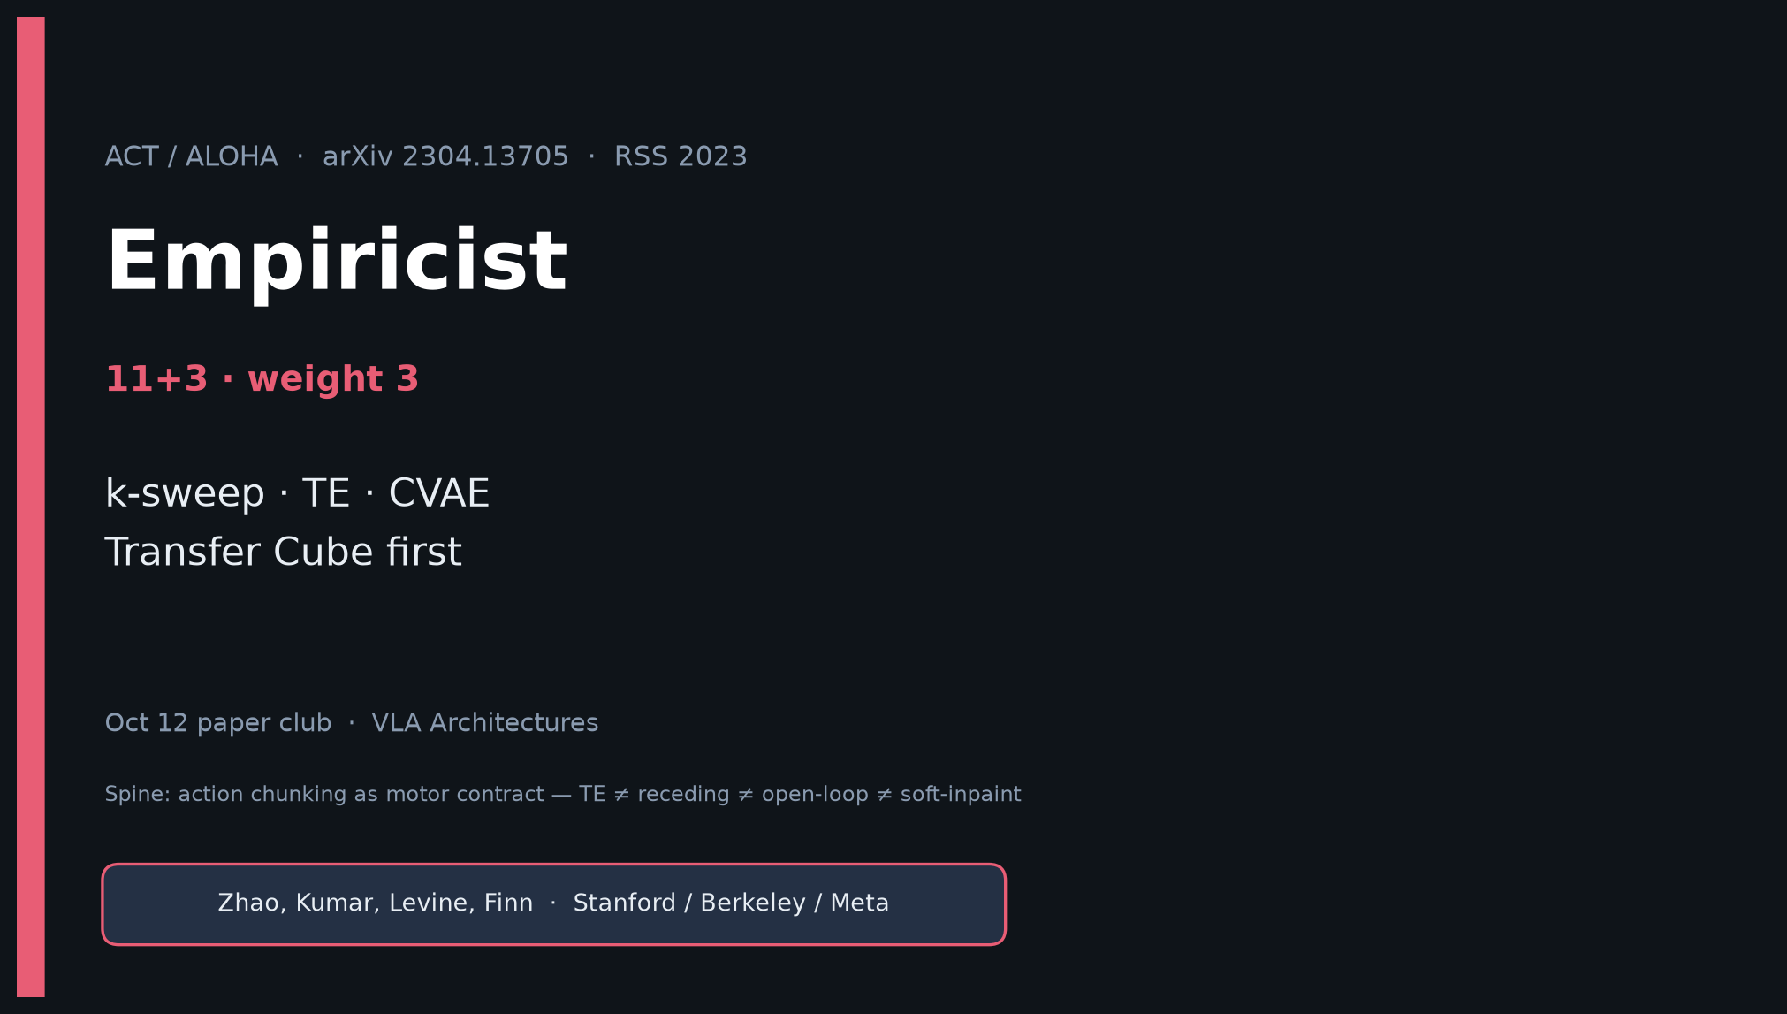
Empiricist · 11+3 · 1/14
Notes:
EMPIRICIST — weight 3 · timing 11+3.
You own: k-sweep, TE on/off, CVAE ablate.
Quiet scout ≲40–60 GPU-h; Transfer Cube first; outlines in env_outline/ — no cluster jobs in quiet mode.
Pass bar: qualitative Fig-8 shape — NOT Table I real parity.

Slide 2
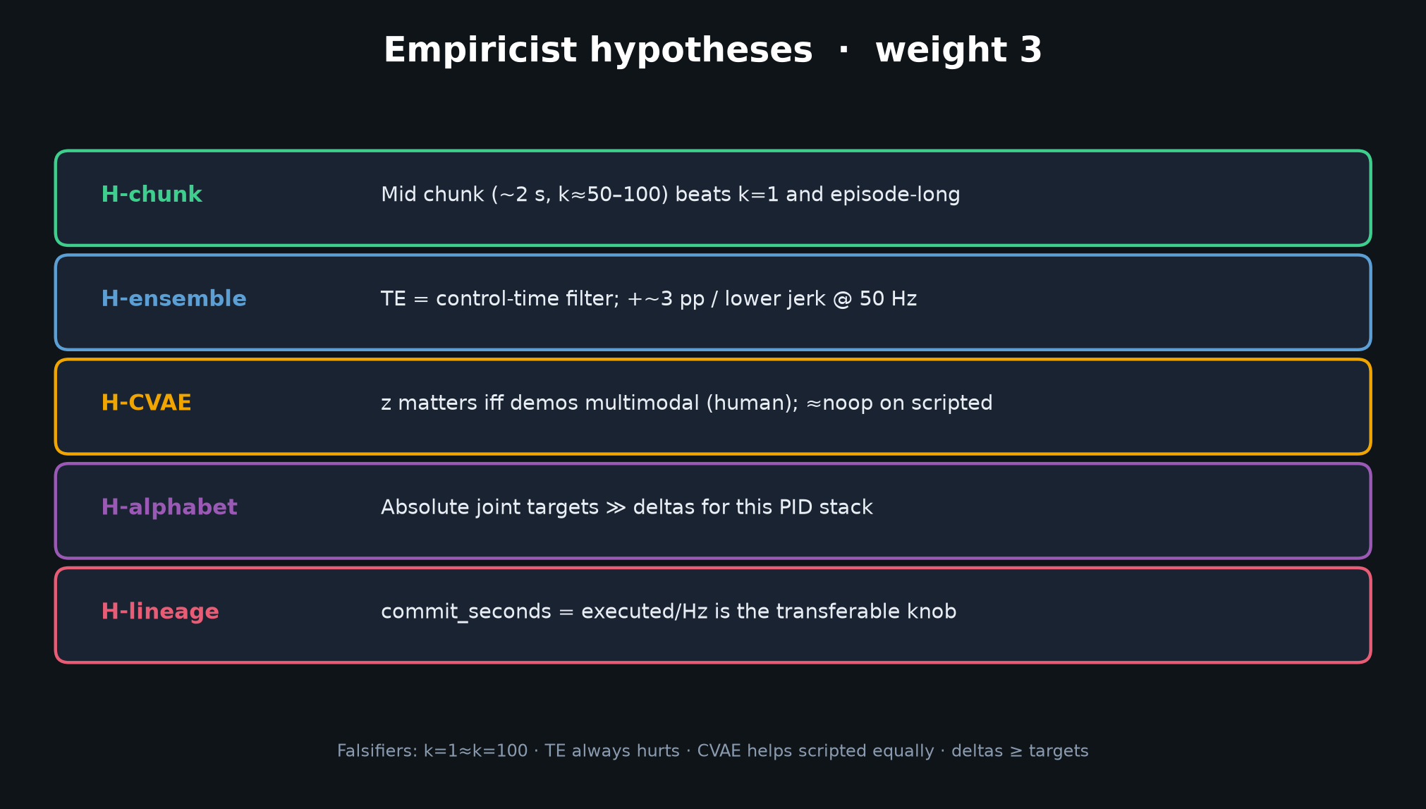
Empiricist · 11+3 · 2/14
Notes:
FIVE HYPOTHESES.
H-chunk: mid ~2s beats k=1 and episode-long.
H-ensemble: TE +~3pp / lower jerk @ 50Hz; task-/Hz-specific.
H-CVAE: critical for human demos; ≈noop scripted.
H-alphabet: absolute targets ≫ deltas.
H-lineage: commit_seconds transferable (k/50 ↔ Ta·Δt ↔ H/Hz).
Falsifiers listed on slide — say them aloud.

Slide 3
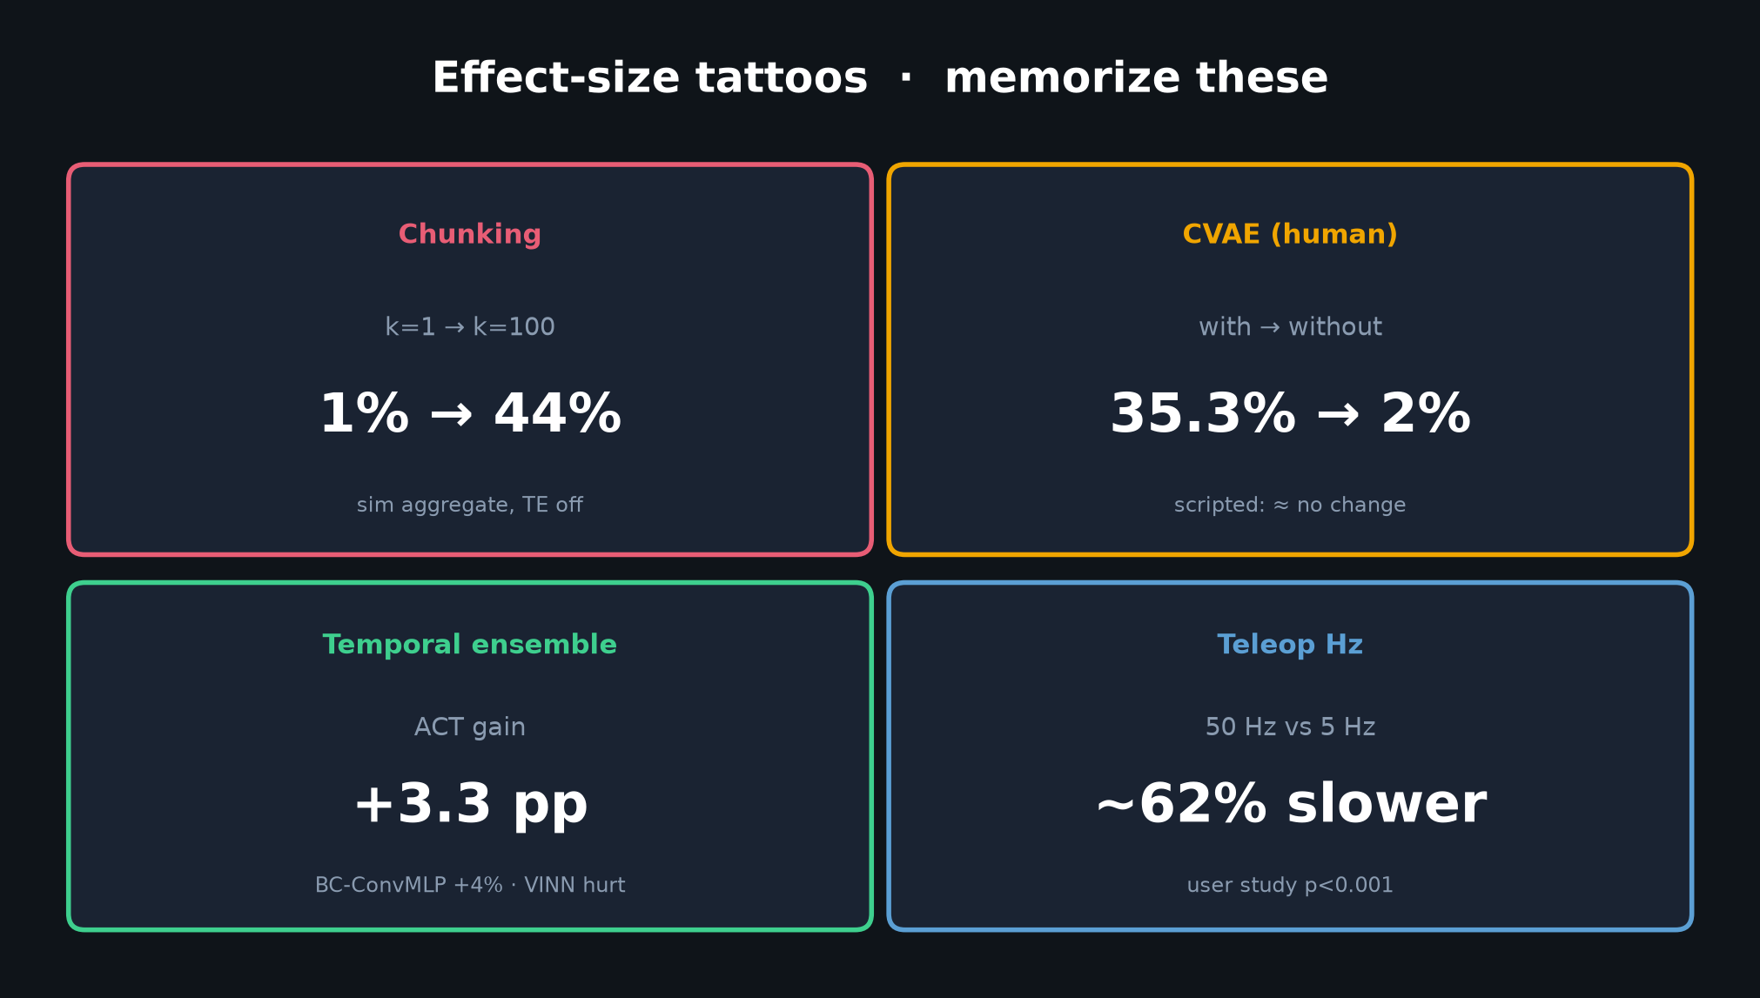
Empiricist · 11+3 · 3/14
Notes:
TATTOOS — memorize.
k=1→100: 1%→44%.
CVAE human: 35.3%→2% without.
TE ACT +3.3pp.
50 vs 5 Hz teleop ~62% slower.
These are the effect sizes you cite when someone asks “does chunking matter?”

Slide 4
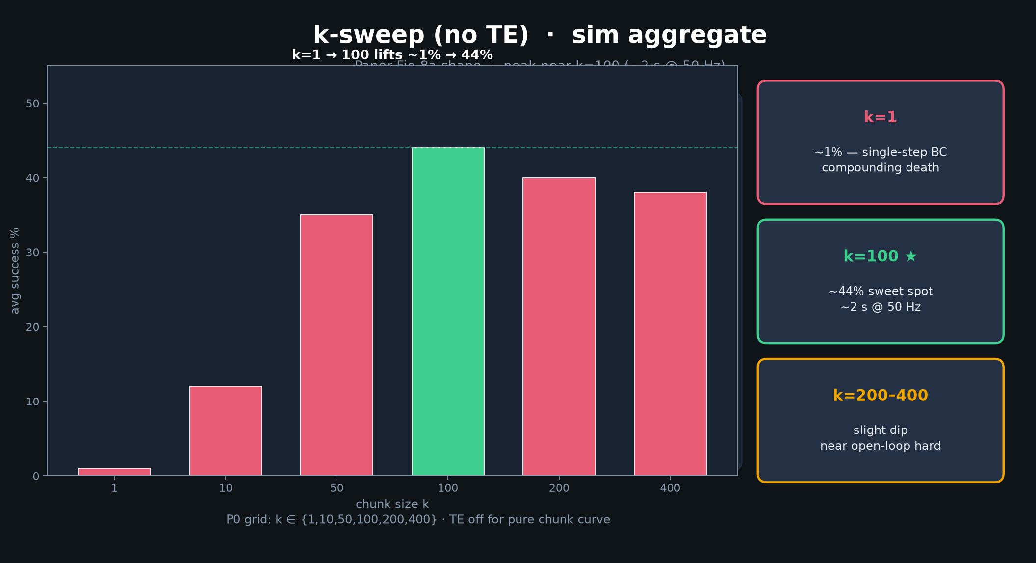
Empiricist · 11+3 · 4/14
Notes:
K-SWEEP — THE Empiricist figure.
P0 grid k∈{1,10,50,100,200,400}, TE off for pure chunk curve.
Expect peak ~100; collapse at 1; slight dip 200–400 (near open-loop).
Transfer Cube / Insertion, 1 seed, short train.

Slide 5
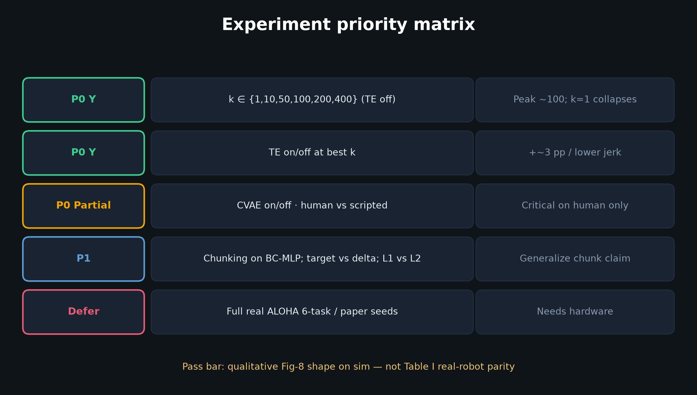
Empiricist · 11+3 · 5/14
Notes:
PRIORITY MATRIX — what to run first.
P0 Y: k-grid; TE on/off.
P0 Partial: CVAE human vs scripted.
P1: chunk on BC-MLP; target vs delta; L1 vs L2.
Defer: full real ALOHA 6-task.

Slide 6
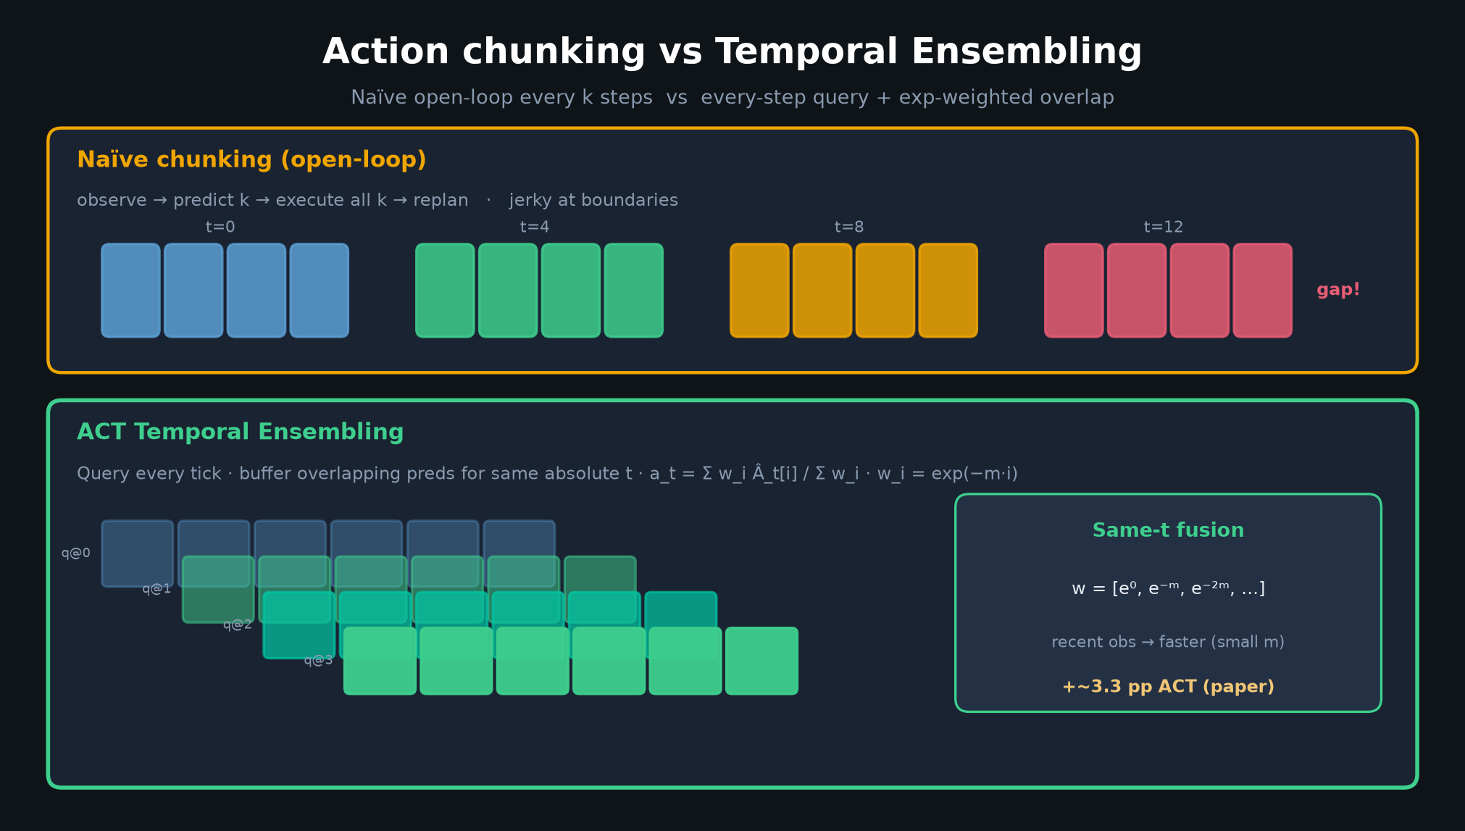
Empiricist · 11+3 · 6/14
Notes:
TE DIAGRAM — what you toggle.
Every-step query + exp-avg same-t. Compare vs naïve open-loop commit of full k.
Log jerk/snap at boundaries TE on vs off.

Slide 7
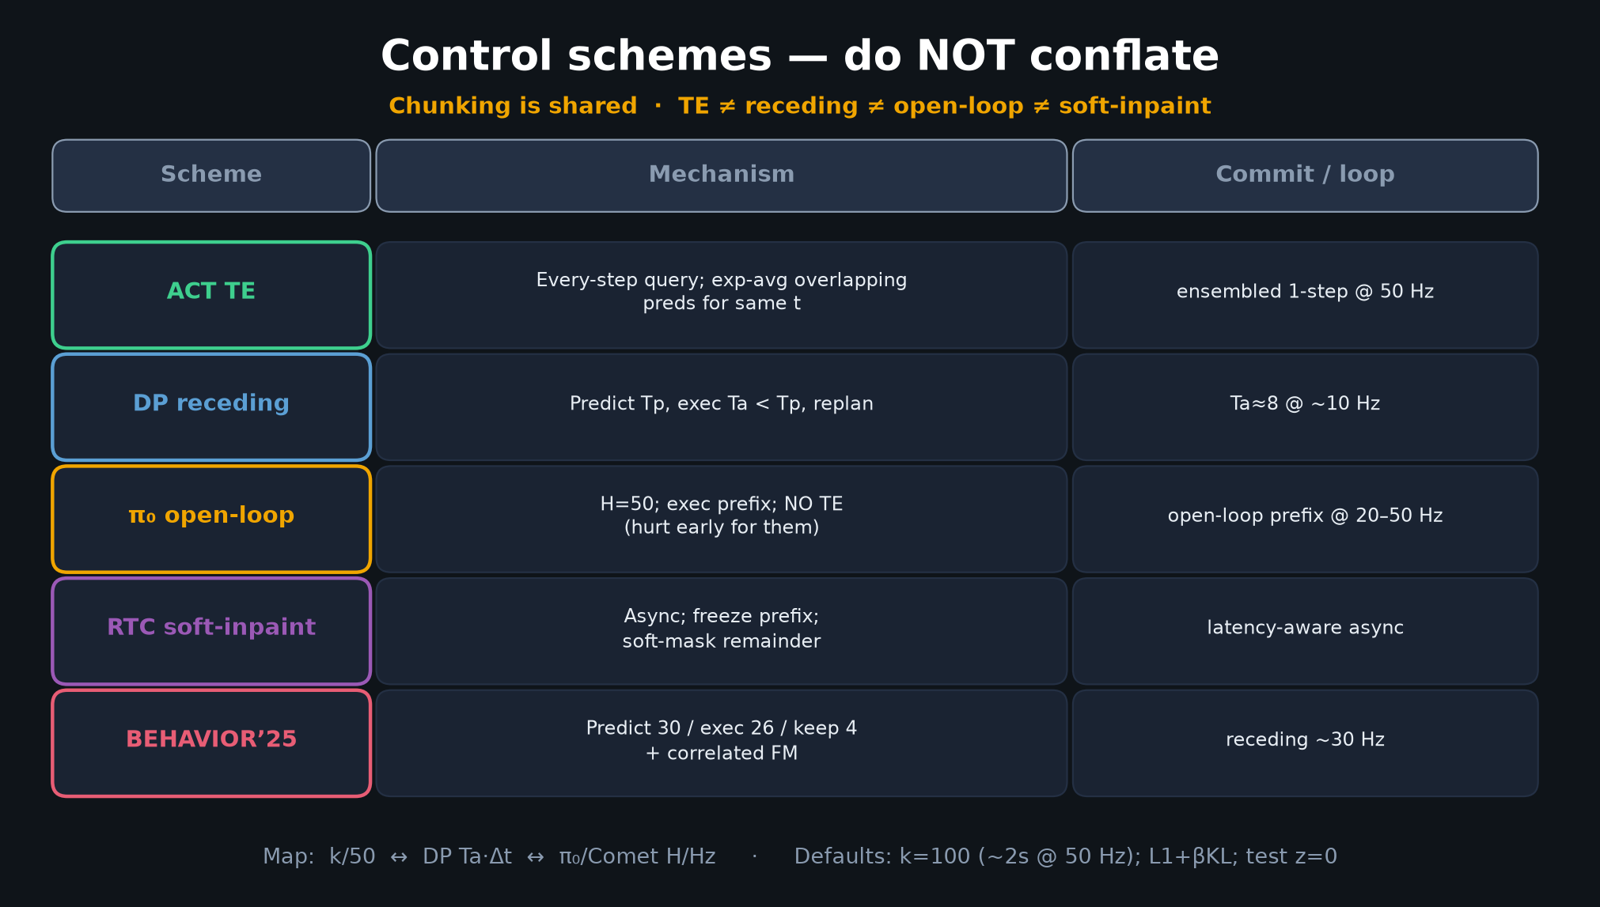
Empiricist · 11+3 · 7/14
Notes:
FIVE-WAY TABLE — when comparing to DP/π₀/RTC, normalize by commit_seconds.
Do NOT claim TE is “the same as” receding or soft-inpaint.
Optional P2: ensemble vs open-loop commit vs π₀-style no-ensemble.

Slide 8
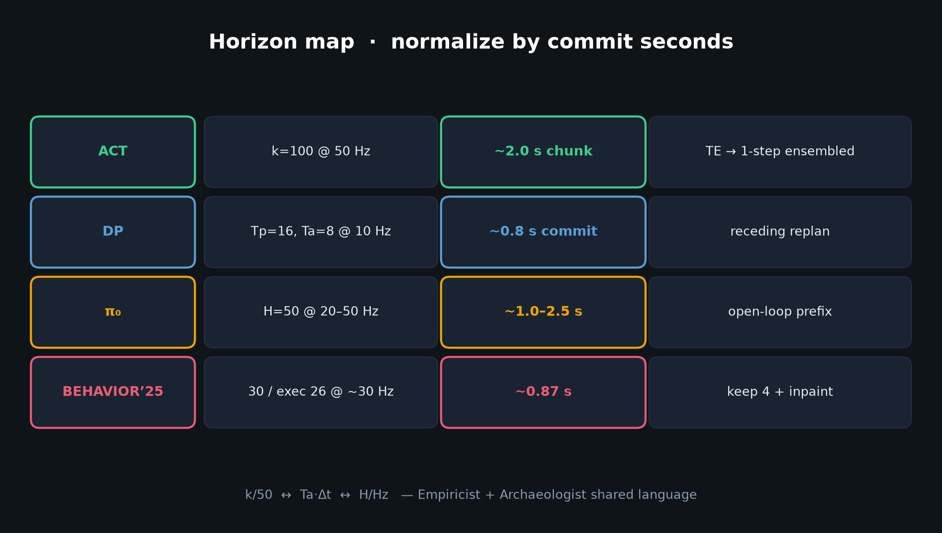
Empiricist · 11+3 · 8/14
Notes:
HORIZON MAP — shared language with Archaeologist.
Your k-sweep is one dialect of the same commit-seconds knob VLAs still tune.

Slide 9
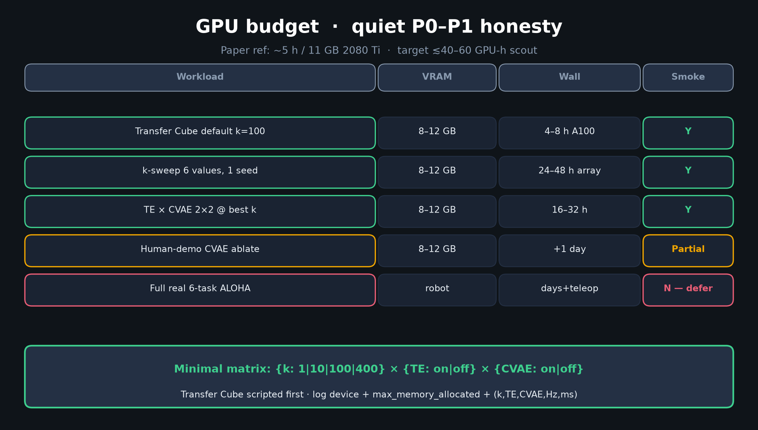
Empiricist · 11+3 · 9/14
Notes:
GPU BUDGET — honesty.
8–12 GB; quiet P0–P1 ≲40–60 GPU-h.
Paper: ~5h / 11GB 2080 Ti.
Log device + max_memory_allocated + (k,TE,CVAE,Hz,ms).
Never call CPU training a “GPU ACT run.”

Slide 10
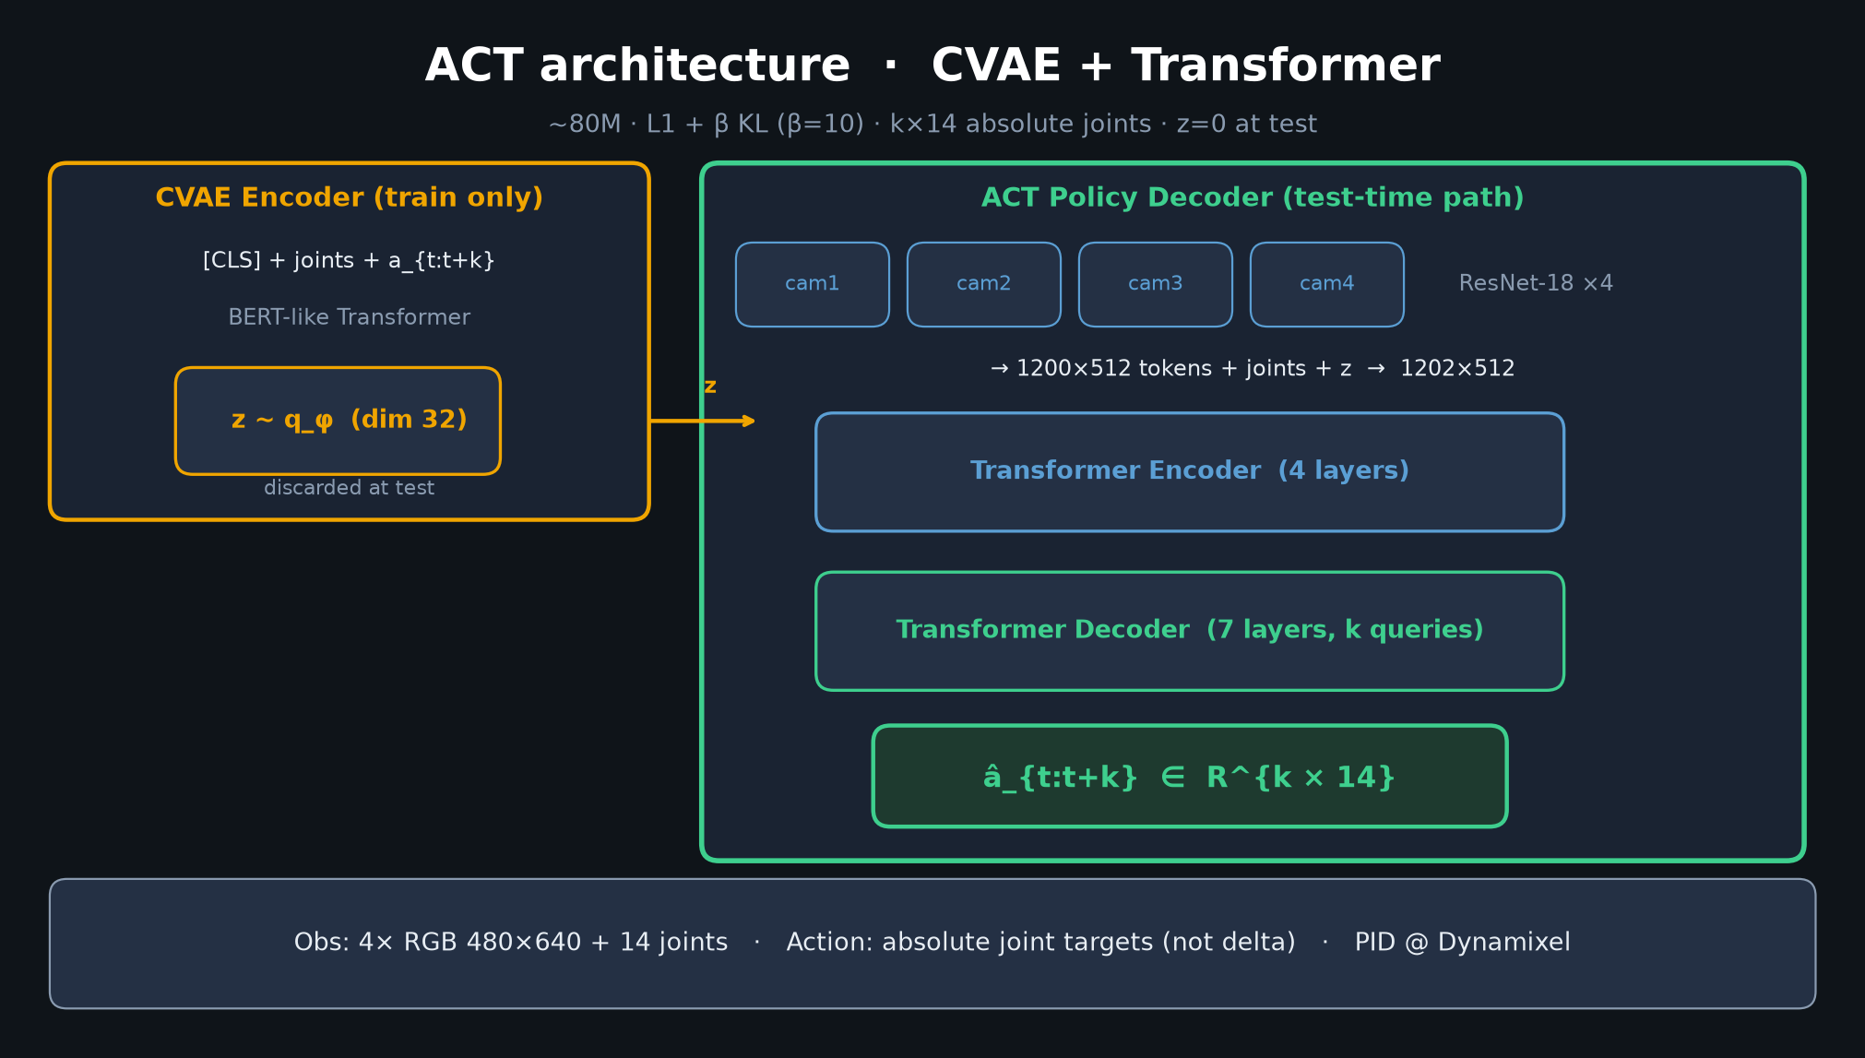
Empiricist · 11+3 · 10/14
Notes:
ACT ARCH — implementation checklist.
L1+βKL β=10; k=100; z~N(0,I) train / z=0 test; absolute joints; 4×ResNet18; enc4/dec7.
Pick lowest val loss ckpt.

Slide 11
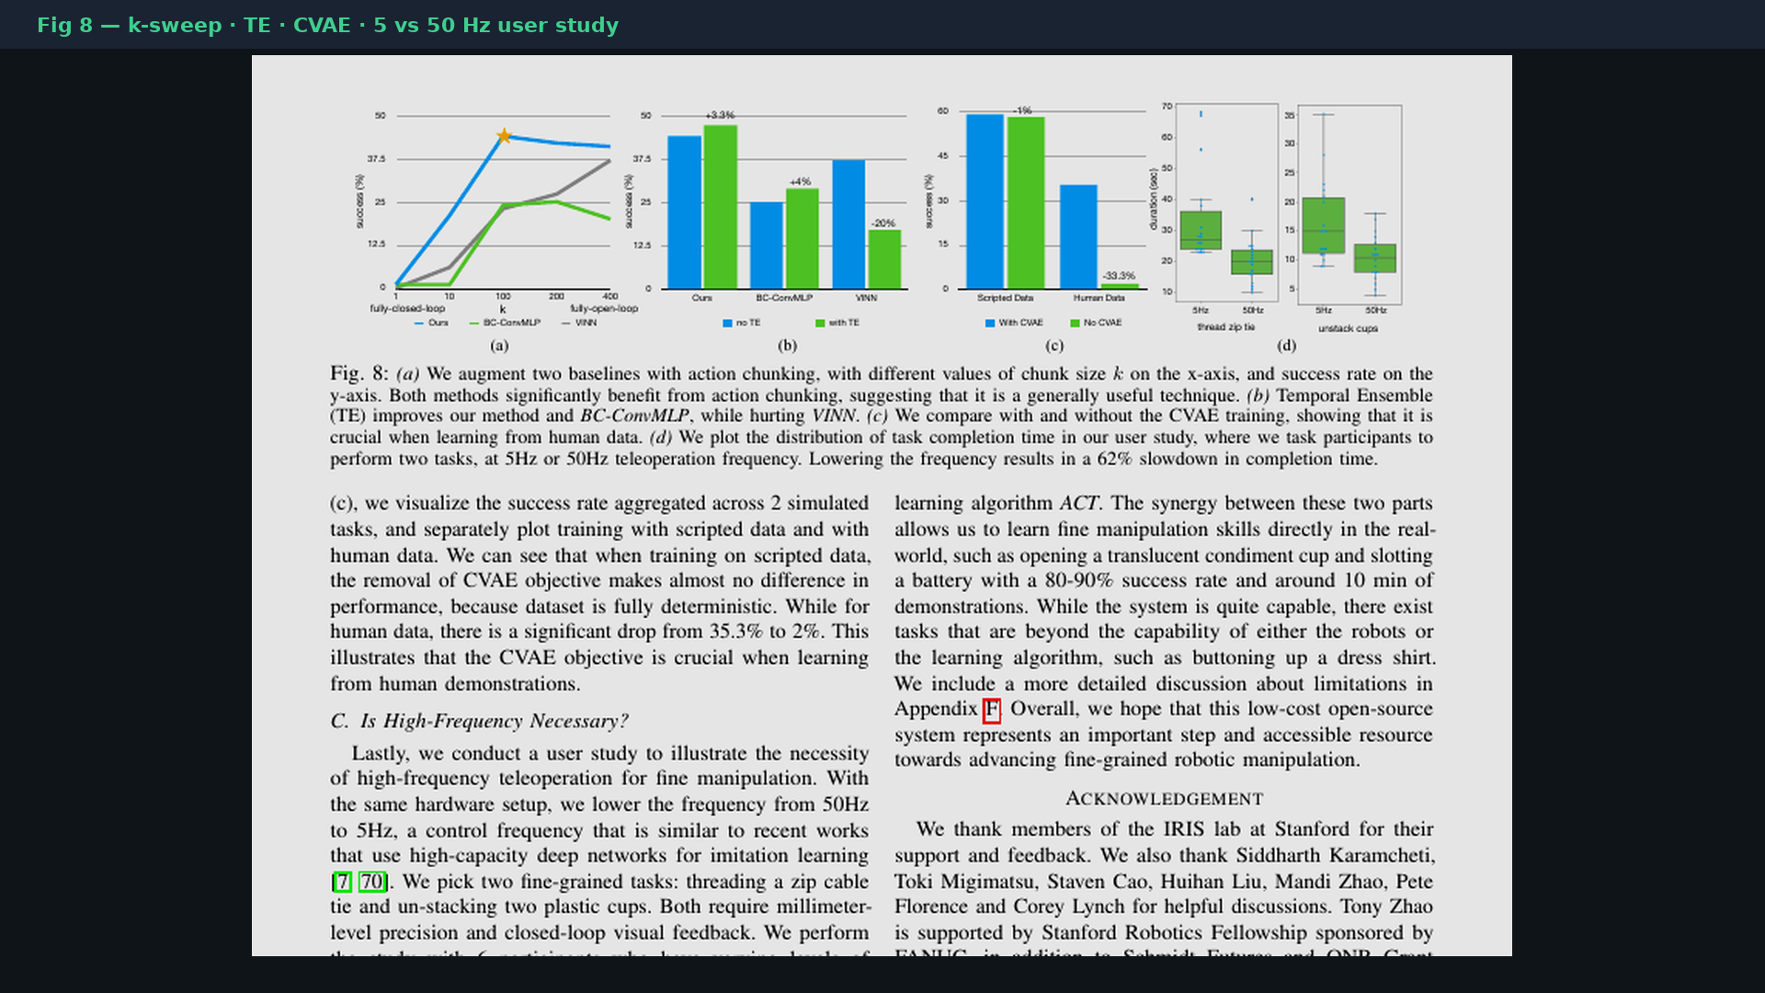
Empiricist · 11+3 · 11/14
Notes:
PAPER FIG 8 region — ground-truth ablation shapes you are trying to reproduce qualitatively.
Digitize per-task curves if time; average endpoints are the tattoos.

Slide 12
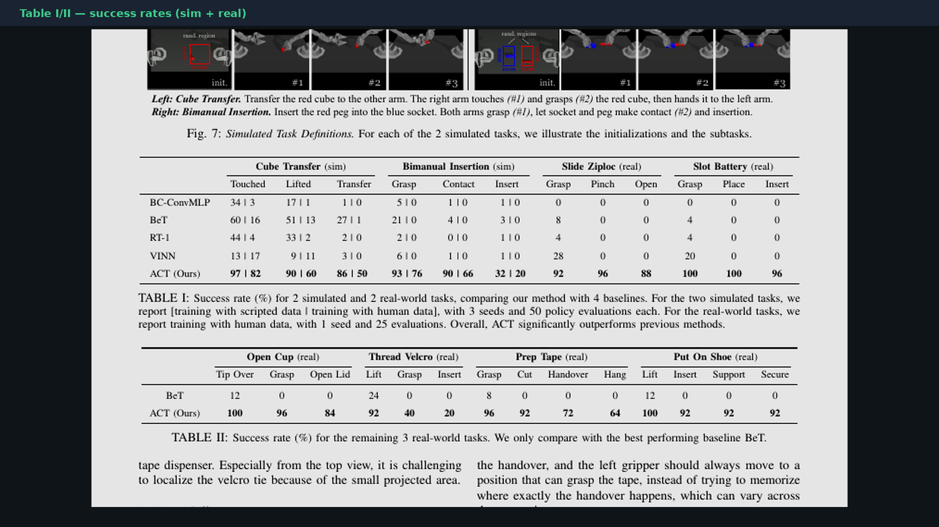
Empiricist · 11+3 · 12/14
Notes:
PAPER TABLES — real/sim success context.
Scout does NOT need to match these; they set the ambition ceiling and show CVAE/human difficulty.

Slide 13
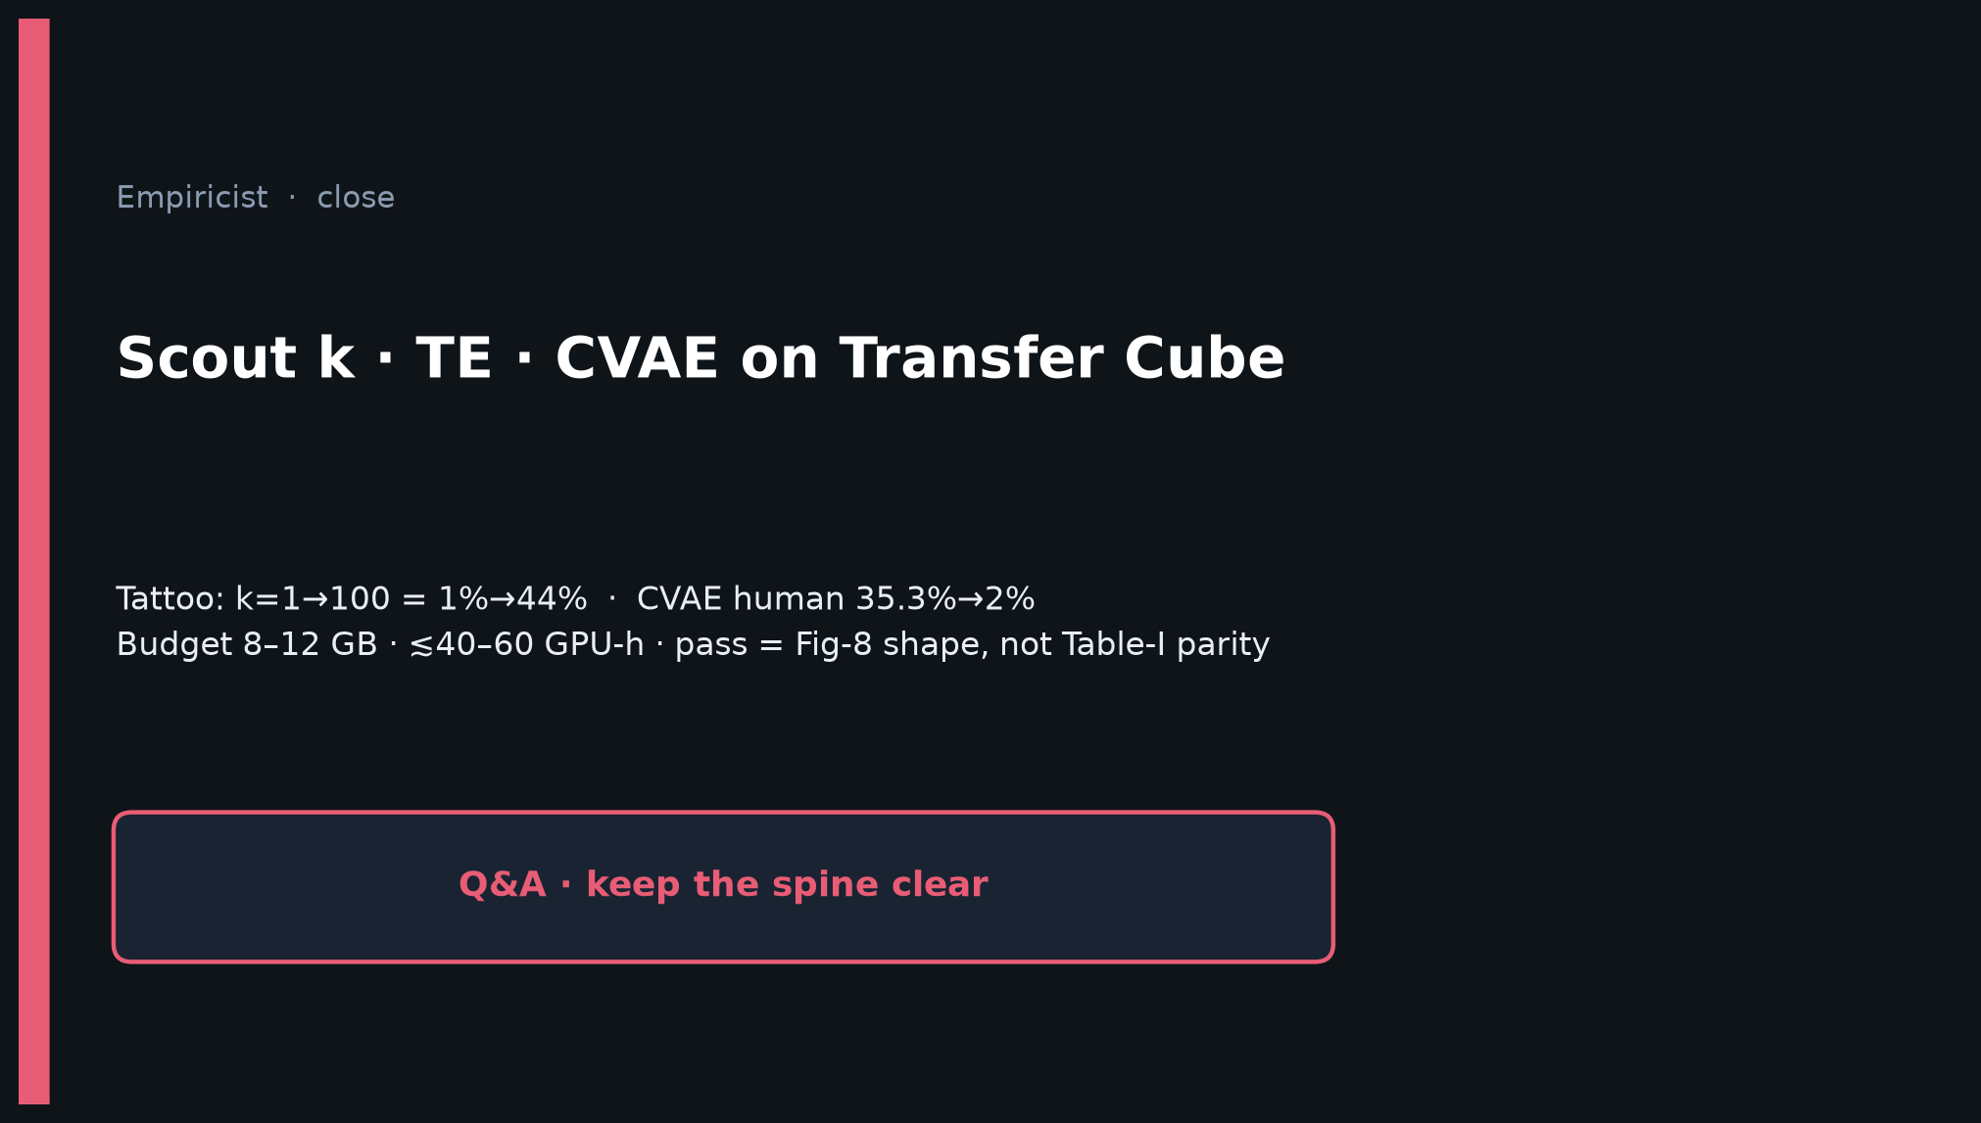
Empiricist · 11+3 · 13/14
Notes:
CLOSE: Scout k · TE · CVAE on Transfer Cube.
Hand qualitative curves to Archaeologist for Sec VI narrative.
Pass = Fig-8 shape, not Table-I parity.

Slide 14
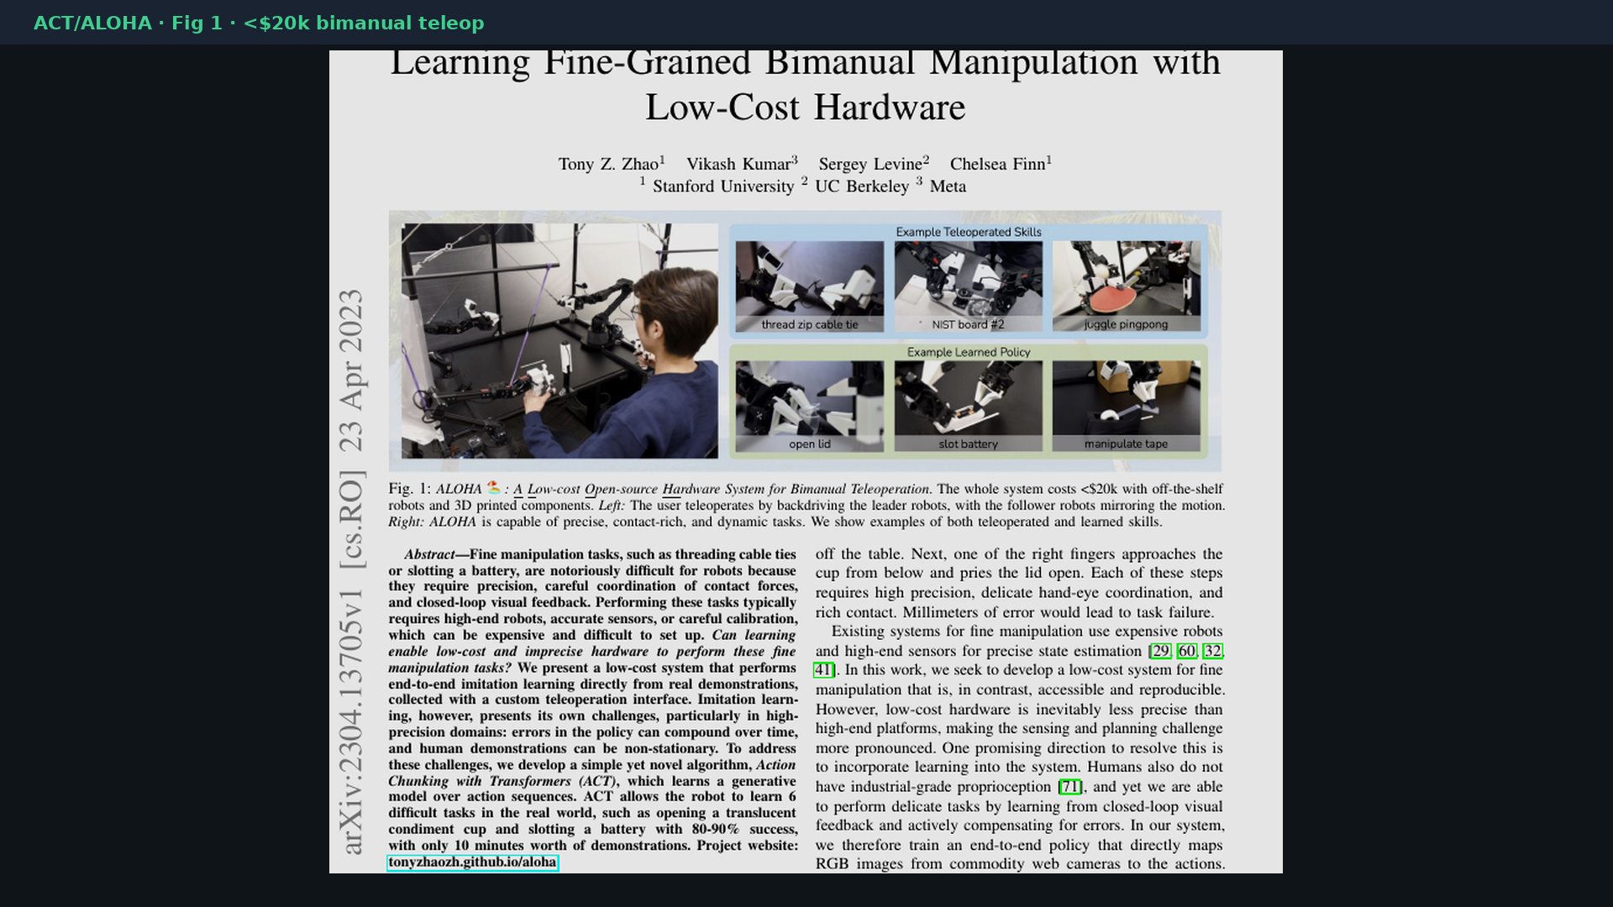
Empiricist · 11+3 · 14/14
Notes:
BACKUP cover.

