Slide 1
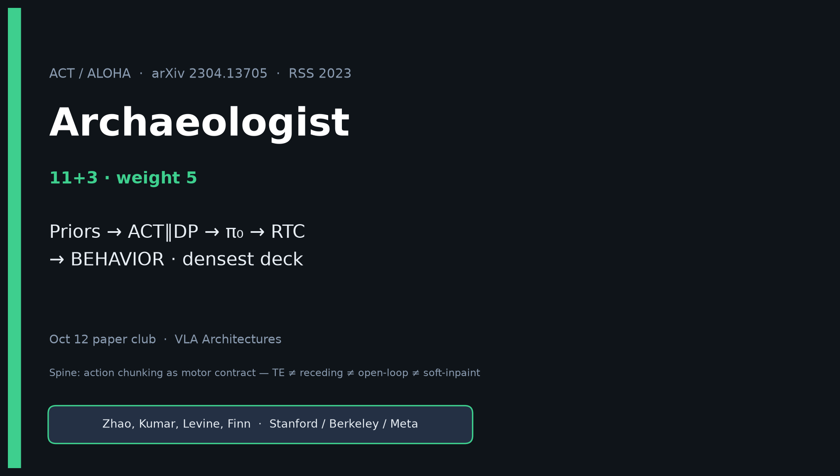
Archaeologist · 11+3 · 1/14
Notes:
ARCHAEOLOGIST — weight 5 · densest deck · timing 11+3.
ONE SENTENCE for the room:
ACT/ALOHA popularized action chunking + temporal ensembling for high-Hz visuomotor BC on open low-cost bimanual hardware — twin 2023 ancestor with Diffusion Policy.
CLEAR spine you will repeat:
TE ≠ DP receding ≠ π₀ open-loop ≠ RTC soft-inpaint ≠ BEHAVIOR 30/26/4.
Chunking is shared; execution dialects differ.
Genealogy one-liner:
ALOHA+ACT (CVAE+TE) ∥ DP → Mobile/ALOHA2 → π₀/π₀.₅ → RTC → BEHAVIOR’25/’26.
Do NOT claim DP invented ACT or vice versa (parallel).
Do NOT claim BEHAVIOR trains ACT/CVAE.

Slide 2
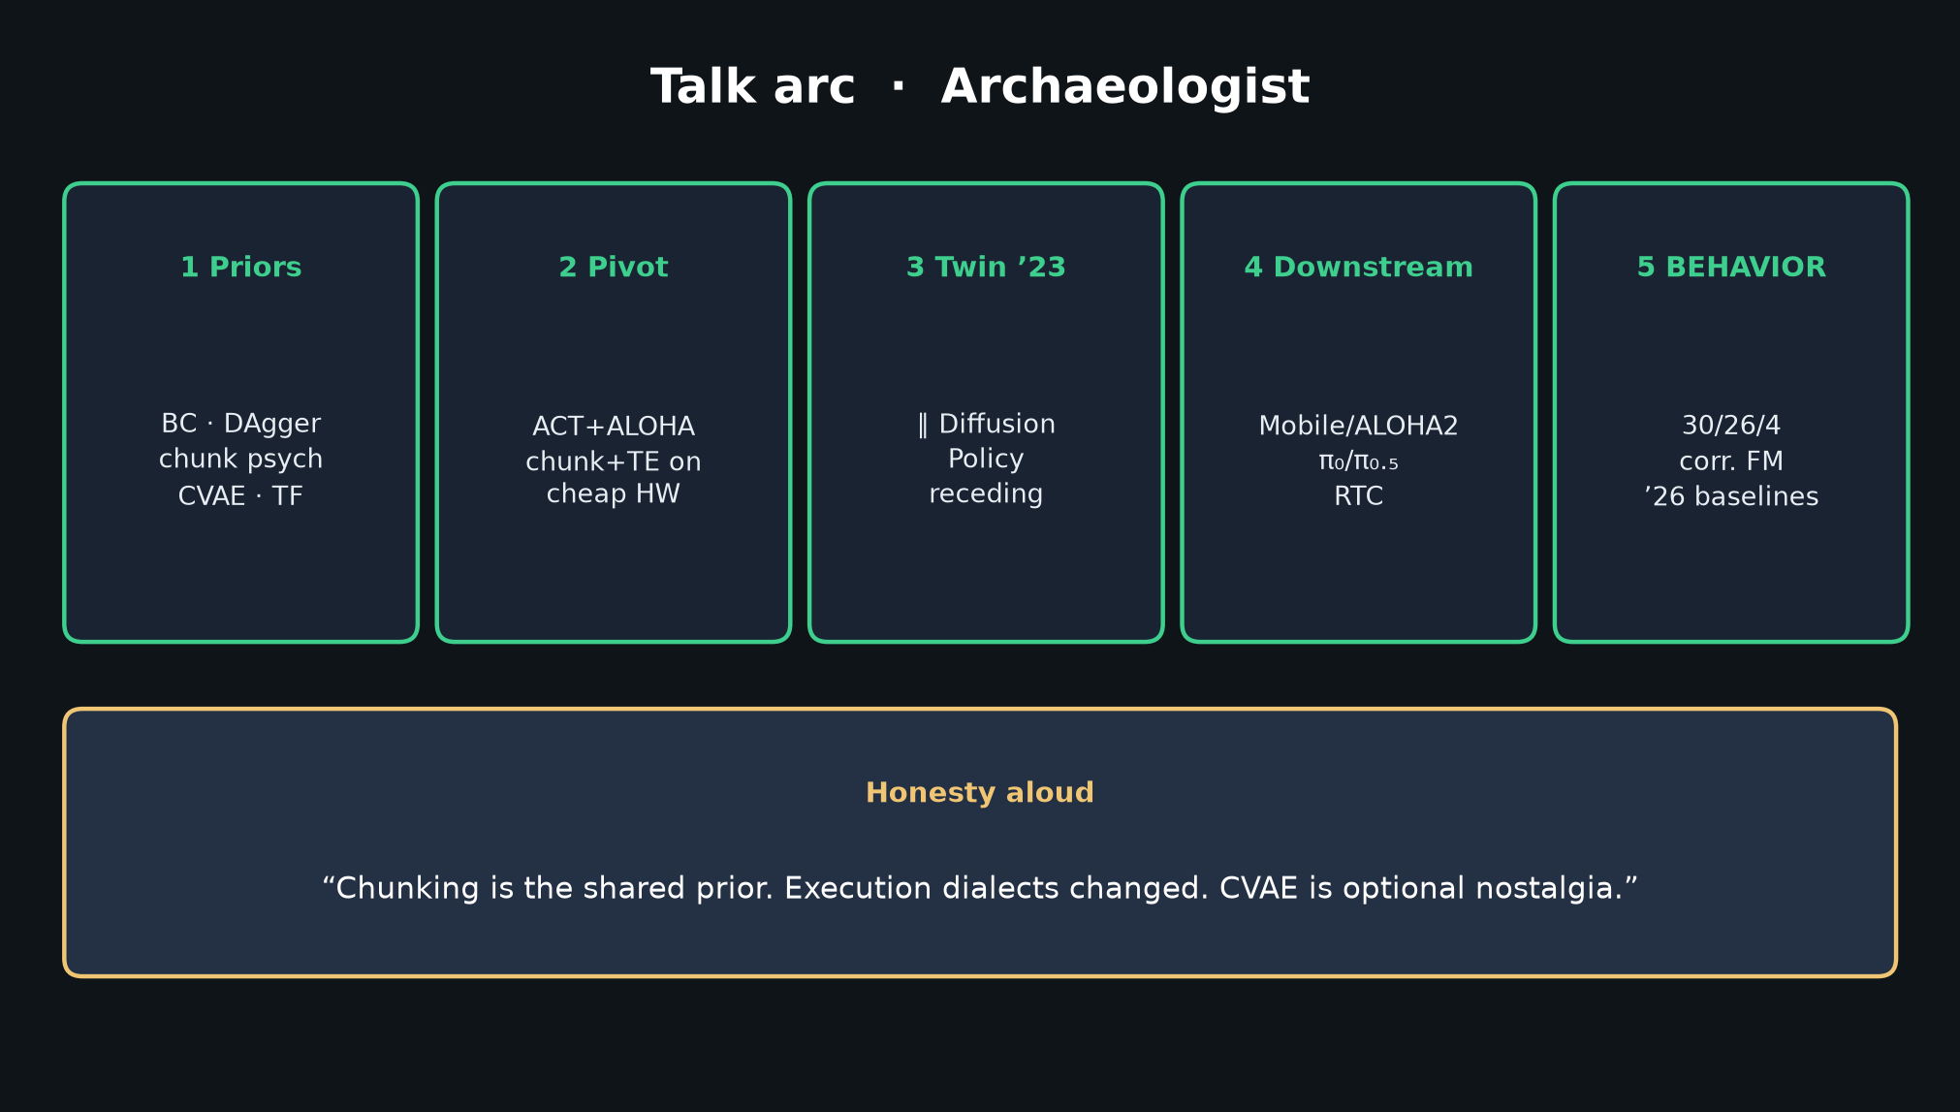
Archaeologist · 11+3 · 2/14
Notes:
TALK ARC — deliver early so the room knows the path.
1) Priors: BC/ALVINN, DAgger compounding, Lai chunk psych, Transformers/BERT, CVAE/β-VAE, BeT/RT-1/VINN, joint teleop, ResNet.
2) Pivot: chunking+TE on cheap bimanual HW.
3) Twin 2023: ∥ Diffusion Policy (diffusion + receding).
4) Downstream: Mobile ALOHA / ALOHA 2 → π₀/π₀.₅ (FM, often no TE) → RTC.
5) BEHAVIOR’25/’26: 30/26/keep4 + correlated FM.
Honesty aloud: “Chunking is the shared prior. Execution dialects changed. CVAE is optional nostalgia.”

Slide 3
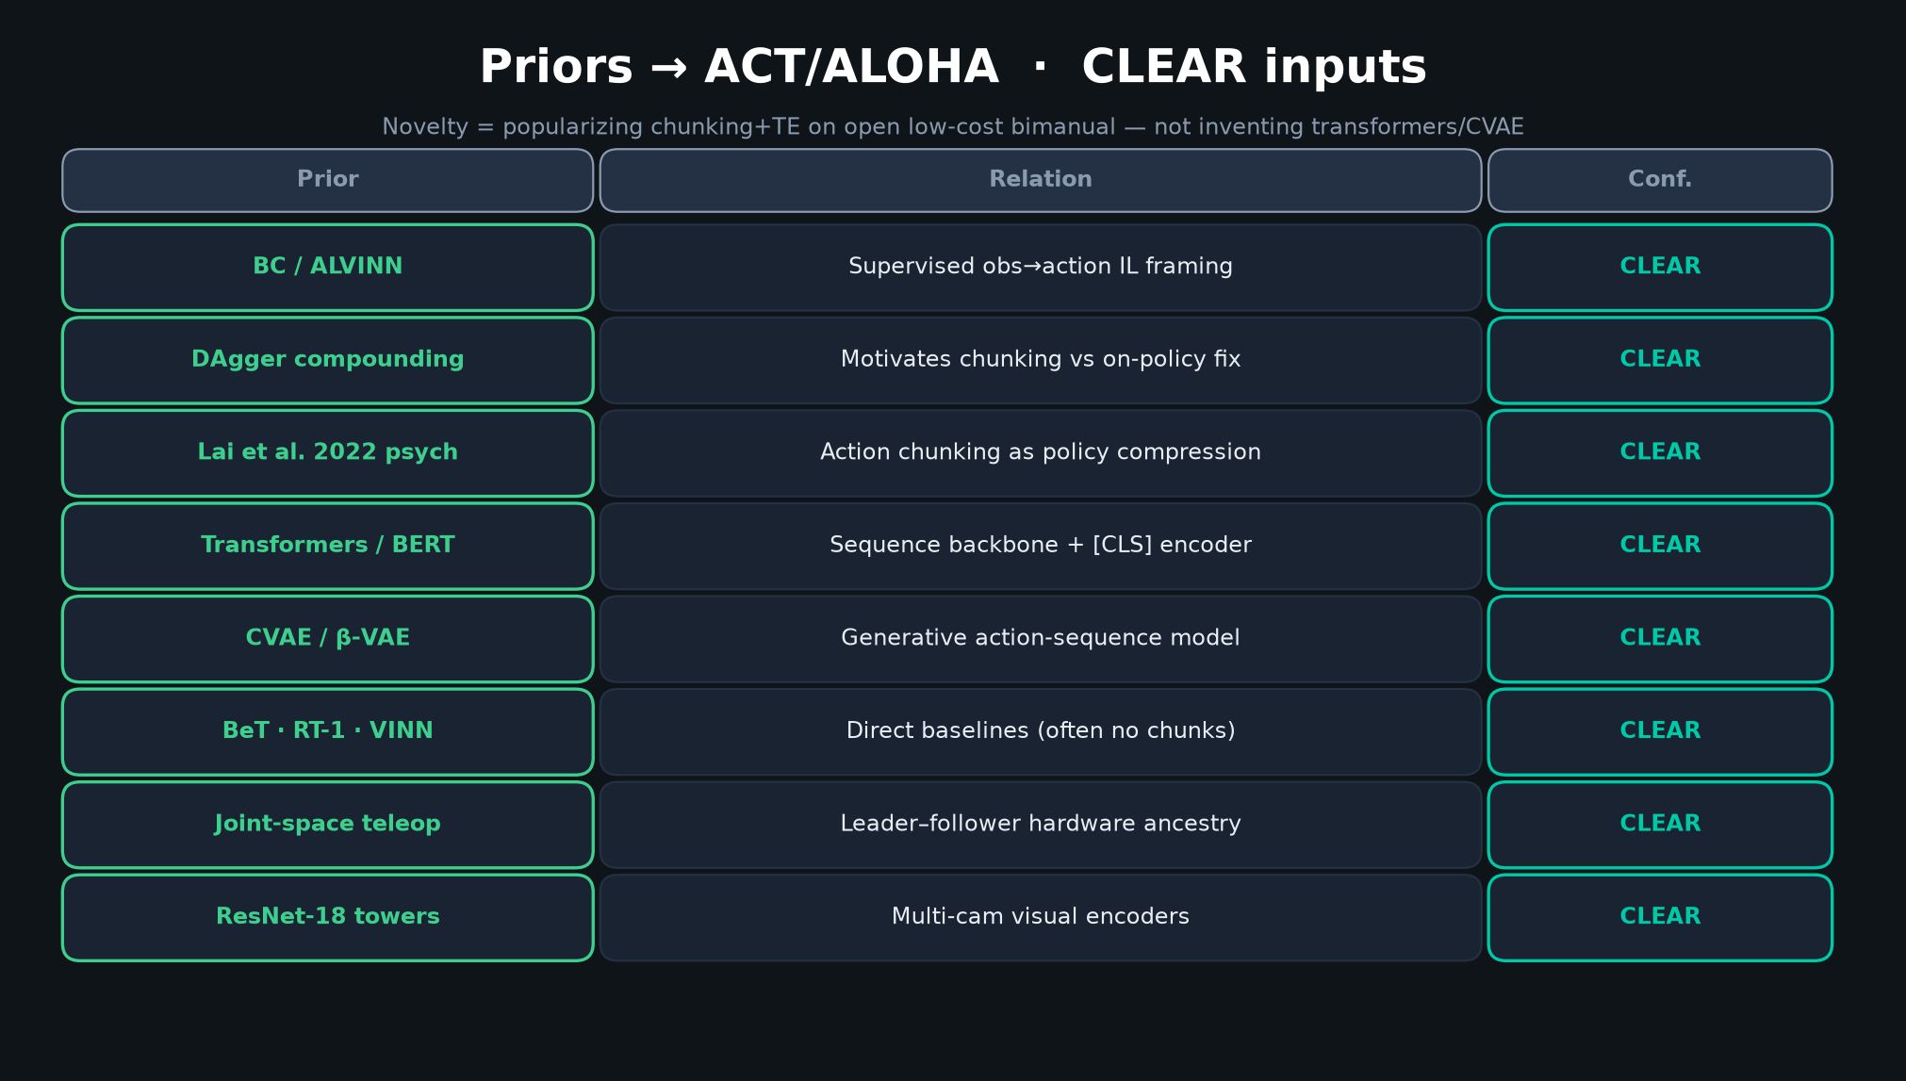
Archaeologist · 11+3 · 3/14
Notes:
PRIORS TABLE — densest slide. Do NOT read every row. Speak the FOILS.
Must-hit:
• DAgger compounding → motivates chunking as alternative to on-policy corrections.
• Lai et al. 2022 psychology → conceptual inspiration for k-step units.
• CVAE/β-VAE + Transformers/BERT → generative sequence backbone.
• BeT/RT-1/VINN → baselines often without chunks in main tables.
Say: “Priors are IL + generative + teleop. Novelty is popularizing chunk+TE on open low-cost bimanual — not inventing transformers.”

Slide 4
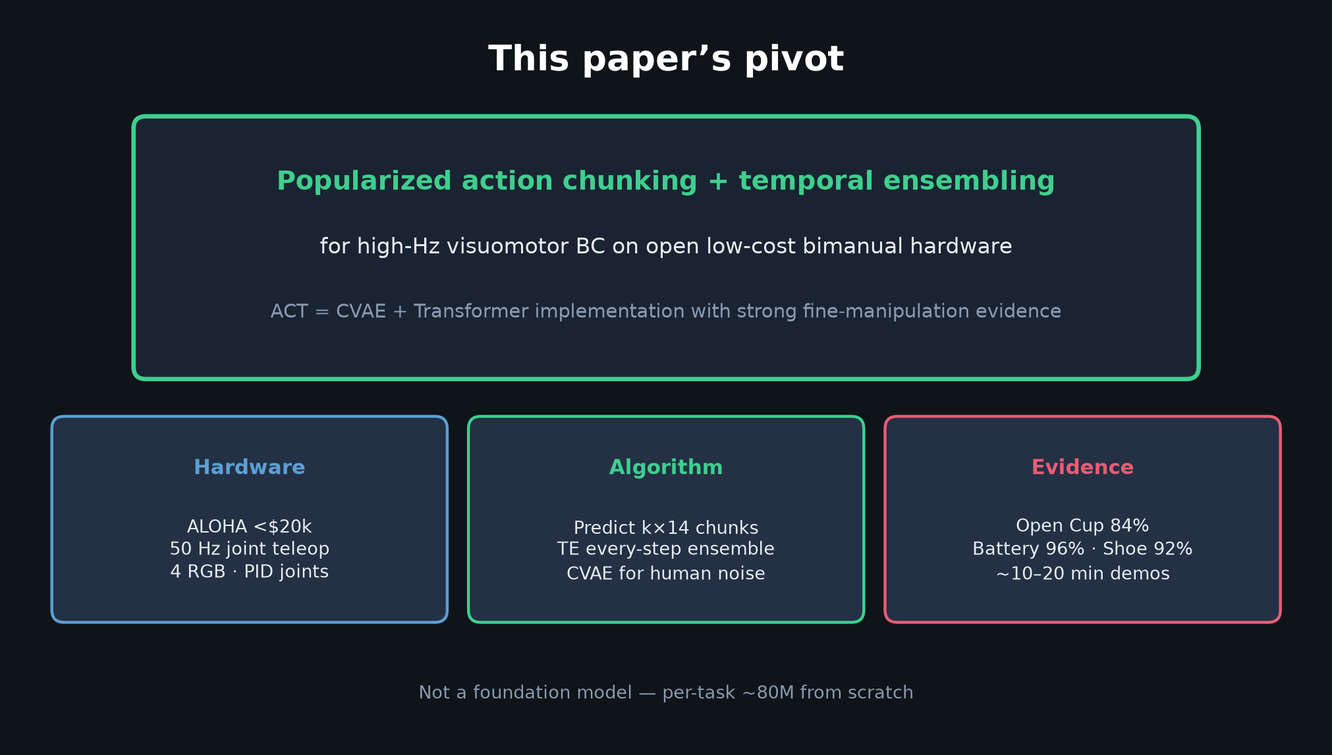
Archaeologist · 11+3 · 4/14
Notes:
PIVOT — this paper’s contribution in one card.
Popularized action chunking + temporal ensembling for high-Hz visuomotor BC on open low-cost bimanual hardware.
ACT = CVAE + Transformer with strong fine-manipulation evidence (Cup 84, Battery 96, Shoe 92…).
Not a foundation model — per-task ~80M from scratch.

Slide 5
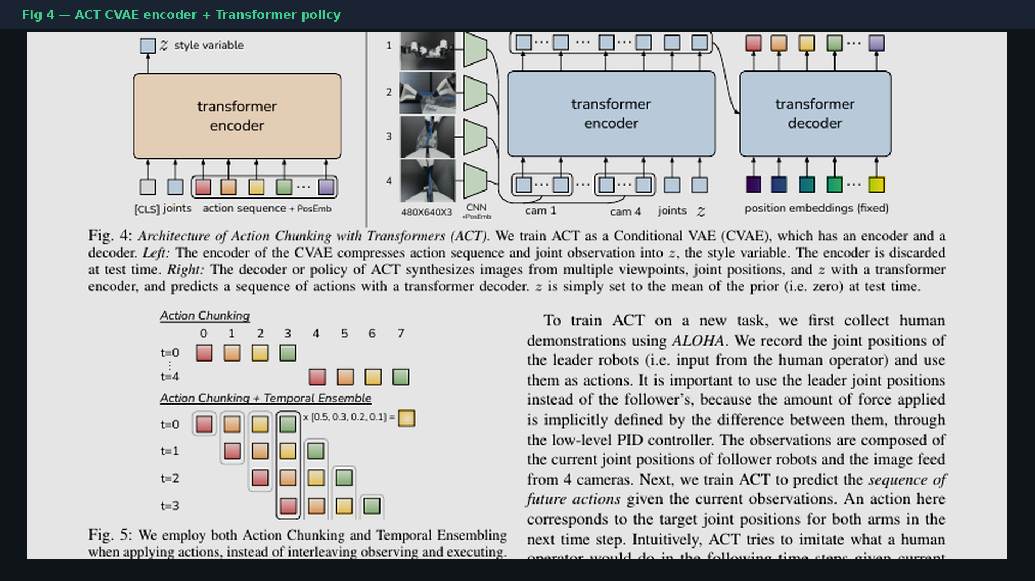
Archaeologist · 11+3 · 5/14
Notes:
PAPER FIG 4 — canonical ACT architecture.
CVAE encoder (train only) → style z; policy decoder ResNet×4 + Transformer enc/dec → k×14 absolute joints.
Test: z=0. Point at this when someone asks “what is ACT exactly?”

Slide 6
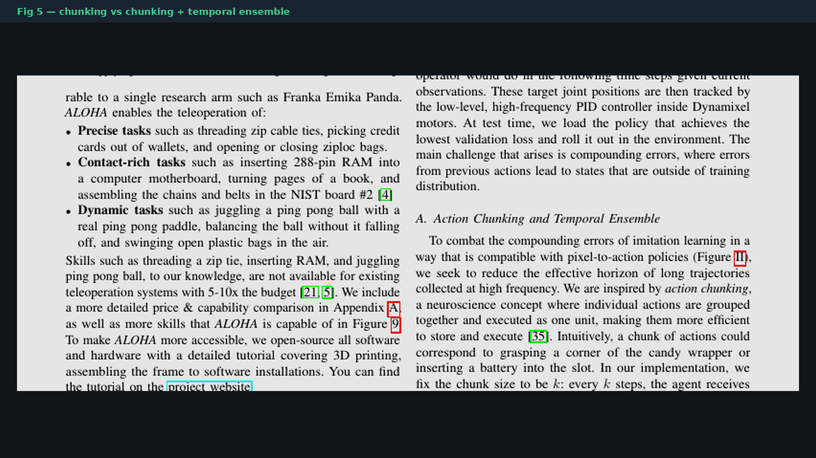
Archaeologist · 11+3 · 6/14
Notes:
PAPER FIG 5 — chunking vs TE schematic. THE motion FLAG diagram from the paper.
Top: naïve open-loop every k. Bottom: every-step query + exp-weighted same-t fusion.
This is ACT’s dialect — not DP receding.

Slide 7
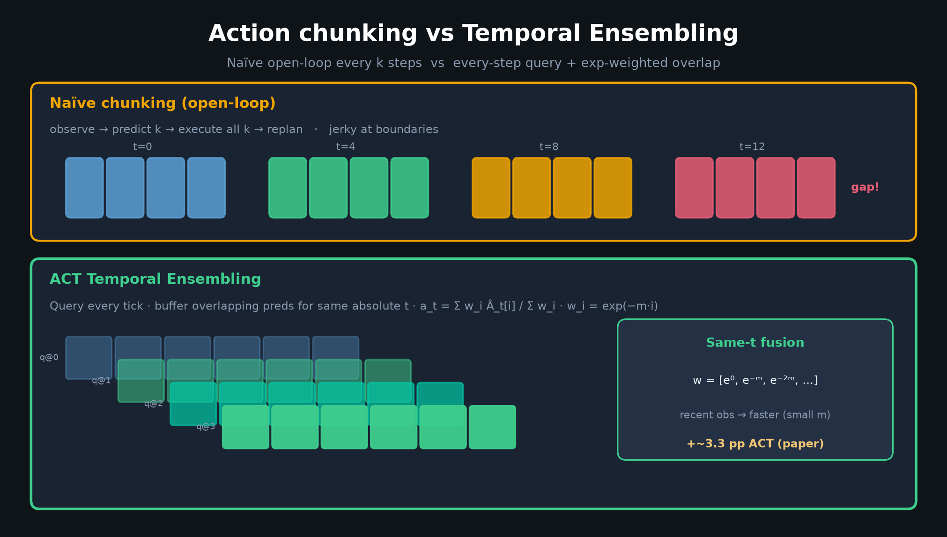
Archaeologist · 11+3 · 7/14
Notes:
TE DIAGRAM (our redraw) — reinforce same-t fusion vs adjacent-time smoothing.
w_i = exp(−m·i). Extra inference cost only. Paper: ACT +3.3 pp; VINN hurt.
Bridge: later stacks often replace TE with receding / soft-inpaint.

Slide 8
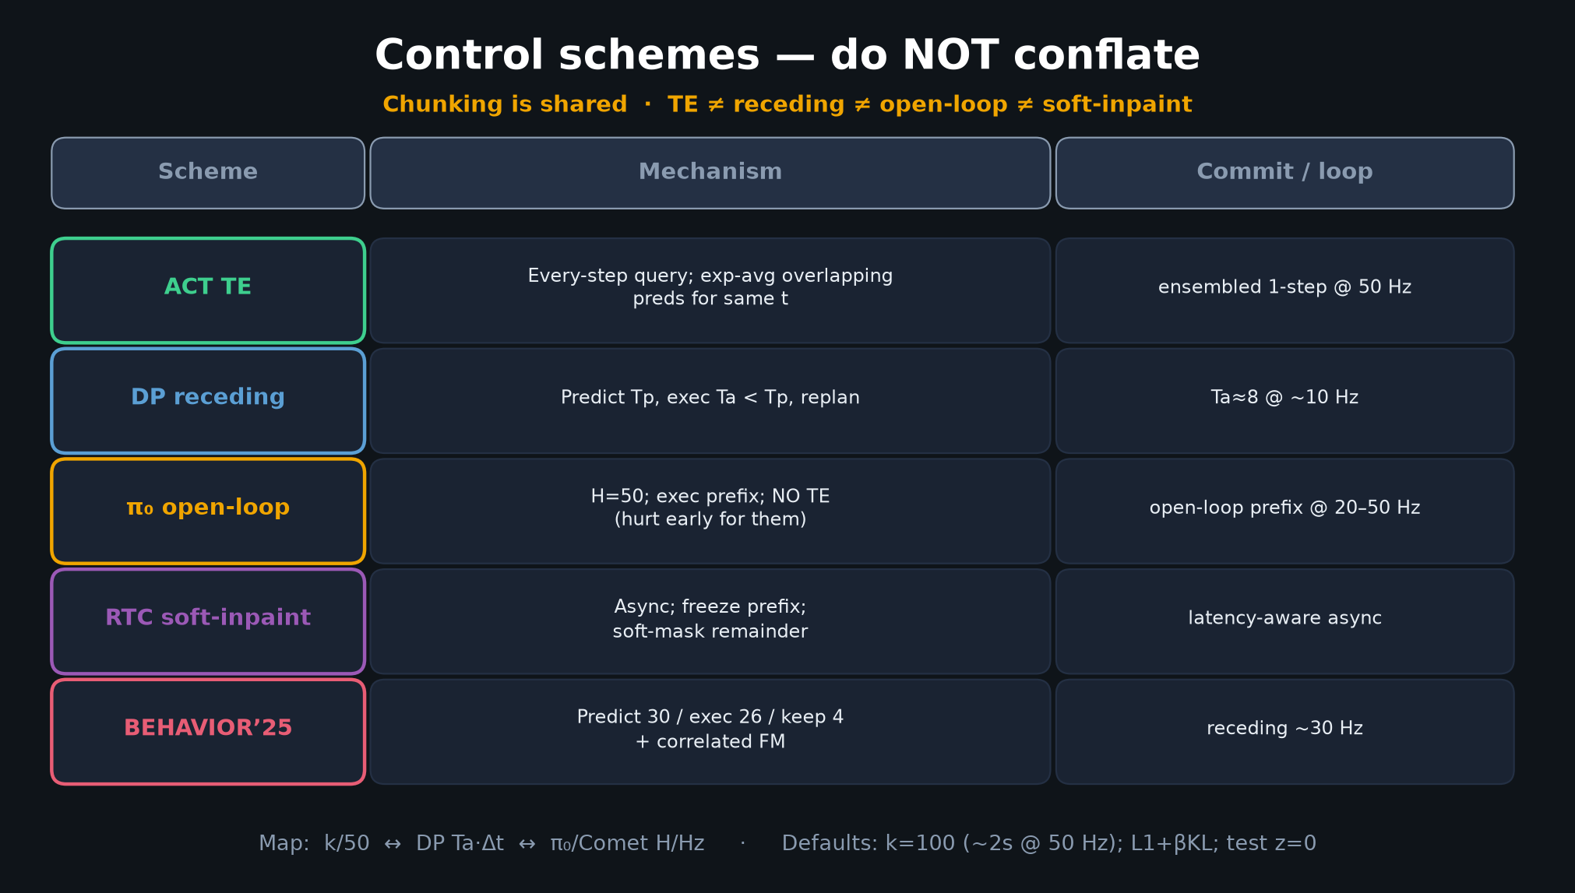
Archaeologist · 11+3 · 8/14
Notes:
FIVE-WAY CONTROL TABLE — MUST HIT. Do not conflate.
| ACT TE | every-step query; exp-avg overlapping preds for same t |
| DP receding | Predict Tp, exec Ta<Tp, replan |
| π₀ open-loop | H=50; exec prefix; NO TE (hurt early for them) |
| RTC soft-inpaint | Async; freeze prefix; soft-mask remainder |
| BEHAVIOR’25 | Predict 30 / exec 26 / keep 4 + correlated FM |
CLEAR: chunking shared; TE ≠ receding ≠ open-loop ≠ soft-inpaint.
Map: k/50 ↔ DP Ta·Δt ↔ π₀/Comet H/Hz.

Slide 9
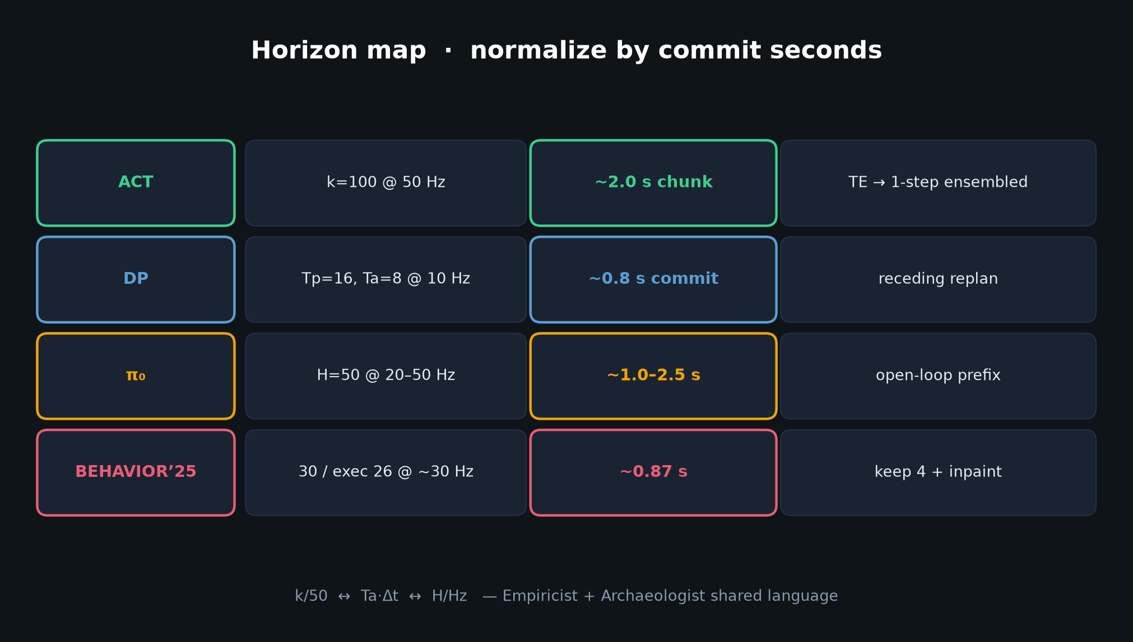
Archaeologist · 11+3 · 9/14
Notes:
HORIZON MAP — normalize by commit_seconds.
ACT k=100@50Hz ≈ 2s chunk with TE 1-step ensembled commit.
DP Ta≈8@10Hz ≈ 0.8s. π₀ H=50 open-loop prefix. BEHAVIOR 30/26/4.
This is the shared language with Empiricist.

Slide 10
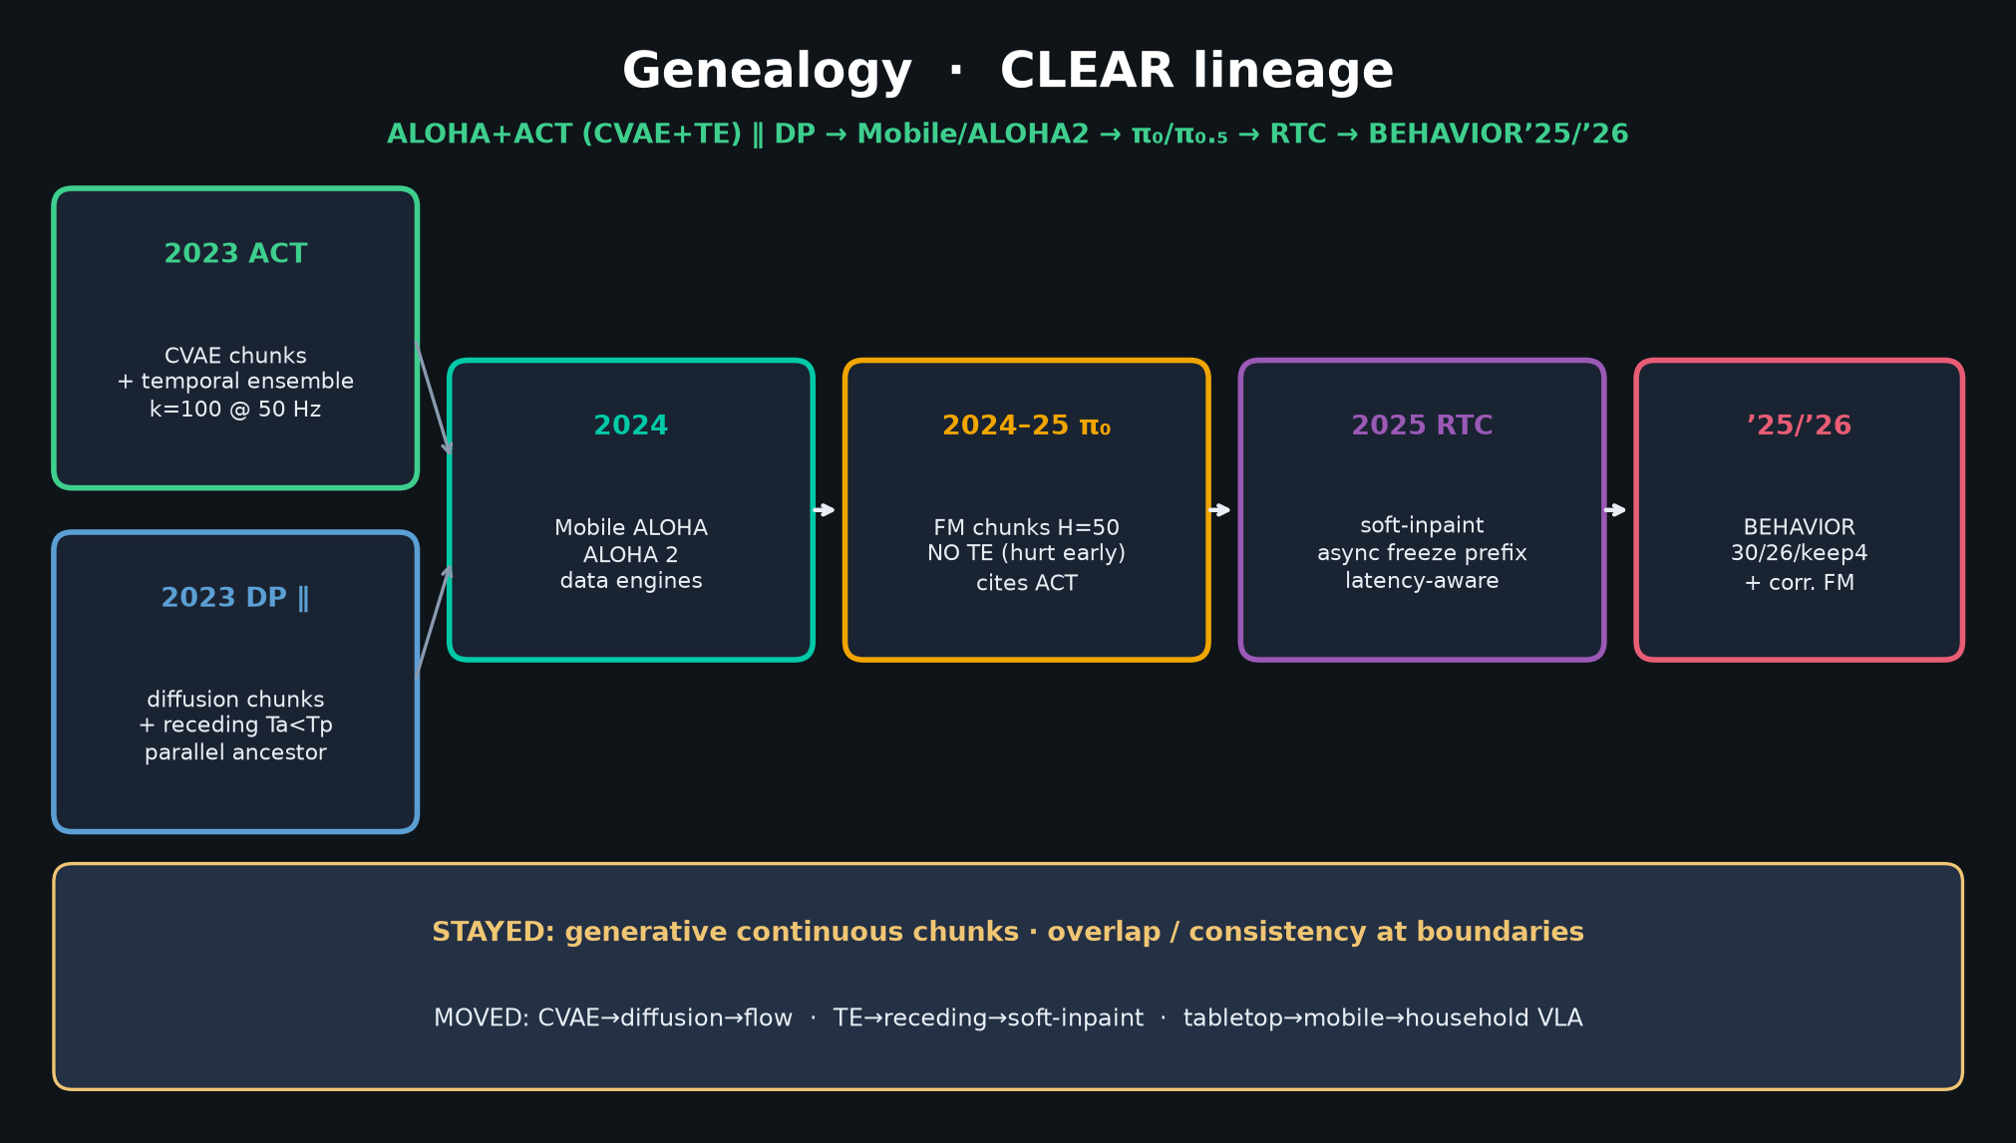
Archaeologist · 11+3 · 10/14
Notes:
GENEALOGY TIMELINE — payoff slide. CLEAR citations.
2023 ACT: CVAE chunks + TE
2023 DP ∥: diffusion + receding (parallel)
2024 Mobile ALOHA / ALOHA 2: data engines
2024–25 π₀/π₀.₅: FM chunks; cites ACT; often no TE
2025 RTC: soft-inpaint async
2025/26 BEHAVIOR: 30/26/keep4 + corr FM
STAYED: generative continuous chunks + overlap need.
MOVED: CVAE→diff→FM; TE→receding→soft-inpaint.

Slide 11
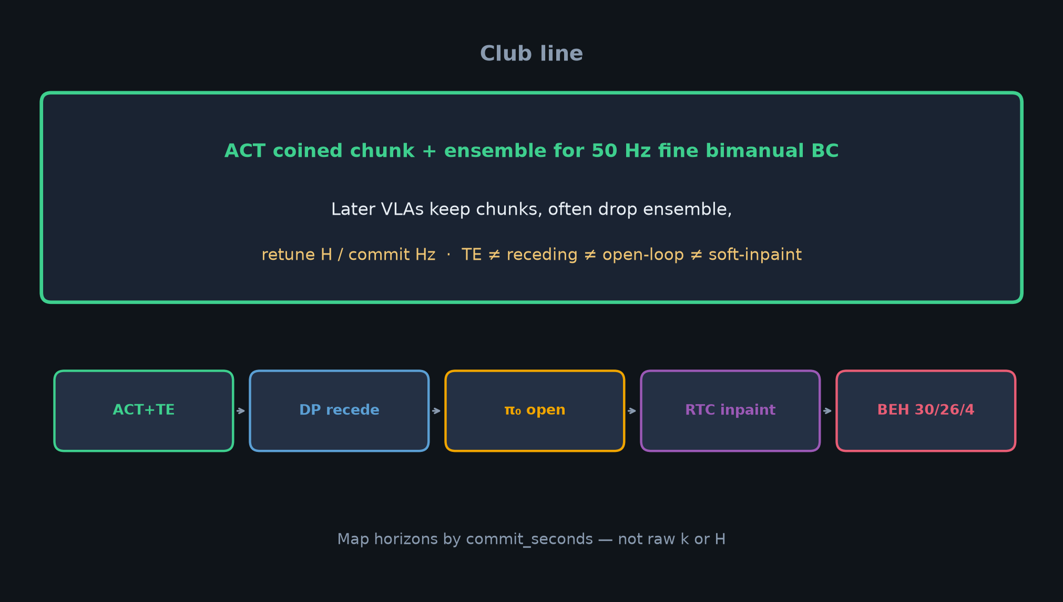
Archaeologist · 11+3 · 11/14
Notes:
CLUB LINE — sentence people leave with.
ACT coined chunk+ensemble for 50Hz fine bimanual BC.
Later VLAs keep chunks, often drop ensemble, retune H/commit Hz.
If Empiricist talks k-sweeps — this is why those knobs still matter in 2026.

Slide 12
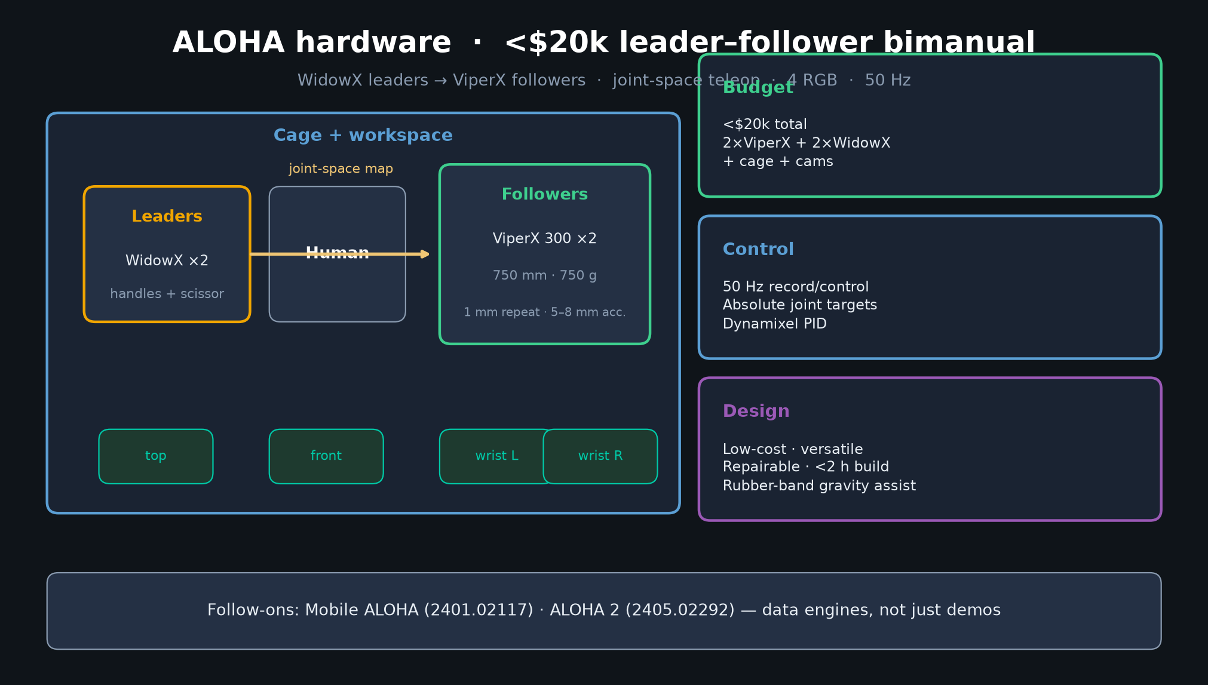
Archaeologist · 11+3 · 12/14
Notes:
ALOHA HARDWARE — cheap data engine ancestry.
<$20k, WidowX→ViperX, joint-space, 4 cams, 50Hz.
Follow-ons Mobile ALOHA / ALOHA 2 continue the hardware fork.

Slide 13
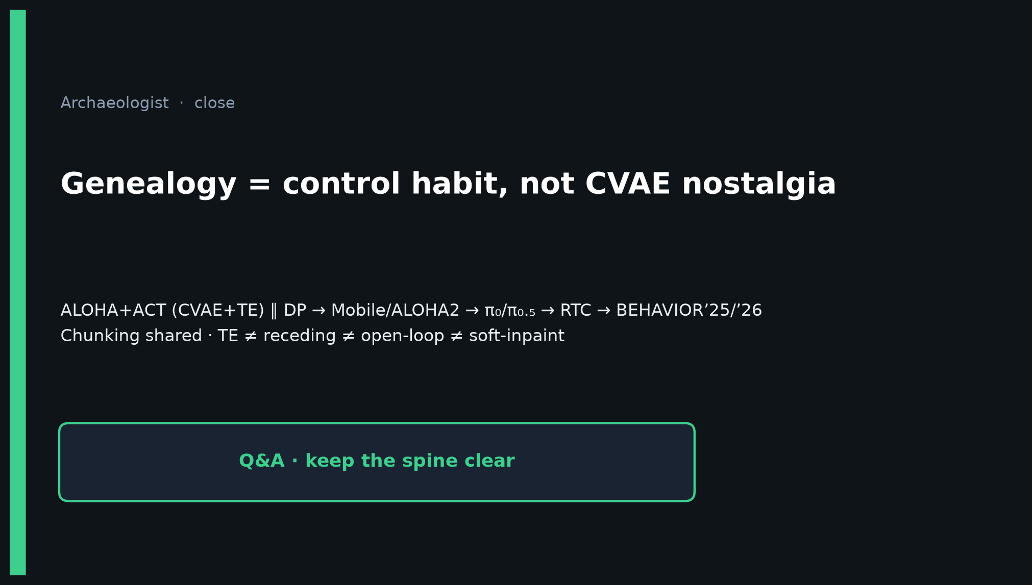
Archaeologist · 11+3 · 13/14
Notes:
Q&A CLOSE.
• “Is TE the same as DP receding?” → No; five-way table.
• “Did π₀ keep TE?” → No; hurt early; open-loop prefix.
• “Did BEHAVIOR use ACT?” → No; inherited chunk habit on Pi0.5 + soft-inpaint.
• “What to cite ACT for in 2026?” → Action chunking + low-cost bimanual teleop — control prior, not FM.
Leave on: Chunking shared · dialects differ · CVAE optional.

Slide 14
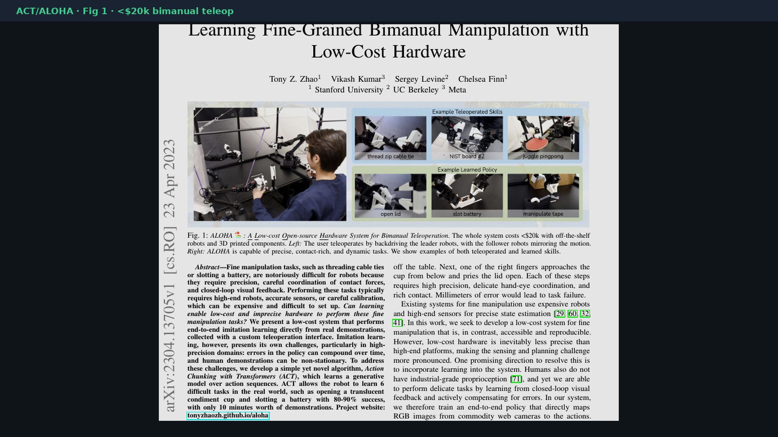
Archaeologist · 11+3 · 14/14
Notes:
BACKUP — paper cover / Fig 1 for bibliography or hardware vibe.

