Slide 1
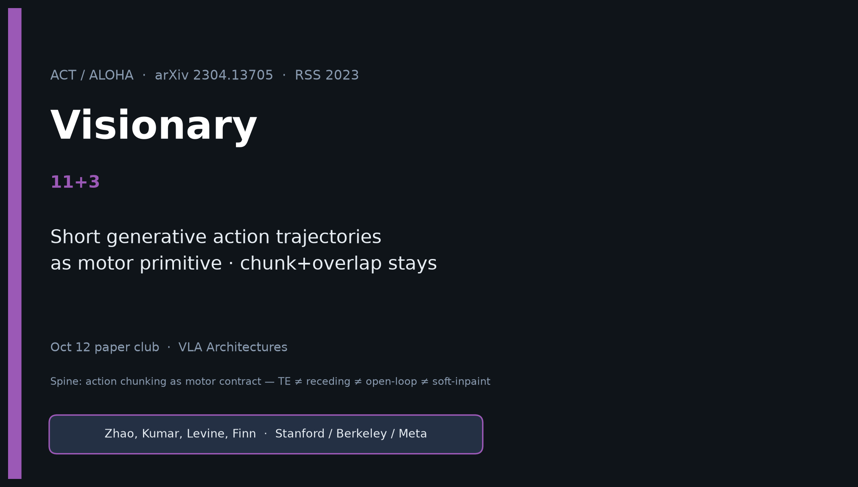
Visionary · 11+3 · 1/12
Notes:
VISIONARY — 11+3.
NO Discord / Drive digressions. Stay on 2026 BEHAVIOR control bets.
Durable idea: short generative action trajectories as motor primitive; chunk+overlap stays while generative family churns.

Slide 2
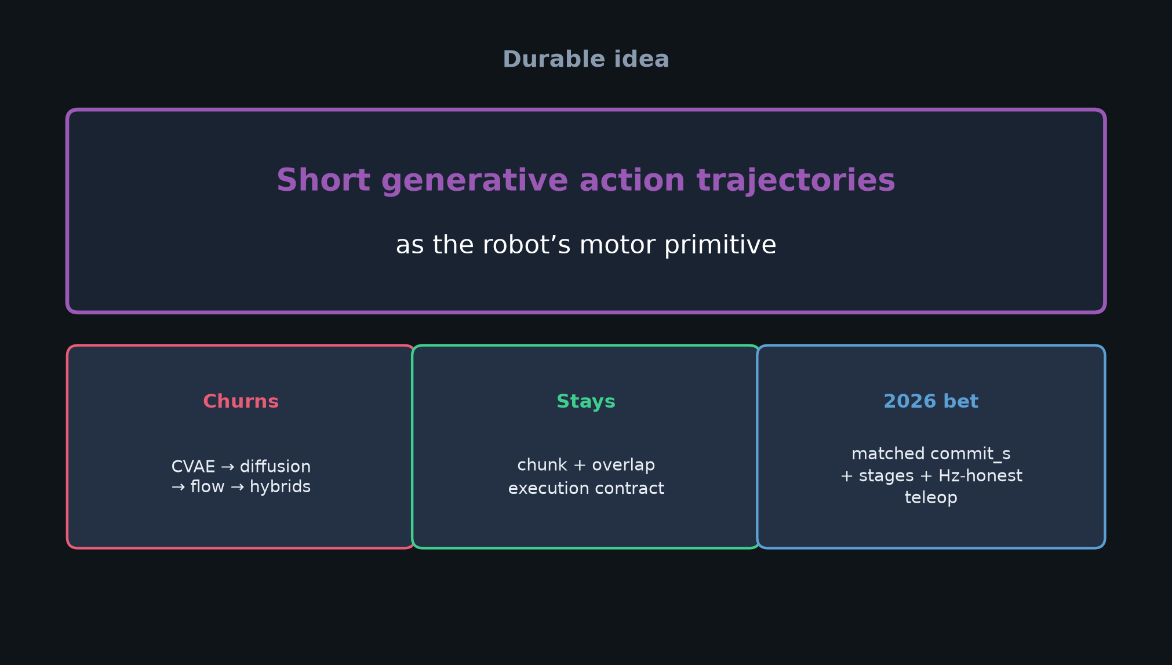
Visionary · 11+3 · 2/12
Notes:
DURABLE IDEA — THE Visionary slide.
Short generative action trajectories as the robot’s motor primitive.
Generative family churns; chunk + overlap execution stays.

Slide 3
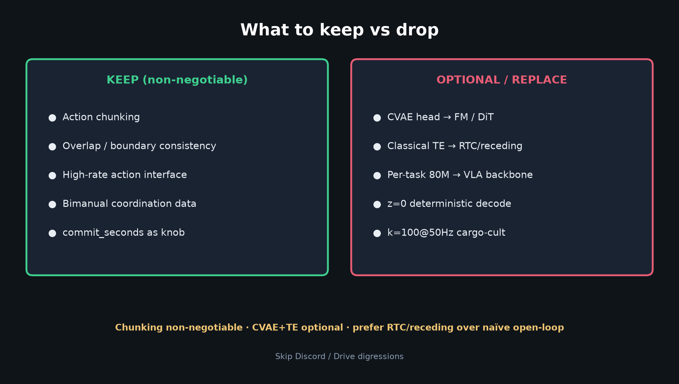
Visionary · 11+3 · 3/12
Notes:
KEEP vs DROP.
Keep: chunking, overlap consistency, high-rate interface, bimanual data, commit_seconds.
Optional/replace: CVAE→FM, TE→RTC/receding, per-task 80M→VLA, z=0, cargo-cult k=100@50Hz.

Slide 4
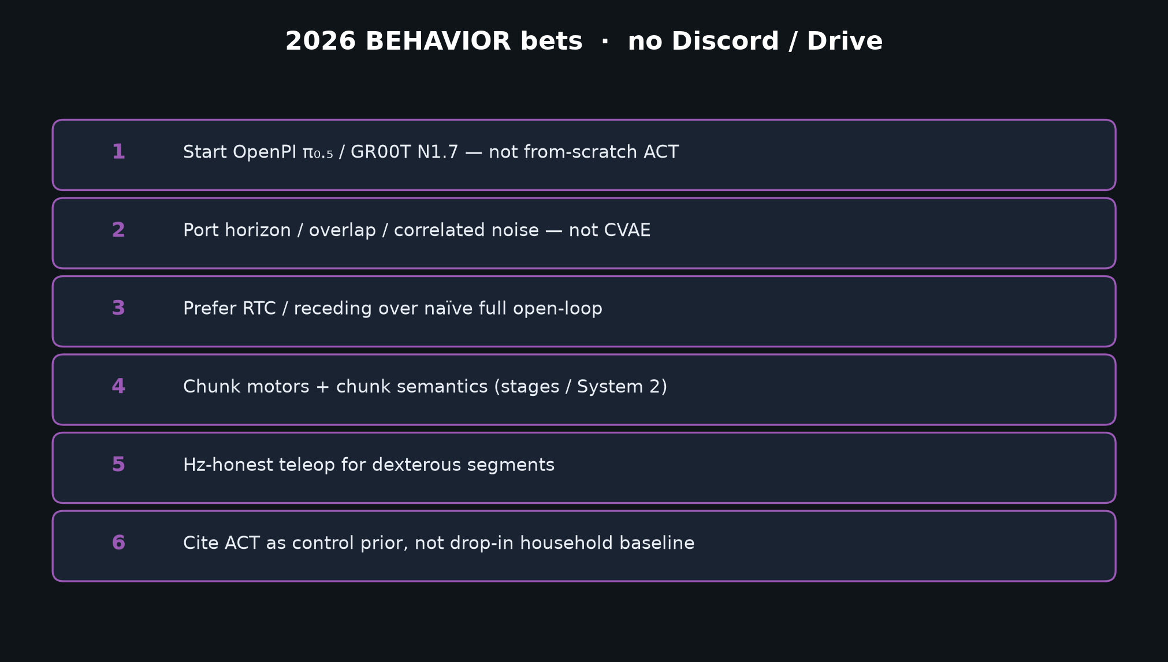
Visionary · 11+3 · 4/12
Notes:
2026 BETS — start OpenPI π₀.₅ / GR00T N1.7; port horizon/overlap/correlated noise — not CVAE.
Prefer RTC/receding over naïve full open-loop. Chunk motors + semantic stages. Hz-honest teleop.
Cite ACT as control prior, not drop-in household baseline.

Slide 5
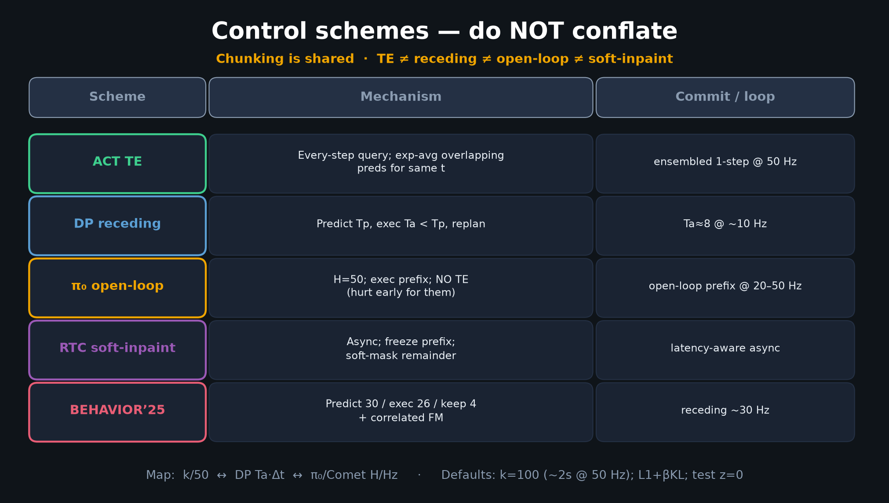
Visionary · 11+3 · 5/12
Notes:
FIVE-WAY TABLE — your deployment dialect menu.
Default Visionary: train chunk generative head; deploy RTC-style soft inpaint (or DP Ta).

Slide 6
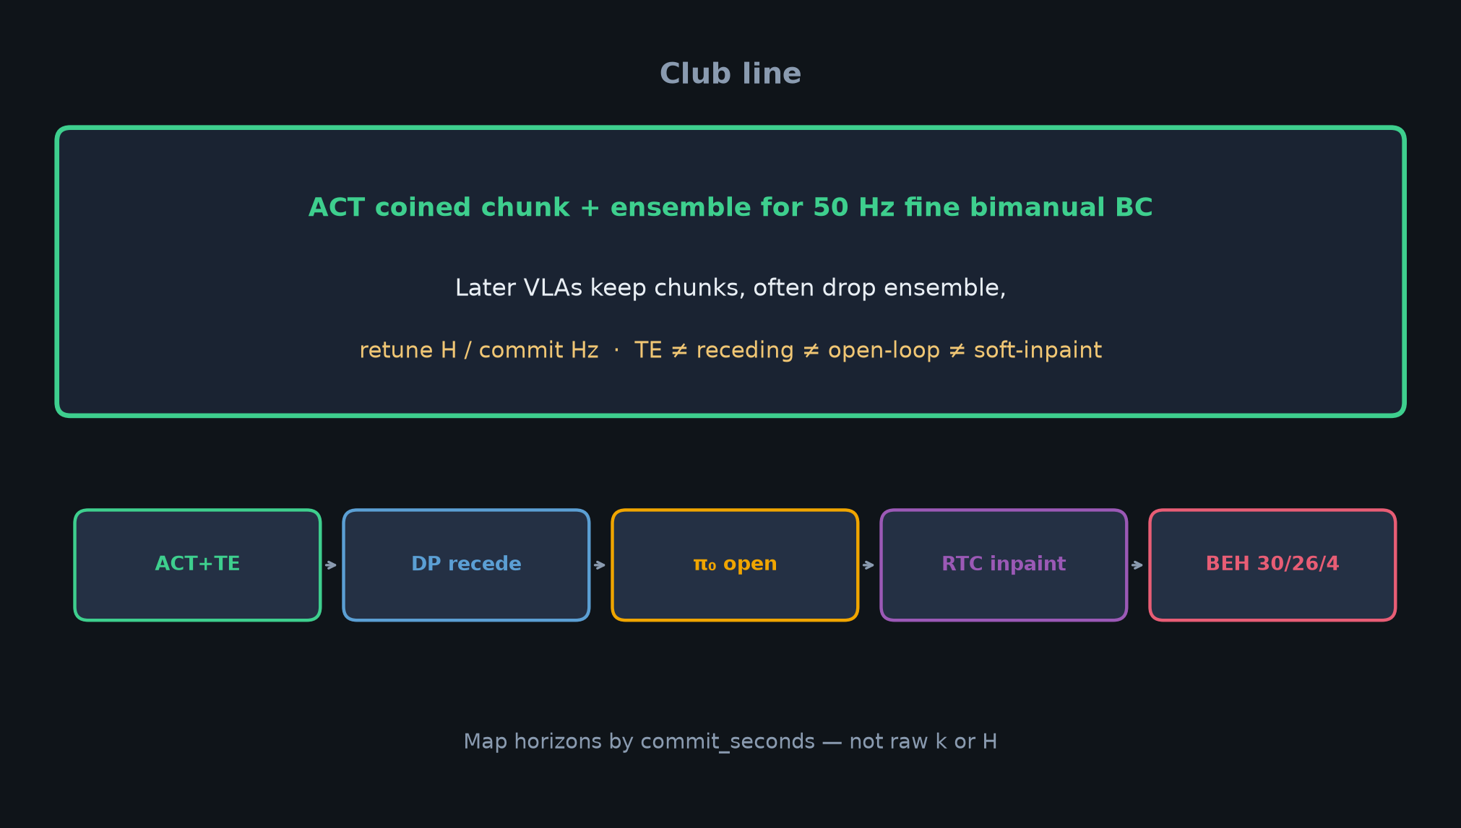
Visionary · 11+3 · 6/12
Notes:
CLUB LINE — inheritance into BEHAVIOR without claiming ACT training.

Slide 7
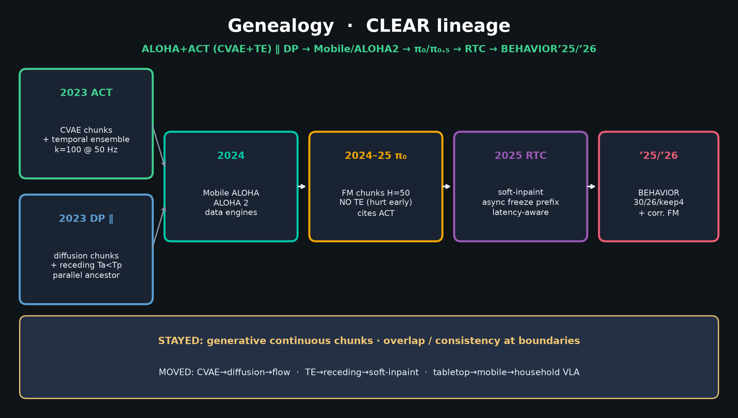
Visionary · 11+3 · 7/12
Notes:
GENEALOGY — where ACT sits; what 2025 proved (chunks inside VLAs; TE mostly abandoned).

Slide 8
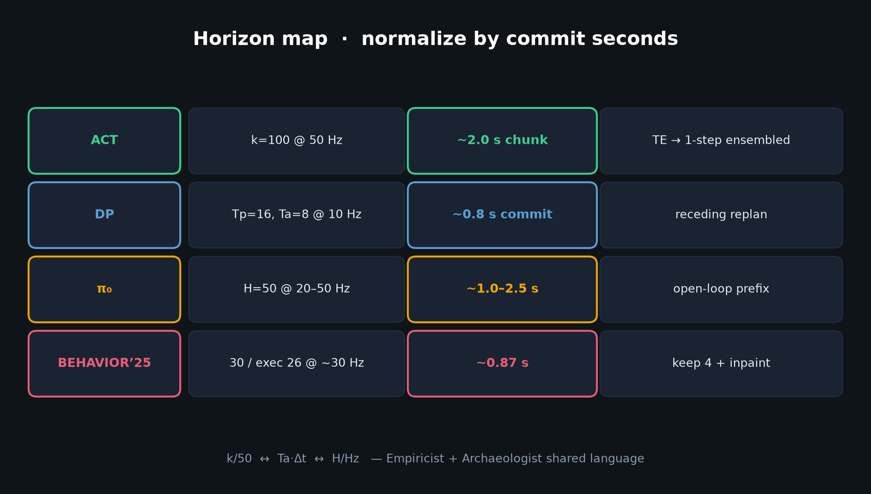
Visionary · 11+3 · 8/12
Notes:
HORIZON MAP — matched commit_seconds bake-off (CVAE vs FM vs DiT) is an Empiricist-sized experiment with Visionary payoff.

Slide 9
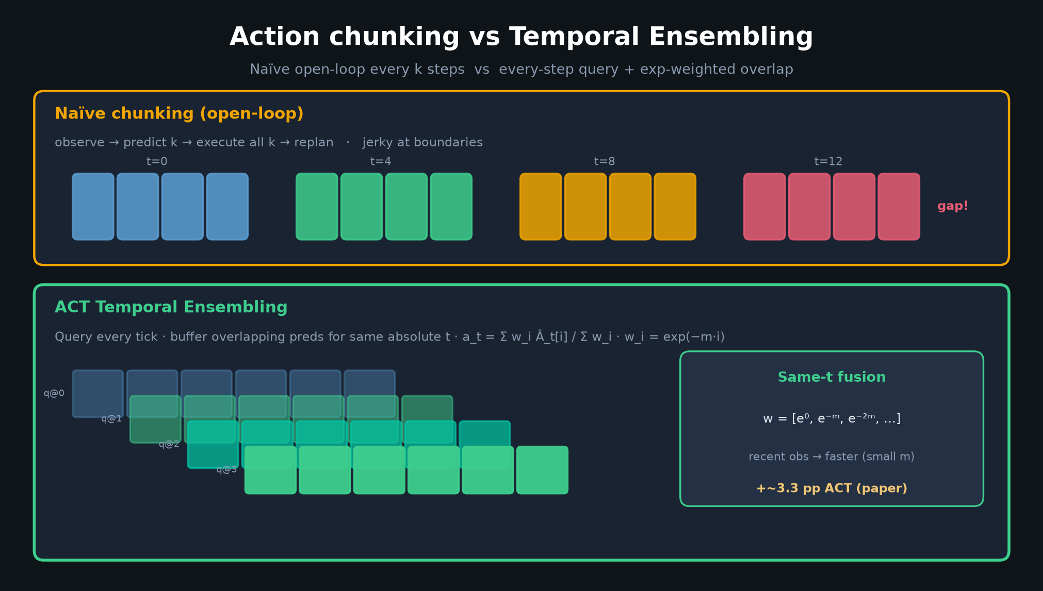
Visionary · 11+3 · 9/12
Notes:
TE redraw — why naïve open-loop dips; why overlap still matters even if classical TE is optional.

Slide 10
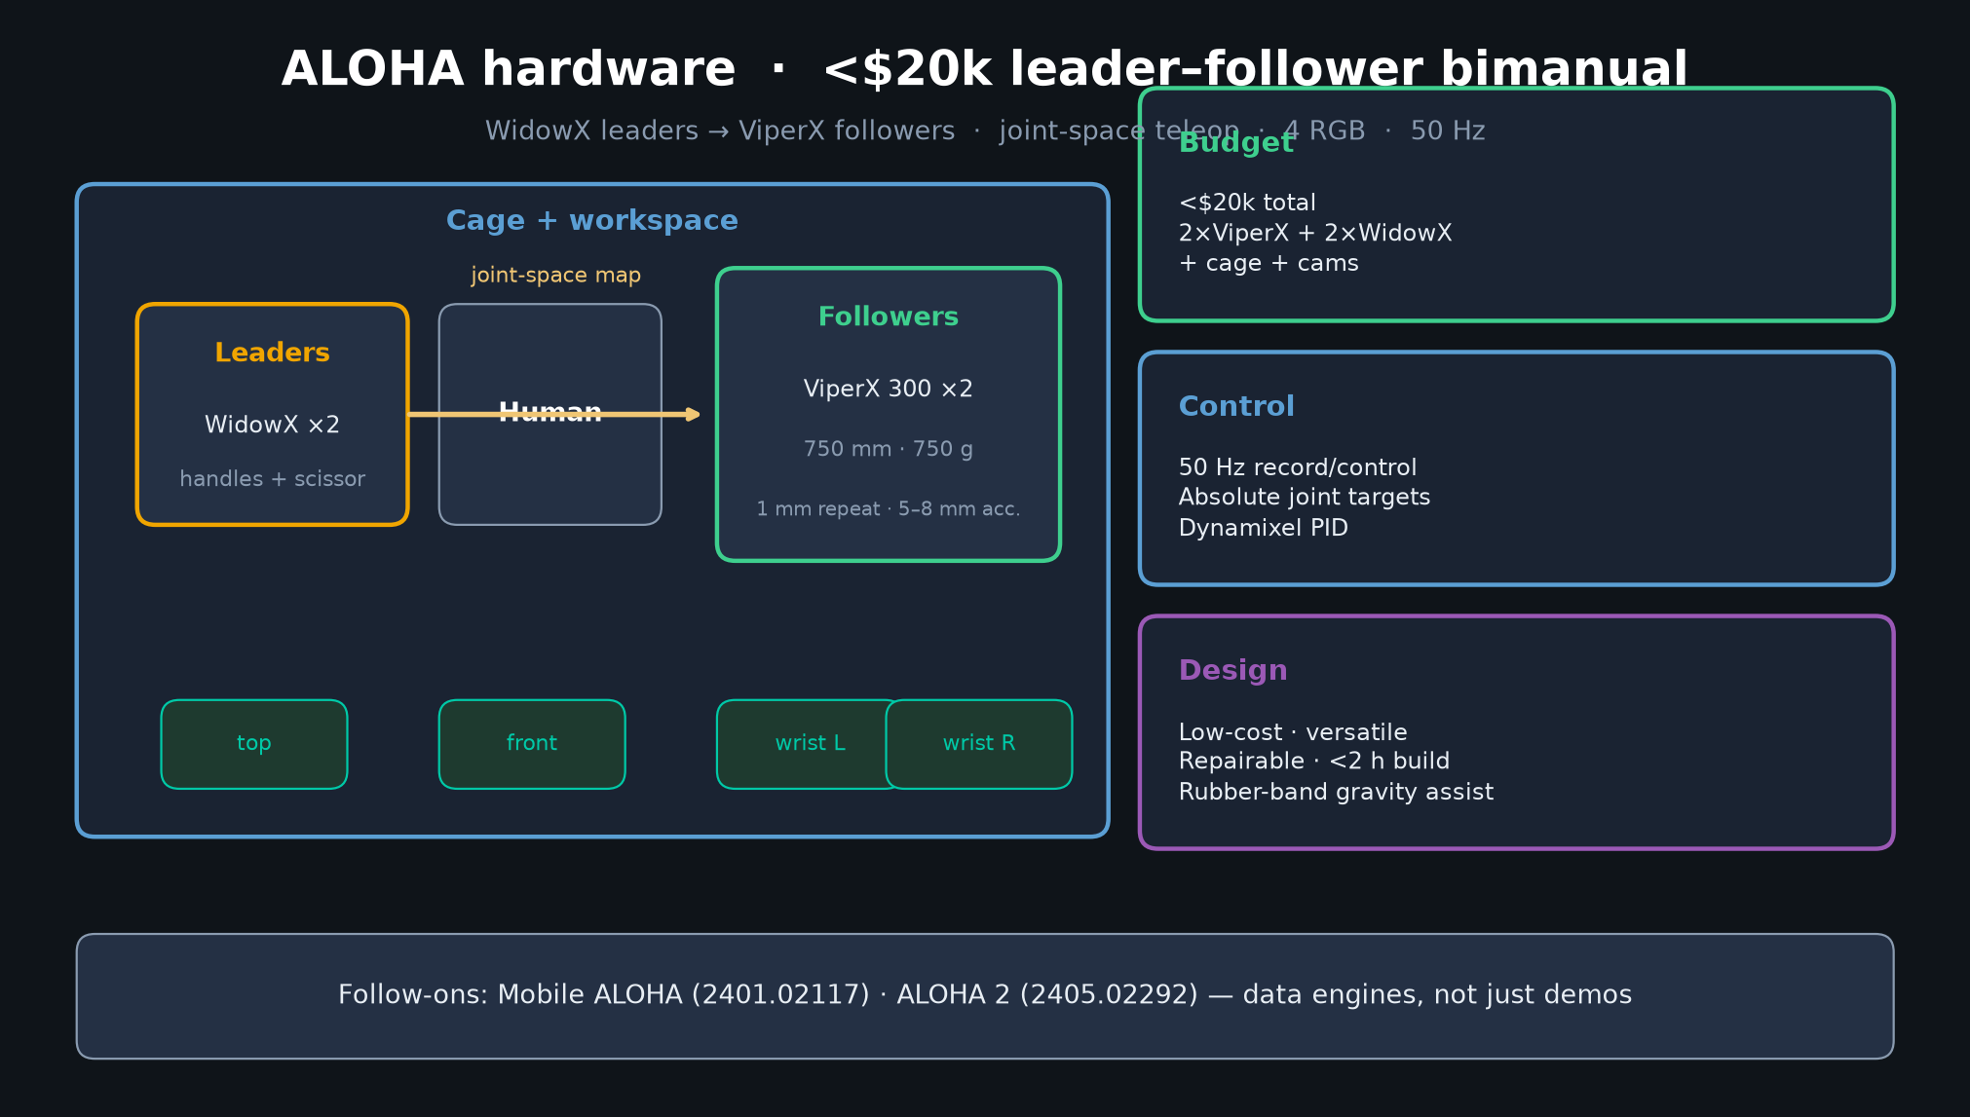
Visionary · 11+3 · 10/12
Notes:
ALOHA HW lesson — data quality × teleop bandwidth unlocks fine skills on inaccurate arms.
For BEHAVIOR sim-first: high-rate low-latency action interfaces + careful demo curation.

Slide 11
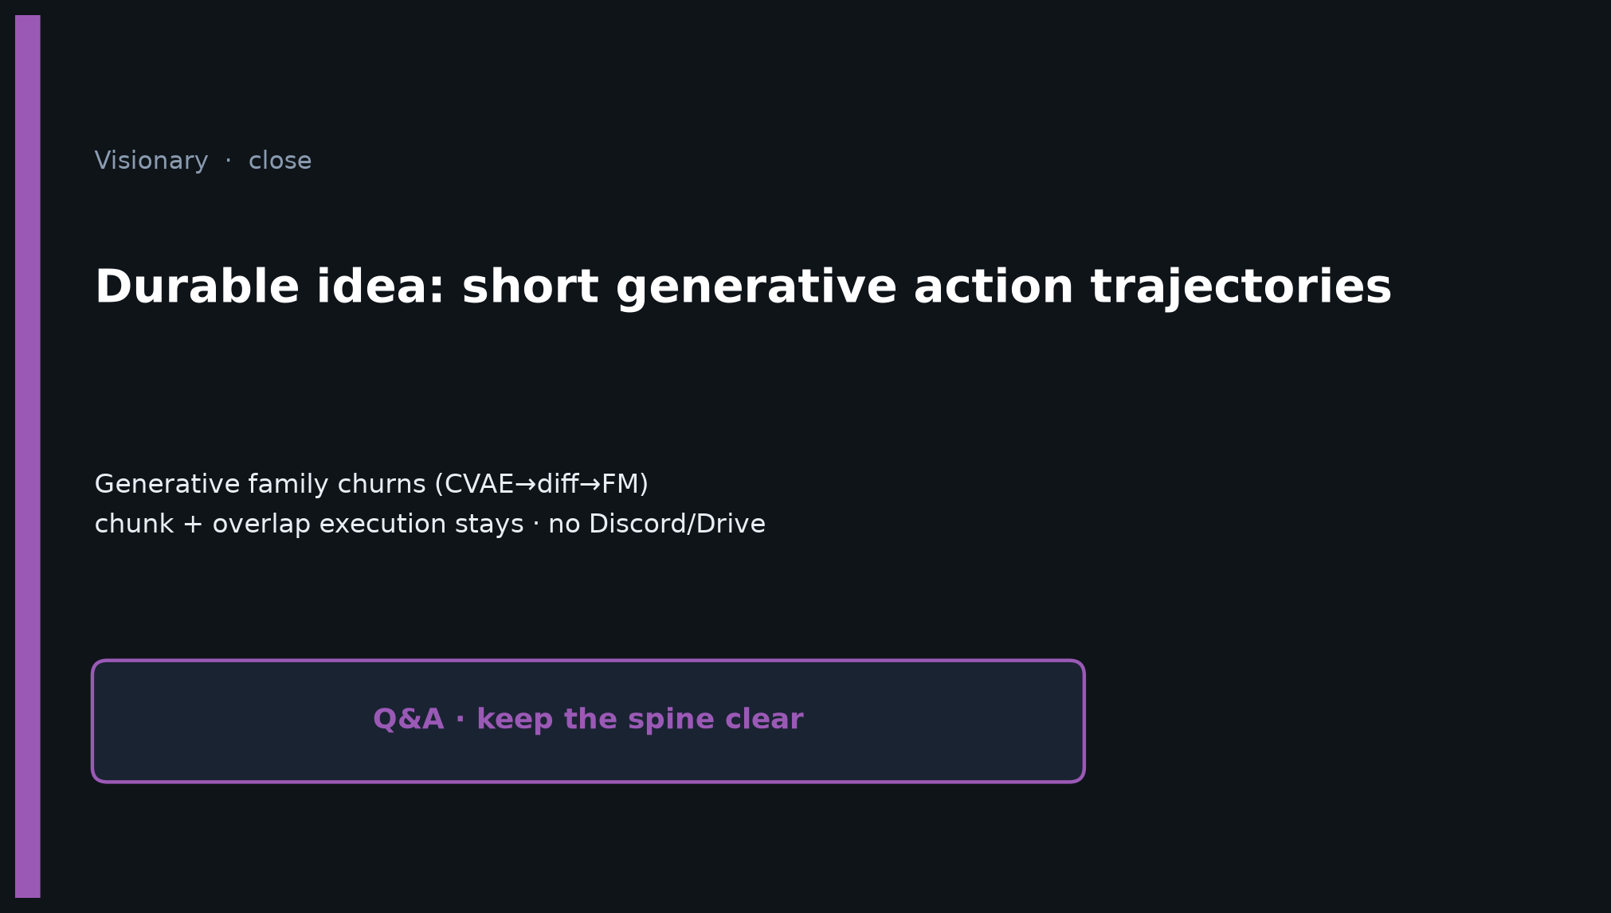
Visionary · 11+3 · 11/12
Notes:
CLOSE on durable idea. Q&A: adaptive horizons, RTC certificates, language×chunk stages.
Skip Discord/Drive.

Slide 12
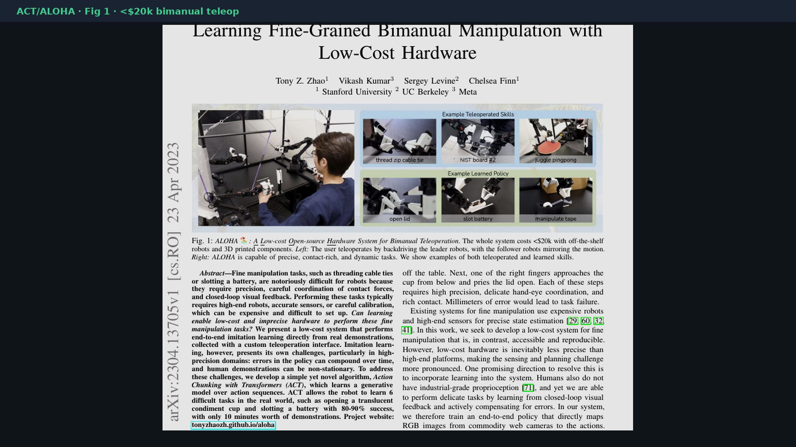
Visionary · 11+3 · 12/12
Notes:
Backup cover.

