Slide 1
DEC 9 · ALTERNATIVE APPROACHES · EMPIRICIST
Smoke the knives.
Do not reprint Table 1.
Balanced pack. Ablation Bot ranks 1–7. Primary smokes: planner removal, BC vs MoPA-PD, BC smoothing. Not a 3M × 5 × 3 rerun.
#1
#2
#4
#3
#5
#6 α
#7
Planner off
BC vs full
Smoothing
DR
Init
Cite
Subopt.
Y
Y
Y
Partial
Partial
cite
cite
Pass: directional morals on #1 and #2 and/or #4, with motion-planner calls at inference logged as 0.
Fail: writing “we reproduced CoRL Table 1” off a Push-lite run.
MoPA-PD · arXiv 2111.06383 · CoRL 2021 · Alternative approaches · Dec 9
Empiricist 1 / 13
Notes:
All seats empty, so this deck is not longer than the others. Ranks are balanced.
• Authoritative order: distilling-motion-planner-2111.06383-ablations.md, ranks 1–7.
• Y primary: #1 planner-on vs distill, #2 BC-Visual vs MoPA-PD, #4 smoothing on/off.
• Partial: #3 DR, #5 init. Cite: #6 α, #7 sub-optimal teacher.
• N: full 3-task × 5-seed × 3M; fresh long MoPA-RL; real-robot critic fine-tune.
• The PDF reports BC wall-clock only (Table 8). No GPU/RAM for full RL.

Slide 2
SHARED SPINE · TATTOO ON EVERY DECK
Five facts that do not change with the seat
01
Train privilege
Classical MP (RRT-Connect) lives inside MoPA-RL (Yamada et al., CoRL 2020). Geometry and the planner are train-time infrastructure, not the shipped controller.
02
Distill, then smooth
Visual BC on direct-action rollouts removes the planner and smooths RRT jitter. MoPA-PD then runs asymmetric SAC: actor from BC, critic from MoPA-RL Q, Re:Rπ = 1:3, small α.
03
Deploy is planner-free pixels
Inference is a 32×32 image plus joints. No RRT-Connect, no object state, no motion planner. The critic’s state privilege ends when training ends.
04
Numbers you must be able to say
Push 100 / 32.0 / 110.8 (ASR / AEL / ADR). Assembly 0 without BC-smooth vs 100 with. DR ≥ 96.7 sim-to-sim (Lift Scenario 1 is worst). Expert Push AEL 111 vs Ours 32.
05
What this paper is not
Not an ancestor of ACT, Diffusion Policy, π₀, OpenVLA, or OXE — contrast poles only. Not a JEPA / LeWM / Cosmos child. Sim-only Sawyer. Do not launder DR into sim-to-real.
MoPA-PD · arXiv 2111.06383 · CoRL 2021 · Alternative approaches · Dec 9
Empiricist 2 / 13
Notes:
Shared spine — say this before the role-specific argument.
• Privileged classical MP (RRT-Connect) at train inside MoPA-RL (Yamada 2020) → visual BC (smooths jitter, drops the planner) → MoPA-PD asymmetric SAC → planner-free pixels at deploy.
• Must-cites: Push 100 / 32.0 / 110.8 (ASR/AEL/ADR). Assembly 0 without BC smoothing vs 100 with. DR ≥ 96.7 sim-to-sim; Lift Scenario 1 is the worst cell. Expert Push AEL 111 vs Ours 32.
• NOT an ancestor of ACT, Diffusion Policy, or VLAs (π₀ / OpenVLA / OXE). CLEAR contrast poles only. NOT a JEPA / LeWM / Cosmos child.
• Sim-only Sawyer MuJoCo, 32×32 images. Real robot is future work in the conclusion. Refuse to launder domain randomization into sim-to-real.
• Preserve paper numbers only. Do not invent BEHAVIOR success rates or a real-robot SR.
• Empiricist use: paper numbers stay citations. Your runs are labeled smoke. Never paste a smoke ASR into a Table 1 cell.

Slide 3
ABLATION BOT · RANKS 1–7
What to run, what to cite, what to refuse
1
Planner-on vs distill
Y
Ours 100/99/100. MoPA-Asym 0/0/0. Push AEL 32 vs 111.
2
BC-Visual vs MoPA-PD
Y
BC 99.4/62.0/97.0. AEL ~108–118 vs 32/42/61.7.
3
Domain-rand zero-shot
Part
All ASR >96. Worst: Lift Scenario 1 = 96.7. No non-DR control.
4
BC smoothing on/off
Y
Assembly 0.0 without, 100.0 with. Fig. 8 is the jitter picture.
5
Weight init on/off
Part
≈0 until 1.2M without. ≈1.0 before 1.0M with.
6
Entropy coefficient α
Cite
Smaller log α is faster. Teacher −0.63 / −2.7 / −0.29.
7
Sub-optimal expert
Cite
Push 69.2→100. Lift 41.4→99.0 after 2M visual steps.
MoPA-PD · arXiv 2111.06383 · CoRL 2021 · Alternative approaches · Dec 9
Empiricist 3 / 13
Notes:
Minimum package: #1 + #2 + #4, then partial #3 and #5, then cite #6 and #7.
• One task. Push is easiest. Assembly is the smoothing moral — cite it, or a 1-seed stub. Do not pretend a full Assembly 3M run.
• Lift is the BC-vs-full ASR moral (62 vs 99). On Push, judge #2 by AEL and ADR.
• Falsifiers: MoPA-Asym ≥ Ours; BC AEL ≤ Ours when both succeed; raw Re ≥ smooth; DR collapses; random init matches BC init; large α wins; distill needs a perfect teacher.

Slide 4
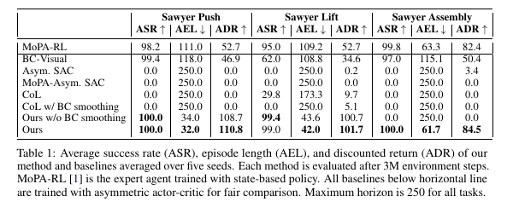
PRIMARY · RANK 1
Planner-off distill vs planner-on controls
#1 smoke
Matched-budget Push: MoPA-PD vs Asym. SAC. MoPA-Asym only if RRT actually runs.
Hard log
Planner calls at inference = 0. Image + joints only.
Paper moral
MoPA-Asym. SAC is 0 on all three. Keeping RRT in the visual loop is not the method.
Not required
Five-seed Assembly at 100%. That number stays a citation.
MoPA-PD · arXiv 2111.06383 · CoRL 2021 · Alternative approaches · Dec 9
Empiricist 4 / 13
Notes:
Rank 1. Table 1, Fig. 3, §4.4.
• Ours ASR 100/99/100. MoPA-Asym 0/0/0. MoPA-RL 98.2/95.0/99.8. Push AEL 32.0 vs 111.0.
• Pass: smoke ASR well above Asym. SAC; AEL directionally below teacher or BC; MP calls at inference = 0.
• If RRT will not install, run Asym. SAC and cite the paper’s MoPA-Asym zero. Do not fake a planner stack.
• Log ASR, AEL, ADR, EE jerk, MP calls, Re source, init, log α, peak VRAM.

Slide 5
PRIMARY · RANK 2
BC is not the paper. Stage 2 is.
PUSH
LIFT
ASSEMBLY
BC-VISUAL
BC-VISUAL
BC-VISUAL
99.4 / 118.0 / 46.9
62.0 / 108.8 / 34.6
97.0 / 115.1 / 50.4
OURS
OURS
OURS
100 / 32.0 / 110.8
99.0 / 42.0 / 101.7
100 / 61.7 / 84.5
ASR already high. AEL is the gap.
ASR is the gap. Stage 2 is required.
ASR high. Path quality is not.
Smoke one task. On Push, an ASR tie is not failure — AEL and ADR must move. Lift makes the ASR moral cleaner. Do not run all three and call it Table 1.
MoPA-PD · arXiv 2111.06383 · CoRL 2021 · Alternative approaches · Dec 9
Empiricist 5 / 13
Notes:
Rank 2. One task.
• Authors: BC is decent on Push and Assembly, not on Lift, and has high AEL / low ADR because it is bounded by the demos. Ours goes beyond the expert.
• Pass: MoPA-PD AEL < BC AEL when both succeed, or ASR much higher on a Lift-like task.
• BC: ~1M pairs, 100 expert trajs, 9:1 split, lr 5e-4, batch 512, select by validation success.
• BC wall-clock only: 30 / 39 / 120 min. That is not the RL budget.

Slide 6
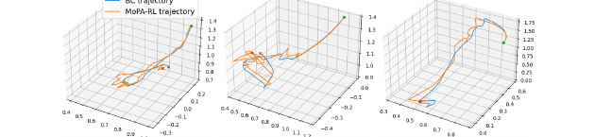
PRIMARY · RANK 4
Smoothing is the Assembly result. Smoke Push. Cite Assembly.
Single factor
Re = BC-smoothed trajectories versus Re = raw MoPA-RL.
Assembly, paper
0 / 250 / 0
vs 100 / 61.7 / 84.5
Push, paper
Both hit ASR 100. AEL 34.0 vs 32.0. Speed and variance are the smoke signal, not a zero.
Pass on Push: smoothed Re ≥ raw on ASR or steps-to-threshold, and jerk or path length drops. Do not report Assembly 100% unless Assembly was run.
MoPA-PD · arXiv 2111.06383 · CoRL 2021 · Alternative approaches · Dec 9
Empiricist 6 / 13
Notes:
Rank 4 is still a primary smoke. The integer is the bot’s focus mix; steering says smoothing is primary. Do not demote it.
• Fig. 8: blue BC, orange MoPA-RL, green start, red end. Qualitative. Log your own jerk. Do not digitize this figure into fake millimeters.
• Lift without smoothing is ASR 99.4 vs 99.0 with, AEL 43.6 vs 42.0. Smoothing does not win every cell. It wins Assembly, variance, and convergence.
• CoL with smoothing does not inherit the Assembly win. Do not move the result onto a different algorithm.

Slide 7
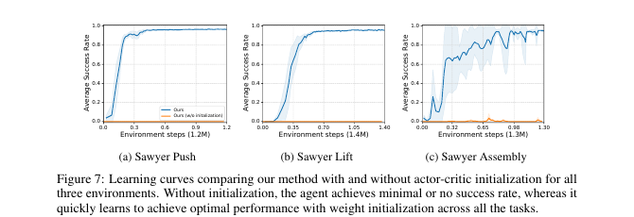
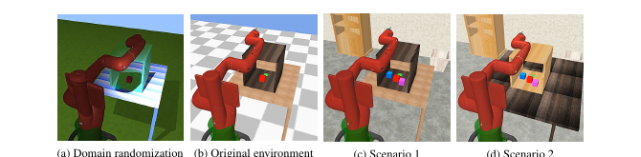
PARTIAL · RANKS 3 AND 5
DR lite and init. Directional. Not a second paper.
#3 DR — Partial
#5 init — Partial
Short DR on Push. Eval original vs a distractor stub. Paper moral: every Table 2 cell ≥ 96.7. There is no non-DR column. Pass = OOD holds up, not “we hit 96.7.”
Same budget, init on vs off. Prose: ~0 until 1.2M without; ≈1.0 before 1.0M with. Early-stop is fine. Log steps-to-first-success. Do not claim 1.2M unless you ran it.
MoPA-PD · arXiv 2111.06383 · CoRL 2021 · Alternative approaches · Dec 9
Empiricist 7 / 13
Notes:
Partial on purpose.
• Table 2 ASR: original 99.7/99.3/100; Scenario 1 100/96.7/100; Scenario 2 99.3/97.3/100. Quote AEL/ADR too if the table is on screen.
• App. C: texture, color, lighting each episode. Fig. 10 is more samples, not new numbers.
• Scenario 1: unseen blue/magenta cubes, walls, floor, furniture. Scenario 2 adds table size and textures.
• Init needs the MoPA critic. Without that checkpoint, cite Fig. 7. Do not substitute a random pretrained encoder and call it this ablation.

Slide 8
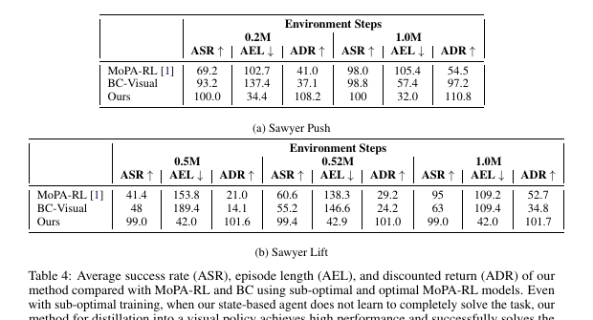
CITE · RANKS 6 AND 7
α and a weak teacher. Quote the PDF. Don’t grid them.
#6 α
Table 3, log α after MoPA-RL: Push −0.63, Lift −2.7, Assembly −0.29.
Visual stage starts lower, to exploit the prior. Figs. 5–6 are qualitative. No per-α ASR table — do not make one.
#7 weak expert
Push @ 0.2M: 69.2 → Ours 100, AEL 34.4.
Lift @ 0.5M: 41.4 → Ours 99.0, AEL 42.0, after 2M visual steps.
Only if an early checkpoint already exists. Do not retrain a long teacher for #7.
MoPA-PD · arXiv 2111.06383 · CoRL 2021 · Alternative approaches · Dec 9
Empiricist 8 / 13
Notes:
Cite. Fold α into primary logs if you want a breadcrumb. Do not center the course on a sweep.
• Sweep in the paper: log α ∈ {0.5, 0, −3, −10, −20, −40}.
• Lift @ 0.52M: MoPA-RL 60.6, Ours 99.4, AEL 42.9, ADR 101.0. Don’t round 41.4 to 40.
• Push @ 1.0M in Table 4a matches main Ours: 100 / 32.0 / 110.8.
• Low α is dangerous if the teacher is wrong. Table 4 is not an adversarial-teacher study.

Slide 9
LOCK THESE BEFORE YOU LAUNCH
Paper knobs. A smoke may shorten steps. It may not retune the story.
Image and SAC
BC
32×32. Adam lr 1e-5. γ 0.99. Batch 256. Replay 1e6. The SAC table uses one network update per env step.
lr 5e-4. Batch 512. ~1M pairs. 9:1 split. 100 expert trajectories. Select by validation success, not test MSE.
Mix and actions
What “3M” means
Re:Rπ = 1:3. Action dim 7 on Push and Assembly, 8 on Lift. Reward scales 0.8 / 0.5 / 1.0. Success < 0.05. Bonus +150. Horizon 250.
Teacher 1M + visual phase 2M when the teacher is required. Five seeds. 100 episodes each. That is the paper. It is not the smoke.
MoPA-PD · arXiv 2111.06383 · CoRL 2021 · Alternative approaches · Dec 9
Empiricist 9 / 13
Notes:
Appendix B. If a smoke changes a knob, write it in the log header.
• MoPA-RL nets: 3× FC-256 ReLU. Visual: 3-layer CNN, 3× FC-256 LeakyReLU, Gaussian head.
• BC scheduler step 5, decay 0.99 (Table 6). Skipping it means you did not match Table 8.
• Assembly task source: IKEA furniture env, Lee, Hu, Lim, ICRA 2021.
• Code pointer from the abstract: clvrai.com/mopa-pd. Pin a commit. Frozen demos if MuJoCo/RRT will not build.

Slide 10
HONESTY BLOCK
A course smoke is not the CoRL protocol
NEVER CLAIM TABLE 1 FROM A PUSH-LITE SMOKE
Paper scale is 3M steps × 5 seeds × 3 tasks, on top of a planner teacher. A short single-seed Push run can support a direction. It cannot support a cell.
Label runs
Frozen teacher
Put “smoke” in the filename and the first log line. Paper numbers stay in a citation column.
Prefer cached MoPA-RL demos. A from-scratch RRT teacher is out of scope.
No hardware fanfic
Metrics
The PDF has BC minutes only. Do not invent GPU hours or a real-robot success rate.
ASR without AEL and ADR hides the result. Log all three, plus planner calls at inference.
MoPA-PD · arXiv 2111.06383 · CoRL 2021 · Alternative approaches · Dec 9
Empiricist 10 / 13
Notes:
Planning envelopes in the quiet deliverable are estimates, not paper measurements: BC ingest on the order of an hour; primary smokes hours to a day; full 3-task paper multi-day. Do not cite them as Liu et al.
• If the job asks for a GPU and the node has none, fail. Do not silently compare a CPU fallback to Table 1.
• Club pass: documented #1 and #2 and/or #4, directional, MP@infer = 0, knobs logged.
• Reject your own note if it says “reproduced Assembly 100%, 5 seeds.”

Slide 11
LOGGING CONTRACT
If it is not in the log, it is not a result
Identity
Privilege
Buffer
Task, seed, step budget, image size, frozen teacher or not.
Planner calls at inference. Critic inputs. Init on or off.
Re source = BC or raw. Mix 1:3 or otherwise. Expert trajectory count.
Outcome
α
DR
ASR, AEL, ADR. Steps to first success. Jerk or path length. Peak VRAM.
log α at start and end. Do not grid it until #1–#4 are logged.
Train factors. Test scene id. Never the words sim-to-real.
MoPA-PD · arXiv 2111.06383 · CoRL 2021 · Alternative approaches · Dec 9
Empiricist 11 / 13
Notes:
One row per run.
• MP calls at inference: the architecture claims zero; the log proves the run you executed.
• If you only have smoothed demos, you cannot claim rank 4. Say so.
• Changing γ voids ADR comparisons. Paper γ is 0.99.
• Laundry sentence: Table 2 is zero-shot across MuJoCo scenes. The authors defer sim-to-real. A color jitter smoke has not crossed that deferral.

Slide 12
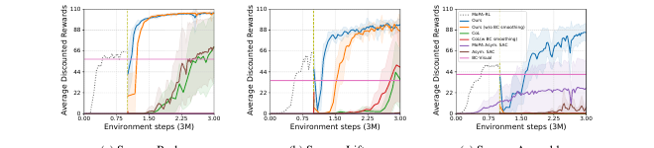
FIG. 3 IS NOT YOUR SMOKE PLOT
Do not overlay a short run and call it a match
Paper curves
0 to 3M steps. Five seeds in the table. MoPA-RL takes the first 1M when it is in the method.
Your curves
Different x-axis until you have actually run 3M. Label the axis in environment steps, and label the run smoke.
What you may say
“Direction matches Fig. 3: distilled policy above asymmetric SAC.” You may not say “we reproduced Fig. 3.”
MoPA-PD · arXiv 2111.06383 · CoRL 2021 · Alternative approaches · Dec 9
Empiricist 12 / 13
Notes:
Fig. 3 caption: all methods trained 3M steps; MoPA-dependent methods use 1M MoPA-RL then 2M visual. Ours has the highest discounted return. Without BC smoothing, two tasks solve more slowly and Assembly fails.
• A smoke that stops at a few hundred thousand steps can still falsify “Asym. SAC is competitive early.” It cannot confirm the 3M ordering.
• If you plot, plot your seeds only. Do not trace the paper’s curves into the same file and present them as your data.

Slide 13
EMPIRICIST CLOSE
Quote these. Refuse the rest.
100 / 32.0 / 110.8. Assembly 0 without BC smoothing, 100 with. DR worst cell 96.7 — and it is still simulation.
Run
Do not run
#1 planner-off, #2 BC vs full, #4 smooth vs raw. Partial #3 and #5 only if the checkpoints exist.
3M × 5 × 3. A fresh long teacher. A real robot. A BEHAVIOR score you do not have.
MoPA-PD · arXiv 2111.06383 · CoRL 2021 · Alternative approaches · Dec 9
Empiricist 13 / 13
Notes:
One-liner: quote 100/32.0/110.8, Assembly 0 without BC smooth, and >96% DR — and refuse to launder sim-to-sim into sim-to-real.
• Expert Push AEL 111 vs 32 belongs in the same breath, or the triple is misread as success rate only.
• BC Lift ASR 62.0 is the number people forget when they say cloning already solved it.

