Slide 1
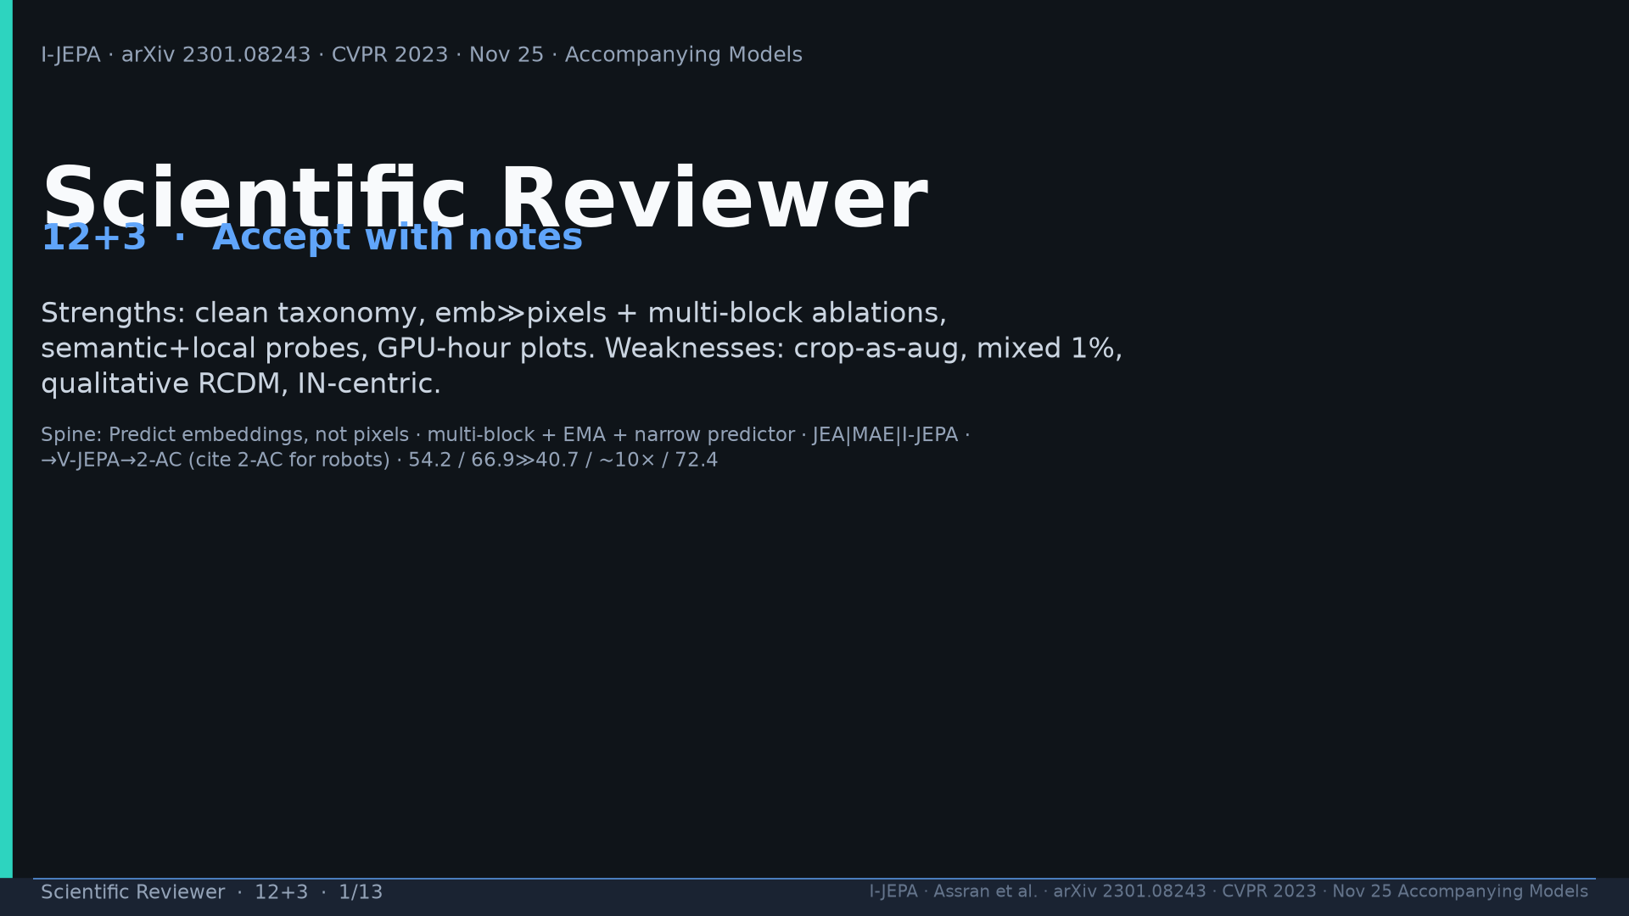
Notes:
Title. Accept with notes. Strengths vs weaknesses framing.

Slide 2
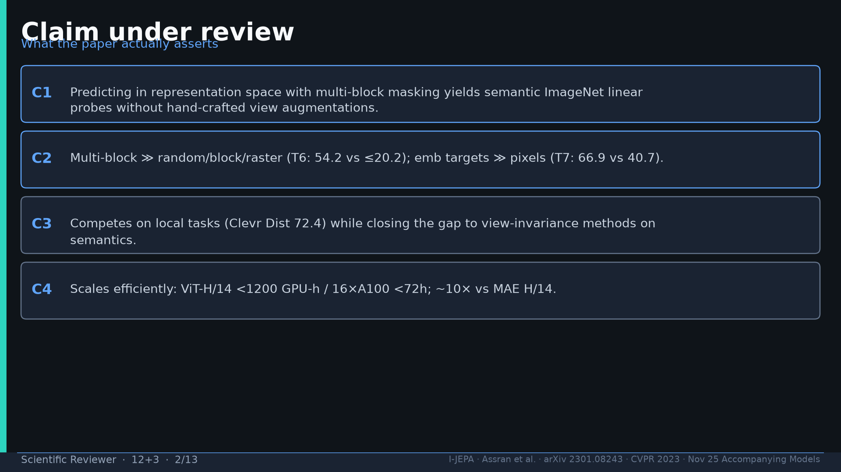
Notes:
Four claims under review: emb prediction sans augs; T6/T7 isolators; dual probes; compute scale.

Slide 3
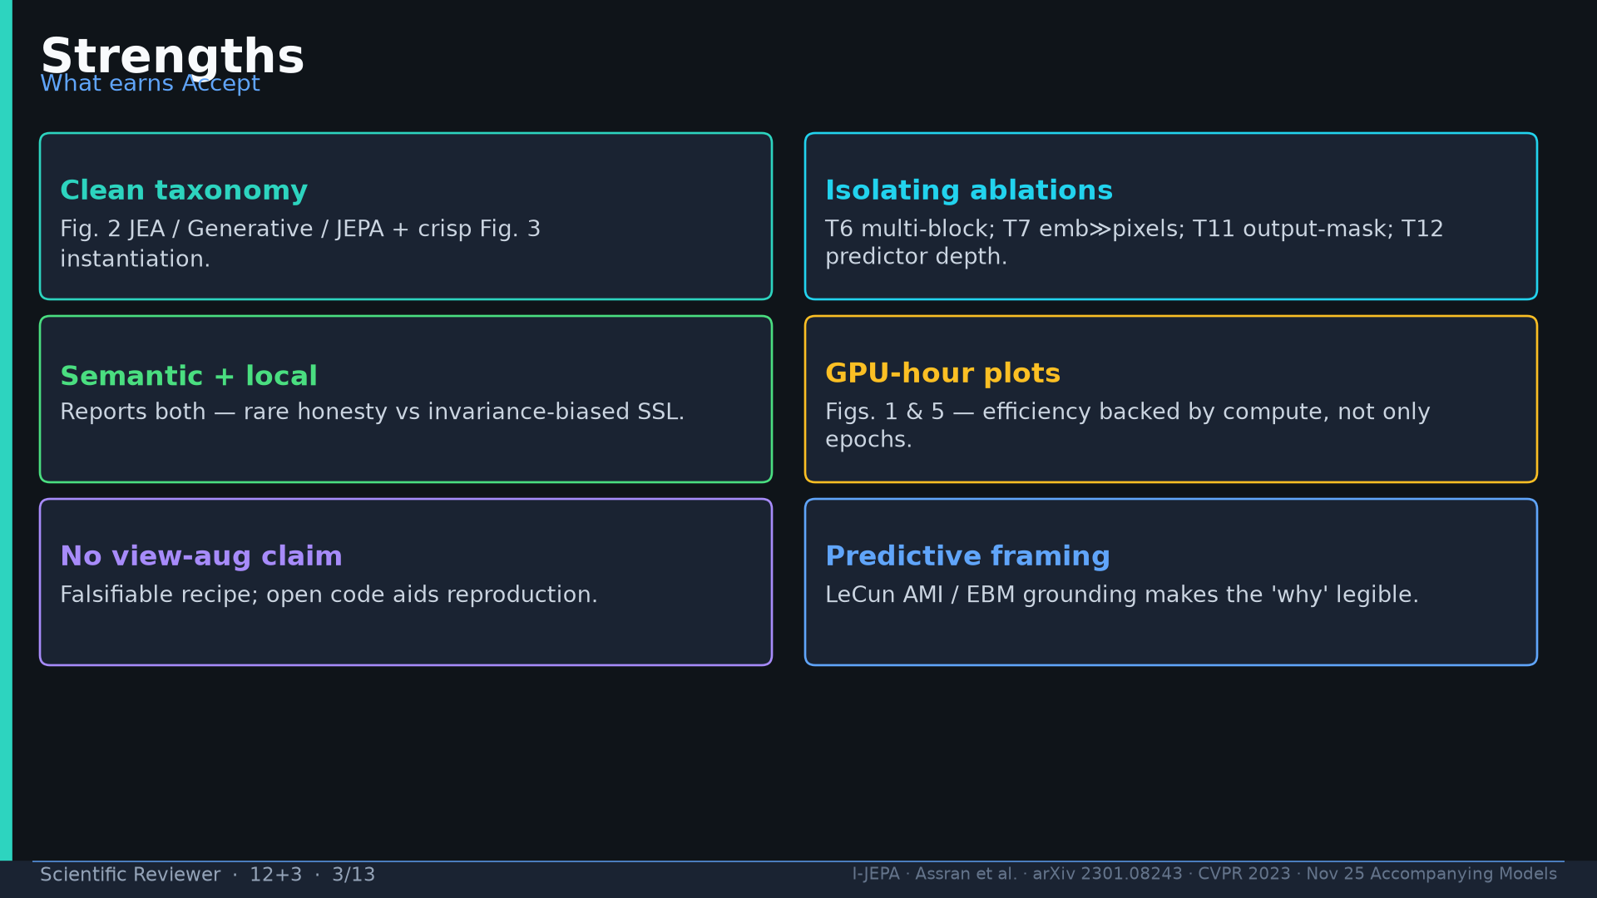
Notes:
Strengths: taxonomy, isolating ablations, semantic+local, GPU-hour plots, open recipe, AMI framing.

Slide 4
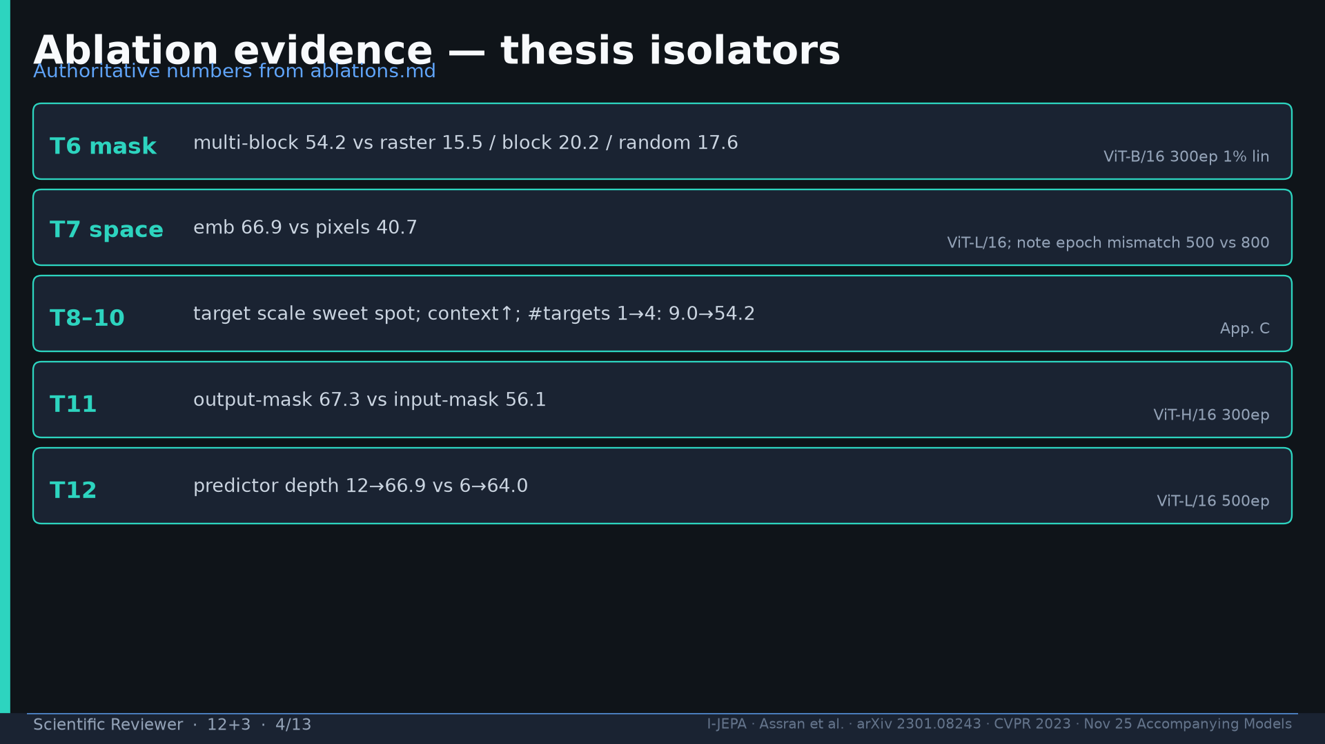
Notes:
Ablations: T6 54.2; T7 66.9≫40.7; T8–10; T11 67.3 vs 56.1; T12 depth. Note T7 epoch mismatch.

Slide 5
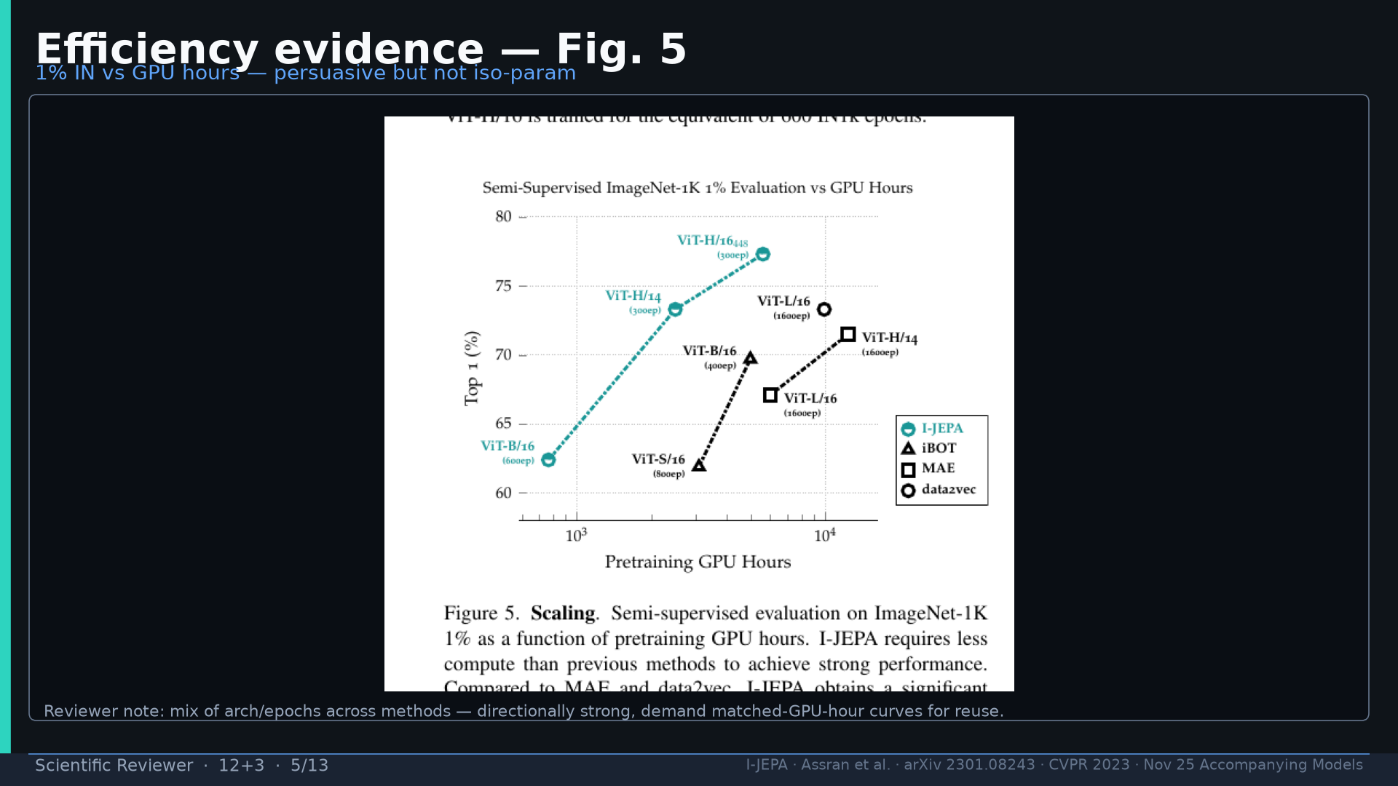
Notes:
Fig.5 efficiency — directionally strong; demand matched-GPU-hour for reuse.

Slide 6
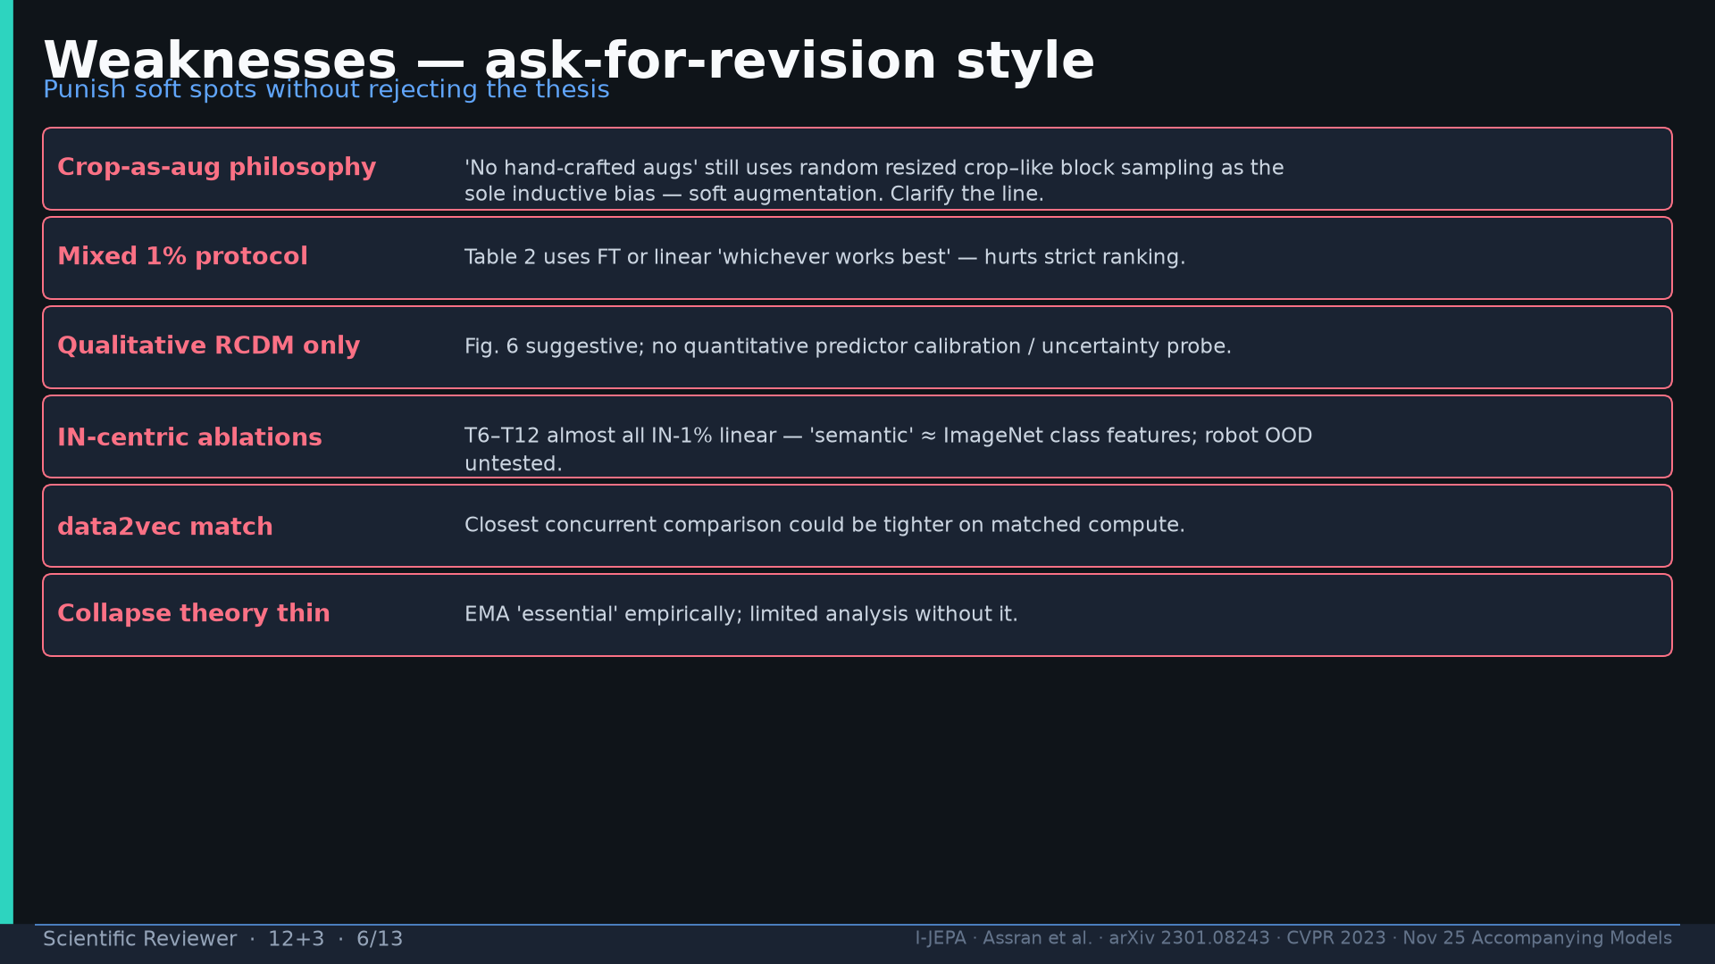
Notes:
Weaknesses: crop-as-aug; mixed 1%; qualitative RCDM; IN-centric; data2vec match; collapse theory.

Slide 7
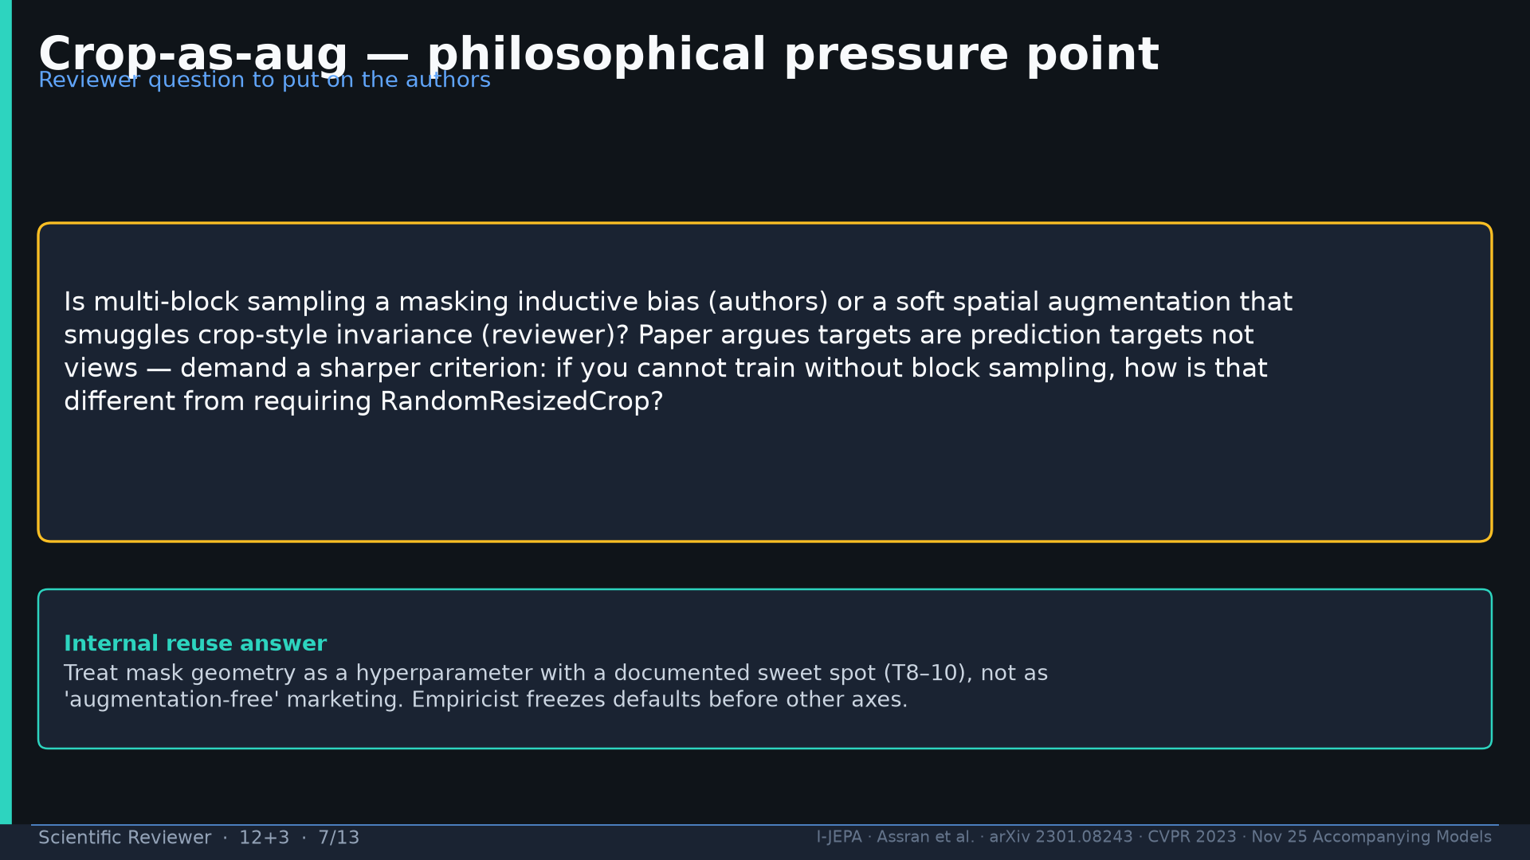
Notes:
Crop-as-aug pressure: is block sampling masking bias or soft RRC? Freeze defaults; don't market aug-free.

Slide 8
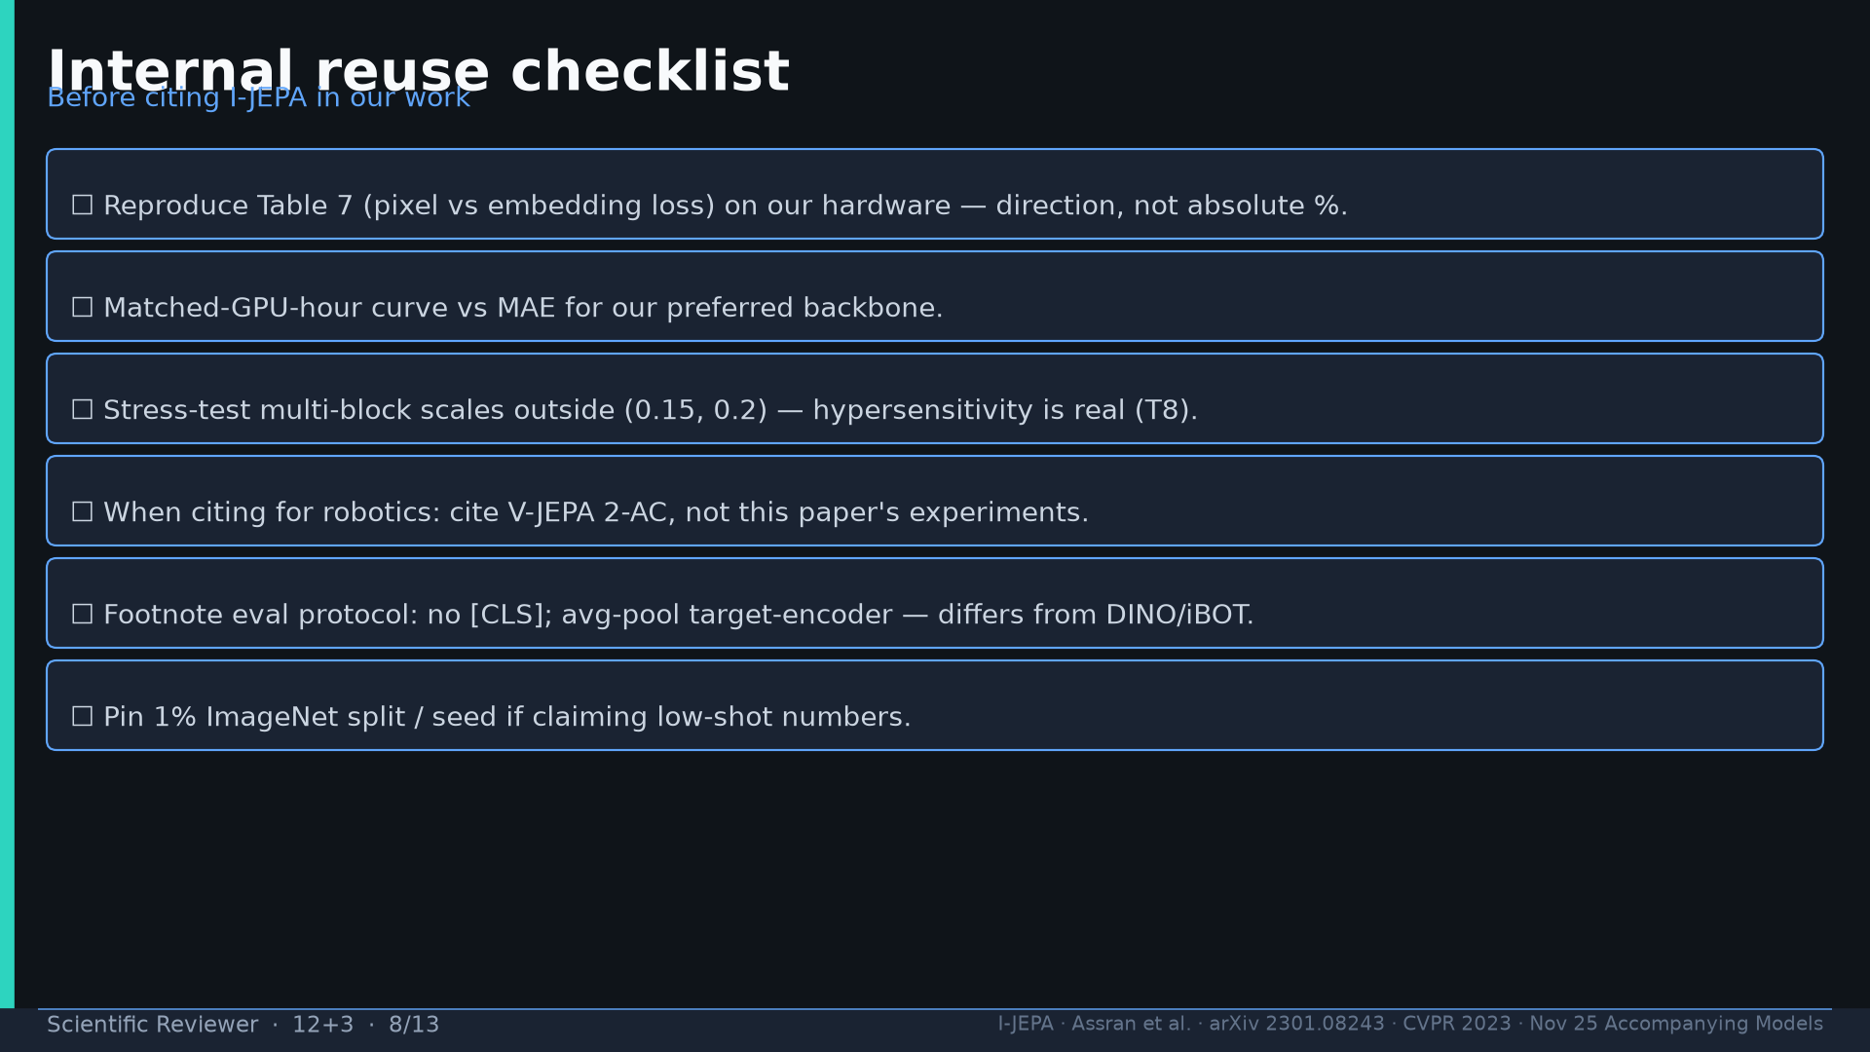
Notes:
Reuse checklist: repro T7; matched GPU-h; stress T8; cite 2-AC for robots; footnote no-[CLS]; pin 1% split.

Slide 9
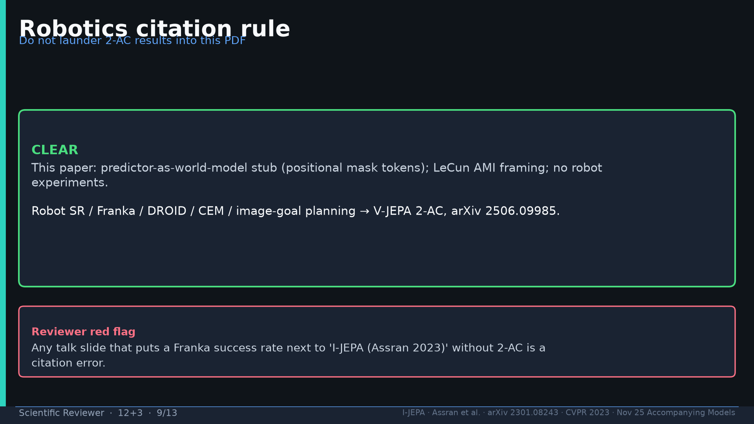
Notes:
Robotics citation rule: Franka SR → 2506.09985 only. Red flag if Assran 2023 alone.

Slide 10
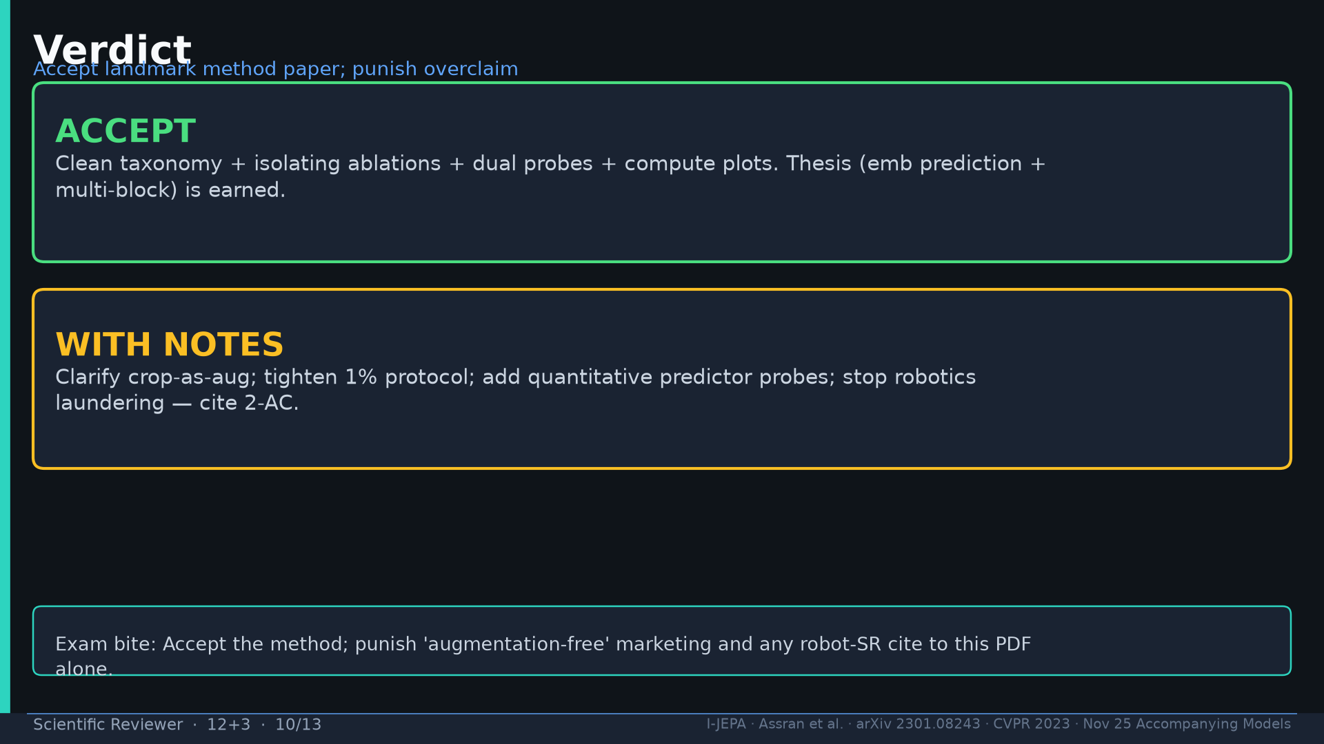
Notes:
Verdict: ACCEPT landmark + WITH NOTES (aug-free + robotics laundering).

Slide 11
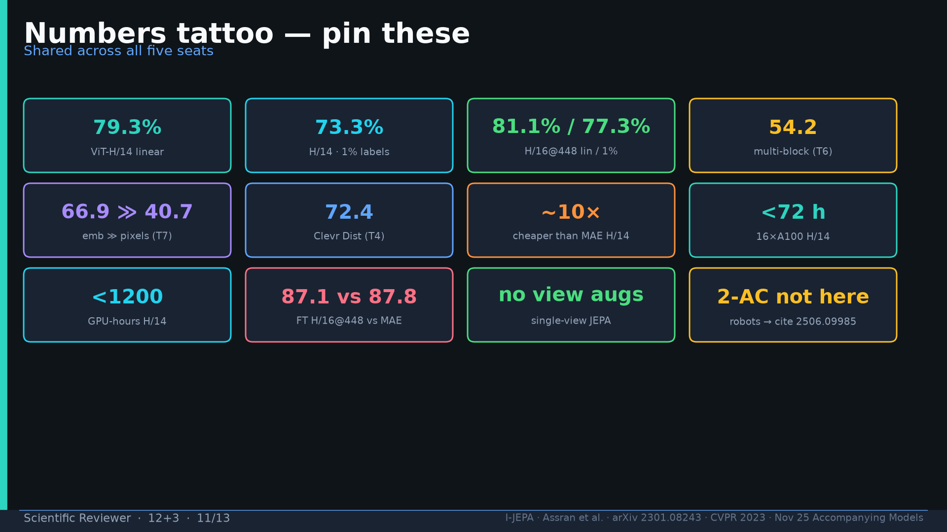
Notes:
Tattoo.

Slide 12
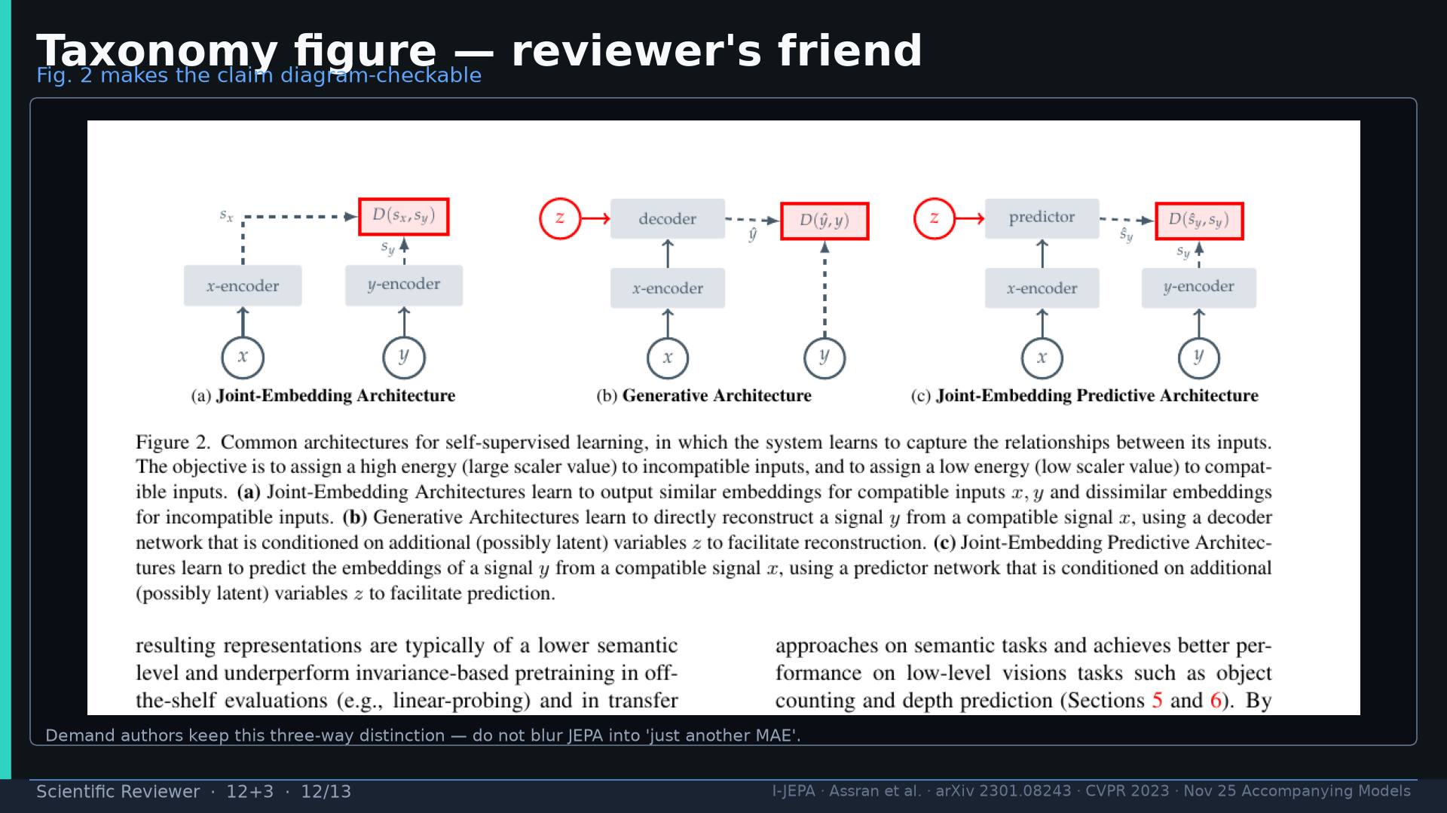
Notes:
Fig.2 taxonomy — keep three-way distinction; don't blur into MAE.

Slide 13
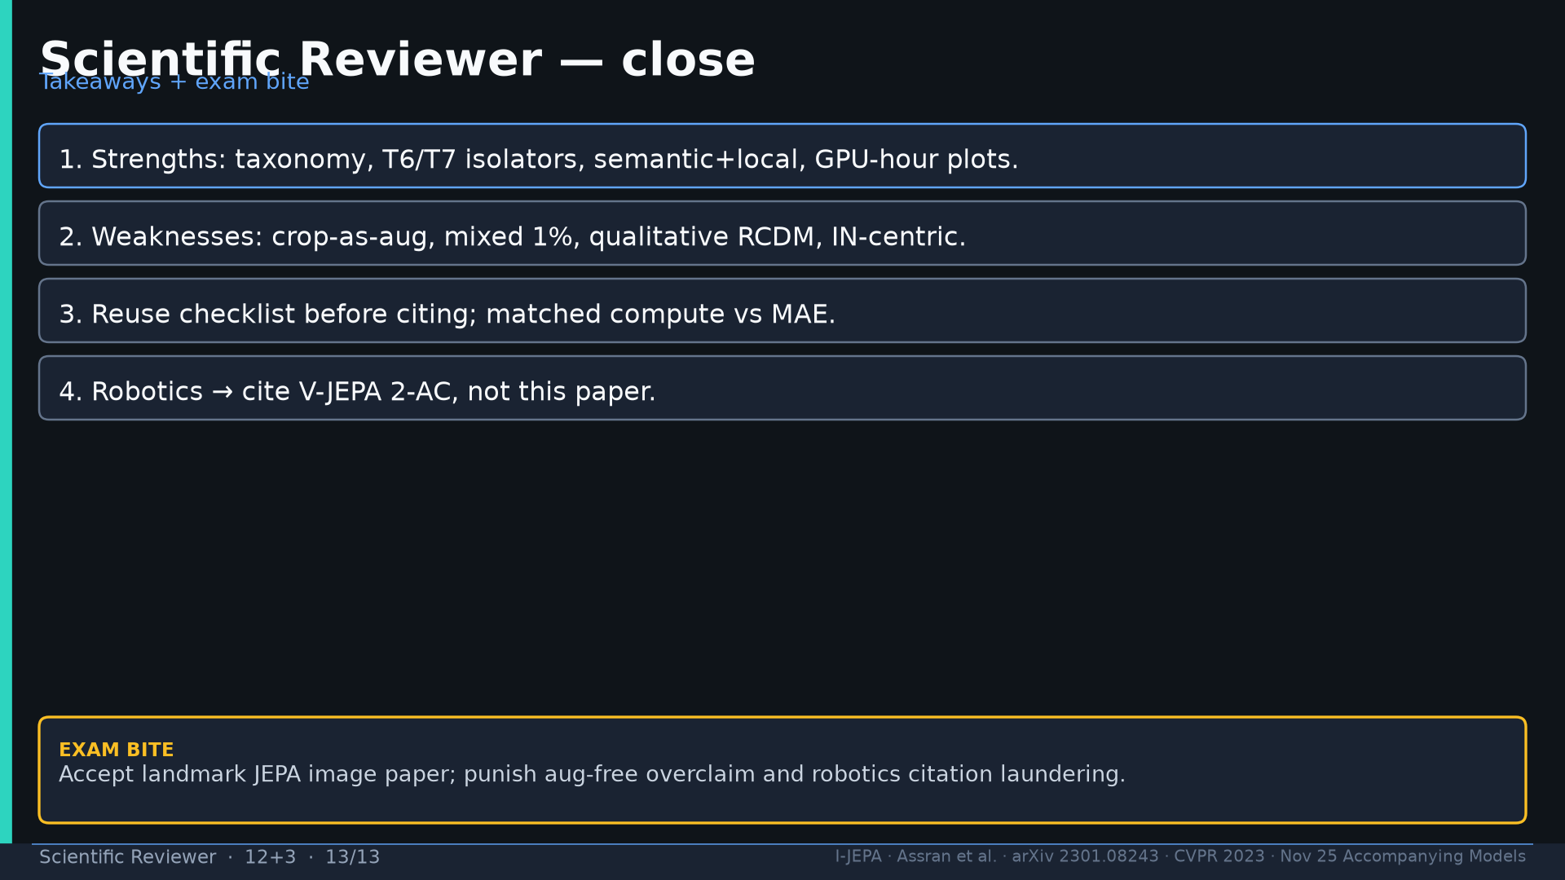
Notes:
Close + exam bite.

