Slide 1
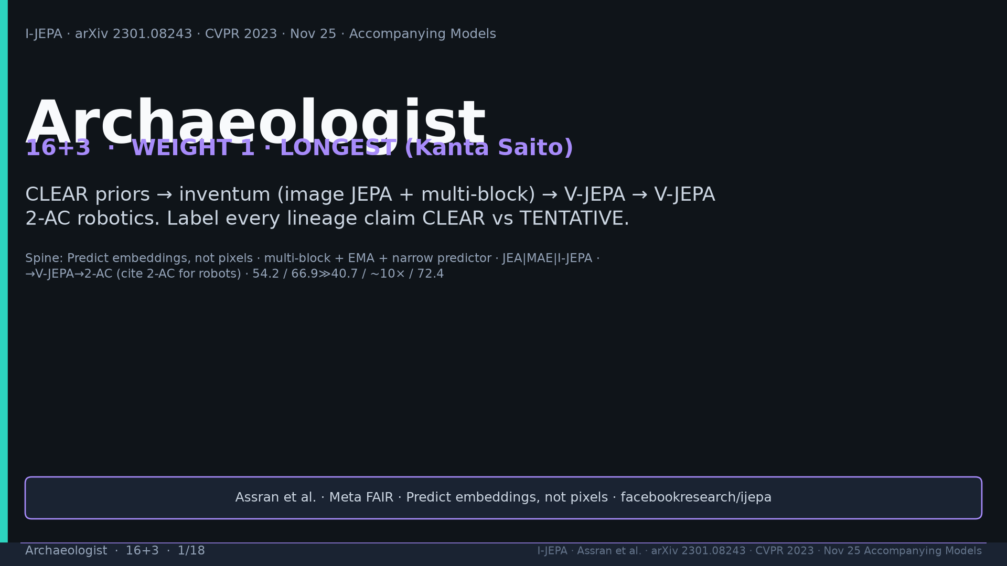
Notes:
Title. Weight 1 LONGEST Kanta. CLEAR vs TENTATIVE on every lineage claim.

Slide 2
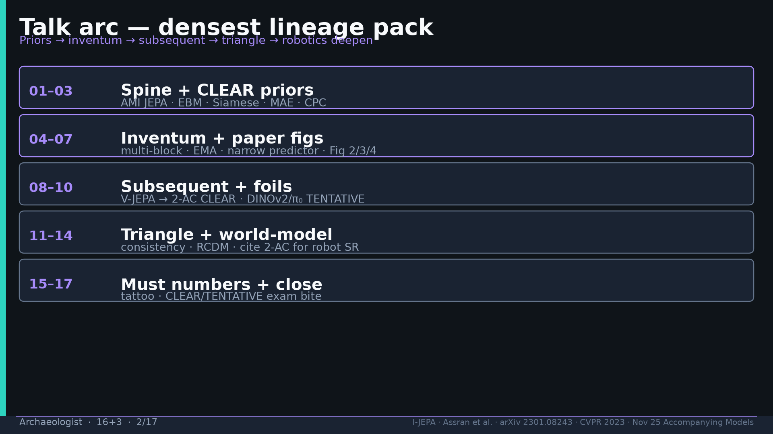
Notes:
Arc: priors → inventum → figs → genealogy → subsequent → foils → triangle → WM deepen → numbers → labels.

Slide 3
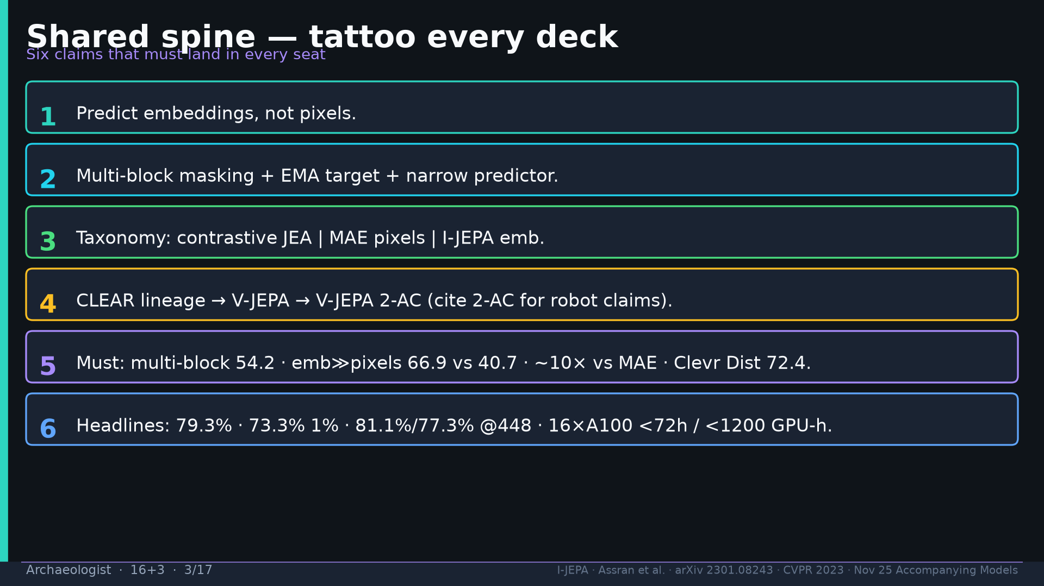
Notes:
Shared spine six claims — tattoo every deck.

Slide 4
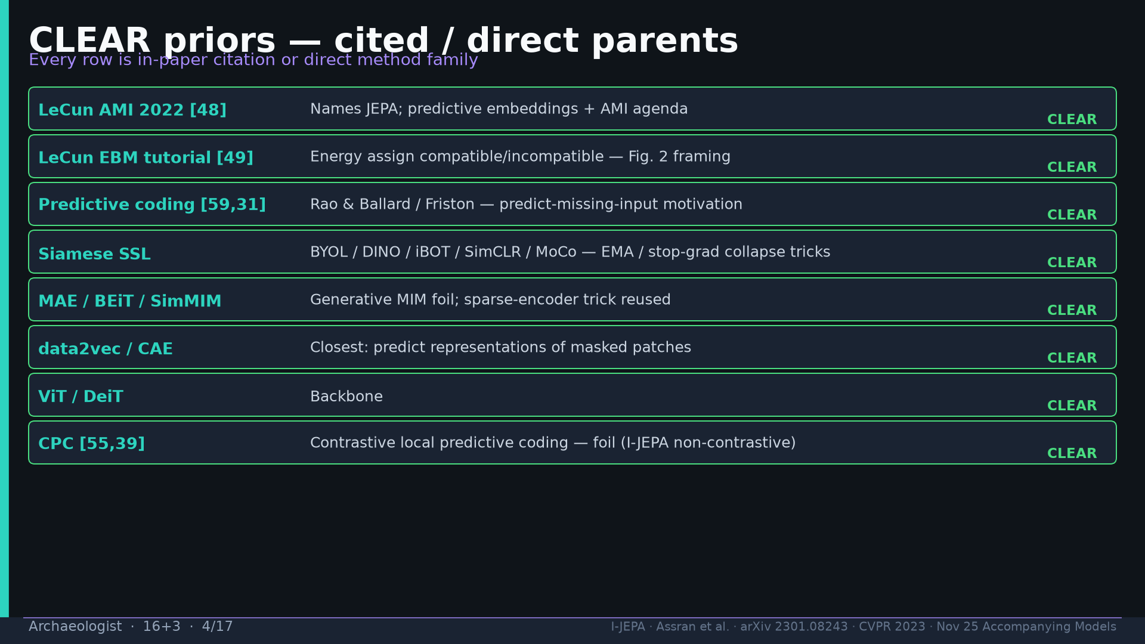
Notes:
CLEAR priors table: AMI JEPA [48], EBM [49], predictive coding, Siamese, MAE, data2vec, ViT, CPC foil.

Slide 5
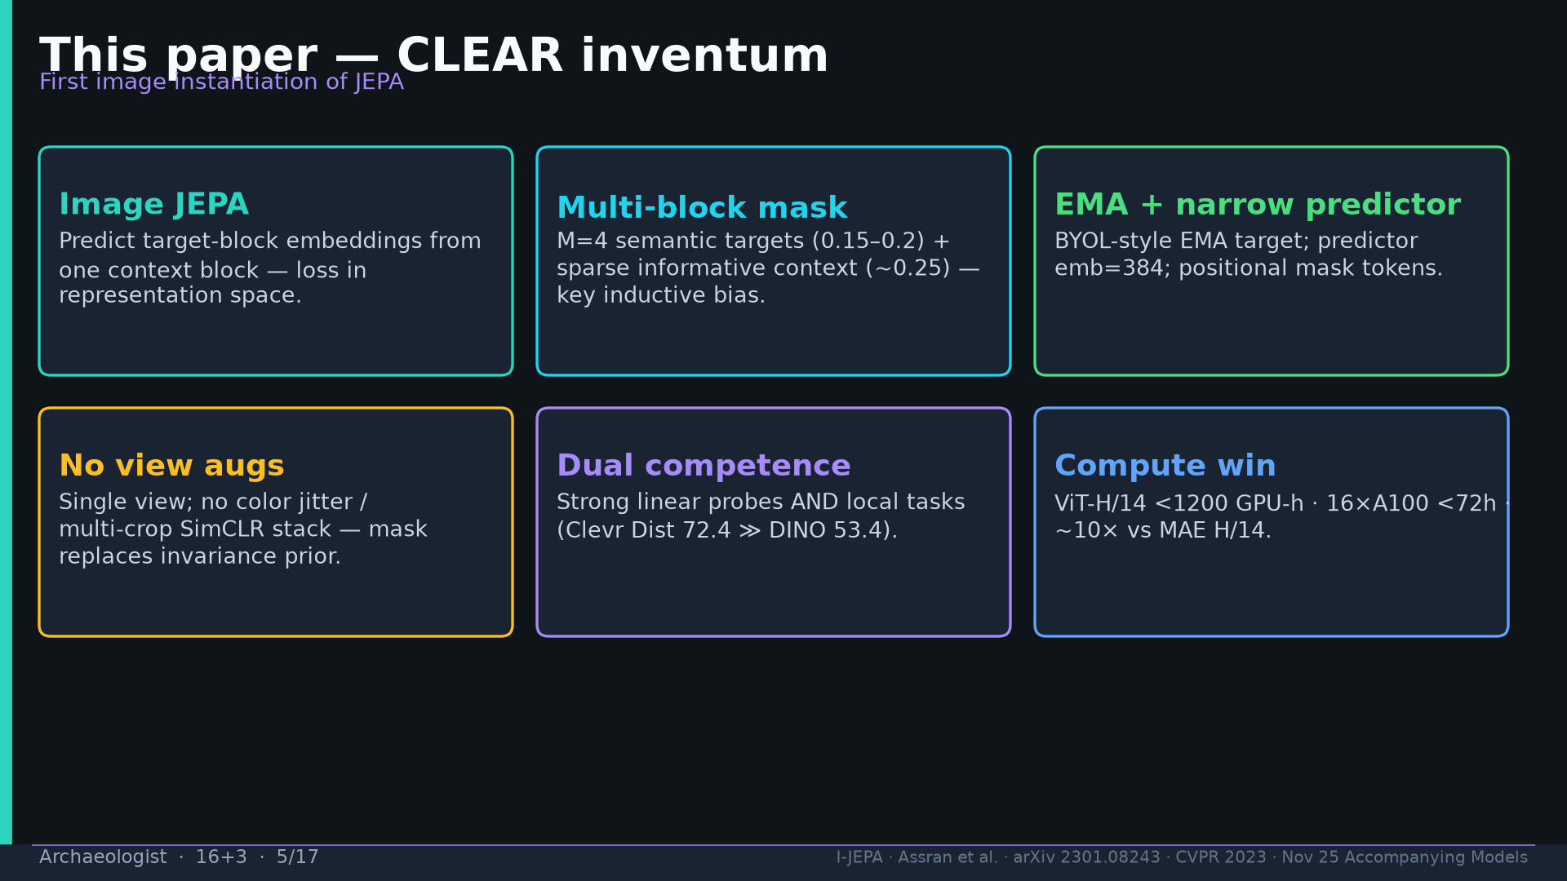
Notes:
Inventum: image JEPA + multi-block + EMA + narrow predictor; no view augs; dual competence; compute win.

Slide 6
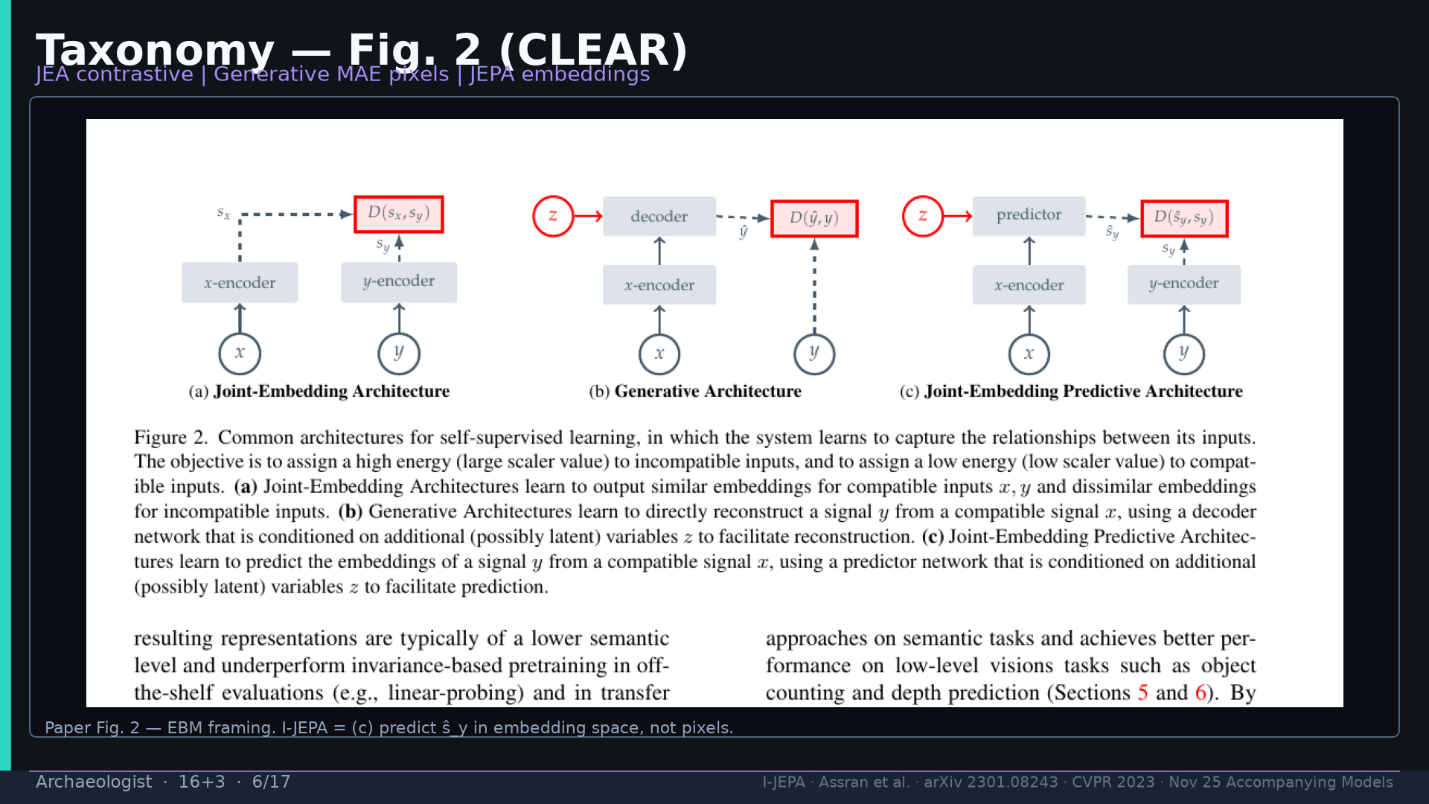
Notes:
Fig.2 taxonomy CLEAR.

Slide 7
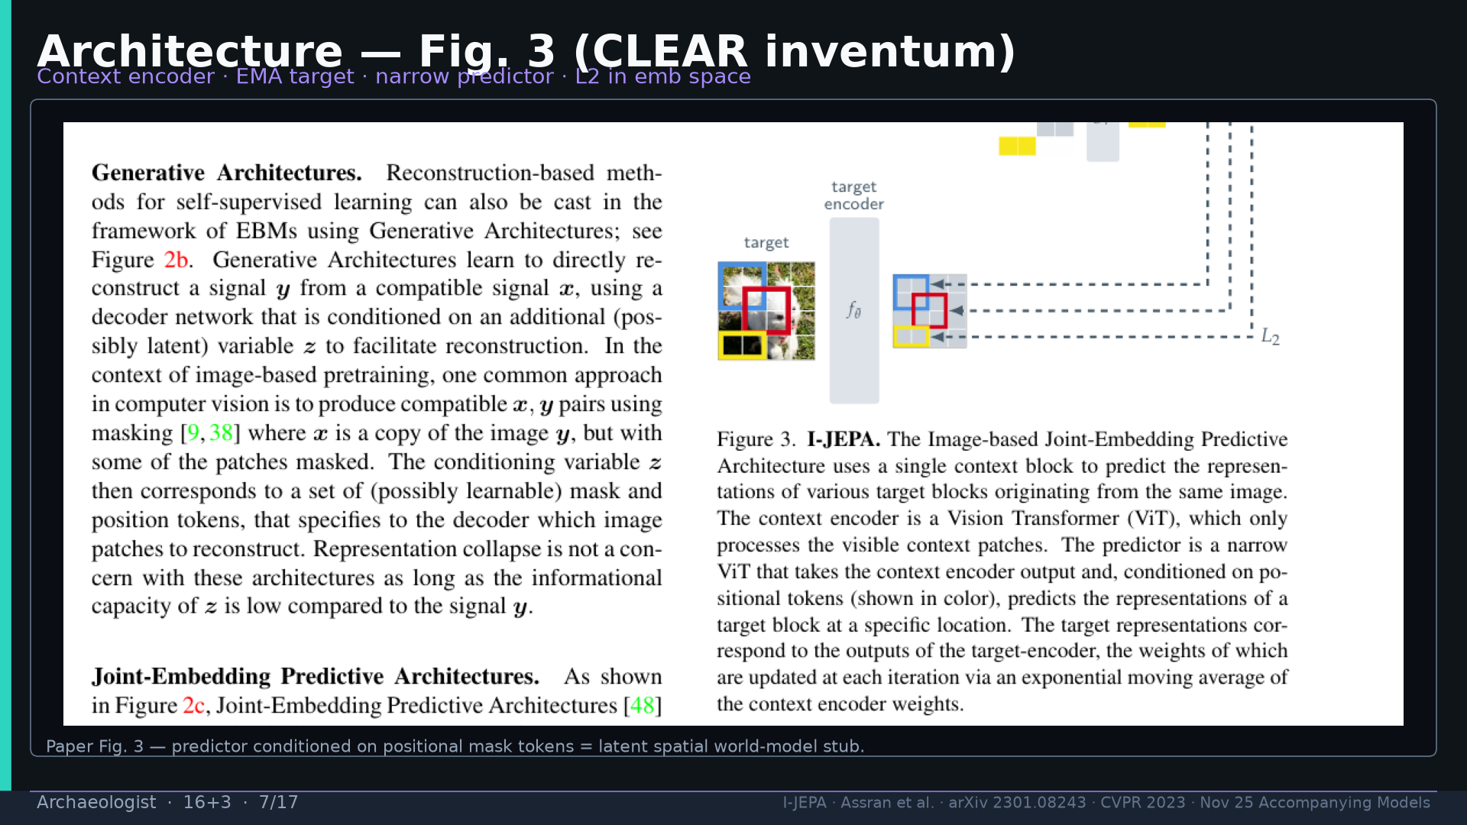
Notes:
Fig.3 architecture CLEAR inventum — predictor = latent spatial WM stub.

Slide 8
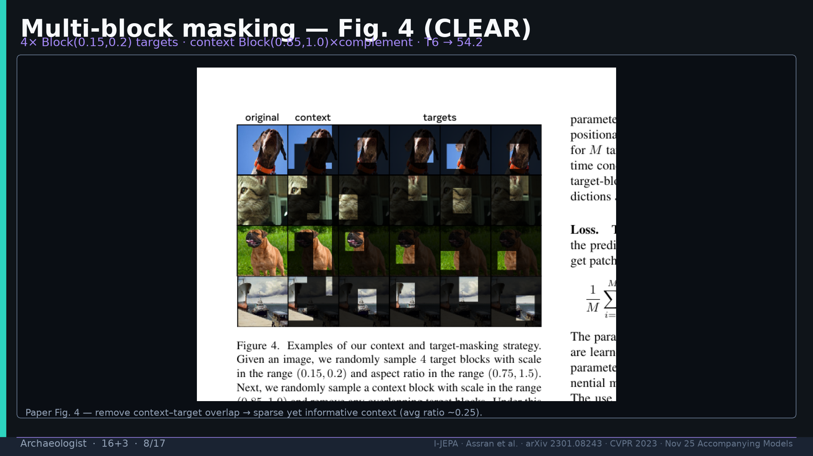
Notes:
Fig.4 multi-block CLEAR — T6 → 54.2.

Slide 9
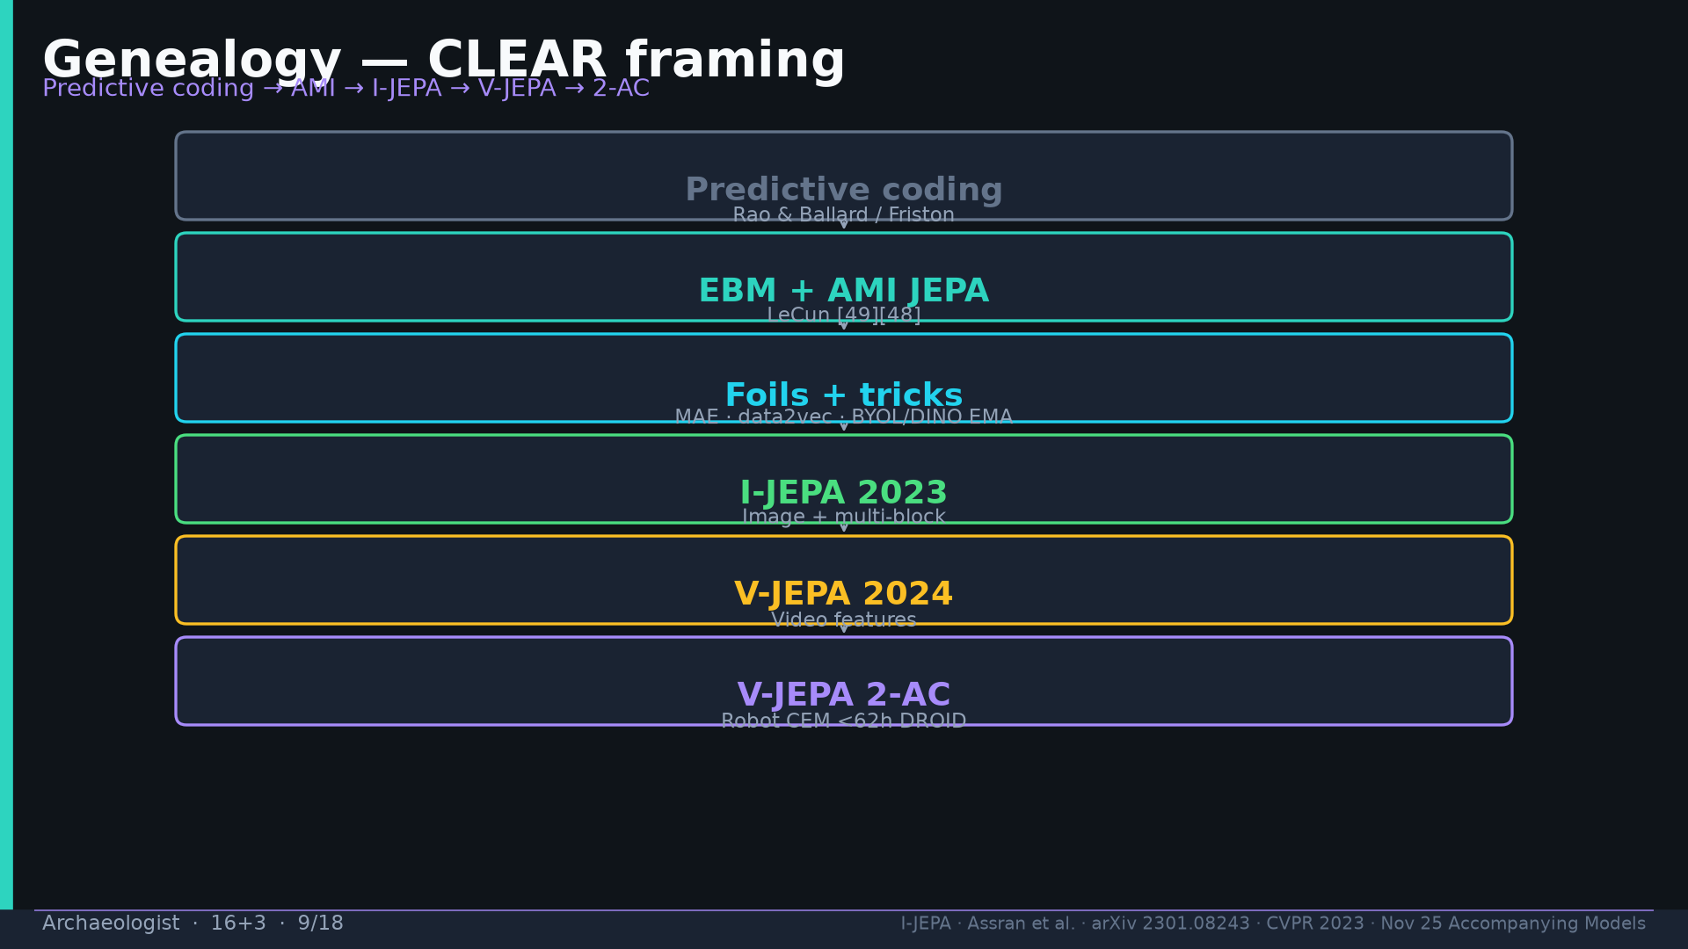
Notes:
Genealogy CLEAR: predictive coding → EBM/AMI → foils → I-JEPA → V-JEPA → 2-AC.

Slide 10
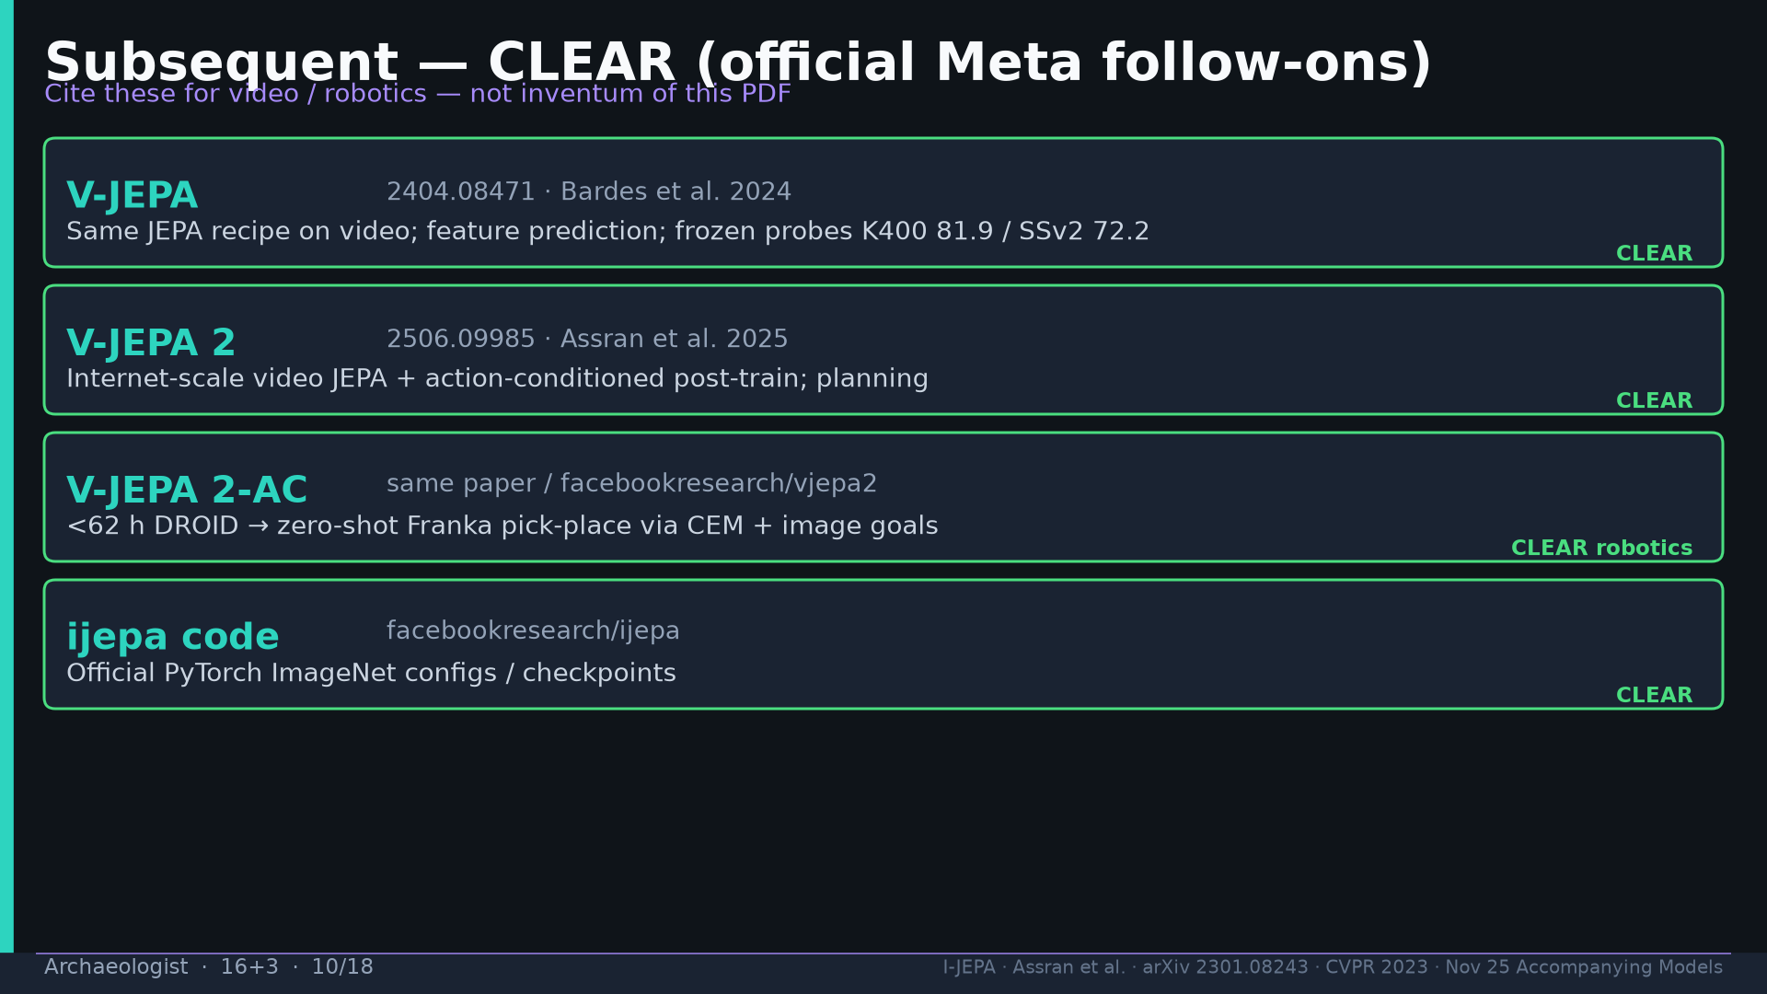
Notes:
Subsequent CLEAR: V-JEPA 2404.08471 → V-JEPA 2 / 2-AC 2506.09985 (<62h DROID → Franka CEM).

Slide 11
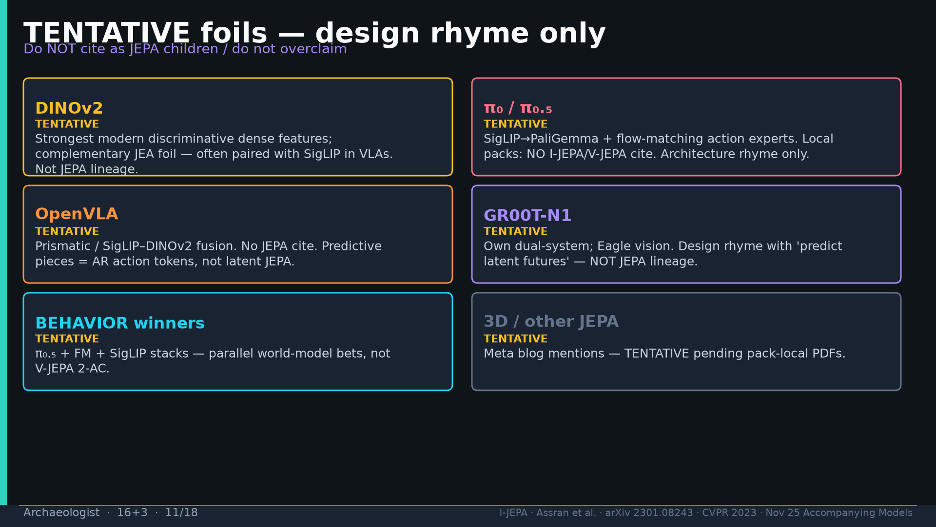
Notes:
TENTATIVE foils: DINOv2, π₀/π₀.₅, OpenVLA, GR00T, BEHAVIOR winners — design rhyme only.

Slide 12
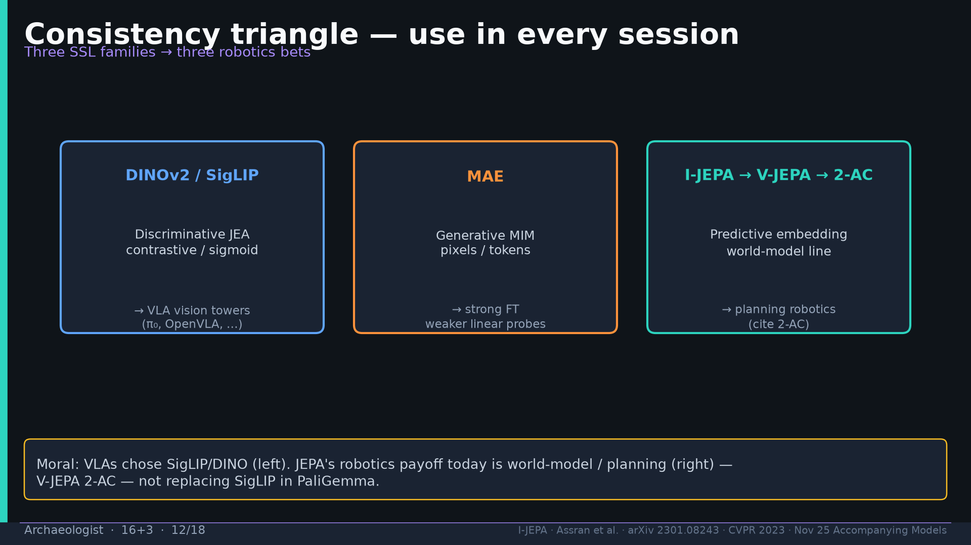
Notes:
Consistency triangle: DINOv2/SigLIP | MAE | I-JEPA→V-JEPA→2-AC.

Slide 13
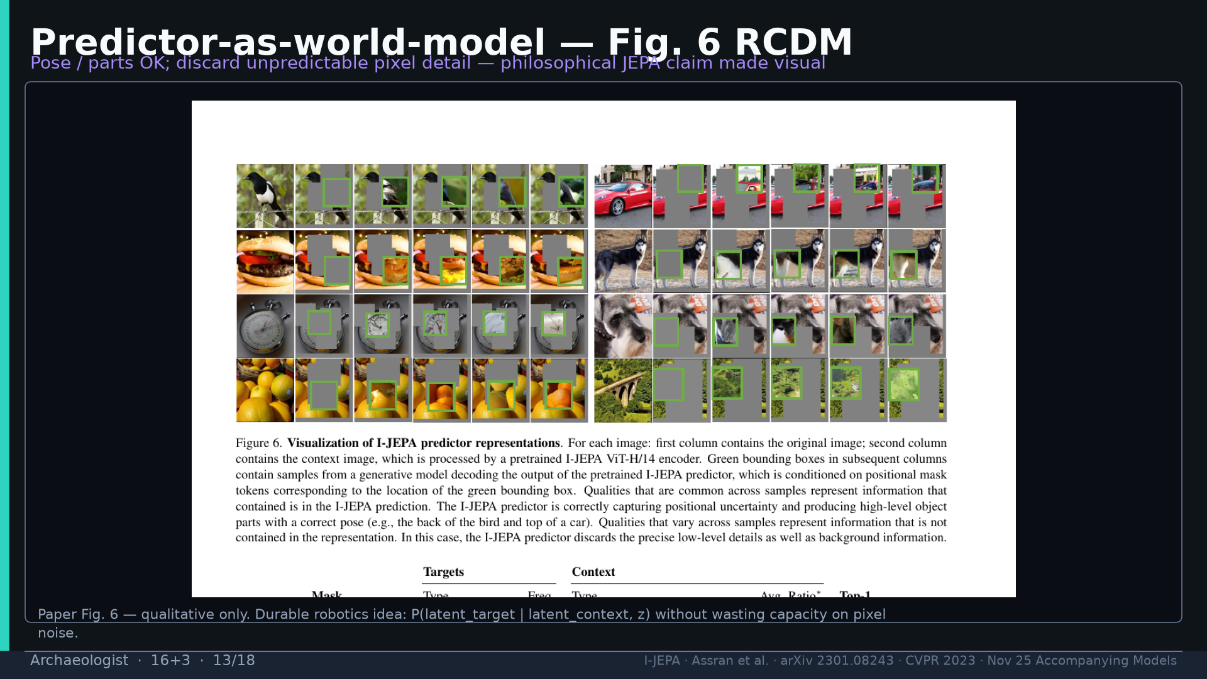
Notes:
Fig.6 RCDM — predictor-as-world-model visual; qualitative only.

Slide 14
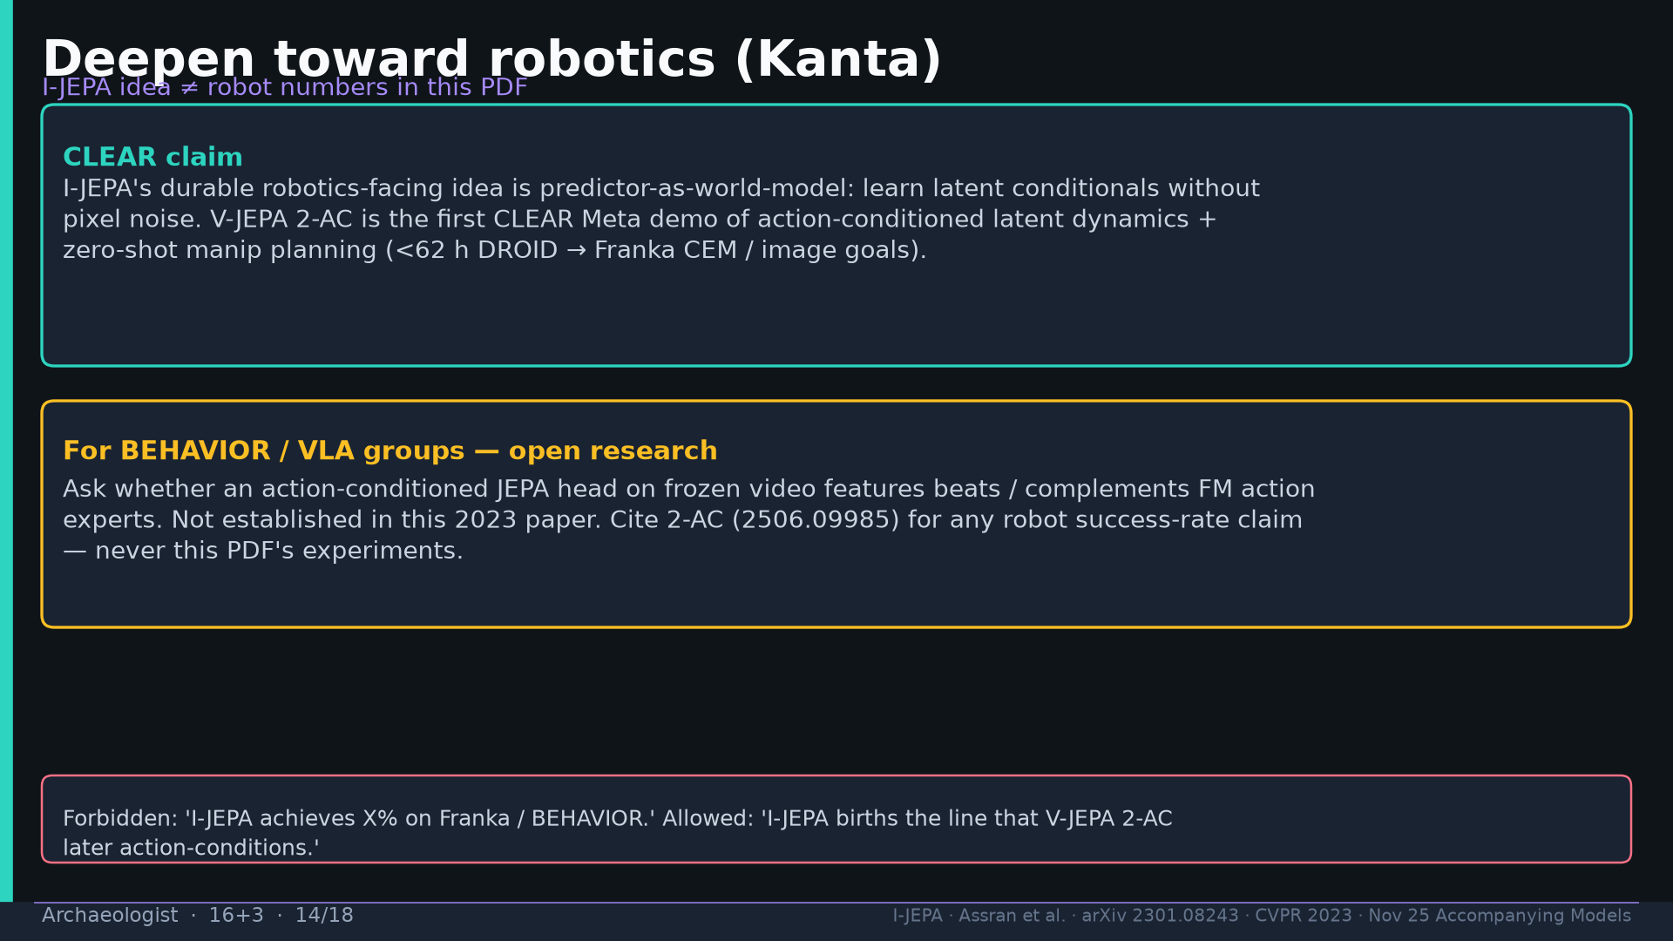
Notes:
Deepen robotics: cite 2-AC for robot SR; open research on action-JEPA head vs FM experts.

Slide 15
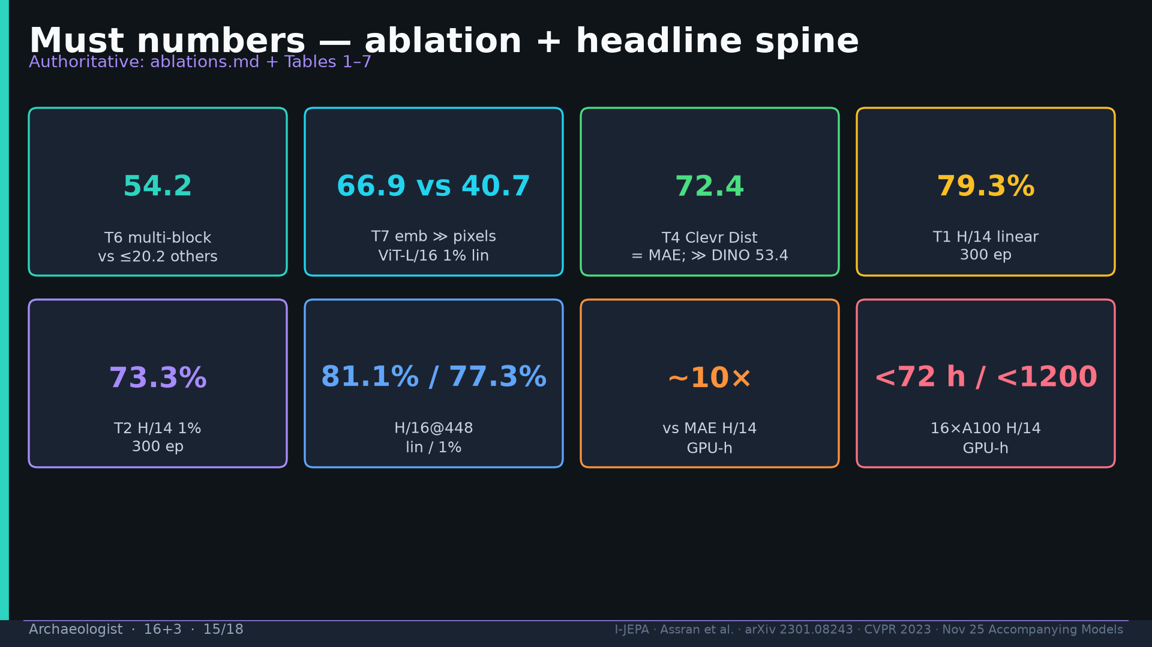
Notes:
Must numbers: 54.2 / 66.9≫40.7 / 72.4 / 79.3 / 73.3 / 81.1·77.3 / ~10× / <72h.

Slide 16
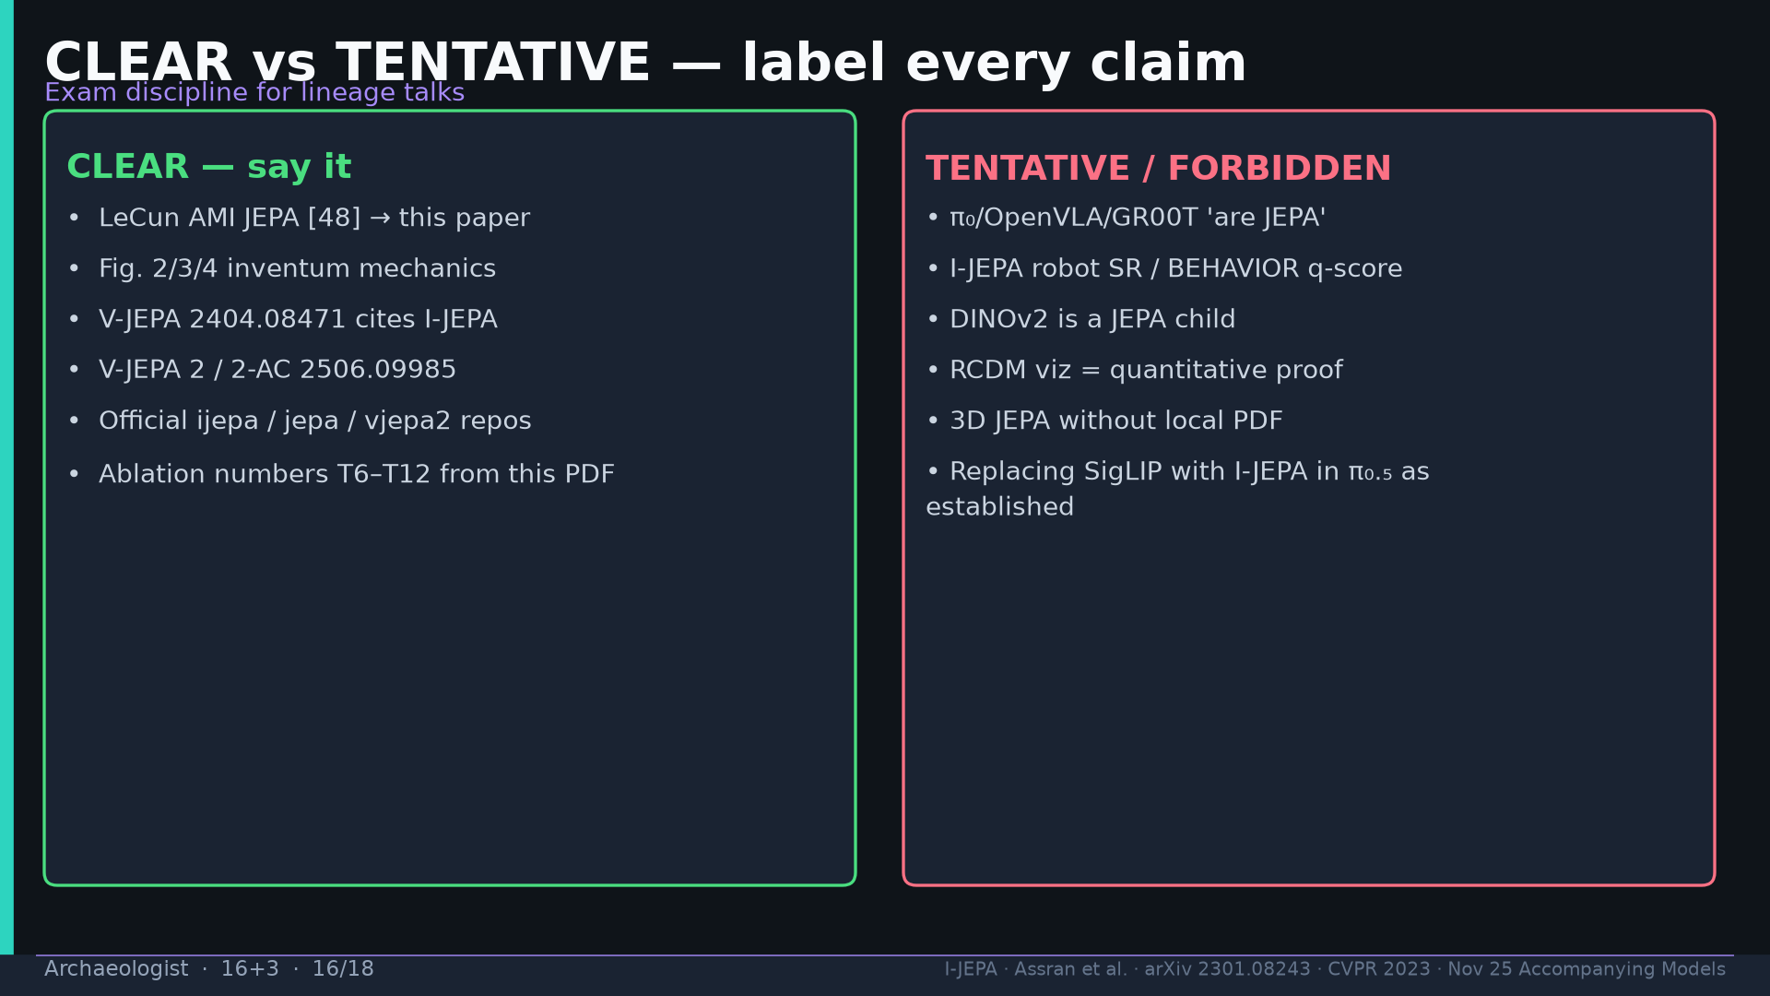
Notes:
CLEAR vs TENTATIVE discipline — exam.

Slide 17
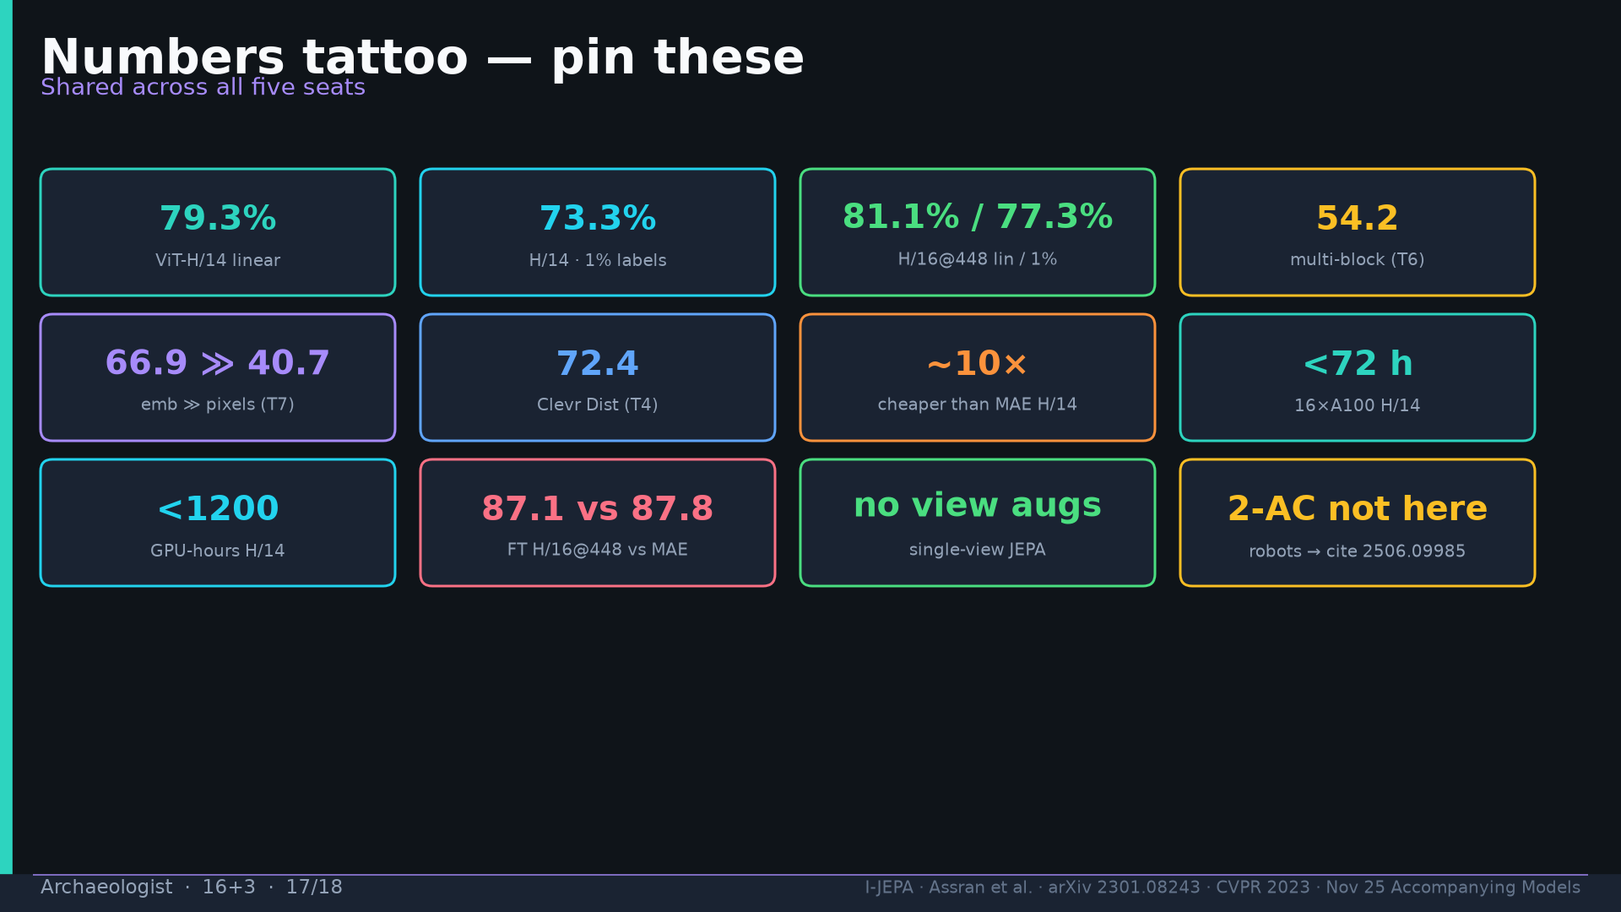
Notes:
Tattoo.

Slide 18
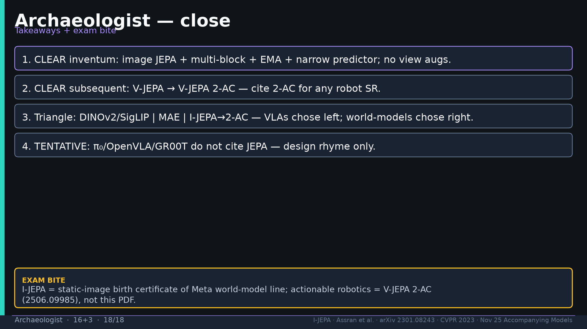
Notes:
Close + exam: birth certificate = I-JEPA; actionable robots = 2-AC.

