Slide 1
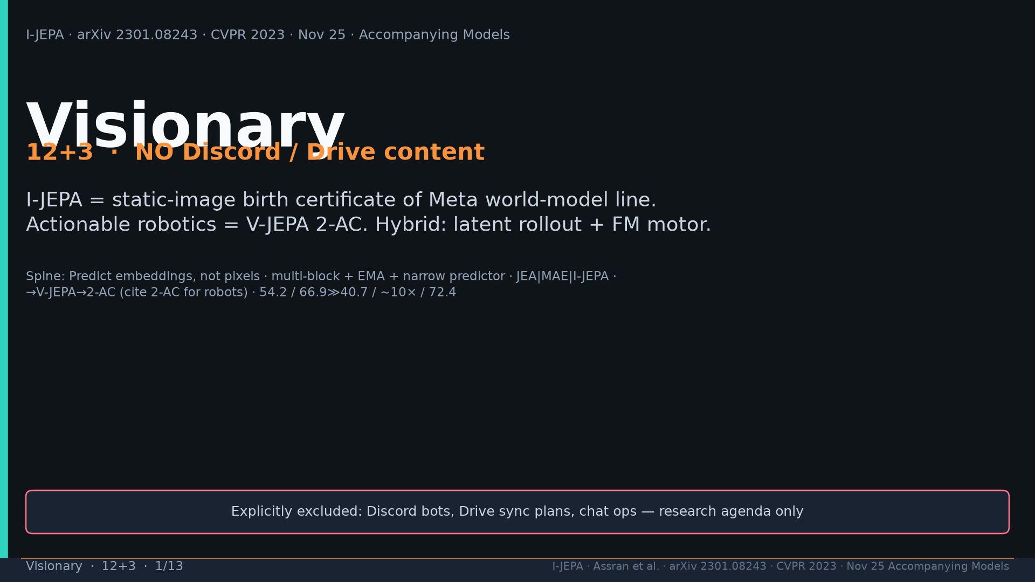
Notes:
Title. NO Discord/Drive. Birth certificate = I-JEPA; actionable = 2-AC.

Slide 2
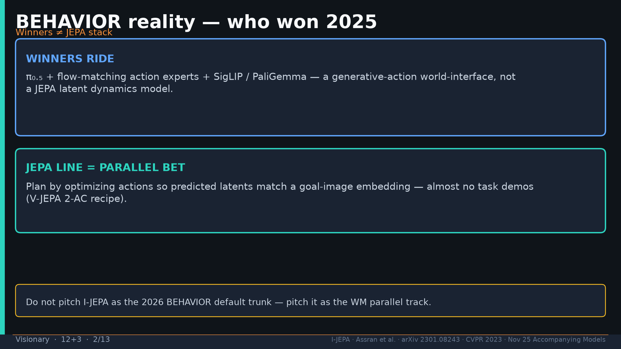
Notes:
BEHAVIOR winners = π₀.₅+FM+SigLIP. JEPA = parallel latent-plan bet.

Slide 3
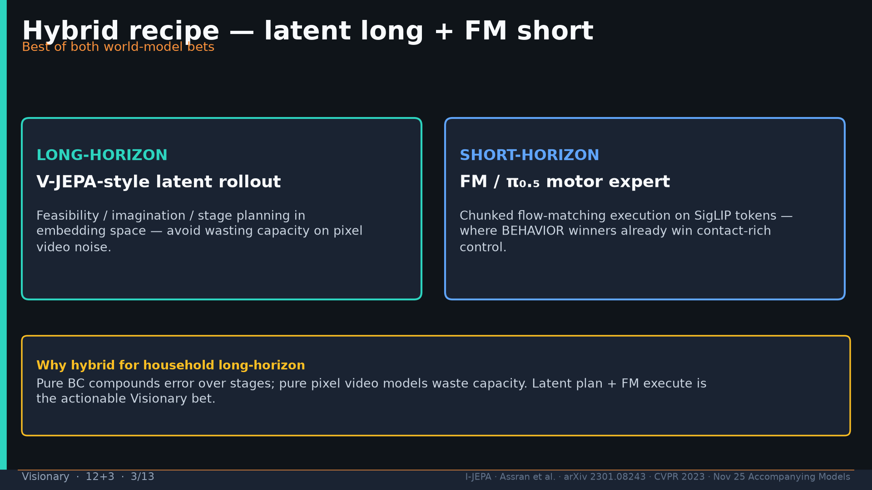
Notes:
Hybrid: V-JEPA-style latent rollout long-horizon + FM motor short-horizon.

Slide 4
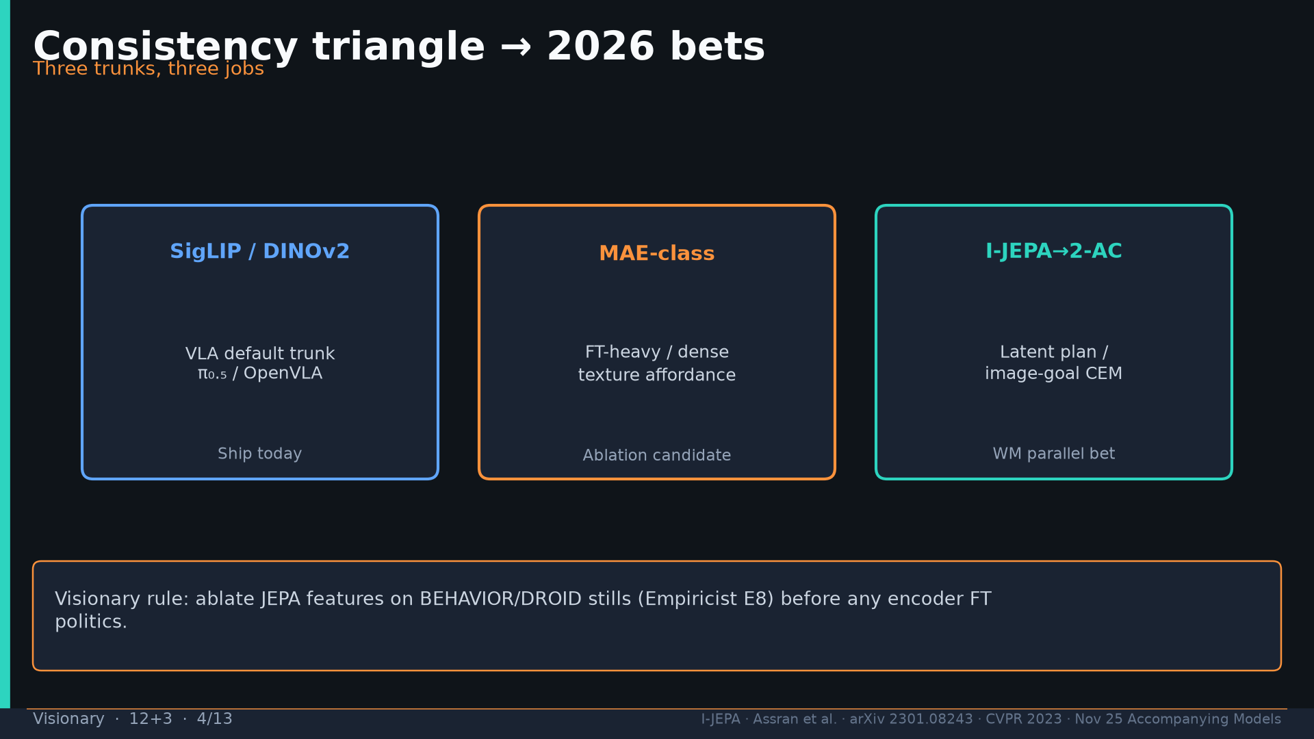
Notes:
Triangle: SigLIP/DINO ship today | MAE ablation | I-JEPA→2-AC WM parallel. E8 before FT politics.

Slide 5
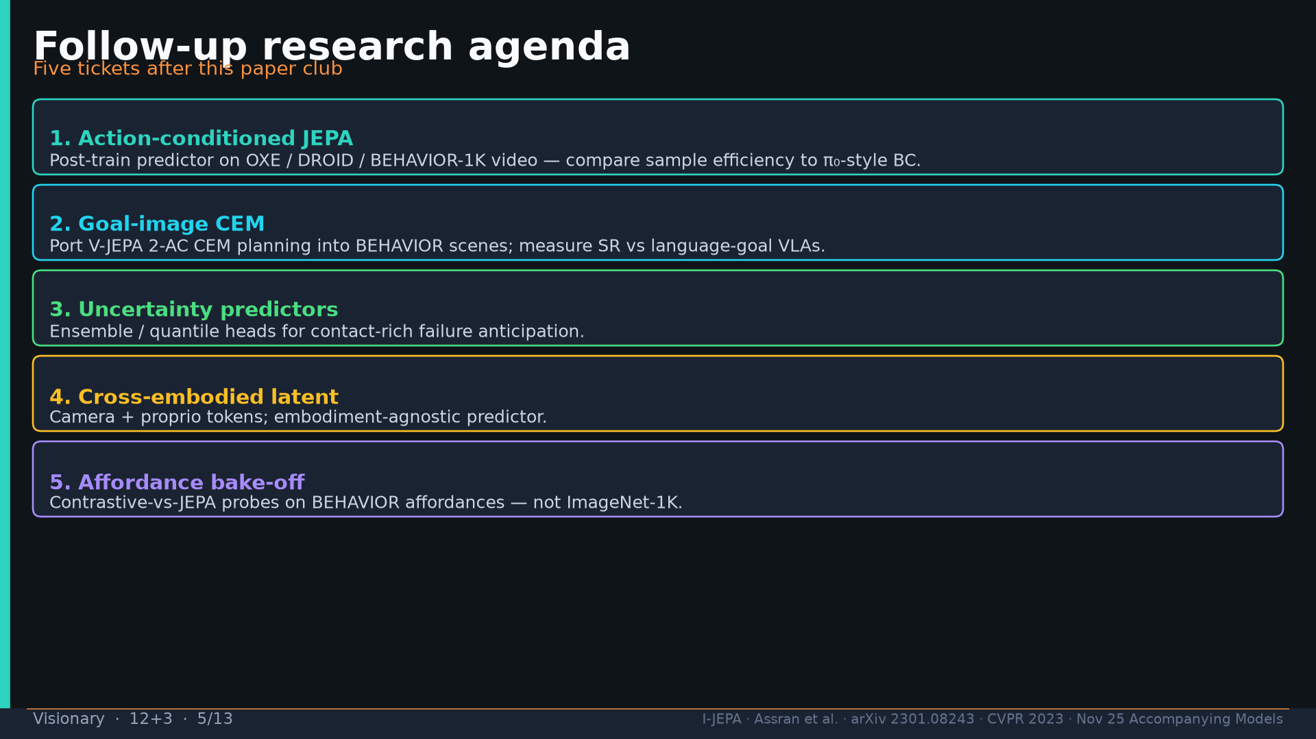
Notes:
Follow-ups: action-JEPA on OXE/DROID; goal-image CEM; uncertainty; cross-embodied; affordance bake-off.

Slide 6
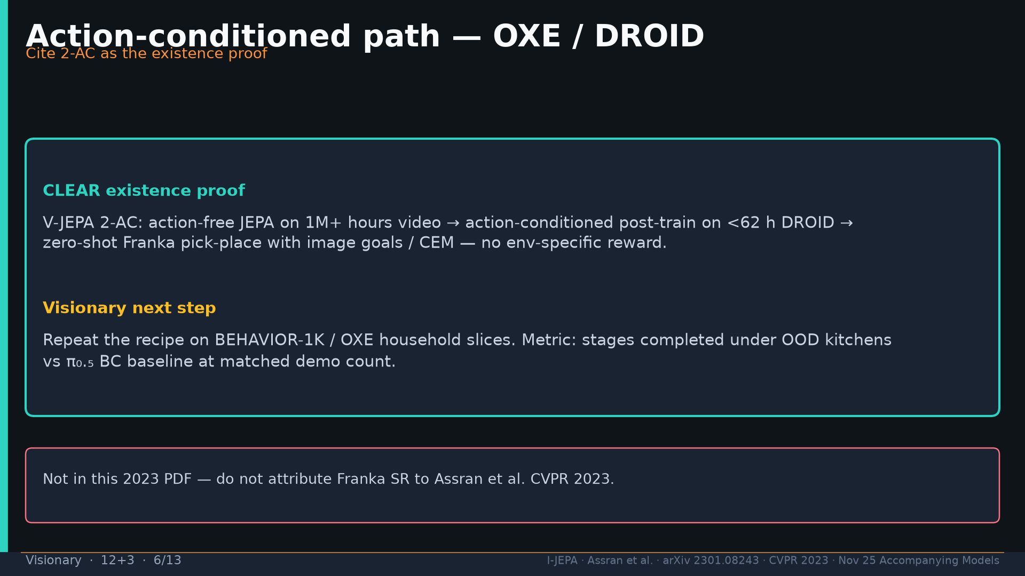
Notes:
2-AC existence proof <62h DROID → Franka CEM. Next: BEHAVIOR-1K / OXE household. Don't attribute SR to 2023 PDF.

Slide 7
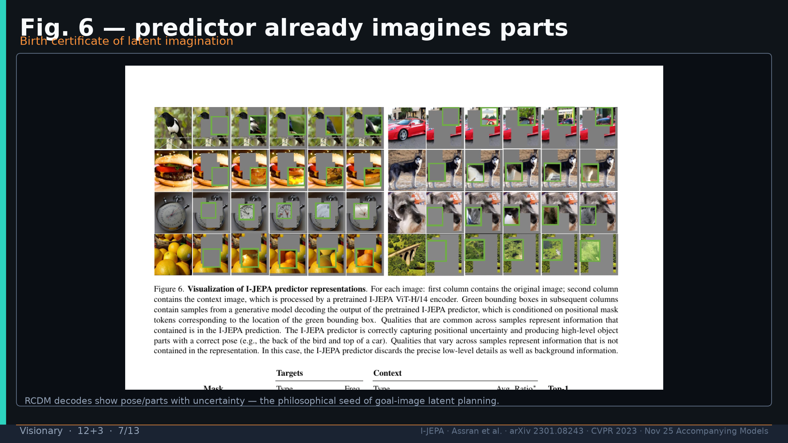
Notes:
Fig.6 RCDM — seed of latent imagination.

Slide 8
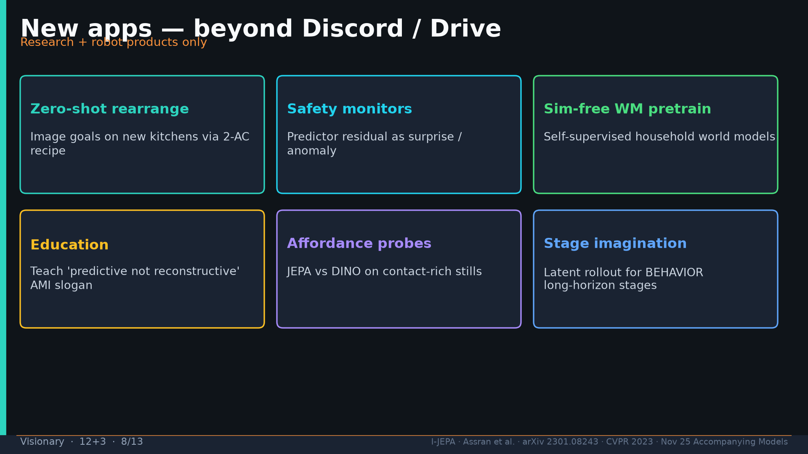
Notes:
Apps: rearrange image-goals; safety residuals; sim-free WM; education; affordance; stage imagination. No Discord/Drive.

Slide 9
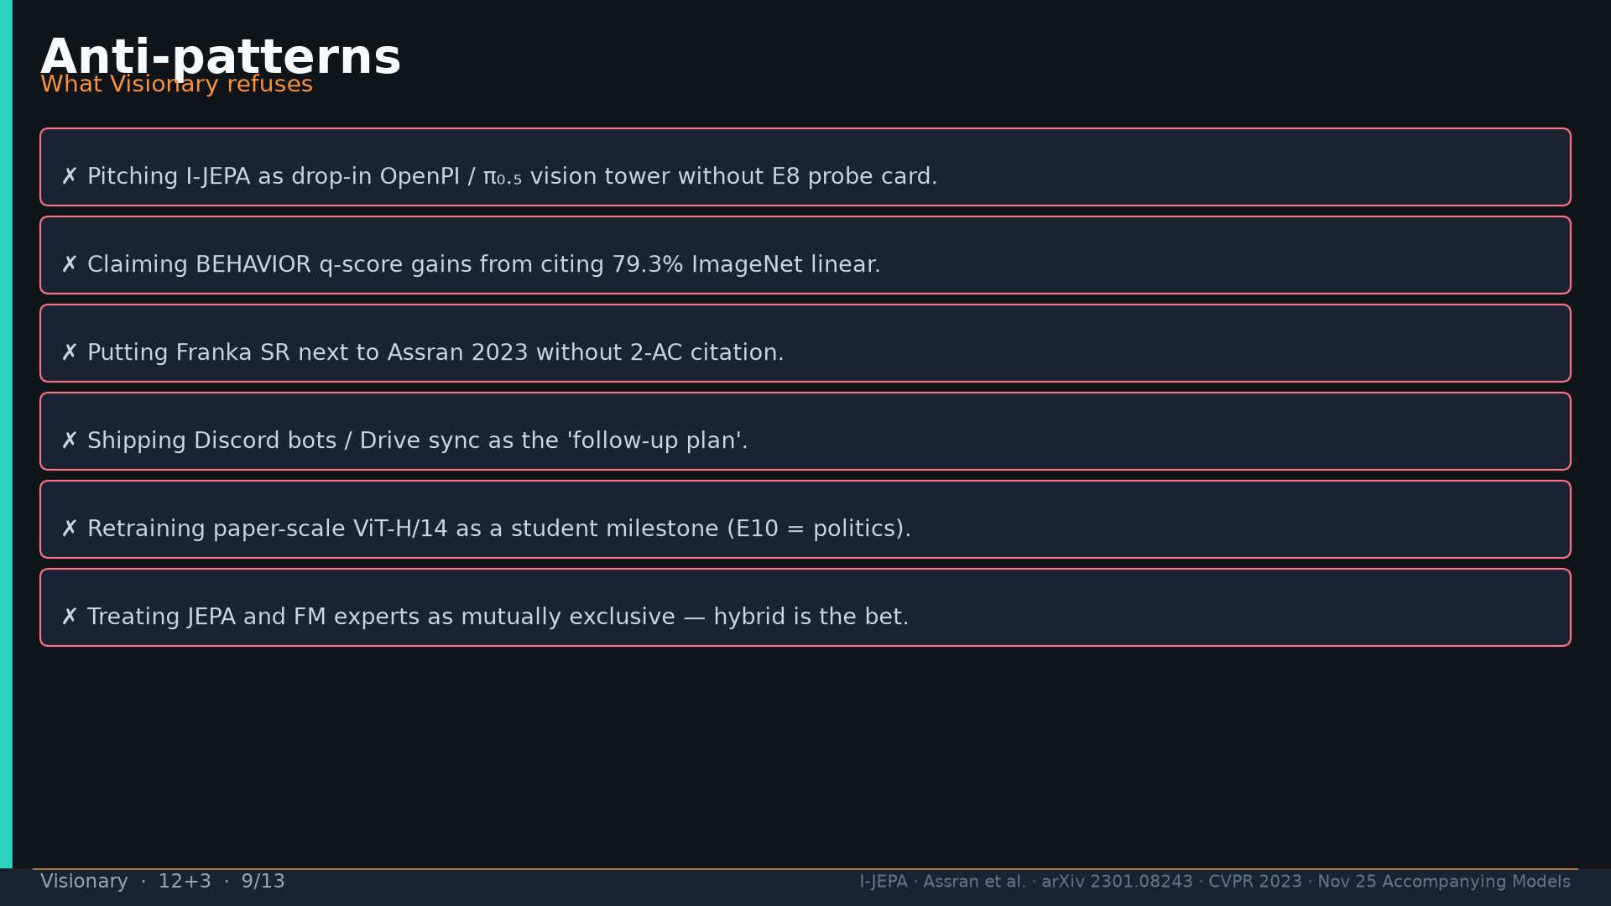
Notes:
Anti-patterns: drop-in tower without E8; IN%→q-score; Franka without 2-AC cite; Discord plans; E10 as milestone; exclusive FM vs JEPA.

Slide 10
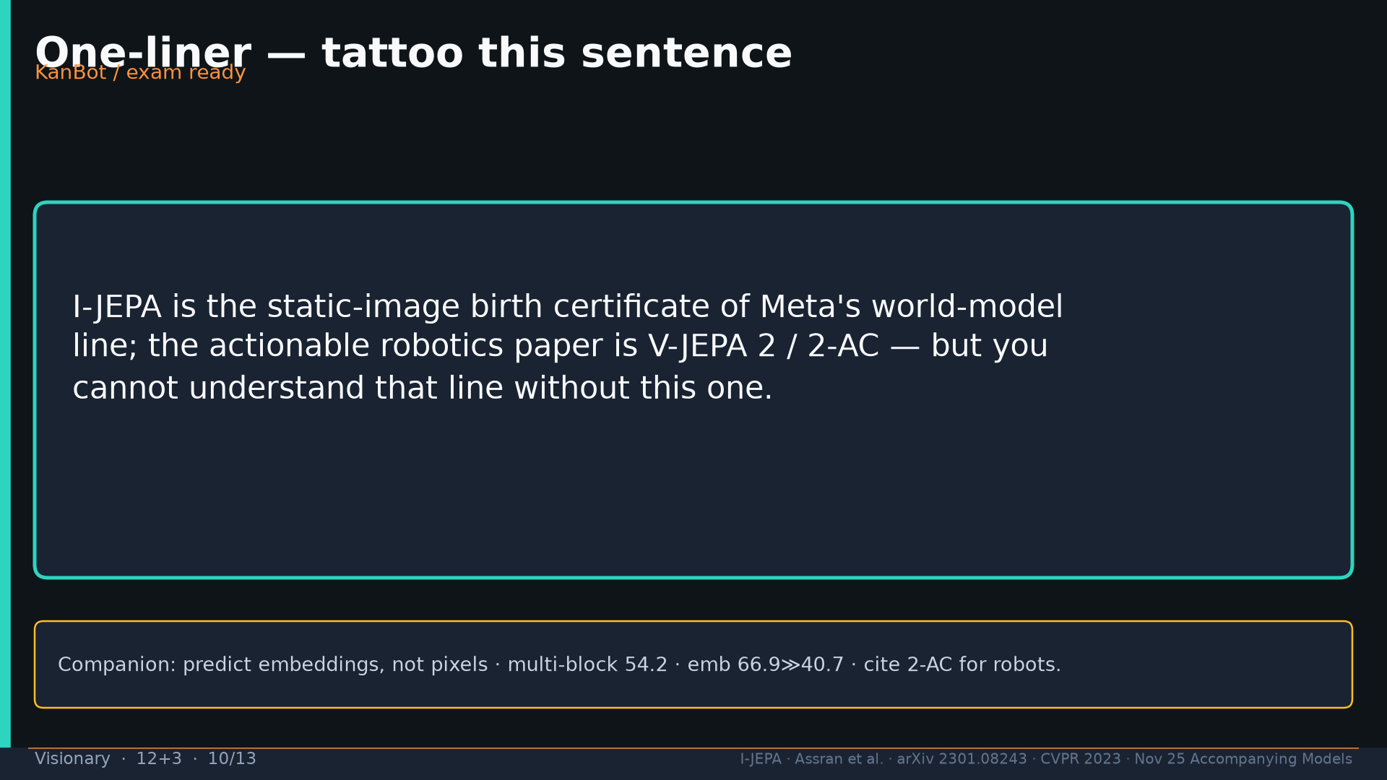
Notes:
One-liner tattoo.

Slide 11
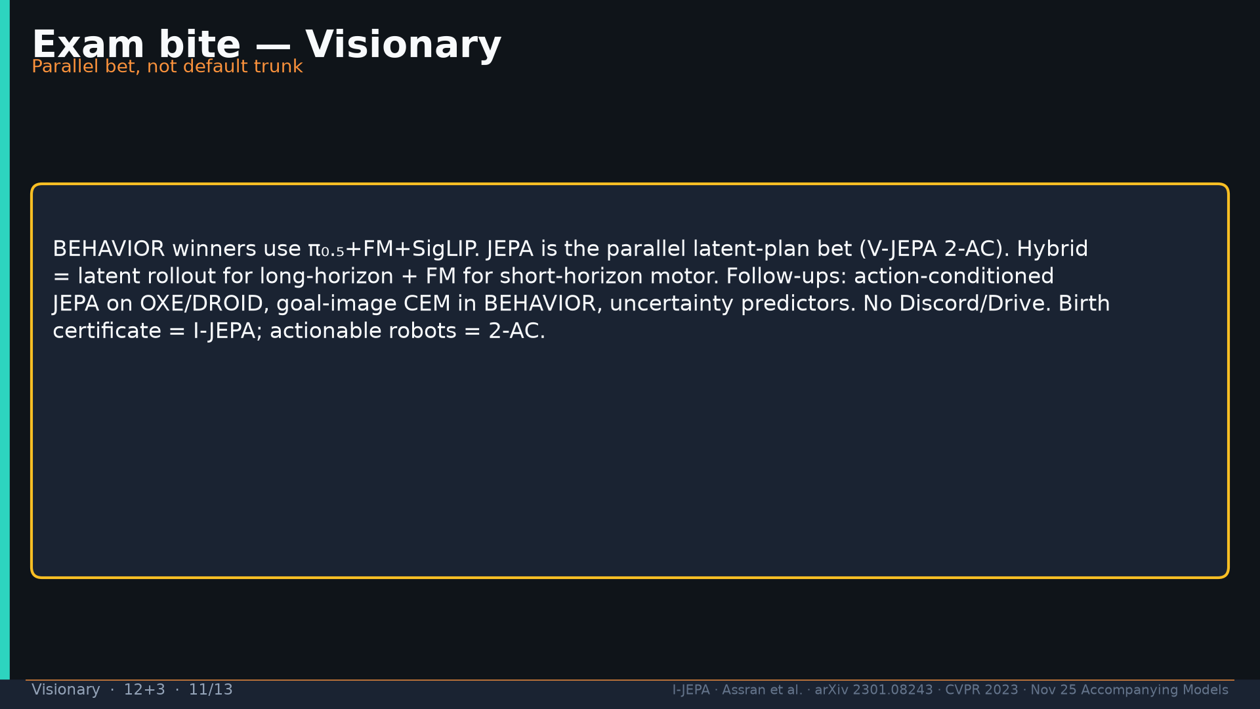
Notes:
Exam bite paragraph.

Slide 12
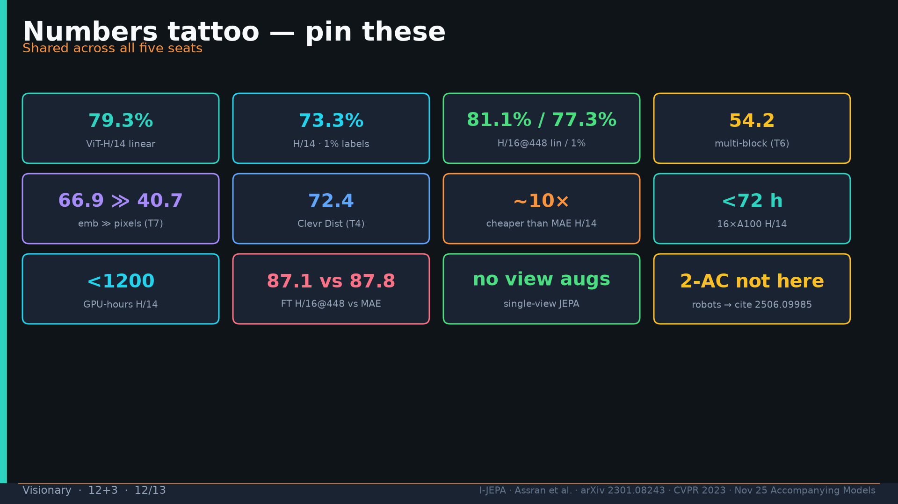
Notes:
Tattoo numbers.

Slide 13
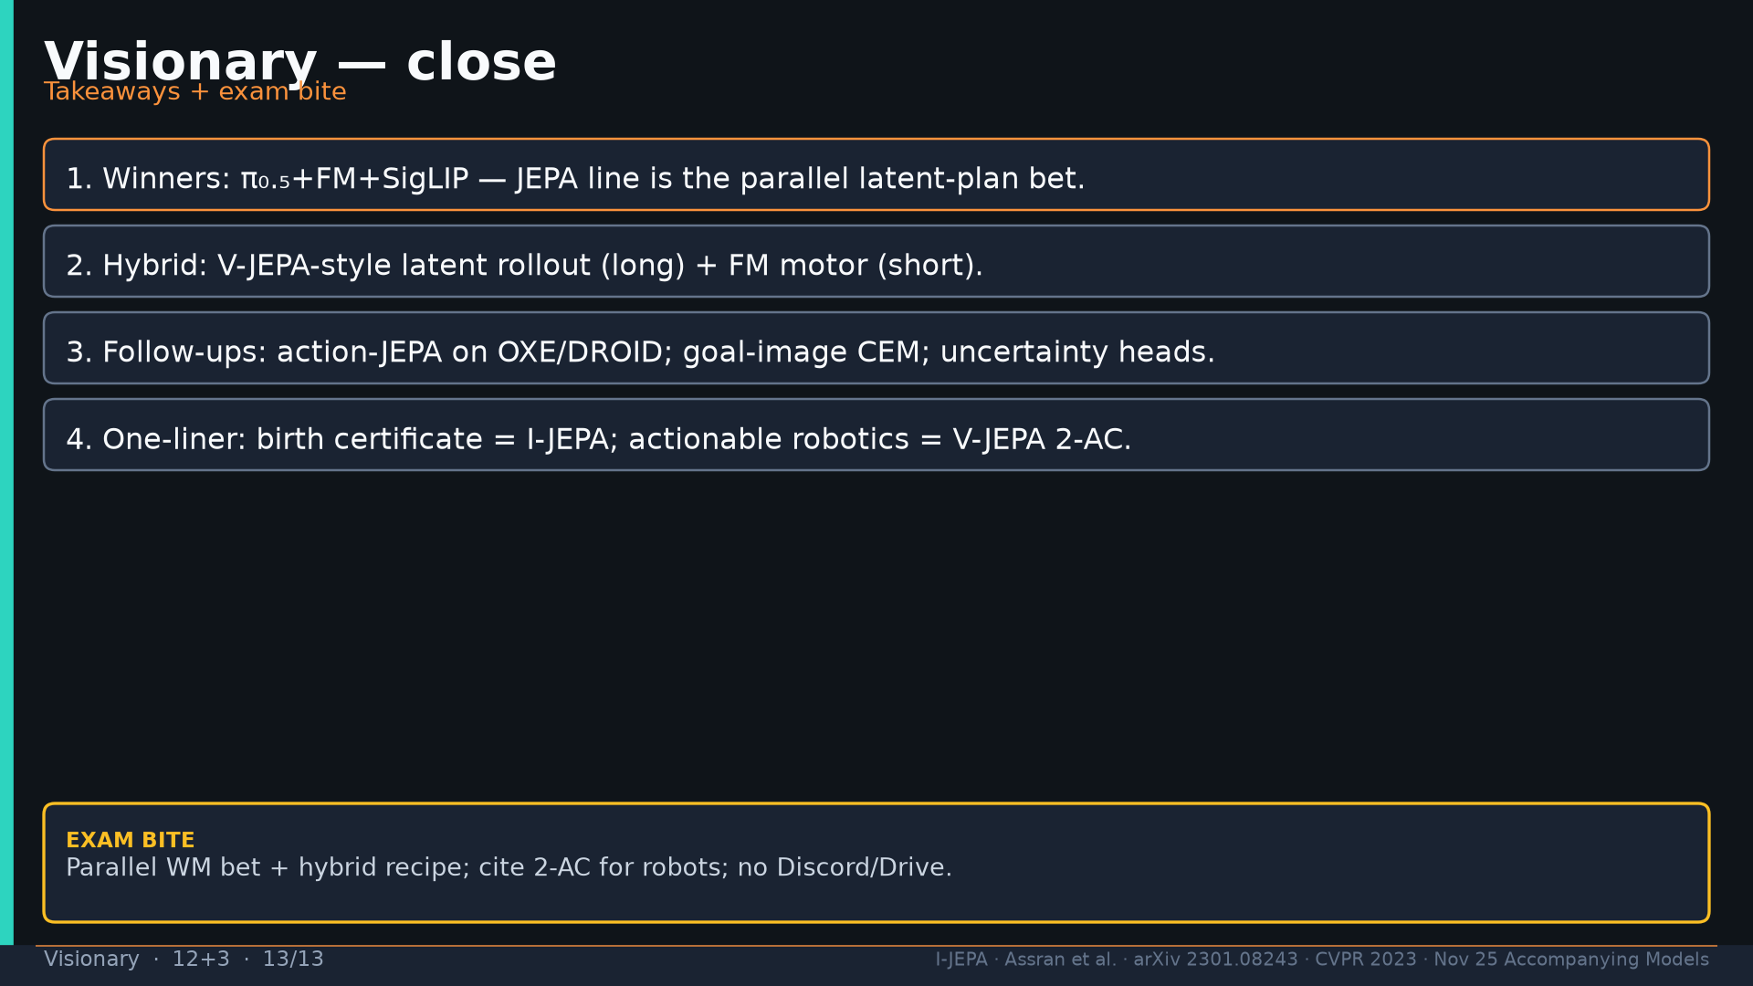
Notes:
Close four takeaways. NO Discord/Drive.

