Slide 1
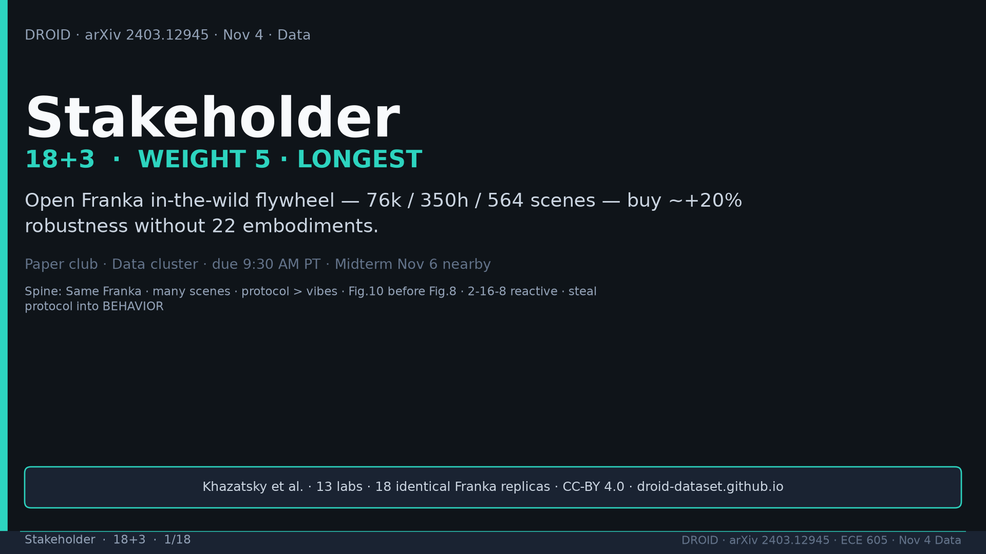
Notes:
Stakeholder · 18+3 · 1/18
Title. Product one-liner: open Franka in-the-wild flywheel 76k/350h/564. Weight 5 longest. Midterm Nov 6 nearby.
Tattoo: 76k / 350h / 564 scenes / 86 tasks / 52 buildings / +22% ID / +17% OOD / obs2-pred16-action8 @15Hz / ~40k co-train ≠ 76k

Slide 2
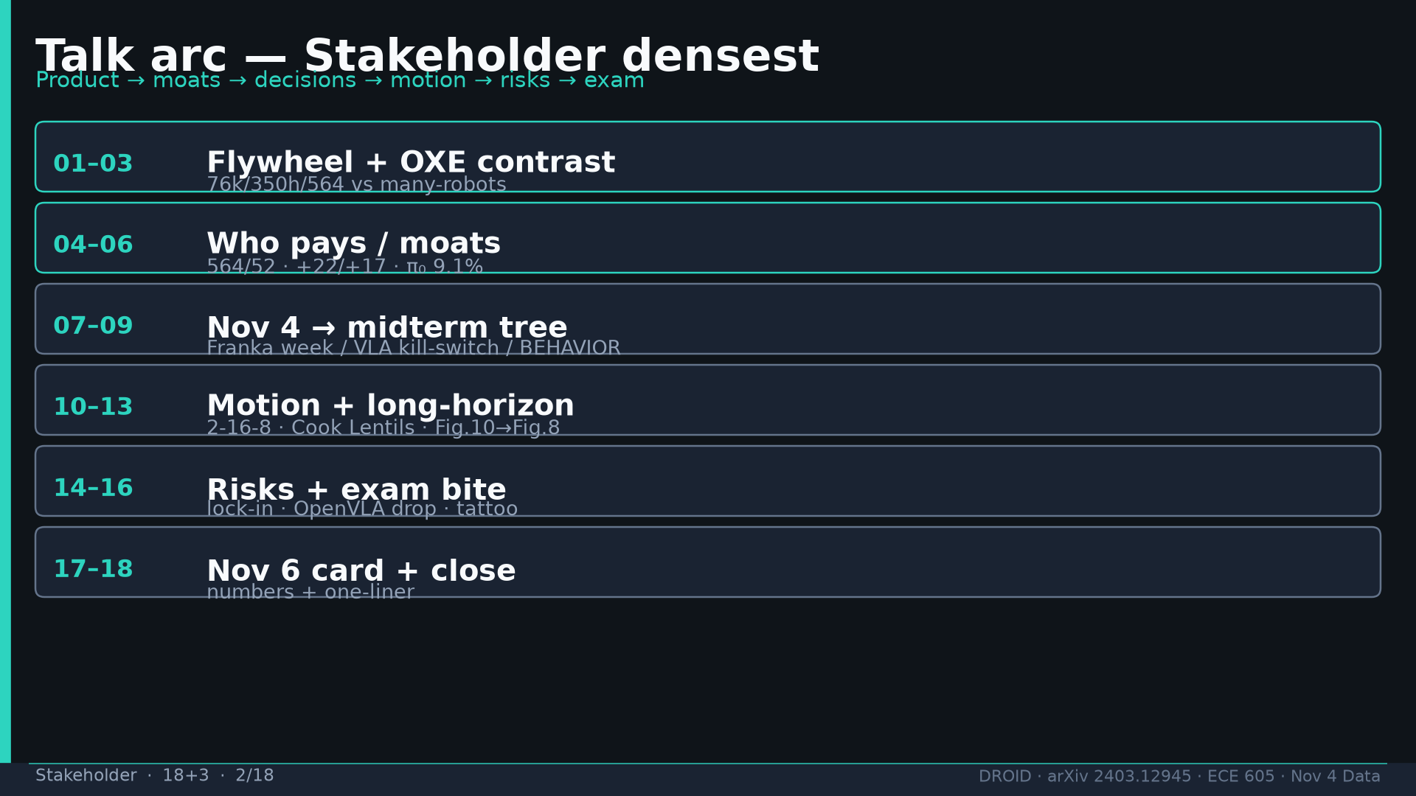
Notes:
Stakeholder · 18+3 · 2/18
Talk arc: flywheel → OXE contrast → who pays/moats → decision tree → motion/long-horizon → Fig10 then Fig8 → risks → exam → tattoo.
Tattoo: 76k / 350h / 564 scenes / 86 tasks / 52 buildings / +22% ID / +17% OOD / obs2-pred16-action8 @15Hz / ~40k co-train ≠ 76k

Slide 3
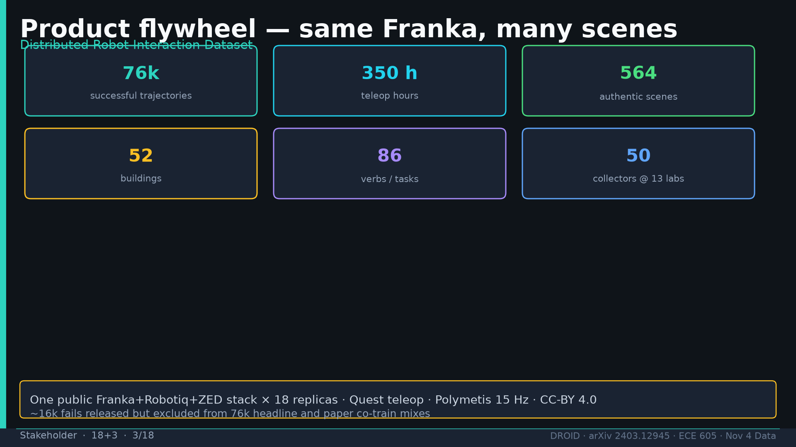
Notes:
Stakeholder · 18+3 · 3/18
Flywheel numbers: 76k traj, 350h, 564 scenes, 52 buildings, 86 verbs, 50 collectors, 13 labs, 18 robots. ~16k fails excluded from 76k.
Tattoo: 76k / 350h / 564 scenes / 86 tasks / 52 buildings / +22% ID / +17% OOD / obs2-pred16-action8 @15Hz / ~40k co-train ≠ 76k

Slide 4
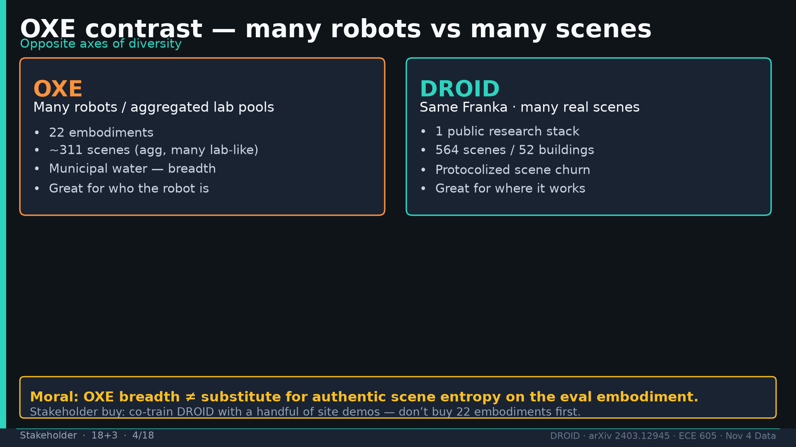
Notes:
Stakeholder · 18+3 · 4/18
OXE = many robots; DROID = same Franka many scenes. Moral: OXE breadth ≠ authentic scene entropy on eval embodiment.
Tattoo: 76k / 350h / 564 scenes / 86 tasks / 52 buildings / +22% ID / +17% OOD / obs2-pred16-action8 @15Hz / ~40k co-train ≠ 76k

Slide 5
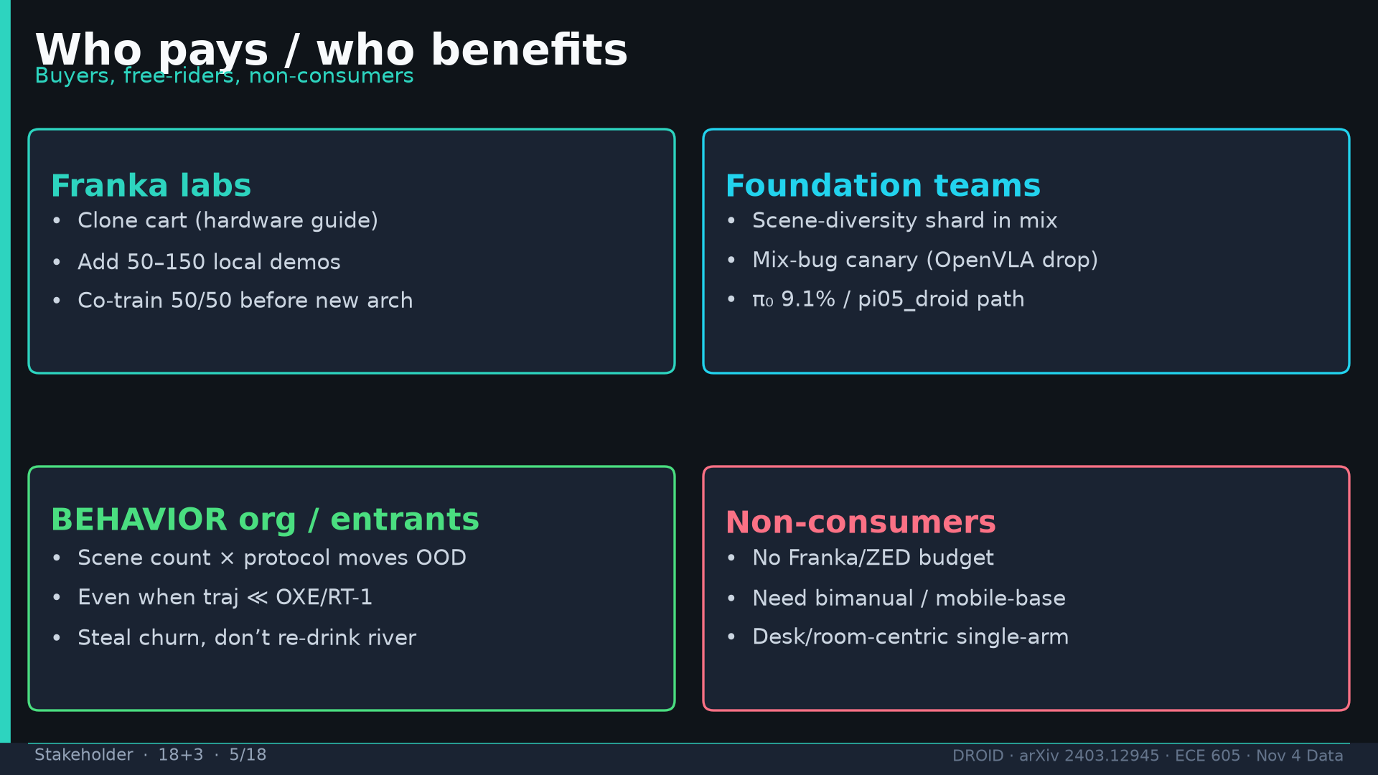
Notes:
Stakeholder · 18+3 · 5/18
Who pays: Franka labs (50-150 demos), foundation teams (shard+canary), BEHAVIOR (protocol). Non-consumers: no Franka/ZED, need bimanual/mobile.
Tattoo: 76k / 350h / 564 scenes / 86 tasks / 52 buildings / +22% ID / +17% OOD / obs2-pred16-action8 @15Hz / ~40k co-train ≠ 76k

Slide 6
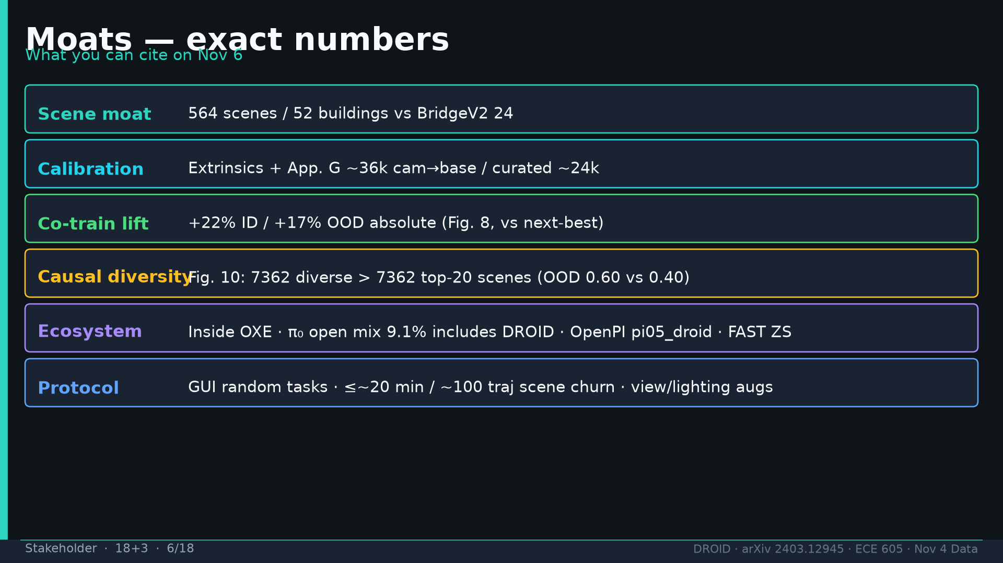
Notes:
Stakeholder · 18+3 · 6/18
Moats: 564/52 vs BridgeV2 24; App.G 36k/24k; +22/+17; Fig10 7362; π₀ 9.1%; protocol knobs.
Tattoo: 76k / 350h / 564 scenes / 86 tasks / 52 buildings / +22% ID / +17% OOD / obs2-pred16-action8 @15Hz / ~40k co-train ≠ 76k

Slide 7
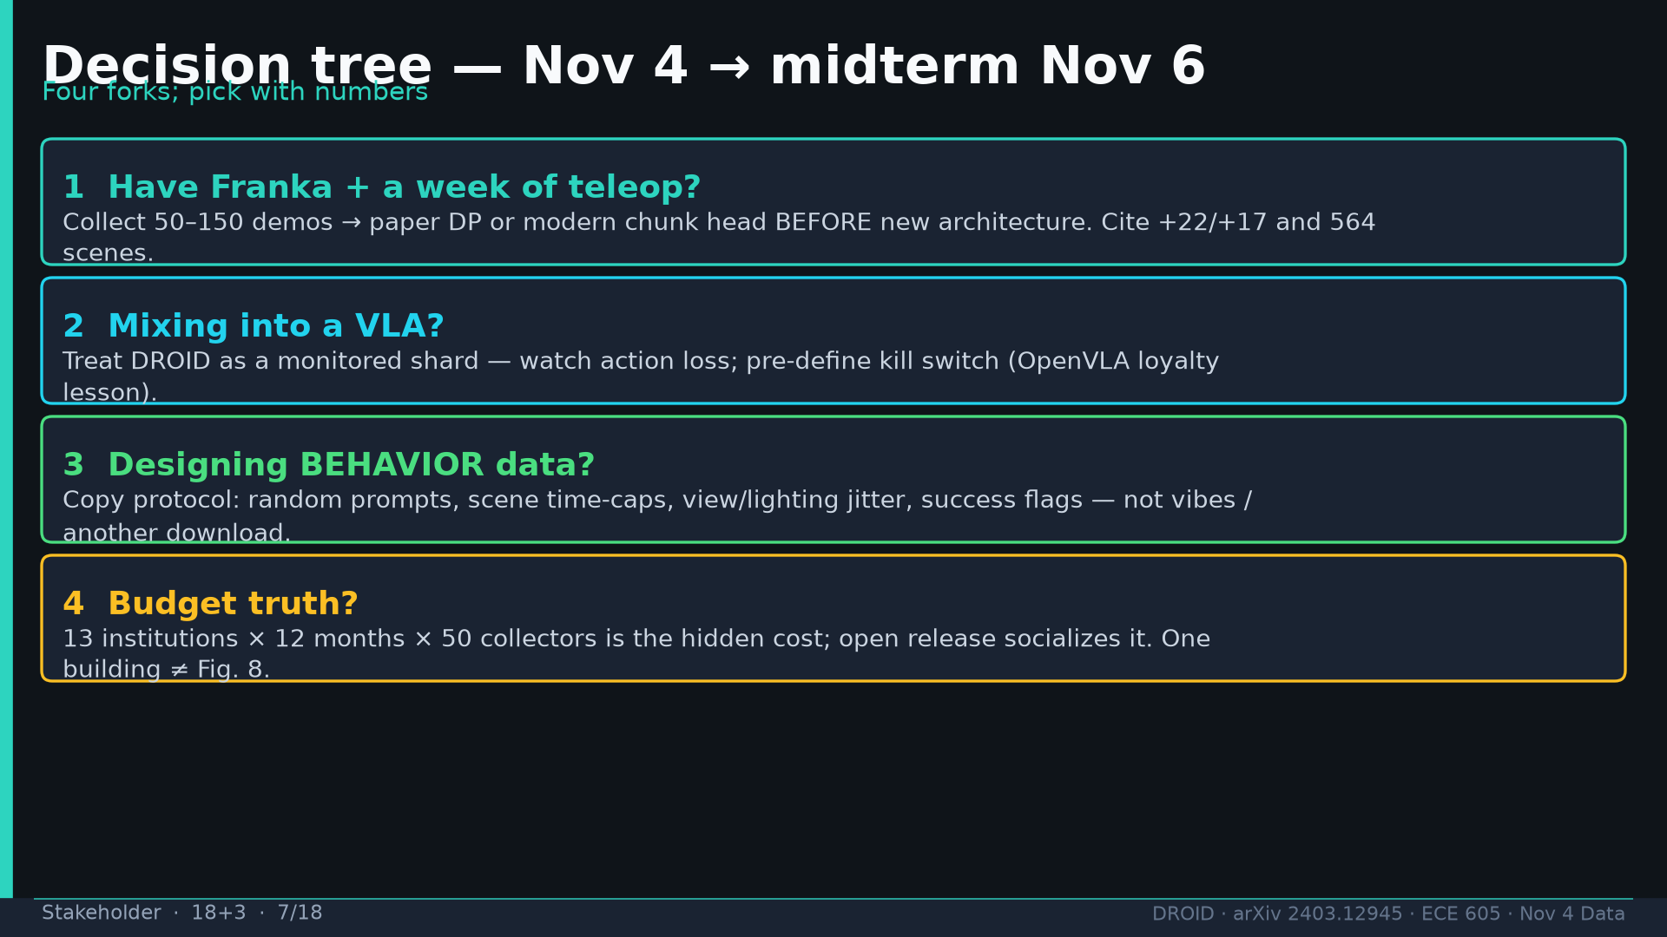
Notes:
Stakeholder · 18+3 · 7/18
Decision tree Nov4→Nov6: (1) Franka week demos (2) VLA mix kill-switch (3) BEHAVIOR protocol copy (4) budget truth 13×12×50.
Tattoo: 76k / 350h / 564 scenes / 86 tasks / 52 buildings / +22% ID / +17% OOD / obs2-pred16-action8 @15Hz / ~40k co-train ≠ 76k

Slide 8
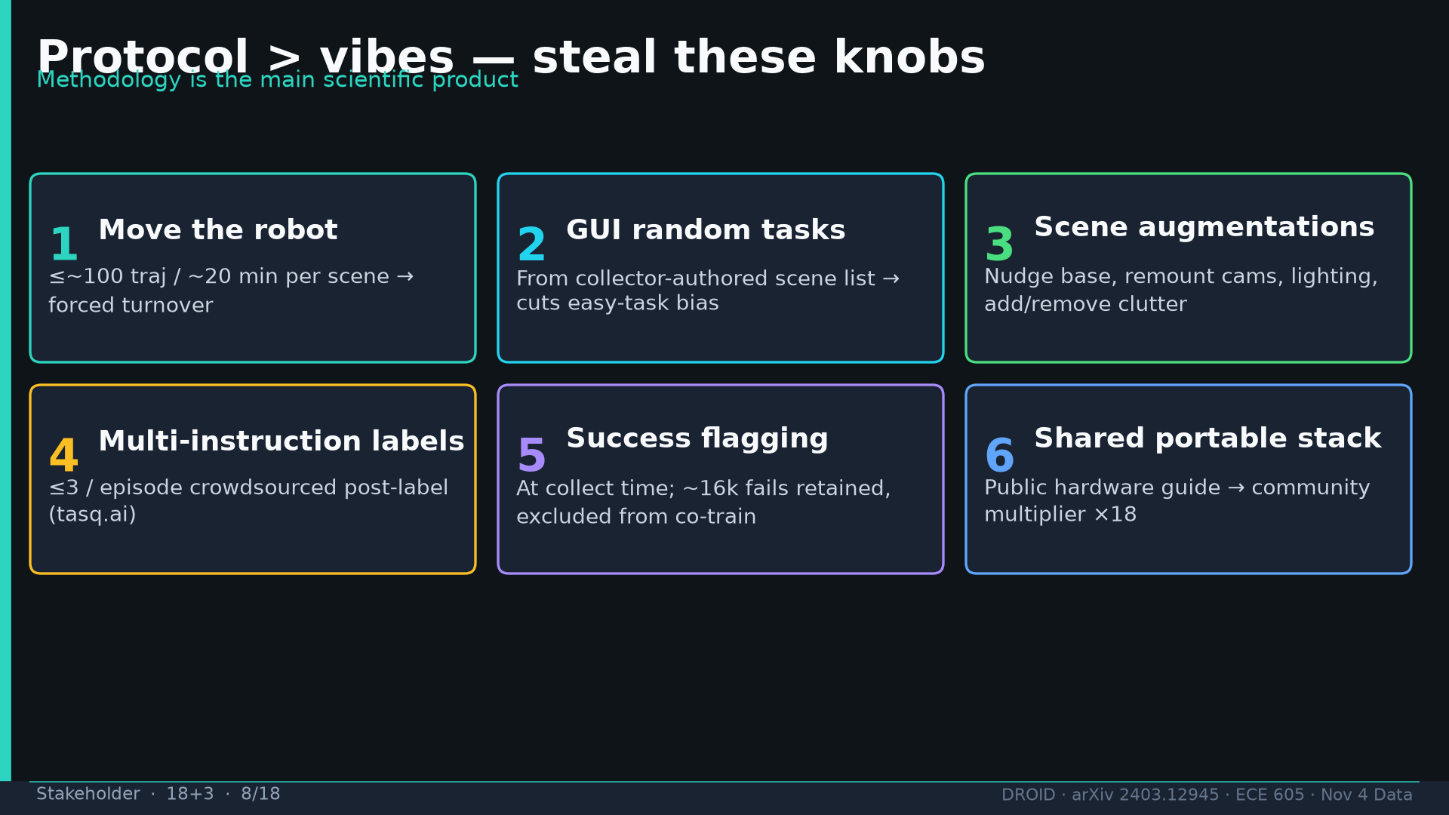
Notes:
Stakeholder · 18+3 · 8/18
Protocol > vibes: move robot ≤20min, GUI random tasks, augs, multi-instruction, success flags, shared stack.
Tattoo: 76k / 350h / 564 scenes / 86 tasks / 52 buildings / +22% ID / +17% OOD / obs2-pred16-action8 @15Hz / ~40k co-train ≠ 76k

Slide 9
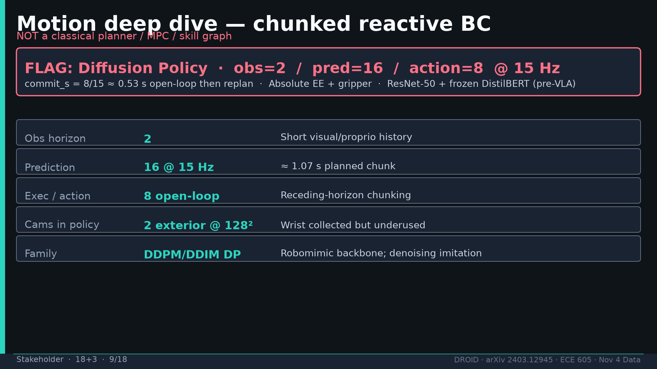
Notes:
Stakeholder · 18+3 · 9/18
MOTION FLAG: chunked reactive DP obs2/pred16/action8 @15Hz. commit≈0.53s. NOT classical planner. ResNet+DistilBERT pre-VLA.
Tattoo: 76k / 350h / 564 scenes / 86 tasks / 52 buildings / +22% ID / +17% OOD / obs2-pred16-action8 @15Hz / ~40k co-train ≠ 76k

Slide 10
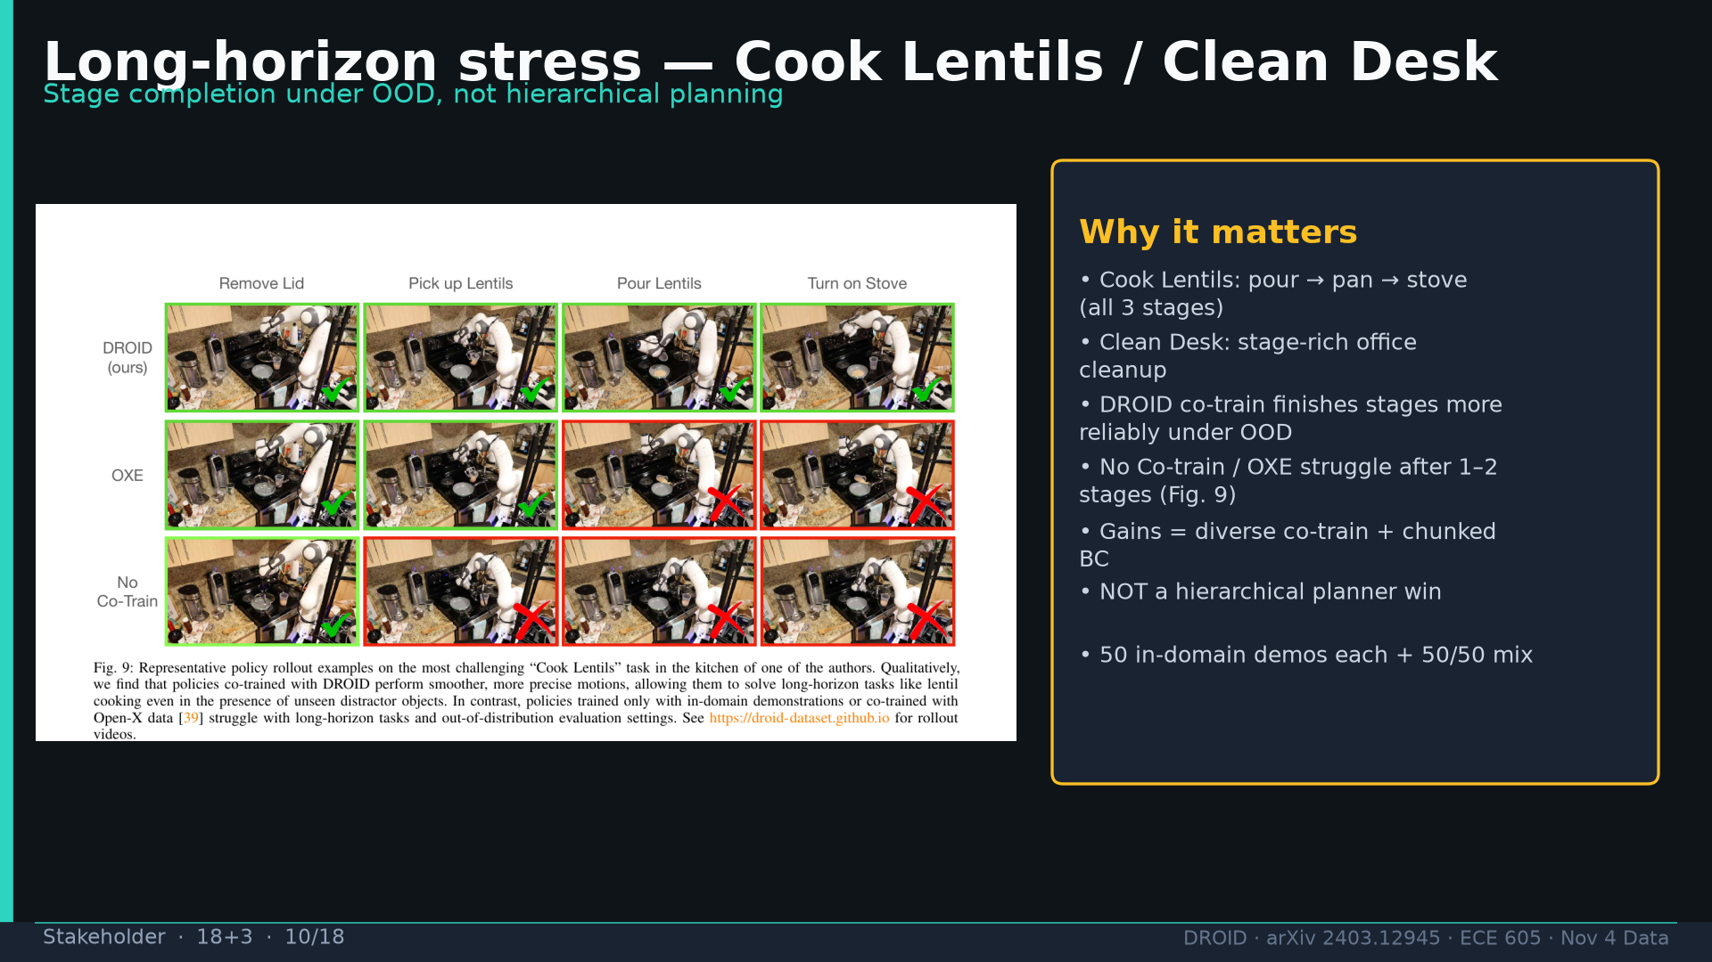
Notes:
Stakeholder · 18+3 · 10/18
Cook Lentils / Clean Desk long-horizon stress. Fig9: DROID finishes stages; OXE/None fail after 1-2. Gains=diverse co-train+chunked BC.
Tattoo: 76k / 350h / 564 scenes / 86 tasks / 52 buildings / +22% ID / +17% OOD / obs2-pred16-action8 @15Hz / ~40k co-train ≠ 76k

Slide 11
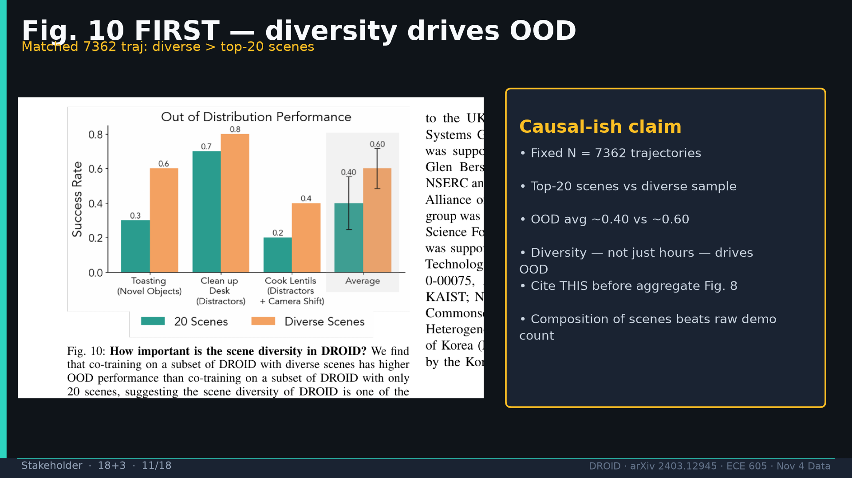
Notes:
Stakeholder · 18+3 · 11/18
FIG10 FIRST for causality: matched 7362 diverse > top-20 scenes OOD 0.60 vs 0.40. Diversity not just hours.
Tattoo: 76k / 350h / 564 scenes / 86 tasks / 52 buildings / +22% ID / +17% OOD / obs2-pred16-action8 @15Hz / ~40k co-train ≠ 76k

Slide 12
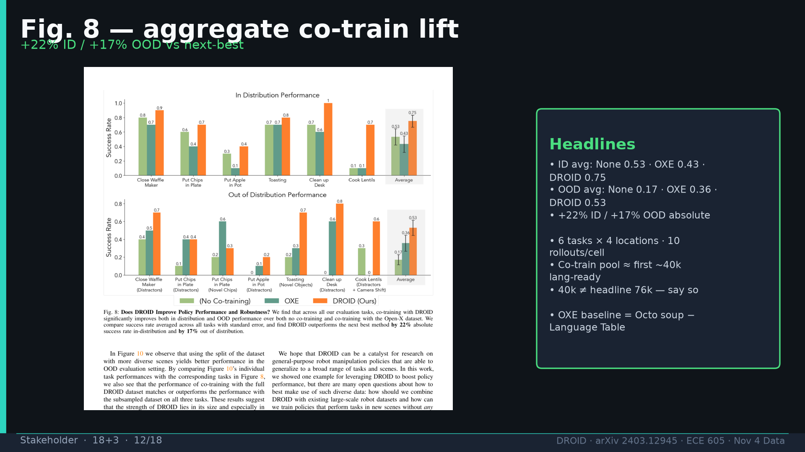
Notes:
Stakeholder · 18+3 · 12/18
FIG8 aggregate: +22% ID / +17% OOD. Caveat ~40k co-train ≠ 76k. OXE=Octo soup−Lang Table. 10 rollouts/cell.
Tattoo: 76k / 350h / 564 scenes / 86 tasks / 52 buildings / +22% ID / +17% OOD / obs2-pred16-action8 @15Hz / ~40k co-train ≠ 76k

Slide 13
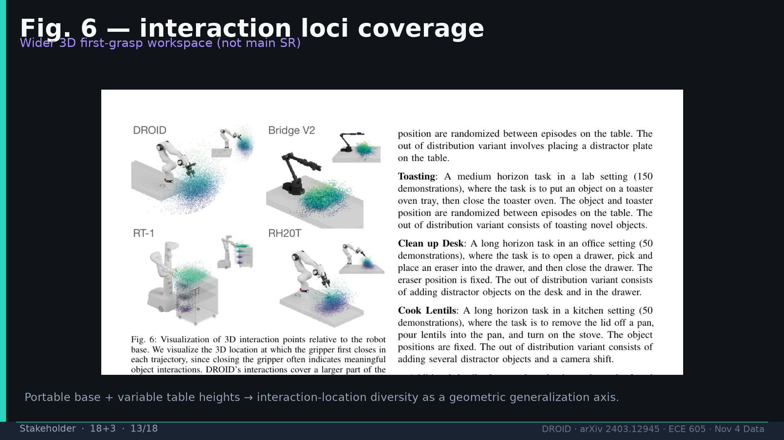
Notes:
Stakeholder · 18+3 · 13/18
Fig6 interaction loci: wider 3D first-grasp workspace. Cite for coverage not main SR.
Tattoo: 76k / 350h / 564 scenes / 86 tasks / 52 buildings / +22% ID / +17% OOD / obs2-pred16-action8 @15Hz / ~40k co-train ≠ 76k

Slide 14
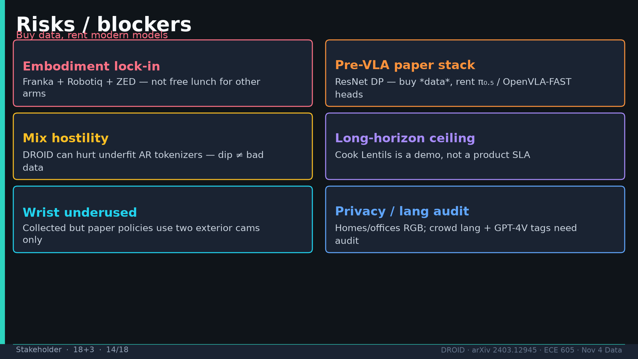
Notes:
Stakeholder · 18+3 · 14/18
Risks: Franka lock-in; pre-VLA stack; OpenVLA drop≠bad data; long-horizon ceiling; wrist underused; privacy/lang audit.
Tattoo: 76k / 350h / 564 scenes / 86 tasks / 52 buildings / +22% ID / +17% OOD / obs2-pred16-action8 @15Hz / ~40k co-train ≠ 76k

Slide 15
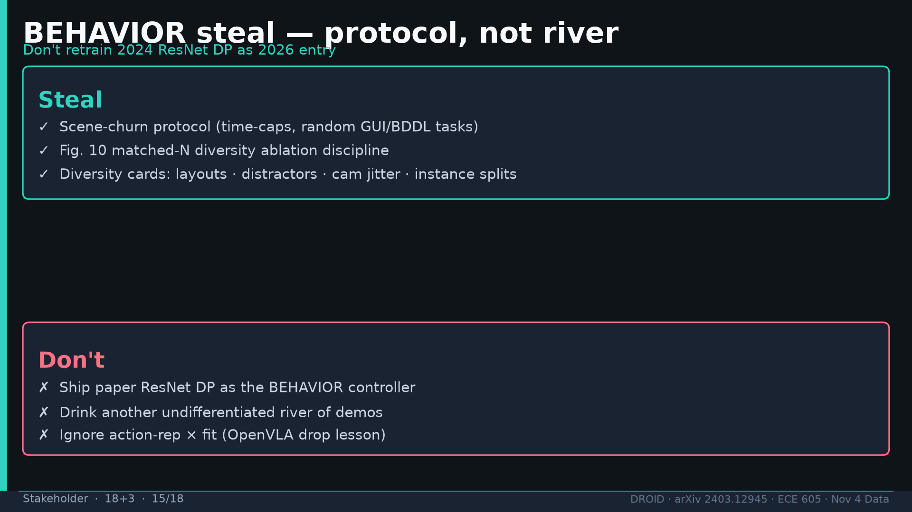
Notes:
Stakeholder · 18+3 · 15/18
BEHAVIOR steal protocol not river. Don't ship 2024 ResNet DP as 2026 entry. Race π₀.₅/N1.7.
Tattoo: 76k / 350h / 564 scenes / 86 tasks / 52 buildings / +22% ID / +17% OOD / obs2-pred16-action8 @15Hz / ~40k co-train ≠ 76k

Slide 16
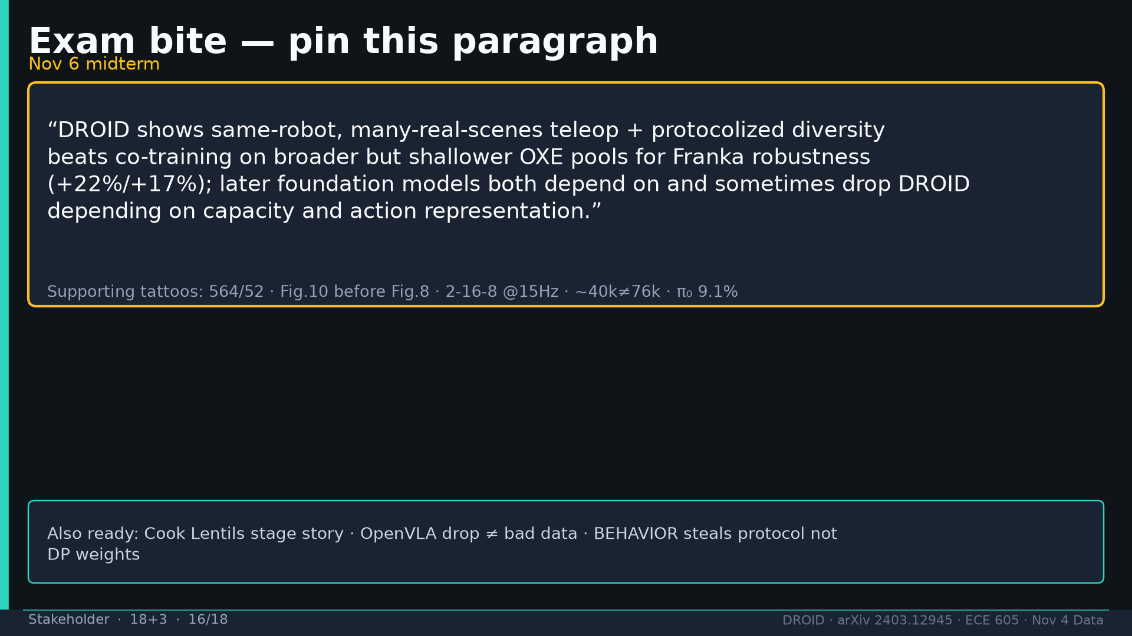
Notes:
Stakeholder · 18+3 · 16/18
EXAM BITE: same-robot many-real-scenes + protocol beats shallower OXE for Franka (+22/+17); later models depend on and sometimes drop DROID.
Tattoo: 76k / 350h / 564 scenes / 86 tasks / 52 buildings / +22% ID / +17% OOD / obs2-pred16-action8 @15Hz / ~40k co-train ≠ 76k

Slide 17
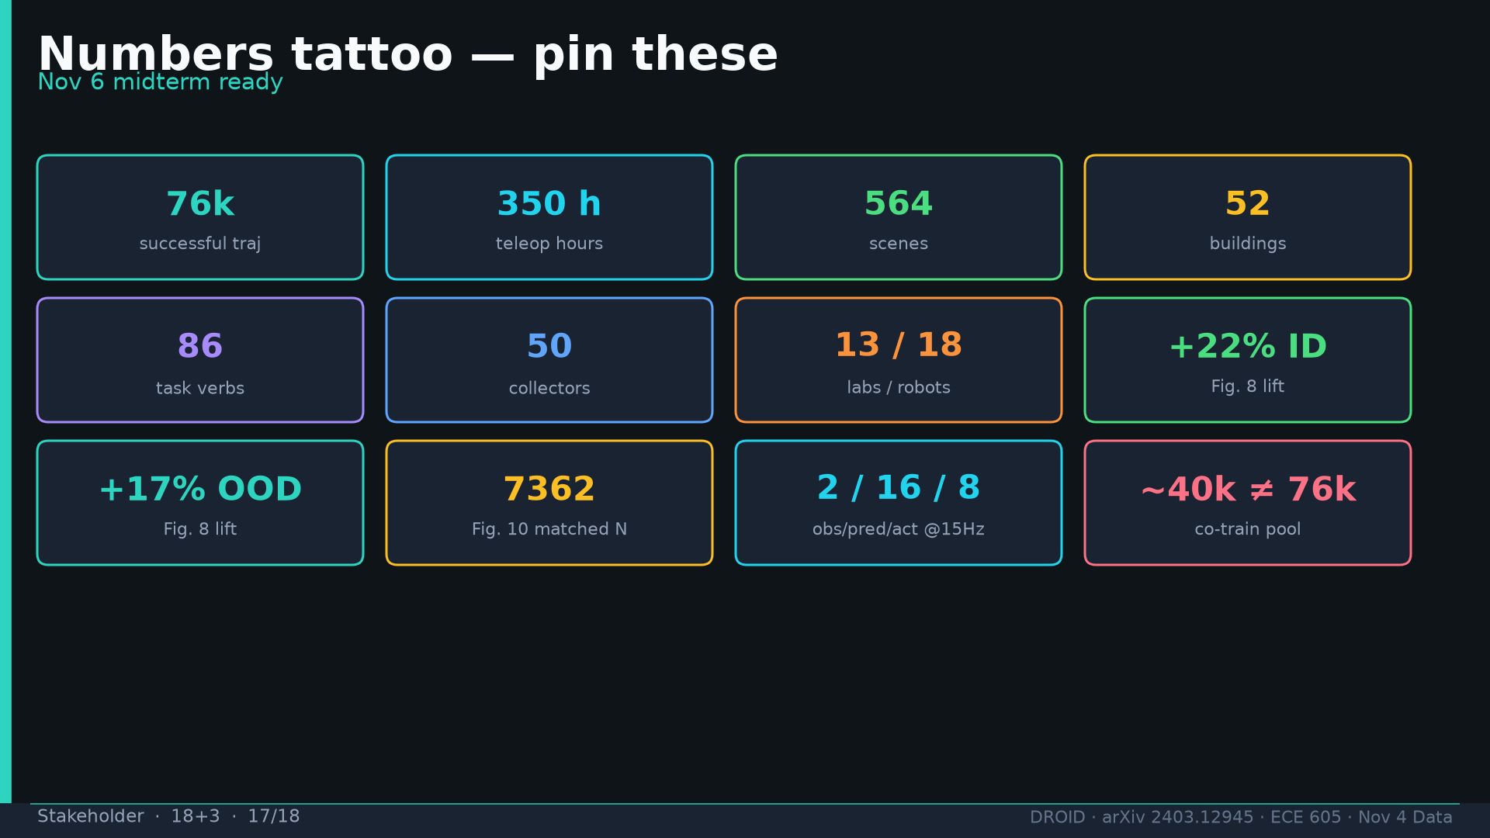
Notes:
Stakeholder · 18+3 · 17/18
Tattoo card: 76k/350h/564/52/86/50/13/18/+22/+17/7362/2-16-8/~40k≠76k.
Tattoo: 76k / 350h / 564 scenes / 86 tasks / 52 buildings / +22% ID / +17% OOD / obs2-pred16-action8 @15Hz / ~40k co-train ≠ 76k

Slide 18
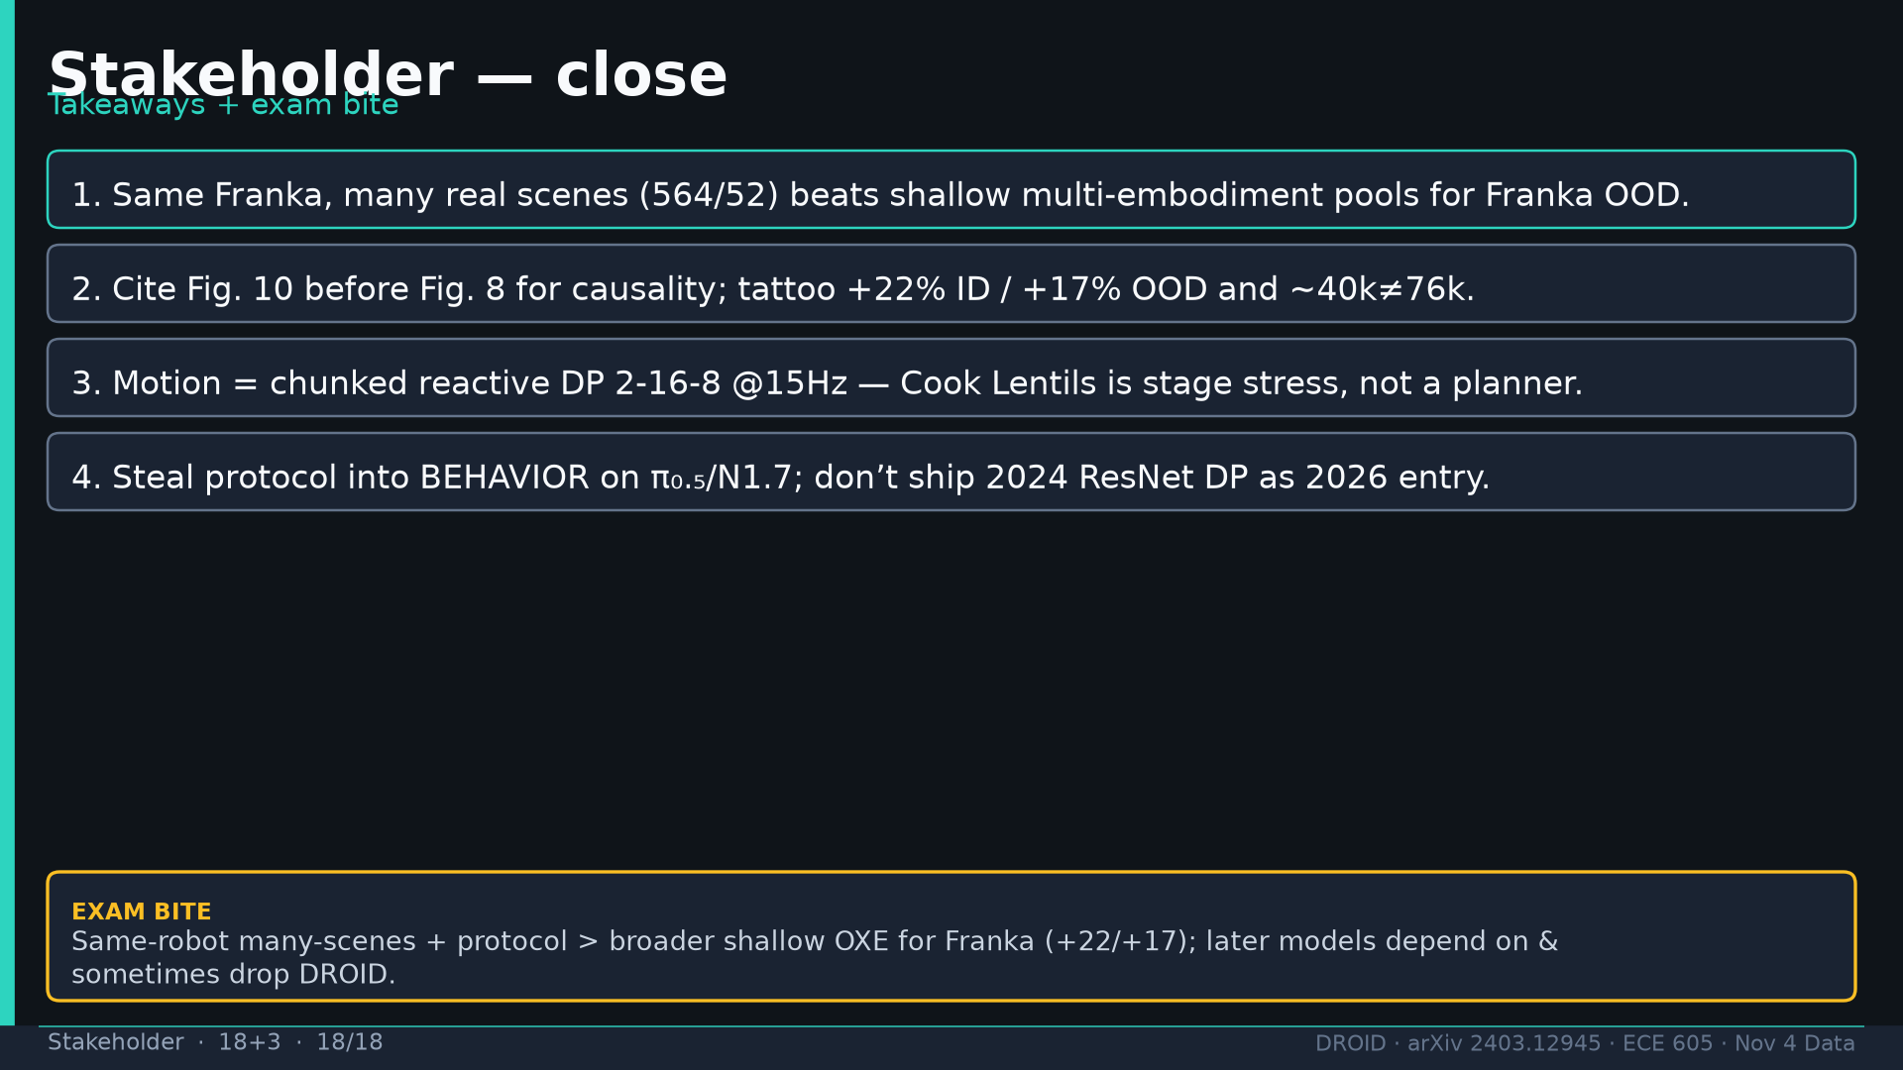
Notes:
Stakeholder · 18+3 · 18/18
Close: four takeaways + exam bite. Q&A.
Tattoo: 76k / 350h / 564 scenes / 86 tasks / 52 buildings / +22% ID / +17% OOD / obs2-pred16-action8 @15Hz / ~40k co-train ≠ 76k

