Slide 1
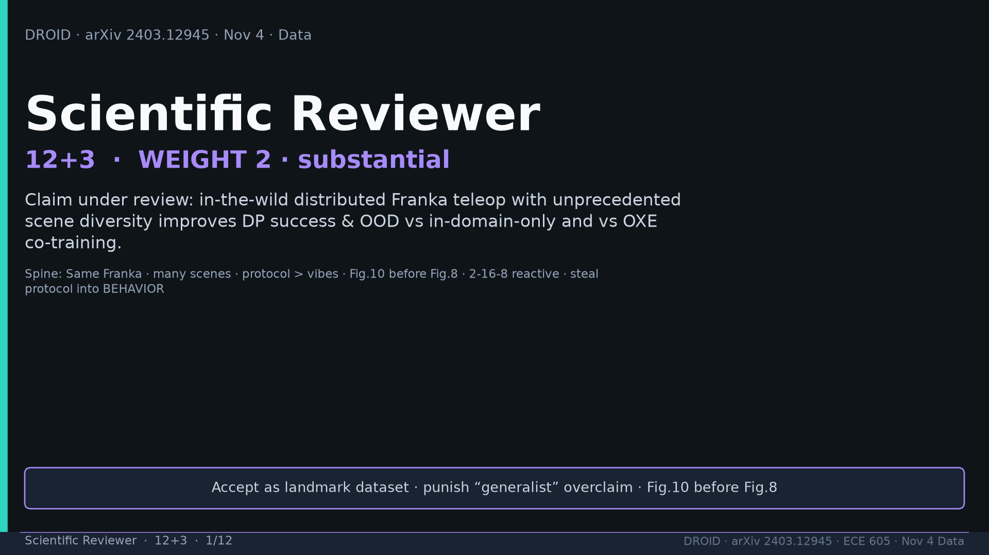
Notes:
Scientific Reviewer · 12+3 · 1/12
Title. Weight 2 substantial. Accept landmark + punish generalist overclaim. Fig10 before Fig8.
Tattoo: 76k / 350h / 564 scenes / 86 tasks / 52 buildings / +22% ID / +17% OOD / obs2-pred16-action8 @15Hz / ~40k co-train ≠ 76k

Slide 2
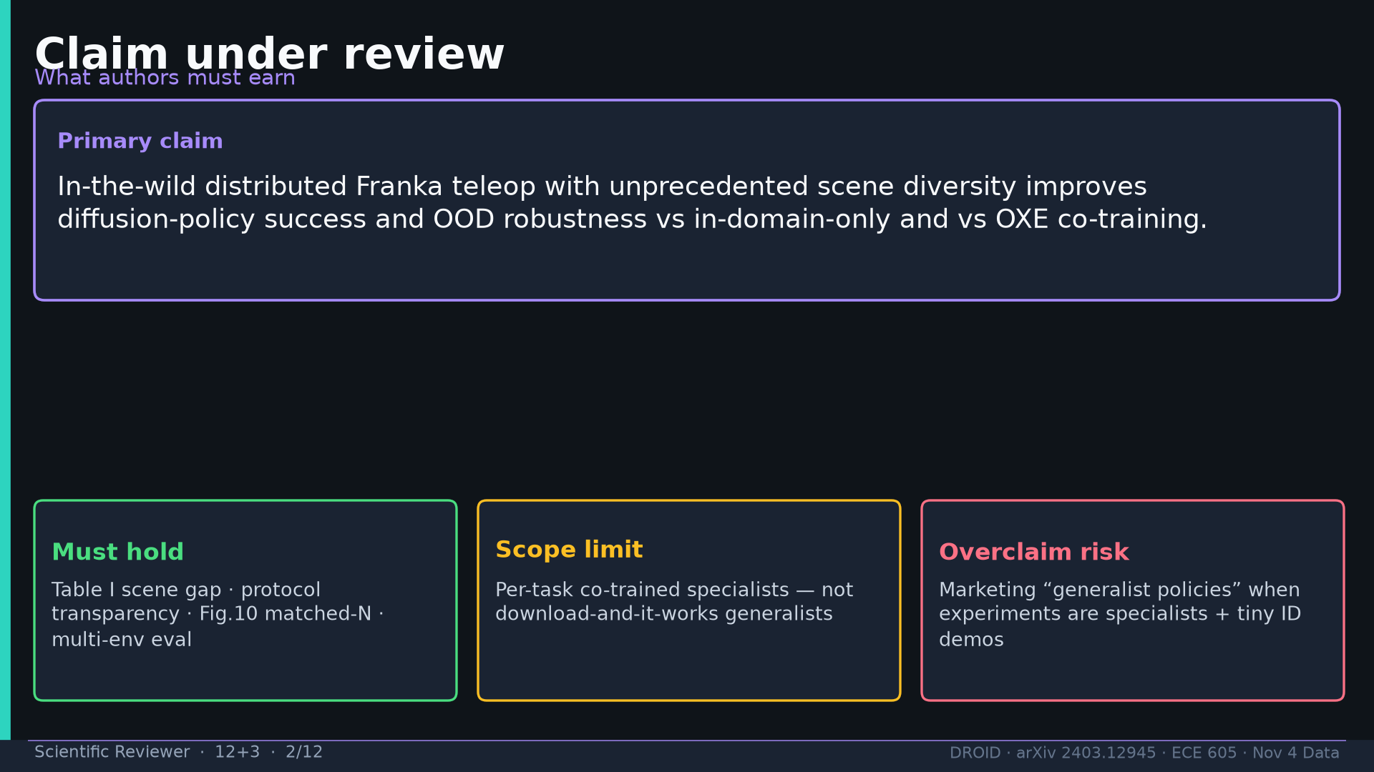
Notes:
Scientific Reviewer · 12+3 · 2/12
Claim under review: in-the-wild Franka teleop with scene diversity improves DP success/OOD vs ID-only and OXE co-train.
Tattoo: 76k / 350h / 564 scenes / 86 tasks / 52 buildings / +22% ID / +17% OOD / obs2-pred16-action8 @15Hz / ~40k co-train ≠ 76k

Slide 3
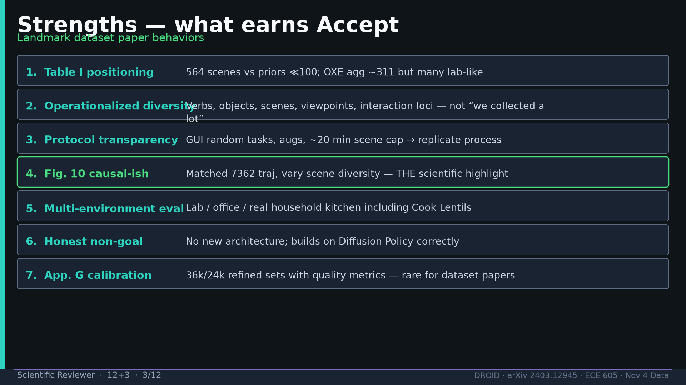
Notes:
Scientific Reviewer · 12+3 · 3/12
Strengths: Table I scenes, operationalized diversity, protocol transparency, Fig10 highlight, multi-env eval, honest non-goal, App.G calib.
Tattoo: 76k / 350h / 564 scenes / 86 tasks / 52 buildings / +22% ID / +17% OOD / obs2-pred16-action8 @15Hz / ~40k co-train ≠ 76k

Slide 4
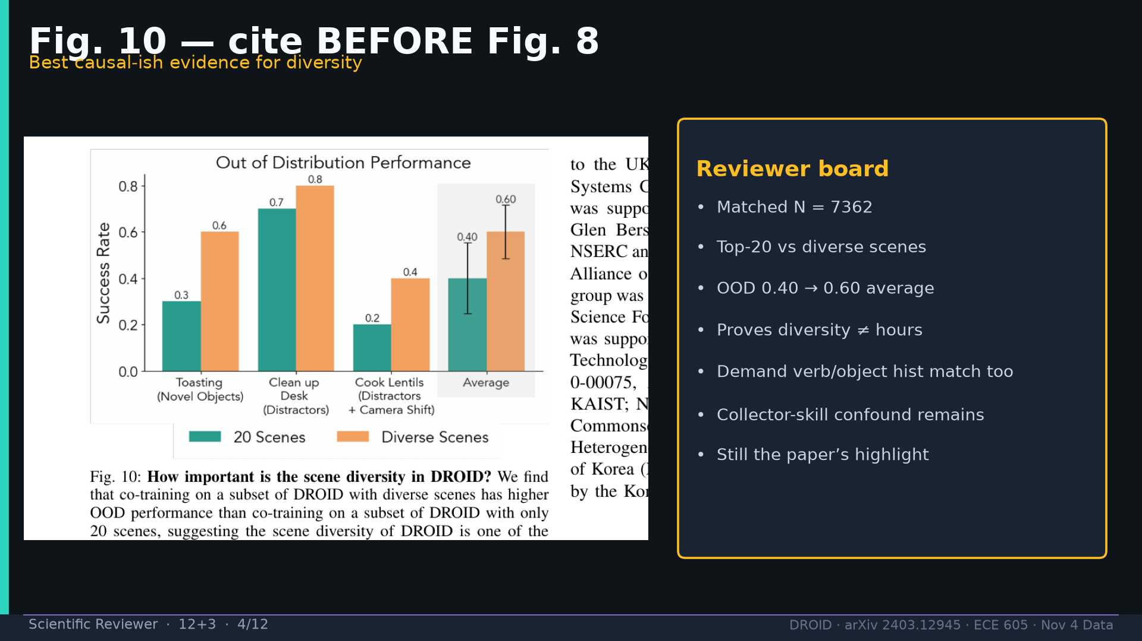
Notes:
Scientific Reviewer · 12+3 · 4/12
Fig10 FIRST: matched 7362, diverse>top-20, OOD 0.40→0.60. Best causal-ish evidence. Still demand verb/object hist match.
Tattoo: 76k / 350h / 564 scenes / 86 tasks / 52 buildings / +22% ID / +17% OOD / obs2-pred16-action8 @15Hz / ~40k co-train ≠ 76k

Slide 5
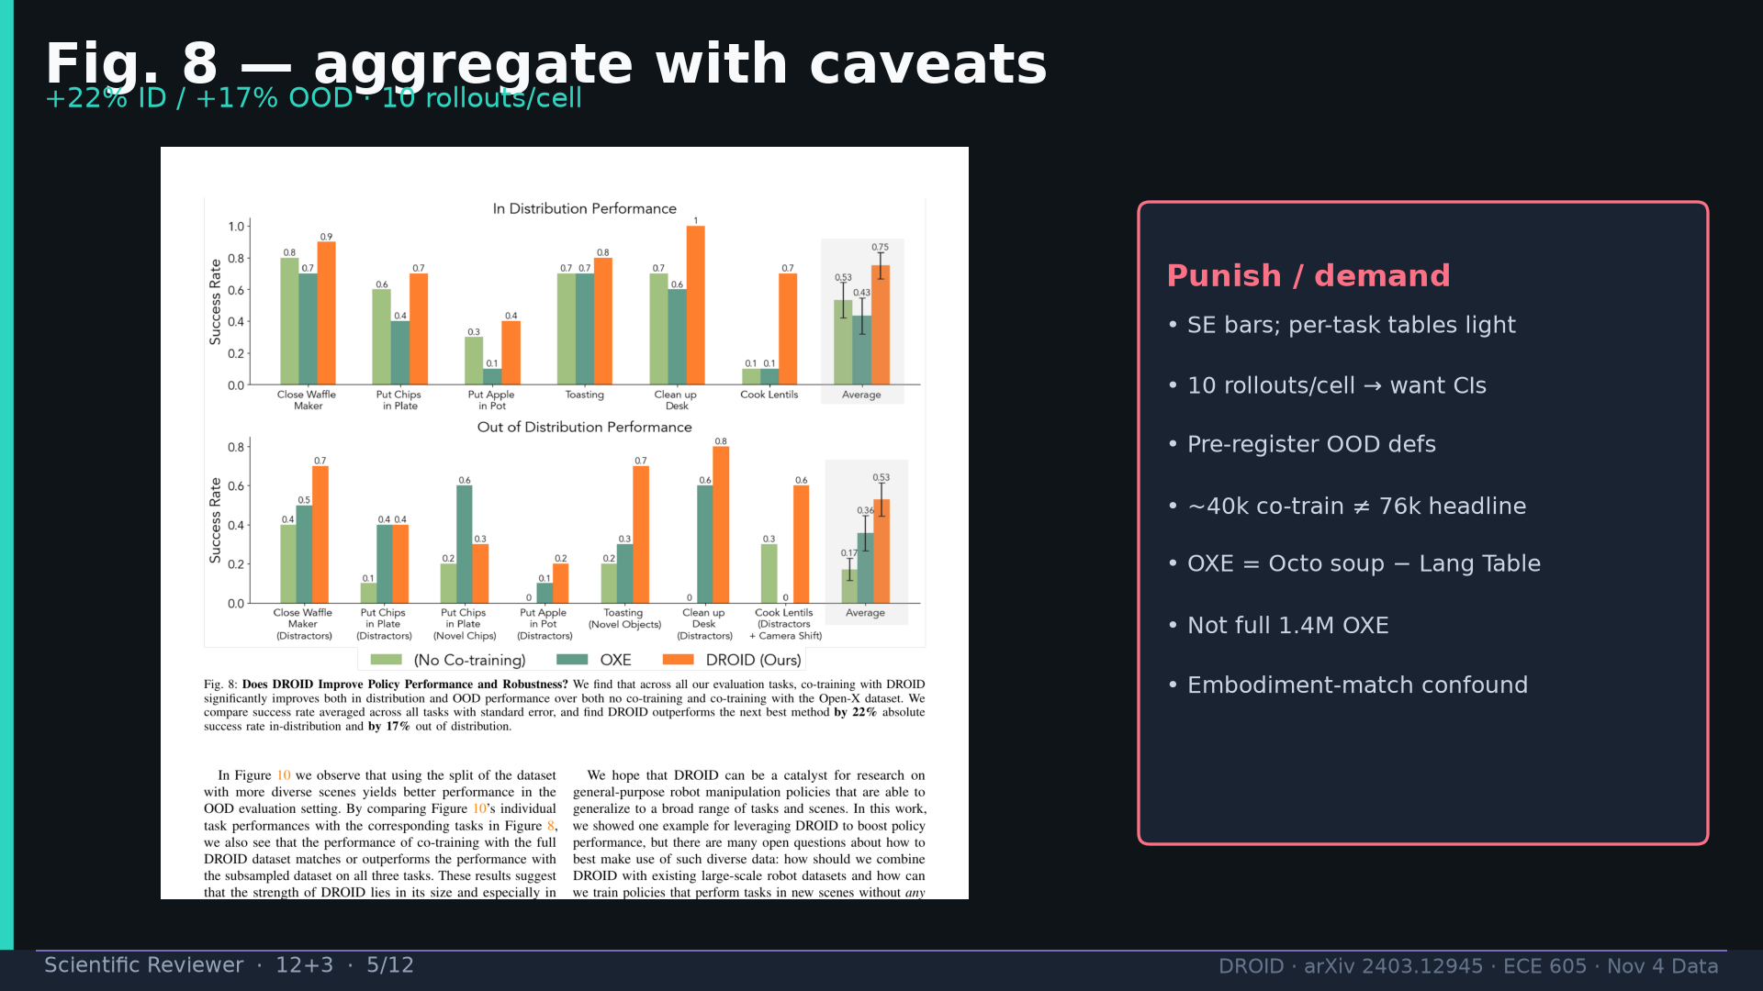
Notes:
Scientific Reviewer · 12+3 · 5/12
Fig8 with caveats: +22/+17 but 10 rollouts/cell, 40k≠76k, OXE soup not 1.4M, embodiment confound.
Tattoo: 76k / 350h / 564 scenes / 86 tasks / 52 buildings / +22% ID / +17% OOD / obs2-pred16-action8 @15Hz / ~40k co-train ≠ 76k

Slide 6
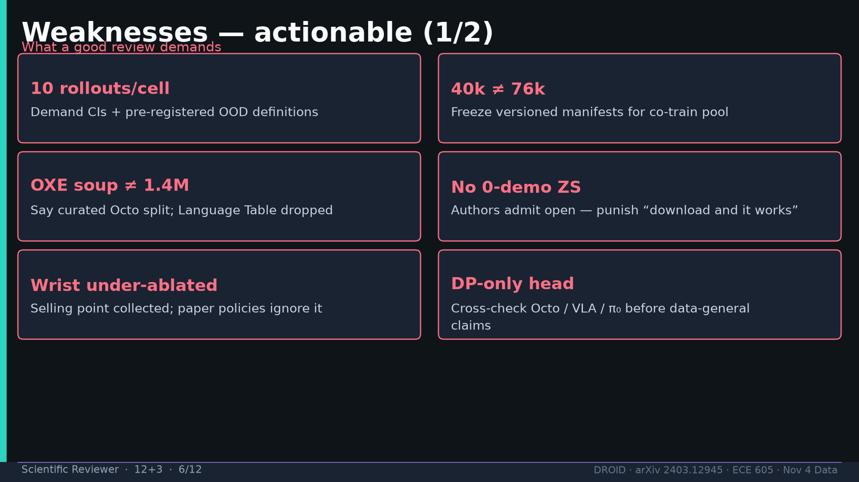
Notes:
Scientific Reviewer · 12+3 · 6/12
Weaknesses 1: rollouts/CIs, 40k≠76k manifests, OXE soup, no 0-demo ZS, wrist under-ablated, DP-only head.
Tattoo: 76k / 350h / 564 scenes / 86 tasks / 52 buildings / +22% ID / +17% OOD / obs2-pred16-action8 @15Hz / ~40k co-train ≠ 76k

Slide 7
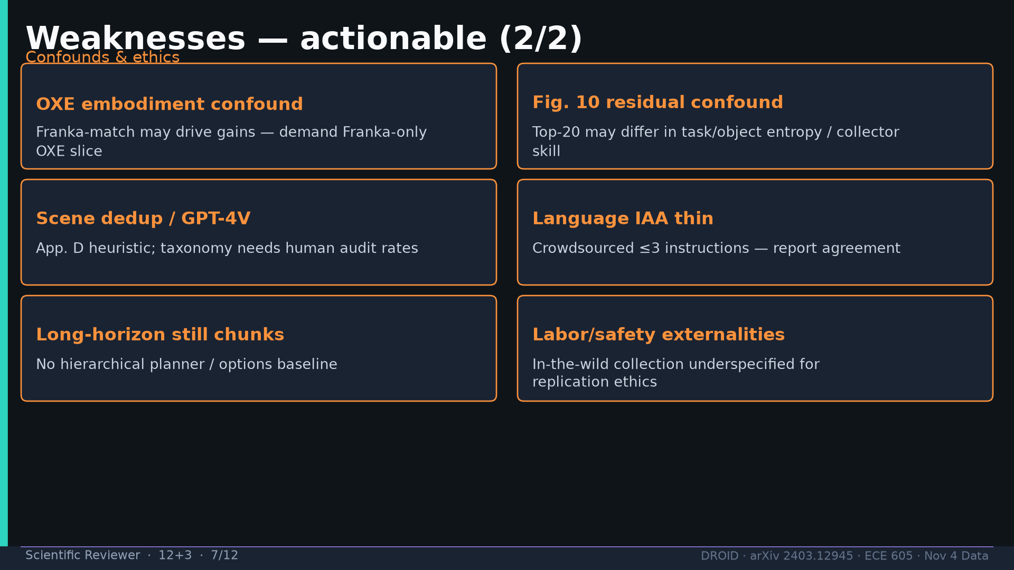
Notes:
Scientific Reviewer · 12+3 · 7/12
Weaknesses 2: Franka-only OXE slice demand, Fig10 residual confound, GPT-4V audit, lang IAA, no hierarchical baseline, labor ethics.
Tattoo: 76k / 350h / 564 scenes / 86 tasks / 52 buildings / +22% ID / +17% OOD / obs2-pred16-action8 @15Hz / ~40k co-train ≠ 76k

Slide 8
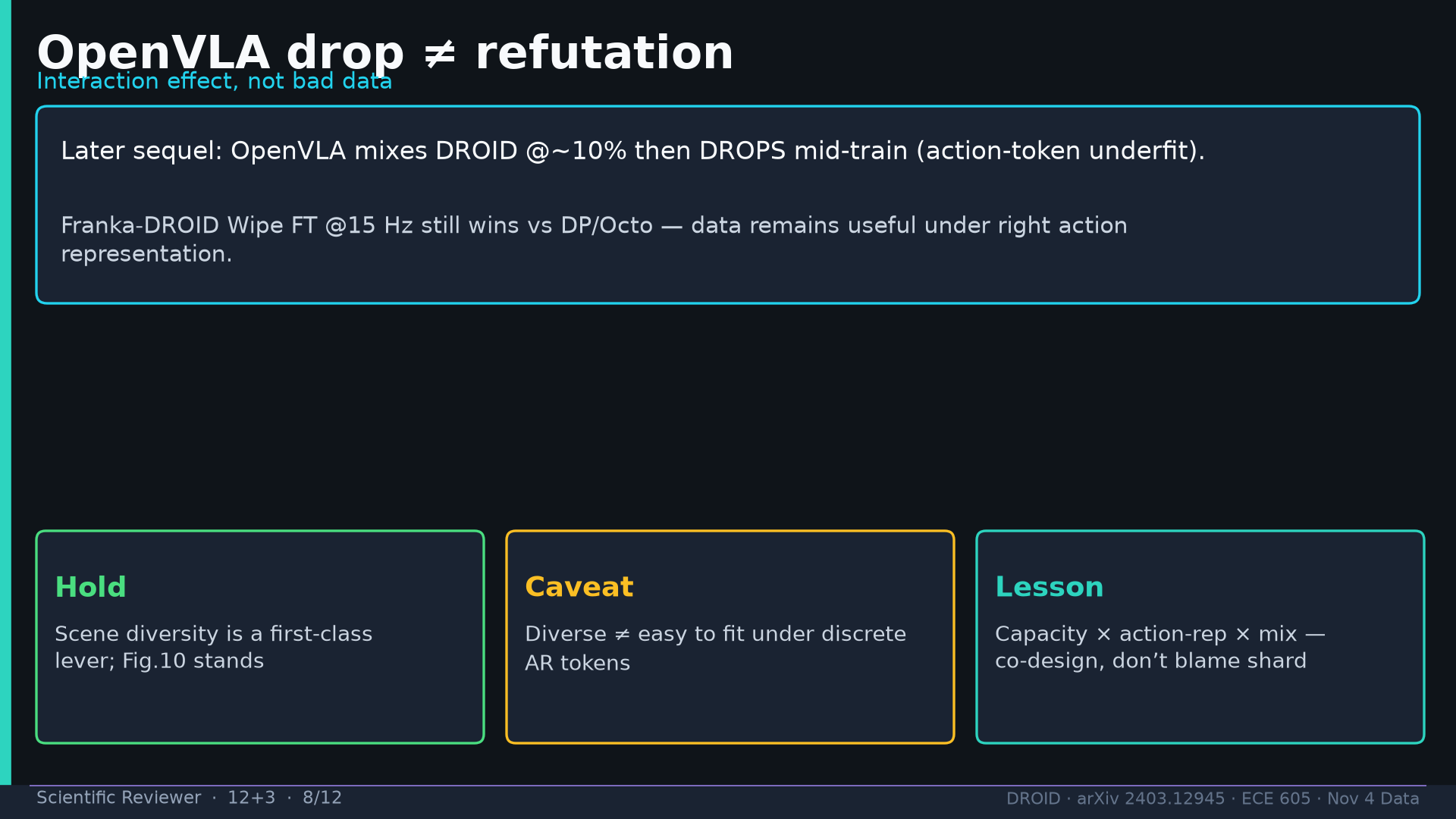
Notes:
Scientific Reviewer · 12+3 · 8/12
OpenVLA drop = interaction effect (capacity×action-rep), not refutation. Wipe FT @15Hz still wins.
Tattoo: 76k / 350h / 564 scenes / 86 tasks / 52 buildings / +22% ID / +17% OOD / obs2-pred16-action8 @15Hz / ~40k co-train ≠ 76k

Slide 9
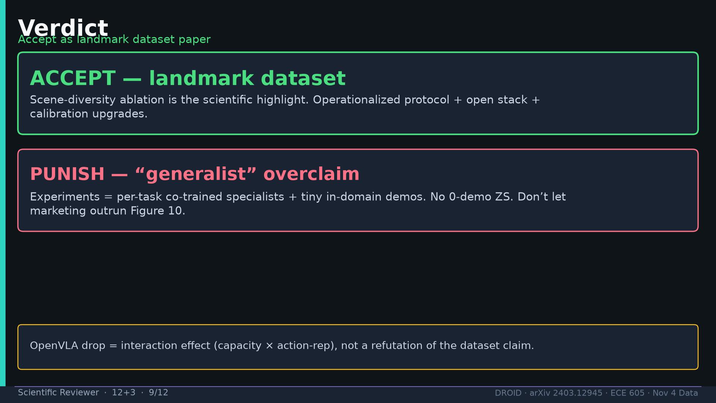
Notes:
Scientific Reviewer · 12+3 · 9/12
VERDICT: Accept landmark dataset. Punish generalist marketing. Specialists + tiny ID demos.
Tattoo: 76k / 350h / 564 scenes / 86 tasks / 52 buildings / +22% ID / +17% OOD / obs2-pred16-action8 @15Hz / ~40k co-train ≠ 76k

Slide 10
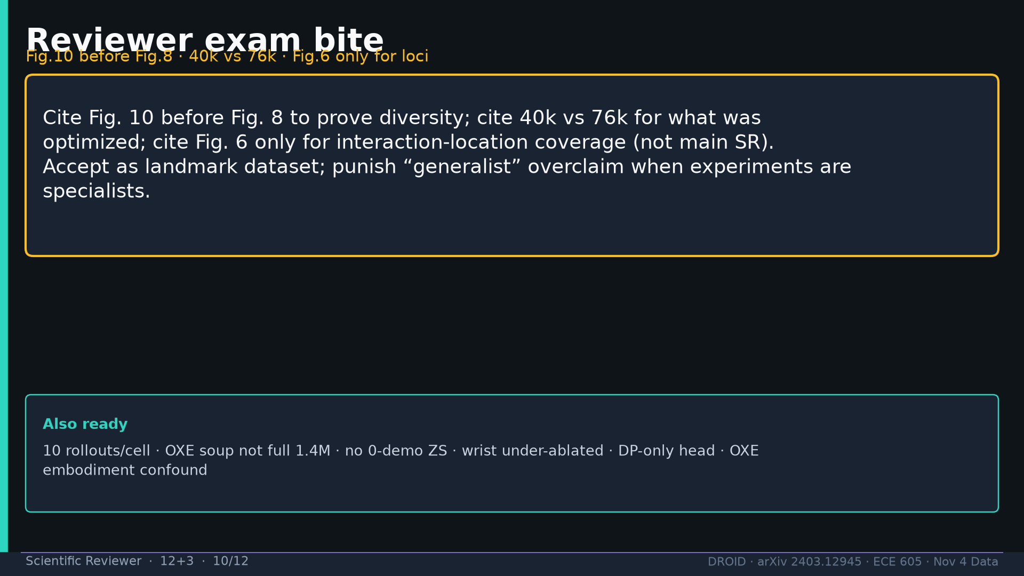
Notes:
Scientific Reviewer · 12+3 · 10/12
Exam bite: Fig10 before Fig8; 40k vs 76k; Fig6 only for loci; accept + punish.
Tattoo: 76k / 350h / 564 scenes / 86 tasks / 52 buildings / +22% ID / +17% OOD / obs2-pred16-action8 @15Hz / ~40k co-train ≠ 76k

Slide 11
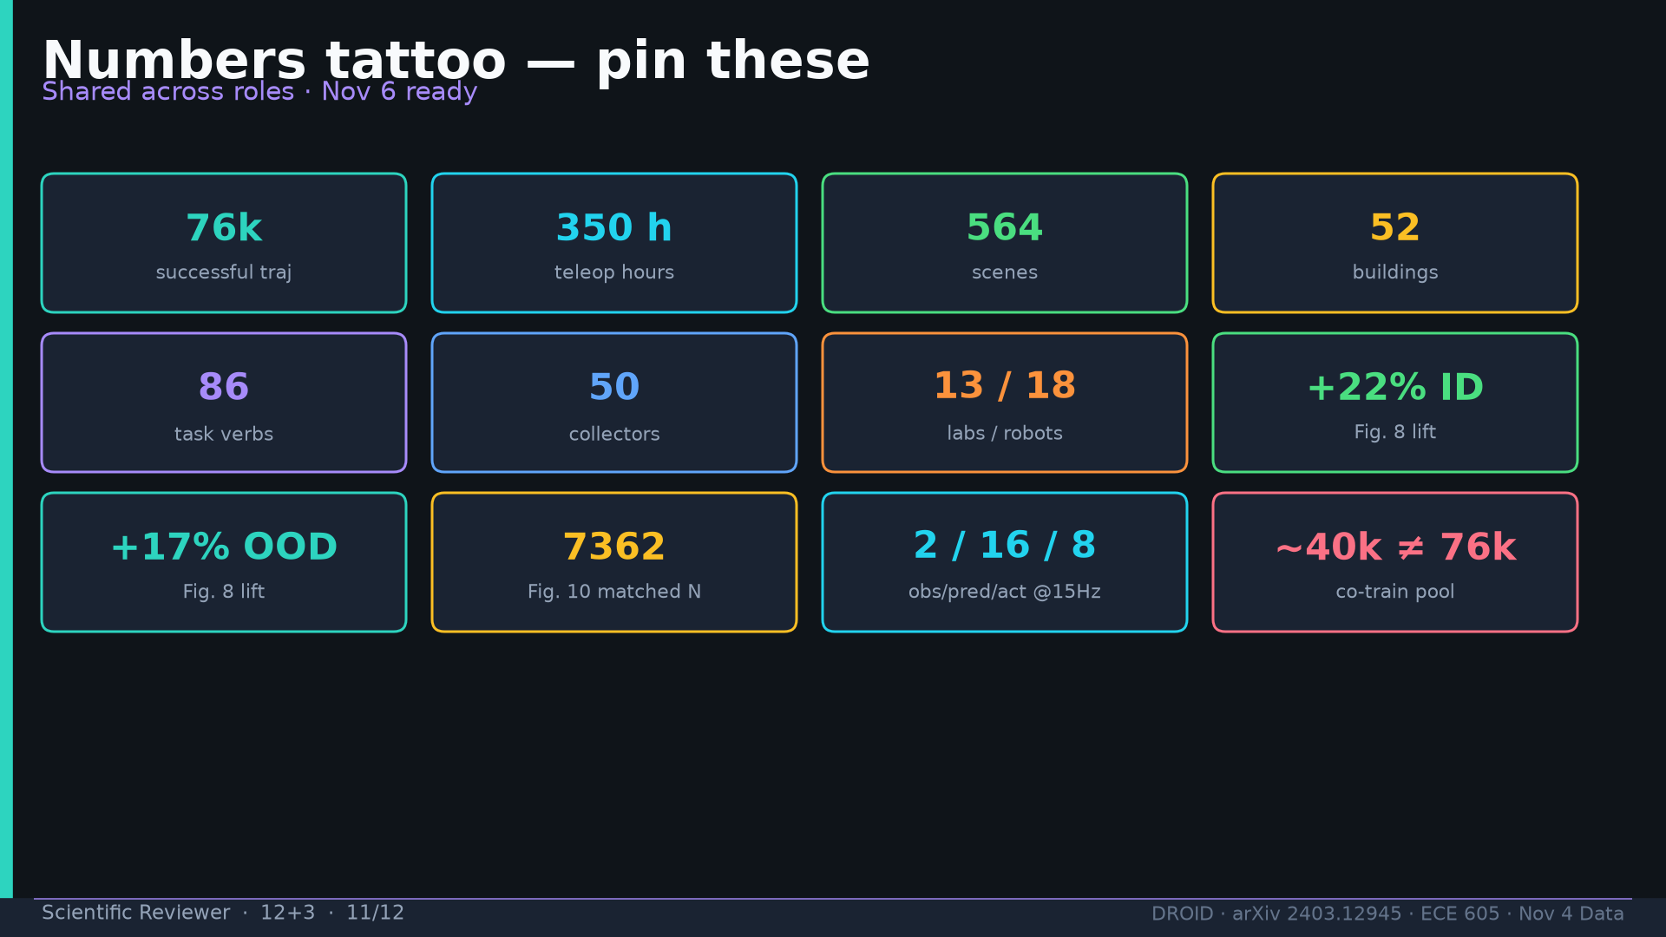
Notes:
Scientific Reviewer · 12+3 · 11/12
Tattoo numbers shared.
Tattoo: 76k / 350h / 564 scenes / 86 tasks / 52 buildings / +22% ID / +17% OOD / obs2-pred16-action8 @15Hz / ~40k co-train ≠ 76k

Slide 12
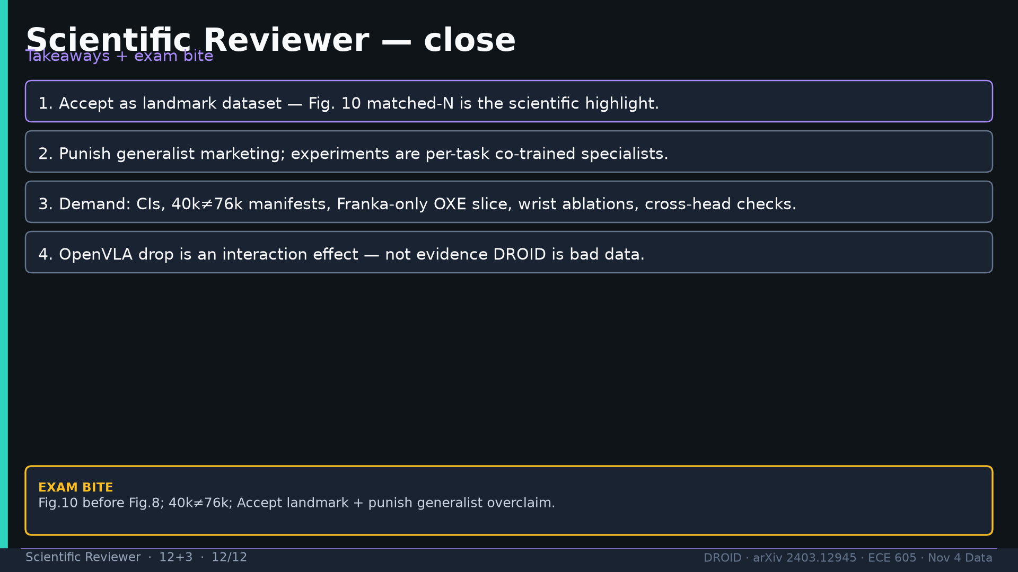
Notes:
Scientific Reviewer · 12+3 · 12/12
Close takeaways + exam bite.
Tattoo: 76k / 350h / 564 scenes / 86 tasks / 52 buildings / +22% ID / +17% OOD / obs2-pred16-action8 @15Hz / ~40k co-train ≠ 76k

