Slide 1
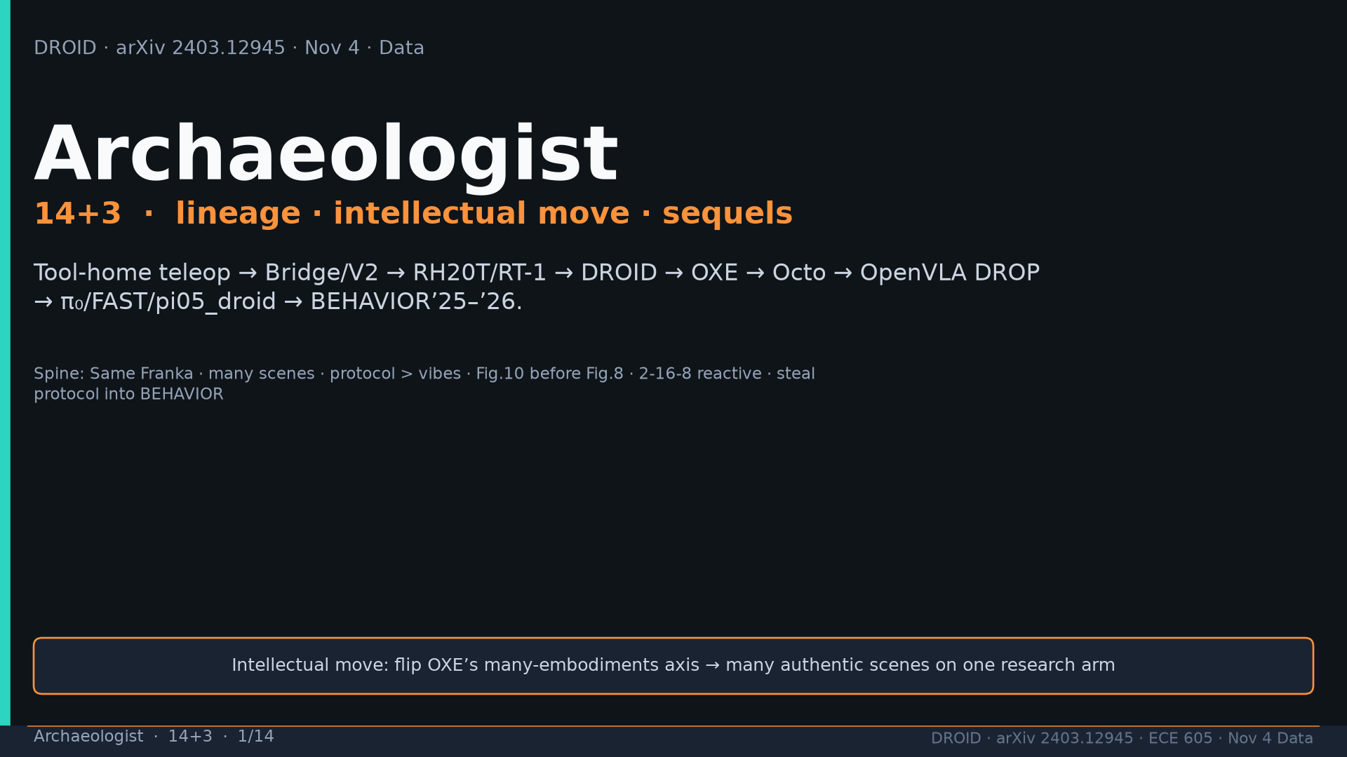
Notes:
Archaeologist · 14+3 · 1/14
Title. Lineage Bridge→DROID→OXE→OpenVLA drop→π→BEHAVIOR. Intellectual move: flip many-embodiments to many scenes.
Tattoo: 76k / 350h / 564 scenes / 86 tasks / 52 buildings / +22% ID / +17% OOD / obs2-pred16-action8 @15Hz / ~40k co-train ≠ 76k

Slide 2
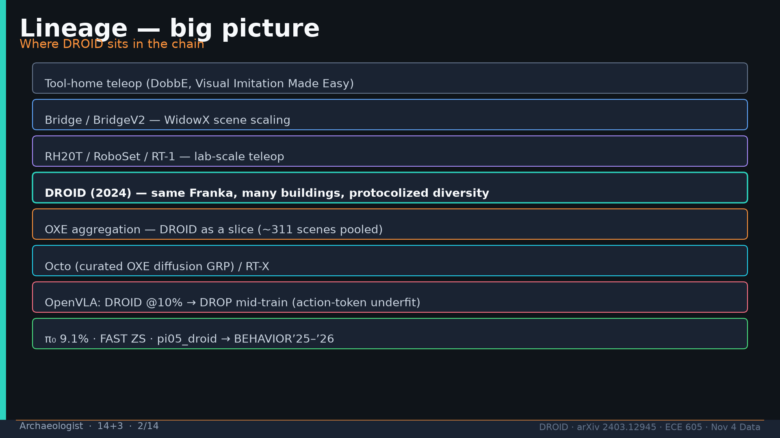
Notes:
Archaeologist · 14+3 · 2/14
Big-picture lineage diagram. DROID 2024 highlighted as same Franka many buildings protocolized diversity.
Tattoo: 76k / 350h / 564 scenes / 86 tasks / 52 buildings / +22% ID / +17% OOD / obs2-pred16-action8 @15Hz / ~40k co-train ≠ 76k

Slide 3
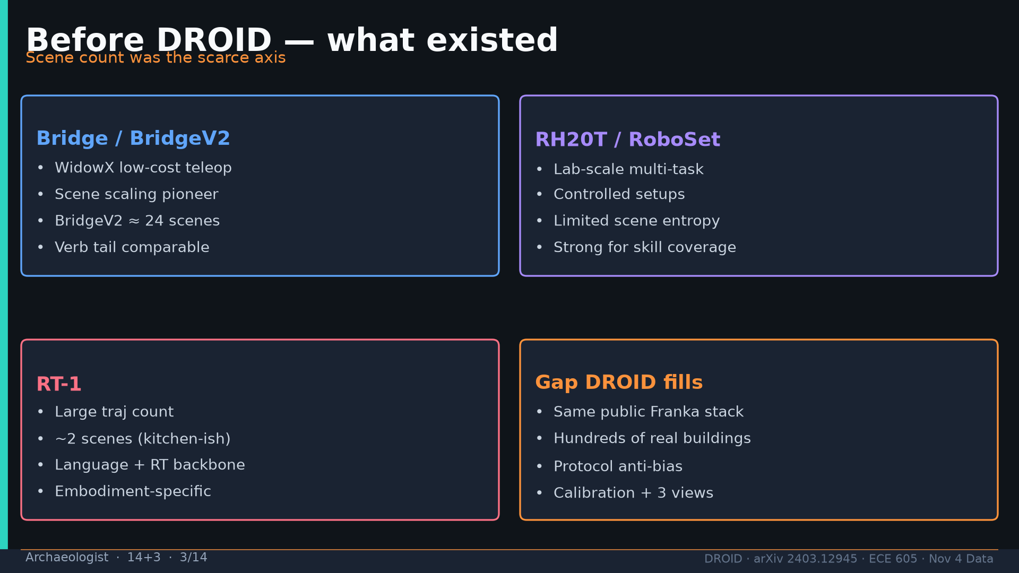
Notes:
Archaeologist · 14+3 · 3/14
Before: BridgeV2≈24 scenes, RH20T/RoboSet lab-scale, RT-1 ~2 scenes. Gap=public Franka + hundreds of buildings + protocol.
Tattoo: 76k / 350h / 564 scenes / 86 tasks / 52 buildings / +22% ID / +17% OOD / obs2-pred16-action8 @15Hz / ~40k co-train ≠ 76k

Slide 4
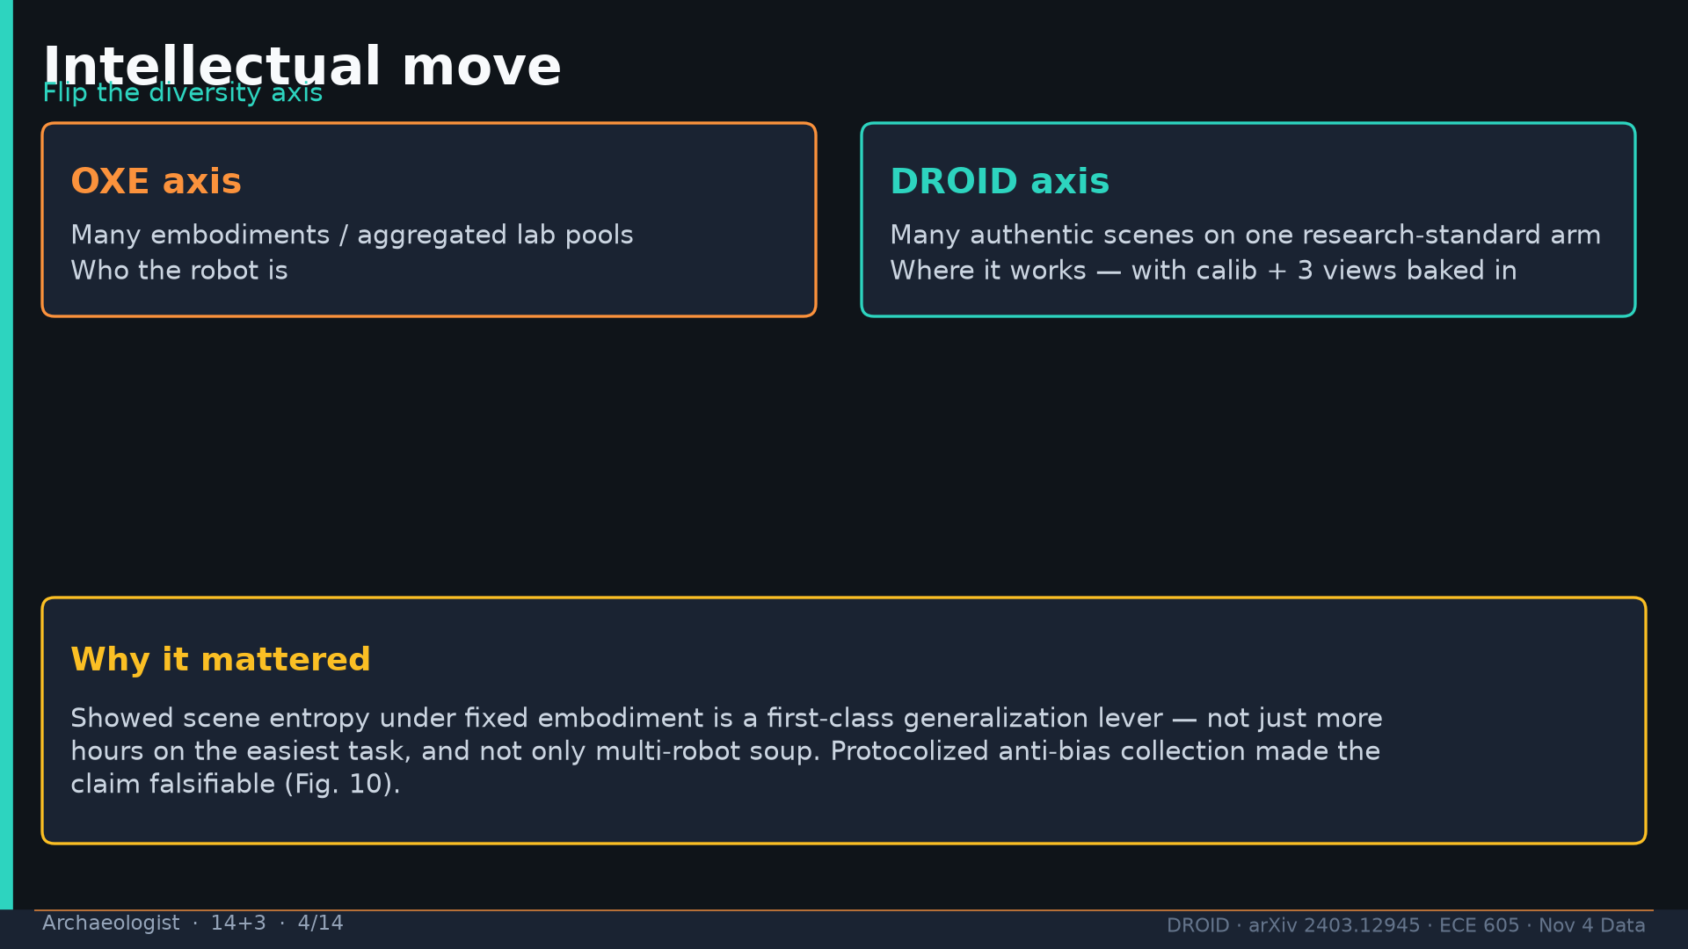
Notes:
Archaeologist · 14+3 · 4/14
Intellectual move: OXE=who; DROID=where. Protocol made claim falsifiable (Fig10).
Tattoo: 76k / 350h / 564 scenes / 86 tasks / 52 buildings / +22% ID / +17% OOD / obs2-pred16-action8 @15Hz / ~40k co-train ≠ 76k

Slide 5
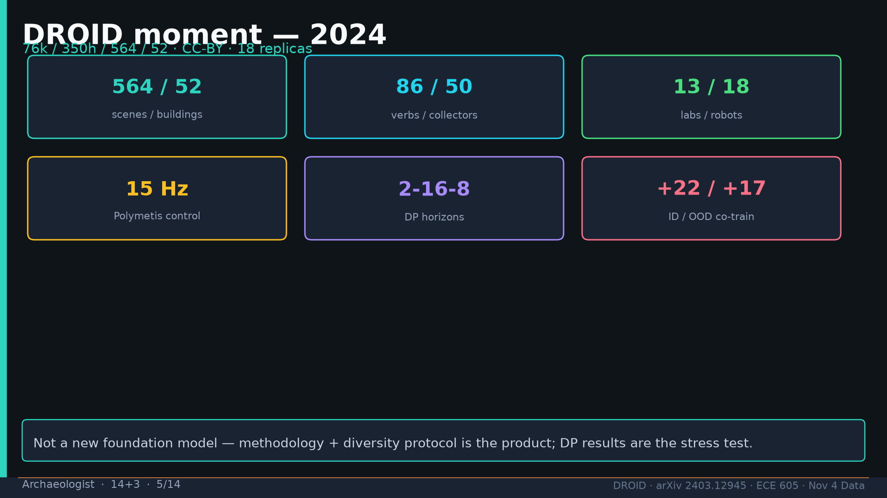
Notes:
Archaeologist · 14+3 · 5/14
DROID moment numbers tattoo: 564/52, 86/50, 13/18, 15Hz, 2-16-8, +22/+17. Methodology is the product.
Tattoo: 76k / 350h / 564 scenes / 86 tasks / 52 buildings / +22% ID / +17% OOD / obs2-pred16-action8 @15Hz / ~40k co-train ≠ 76k

Slide 6
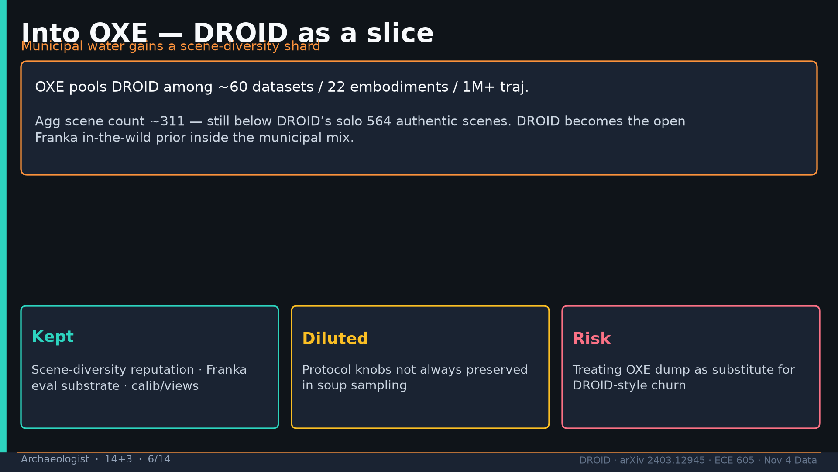
Notes:
Archaeologist · 14+3 · 6/14
Into OXE as slice. Agg scenes~311 still < DROID solo 564. Protocol knobs may dilute in soup.
Tattoo: 76k / 350h / 564 scenes / 86 tasks / 52 buildings / +22% ID / +17% OOD / obs2-pred16-action8 @15Hz / ~40k co-train ≠ 76k

Slide 7
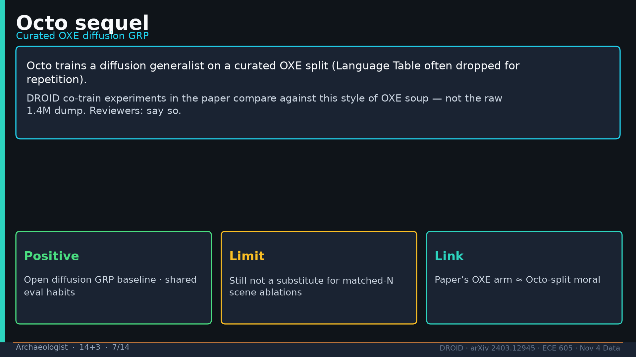
Notes:
Archaeologist · 14+3 · 7/14
Octo: curated OXE diffusion GRP. Paper OXE arm ≈ Octo-split moral (Lang Table dropped).
Tattoo: 76k / 350h / 564 scenes / 86 tasks / 52 buildings / +22% ID / +17% OOD / obs2-pred16-action8 @15Hz / ~40k co-train ≠ 76k

Slide 8
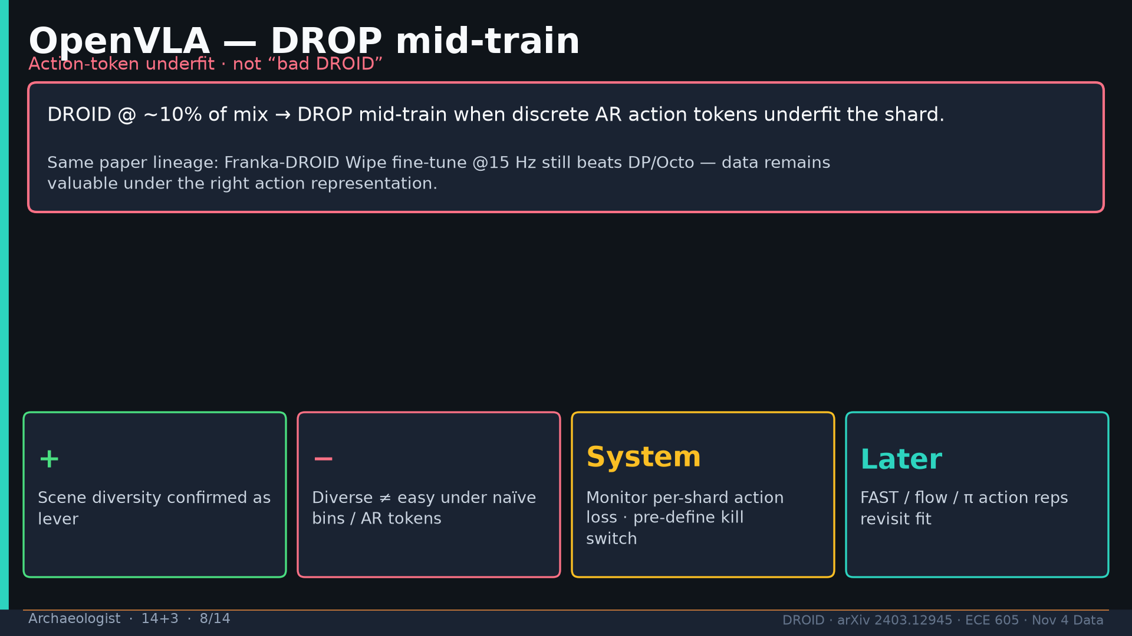
Notes:
Archaeologist · 14+3 · 8/14
OpenVLA DROP mid-train at ~10% DROID — action-token underfit. Wipe FT still wins. − lesson: diverse≠easy under AR tokens.
Tattoo: 76k / 350h / 564 scenes / 86 tasks / 52 buildings / +22% ID / +17% OOD / obs2-pred16-action8 @15Hz / ~40k co-train ≠ 76k

Slide 9
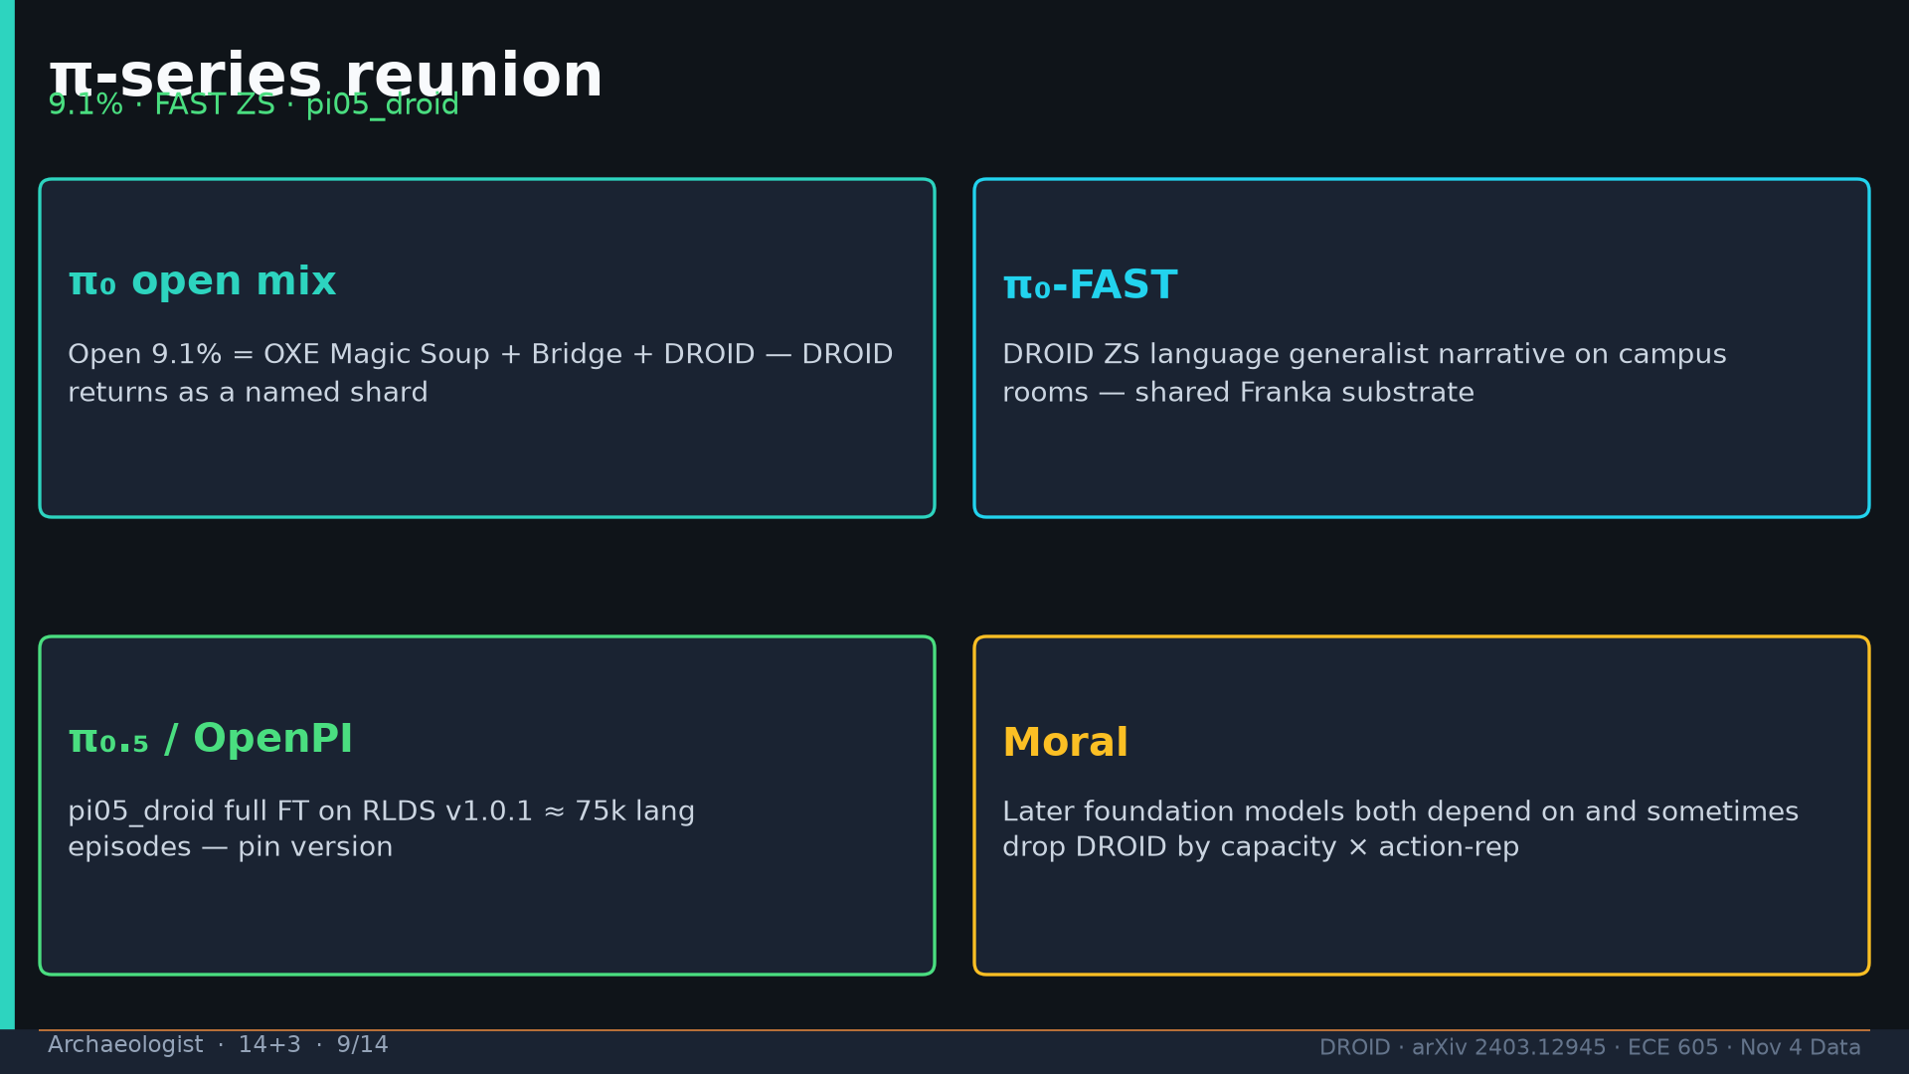
Notes:
Archaeologist · 14+3 · 9/14
π reunion: open mix 9.1% includes DROID; FAST ZS campus; pi05_droid ≈75k lang eps v1.0.1.
Tattoo: 76k / 350h / 564 scenes / 86 tasks / 52 buildings / +22% ID / +17% OOD / obs2-pred16-action8 @15Hz / ~40k co-train ≠ 76k

Slide 10
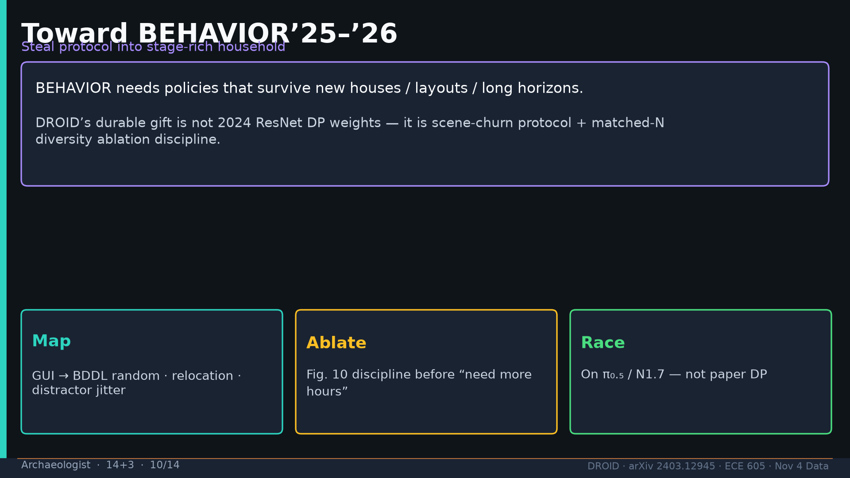
Notes:
Archaeologist · 14+3 · 10/14
BEHAVIOR’25–’26: steal protocol + ablation discipline; race on π₀.₅/N1.7.
Tattoo: 76k / 350h / 564 scenes / 86 tasks / 52 buildings / +22% ID / +17% OOD / obs2-pred16-action8 @15Hz / ~40k co-train ≠ 76k

Slide 11
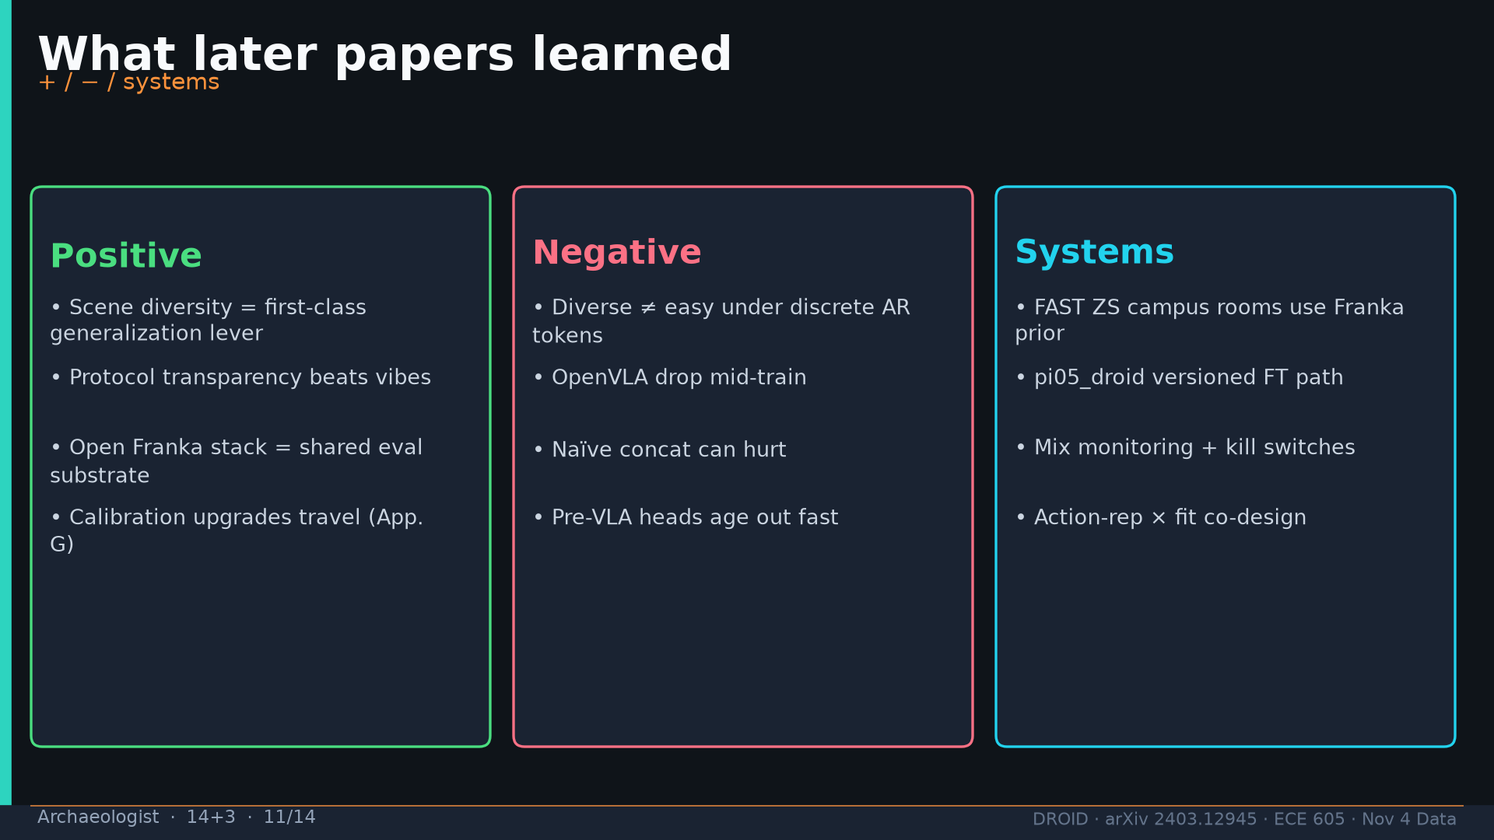
Notes:
Archaeologist · 14+3 · 11/14
What later learned +/- / systems.
Tattoo: 76k / 350h / 564 scenes / 86 tasks / 52 buildings / +22% ID / +17% OOD / obs2-pred16-action8 @15Hz / ~40k co-train ≠ 76k

Slide 12
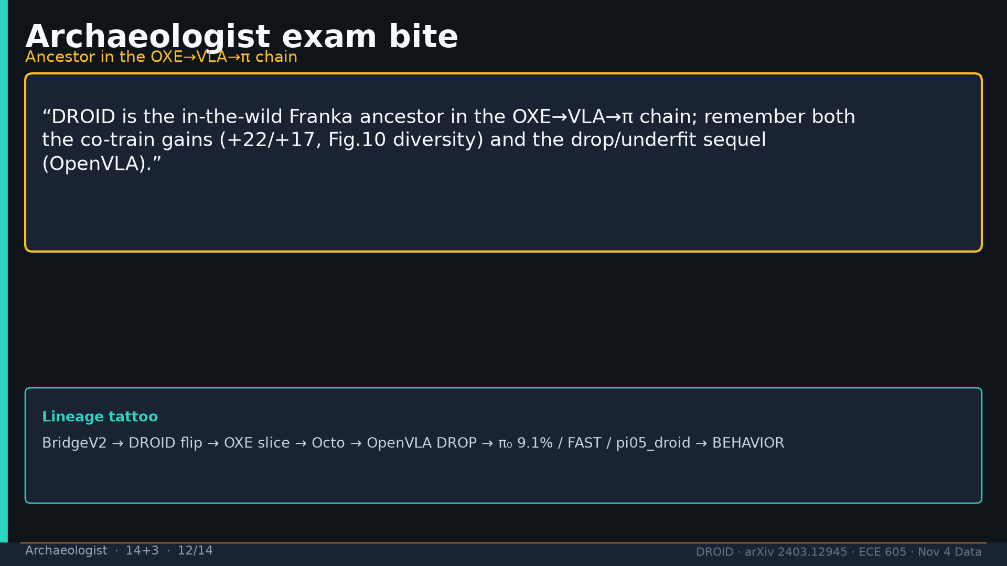
Notes:
Archaeologist · 14+3 · 12/14
Exam bite: in-the-wild Franka ancestor; cite co-train gains AND drop/underfit sequel.
Tattoo: 76k / 350h / 564 scenes / 86 tasks / 52 buildings / +22% ID / +17% OOD / obs2-pred16-action8 @15Hz / ~40k co-train ≠ 76k

Slide 13
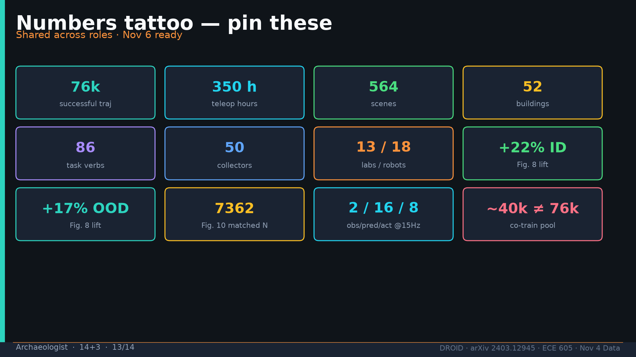
Notes:
Archaeologist · 14+3 · 13/14
Tattoo.
Tattoo: 76k / 350h / 564 scenes / 86 tasks / 52 buildings / +22% ID / +17% OOD / obs2-pred16-action8 @15Hz / ~40k co-train ≠ 76k

Slide 14
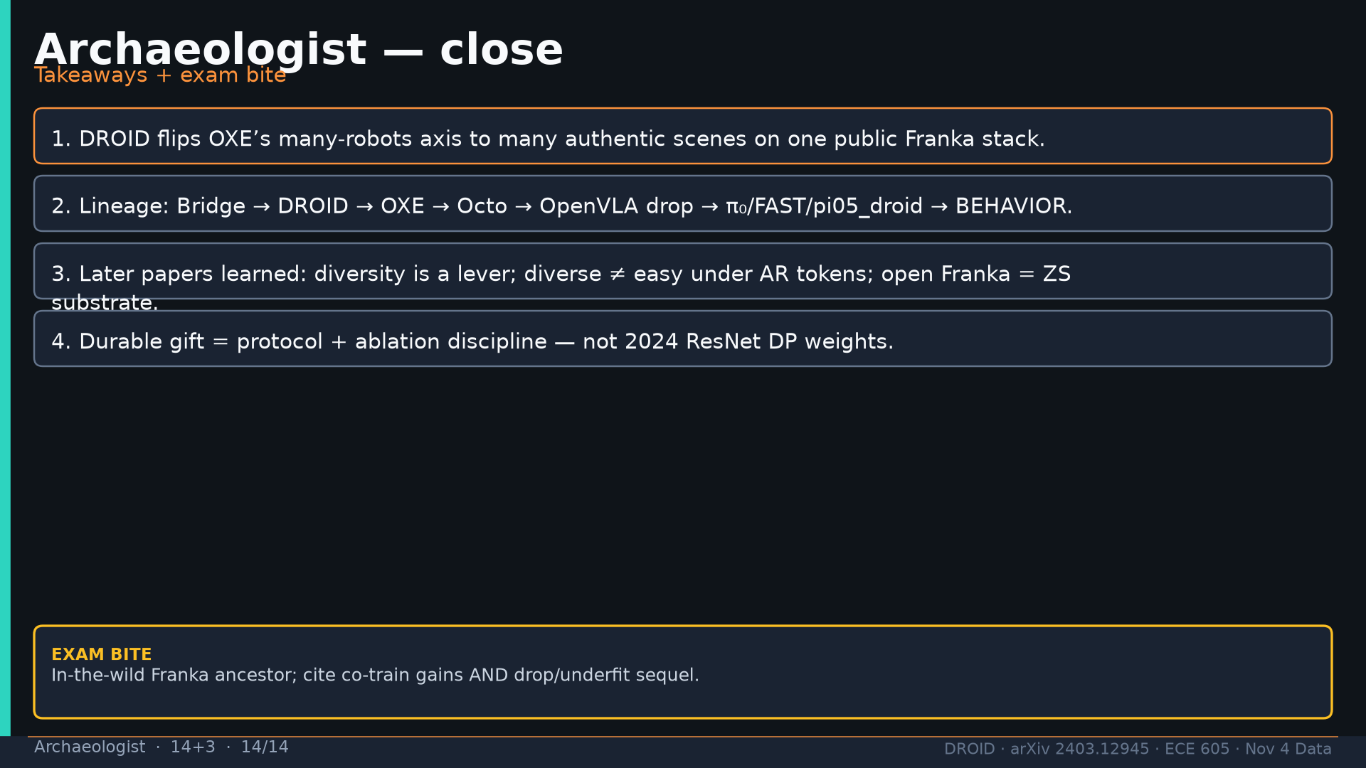
Notes:
Archaeologist · 14+3 · 14/14
Close takeaways.
Tattoo: 76k / 350h / 564 scenes / 86 tasks / 52 buildings / +22% ID / +17% OOD / obs2-pred16-action8 @15Hz / ~40k co-train ≠ 76k

