Slide 1
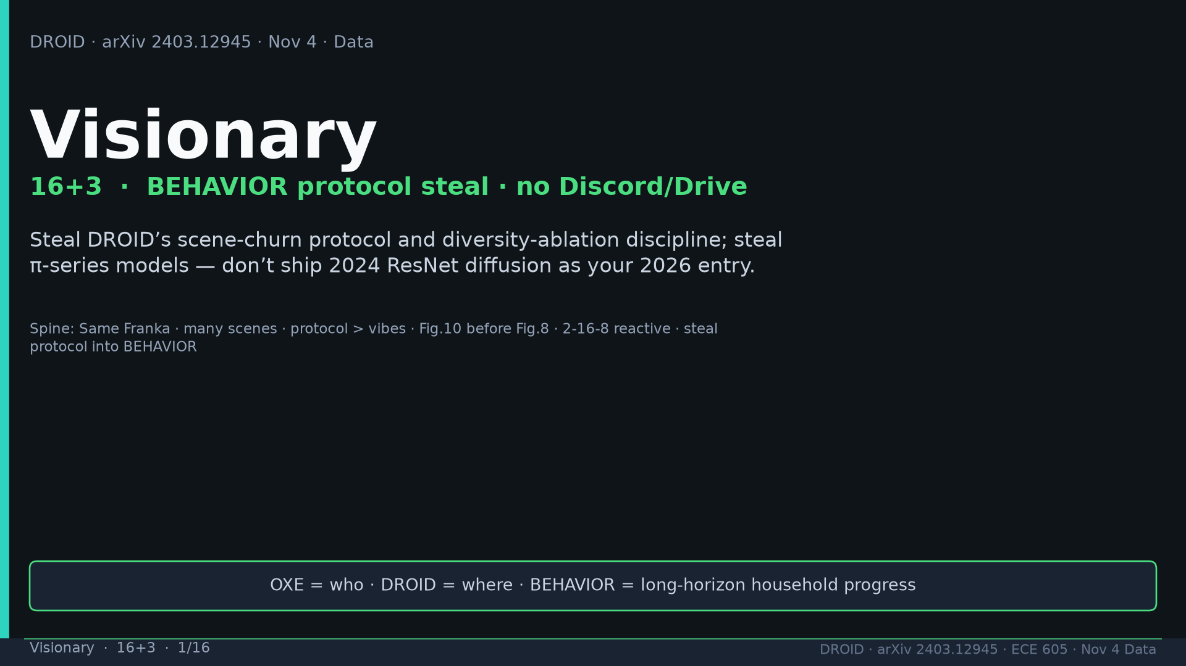
Notes:
Visionary · 16+3 · 1/16
Title. NO Discord/Drive. Steal protocol + π models; don't ship 2024 ResNet DP. OXE=who DROID=where BEHAVIOR=progress.
Tattoo: 76k / 350h / 564 scenes / 86 tasks / 52 buildings / +22% ID / +17% OOD / obs2-pred16-action8 @15Hz / ~40k co-train ≠ 76k

Slide 2
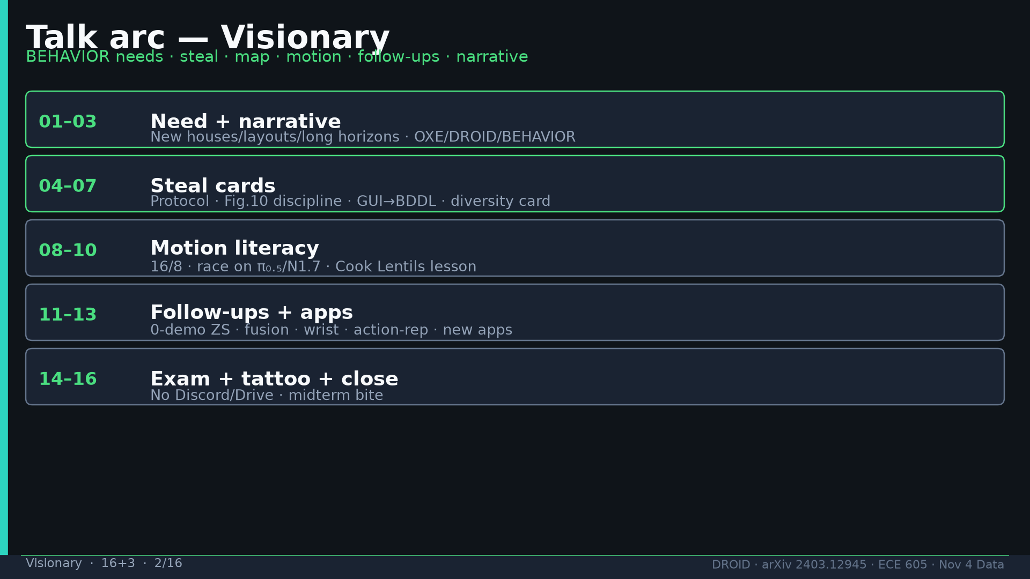
Notes:
Visionary · 16+3 · 2/16
Talk arc overview.
Tattoo: 76k / 350h / 564 scenes / 86 tasks / 52 buildings / +22% ID / +17% OOD / obs2-pred16-action8 @15Hz / ~40k co-train ≠ 76k

Slide 3
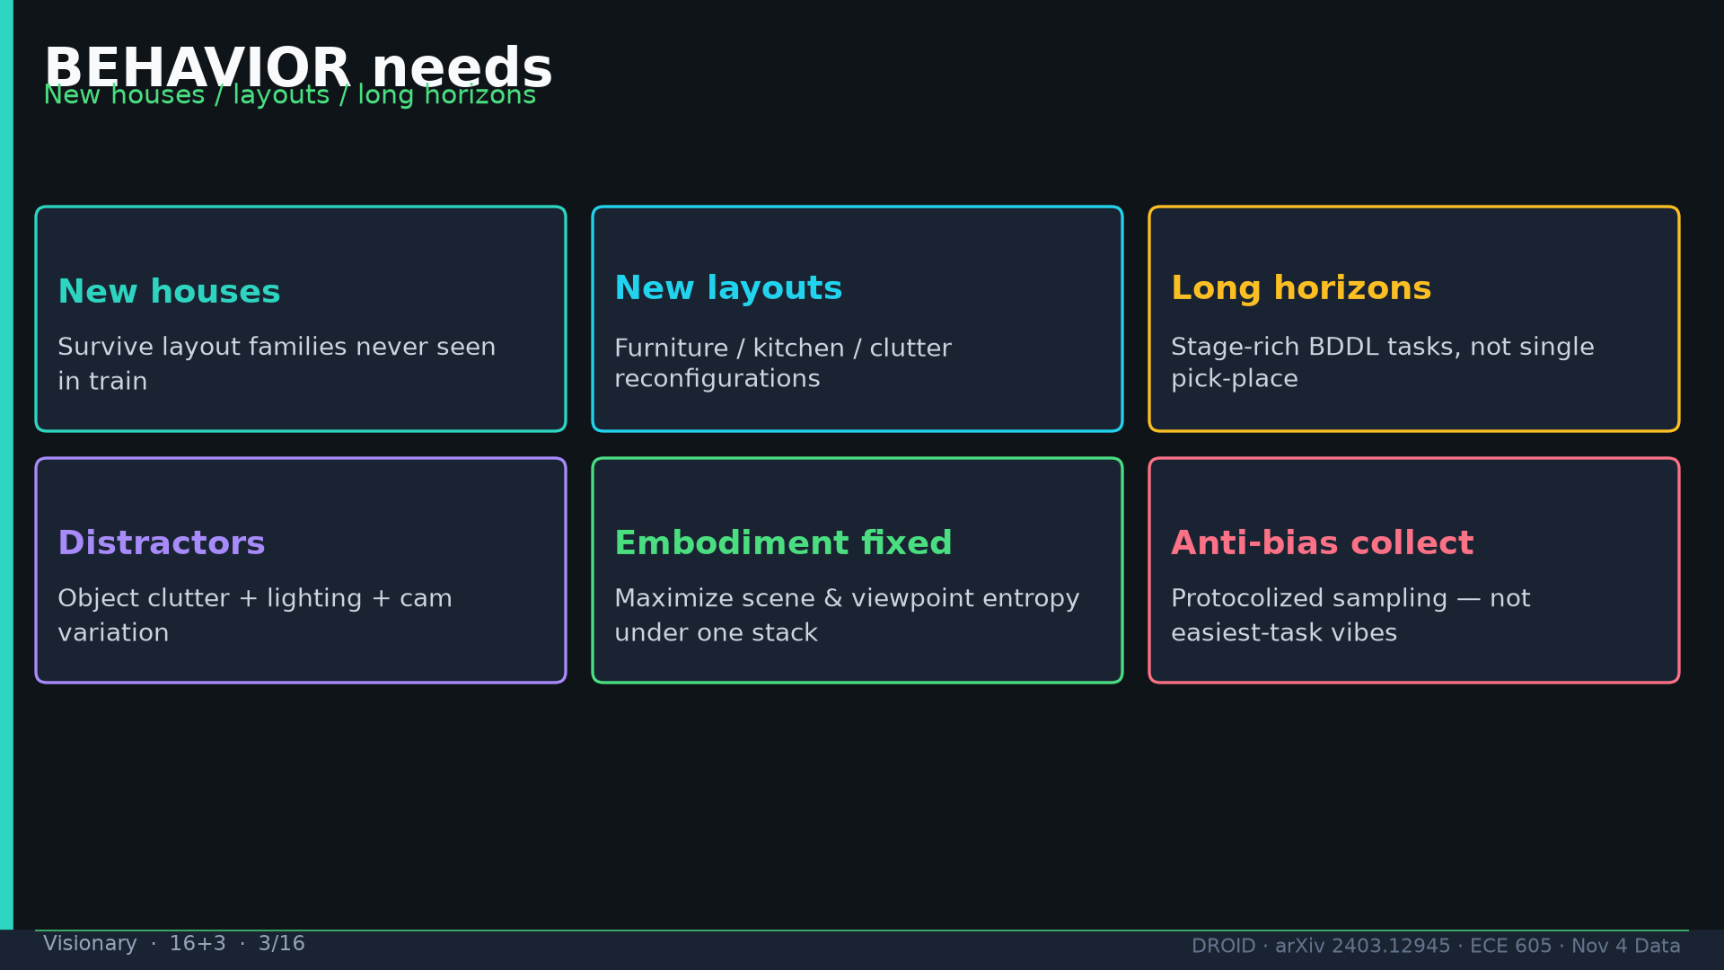
Notes:
Visionary · 16+3 · 3/16
BEHAVIOR needs: new houses/layouts/long horizons/distractors; fixed embodiment; anti-bias collect.
Tattoo: 76k / 350h / 564 scenes / 86 tasks / 52 buildings / +22% ID / +17% OOD / obs2-pred16-action8 @15Hz / ~40k co-train ≠ 76k

Slide 4
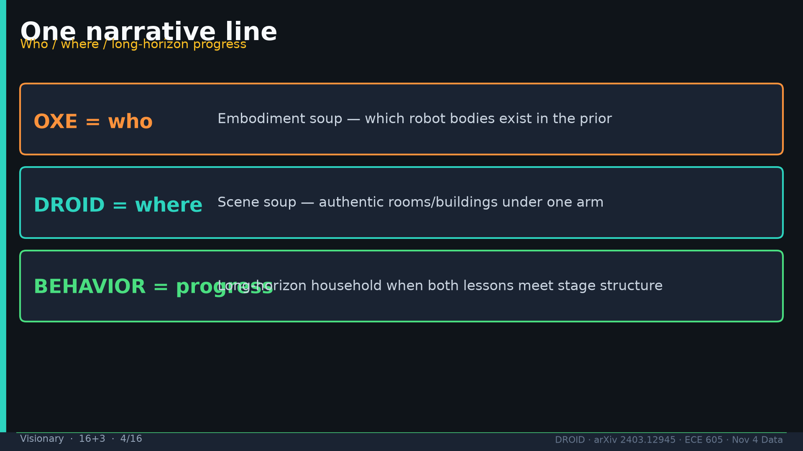
Notes:
Visionary · 16+3 · 4/16
Narrative: OXE=who · DROID=where · BEHAVIOR=long-horizon household progress.
Tattoo: 76k / 350h / 564 scenes / 86 tasks / 52 buildings / +22% ID / +17% OOD / obs2-pred16-action8 @15Hz / ~40k co-train ≠ 76k

Slide 5
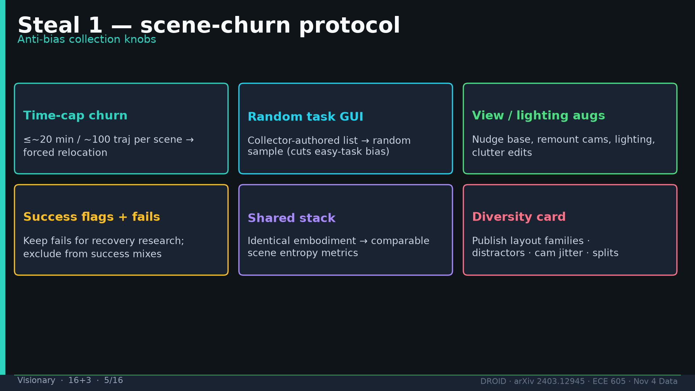
Notes:
Visionary · 16+3 · 5/16
Steal 1: scene-churn protocol knobs (time-cap, random GUI, augs, fails, shared stack, diversity card).
Tattoo: 76k / 350h / 564 scenes / 86 tasks / 52 buildings / +22% ID / +17% OOD / obs2-pred16-action8 @15Hz / ~40k co-train ≠ 76k

Slide 6
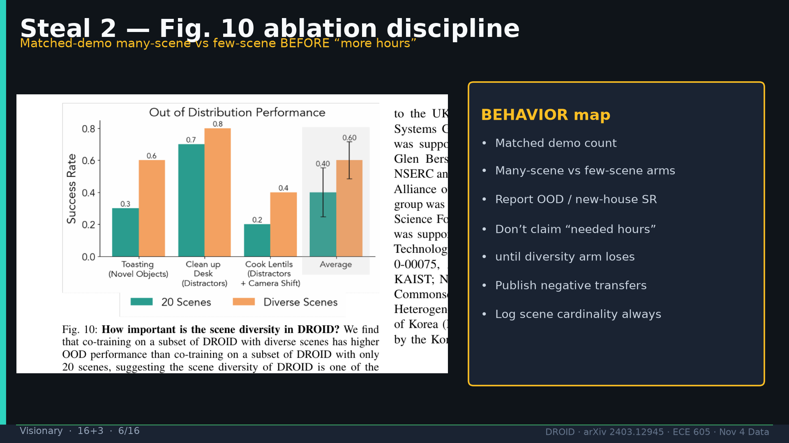
Notes:
Visionary · 16+3 · 6/16
Steal 2: Fig10 matched-N discipline before claiming need more hours.
Tattoo: 76k / 350h / 564 scenes / 86 tasks / 52 buildings / +22% ID / +17% OOD / obs2-pred16-action8 @15Hz / ~40k co-train ≠ 76k

Slide 7
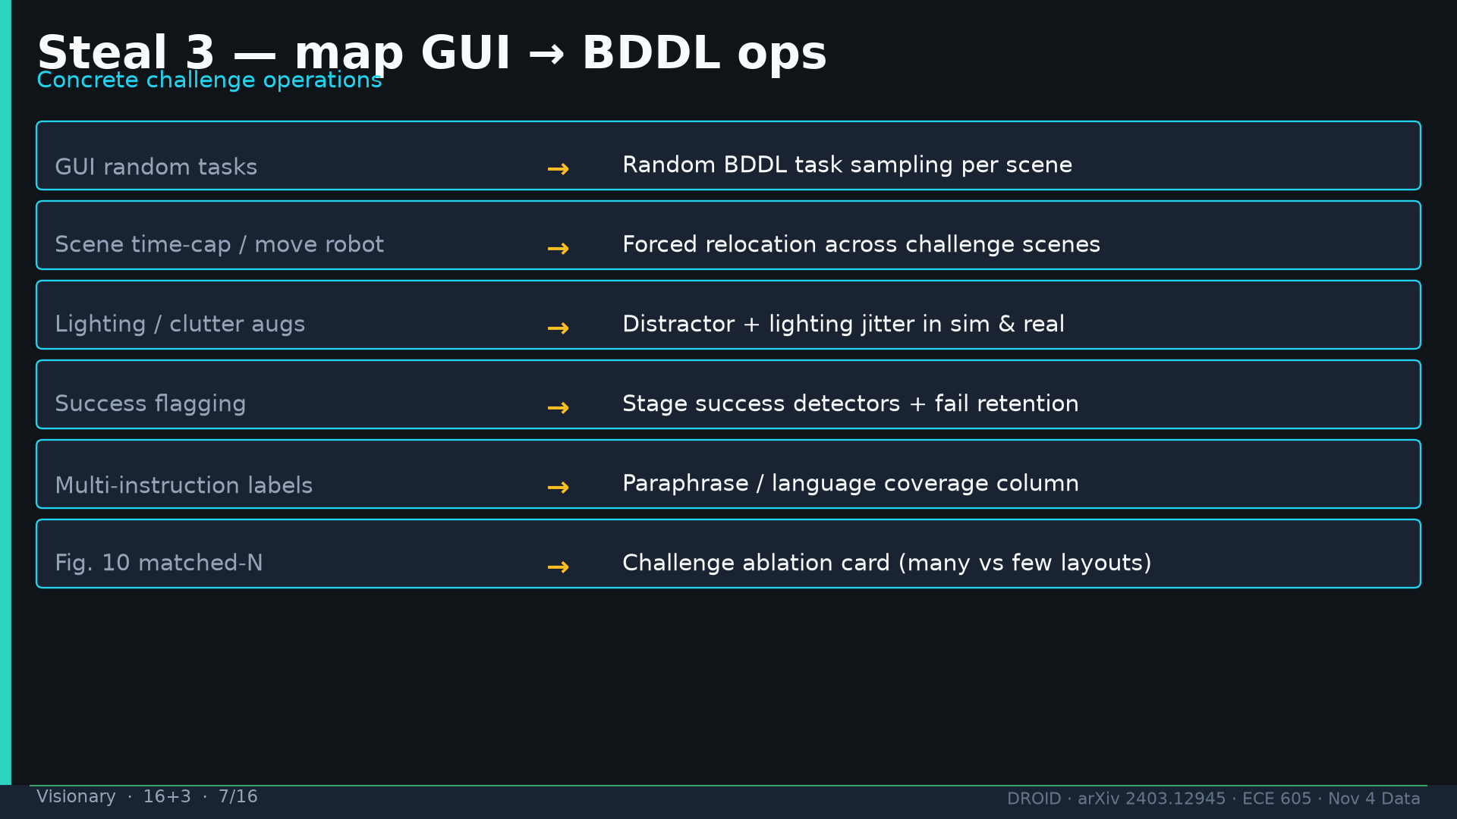
Notes:
Visionary · 16+3 · 7/16
Steal 3: map GUI→BDDL random, relocation, distractor jitter, stage detectors, paraphrase column, ablation card.
Tattoo: 76k / 350h / 564 scenes / 86 tasks / 52 buildings / +22% ID / +17% OOD / obs2-pred16-action8 @15Hz / ~40k co-train ≠ 76k

Slide 8
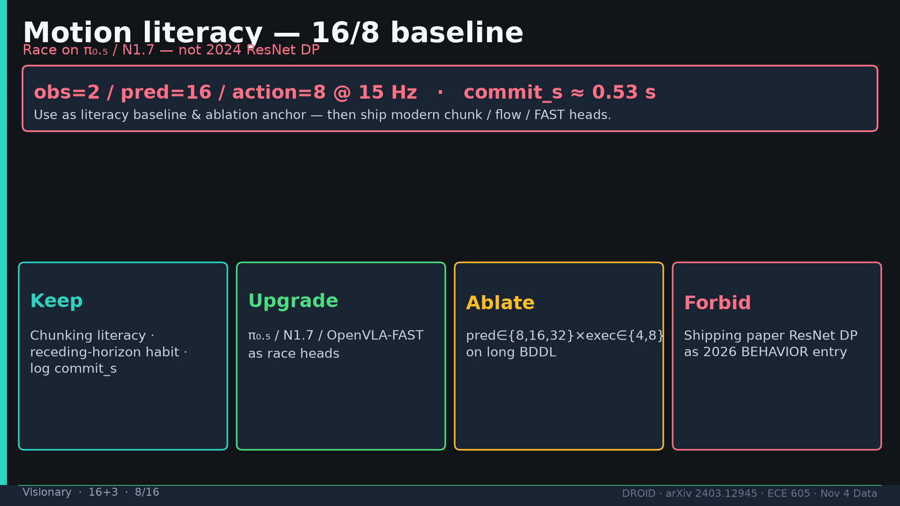
Notes:
Visionary · 16+3 · 8/16
Motion: 16/8 literacy; upgrade to π₀.₅/N1.7; ablate horizons; FORBID shipping paper ResNet DP as 2026 entry.
Tattoo: 76k / 350h / 564 scenes / 86 tasks / 52 buildings / +22% ID / +17% OOD / obs2-pred16-action8 @15Hz / ~40k co-train ≠ 76k

Slide 9
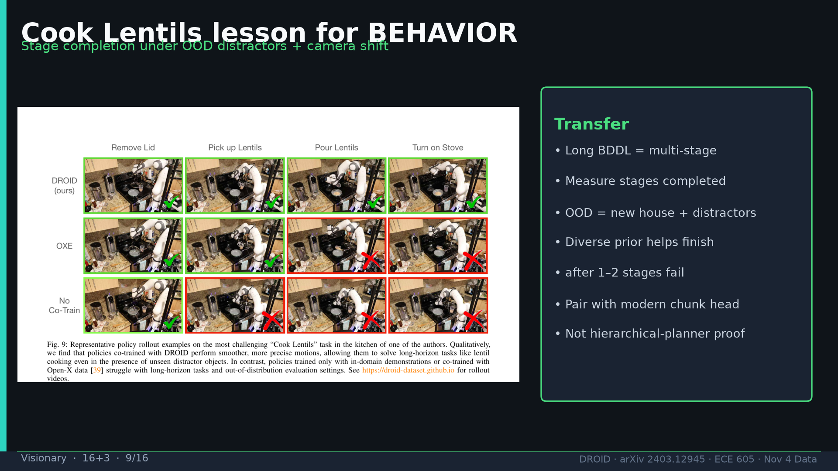
Notes:
Visionary · 16+3 · 9/16
Cook Lentils lesson: stage completion under OOD; pair diverse prior with modern chunk head.
Tattoo: 76k / 350h / 564 scenes / 86 tasks / 52 buildings / +22% ID / +17% OOD / obs2-pred16-action8 @15Hz / ~40k co-train ≠ 76k

Slide 10
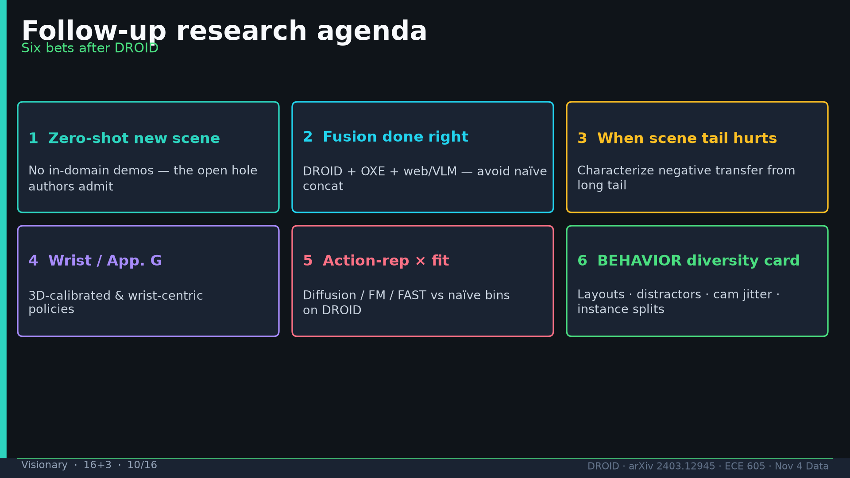
Notes:
Visionary · 16+3 · 10/16
Follow-ups: 0-demo ZS, fusion, when tail hurts, wrist/App.G, action-rep×fit, BEHAVIOR diversity card.
Tattoo: 76k / 350h / 564 scenes / 86 tasks / 52 buildings / +22% ID / +17% OOD / obs2-pred16-action8 @15Hz / ~40k co-train ≠ 76k

Slide 11
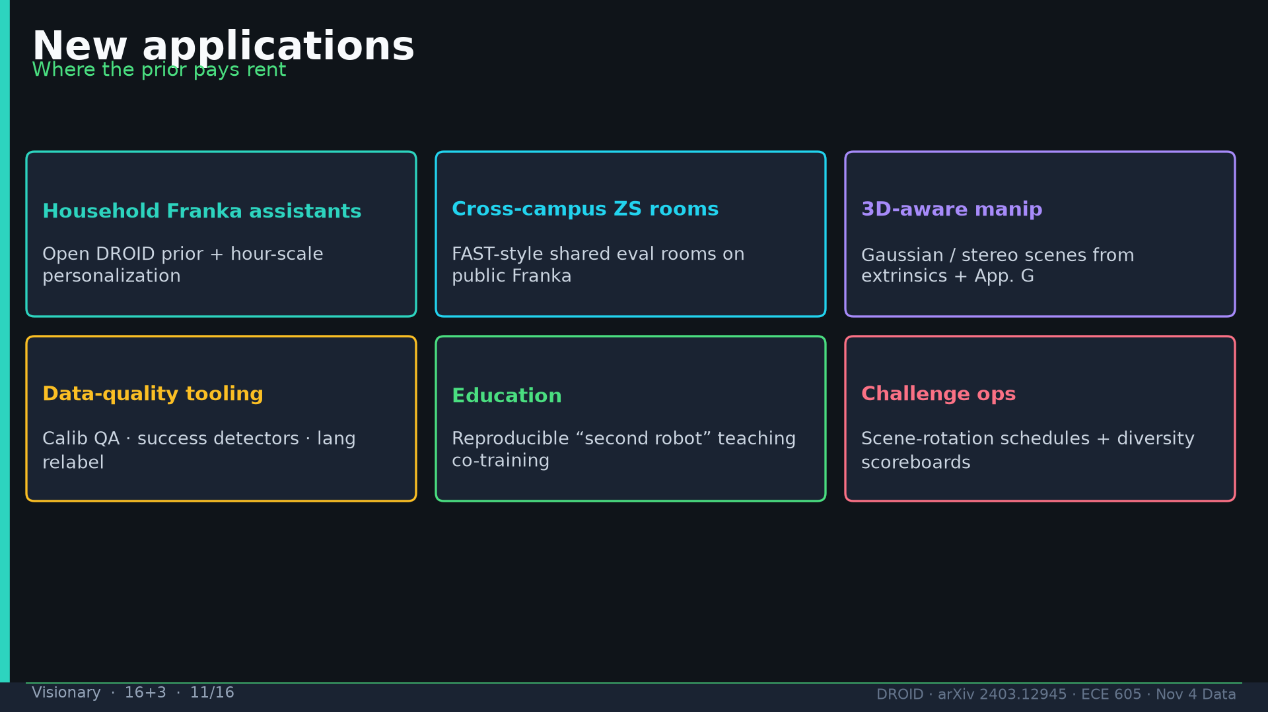
Notes:
Visionary · 16+3 · 11/16
New apps: household prior, campus ZS rooms, 3D calib, data-quality tooling, education, challenge ops.
Tattoo: 76k / 350h / 564 scenes / 86 tasks / 52 buildings / +22% ID / +17% OOD / obs2-pred16-action8 @15Hz / ~40k co-train ≠ 76k

Slide 12
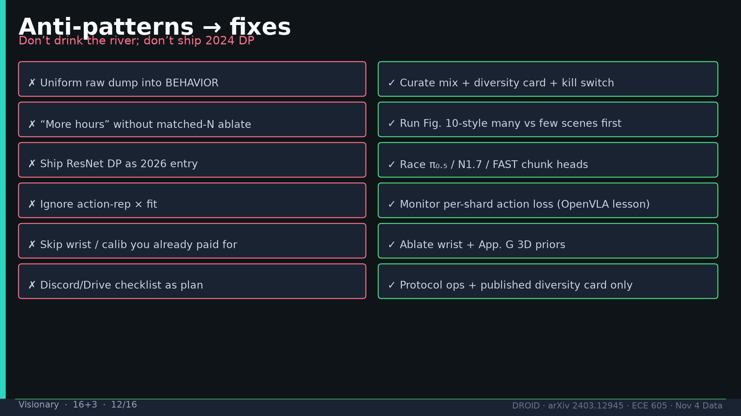
Notes:
Visionary · 16+3 · 12/16
Anti-patterns→fixes. Explicitly no Discord/Drive checklist as plan.
Tattoo: 76k / 350h / 564 scenes / 86 tasks / 52 buildings / +22% ID / +17% OOD / obs2-pred16-action8 @15Hz / ~40k co-train ≠ 76k

Slide 13
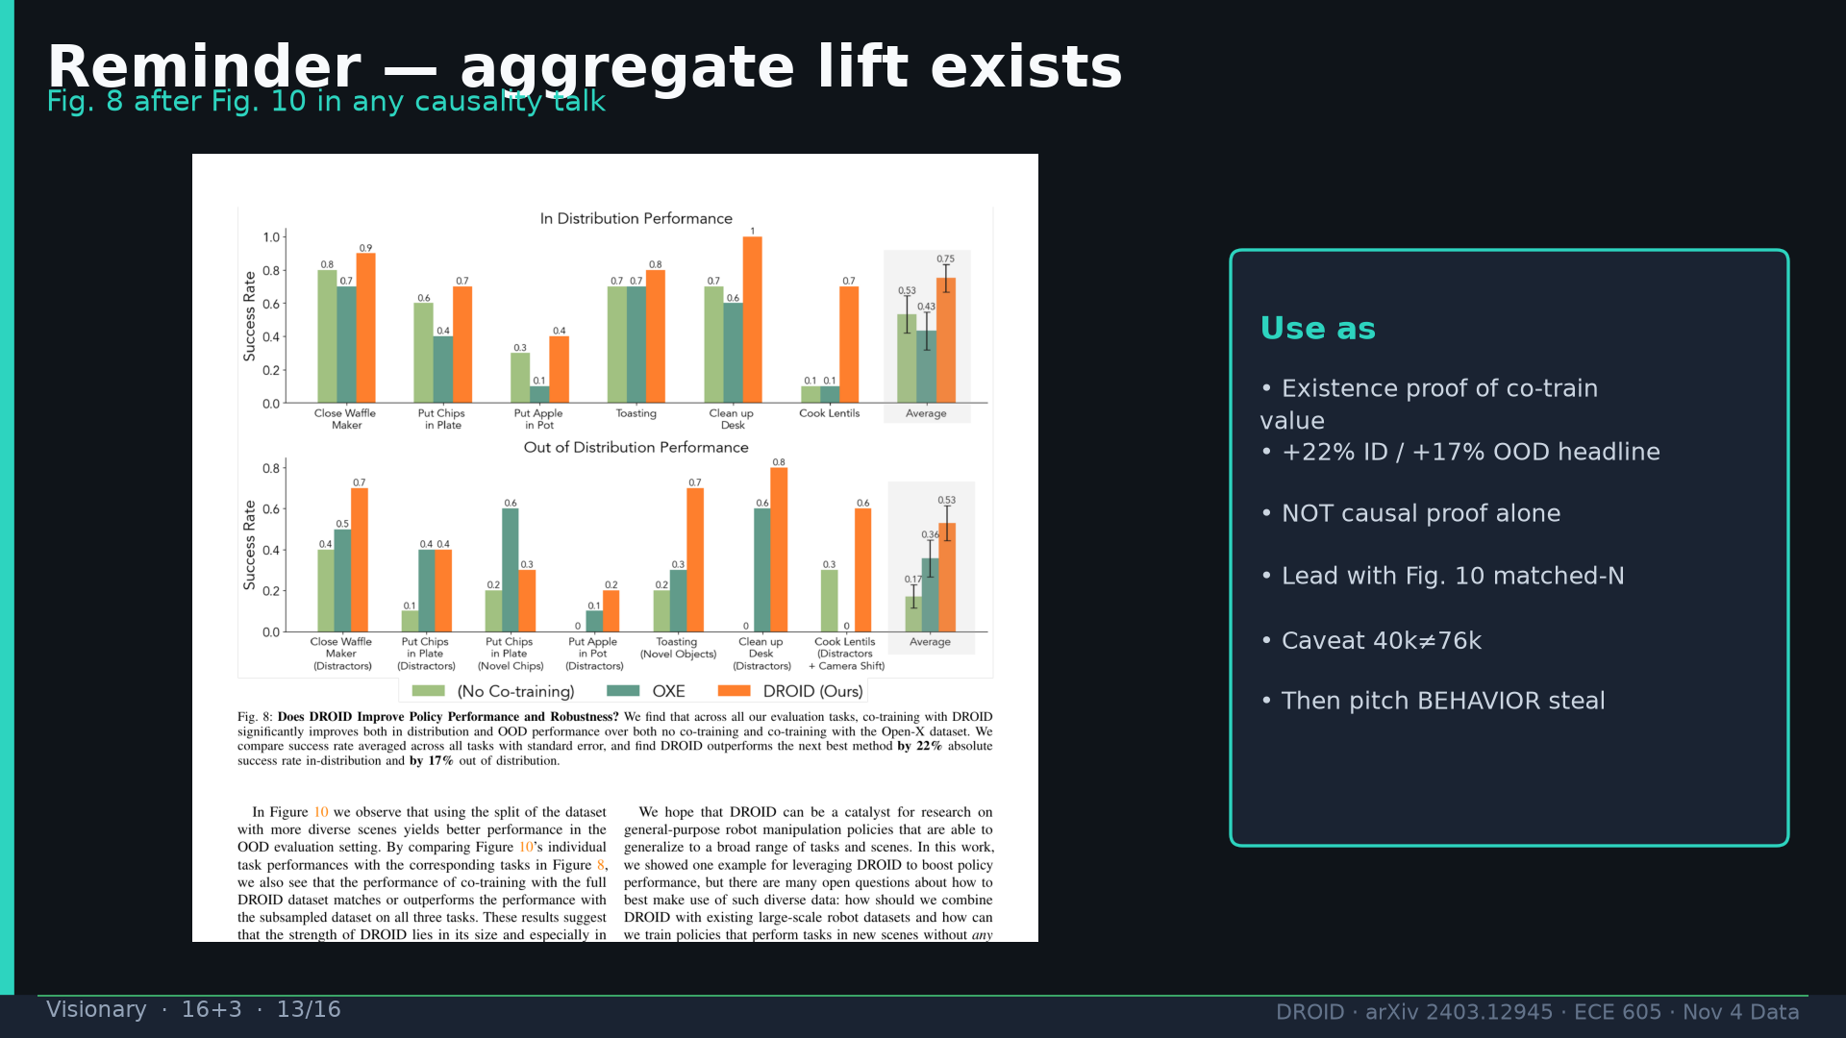
Notes:
Visionary · 16+3 · 13/16
Fig8 reminder after Fig10 for causality talks. +22/+17 existence proof; caveat 40k≠76k.
Tattoo: 76k / 350h / 564 scenes / 86 tasks / 52 buildings / +22% ID / +17% OOD / obs2-pred16-action8 @15Hz / ~40k co-train ≠ 76k

Slide 14
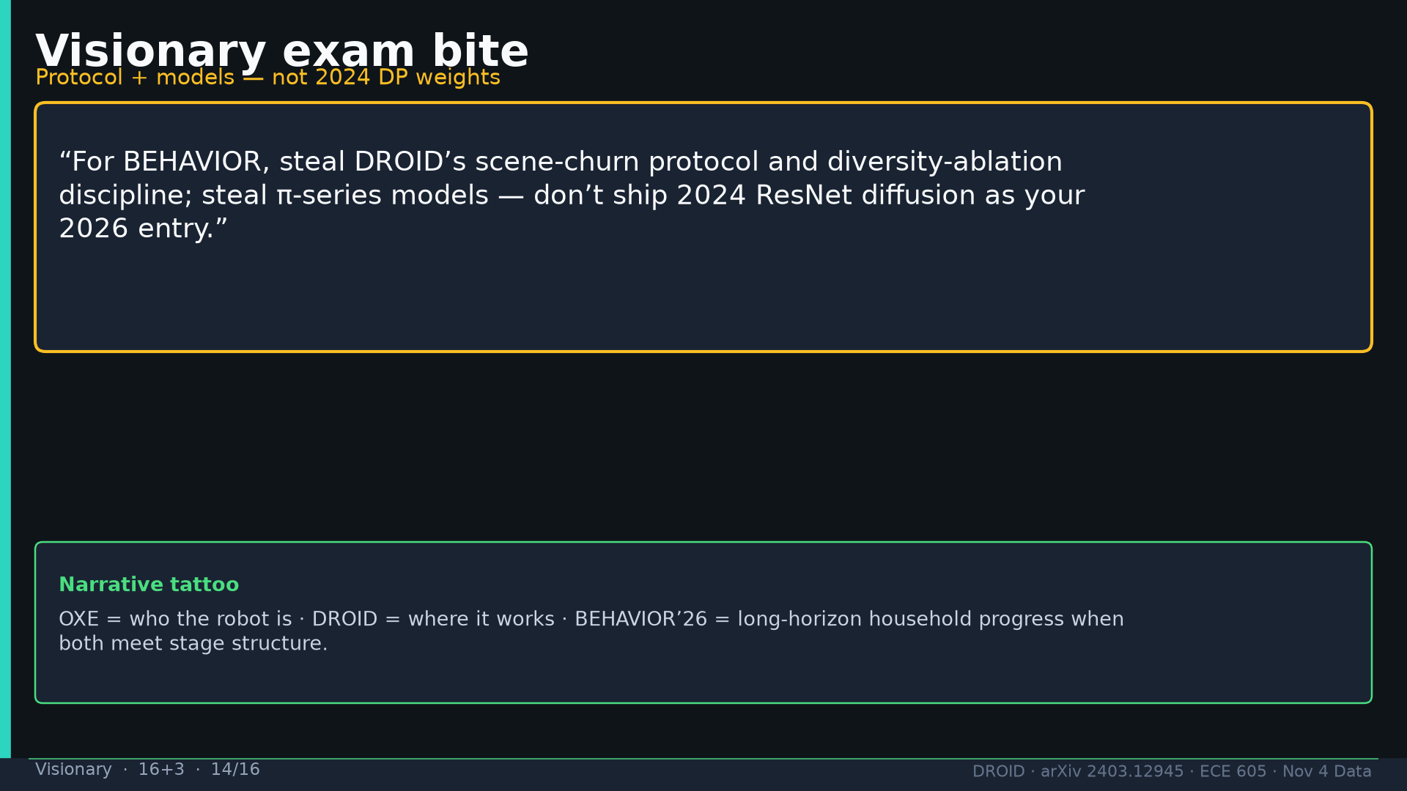
Notes:
Visionary · 16+3 · 14/16
Exam bite: steal protocol + ablation discipline; steal π models — not 2024 ResNet DP.
Tattoo: 76k / 350h / 564 scenes / 86 tasks / 52 buildings / +22% ID / +17% OOD / obs2-pred16-action8 @15Hz / ~40k co-train ≠ 76k

Slide 15
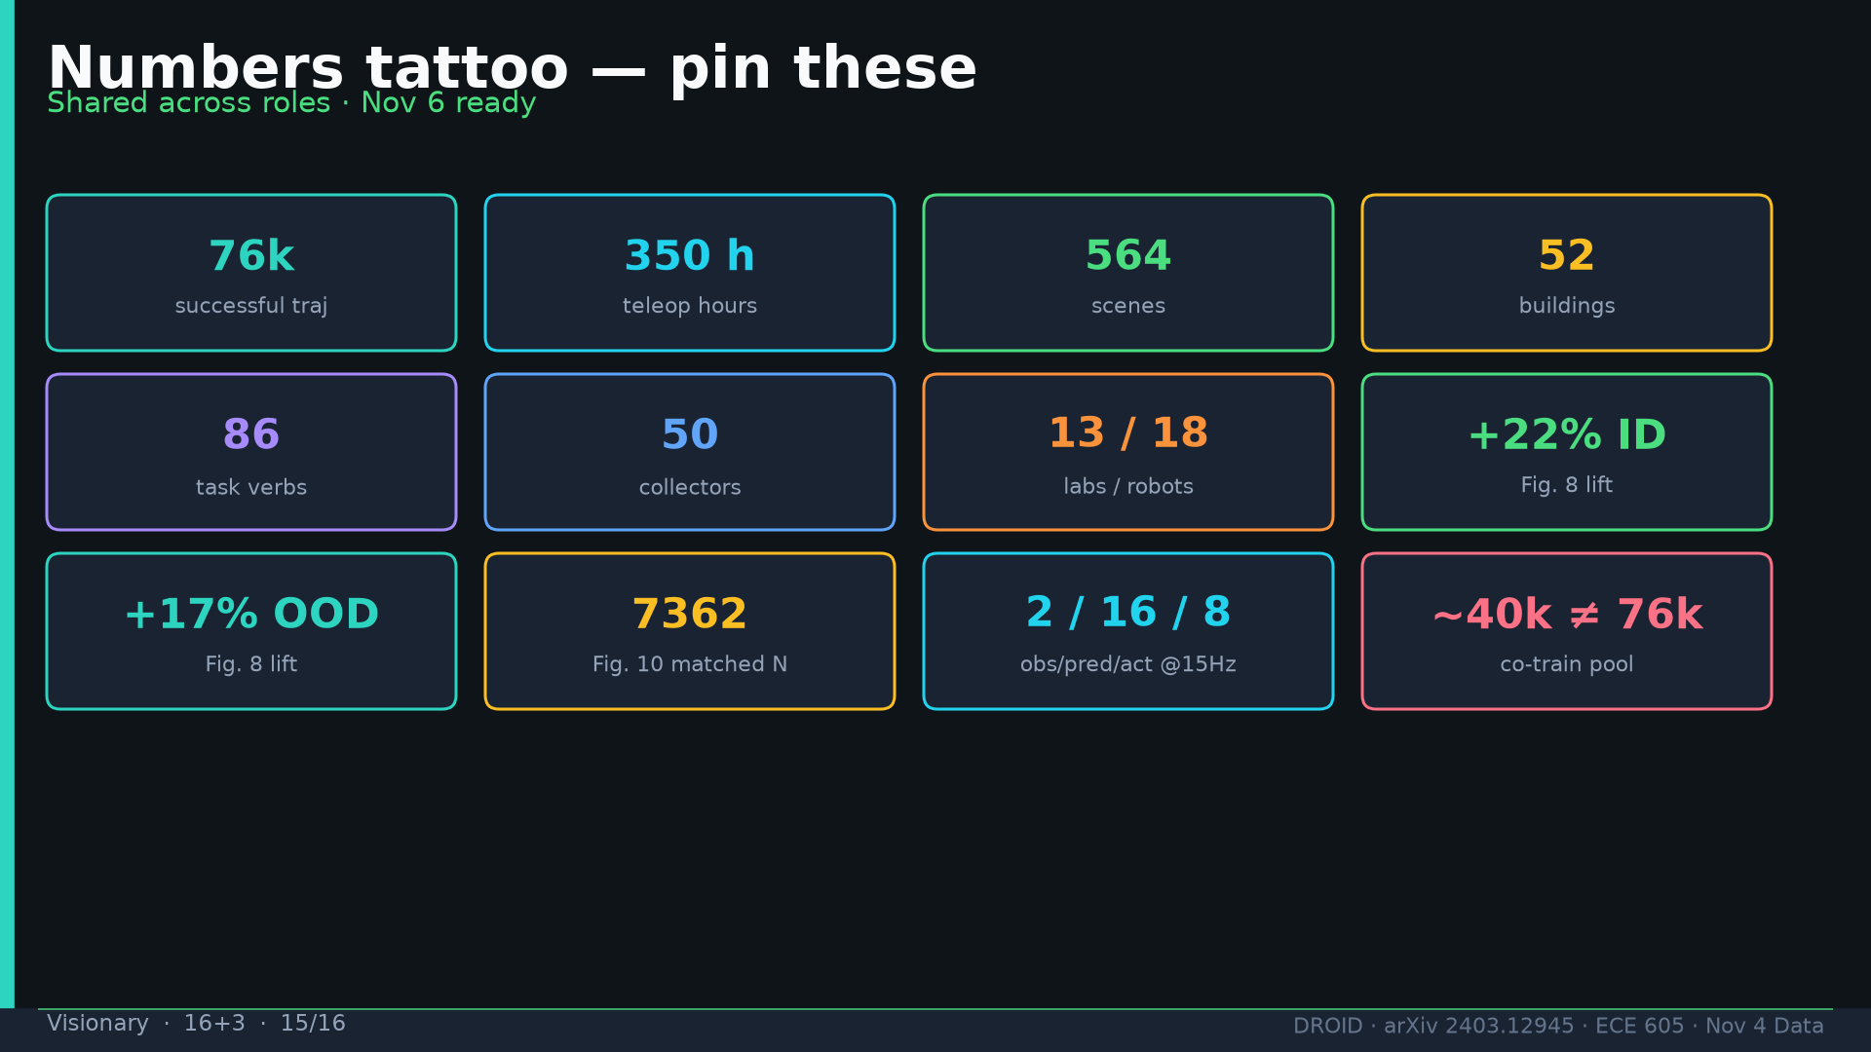
Notes:
Visionary · 16+3 · 15/16
Tattoo.
Tattoo: 76k / 350h / 564 scenes / 86 tasks / 52 buildings / +22% ID / +17% OOD / obs2-pred16-action8 @15Hz / ~40k co-train ≠ 76k

Slide 16
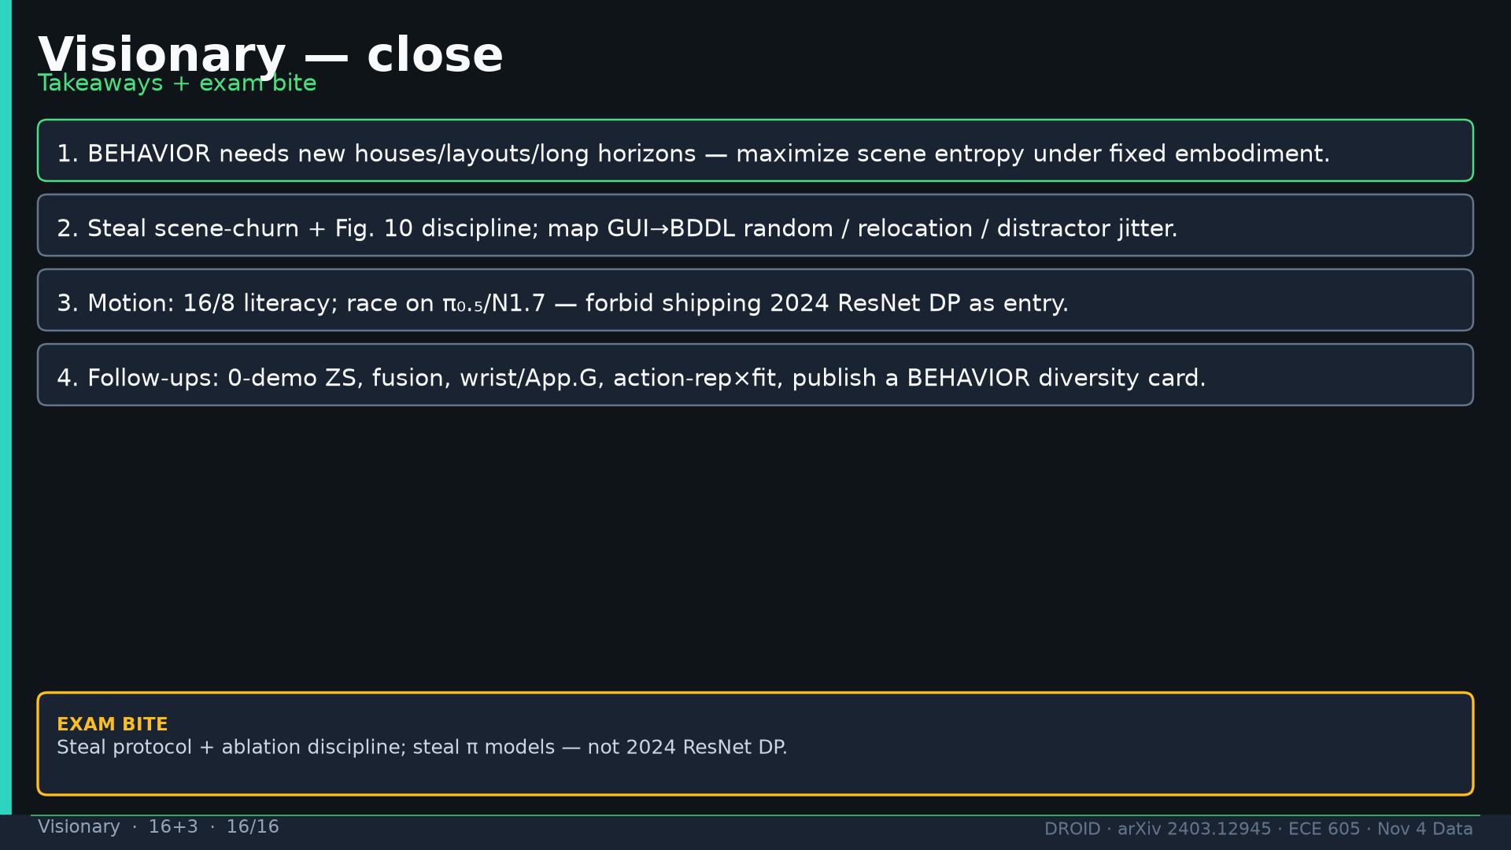
Notes:
Visionary · 16+3 · 16/16
Close four takeaways + exam bite. NO Discord/Drive content in deck.
Tattoo: 76k / 350h / 564 scenes / 86 tasks / 52 buildings / +22% ID / +17% OOD / obs2-pred16-action8 @15Hz / ~40k co-train ≠ 76k

