Slide 1
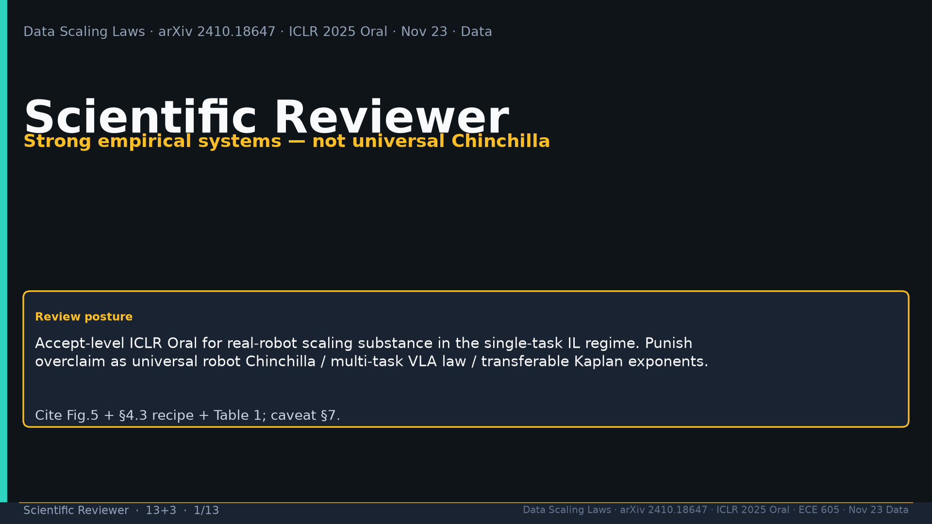
Notes:
Title. Strong empirical systems — not universal Chinchilla. Cite Fig.5+recipe+Tab.1; caveat §7.

Slide 2
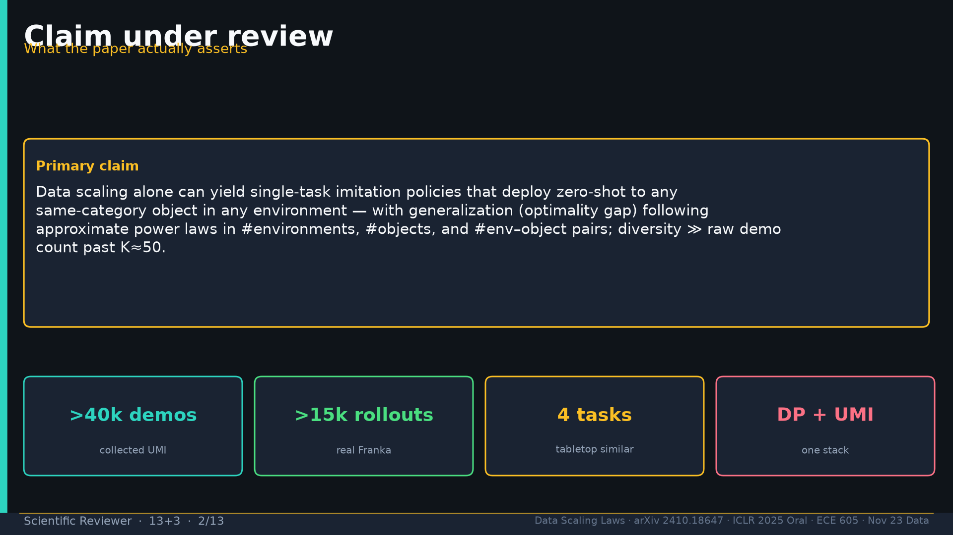
Notes:
Claim: single-task IL ZS any same-cat object/env; power laws on M/N/pairs; diversity≫K past 50. >40k/>15k; 4 tasks; DP+UMI.

Slide 3
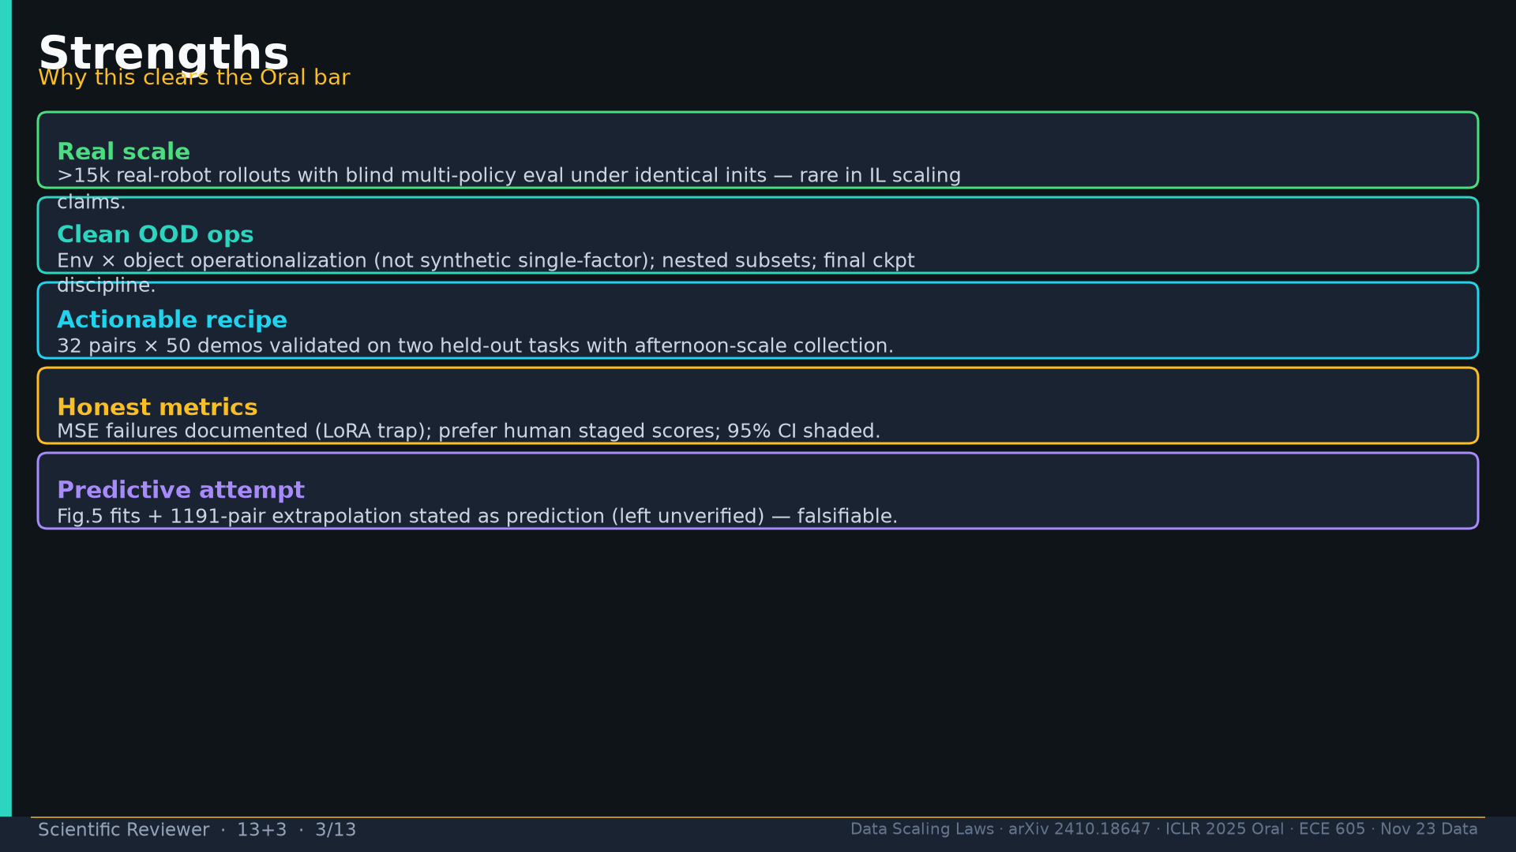
Notes:
Strengths: real >15k blind rollouts; clean env×obj OOD; actionable recipe; honest MSE; falsifiable 1191 prediction.

Slide 4
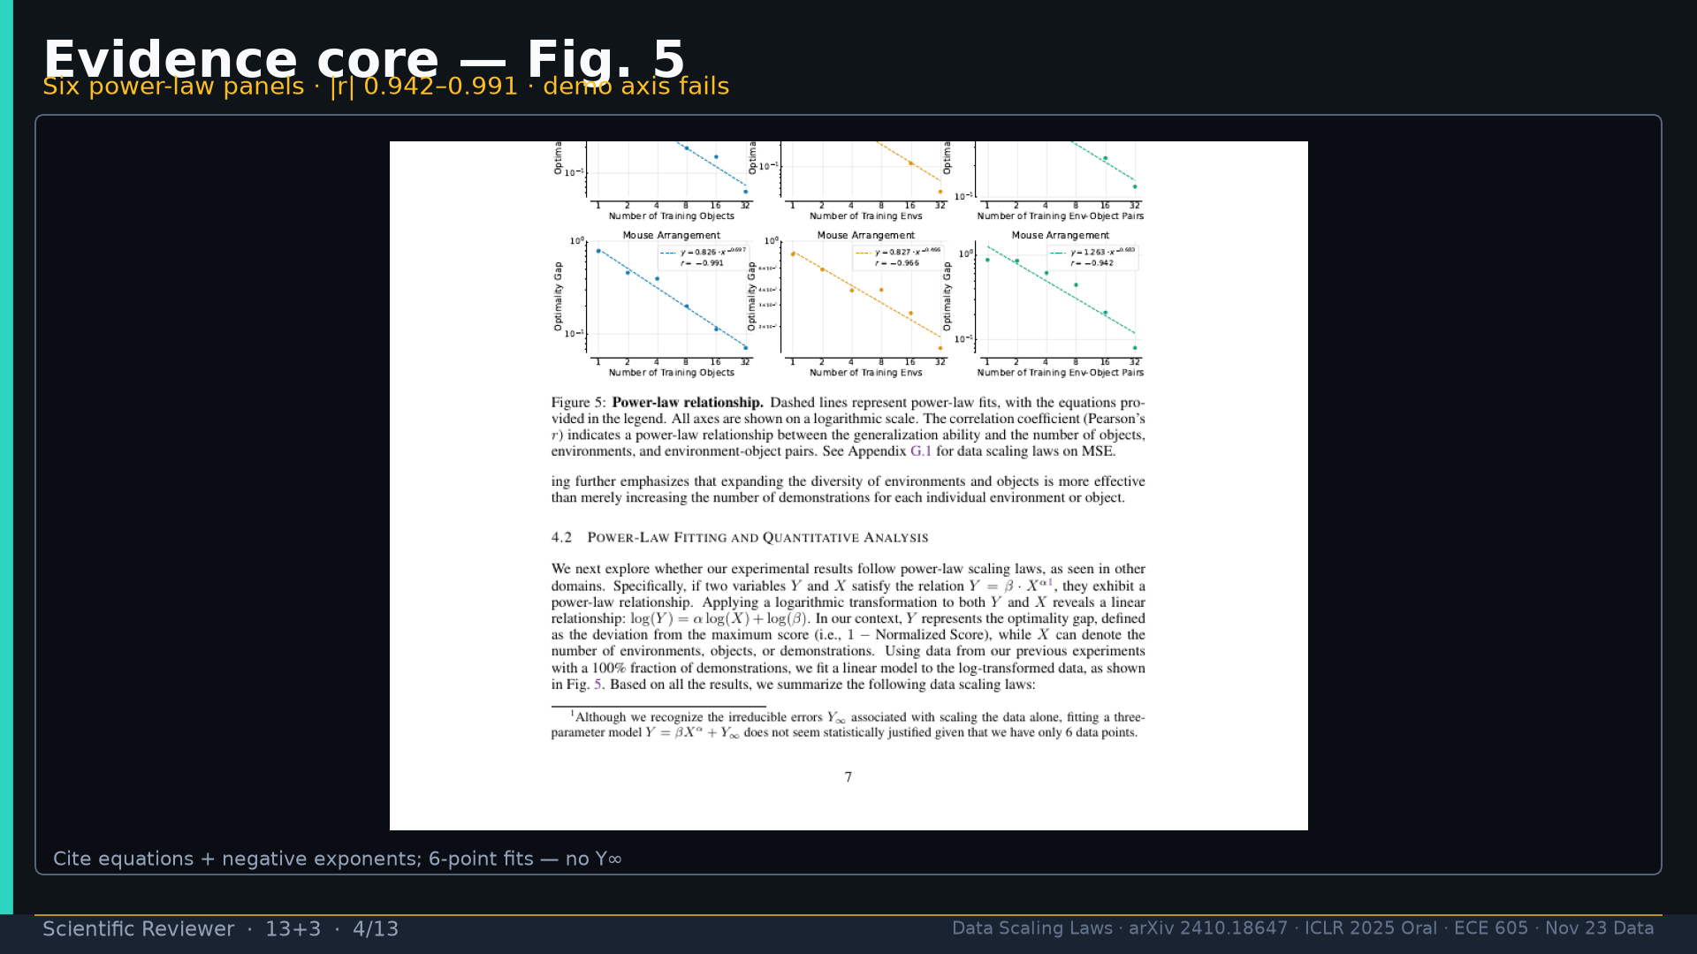
Notes:
Fig.5 evidence: six panels |r|0.942–0.991; demo axis fails; 6-point no Y∞.

Slide 5
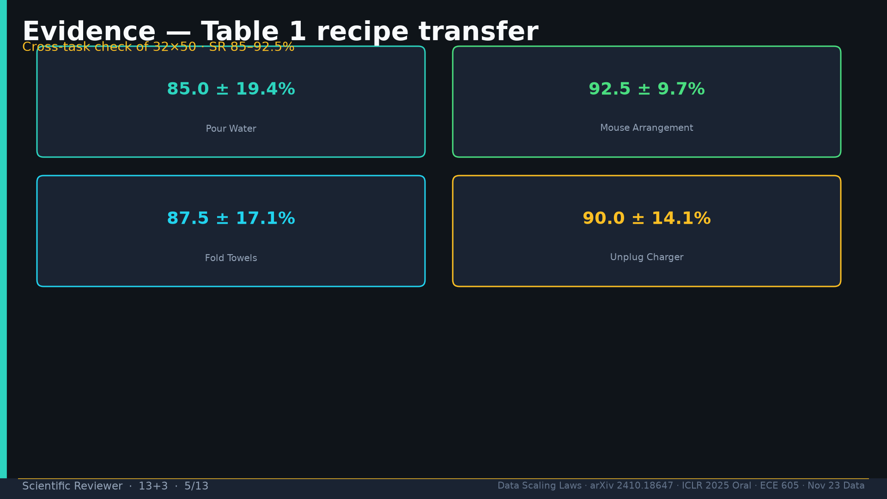
Notes:
Tab.1: SR 85–92.5% across 4 tasks under 32×50.

Slide 6
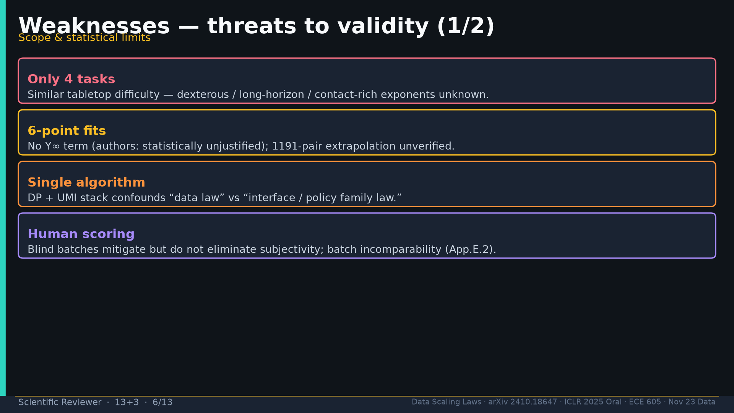
Notes:
Weak1: 4 tasks; 6-point fits; DP+UMI confound; human scoring + batch incomparability.

Slide 7
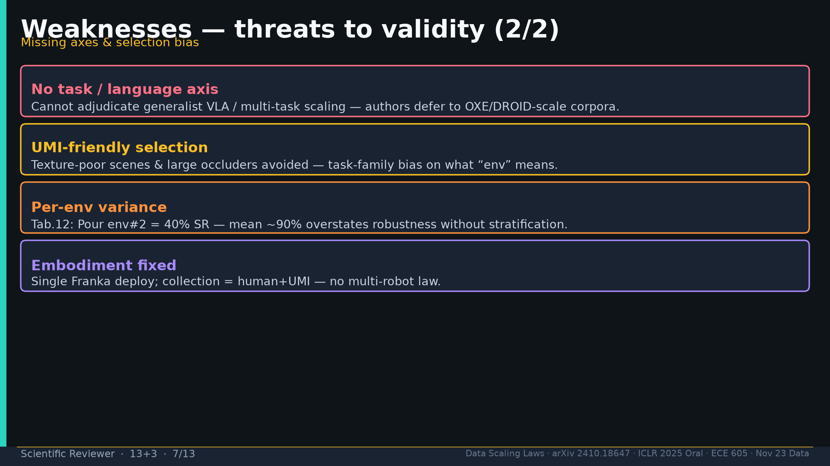
Notes:
Weak2: no task/lang axis; UMI selection bias; per-env variance 40%; single embodiment.

Slide 8
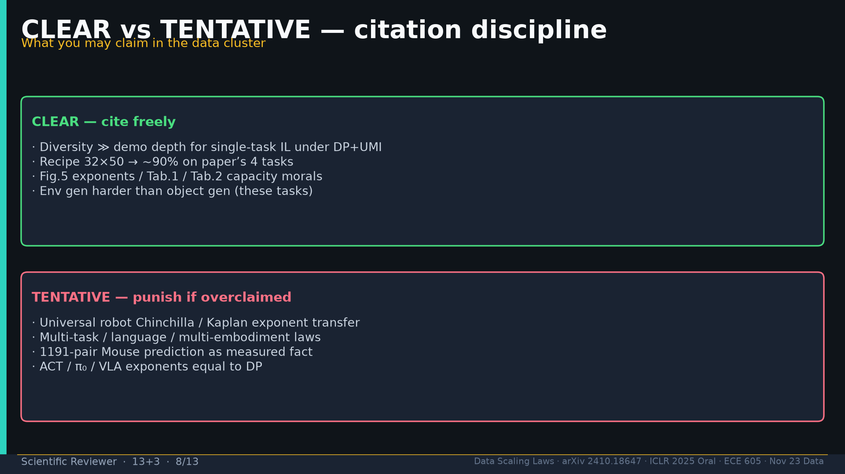
Notes:
CLEAR vs TENTATIVE: cite diversity/recipe/Fig.5/Tab.1/Tab.2; punish Chinchilla/multi-task/1191-as-fact/ACT-equal.

Slide 9
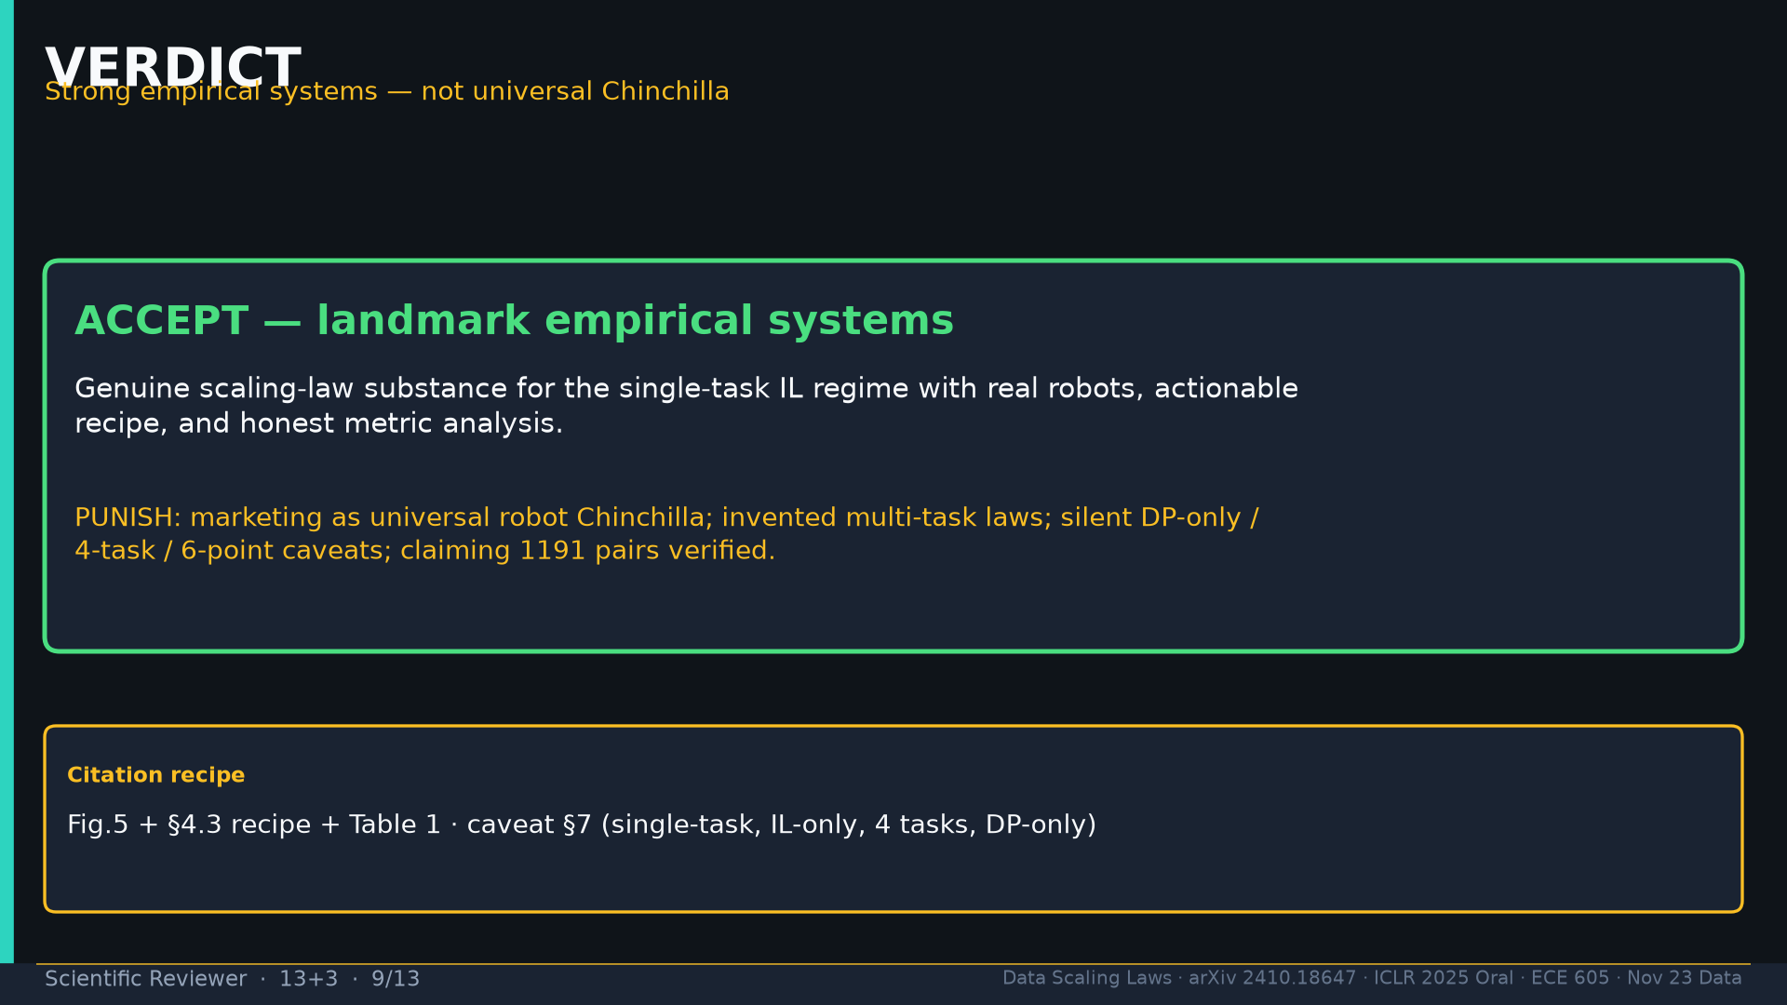
Notes:
VERDICT Accept landmark systems; punish universal Chinchilla marketing.

Slide 10
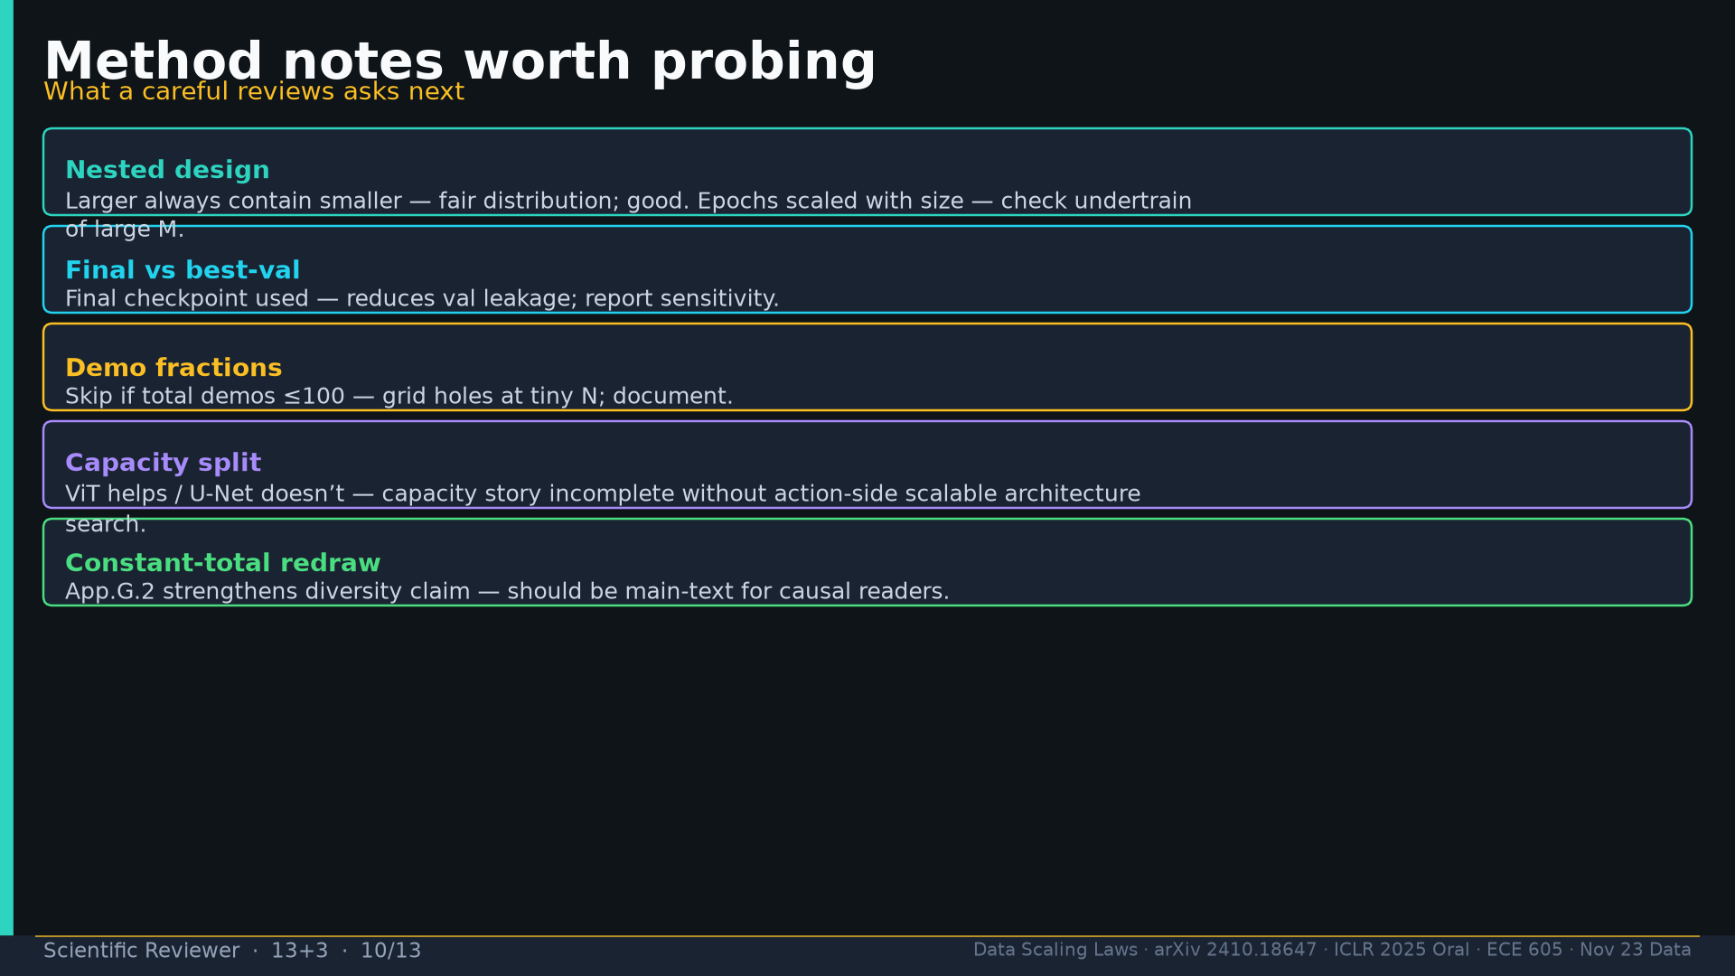
Notes:
Method probes: nested design; final ckpt; demo-fraction holes; capacity split; App.G.2 should be main-text.

Slide 11
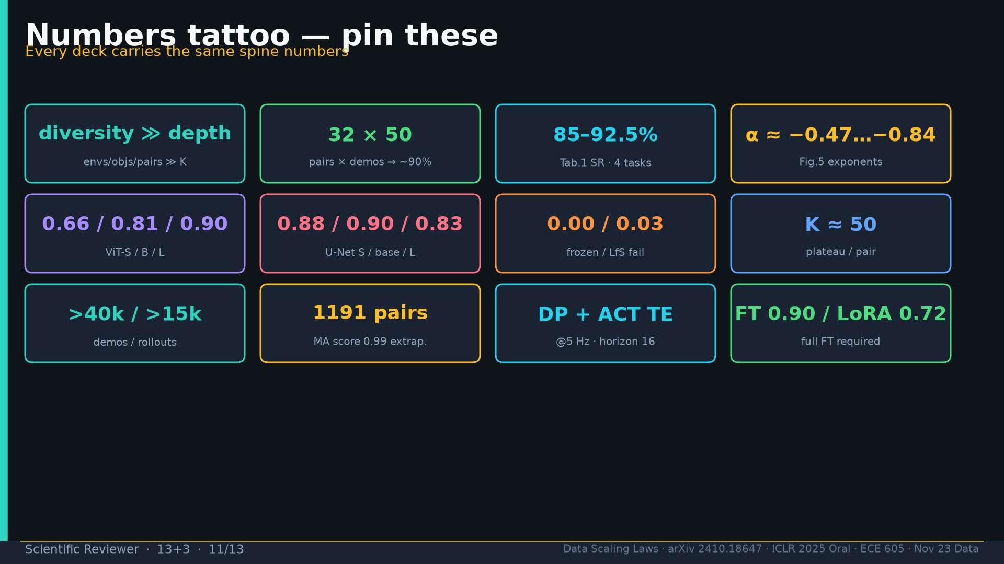
Notes:
Tattoo.

Slide 12
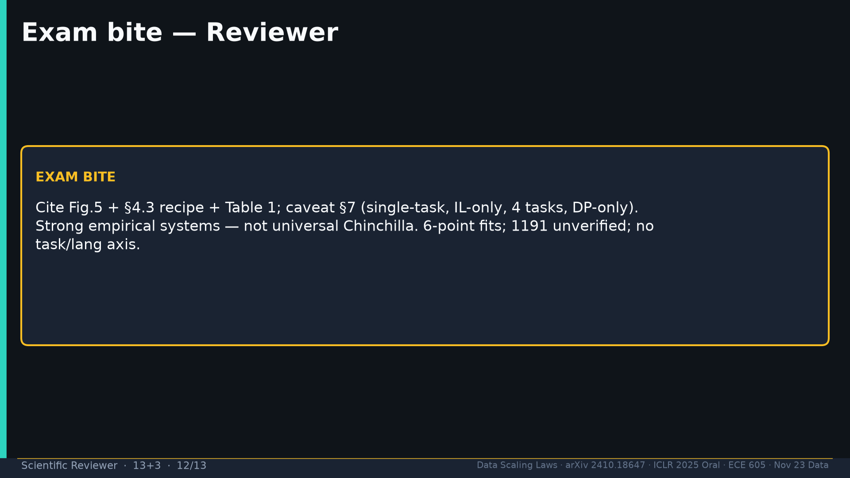
Notes:
Exam: cite Fig.5+recipe+Tab.1; caveat §7; not universal Chinchilla.

Slide 13
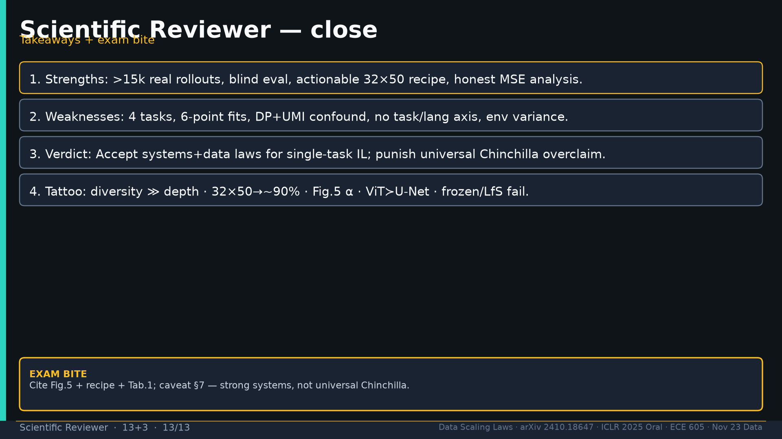
Notes:
Close.

