Slide 1
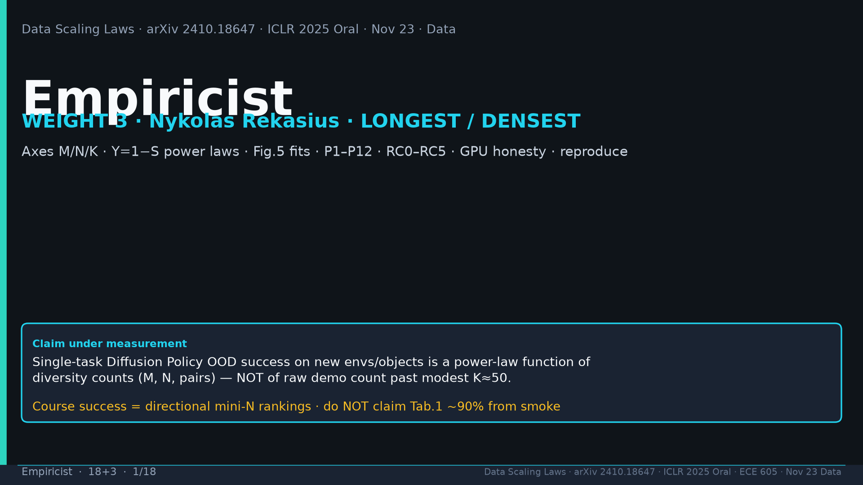
Notes:
Title. WEIGHT 3 Nykolas LONGEST. Claim: OOD is power-law of diversity not raw demos past K≈50. Success=directional mini-N; NEVER claim Tab.1 90% from smoke.

Slide 2
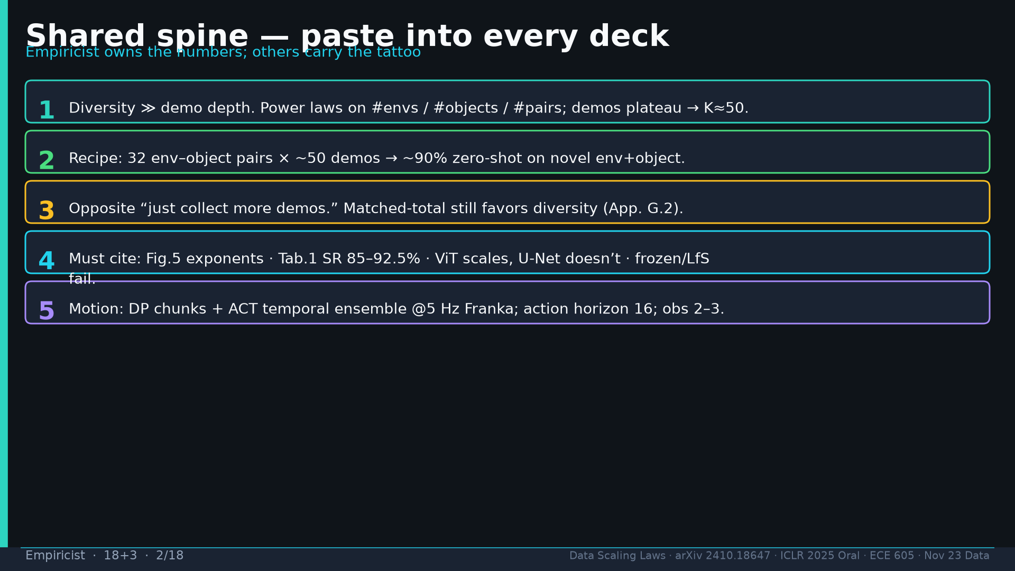
Notes:
Spine 1–5: diversity≫depth; 32×50→~90%; opposite more-demos; Fig.5/Tab.1/ViT≻U-Net/frozen; DP+ACT TE @5Hz hor16.

Slide 3
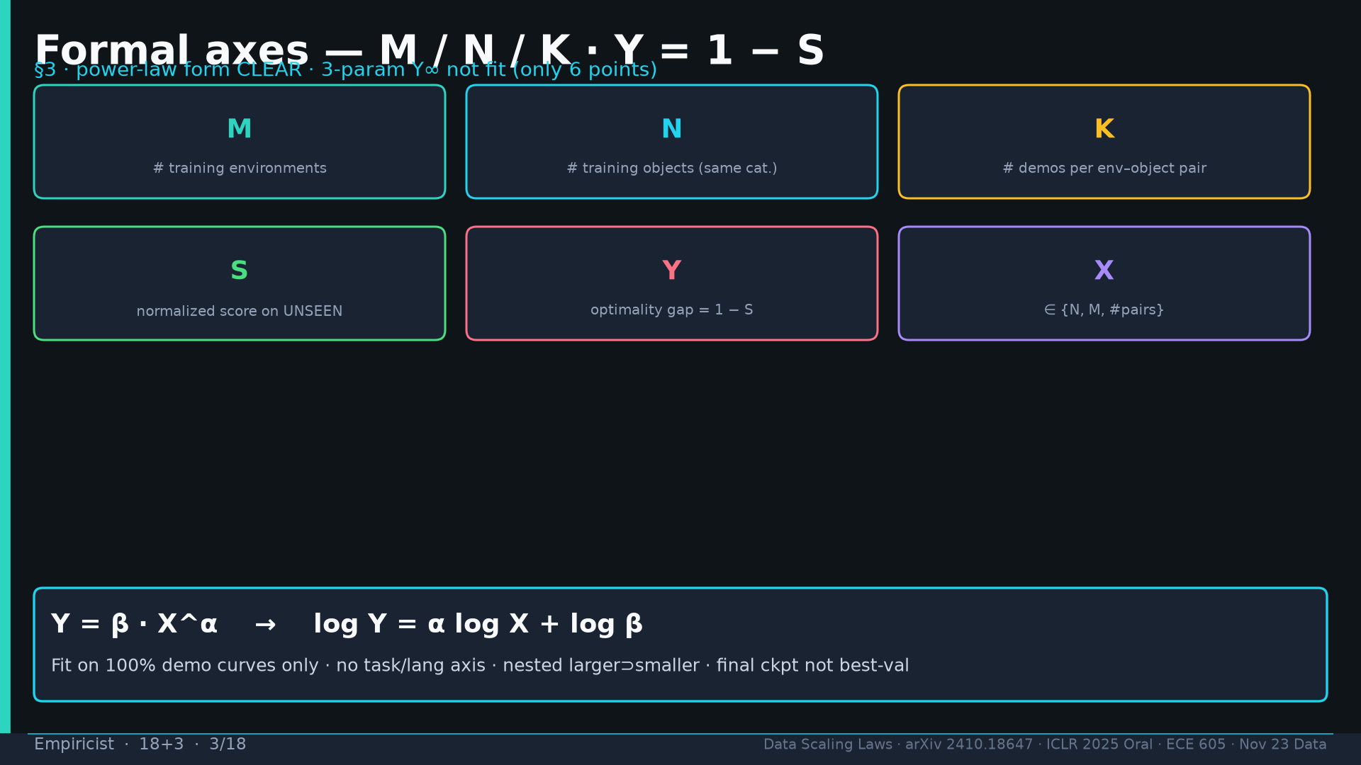
Notes:
Axes: M envs, N objects, K demos/pair, S score unseen, Y=1−S, X∈{N,M,pairs}. Y=βX^α; no Y∞ with n=6; no task/lang axis.

Slide 4
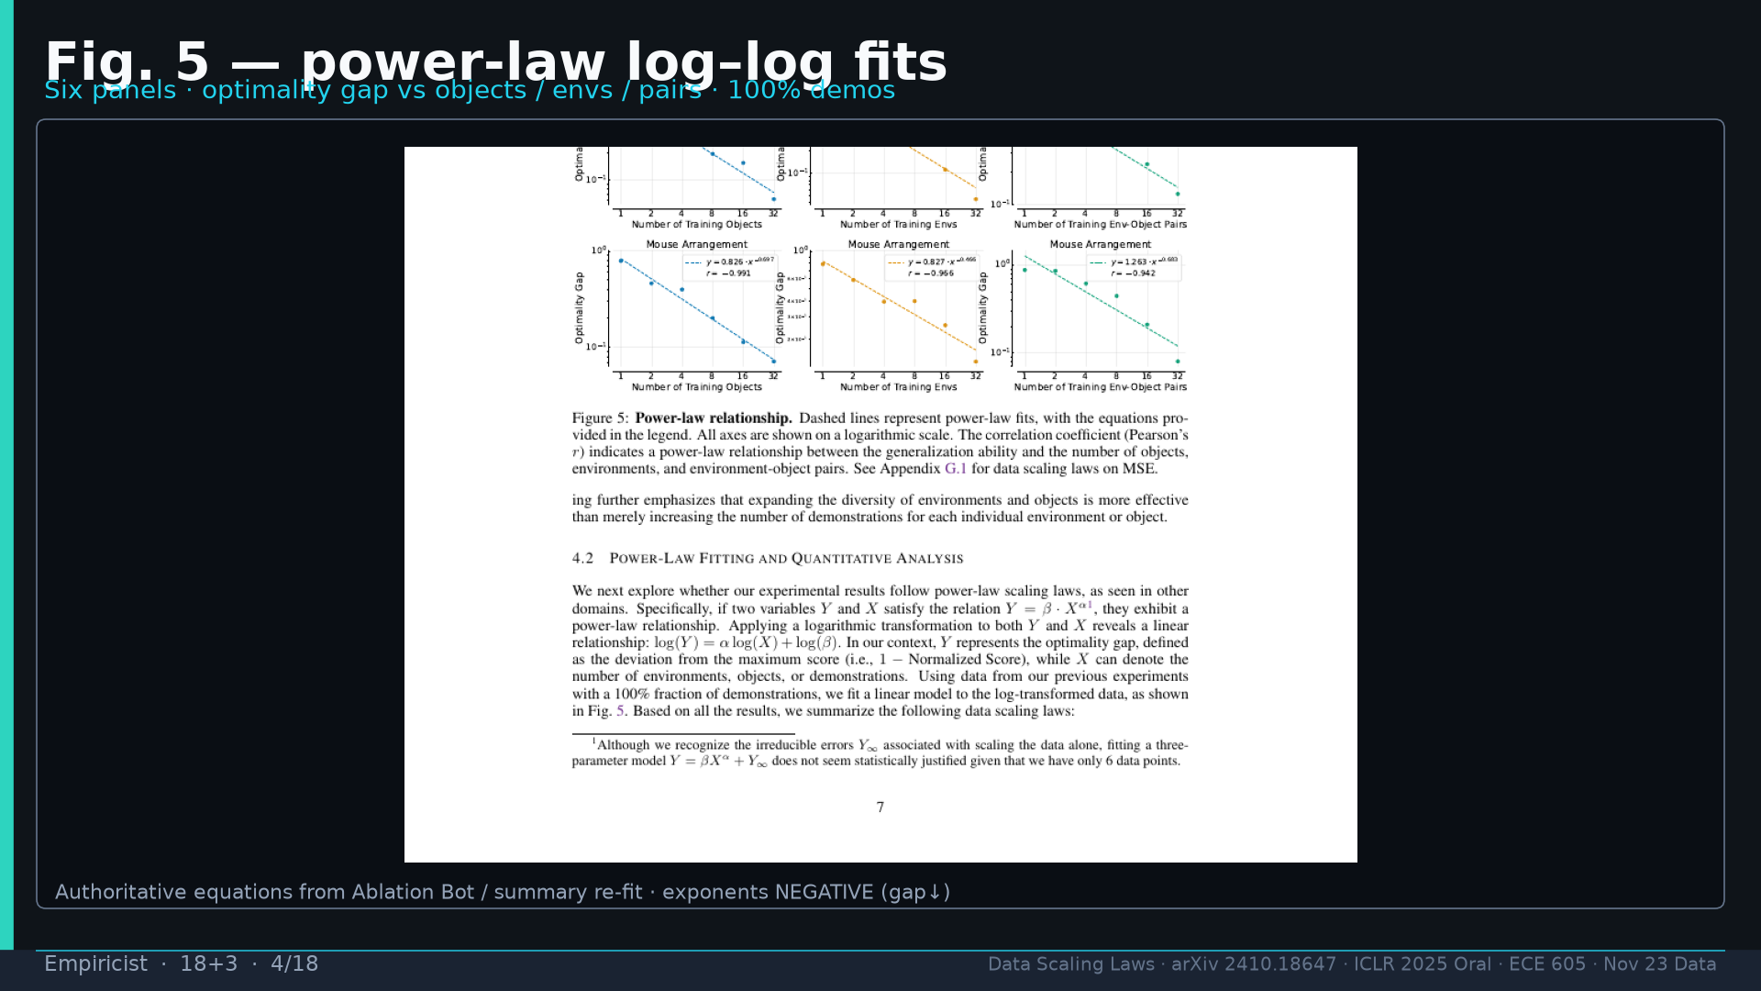
Notes:
Fig.5 image: six log–log panels; exponents NEGATIVE (gap↓).

Slide 5
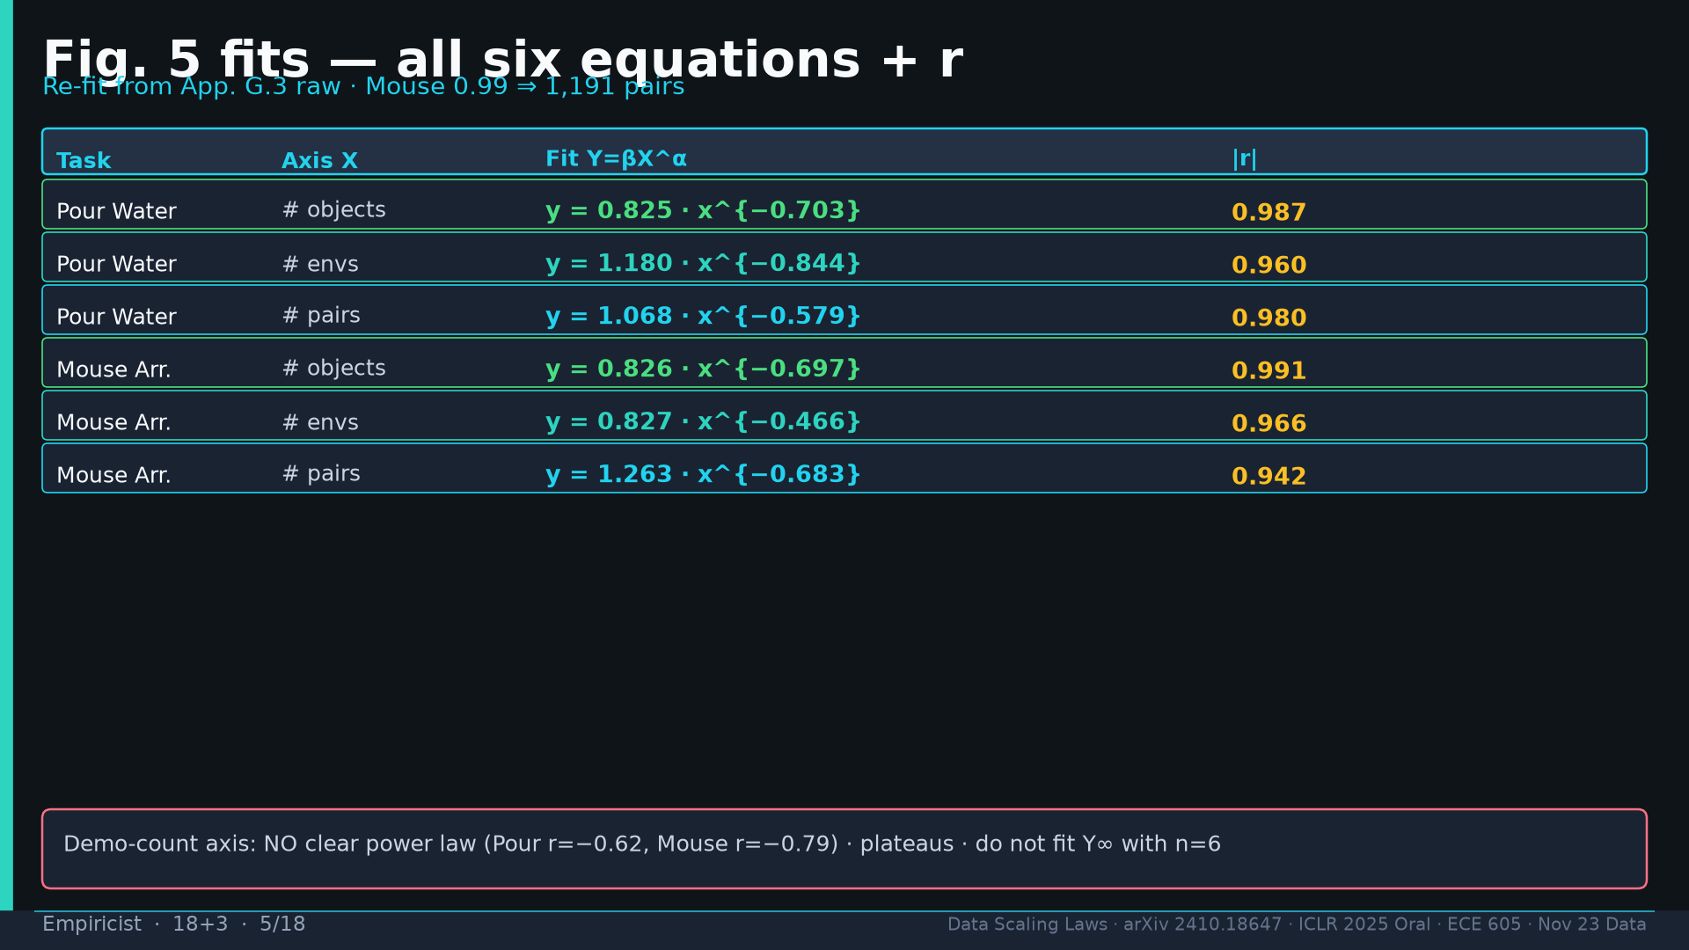
Notes:
All six fits: PW obj/env/pair 0.825x^−0.703 r0.987 / 1.180x^−0.844 r0.960 / 1.068x^−0.579 r0.980; MA 0.826x^−0.697 r0.991 / 0.827x^−0.466 r0.966 / 1.263x^−0.683 r0.942; MA 0.99→1191; demo r −0.62/−0.79 no clear law.

Slide 6
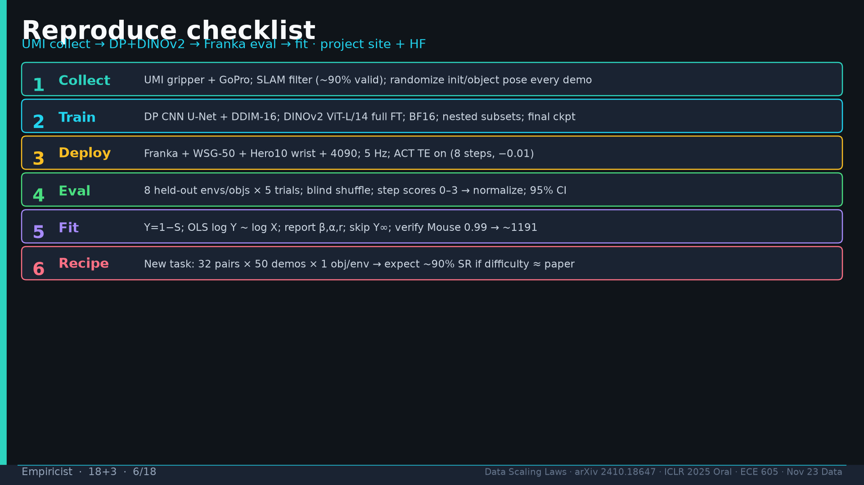
Notes:
Reproduce: UMI collect→DP+DINOv2 FT→Franka 5Hz ACT TE→blind staged eval→fit logY~logX→recipe verify 32×50.

Slide 7
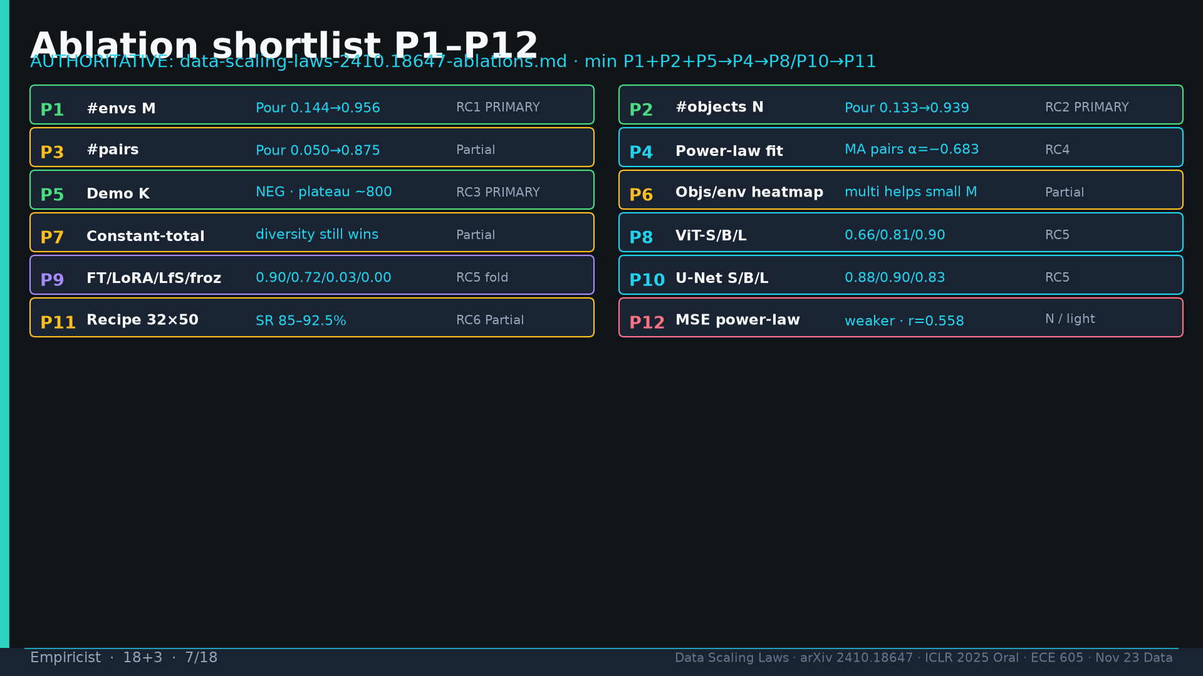
Notes:
P1–P12 AUTHORITATIVE Ablation Bot; min P1+P2+P5→P4→P8/P10→P11. PRIMARY RC1/RC2/RC3.

Slide 8
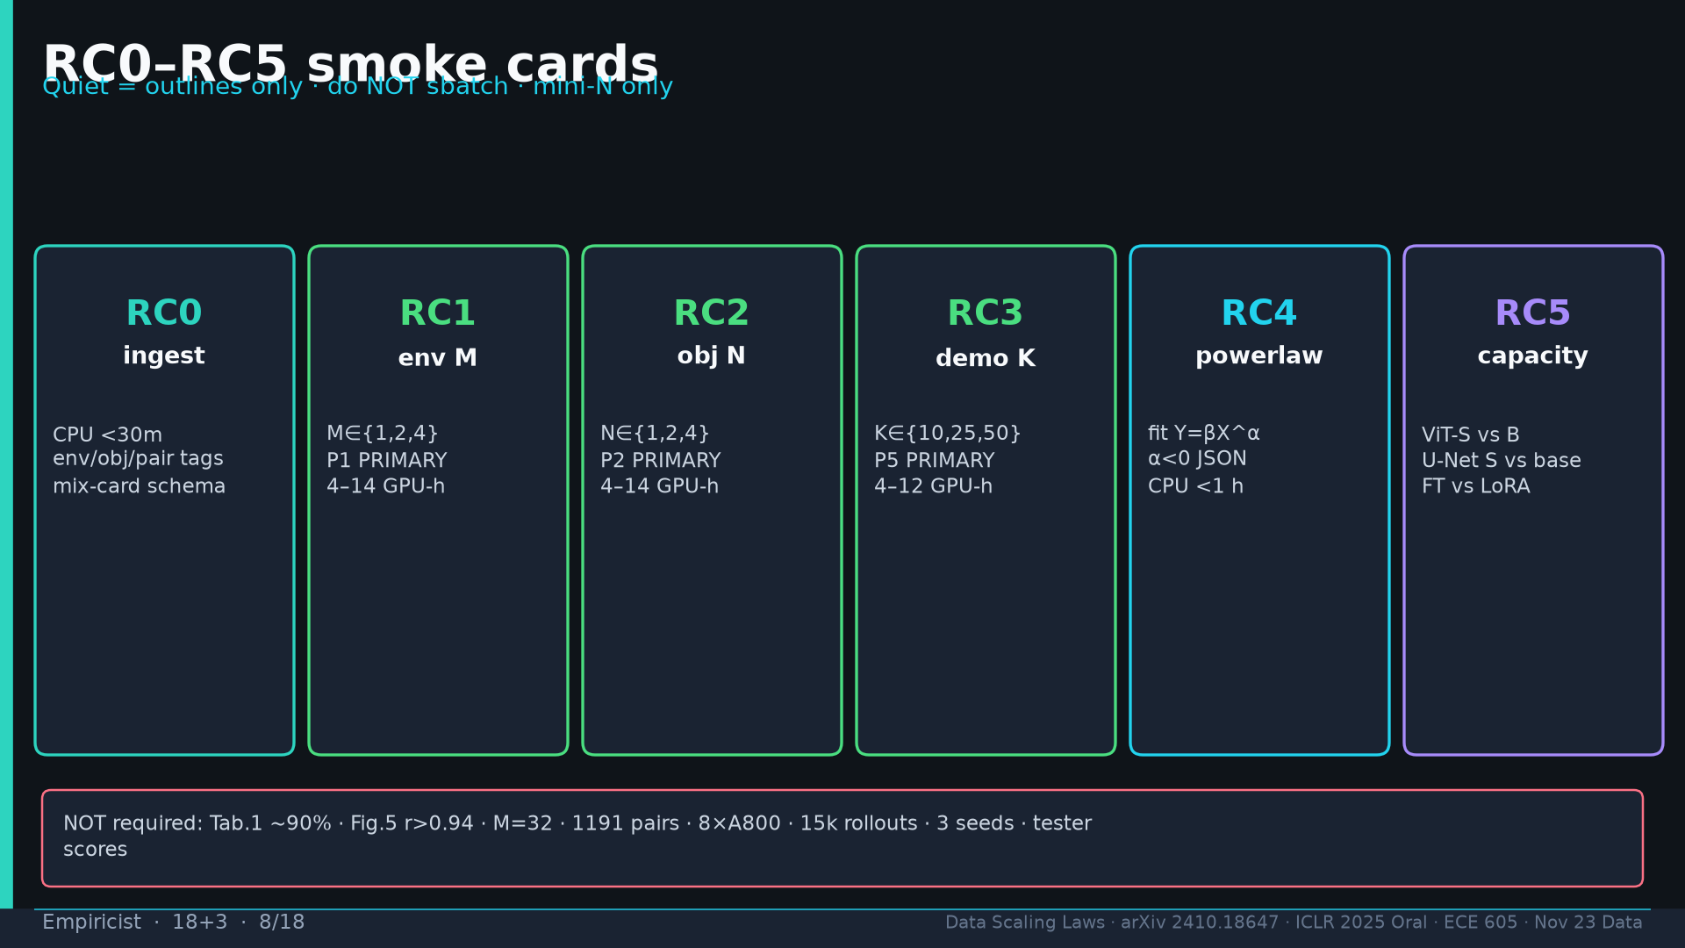
Notes:
RC0–RC5 smoke cards; NOT required Tab.1 90%/M=32/1191/8×A800/15k/3 seeds.

Slide 9
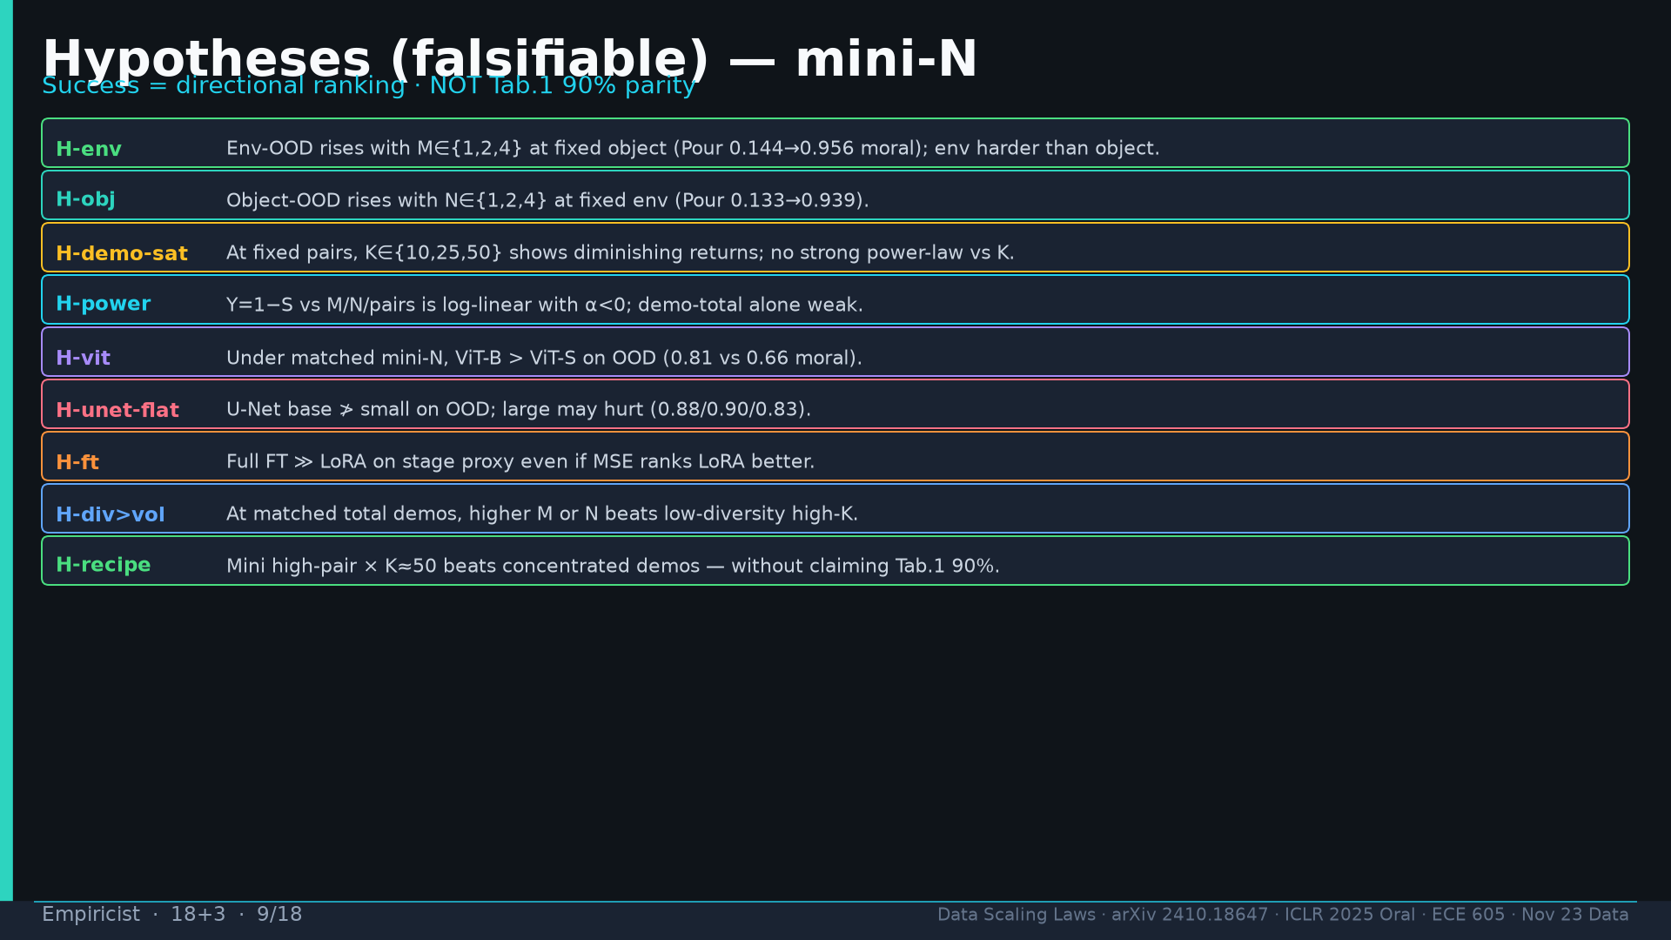
Notes:
Hypotheses H-env/H-obj/H-demo-sat/H-power/H-vit/H-unet-flat/H-ft/H-div>vol/H-recipe; falsifiers = flat M/N, K linear power-law, ViT-S≈B, LoRA≥FT on proxy; mini-N M,N∈{1,2,4} K∈{10,25,50}.

Slide 10
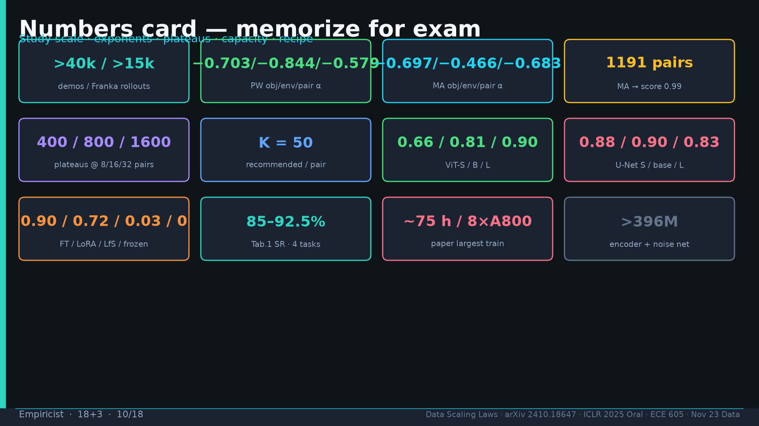
Notes:
Numbers card: >40k/>15k; αs; 1191; plateaus 400/800/1600; K=50; ViT 0.66/0.81/0.90; U-Net 0.88/0.90/0.83; FT/LoRA/LfS/froz; Tab.1 85–92.5%; 75h/8×A800; >396M.

Slide 11
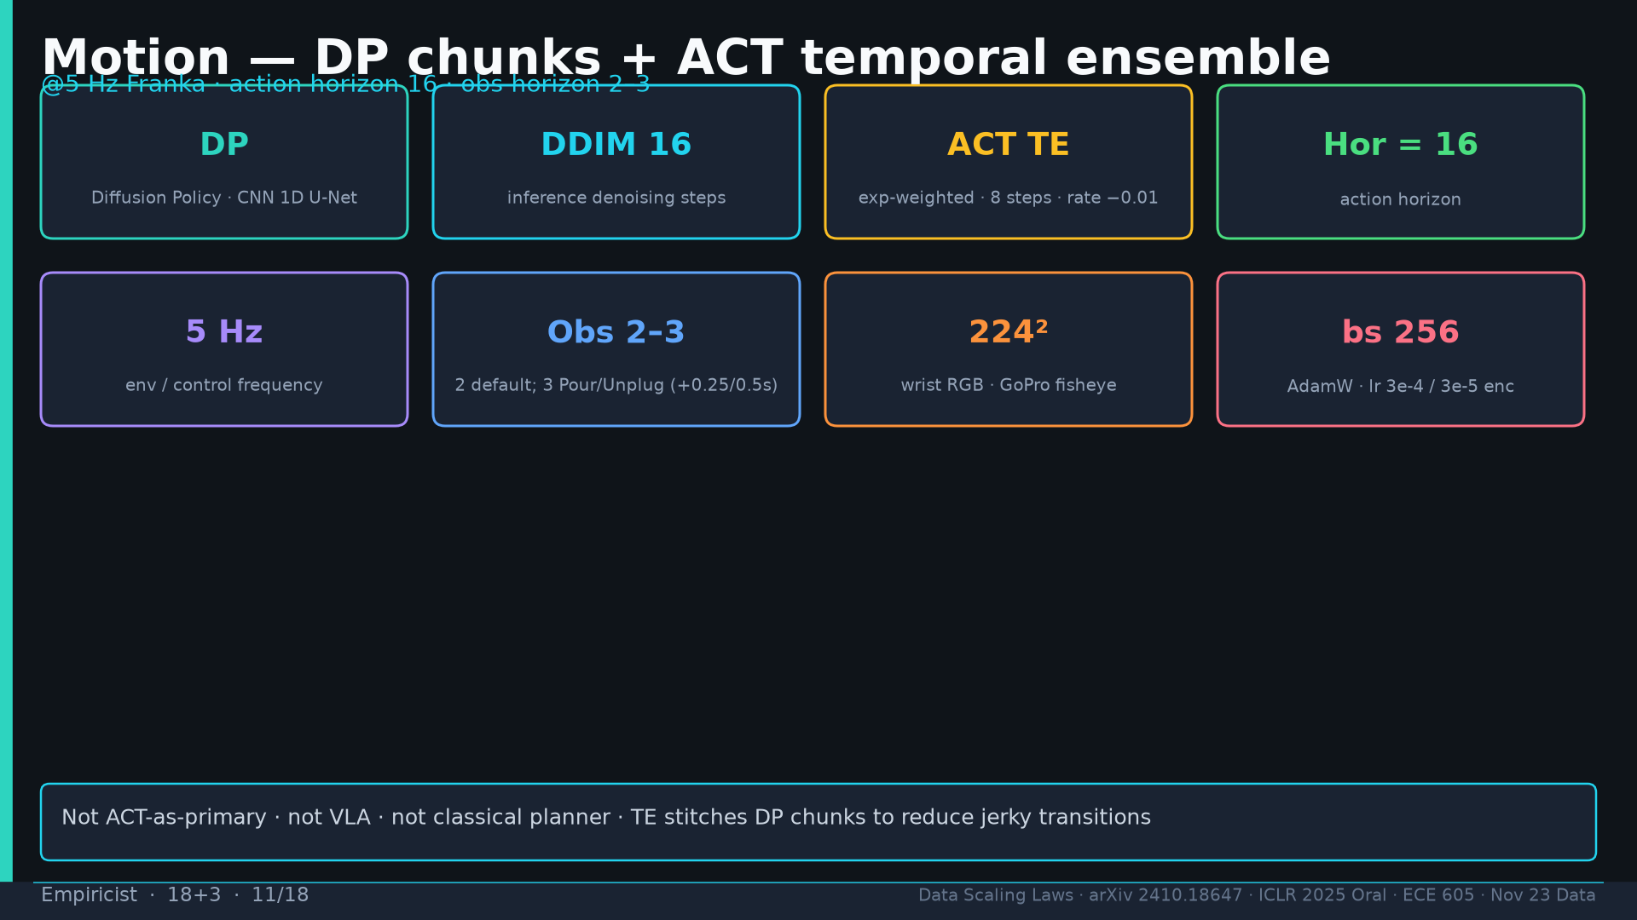
Notes:
Motion: DP DDIM16; ACT TE 8@−0.01; hor16; 5Hz; obs2–3; 224²; bs256.

Slide 12
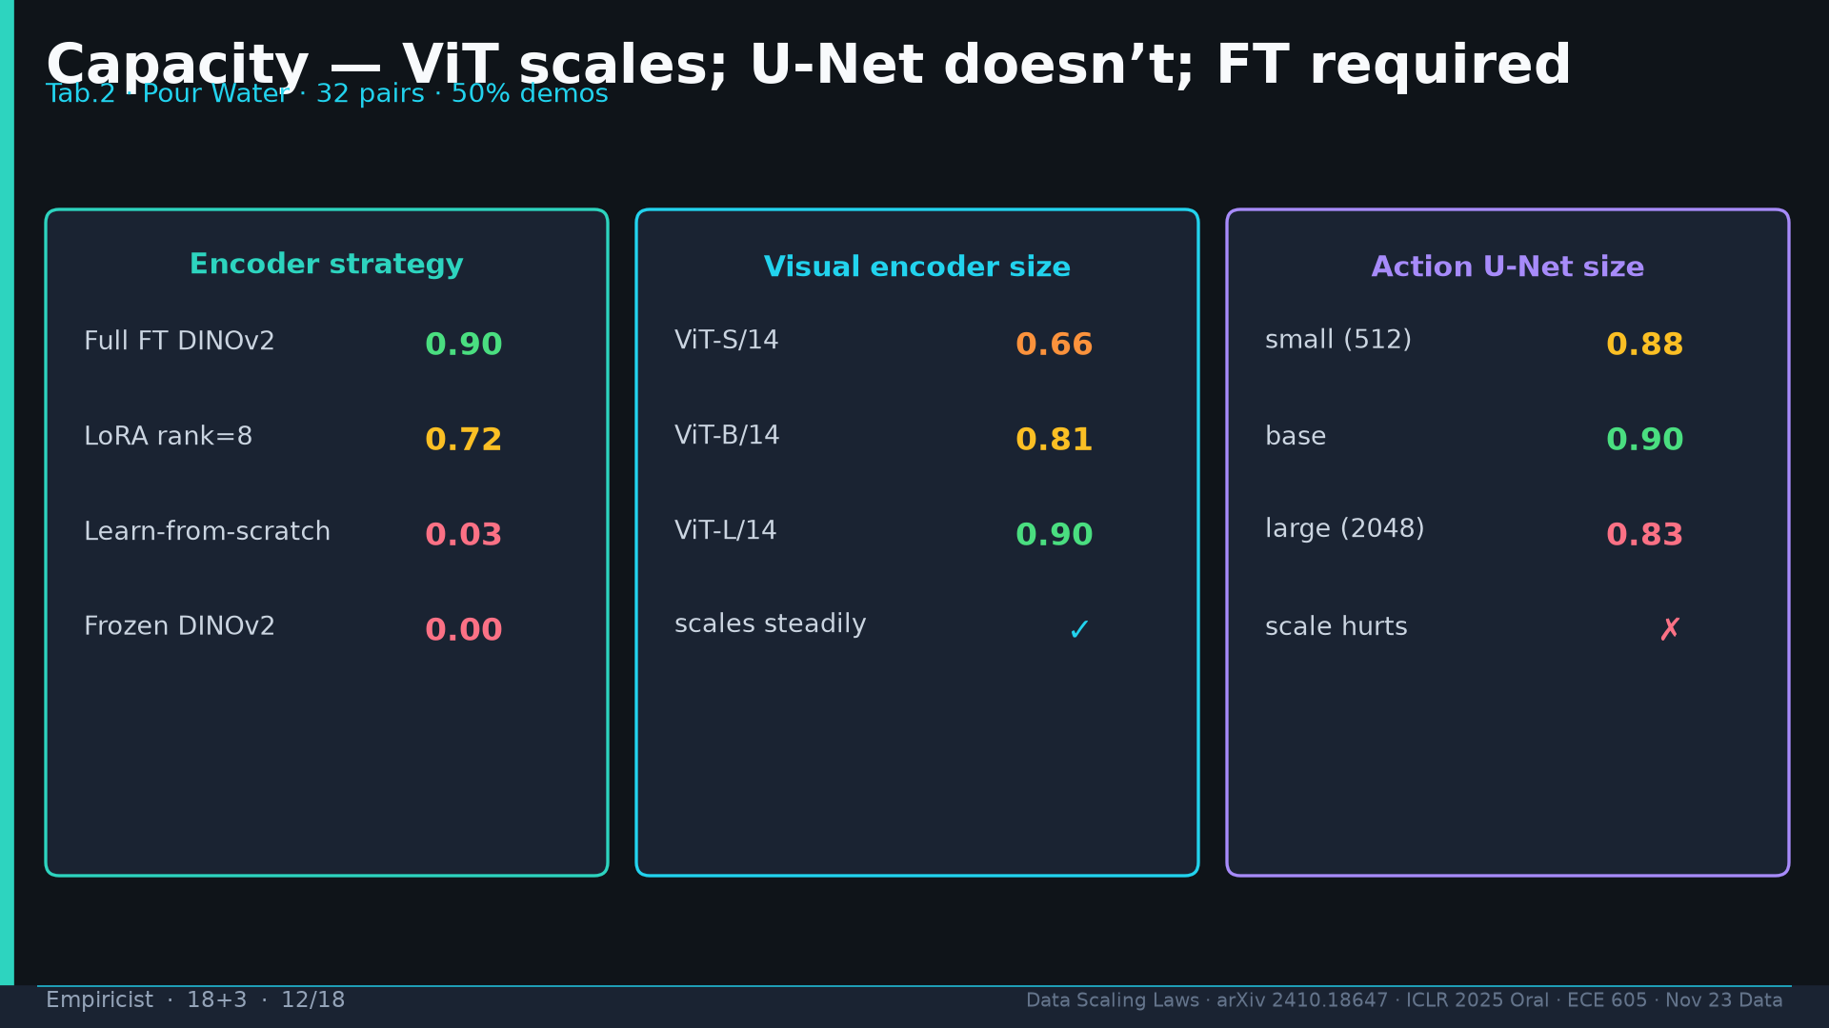
Notes:
Capacity Tab.2: FT0.90 LoRA0.72 LfS0.03 frozen0.00; ViT scales; U-Net large hurts 0.83.

Slide 13
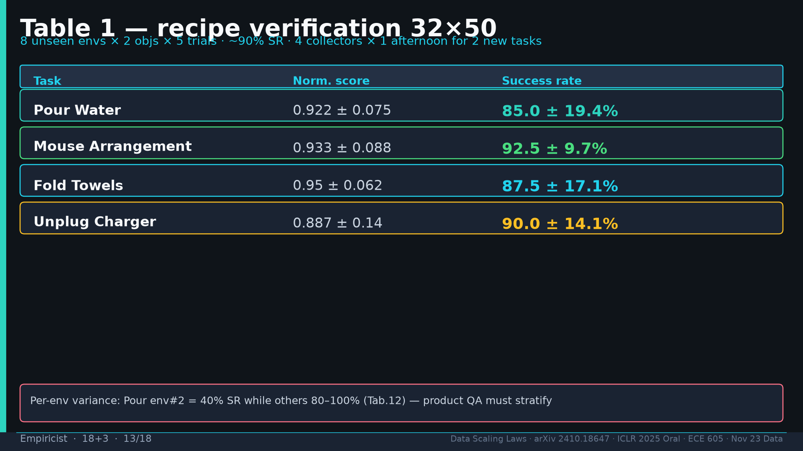
Notes:
Tab.1 recipe verify; per-env variance Pour env2=40%.

Slide 14
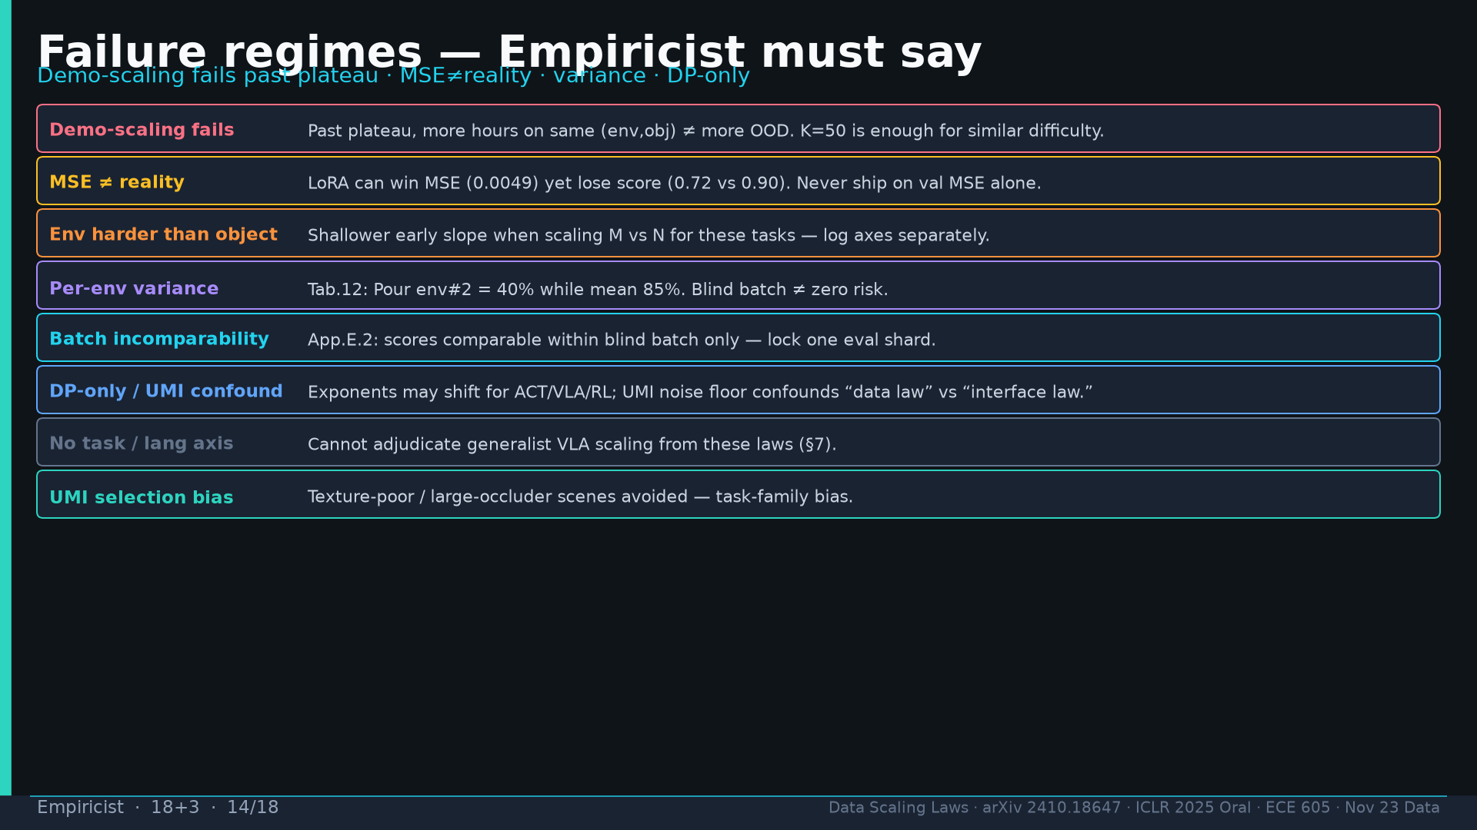
Notes:
Failures: demo-scaling past plateau; MSE≠reality; env harder; variance; batch incomparability; DP-only; no task axis; UMI bias.

Slide 15
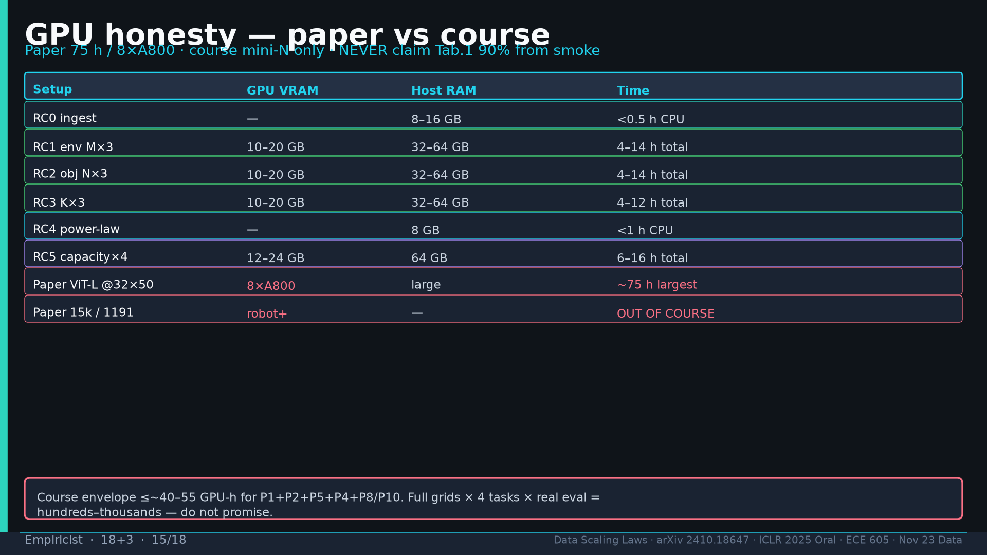
Notes:
GPU honesty: course ≤~40–55 GPU-h; paper 75h/8×A800 OUT; never claim Tab.1 from smoke.

Slide 16
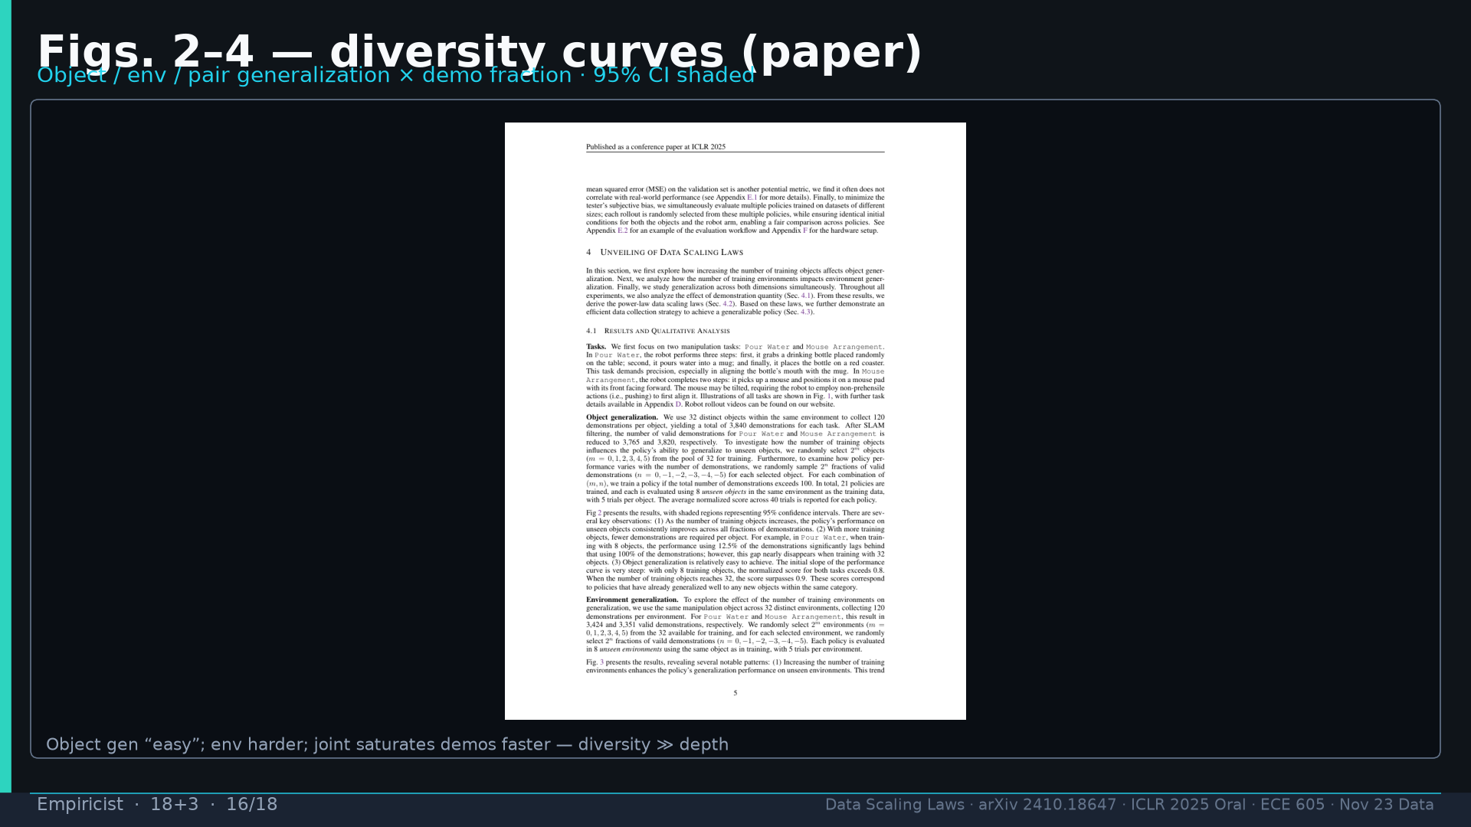
Notes:
Figs 2–4 diversity curves: object easy; env harder; joint saturates demos faster.

Slide 17
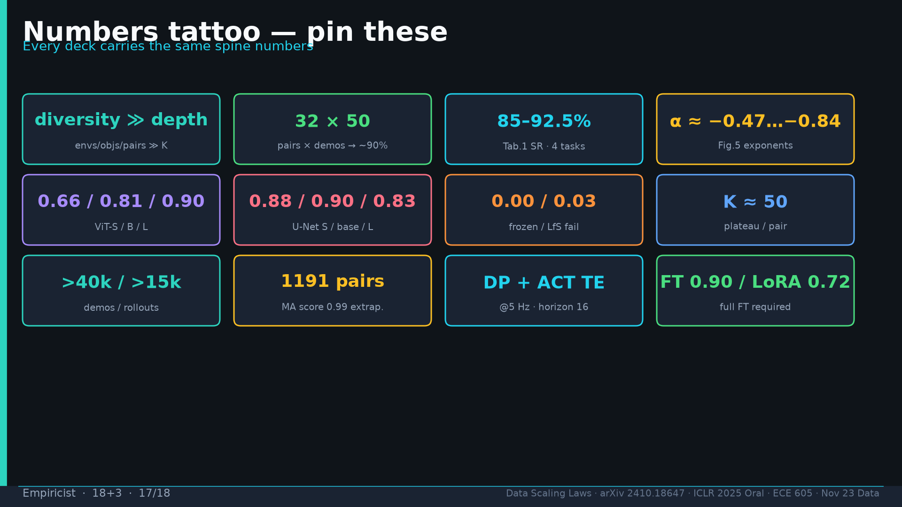
Notes:
Tattoo shared.

Slide 18
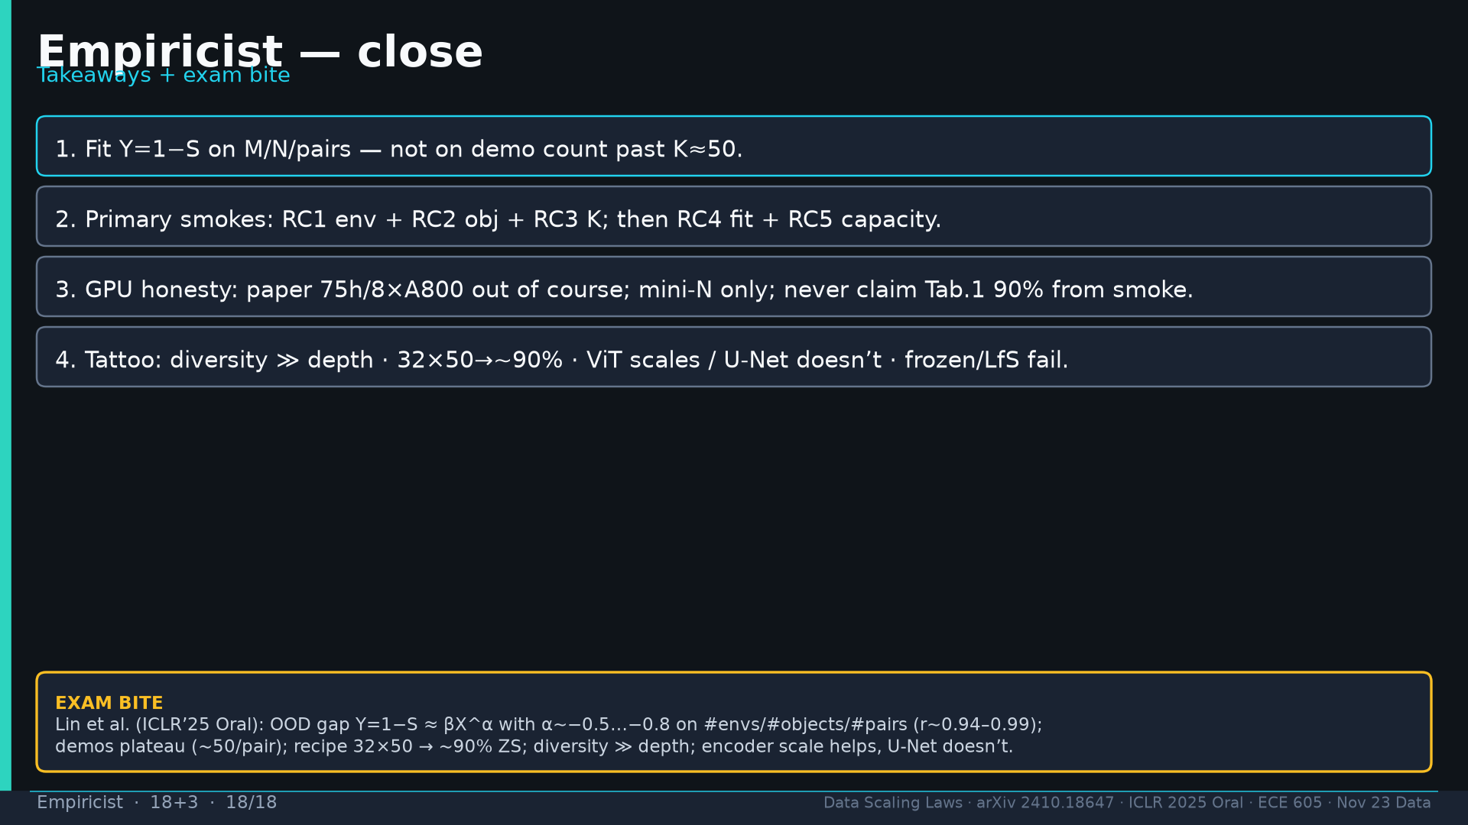
Notes:
Close + exam bite for Nykolas: Y=1−S≈βX^α α∼−0.5…−0.8; K≈50; 32×50→~90%; diversity≫depth; ViT≻U-Net.

