Slide 1
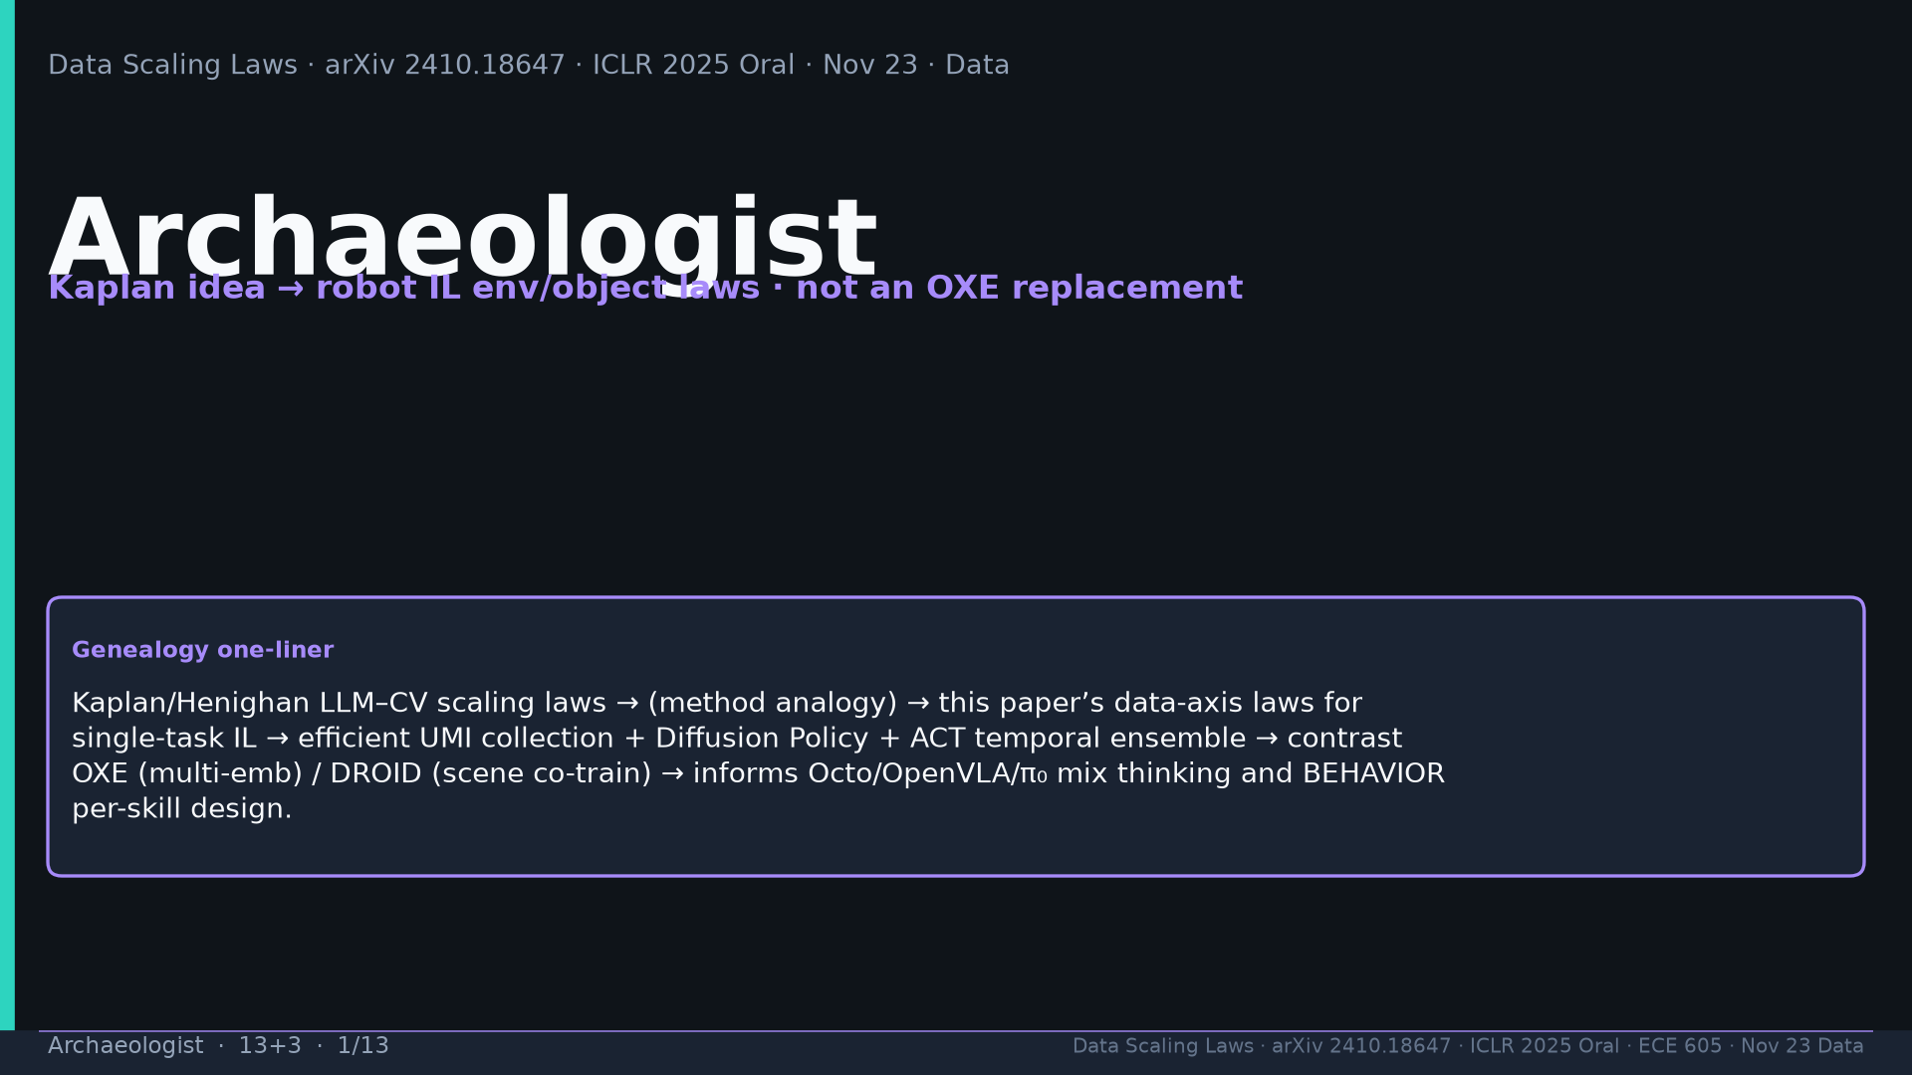
Notes:
Title. Kaplan idea → robot IL env/object laws; not OXE replacement.

Slide 2
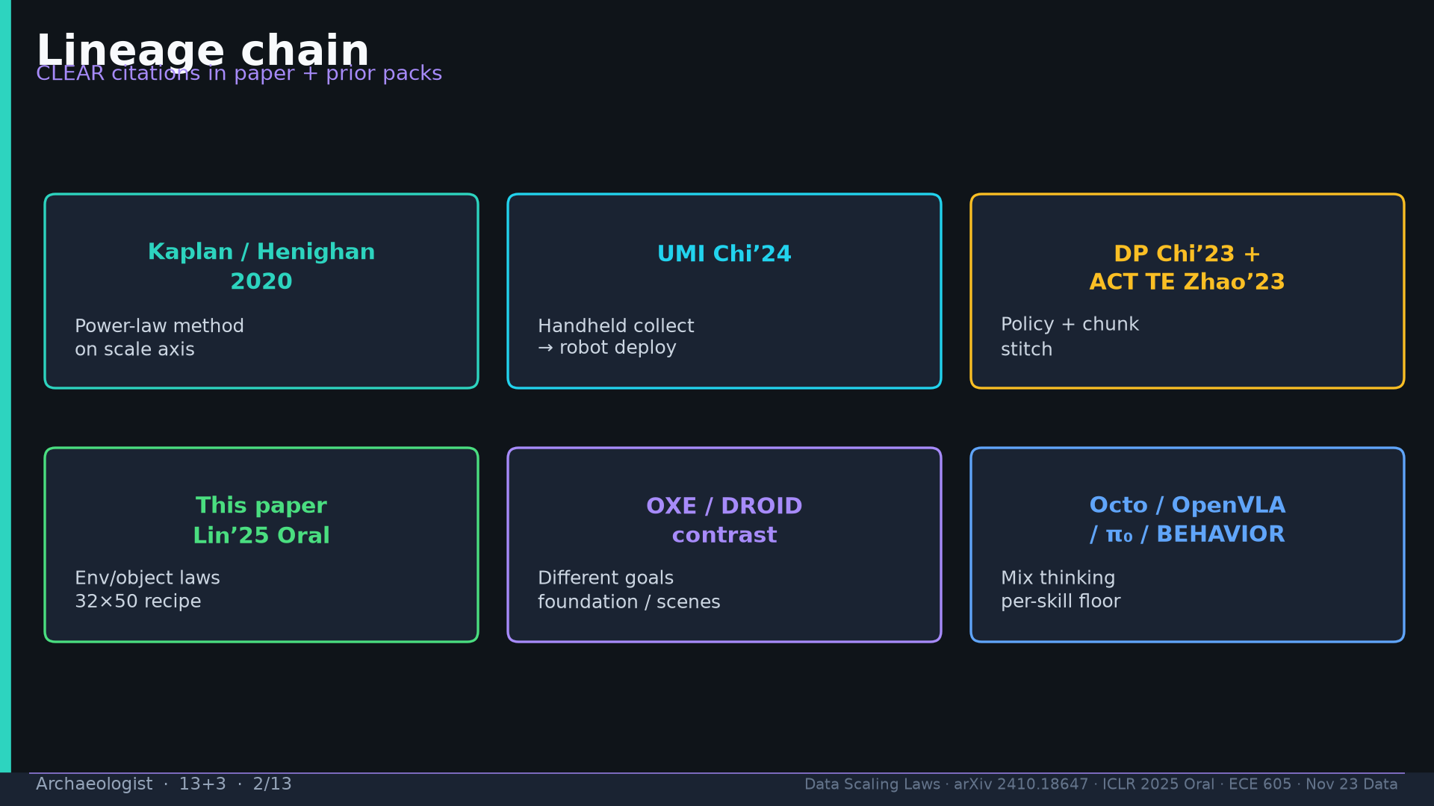
Notes:
Lineage: Kaplan→UMI→DP+ACT TE→Lin’25→OXE/DROID contrast→Octo/OpenVLA/π₀/BEHAVIOR.

Slide 3
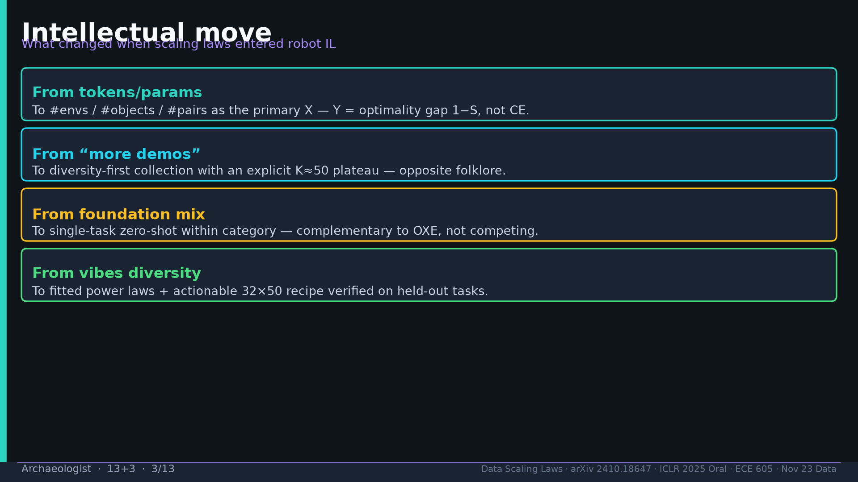
Notes:
Intellectual move: tokens→M/N/pairs; more-demos→diversity+K50; foundation→single-task ZS; vibes→fitted laws+recipe.

Slide 4
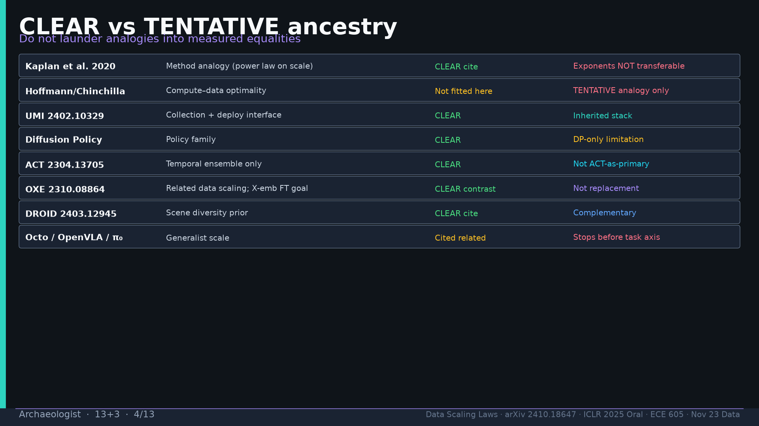
Notes:
CLEAR/TENTATIVE table: Kaplan method CLEAR exponents TENTATIVE; Chinchilla not fitted; UMI/DP/ACT/OXE/DROID CLEAR; Octo related stops before task.

Slide 5
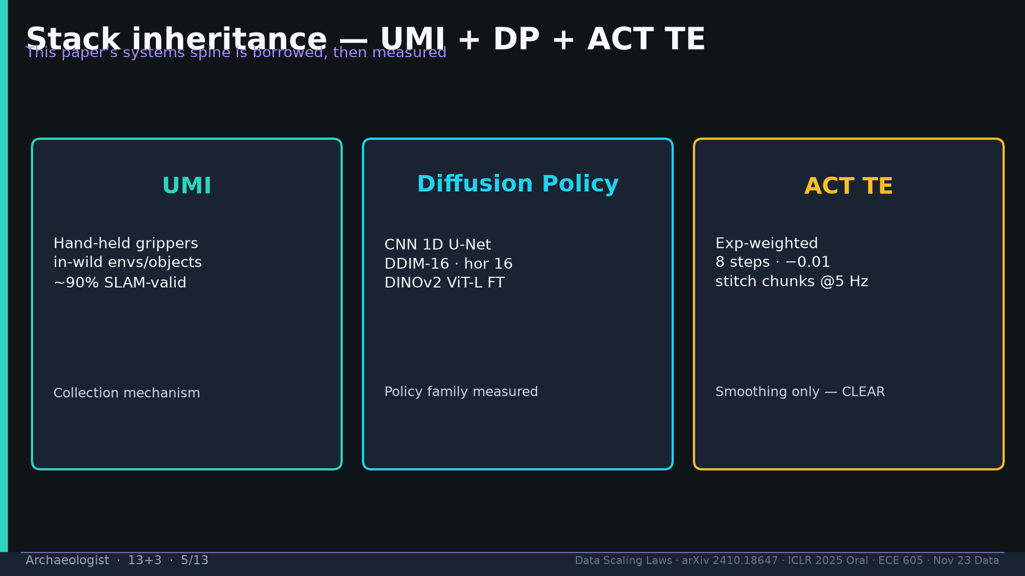
Notes:
Stack inheritance: UMI collect; DP measured; ACT TE smoothing only.

Slide 6
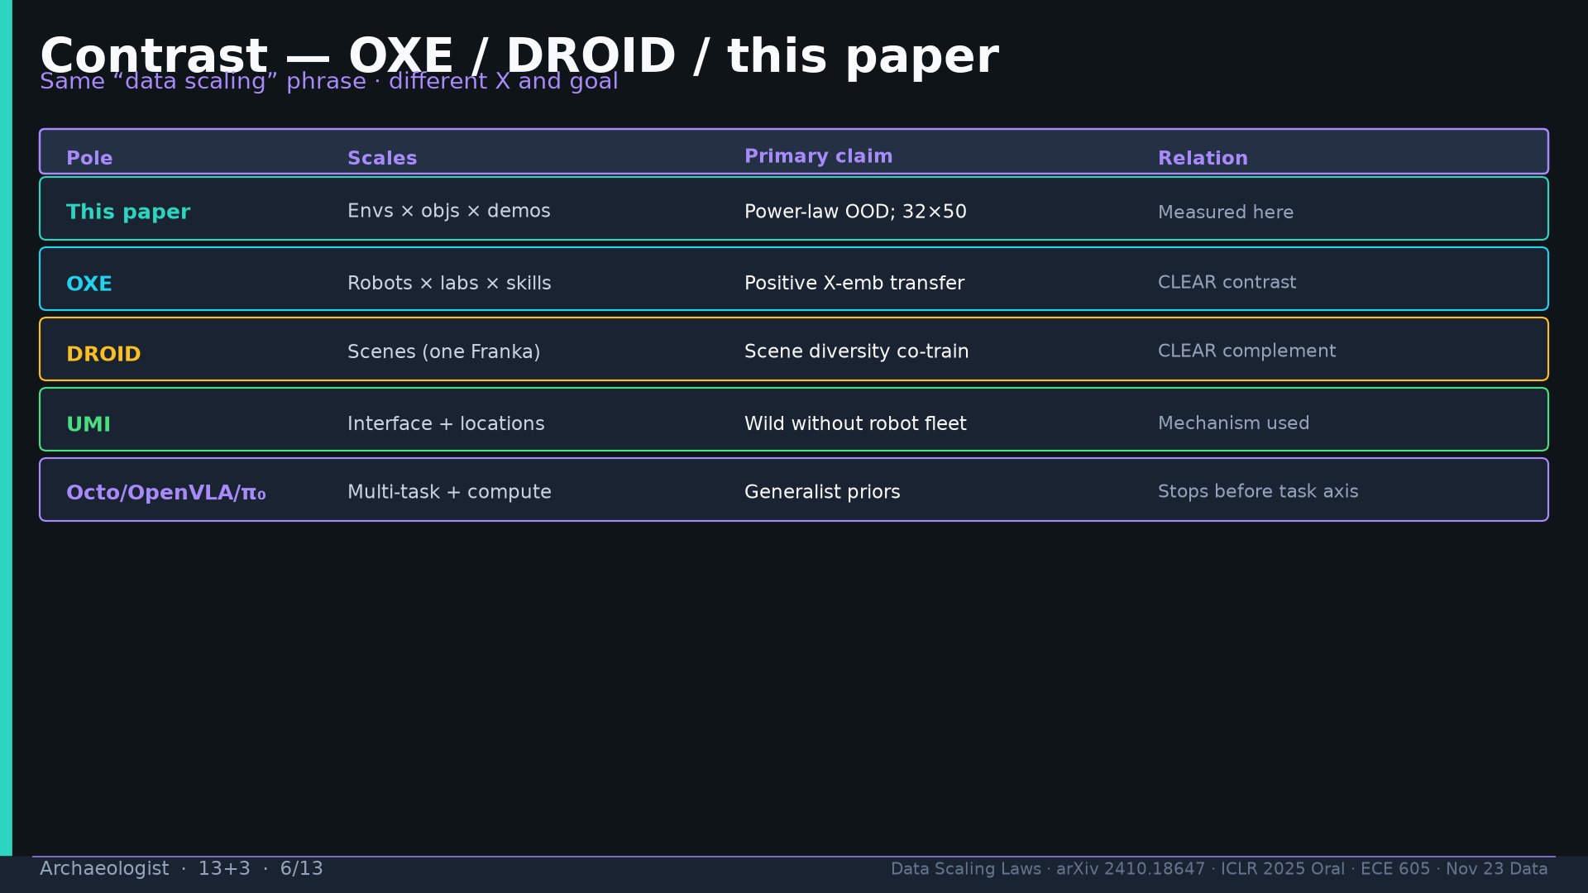
Notes:
Contrast poles table: this paper / OXE / DROID / UMI / Octo — different X and goals.

Slide 7
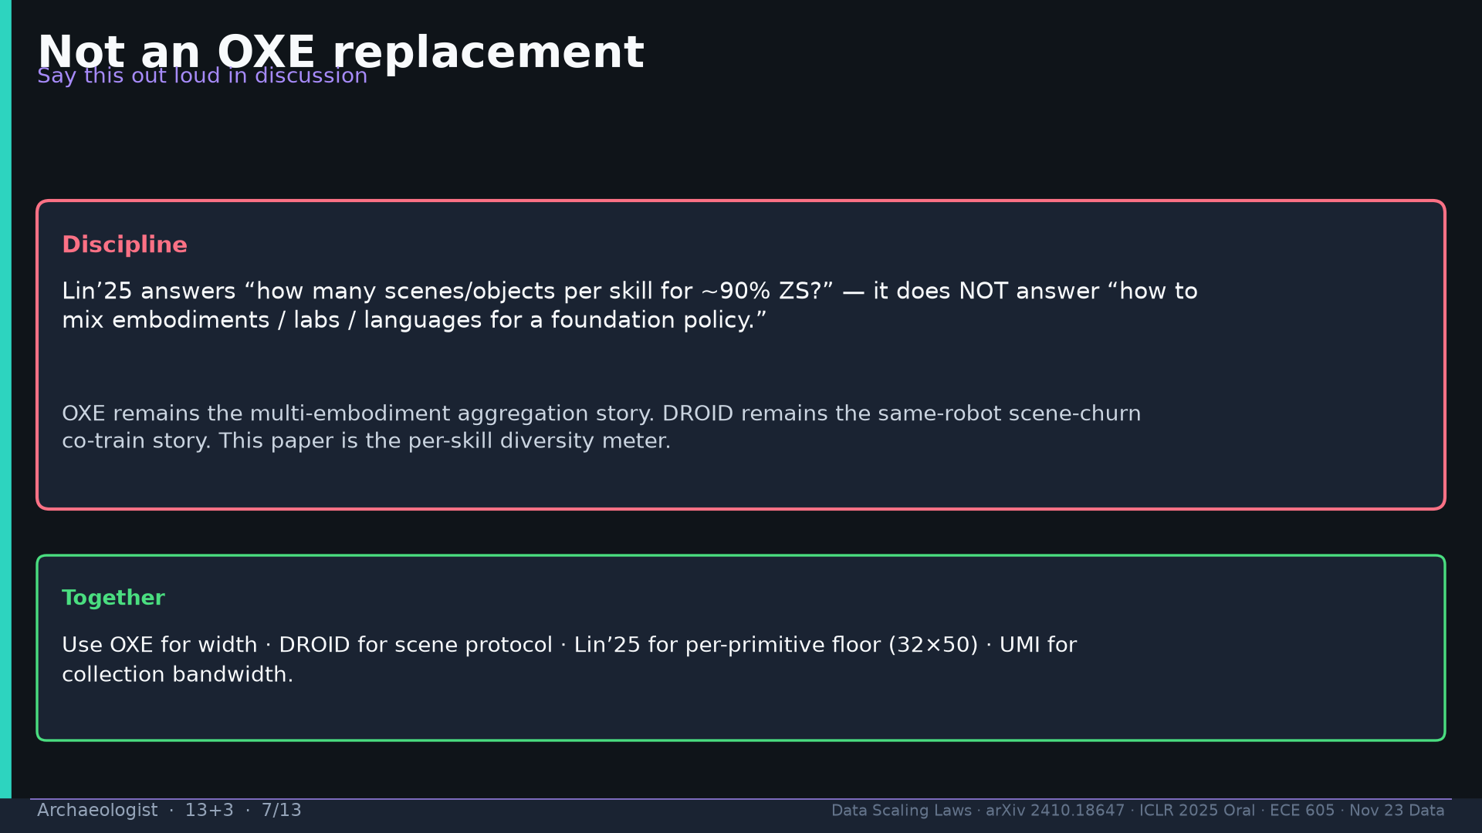
Notes:
Not OXE replacement: Lin’25 = per-skill meter; OXE=width; DROID=scene protocol; UMI=bandwidth.

Slide 8
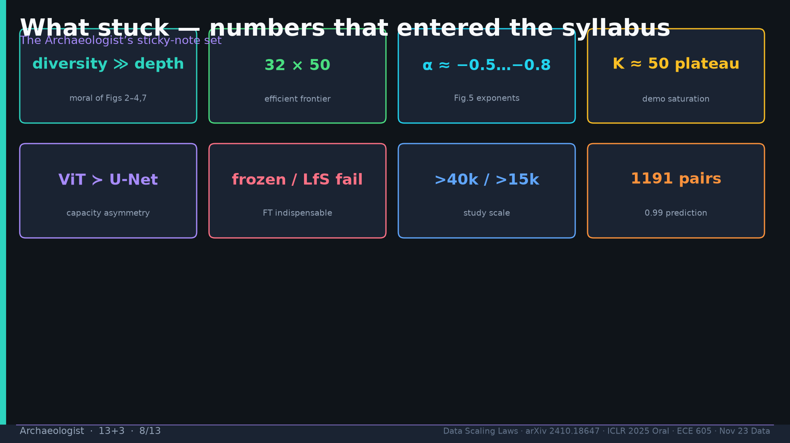
Notes:
Sticky numbers: diversity≫depth; 32×50; α; K50; ViT≻U-Net; frozen fail; >40k/>15k; 1191.

Slide 9
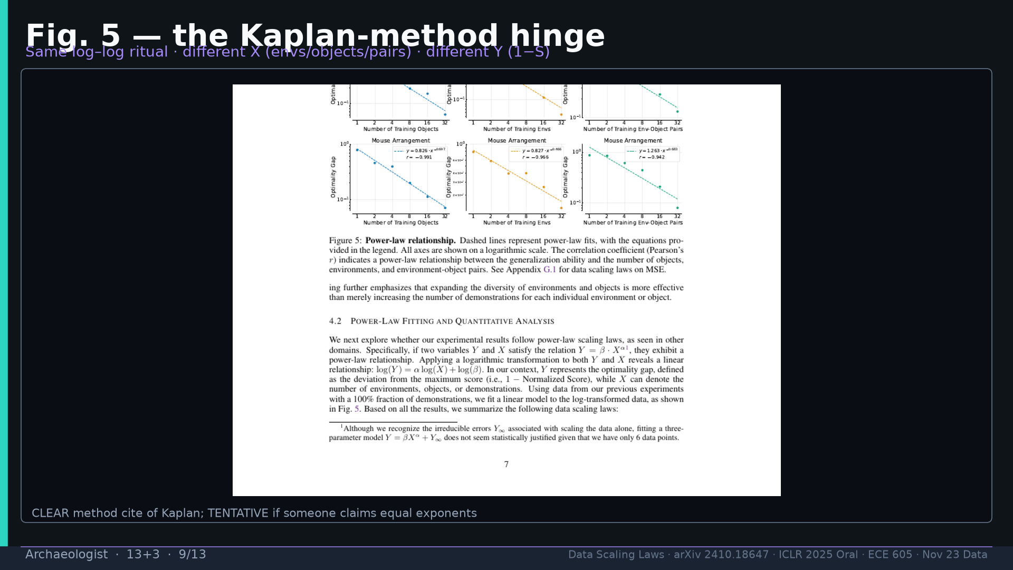
Notes:
Fig.5 Kaplan-method hinge: same ritual different X/Y.

Slide 10
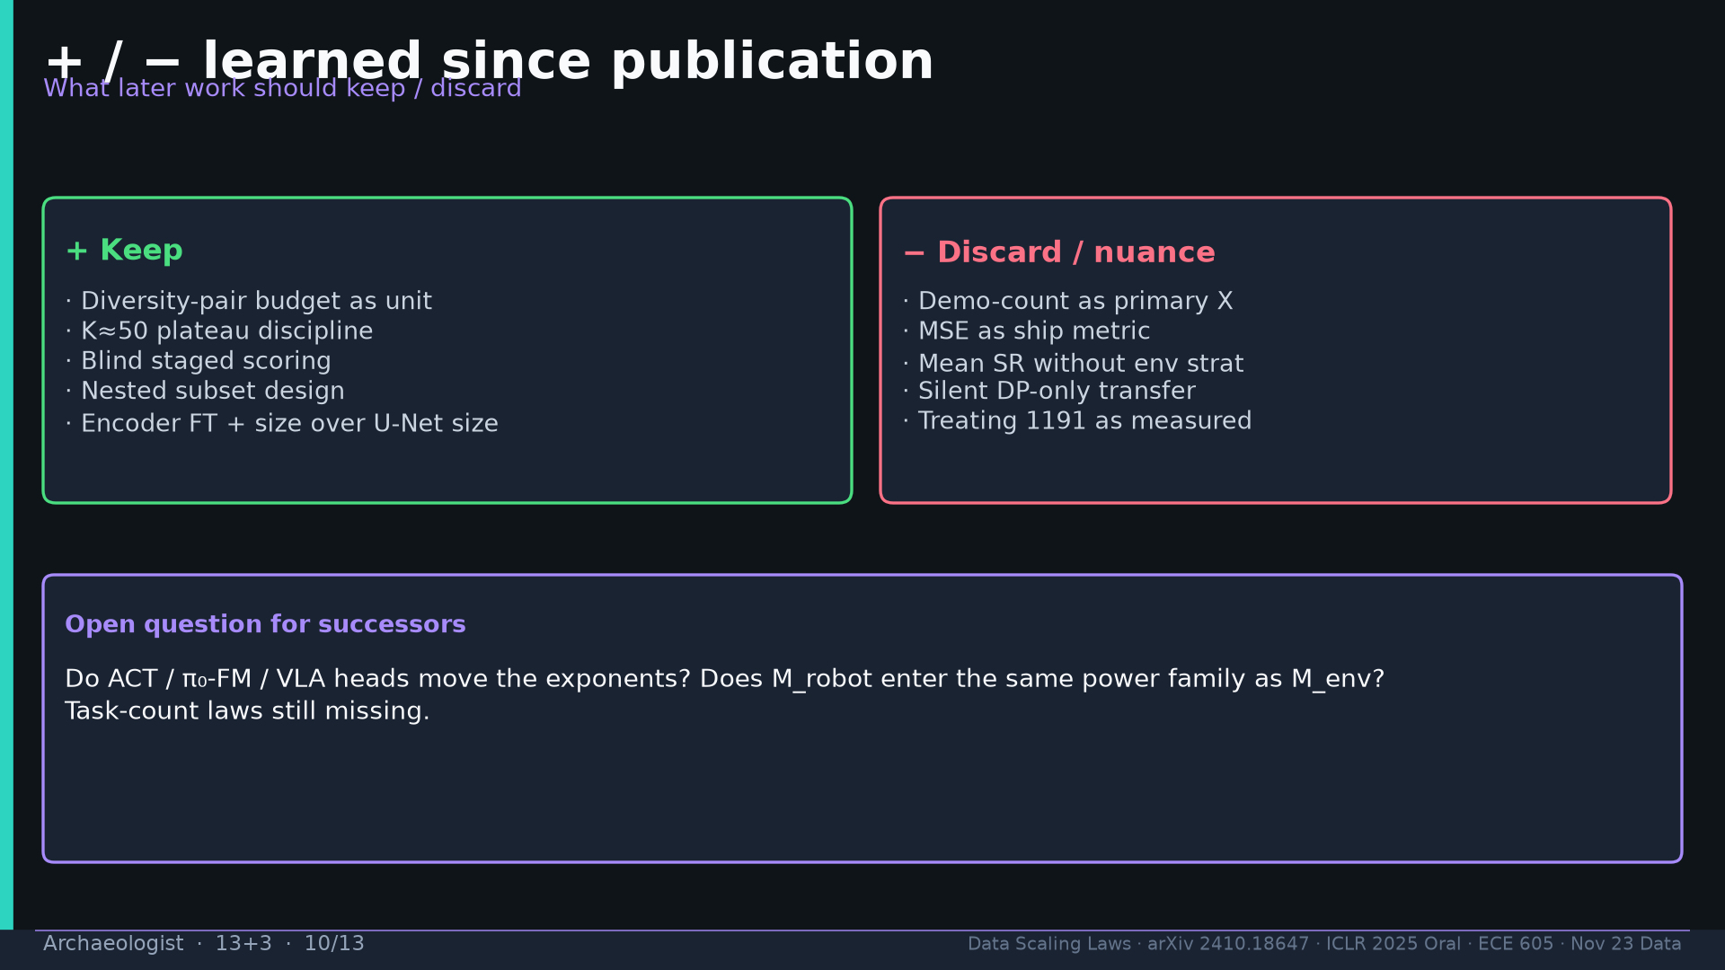
Notes:
+ keep diversity budget/K50/blind/nested/ViT FT; − discard demo-X/MSE-ship/mean-only/silent head-swap/1191-as-fact.

Slide 11
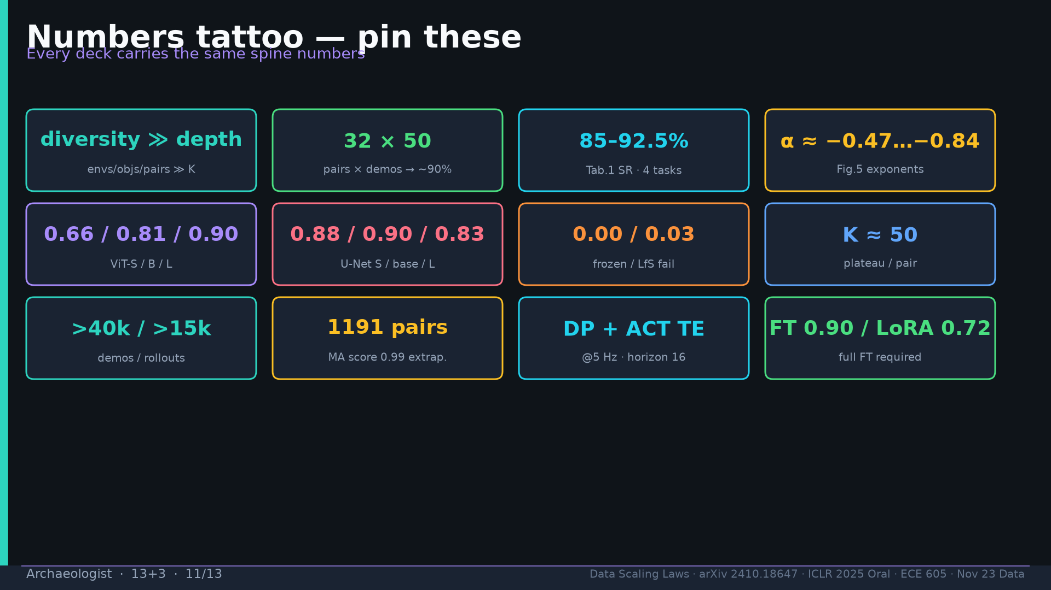
Notes:
Tattoo.

Slide 12
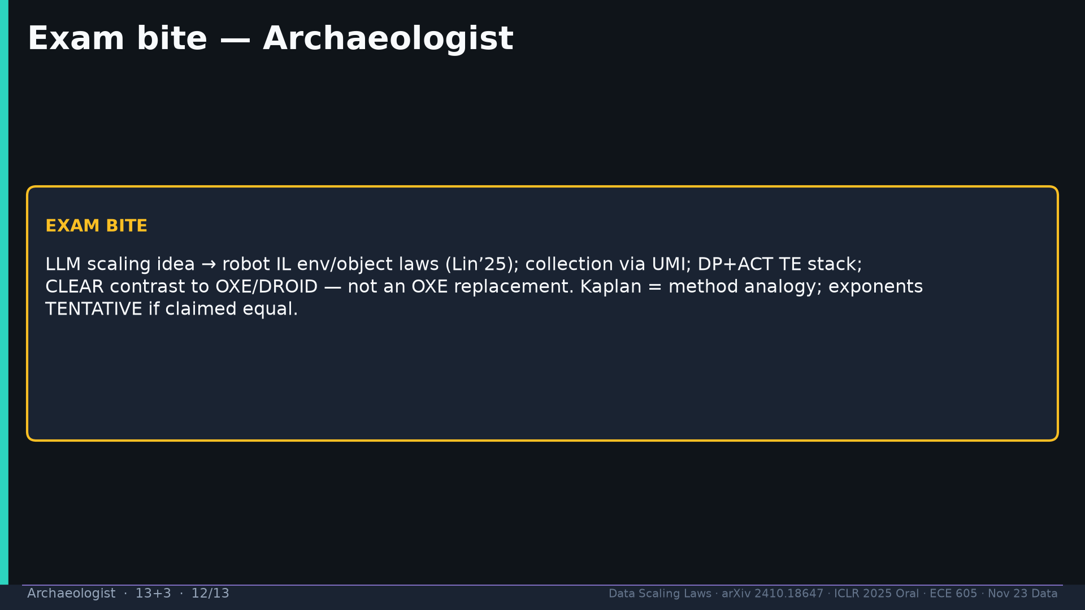
Notes:
Exam: LLM scaling idea → robot IL env/object laws; UMI; not OXE replacement.

Slide 13
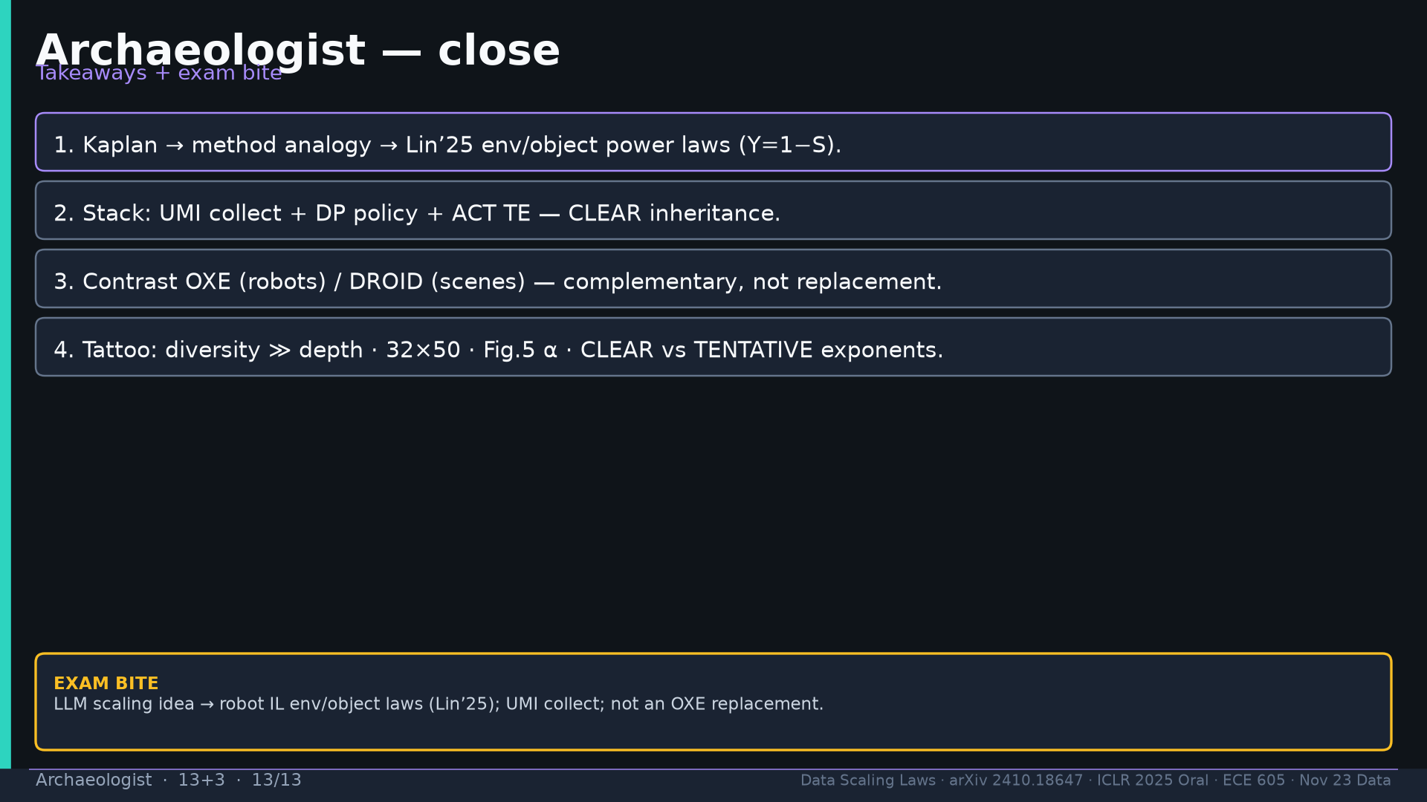
Notes:
Close.

