Slide 1
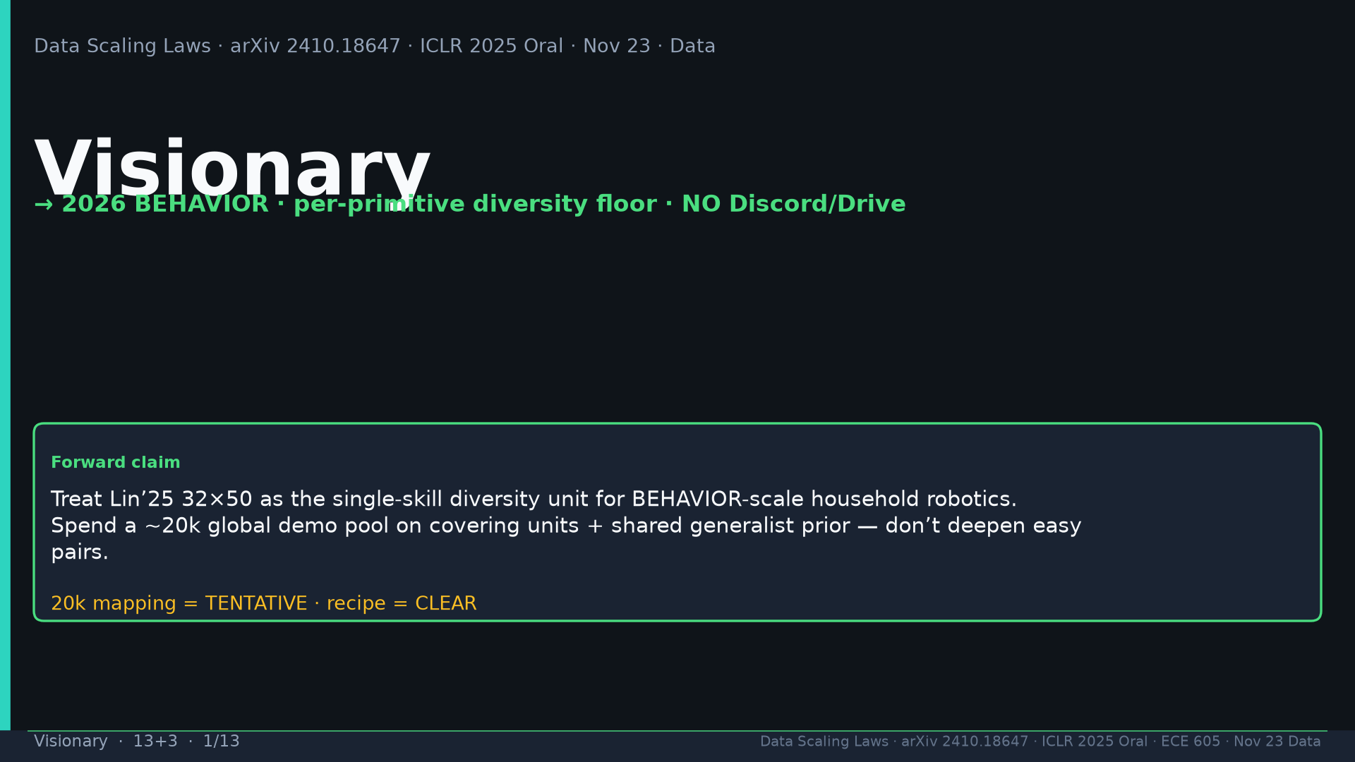
Notes:
Title. →2026 BEHAVIOR; 32×50 unit; NO Discord/Drive. 20k mapping TENTATIVE; recipe CLEAR.

Slide 2
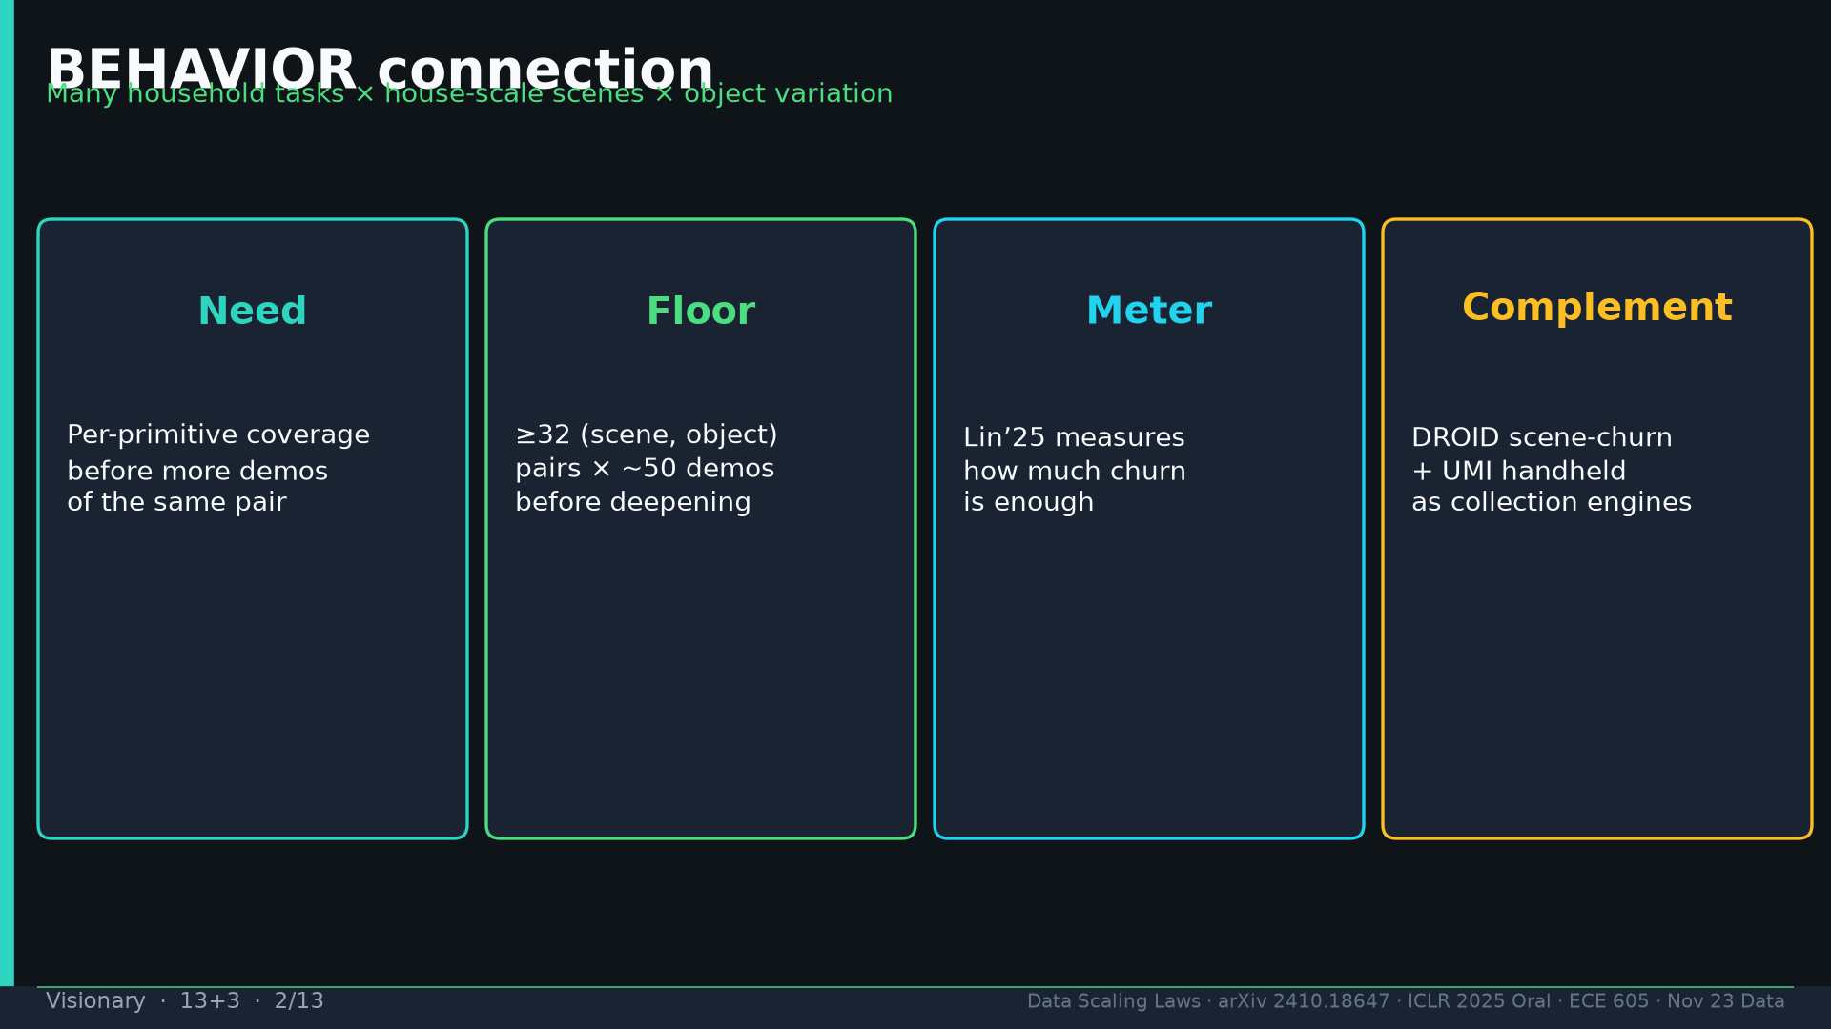
Notes:
BEHAVIOR need/floor/meter/complement (DROID+UMI).

Slide 3
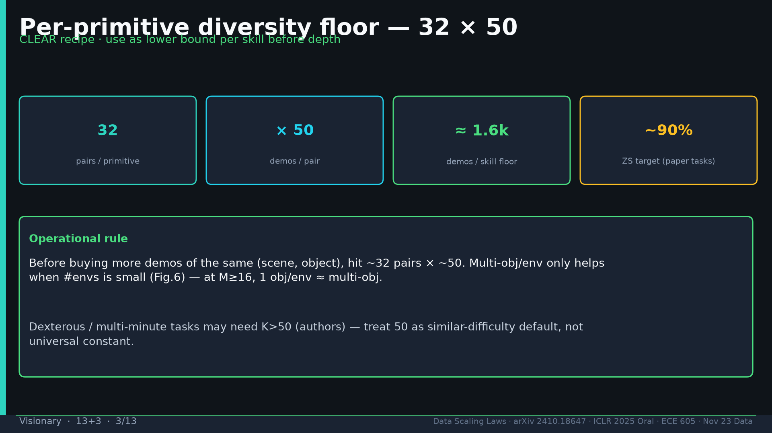
Notes:
Floor 32×50 CLEAR; multi-obj only helps small M; K>50 only for harder dex/LH.

Slide 4
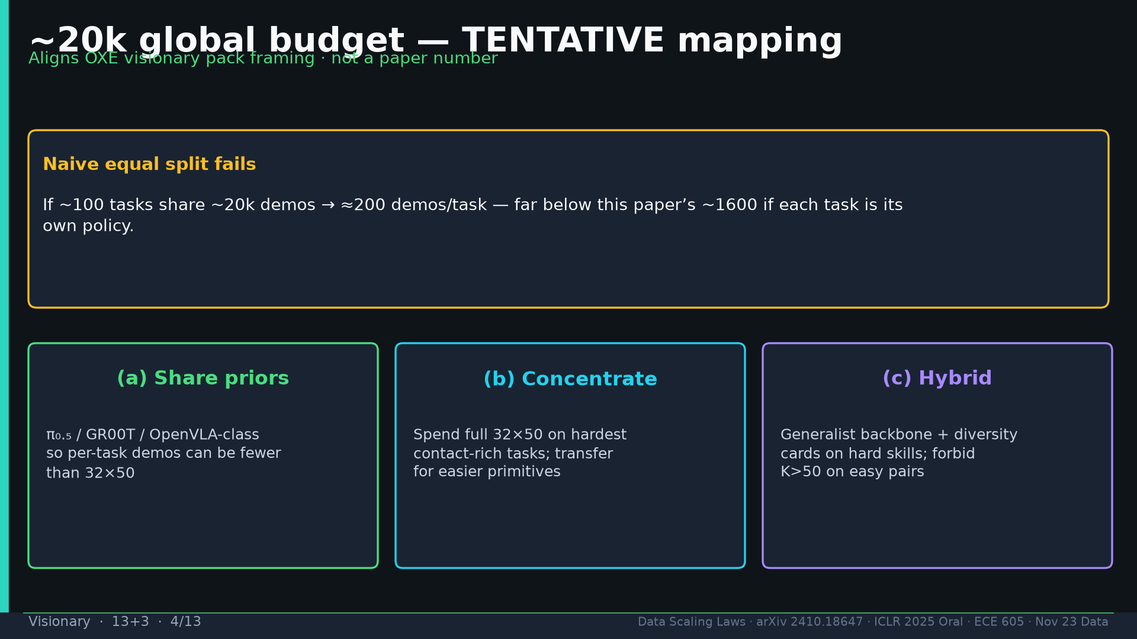
Notes:
~20k TENTATIVE: naive 200/task fails; (a) share priors π₀.₅ (b) concentrate hard (c) hybrid.

Slide 5
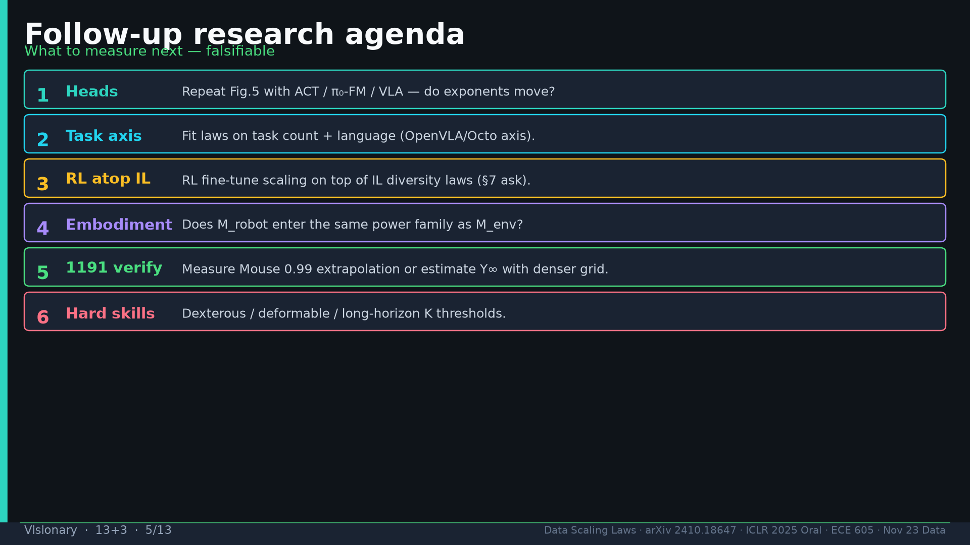
Notes:
Follow-ups: ACT/π/VLA heads; task+lang axis; RL atop IL; M_robot; verify 1191; hard-skill K.

Slide 6
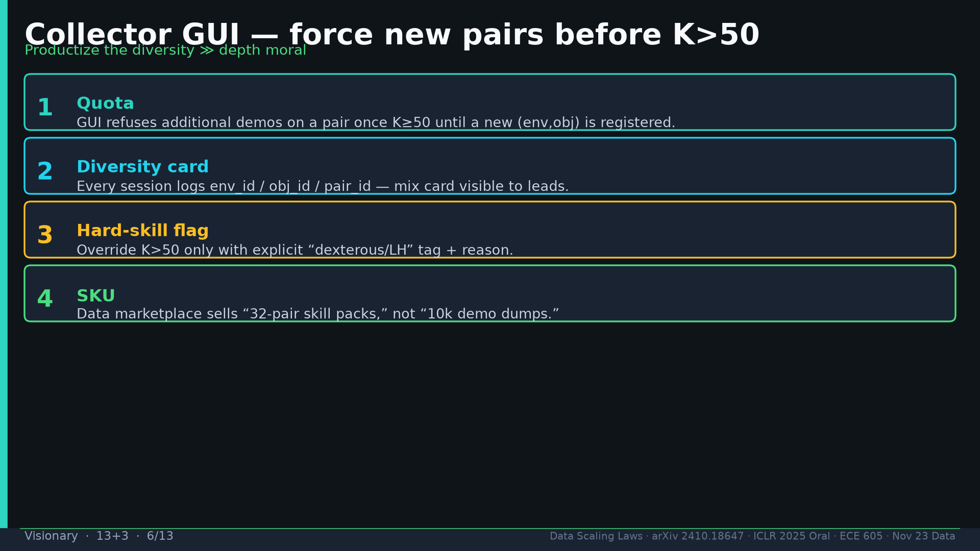
Notes:
Collector GUI: refuse K>50 until new pair; diversity cards; hard-skill override; SKU 32-pair packs.

Slide 7
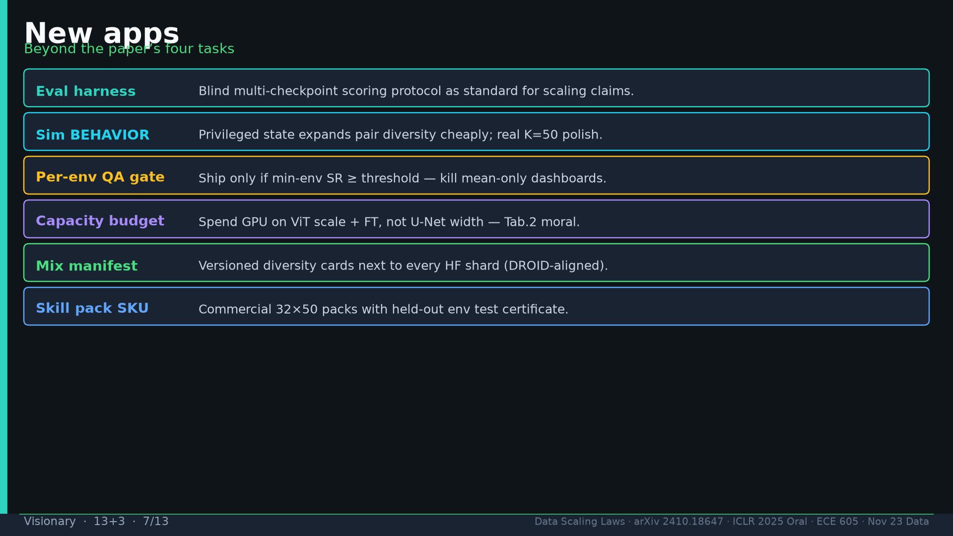
Notes:
Apps: eval harness; sim expand pairs; per-env QA; ViT budget; mix manifests; skill-pack SKU.

Slide 8
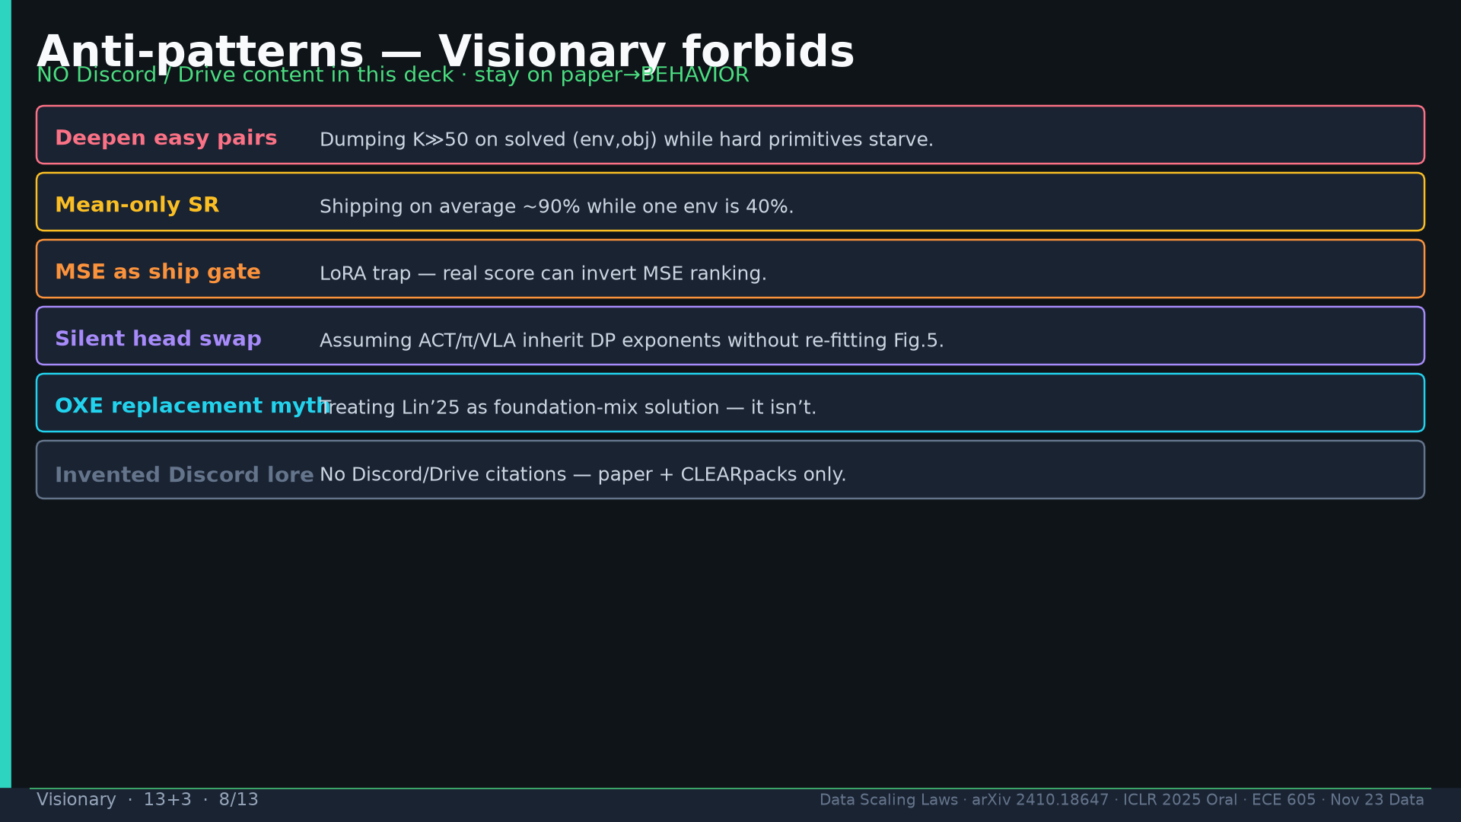
Notes:
Anti: deepen easy; mean-only; MSE gate; silent head swap; OXE-replacement myth; no Discord/Drive lore.

Slide 9
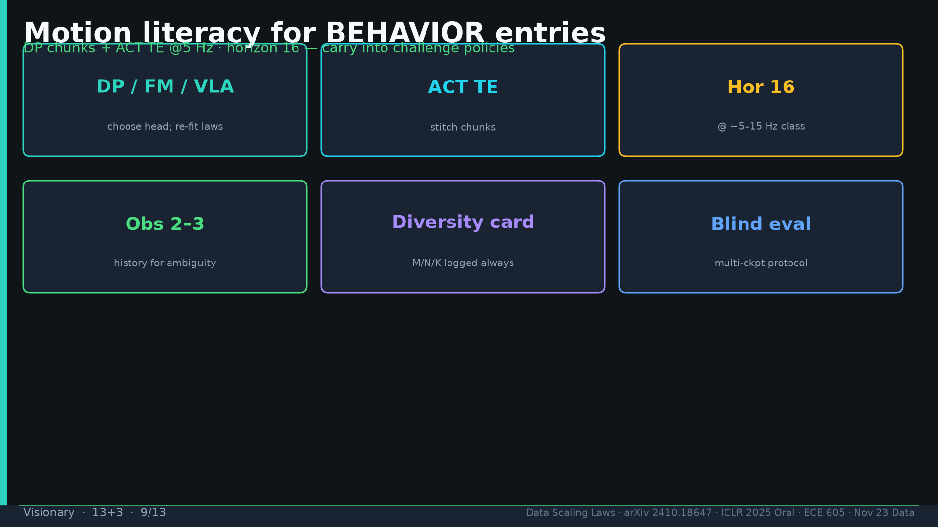
Notes:
Motion literacy: choose head+refit; ACT TE; hor16; obs2–3; diversity card; blind eval.

Slide 10
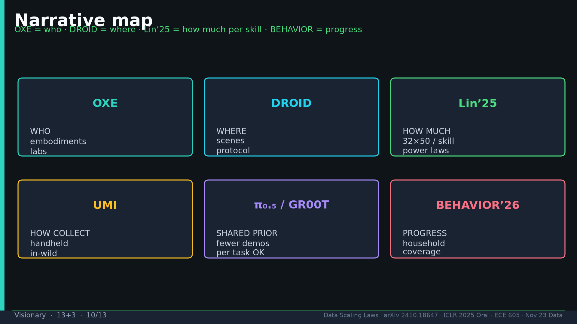
Notes:
Map: OXE=who DROID=where Lin=how much UMI=collect π₀.₅=prior BEHAVIOR=progress.

Slide 11
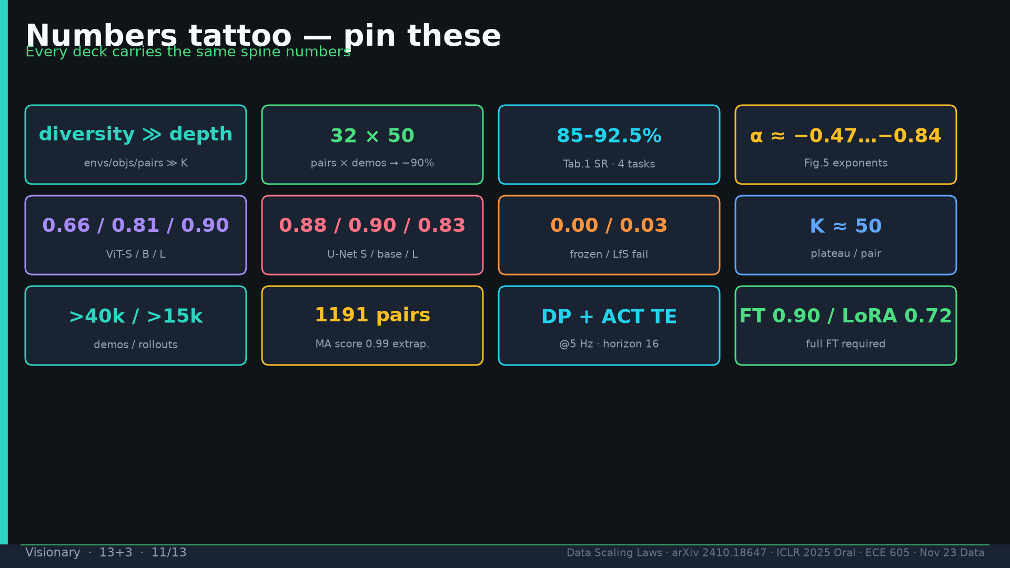
Notes:
Tattoo.

Slide 12
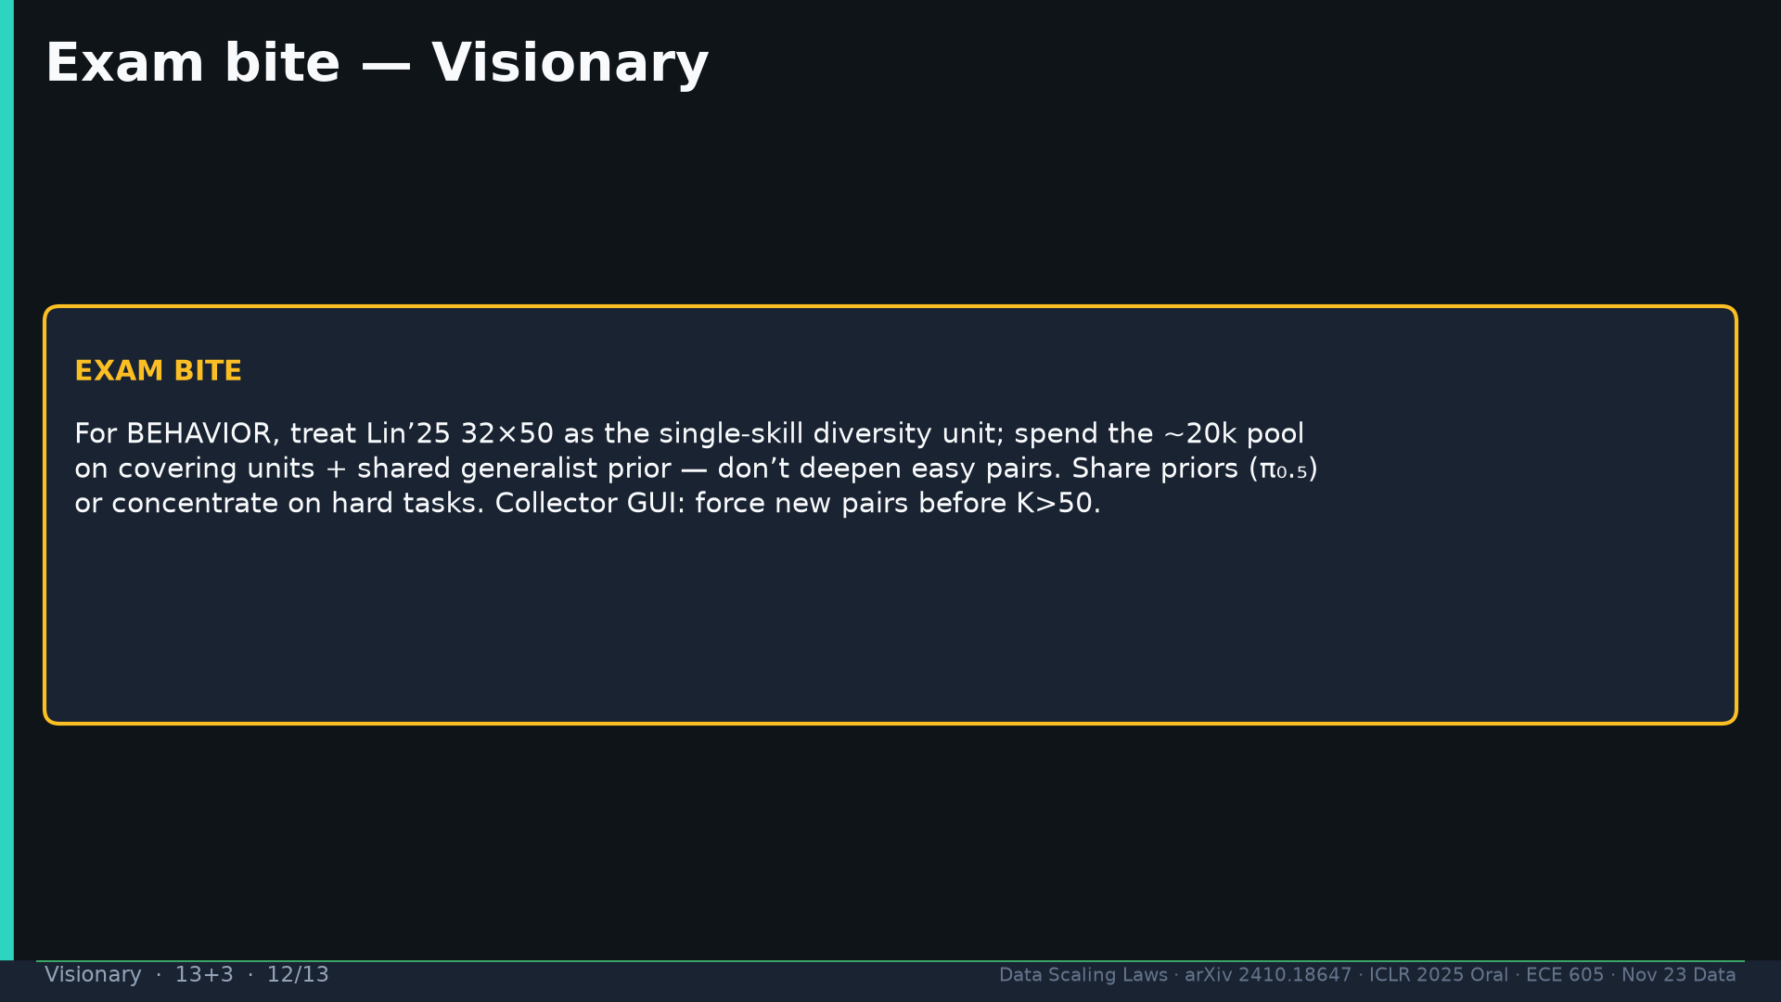
Notes:
Exam: BEHAVIOR treat 32×50 as single-skill unit; cover + shared prior; don’t deepen easy; GUI force new pairs.

Slide 13
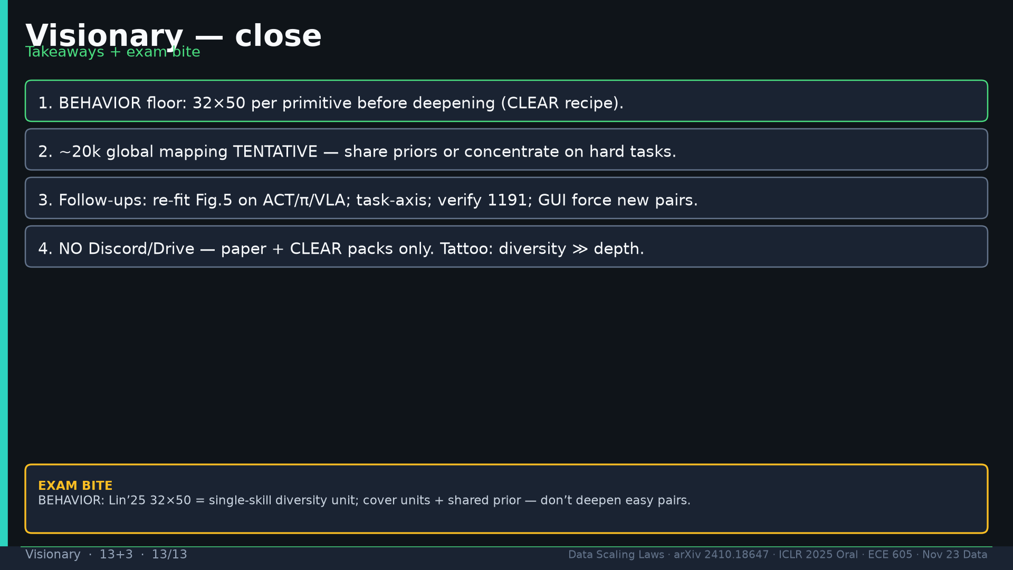
Notes:
Close. NO Discord/Drive.

