Slide 1
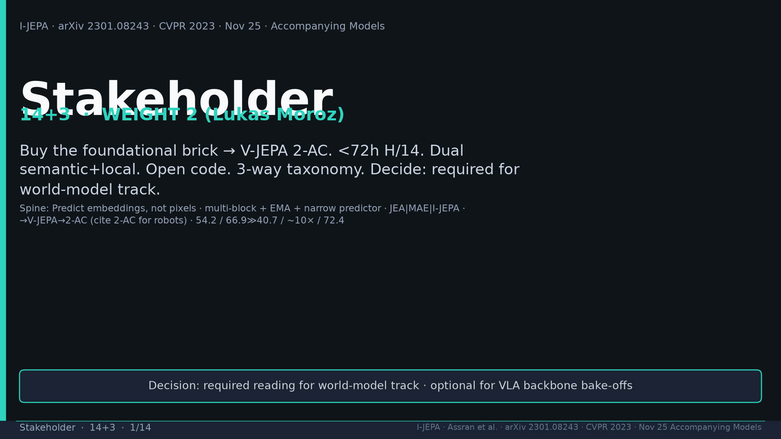
Notes:
Title. Weight 2 Lukas. Buy foundational brick → V-JEPA 2-AC. Decision: required WM; optional VLA.

Slide 2
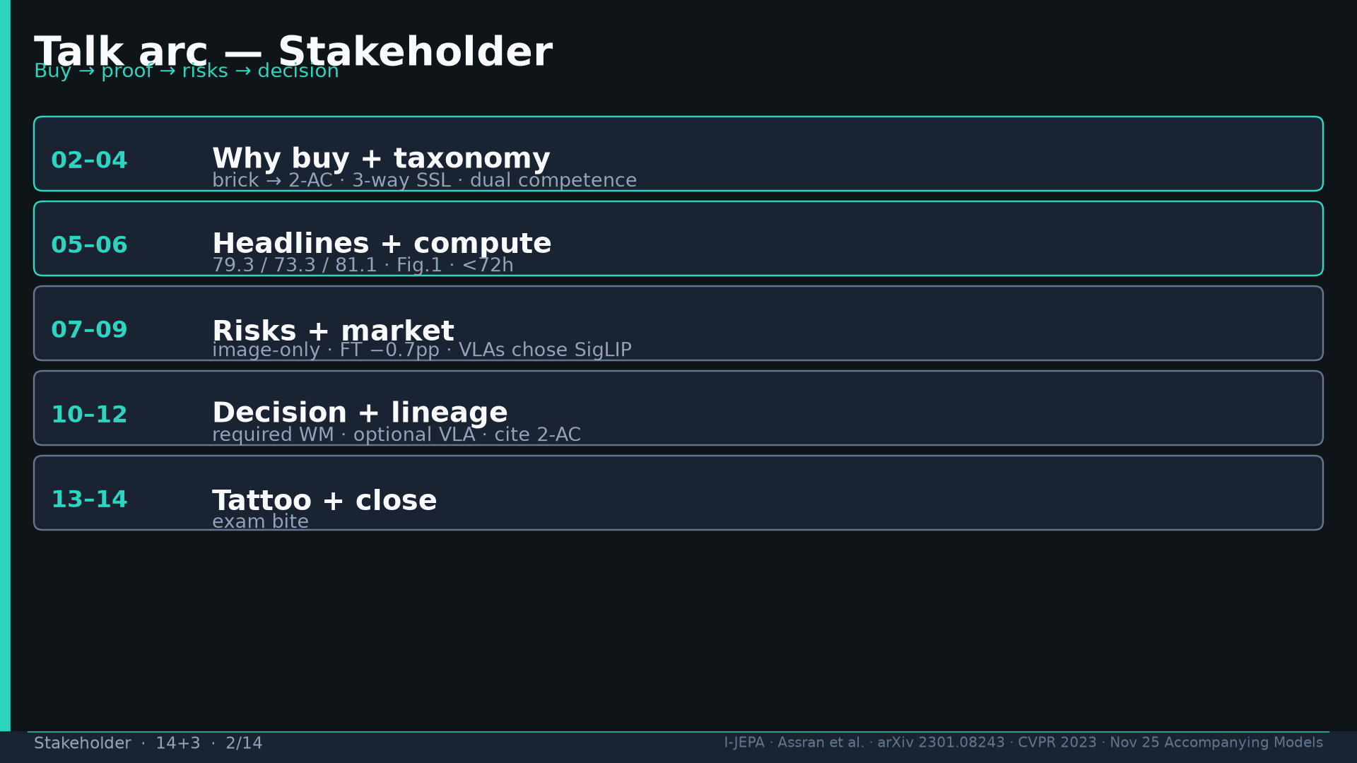
Notes:
Arc: buy → taxonomy → compute → dual → risks → market → decision → lineage → numbers → exam.

Slide 3
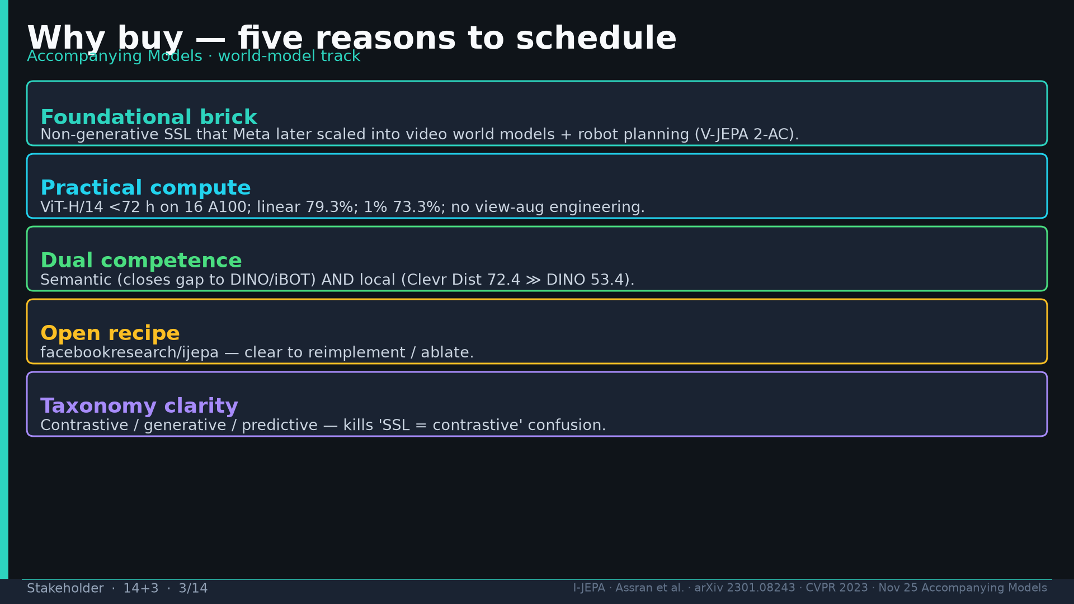
Notes:
Five buy reasons: brick, <72h compute, dual competence, open code, 3-way taxonomy.

Slide 4
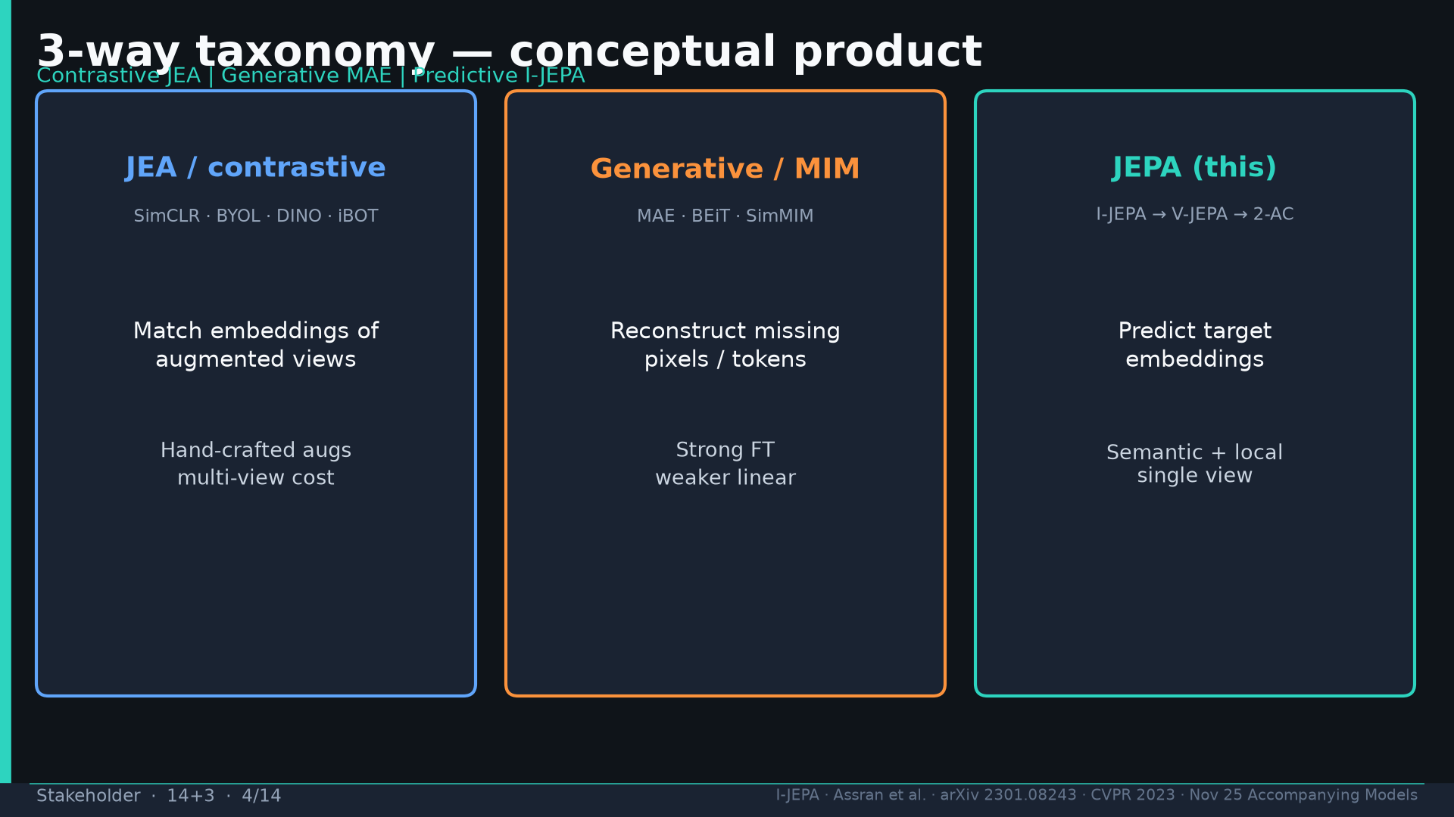
Notes:
Taxonomy: JEA contrastive | MAE pixels | I-JEPA emb. Say the three families aloud.

Slide 5
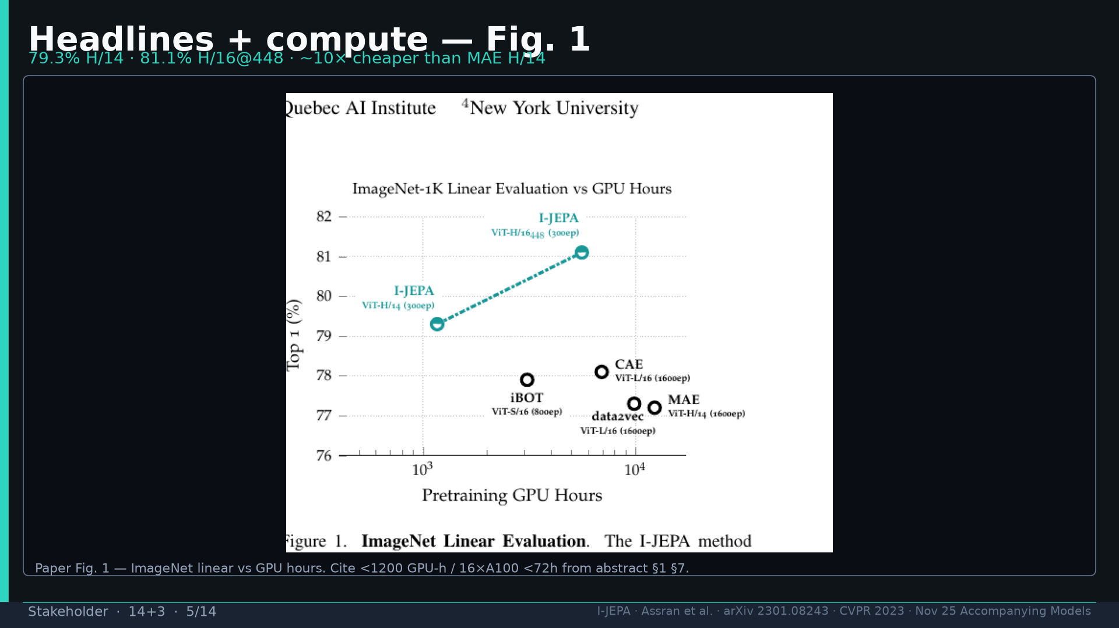
Notes:
Fig.1 compute: 79.3% H/14; 81.1% @448; ~10× vs MAE; cite <1200 GPU-h / 16×A100 <72h.

Slide 6
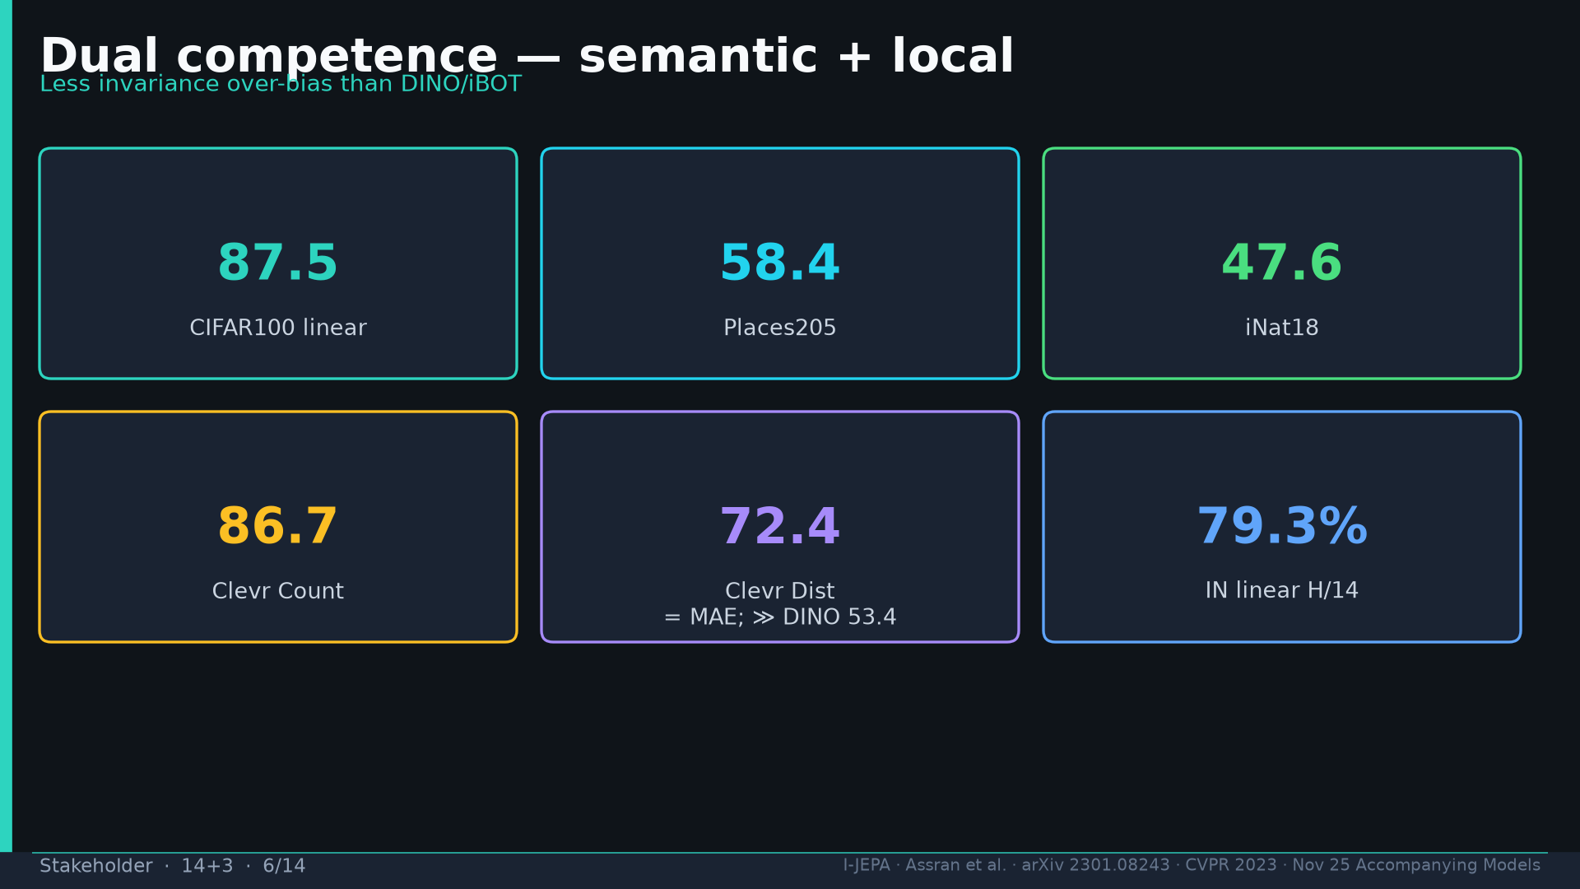
Notes:
Dual: CIFAR 87.5 / Places 58.4 / iNat 47.6 / Clevr Count 86.7 / Dist 72.4 ≫ DINO 53.4.

Slide 7
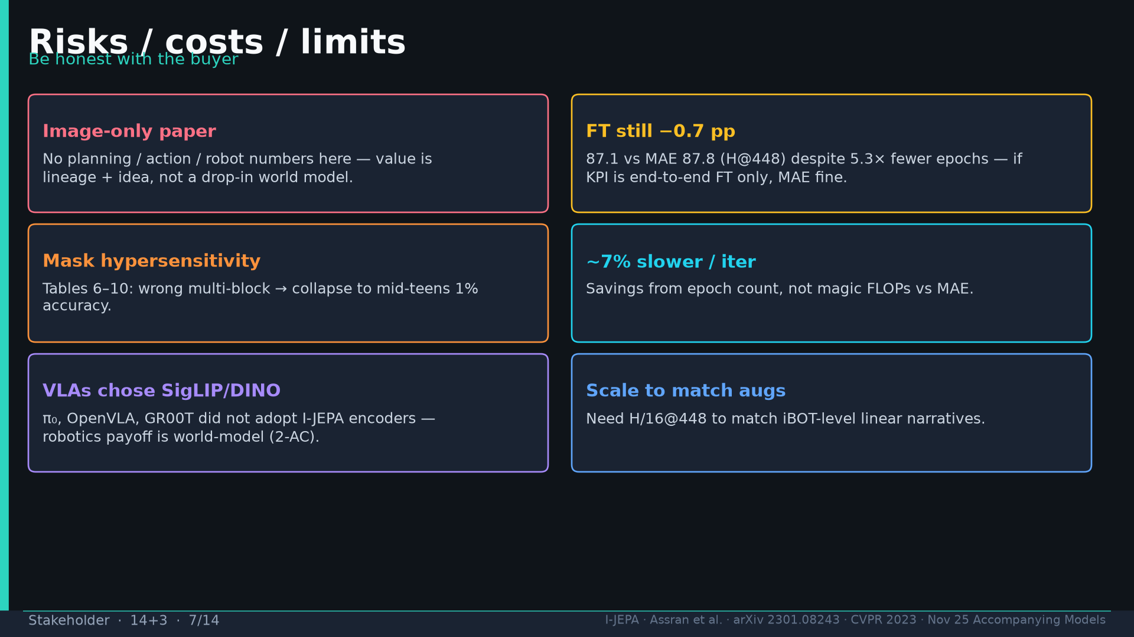
Notes:
Risks: image-only; FT −0.7pp; mask hypersensitivity; 7% slower/iter; VLAs chose SigLIP; need scale.

Slide 8
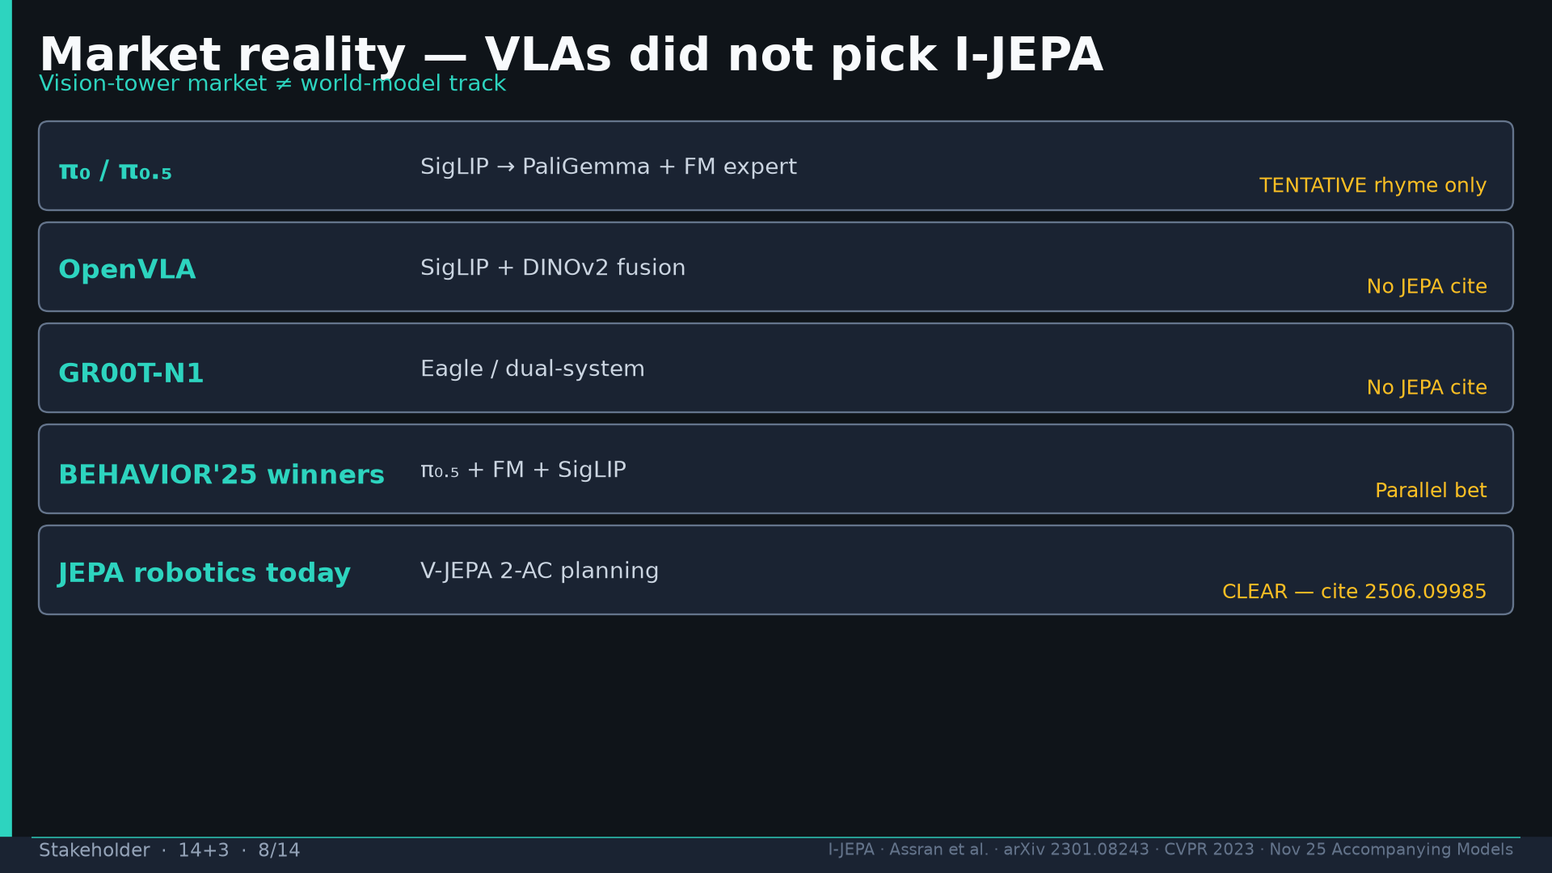
Notes:
Market: π₀/OpenVLA/GR00T/BEHAVIOR winners — no I-JEPA tower. Robotics payoff = 2-AC planning.

Slide 9
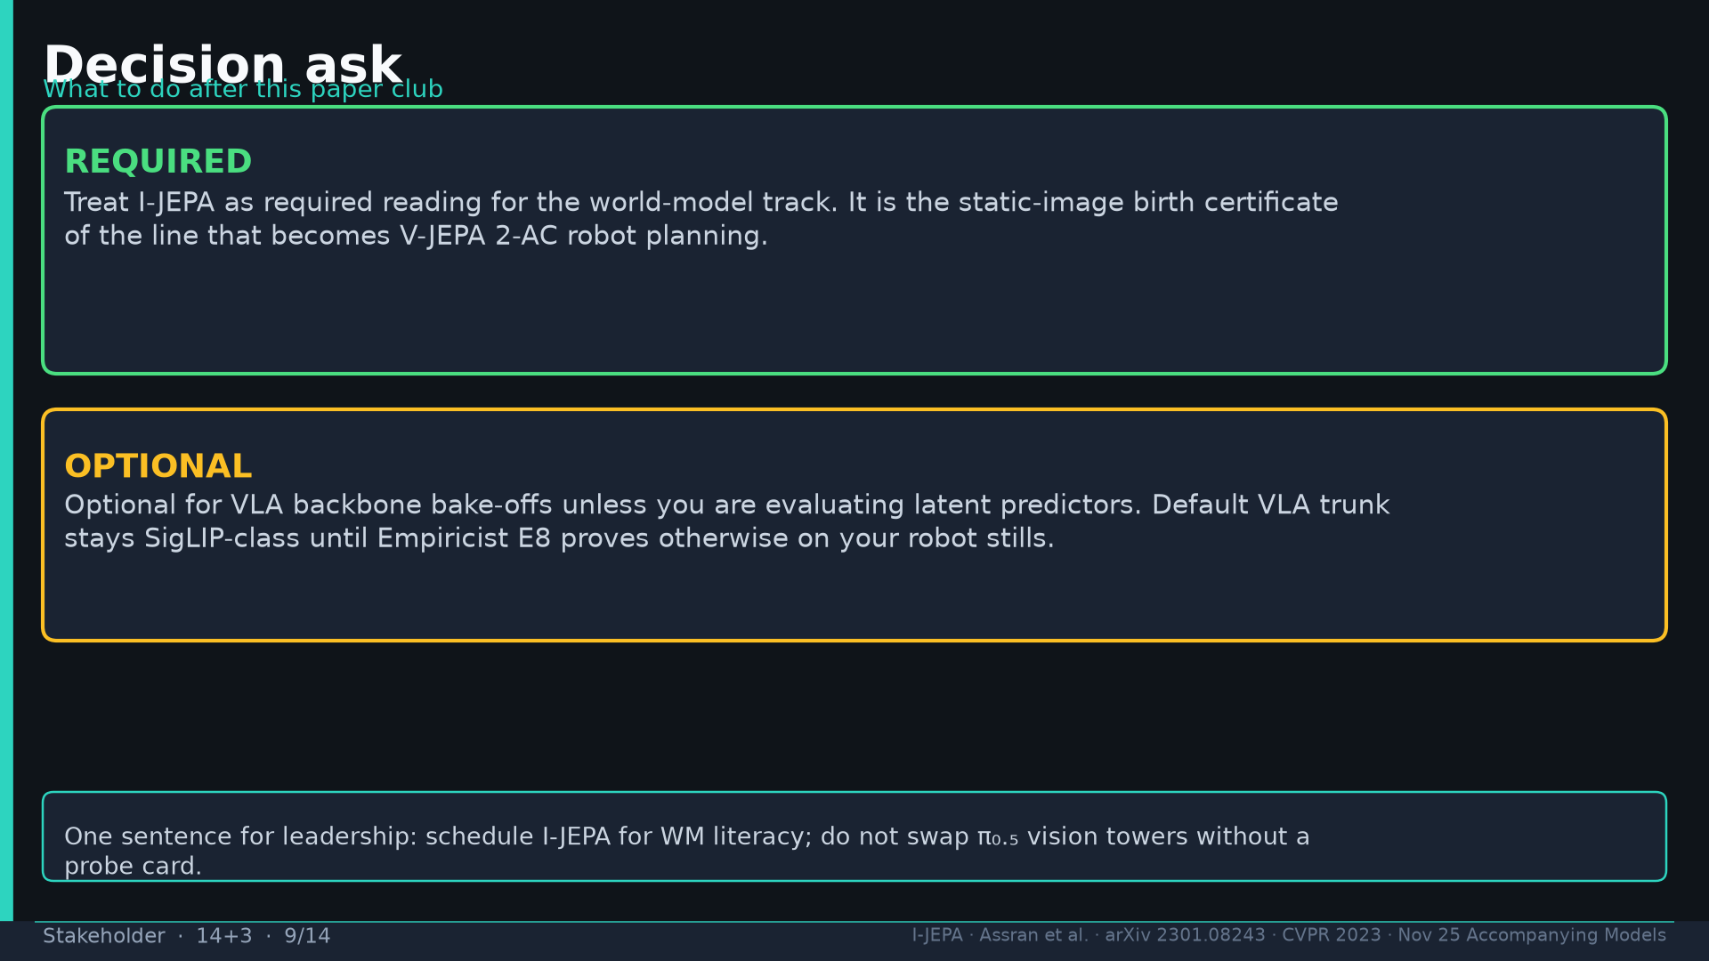
Notes:
Decision: REQUIRED world-model track; OPTIONAL VLA bake-offs unless evaluating latent predictors.

Slide 10
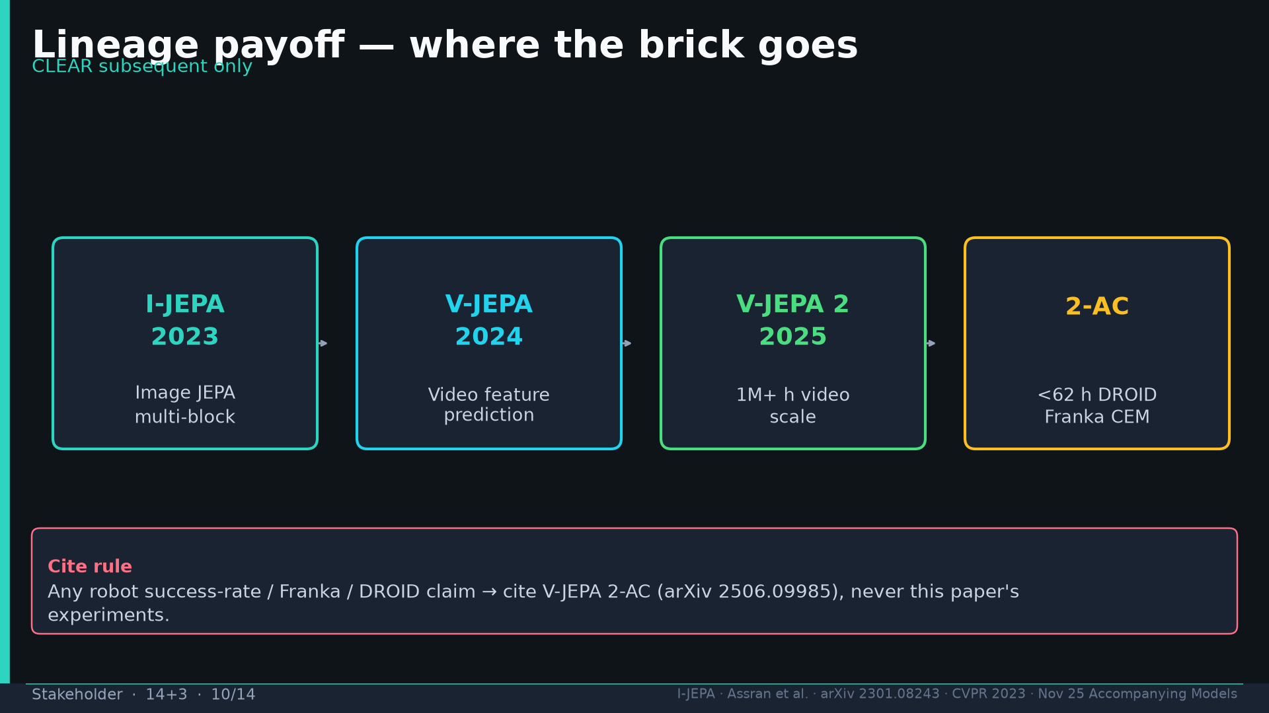
Notes:
Lineage CLEAR: I-JEPA → V-JEPA → V-JEPA 2 → 2-AC. Cite 2506.09985 for robot SR.

Slide 11
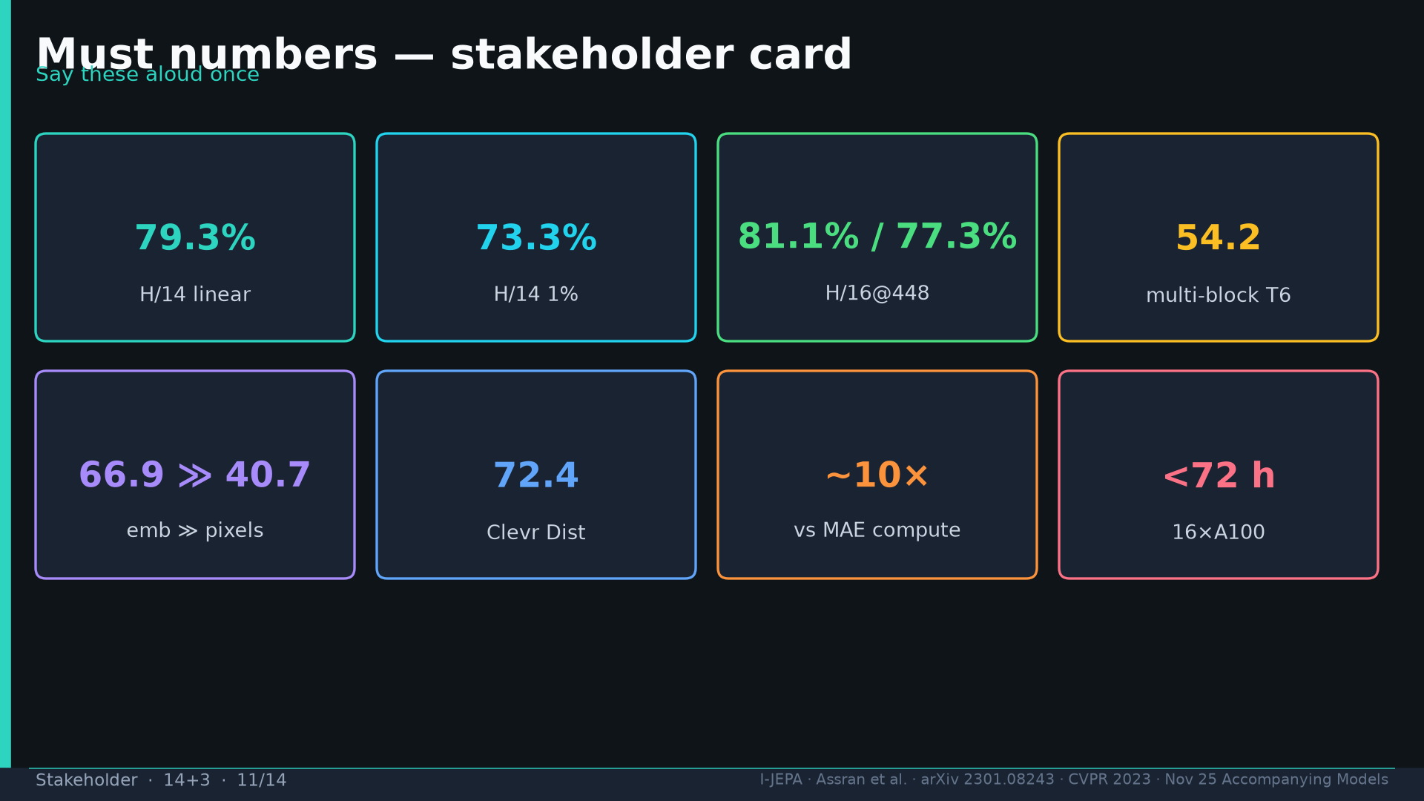
Notes:
Must numbers tattoo aloud once.

Slide 12
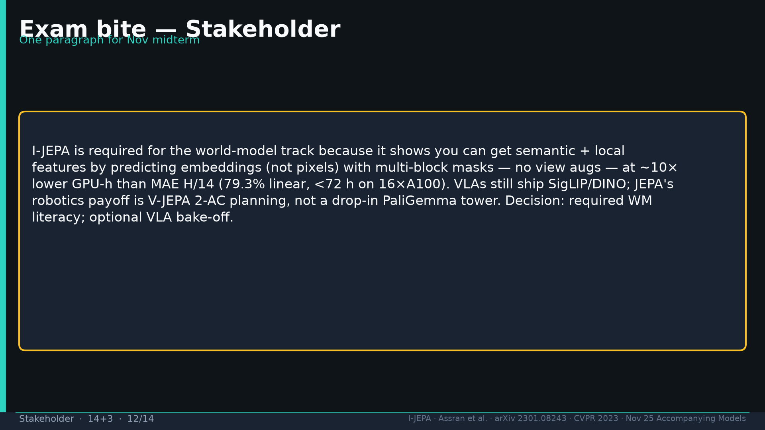
Notes:
Exam bite paragraph — practice once.

Slide 13
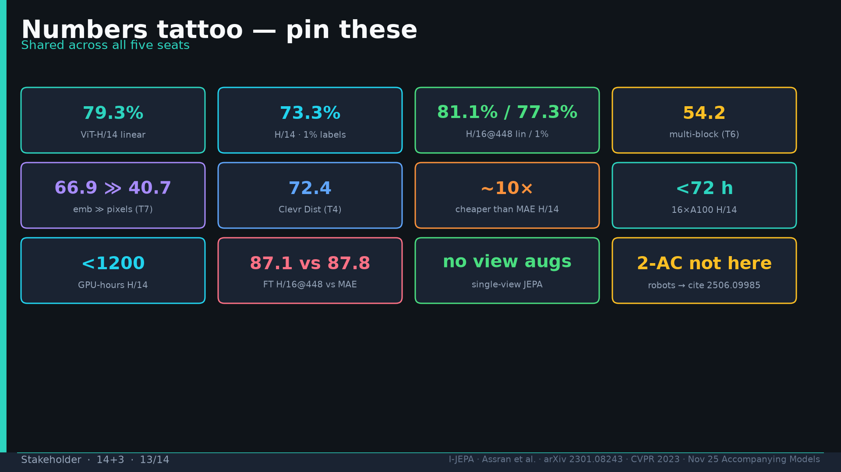
Notes:
Tattoo card shared.

Slide 14
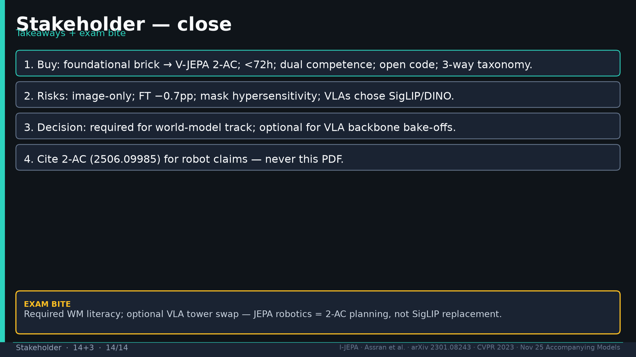
Notes:
Close four takeaways + exam bite.

